Slide 1

Hyderabad Housing Insights 2025: Rental Flats Analysis

Slide 2

About me
Background (BSC (Cs,mathematics) + MBA)
work experience
5+ years in Data Validation and Research Analyst
Share your linked-in and git-hub profile URL's https://www.linkedin.com/in/rakesh-pallagani-59233514b/
https://github.com/Pallaganirakesh175

Slide 3
Agenda
Business Problem and Use case domain understanding
1. Business Problem
In the competitive real estate rental market, both property owners and tenants face decision-making challenges:
Property owners/agents need to set competitive rental prices that attract tenants while maximizing returns.
Tenants want to find properties that offer the best value for money in terms of size, location, and amenities.
Brokers and property platforms need insights on demand trends, price variations, and furnishing preferences to better serve their customers.
Objective of the Project
Stakeholders:
Property Owners / Landlords – to price properties competitively.
Tenants – to choose cost-effective and suitable homes.
Real Estate Brokers / Agents – to understand market demand and target the right audience.
Property Listing Platforms – to enhance search results, filters, and recommendations.
Web Scraping – Details (Websites, Processor you followed)
Websites Used: The dataset was collected from popular Indian property rental listing platforms such as:
Housing.com – Listings with detailed amenities and user ratings.

Slide 4
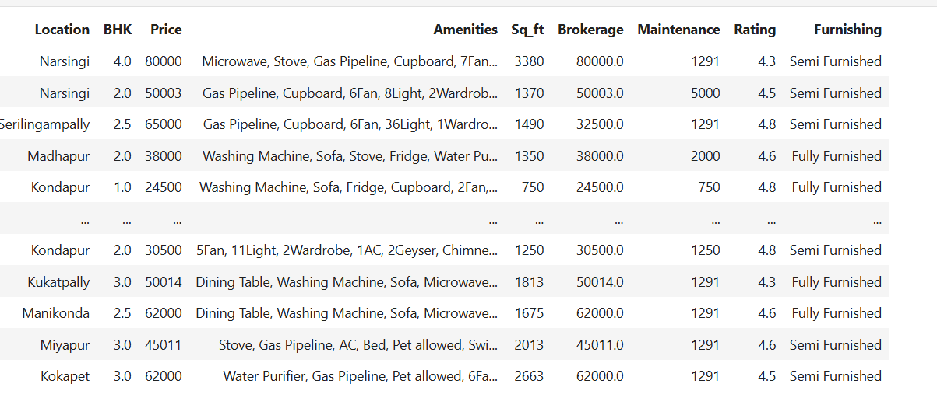
Contains rental property listings across various Hyderabad locations (Narsingi, Kondapur, Madhapur, etc.)
10 columns covering property details, pricing, amenities, and ratings
Shows both semi-furnished and fully furnished properties
Price range: ₹24,500 to ₹80,000 per month
Property sizes: 750 to 3380 sq ft
Includes BHK configurations from 1.0 to 4.0
Features extensive amenity details (appliances, furniture, utilities)
Contains brokerage costs and maintenance fees and Properties have high ratings (4.3 to 4.8 out of 5)

Slide 5
Process Followed:
Identifying Target Data Points – Location, BHK, Price, Amenities, Sq. ft., Brokerage, Maintenance, Rating, Furnishing type.
HTML Structure Analysis – Used the browser’s developer tools (Inspect Element) to identify relevant HTML tags and CSS classes containing required data.
Data Extraction – Used Python libraries:
requests → to fetch HTML content from listing pages.
Beautiful Soup → to parse HTML and extract structured data.
Iterated through multiple listing pages to ensure a large and diverse dataset.
Exploratory Data Analysis:
a. Data Cleaning Steps
Data Cleaning – Removed duplicates, handled missing values, standardized formats (e.g., converting “2 BHK” to 2.0).
Filling null values with mean for values and and variables with most common repeated and changed the format also(object to int(), float())
Data Export – Saved the final dataset as a .csv file for further analysis.

Slide 6
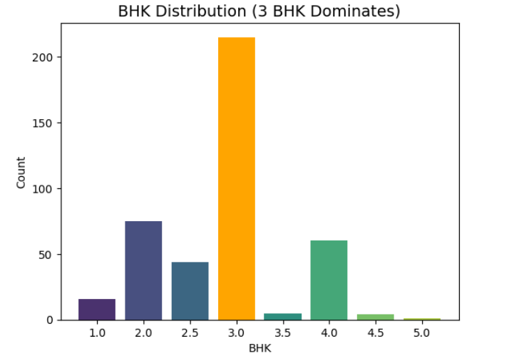
3 BHK homes dominate, making up the highest count, followed by 2 BHK and 4 BHK units.

Slide 7
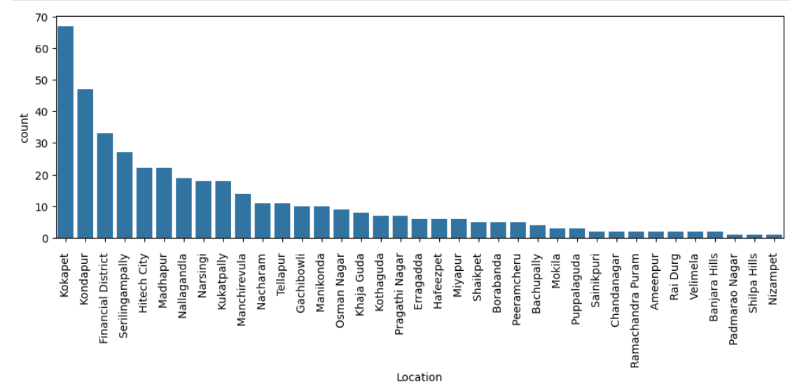
Kokapet, Kondapur, and Financial District dominate with the highest counts, while areas like Shilpa Hills and Nizampet have very few listings.

Slide 8
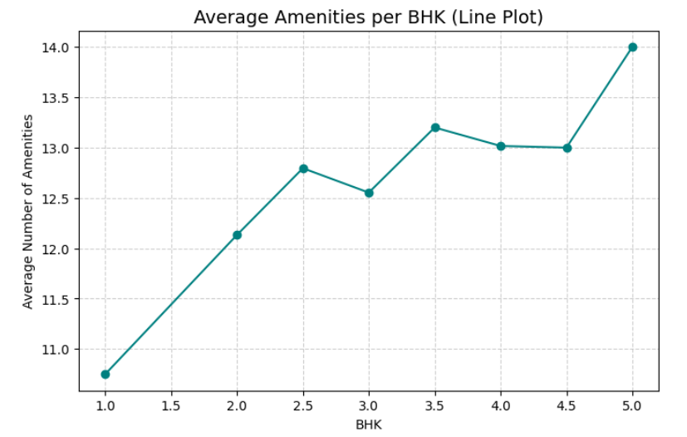
Higher BHK units generally have more amenities, with 5 BHK homes offering the most on average. Lift, Power Backup, Intercom, Gym, and Garden

Slide 9
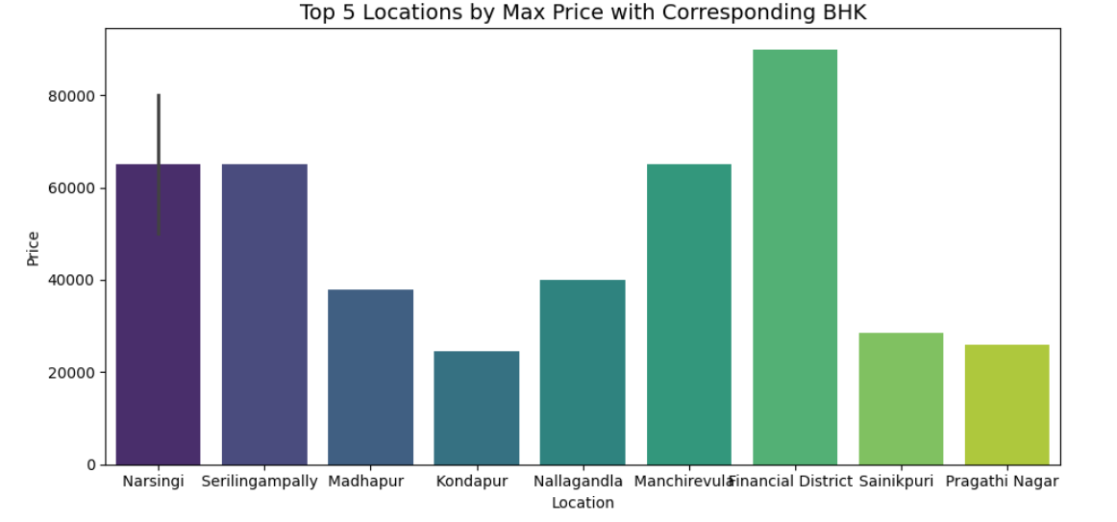
Financial District leads with the highest max price, followed by Narsingi, Serilingampally, and Manchirevula.

Slide 10
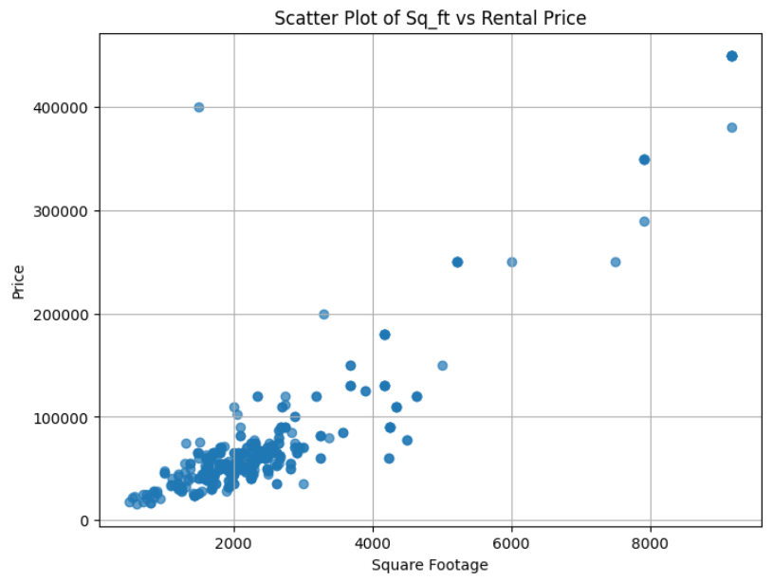
larger homes have higher rental prices, though there are some outliers where small homes are very expensive.

Slide 11
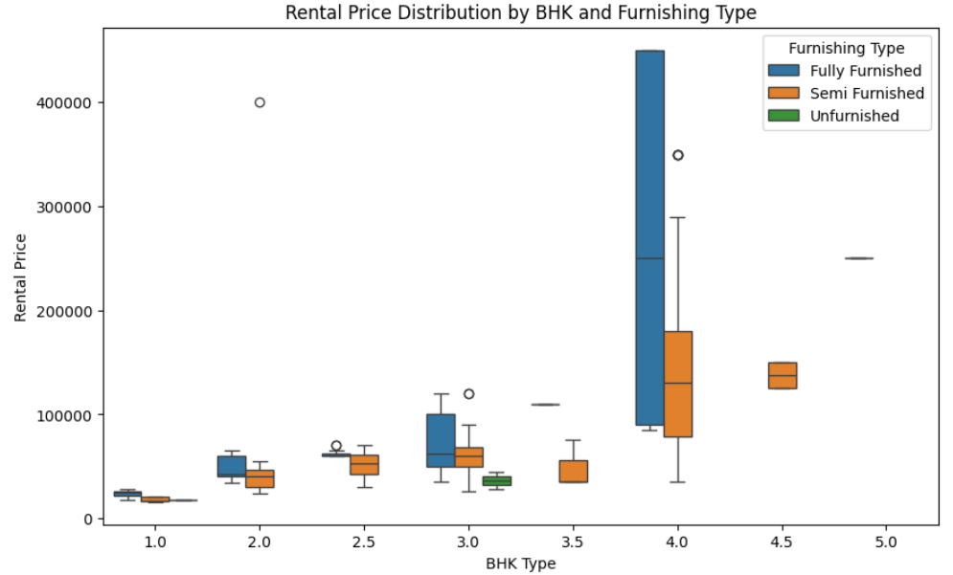
Fully furnished homes tend to have the highest rental prices, especially for 3 and 4 BHK units, while unfurnished ones remain the cheapest.

Slide 12
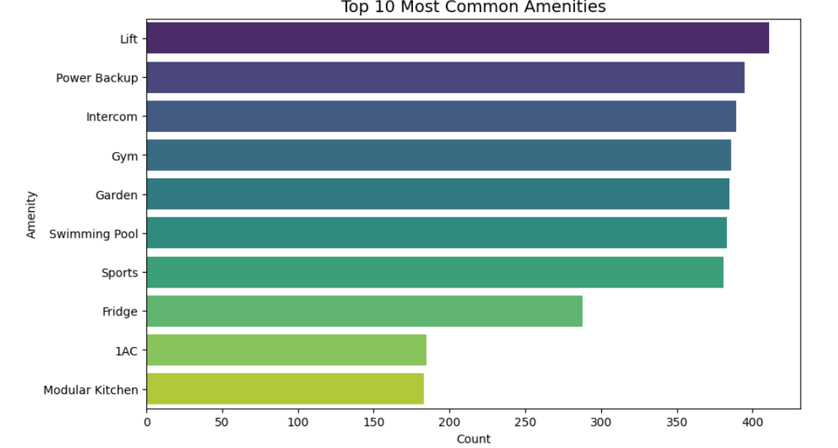
Lift, Power Backup, Intercom, Gym, and Garden are the most frequently offered amenities, while AC and Modular Kitchen are comparatively less common.

Slide 13
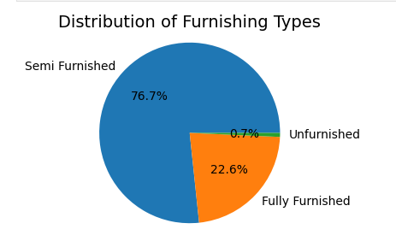
🟦 Semi Furnished dominates with 76.7%, meaning most rental homes are partially furnished.
🟧 Fully Furnished makes up 22.6%, providing a ready-to-move option.
🟩 Unfurnished is very rare at just 0.7%, indicating few bare homes are available.
👉 Insight: Most tenants prefer at least some basic furnishing (semi or fully furnished), with unfurnished homes being almost negligible in the market.

Slide 14
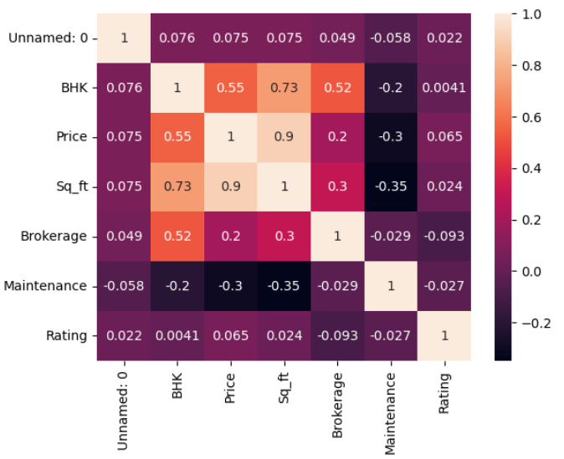
Brokerage depends on BHK & Sq_ft.
Ratings are independent of price or size → they likely depend on quality of living & amenities.
Price is mainly driven by Size (Sq_ft) and BHK count.

Slide 15
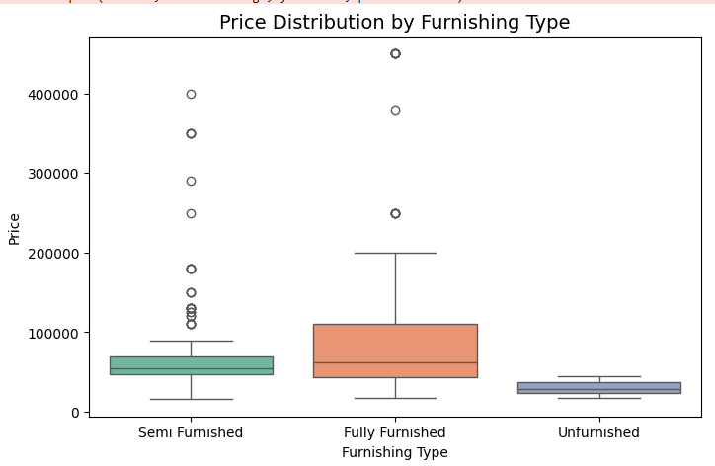
This box plot shows that fully furnished properties have the highest median rental prices, while unfurnished properties are the most affordable. Semi-furnished units show moderate pricing with some outlier properties commanding exceptionally high rents.

Slide 16
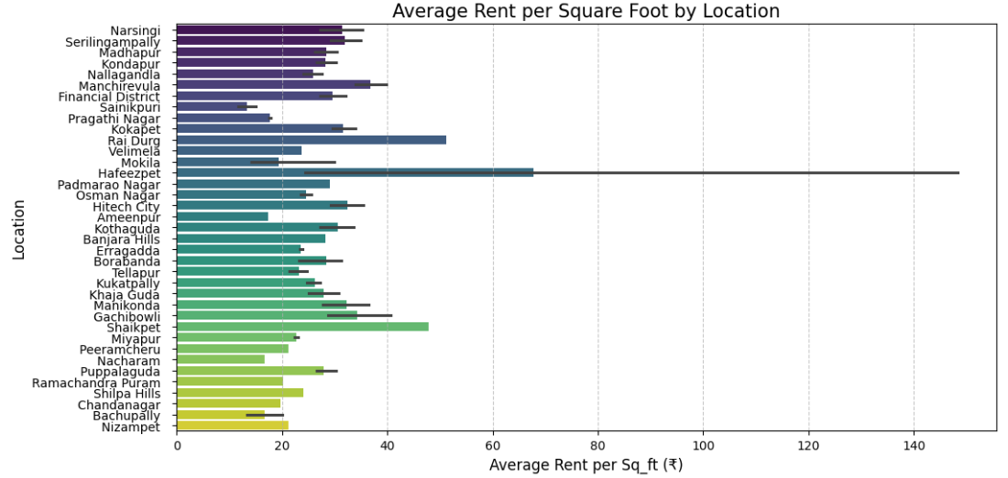
ChatGPT said:
This chart shows the average rent per square foot across different locations in Hyderabad. We can see that Hafeezpet has the highest rent per sq. ft., while most other areas cluster around ₹15–40.

Slide 17
Conclusion (Key finding overall)
Price is mainly determined by property size (Sq.ft) and BHK, followed by furnishing type.
Fully Furnished homes capture the premium market, while unfurnished homes cater to affordability.
Brokerage costs scale with property size, making them a hidden cost driver.
Ratings should be studied separately (perhaps tied to amenities or neighborhood factors, not just cost).

Slide 18


Slide 19

THANK YOU

