Slide 1
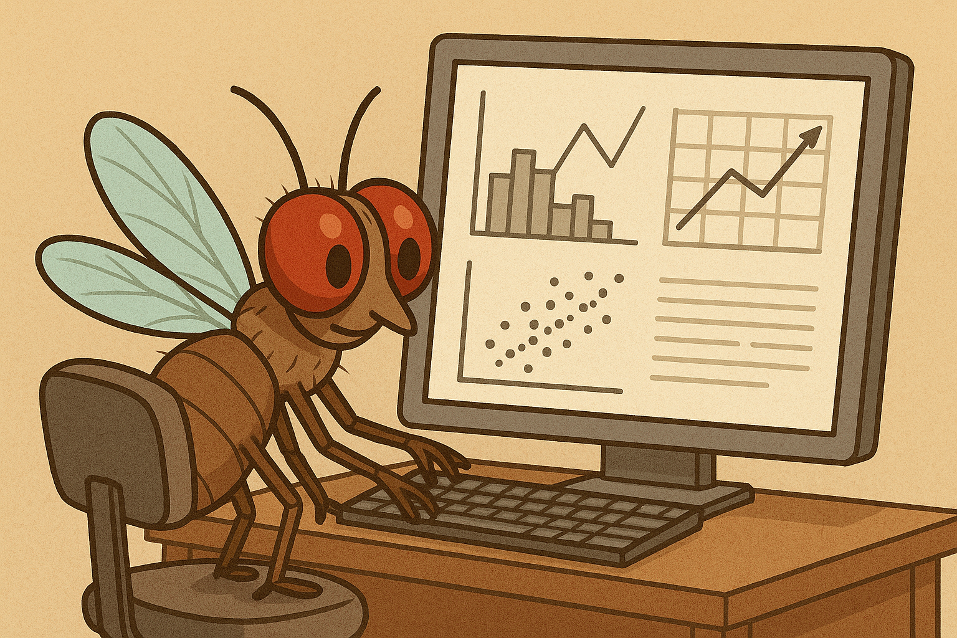
Analysis of Flight Assay Data
Jun Ishigohoka

Slide 2
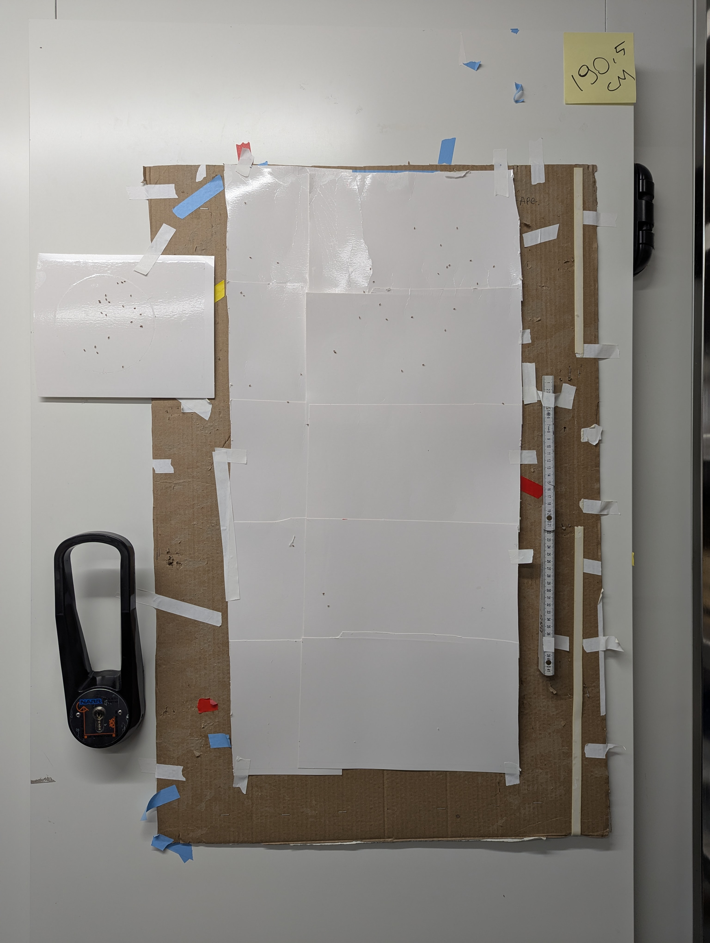
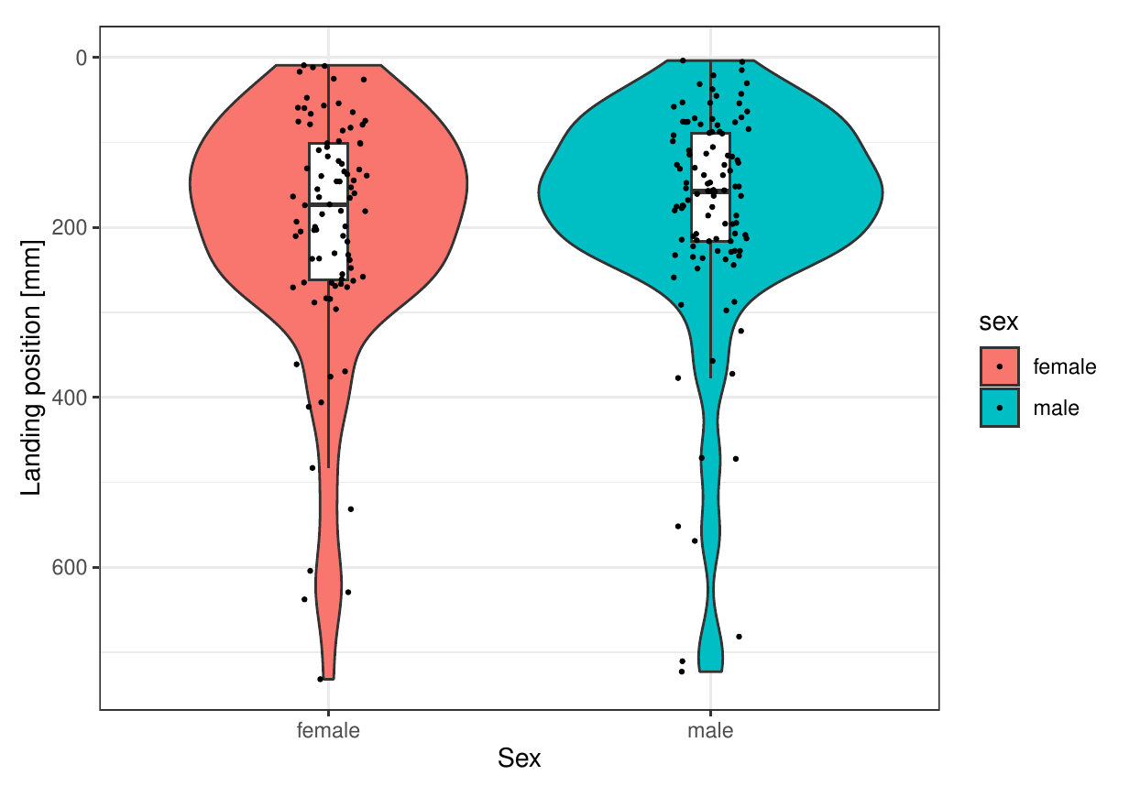
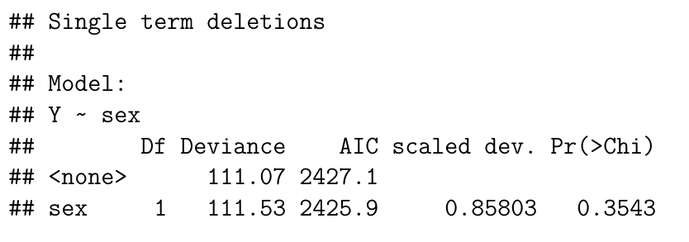

Slide 4
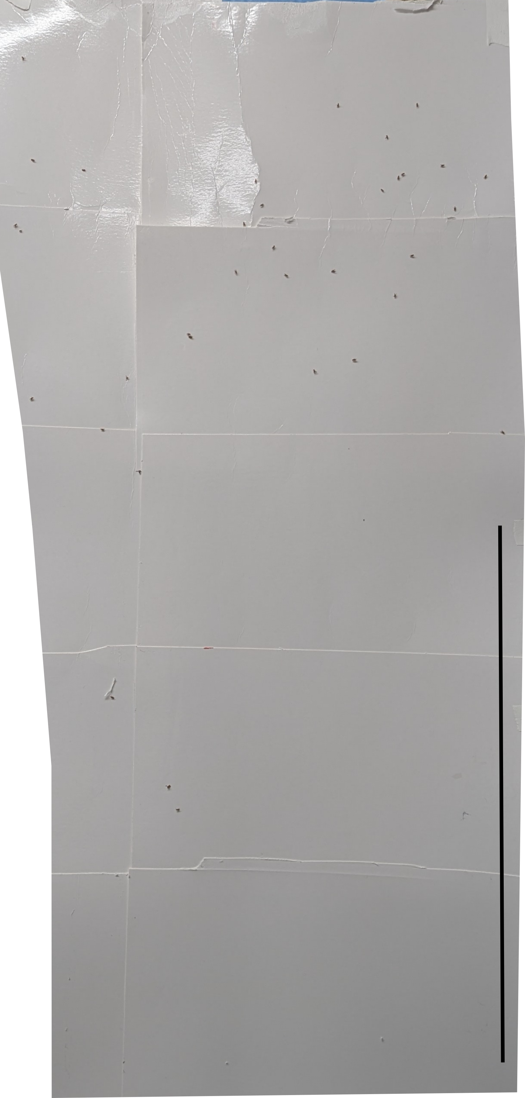

Slide 5
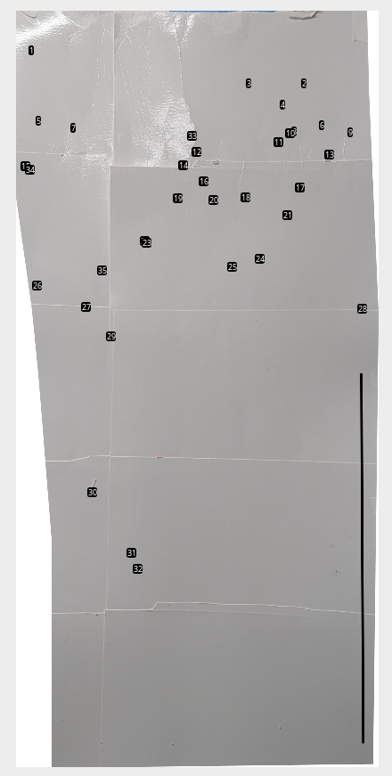

Slide 7
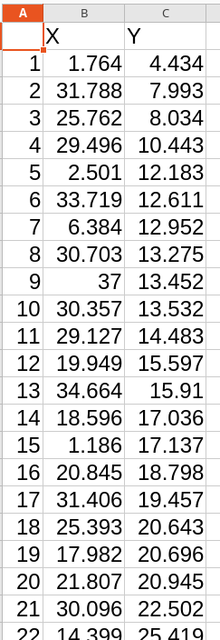

Slide 9


Part 1: Image analysis with ImageJ
ImageJ
FIJI

Slide 10


Part 2: Statistical analysis in R
R
RStudio

Slide 11
Part 1: Image analysis with ImageJ

Slide 12
Preparation
Copy the materials from shared folder to your desktop
Open ImageJ
Install ImageJ macro (FlightAssay.ijm)

Slide 13
Image analysis

Slide 14
How to download ImageJ macro (FlightAssay.ijm)
https://github.com/PallaresLab/EMBL_Drosophila_course_2025

Slide 15
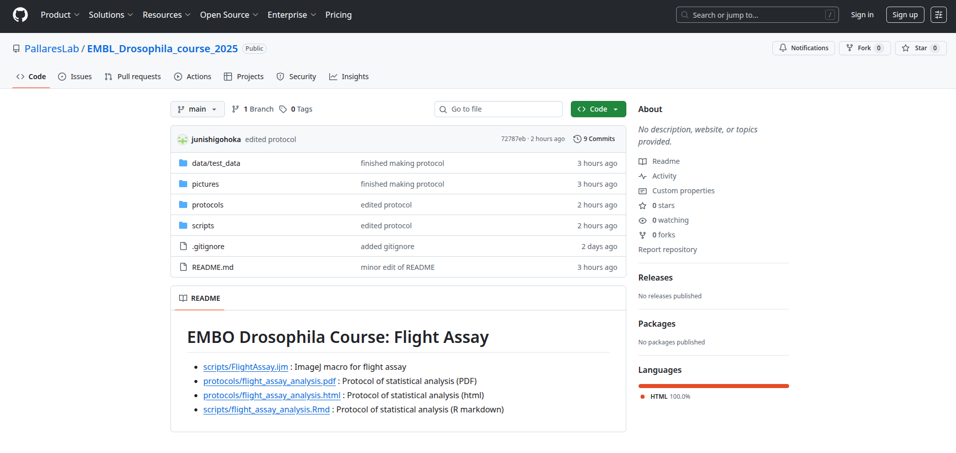
How to download ImageJ macro (FlightAssay.ijm)
https://github.com/PallaresLab/EMBL_Drosophila_course_2025

Slide 16
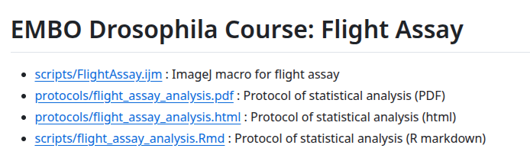
How to download ImageJ macro (FlightAssay.ijm)
https://github.com/PallaresLab/EMBL_Drosophila_course_2025

Slide 17
How to download ImageJ macro (FlightAssay.ijm)
https://github.com/PallaresLab/EMBL_Drosophila_course_2025

Slide 18
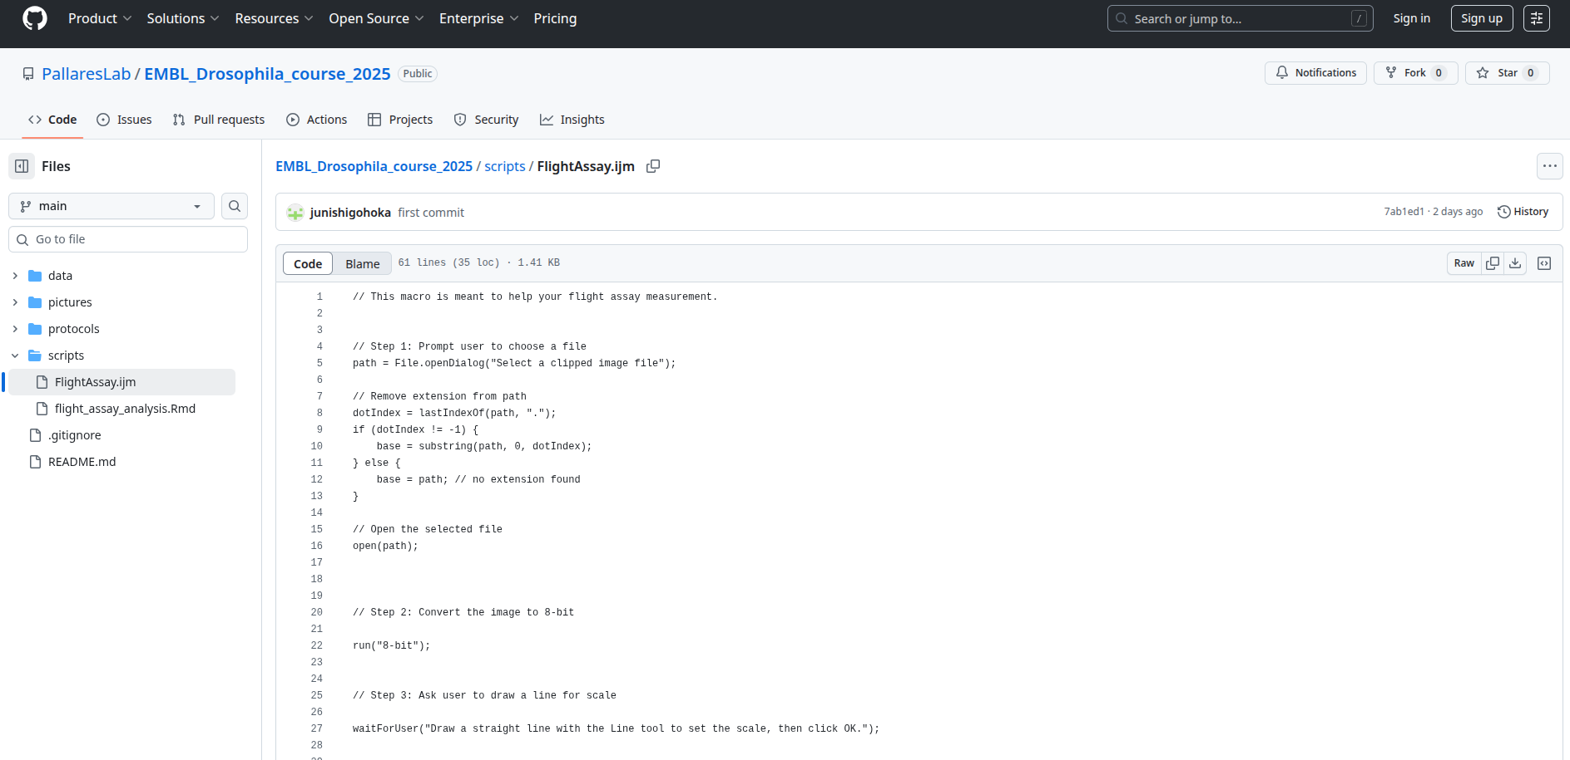
How to download ImageJ macro (FlightAssay.ijm)
https://github.com/PallaresLab/EMBL_Drosophila_course_2025

Slide 19
How to install FlightAssay.ijm to ImageJ

Slide 21
Part 2: Statistical analysis in R

Slide 23
How to download R recipe
https://github.com/PallaresLab/EMBL_Drosophila_course_2025

Slide 24
How to download R recipe
https://github.com/PallaresLab/EMBL_Drosophila_course_2025

Slide 25
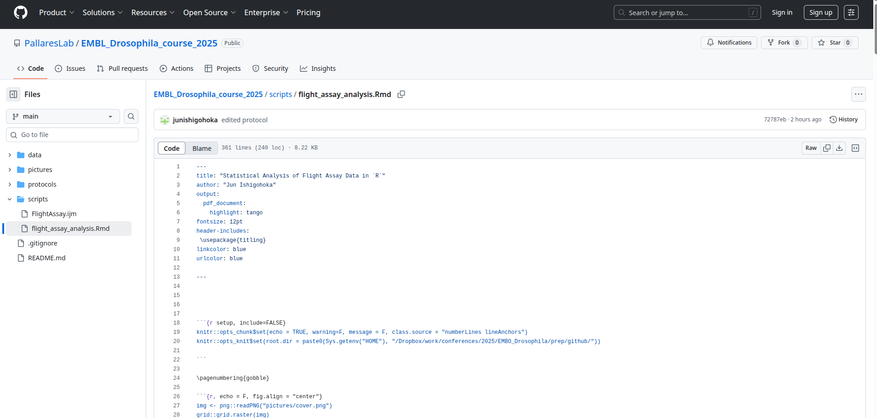
How to download R recipe
https://github.com/PallaresLab/EMBL_Drosophila_course_2025

Slide 26
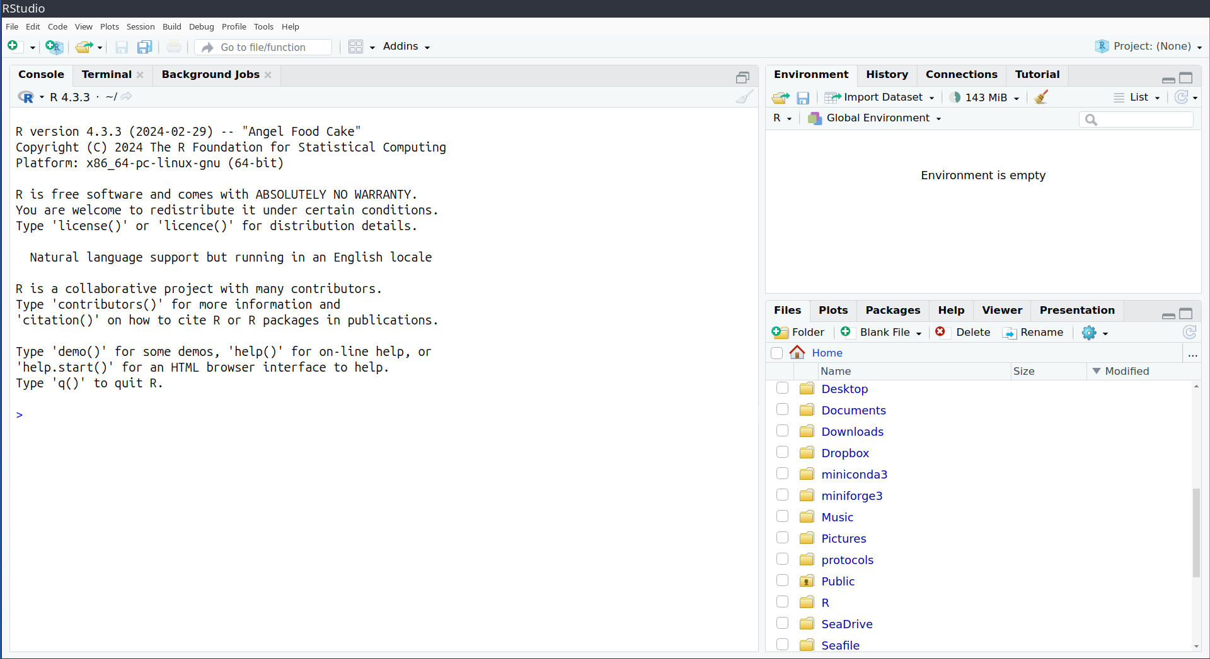
How to run R recipe

Slide 27
How to run R recipe
Navigate, find, and click the downloaded R markdown file (flight_assay_analysis.Rmd)

Slide 28
Optional: You can see instruction in PDF or HTML
https://github.com/PallaresLab/EMBL_Drosophila_course_2025

Slide 29
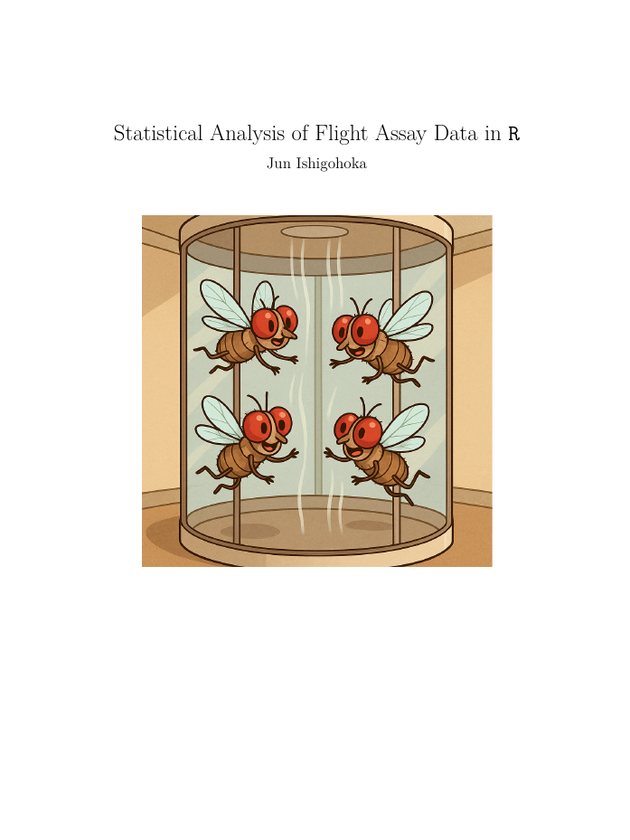
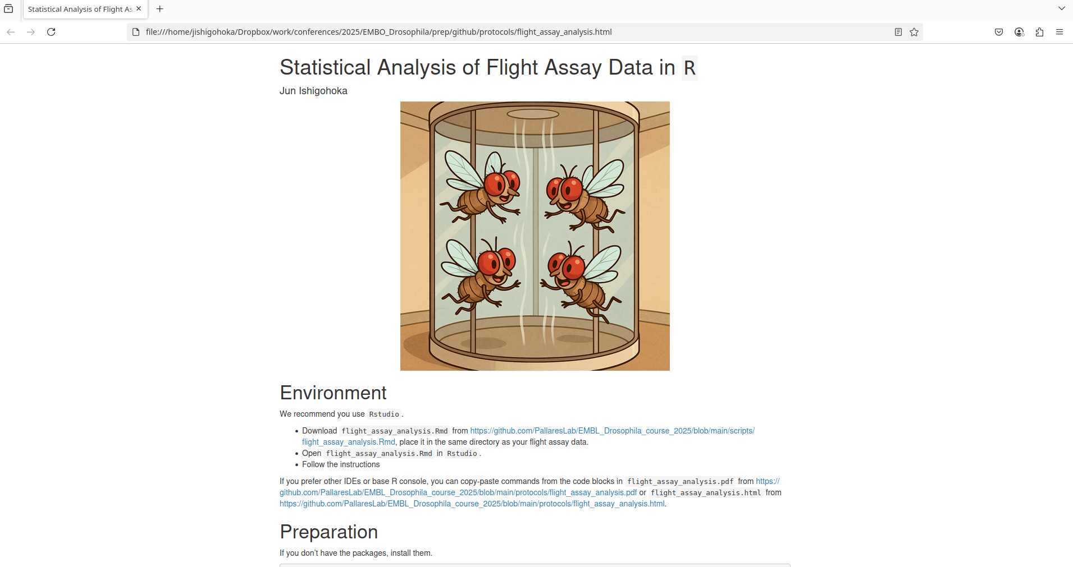
Optional: Instructions on PDF or HTML

