Slide 1
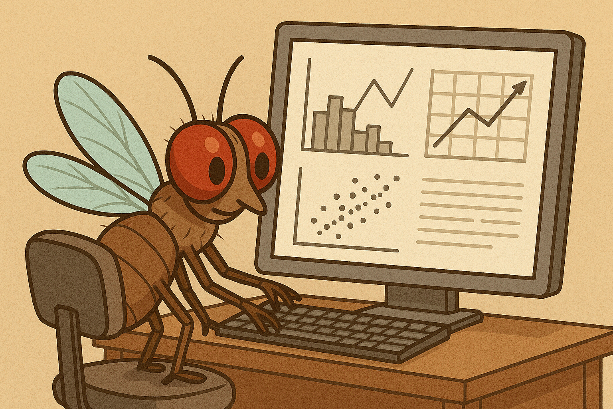
Analysis of Flight Assay Data
Jun Ishigohoka

Slide 2
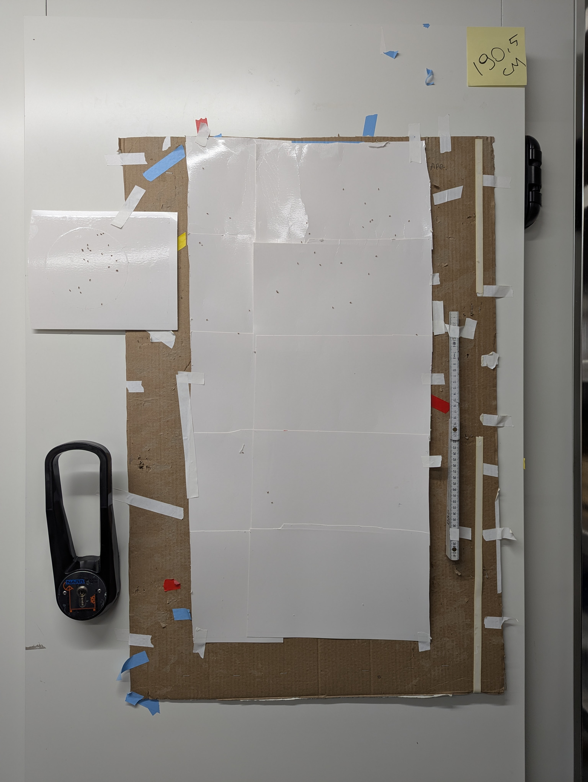
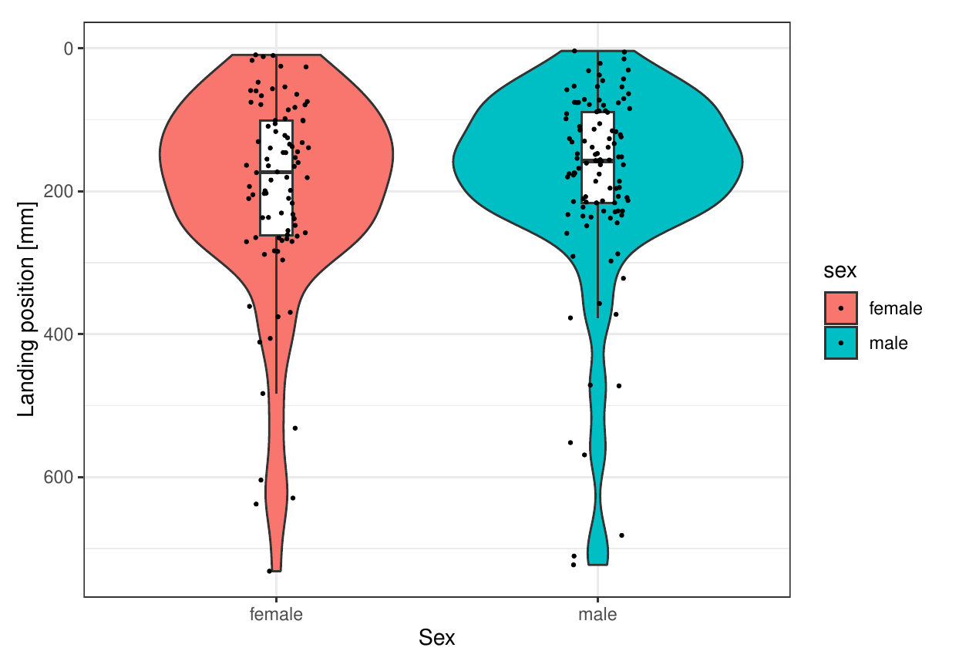
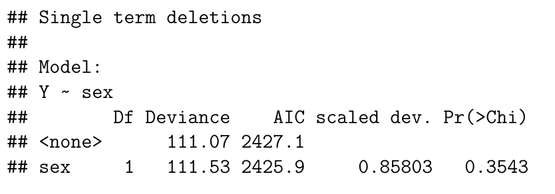

Slide 4
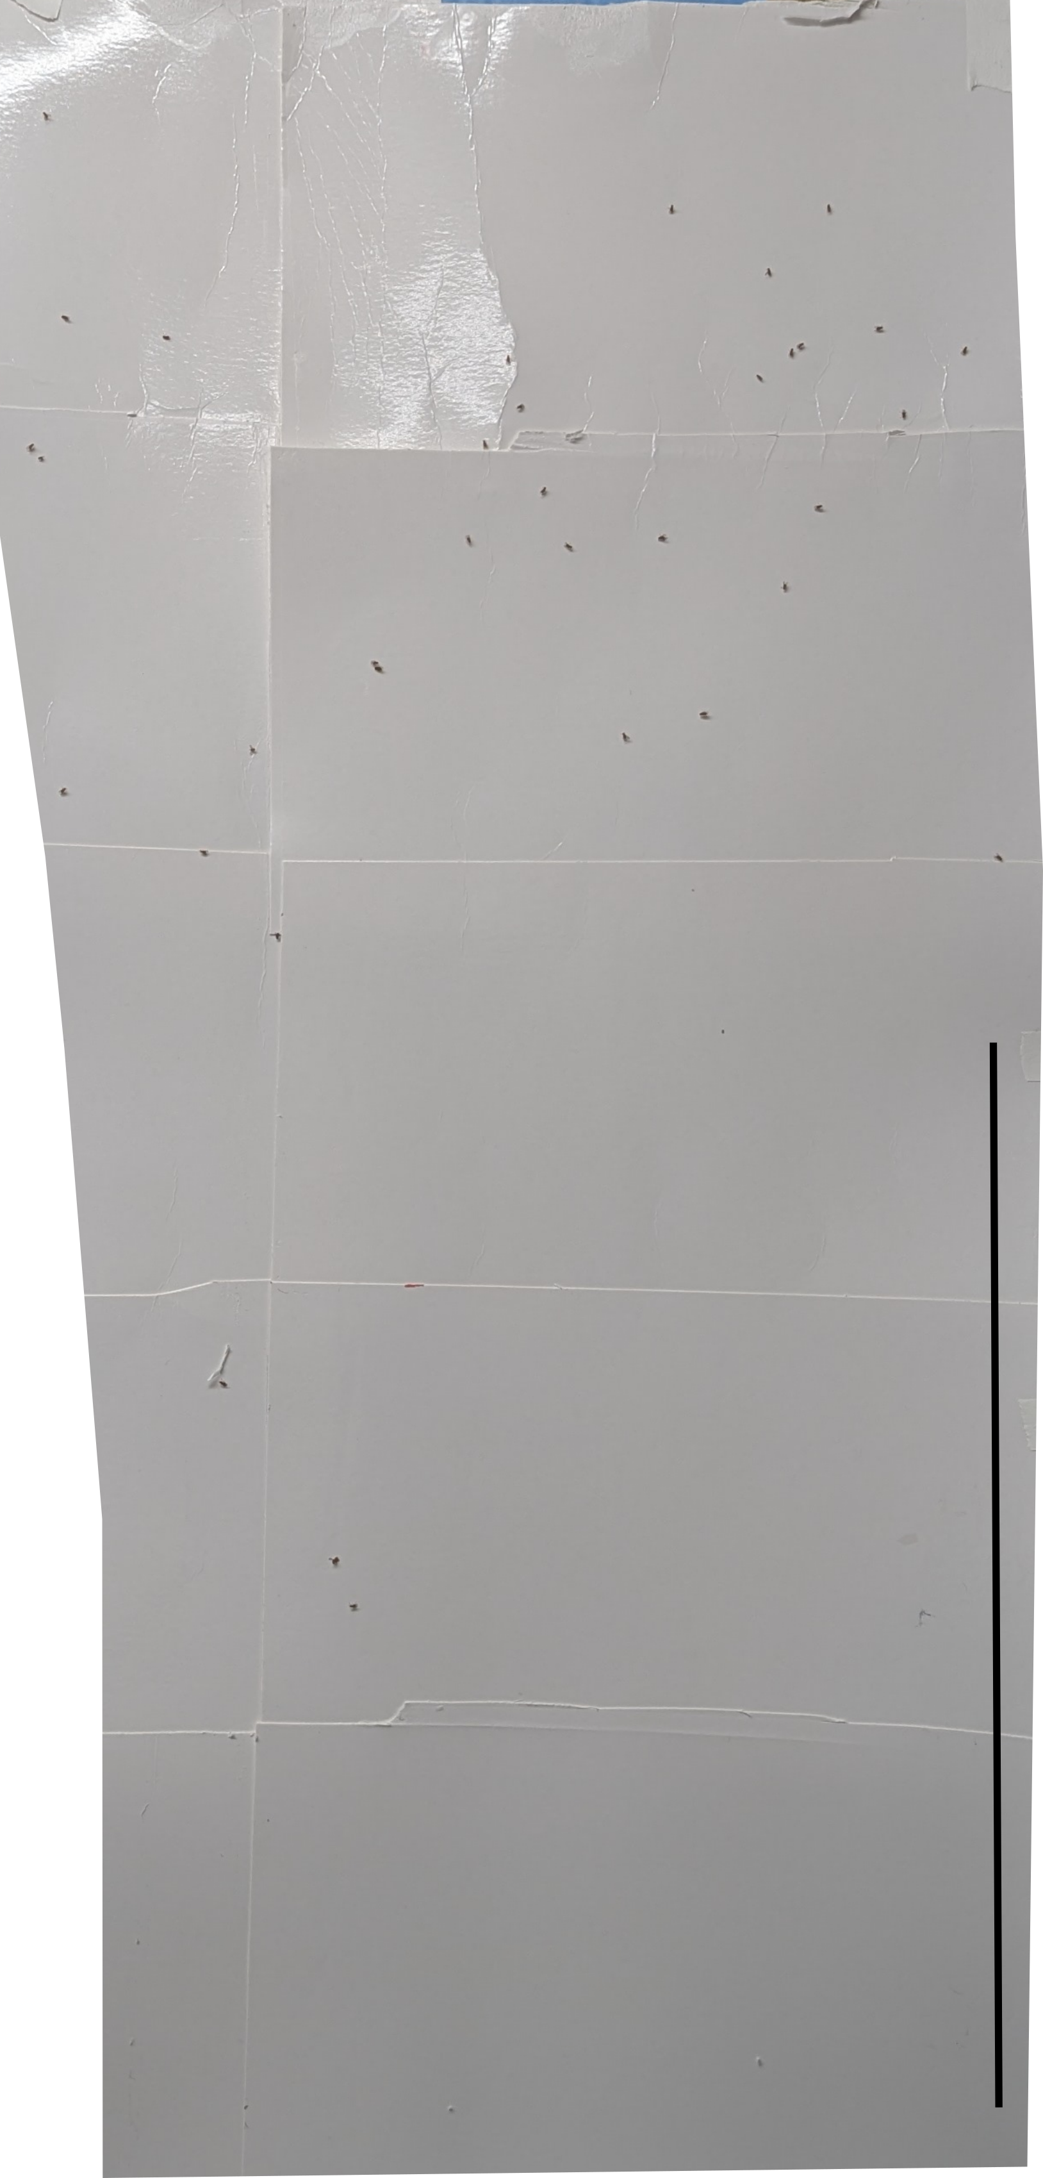

Slide 5

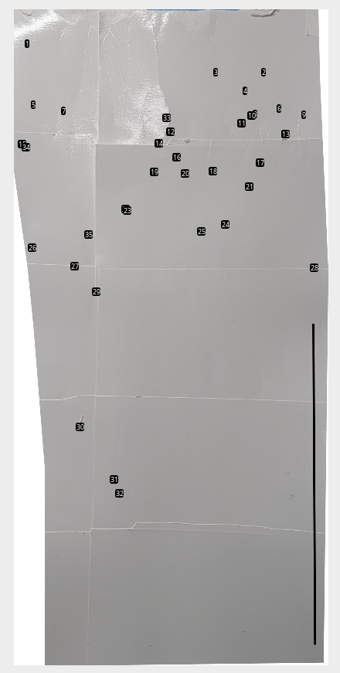

Slide 6
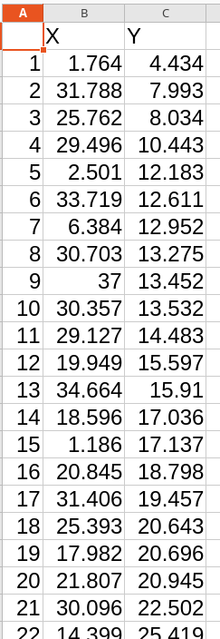

Slide 7


Slide 9
How to download ImageJ macro (FlightAssay.ijm)
https://github.com/PallaresLab/EMBL_Drosophila_course_2025

Slide 10
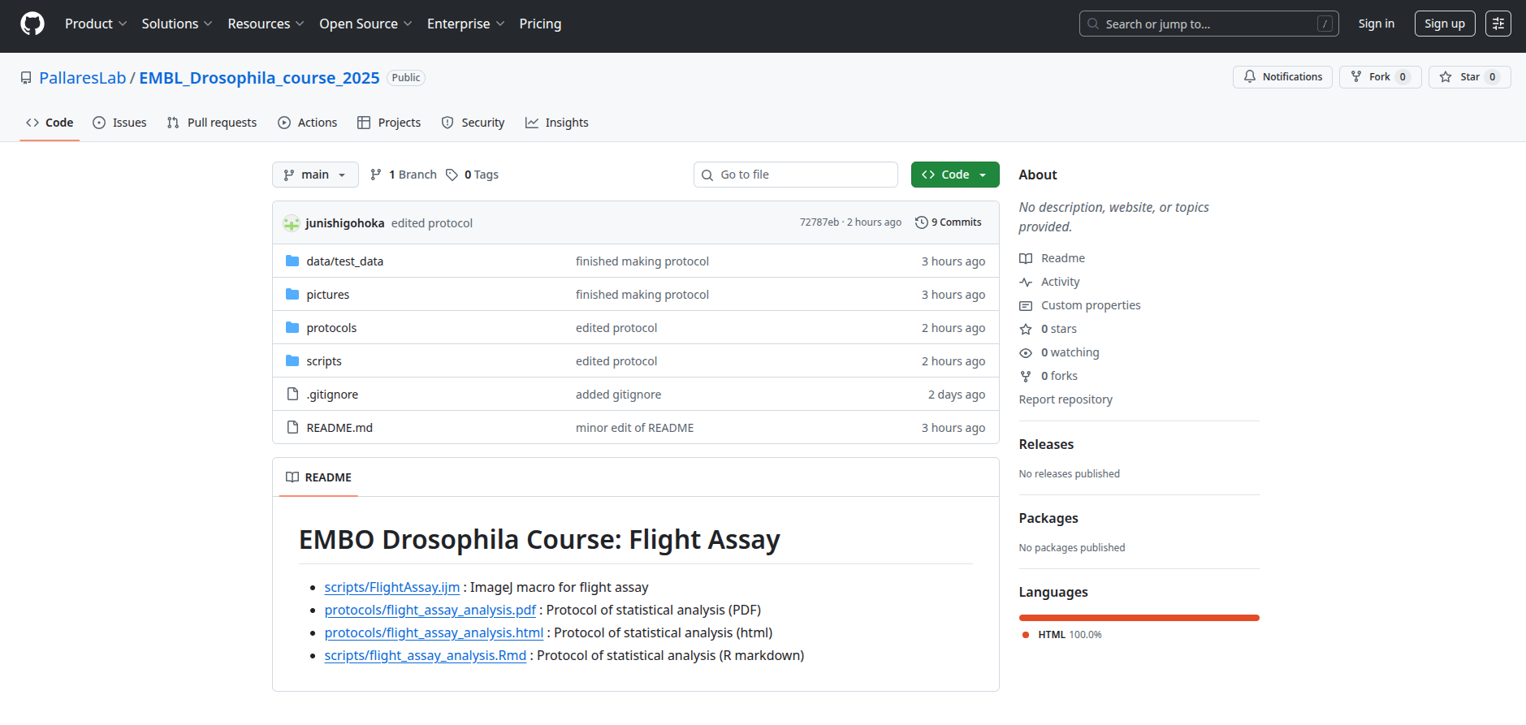
How to download ImageJ macro (FlightAssay.ijm)
https://github.com/PallaresLab/EMBL_Drosophila_course_2025

Slide 11
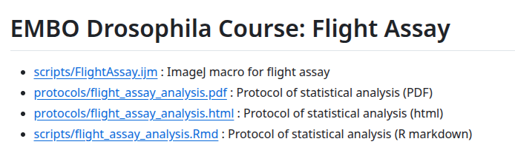
How to download ImageJ macro (FlightAssay.ijm)
https://github.com/PallaresLab/EMBL_Drosophila_course_2025

Slide 12
How to download ImageJ macro (FlightAssay.ijm)
https://github.com/PallaresLab/EMBL_Drosophila_course_2025

Slide 13
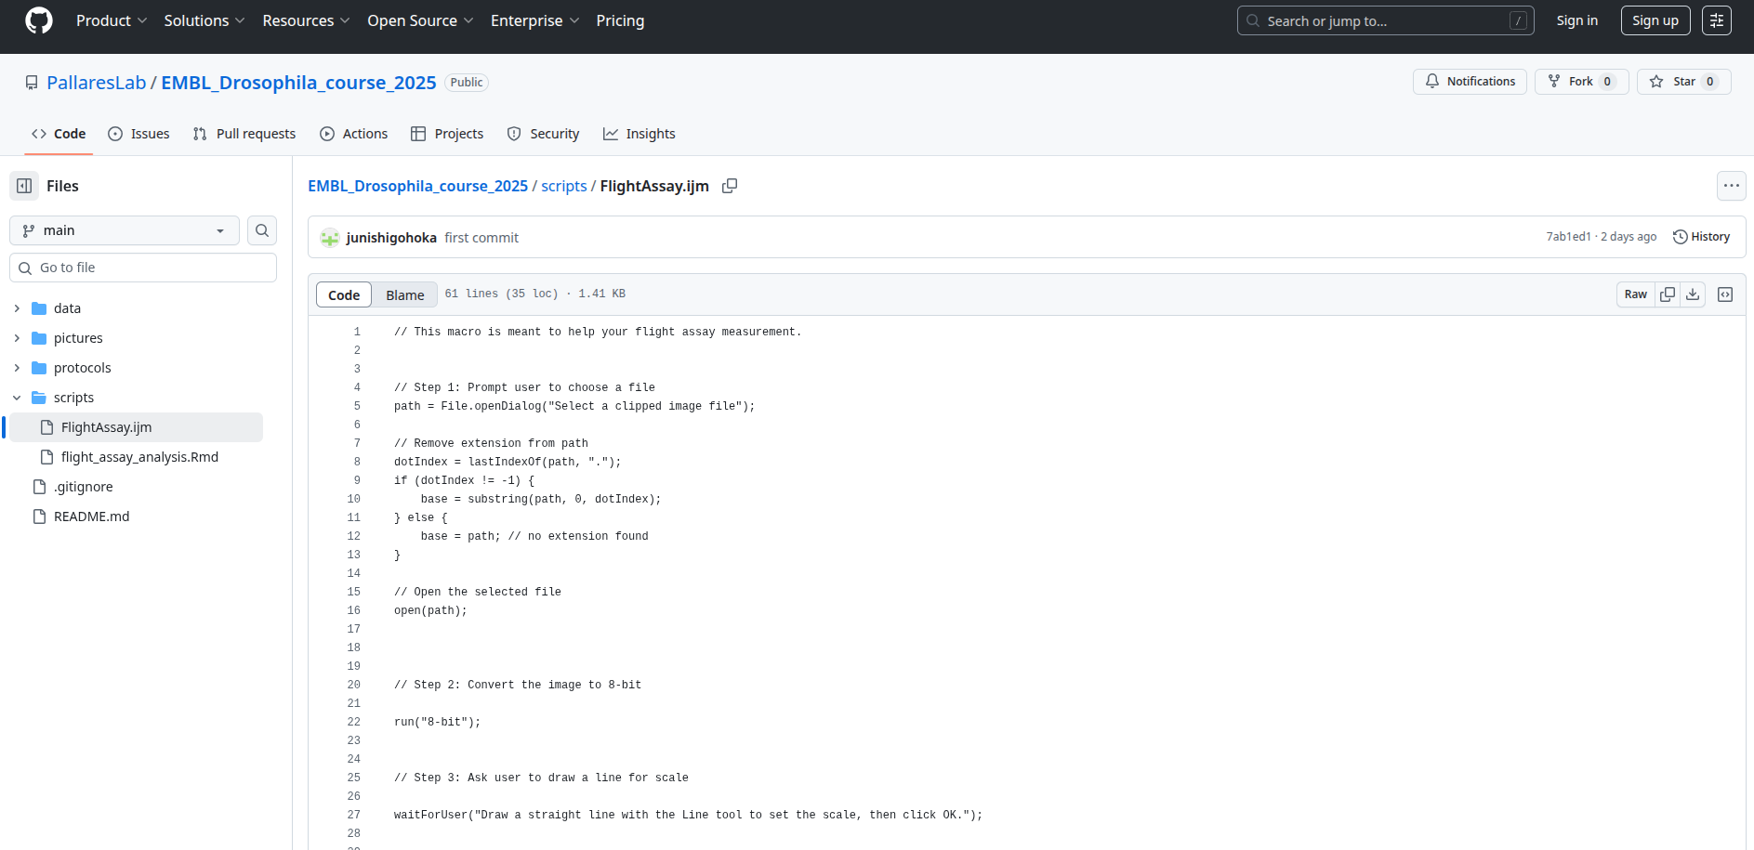
How to download ImageJ macro (FlightAssay.ijm)
https://github.com/PallaresLab/EMBL_Drosophila_course_2025

Slide 14
How to install FlightAssay.ijm to ImageJ

Slide 18
How to download R recipe
https://github.com/PallaresLab/EMBL_Drosophila_course_2025

Slide 19
How to download R recipe
https://github.com/PallaresLab/EMBL_Drosophila_course_2025

Slide 20
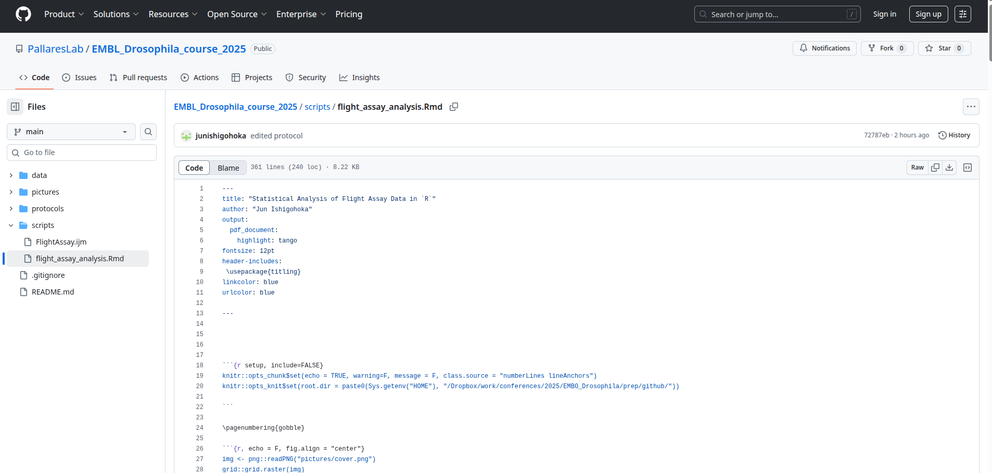
How to download R recipe
https://github.com/PallaresLab/EMBL_Drosophila_course_2025

Slide 21
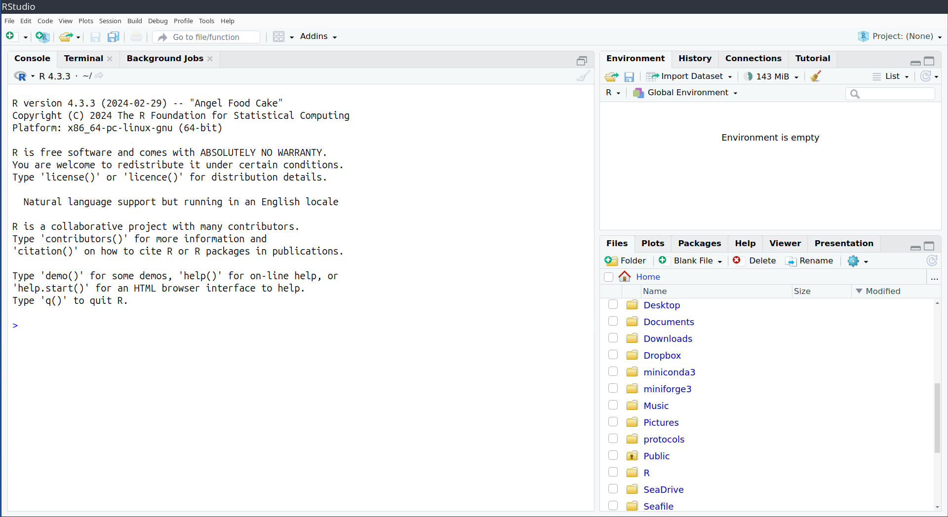
How to run R recipe

Slide 22
How to run R recipe
Navigate, find, and click the downloaded R markdown file (flight_assay_analysis.Rmd)

Slide 23
Optional: You can see instruction in PDF or HTML
https://github.com/PallaresLab/EMBL_Drosophila_course_2025

Slide 24
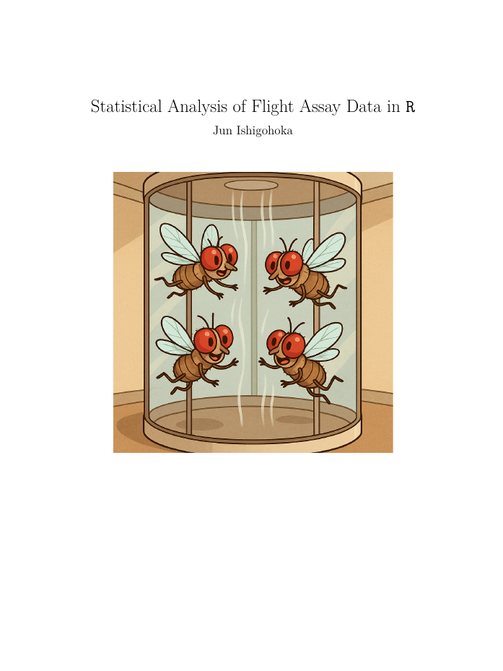
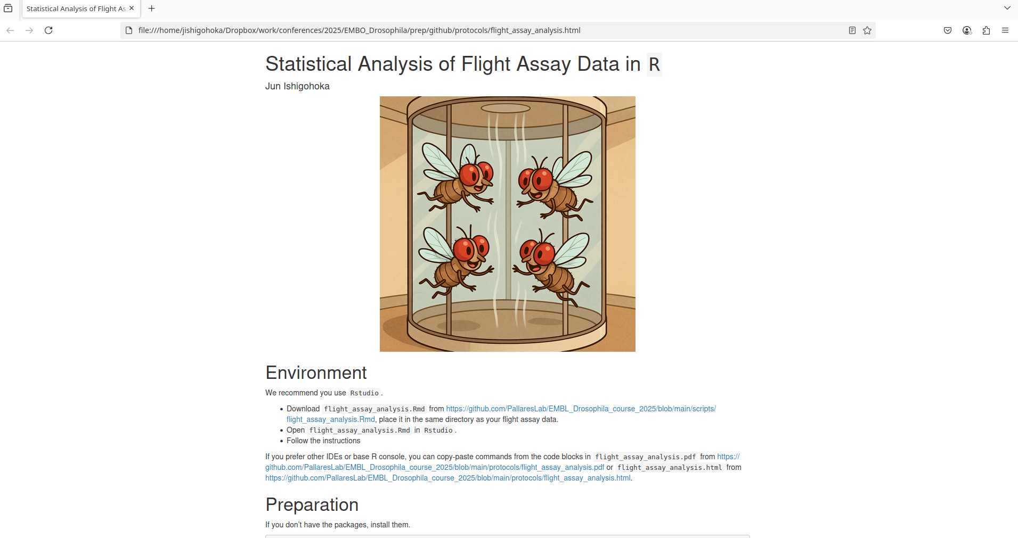
Optional: You can see instructions in PDF or HTML

