Slide 1
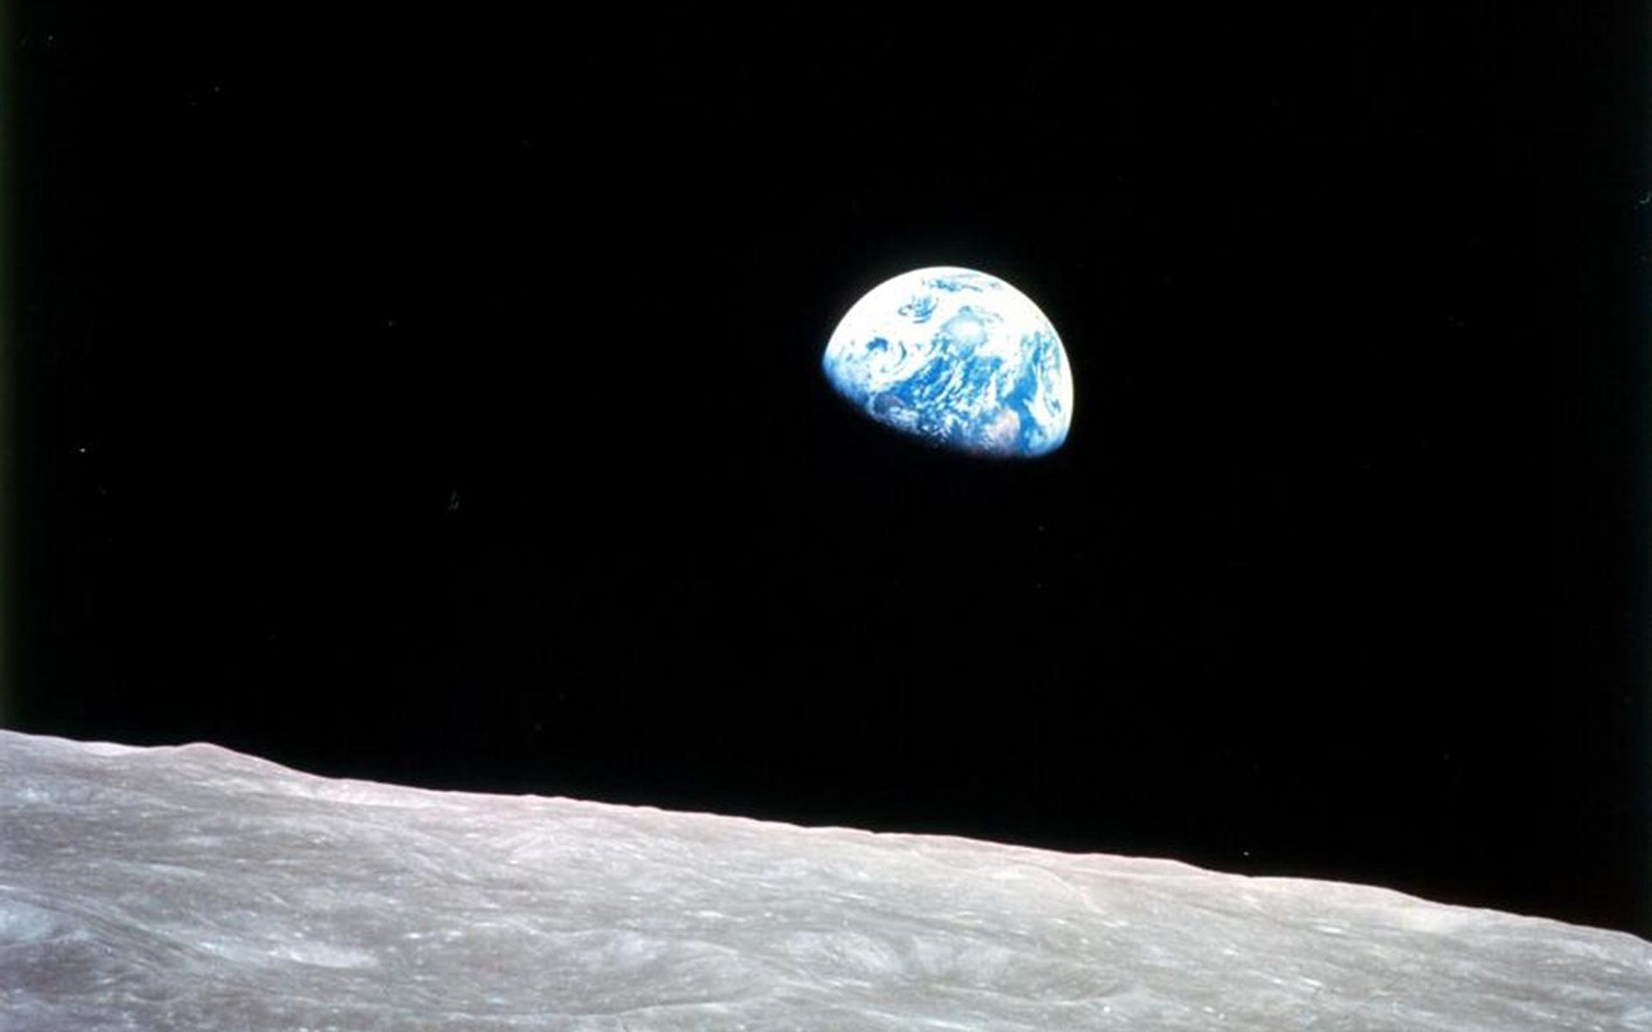
GAUSS
INVESTOR BRIEF
01
PROJECT GAUSS
Mission data,
made decision-ready.
An evidence-first assurance layer for AI-augmented space operations.
INVESTOR BRIEF / AUGUST 2026
Ground-first. Flight-candidate ready. Command-inert by design.
Notes:
Open with the category shift: space operators have more data, more autonomy pressure, and less tolerance for untraceable decisions.
[Sources]
- User-provided: Gauss_Aurora_Pitch_Deck_v1.pptx
- User-provided: Project_Gauss_Data_Architecture_for_AI_Automation_in_Space.pdf
[Sources]
- NASA Earthrise image: https://science.nasa.gov/resource/image-earthrise/
- Image asset: https://assets.science.nasa.gov/dynamicimage/assets/science/esd/climate/2023/12/August-2013_1920x1200.jpg

Slide 2
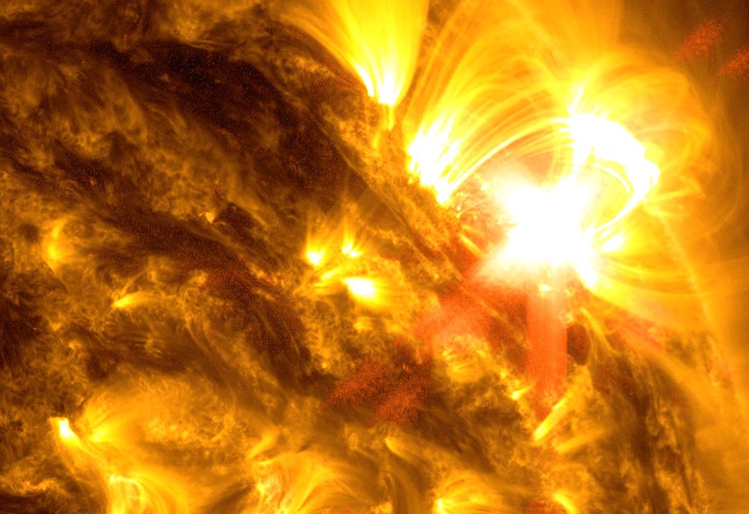
GAUSS
PROBLEM
02
Fragmented evidence is expensive.
SPACE WEATHER SIGNAL
The data exists. The decision context does not.
•
Fragmented
Telemetry, space-weather, SSA, memory, and ground-system evidence live in separate lanes.
CME context is only useful when the operator can trace it to the decision.
•
Opaque
AI can flag an anomaly, but operators still need provenance, confidence, and a safe fallback.
•
Costly
Every delayed or disputed decision compounds mission risk, engineering time, and procurement friction.
Notes:
Frame the problem as operational evidence fragmentation, not a generic AI opportunity. The buyer is paying to reduce decision latency and audit friction.
[Sources]
- User-provided: Project_Gauss_Data_Architecture_for_AI_Automation_in_Space.pdf
- Repo: config/product-packages.json and config/product-packages.schema.json
[Sources]
- NASA solar-flare / space-weather asset in repository: research/documentation-rag/What Is the Solar Wind_ - NASA Science.html
- NASA SOHO CME gallery: https://soho.nascom.nasa.gov/bestofsoho/SolarCorona/las021.html

Slide 3

GAUSS
WHY NOW
03
AI is ready; mission infrastructure still needs trust.
Gauss sits in the trust gap between raw data and safe action.
THE WINDOW
TARGET PROFILES
◈
FIRST MOTION
>
COMMAND PATH
⊘
8
Ground
Inert
research profiles
integration first
approval-gated
A sharper wedge than “AI for space”
More spacecraft. More sensor streams. More critical infrastructure depending on orbital services.
Mission-data assurance: quality, provenance, radiation context, replay, and bounded inference across the existing ground segment.
Notes:
Use the target count as research coverage, not traction. The commercial wedge is explicitly ground-first; flight-candidate work remains an external evidence gate.
[Sources]
- Repo: config/mission-targets.json and config/mission-target.schema.json
- Repo: development/memory/DECISIONS.md, D-110 (2026-08-19)
- User-provided: Gauss_Aurora_Pitch_Deck_v1.pptx
[Sources]
- NASA magnetosphere visualization asset in repository: research/documentation-rag/What Is the Solar Wind_ - NASA Science.html
- NASA radiation-belt context: https://svs.gsfc.nasa.gov/4241/

Slide 4
GAUSS
PRODUCT
04
Gauss makes AI decisions ready for operations.
A neutral assurance layer that helps teams trust, explain, and safely act on mission data.
WHAT TEAMS ALREADY HAVE
GAUSS ASSURANCE
WHAT OPERATORS GET
Validate
Explain
Gate
Mission data
Weather context
Operator history
Existing systems
Confidence signals
Decision context
Safe fallback
Decision-ready
evidence
Audit trail
No command authority
•
•
Start with the ground segment. Earn the right to move closer to flight.
Notes:
Visible copy is investor-facing. The underlying product boundary remains quality, provenance, correlation, replay, bounded inference, and approval-gated safety. Partners retain sensors, mission control, communications hardware, trust roots, and command authority.
[Sources]
- Repo: config/product-packages.json and config/product-packages.schema.json
- User-provided: Project_Gauss_Data_Architecture_for_AI_Automation_in_Space.pdf

Slide 5
GAUSS
PRODUCT
05
Three packages turn trust into expansion.
Land with one mission team, then expand across fleets and infrastructure.
01 / LAND
↗
02 / EXPAND
◎
03 / EXTEND
⇄
Fleet Integration
Flight Candidate Adapter
Federated Bridge Node
Make existing mission data trustworthy across teams, workflows, and customer handoffs.
Carry validated evidence toward future onboard deployment without claiming flight qualification.
Move trusted data across zones, partners, and protected infrastructure as the network grows.
Start on the ground
Earn the flight path
Expand the boundary
The boundary is the moat: Gauss makes external mission systems more trustworthy without pretending to own them.
Notes:
Package names and boundaries are from the repository product catalog. The visible copy is intentionally non-technical; do not describe the flight-candidate adapter as flight-qualified.
[Sources]
- Repo: config/product-packages.json and config/product-packages.schema.json

Slide 6

GAUSS
MARKET
06
Start where data quality is already a budget line.
Gauss sells first to operators and integrators who cannot afford ambiguous telemetry.
BUYER WEDGE | MISSION PROFILE | PAIN WE SOLVE | LANDING MOTION
Commercial satcom | LEO / MEO fleets | Fleet-wide evidence, replay, stale/gap detection | Pilot → annual fleet license
Weather + space weather | GEO ground segment | Radiation context, quality, operator confidence | Ground assurance + data partner
Earth observation | LEO data relay | Data lineage, anomaly triage, integration assurance | Integration package
Lunar relay / integrator | Lunar + ground simulation | DTN, provenance, approval-gated compute | Bridge-node design partner
8 research profiles across satcom, weather/space weather, Earth observation, PNT, lunar relay, and mission integration.
Notes:
These are research profiles and segment hypotheses, not signed customers. The first commercial motion is mission-data and integration buyers serving communications, weather, EO, and cislunar relay systems.
[Sources]
- Repo: config/mission-targets.json and config/mission-target.schema.json
- Repo: development/memory/DECISIONS.md, D-110 (2026-08-19)

Slide 7
GAUSS
MARKET
07
A focused beachhead before the orbital infrastructure upside.
Use a transparent internal model; let customer evidence tighten the market over time.
INTERNAL PLANNING MODEL / DIRECTIONAL LADDER, NOT AUDITED RESEARCH
TAM
TAM
$3–5B
$3–5B
Broad mission-data + infrastructure category
SAM
Mission-data, ground, and distributed in-space infrastructure category.
$900M–$1.75B
Initial ground and distributed-space wedge
SOM
$500k ARR
Five $100k fleet accounts
SOM is deliberately operational: five $100k fleet accounts, not a speculative share of a trillion-dollar category.
Notes:
TAM and SAM are internal planning ranges and should be presented as a scenario, not audited market research. SOM is tied to the current five-account ARR model.
[Sources]
- Repo: development/memory/DECISIONS.md, D-110 (2026-08-19)
- User-provided: Gauss_Aurora_Pitch_Deck_v1.pptx

Slide 8
GAUSS
COMMERCIAL
08
Five fleet accounts can establish the first $500k ARR base.
Charge for the platform annually; keep implementation and flight engineering outside ARR.
REVENUE STACK
◒
Paid evaluation
$20k–$35k
6–10 weeks; credit toward conversion
Annual platform
$100k–$150k
Fleet / mission capacity, not seats
Implementation
$30k–$100k
One-time adapters and onboarding
Flight candidate
$150k–$400k
NRE; external evidence gates
$k ARR / annualized contract value
Notes:
Pricing is a starting hypothesis for customer validation. The $500k ARR path is five $100k annual fleet accounts; pilots, implementation, and NRE are not ARR.
[Sources]
- Repo: development/memory/DECISIONS.md, D-110 (2026-08-19)

Slide 9
GAUSS
COMMERCIAL
09
Charge now. Gate access with evidence.
Billing, compliance, and mission clearance are separate server-side gates.
□
◎
∑
>
⊙
01
02
03
04
05
Select package
Profile the mission
Contract + pay
Provision
Approve scope
Ground / fleet / enterprise
Jurisdiction, data class, deployment
Stripe or invoice / PO
Entitlements after verified webhook
Evidence-ready access only
REGULATORY READINESS PACK
GDPR / DPA
NIS2 applicability
EAR / ITAR review
NIST / CUI scope
Status is evidence-based: unknown → assessing → evidence required → approved.
Notes:
This is a product workflow, not a legal conclusion. Keep payment separate from clearance. Stripe webhooks should drive internal entitlements; regulatory applicability requires customer-specific review.
[Sources]
- https://docs.stripe.com/billing/subscriptions/webhooks and https://docs.stripe.com/billing/entitlements
- https://eur-lex.europa.eu/legal-content/EN/TXT/?from=FI&uri=CELEX%3A32022L2555; https://eur-lex.europa.eu/legal-content/EN/TXT/?qid=1590424137028&uri=CELEX%3A32016R0679; https://csrc.nist.gov/pubs/sp/800/171/r3/final

Slide 10


GAUSS
POSITIONING
10
The whitespace sits between operations, context, and trust.
Adjacent platforms own one layer. Gauss connects the evidence needed to act.
CATEGORY | EXAMPLE | PUBLICLY POSITIONED STRENGTH | GAUSS WHITE SPACE
GROUND C3 | Yamcs / OpenC3 | Command, telemetry, procedures, limits, logs, replay, and operator control. | Cross-system evidence, provenance, and decision gates.
SPACE INTELLIGENCE | Slingshot Portal | Space data, AI analytics, and mission workflows from sense → fuse → decide → act. | Auditable evidence that travels across the customer stack.
AI OBSERVABILITY | Arize / Fiddler | Model and agent evals, monitoring, drift, explainability, and trust metrics. | Mission context: telemetry, radiation, safety, and operator authority.
ONBOARD AUTONOMY | AIKO orbital_OLIVER | Onboard planning, resource-aware decisions, and autonomous execution. | Ground-first assurance before flight deployment; partner-neutral by design.
GAUSS | Evidence layer | Validate, explain, and gate decisions across heterogeneous mission data. | Own the seam between raw signals and safe action.
CATEGORY WEDGE
A partner-neutral evidence layer across space data, mission control, and AI.
Notes:
Illustrative positioning, not feature parity. Named companies are category references only; no partnership or endorsement is implied. Publicly positioned strengths are summarised from official product pages.
[Sources]
- Yamcs official product overview and logo: https://yamcs.org/
- OpenC3 COSMOS official overview and logo: https://openc3.com/
- Slingshot Portal official product overview and logo: https://www.slingshot.space/product-portal
- Arize official AI observability overview and logo: https://arize.com/
- Fiddler official observability overview and logo: https://docs.fiddler.ai/observability/monitoring
- AIKO orbital_OLIVER official product overview and logo: https://aikospace.com/solutions/oliver
- Gauss positioning is an internal, partner-neutral thesis; not a claim of feature parity.

Slide 11
GAUSS
TEAM
11
A compact founding team built around mission context.
Product leadership, operator experience, and space-systems execution in one loop.
JN
Joshua Nathan
◈
KL
Kristina Logunova
◎
SH
Shubham Hule
✦
CEO / Founder & mission lead
COO
CTO
Product direction, mission context, and commercial wedge.
Human–computer interaction and operator experience.
Space systems engineering and technical execution.
ADVISOR NETWORK
Barbara J. Thompson / Solar physics & NASA Goddard
Eleni Petrakou / Particle physics & space weather
Jamie Berry / Aerospace, defence & space finance
The team slide is factual; the next diligence layer is specific founder proof and customer evidence.
Notes:
Named team members and advisor network are taken from the user-provided Gauss_Aurora_Pitch_Deck_v1.pptx. Add measurable founder achievements, customer references, or formal advisor status only when verified.
[Sources]
- User-provided: Gauss_Aurora_Pitch_Deck_v1.pptx

Slide 12
GAUSS
EXECUTION
12
Design partners first. Procurement-ready expansion next.
The next 18 months turn the evidence contract into repeatable revenue.
0–6 mo
◈
6–12 mo
◎
12–18 mo
⊕
Prove the wedge
Convert the motion
Expand the boundary
2 paid ground pilots
First compliance evidence pack
2–3 annual fleet contracts
Repeatable onboarding + billing
5 paid fleet accounts
$500k ARR target
The commercial proof point is repeatable evidence delivery, not a speculative claim of autonomous spacecraft operations.
Notes:
These are internal milestones, not achieved traction. Keep the hosted-payload path bounded and avoid claiming flight qualification.
[Sources]
- Repo: development/memory/DECISIONS.md, D-110 (2026-08-19)
- Repo: config/product-packages.json and config/product-packages.schema.json

Slide 13
GAUSS
THE ASK
13
$1.5M
to make mission-data assurance a repeatable commercial category.
THE PROOF POINT
5 fleet
accounts
USE OF FUNDS / INTERNAL PLAN
Product + integrations
45%
$500k ARR
Ground-first
Evidence-ready
Security + compliance
20%
GTM + design partners
20%
Operations + runway
15%
Gauss gives space operators a safer path from data abundance to trusted action.
Notes:
Close on the proof point: five paid fleet accounts and a repeatable evidence contract. Funding allocation is an internal planning scenario.
[Sources]
- Repo: development/memory/DECISIONS.md, D-110 (2026-08-19)
- Repo: config/product-packages.json and config/product-packages.schema.json
- User-provided: Gauss_Aurora_Pitch_Deck_v1.pptx

Slide 14
GAUSS
READINESS
14
Investor-ready story; diligence-ready evidence is next.
A practical readiness scorecard for a space-software raise.
LENS | MUST SHOW | GAUSS TODAY | STATUS
SPACE FIT | Clear space connection; viable business plan; credible milestones. | Ground-first space operations wedge, product packages, market model, 18-month plan. | PARTIAL
PRODUCT + PROGRESS | Matter-of-fact product; unique insight; progress; business model; founders; ask. | Clear wedge, pricing, ARR path, and team slide. Specific founder proof and customer progress remain thin. | PARTIAL
SCALE + DEFENSE | Addressable market; experienced team; scalable model; defensibility. | Market wedge, competition, commercial path, and team roles are visible. IP, heritage, and TRL evidence still need proof. | PARTIAL
VISUAL + PROOF | One claim per slide; hard proof; bold visuals; credible milestones; clear next action. | Consistent system, source-backed notes, native charts/tables, and ground-first milestones. | PASS
INVESTOR DECISION | Why now; why this team; why this round; what changes after funding. | Why now, $1.5M use of funds, $500k ARR, and team slide are clear. Why Gauss can win still needs proof. | PARTIAL
NEXT UNLOCKS
Founder proof • customer LOI / pilot evidence • prototype + TRL / IRL • IP / moat map • CAC, payback, and gross-margin evidence
Notes:
This is an internal readiness scorecard for the current investor deck, not an eligibility determination. The next diligence unlocks are founder credibility, customer proof, explicit readiness evidence, and IP defensibility.
[Sources]
- User-provided Gauss_Aurora_Pitch_Deck_v1.pptx
- Internal Gauss repository planning model and product notes
- https://www.starcloud.com/
- https://investors.rocketlabcorp.com/
- https://www.relativityspace.com/about

