Slide 1
Scalable Network I/O: From select to io_uring
CS 331 Computer Networks · Team T008 · Project ID 13
Chitiveli Hemcharan Varma
Gella Naga Sai Krishna
Guransh Kaur Saran
Kowel P Laloo
Pallav Biyala
2411095
24110122
24110127
24110168
24110234
Notes:
Introduce the team and the question: how do Linux's four event-notification mechanisms compare when the application code is held constant?

Slide 2
Problem and objectives
Problem
Which Linux I/O mechanism should a single-threaded server use, and when does it matter?
select
poll
epoll
io_uring
Scans every fd; FD_SETSIZE 1024 limit
Scans an array of fds; no hard limit
Kernel reports only ready fds
Shared submission / completion queues
Objectives
Implement all four backends behind one I/O interface; same application code on each
Build two servers on it: an echo server and an HTTP/1.1 file transfer server
Benchmark with a reproducible runner: 5 runs per test, CPU pinning, every run validated
Explain results with CPU time and syscall counters, not only throughput
Notes:
Holding the application constant means any difference comes from the event-notification layer.

Slide 3
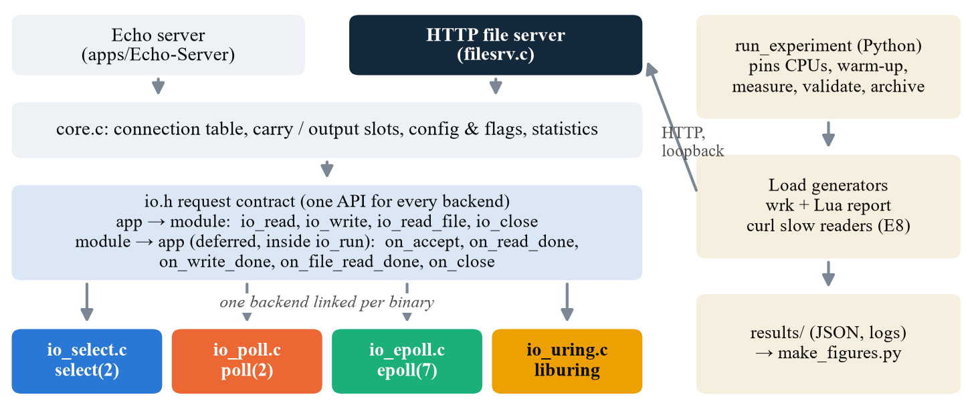
Architecture
Design
Apps talk only to io.h; exactly one backend is linked into each binary
Notes:
io.h is request-based: the app asks for io_read, io_write, io_read_file or io_close and gets a callback when done. Readiness backends wait for readiness then call recv/send; io_uring queues the operation. Completions are deferred to the next loop iteration, so callbacks never recurse. Eight binaries: two apps times four backends.

Slide 4
Testbed and method
Setup
One laptop, loopback TCP, server pinned to one core, 5 runs per test
wrk client
4 threads · CPUs 2–5
Loopback TCP
127.0.0.1
Server
1 thread · CPU 1
Backend
select / poll / epoll / io_uring
Machine
Method
Tools
Intel i5-10300H, 4 cores / 8 threads
WSL2, Linux 6.18.54, ~8 GB RAM
somaxconn 4096; 10,240 open files
10 s warm-up, 30 s measured, 10 s cool-down
5 runs per test, median shown
Runs validated automatically; raw logs kept
C17 + GCC, liburing
Python experiment runner
wrk (+ Lua), curl, matplotlib
TO ADD (echo-server team): echo test settings
Message sizes, connection counts and client tool/command used for the echo experiments (one line).
Notes:
File-transfer settings are filled in. Echo team: replace the yellow box with your echo workload in one line, or delete it if your settings are identical.

Slide 5
Echo server: design
Echo
[Echo team: one-line takeaway about the echo server design]
TO ADD (echo-server team): how the echo server works
Message framing: what --msg-size means and how a message boundary is detected
How echo uses io_read / io_write and the carry slot (partial reads and writes)
One round trip mapped to callbacks: on_read_done → io_write → on_write_done → io_read
Correctness: checks passed per backend (e.g. x/x on all four)
TO ADD (echo-server team): diagram
A small flow diagram of one echo round trip (client → server → client)
Keep the colours: select blue, poll orange, epoll green, io_uring yellow
Notes:
Echo team: replace both yellow boxes. Keep the title position and the blue takeaway line under the title.

Slide 6
Echo server: throughput
Echo
[Echo team: one-line takeaway, e.g. which backend scales best with connections]
TO ADD (echo-server team): throughput chart
Native PowerPoint chart (Insert → Chart): round trips/s vs concurrent connections (e.g. 1, 10, 100, 1000)
One series per backend in the deck colours: select 2A78D6, poll EB6834, epoll 1BAF7A, io_uring EDA100
Plot the median of 5 runs, the same convention as the file-transfer slides
TO ADD (echo-server team): what we see
2–3 short bullets with numbers (e.g. epoll vs poll at 1000 connections)
One bullet on why (e.g. O(n) scans vs ready list)
Notes:
Echo team: chart on the left, 2 to 3 bullets on the right, mirroring the file-transfer slides.

Slide 7
Echo server: latency and message size
Echo
[Echo team: one-line takeaway about latency or message size]
TO ADD (echo-server team): latency chart
Mean and/or p99 latency vs message size (e.g. 64 B to 64 KiB) or vs connections
Same four colours, median of 5 runs
TO ADD (echo-server team): second chart (CPU or message size)
e.g. server CPU per message vs epoll, or throughput vs message size
If you have no second chart, widen the left chart and delete this box
TO ADD (echo-server team): 2 bullets
What the charts show, with numbers, and the reason behind it.
Notes:
Echo team: two charts side by side plus two bullets underneath, the same layout as the file-transfer result slides.

Slide 8
File transfer server: design
File server
HTTP/1.1 GET over keep-alive connections, files sent in 64 KiB chunks
Receive
parse GET, check file name
Send header
io_write (own buffer)
Read chunk
io_read_file ≤ 64 KiB
Write chunk
io_write, repeat until done
Next request
keep-alive, or close
Returns 200, 400, 404 or 405; header and file data never share a buffer, because buffer ownership differs between backends
read() + write() through user space (no sendfile), so every byte goes through the backend
Five experiments, 360 runs (357 accepted): concurrency and file size (E5a), connection reuse (E5b), buffers (E7), slow readers (E8), TCP_NODELAY (E9)
Correctness: 9/9 checks per backend, 36/36 in total
Notes:
The dark boxes are the loop that repeats for each 64 KiB chunk of the file.

Slide 9
Concurrency and file size
E5a
Backends tie up to 100 connections; at 1000, poll slows and io_uring starves some clients
1 → 100 connections: +37% on every backend. At 1000, poll drops to 4,989 req/s vs 5,484 for epoll (it rescans its whole pollfd array every loop).
io_uring at 1000: same throughput, but p99 latency 13.5 s vs 0.24 s for epoll. Large files hit the same ~170 MB/s ceiling on all four.
Notes:
Latency follows Little's law: connections divided by throughput. The io_uring tail appeared in all 5 runs and is a fairness problem, not a speed problem.

Slide 10
Connection reuse and buffer sizes
E5b · E7
Chunk size matters (−41% at 16 KiB); keep-alive and socket buffers barely matter here
Keep-alive measured +5 to +8%, but the same test varied 7–12% between sessions, so this result is inconclusive.
16 KiB chunks: 4× the read/write cycles, 2.4× the CPU per file, −41% throughput. Socket buffer sizes change nothing.
Notes:
SO_RCVBUF has no effect because the server only receives a short GET. A 64 KiB SO_SNDBUF still holds a whole 64 KiB chunk.

Slide 11
Slow readers and TCP_NODELAY
E8 · E9
Nagle + delayed ACK cut small-file throughput by 62% on every backend
Non-blocking servers absorb slow readers: 10 change nothing, 100 cost 7–11% (run 3 rejected for 3 backends, so this is optimistic).
Header and body are two writes; Nagle holds the small body for the client's ~40 ms delayed ACK: 100 conns ÷ 44 ms ≈ 2,270 req/s, as measured.
Notes:
At 64 KiB only a 53-byte tail is held, and the full segment before it makes the client ACK immediately, so TCP_NODELAY has no effect there.

Slide 12
Why all four look the same
Analysis
The server is never saturated; the backends differ only in CPU cost
The core is ≤ 48% busy in every test, so the client (wrk on 2 physical cores) and loopback set the limit; the backend's wait step is ~1% of the work.
poll +27% CPU at 1000 conns; io_uring −12% on large files, mostly because our other backends copy each chunk one extra time.
Notes:
At 100 connections the server waits about 180 times a second and handles about 33 responses per wakeup, against about 17,700 read/write calls a second that are identical code on every backend.

Slide 13
Conclusions
Summary
What we learned from both servers
File transfer server
TO ADD (echo-server team): echo server conclusions
2–3 bullets in the same style as the left panel
Say whether backend differences are bigger for echo than for file transfer, and why
Backends tie on throughput: the server was never saturated (≤ 48% busy)
They differ in CPU cost (poll +27% at 1000 conns) and in the tail (io_uring p99 13.5 s at 1000)
TCP and buffer settings matter more than the backend: TCP_NODELAY −62%, 16 KiB chunks −41%
Notes:
Echo team: fill the right panel; keep both panels the same size.

Slide 14
Limitations and future work
Next
What we would change to make the comparison conclusive
Limitation | Fix
Server never saturated; client CPU not recorded | Cap the server with a cgroup CPU quota; record client CPU; give wrk its own cores
Extra copy in readiness backends; basic io_uring; built at -O0 | Read straight into the send buffer; use sendfile/splice; build with -O2; use io_uring's advanced features
Closed-loop load only; WSL2 loopback | Add a fixed-rate test (wrk2 -R); repeat key tests over a real network
5 runs, no significance tests; E5b halves in separate sessions | More runs with confidence intervals; rerun E5b in one session
TO ADD (echo team): echo-specific limitation | TO ADD (echo team): its fix
Notes:
Echo team: replace the yellow row; add a second row if needed.

Slide 15
Thank you
Questions?
Code, raw results and report: github.com/Pallav-Biyala/CS331-T008-NetworkIO (branch project2)
Notes:
Point to report/CS331-T008-Report.pdf for the full analysis.

