Slide 1

CS331: COMPUTER NETWORKS | TEAM T008
Scalable Network I/O
From select( ) to io_uring : Benchmarking Five I/O Engines
Single-threaded TCP echo servers: a deep dive into Linux socket mechanisms
select
poll
epoll
io_uring
Notes:
We built and benchmarked four completely different ways to handle thousands of simultaneous TCP connections — using only a single CPU thread. Today we'll show you why the 50-year-old design of select is still fast in some cases, and why io_uring — the newest Linux I/O primitive — can actually be slower if you use it wrong.
1

Slide 2
Project Statement & Objectives
THE PROBLEM
OBJECTIVES
Modern servers must juggle thousands of simultaneous TCP connections on a single thread. The I/O multiplexing mechanism chosen decides throughput, latency, memory footprint, and CPU cost.
1
Implement : 4 single-threaded C servers; one per mechanism
2
Benchmark : Concurrent loads from 10 → 10,000 using tcpkali
Mechanism | Year | Core Design
select | 1983 | Bitmap of fds, full copy per call; hard 1024-fd kernel limit
poll | 1997 | Array of structs, no fd limit; full array copy per call
epoll | 2002 | Kernel-resident interest list, O(1) event delivery
io_uring | 2019 | Async ring buffers, batched syscalls via shared mmap
Measure : Throughput, p99 latency, syscalls, context switches
3
4
Analyse : Theory vs. reality across all four metrics
5
Demonstrate : The newest mechanism is not always the fastest
Notes:
1

Slide 3
Design & Architecture
Five Engines, One Shared Interface
Shared foundation (network_utils.c) : socket creation, non-blocking mode (fcntl), TCP_NODELAY, SO_REUSEADDR
Every server : single-threaded, port 8080, echoes bytes back with a 64KB per-client output buffer and flush-until EAGAIN state machine
1
2
3
4
1983
1997
2002
2019
select
poll
epoll
io_uring
  Custom my_fd_set bitmap, cast to fd_set*; kernel scans and copies back; user scans all bits. Hard kernel limit: 1024 fds.
  Complexity / Trait: O(N) scan, capped at 1024 clients
  Passes a pollfd array on every call; kernel fills revents; user walks the whole array. No fd-count ceiling — capped at 10,000 for fairness.
  Complexity / Trait: O(N) copy, up to 10,000 clients
  Interest list lives in the kernel as a red-black tree; epoll_wait returns only ready fds. State transitions managed via epoll_ctl(MOD) to switch between EPOLLIN / EPOLLIN|EPOLLOUT.
  Complexity / Trait: O(1) event delivery
  Submit ops via an SQ ring; kernel completes async, posts to a CQ ring via shared mmap. SOCK_NONBLOCK set directly in the ACCEPT SQE; no fcntl() round-trip per connection. MAX_CLIENTS (10,000) is actively enforced via an active_clients counter.
  Complexity / Trait: Async rings, batched io_uring_enter calls
Notes:
2

Slide 4
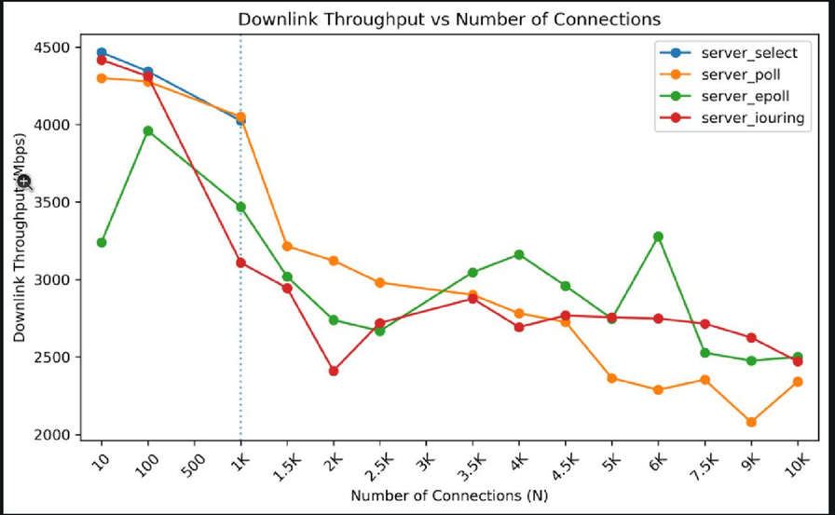
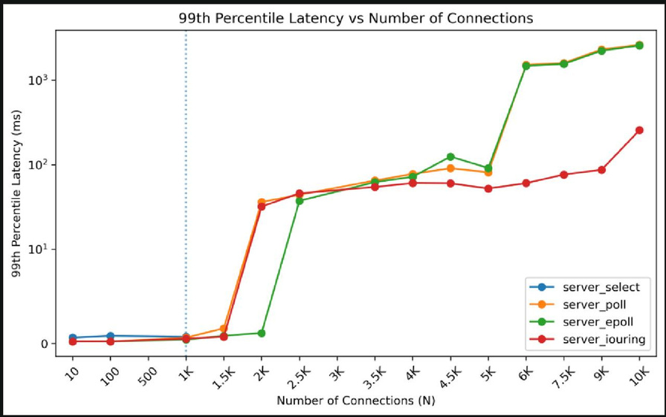
Fixes & Benchmark Results
1
Enforcing select's 1024-fd Limit
2
Idiomatic io_uring Accept (fcntl Removed):
3
MAX_CLIENTS Actually Enforced for io_uring:
4
Output Buffer + Flush State Machine (all engines):
5
Mid-loop SQ Drain (maybe_flush):
Custom my_fd_set bitmap sized to MAX_CLIENTS = 1024. Connections with fd ≥ 1024 are rejected cleanly. select is tested only up to 1000 connections where it can operate correctly.
accept_flags = SOCK_NONBLOCK in the ACCEPT SQE hands back an already-nonblocking fd directly from the kernel; no fcntl(F_GETFL)/fcntl(F_SETFL) round-trip per connection.
Added an active_clients counter (incremented in alloc_client, decremented in free_client). Connections past 10,000 are rejected via submit_close.
64 KB per-client buffer; flush_outbound_buffer retries until EAGAIN; memmove shifts remaining bytes; zero data loss under backpressure.
If fewer than 4 SQ slots remain during CQ drain, ring_submit(r, 0) is called immediately to prevent ring exhaustion under 5000+ connection bursts.
  select: ~4025 Mbps (fails at 1500+ conns)
  poll: ~4050 Mbps, degrades to ~2364 Mbps at 5000 conns
  epoll: ~3469 Mbps at 1000, ~2747 Mbps at 5000 conns
  io_uring: ~3109 Mbps at 1000, holds ~2756 Mbps at 5000 conns
  At 1000 connections, all four engines: 0.4–0.7 ms
  At 5000 conns — poll: 81.2 ms, epoll: 91.3 ms, io_uring: 52.3 ms
Notes:
3

Slide 5
Non-functional Analysis
Setup : tcpkali (core 1) drives load against the server (core 0) · loads swept 10 → 10,000 connections · measured over a 10s sustained window · 512-byte message payload · connect-rate 10,000/s
  select: Competitive at low load (~4465 Mbps @ 10 conns, ~4025 Mbps @ 1000 conns), then collapses to NaN at 1500+ conns due to the 1024-fd hard limit.
  poll: Starts strong (~4300 Mbps @ 10 conns), degrades steadily to ~2364 Mbps @ 5000 conns due to O(N)O(N) full-array copy on every call.
  epoll: ~3240 Mbps @ 10 conns, peaks ~3960 Mbps @ 100 conns, holds ~2747 Mbps @ 5000 conns. Most consistent curve at mid-to-high load.
  io_uring: ~4417 Mbps @ 10 conns, drops to ~3109 Mbps @ 1000 conns as CQE harvest cost grows; stabilises ~2472–2756 Mbps at 5000–10,000 conns.
  All engines track closely below 1000 conns (< 1 ms p99).
  At 2000 conns: poll jumps to 36.2 ms, epoll to 37.4 ms, io_uring to 32.0 ms.
  At 5000 conns: poll 81.2 ms, epoll 91.3 ms, io_uring 52.3 ms.
  At 6000+ conns: poll and epoll spike to 1.5–2.6 s; io_uring stays in the 52–88 ms range.
  select shows sub-millisecond p99 at ≤ 1000 conns (its valid operating range).
Notes:
4

Slide 6
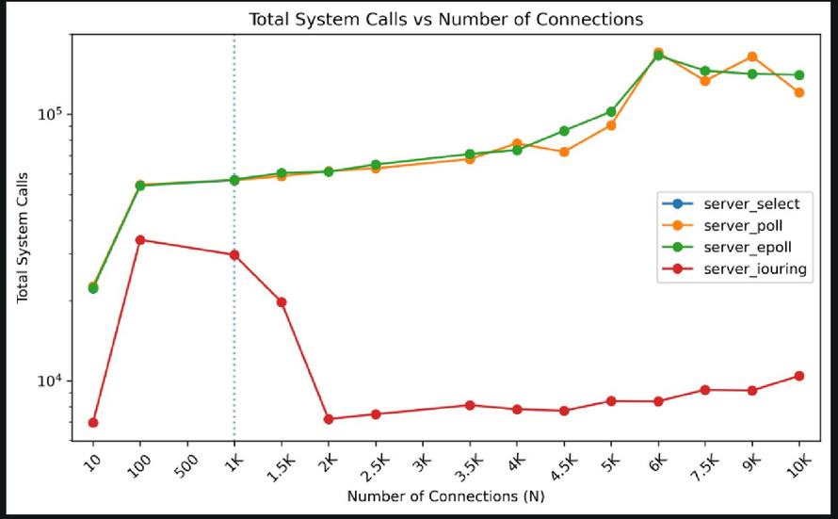
Non-functional Analysis
  select / poll / epoll: Dominated by sendto + recvfrom at low loads (10K–26K calls @ 10 conns); primary multiplexing syscall (pselect6 / poll / epoll_wait) is comparatively rare.
  io_uring: sendto/recvfrom replaced by ring operations; io_uring_enter calls reduced via batching — measurably fewer multiplexing-layer syscalls at scale.
  Paradox: Fewer syscalls ≠ fastest — memory-barrier cost on the SQ/CQ rings and CQE harvest overhead replaces syscall overhead for small 512-byte echo messages.
RELIABILITY & CORRECTNESS
Graceful disconnect
EAGAIN handled
SIGPIPE suppressed
Ring-exhaustion guard
Zero data loss
Notes:
5

Slide 7
Challenges & Key Takeaways
1
select's 1024-fd Limit
2
Partial Sends
3
Ring Exhaustion (io_uring)
4
io_uring fcntl Overhead
5
Strace Interference
  Problem: The Linux kernel's select() syscall silently ignores nfds > 1024 regardless of bitmap size — memory corruption risk above fd 1024.
  Fix: MAX_CLIENTS = 1024; connections with fd ≥ 1024 rejected cleanly; select benchmarked only at ≤ 1000 conns where it is correct.
  Problem: send() silently drops data when the kernel send buffer fills under load.
  Fix: Per-client 64 KB output buffer; flush_outbound_buffer loops until EAGAIN; buffer compacted with memmove.
  Problem: io_uring SQ fills up during burst accept + recv/send at 5000+ connections.
  Fix: maybe_flush() drains the SQ mid-loop whenever fewer than 4 slots remain.
  Problem: Earlier build added fcntl(F_GETFL)/fcntl(F_SETFL) per accepted connection, undermining the zero-syscall premise.
  Fix: accept_flags = SOCK_NONBLOCK in the ACCEPT SQE; kernel delivers an already-nonblocking fd — no round-trip.
  Problem: ptrace overhead skewed syscall counts 10×.
  Fix: strace attached post ramp-up; measurements taken over a clean 10 s window.
KEY TAKEAWAYS
Does O(N) hurt select/poll? | select hits a hard 1024-fd wall; valid only under 1000 conns. poll degrades gracefully but latency explodes past 2000 conns.
Is epoll truly O(1)? | For event notification, yes. But at 6000+ conns the kernel TCP stack — not epoll — saturates, causing latency spikes to 1–2 s.
Does io_uring cut syscall overhead? | Yes, io_uring_enter calls are batched and sendto/recvfrom replaced by ring ops. But memory-barrier cost on small 512-byte messages limits the gain.
Is newer always faster? | No. At moderate loads (100–1000 conns), poll and select match or beat epoll on throughput. io_uring shows the best p99 latency at 5000–10,000 conns but not the highest throughput.
When does io_uring make sense? | Large I/O payloads, CPU-pinned always-busy workloads, or when minimising syscall count matters more than raw echo throughput on tiny messages.
Notes:
6

