Slide 1
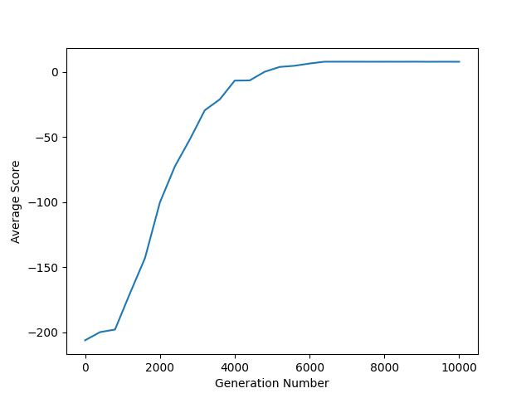
Reinforcement Learning for Taxi
Pallav Pant, Joshua Lahr, Shannon Flaherty
–
PHY 5680 – THE OHIO STATE UNIVERSITY – DEPARTMENT OF PHYSICS
INTRODUCTION
The goal of this project is to train an Artificial Intelligence (AI) to learn to play games, such as Taxi, Tetris or Super Mario Bros using Reinforcement Learning Techniques.
Games are a useful training tool since they provide a structured environment for AI systems to learn and improve their performance. The rules of the game create a well-defined problem space, making it easier to train AI models. Games often also provide easy methods for evaluating these models since there might be an explicit goal or a built-in scoring system.
Q-Learning
The Artificial Intelligence uses a value-based method. It decides the best move based on a Q-function which depends on the current state and on Q-values.
It uses an Epsilon-Greedy Algorithm to converge towards the Q-values with the highest reward potential.
Temporal Difference Method
We used the Temporal Difference method to update the Q-values, which alters these values after every move depending on the largest predicted reward.
A possible alternative would be the Monte-Carlo Method.
Head 3, to label the table below
Avg Score v/s Generation No.
Taxi
The game Taxi is relatively simple. It consists of a 5x6 map with obstacles and 4 pickup/drop-off spots for passengers. The Taxi has 6 possible moves. Translation in the 4 directions and picking up and dropping off a passenger.
Since it offers a "Transferable Skill," this game is particularly significant for training AI models. Robots can learn how to move in the real world by being trained on this game at a larger scale with more complicated terrain, which may include movement in the third dimension.
RESULTS
Images
Images must be 72 to 100 dpi in their final size, or use a rule of thumb of 2 to 4 megabytes of uncompressed .tif file per square foot of image. For instance, a 3x5 photo that will be 6x10 in size on the final poster should be scanned at 200 dpi.
We prefer that you import tif or jpg images into PowerPoint. Generally, if you double click on an image to open it in Microsoft Photo Editor, and it tells you the image is too large, then it is too large for PowerPoint to handle too. We find that images 1200x1600 pixels or smaller work very well. Very large images may show on your screen but PowerPoint cannot print them.
CONCLUSIONS
We have created this template with scientific researchers in mind. We encourage any comments or suggestions so that we can continue to update and improve this template.
E-mail identity@osu.edu with suggestions.
Head 3, to label the table below
AIM
How to use this template:
Highlight this text and replace it with new text from a Microsoft Word document or other text-editing program. The text size for body copy and headings and the typeface has been set for you. The text boxes and photo boxes may be resized, eliminated, or added as nec essary. The references to the department, college and university, including the logo, should remain.
BIBLIOGRAPHY
References. lum exer adipsustrud doloree tuerat lorpera esenibh eu faccum eum iuscili quamcommy nit lorerillut ullam quat lore verostrud ming et, si tie faciliquisse modolortin volore
vel et vel dionsenit adit, consenim zzrillute el euguerostie faci bla conse minim zzriure tio dolore tet, volobor si.
Velit vendipit, quat iustrud eraeseniat do conummod ea alisci tie vel ea commodo lortis aliquamcommy niat aliquat niam ercillan eu feugue magnisl utpat autat.
Ut nostionsed molobore feugiam quiscing exeraese ting etue dit atetum ipsum inim ex exercin cincincinci et lut incinis er in
henibh esequat, quis aci eniamet ut ad modolutpat wis eumsandipit aliquipsum zzriure verosto enim ea feu faccum vulputet vel utet non ute conse tis dip er aliquam cortin henim duipisim iuscing ex et nos dolorem zzrit wiscilit er sisl.
Sim ipsum dolorem velis aut vulputpat eu facilit am delestrud eui blan vendre elisisc illaorp ercilisi blan eu faccumsandre tat dipit nis dionull amconsequa.
Preview
To see your in poster in actual size, go to view-zoom-100%. Posters to be printed at 200% need to be viewed at 200%.
Head 3, to label the table below
Printing your Poster
There is a handful of cost-effective places with poster printing capabilities at the university. Plan ahead as one poster can take 30 minutes or longer to print.
A list of places at Ohio State where you can print posters can be found here:
go.osu.edu/osuposter
small copyIm ipit, quam aliquis nullan volobor am quat vulla faci bla feuisl ea facidunt luptatin ut prat. Henim do conse feum nim velessim nulla augiat, quat acil ulla acin henim irit alit praesto commod te doloborperos acilla facincin henit lan henim ilit atincil laortisl enit praestie molore feugiam ver in eummy nos dolortisi bla faci Rit dolesendus, tet endenis ea volupta eperere ssenem nam hictus.
ACKNOWLEDGEMENTS
Check to make sure you’ve acknowledged partner and funding agencies, either with text or with thei logos.
small copyIm ipit, quam aliquis nullan volobor am quat vulla faci bla feuisl ea facidunt luptatin ut prat. Henim do conse feum nim velessim nulla augiat, quat acil ulla acin henim irit alit praesto commod te doloborperos acilla facincin henit lan henim ilit atincil laortisl enit praestie molore feugiam ver in eummy nos dolortisi bla faci
https://github.com/Pallav-Pant/BigDataProject.git

