Slide 1
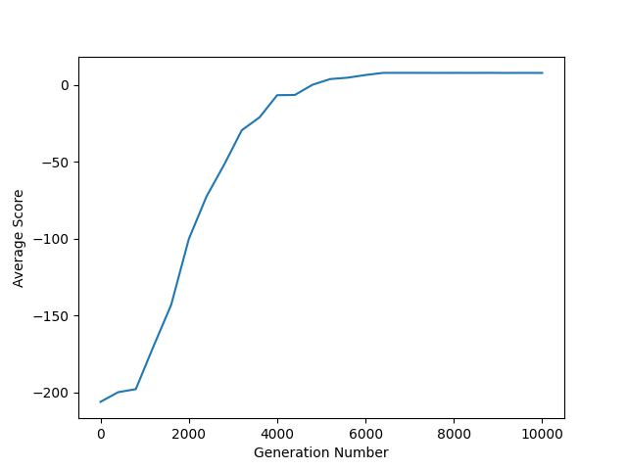

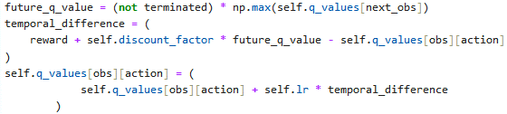
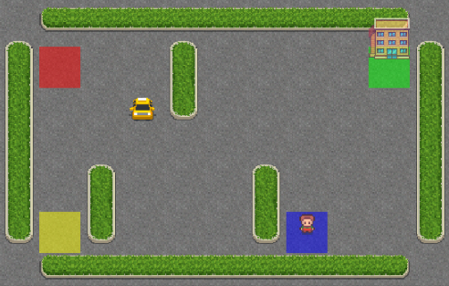
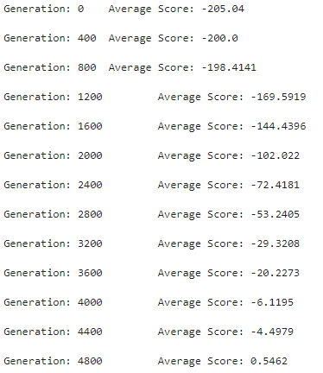
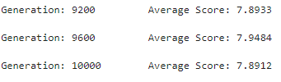

Reinforcement Learning for Taxi
Pallav Pant, Joshua Lahr, Shannon Flaherty
–
PHY 5680 – THE OHIO STATE UNIVERSITY – DEPARTMENT OF PHYSICS
Introduction
The goal of this project is to train an Artificial Intelligence (AI) to learn to play games, such as Taxi, Tetris or Super Mario Bros using Reinforcement Learning Techniques.
Games are a useful training tool since they provide a structured environment for AI systems to learn and improve their performance. The rules of the game create a well-defined problem space, making it easier to train AI models. Games often also provide easy methods for evaluating these models since there might be an explicit goal or a built-in scoring system.
Q-Learning
The Artificial Intelligence uses a value-based method. It decides the best move based on a Q-function which depends on the current state and on “Q-values”. For any given state there is an array of 6 Q-values corresponding to the 6 possible actions, which essentially prescribe the probabilities of a given action being the best one.
We have opted to use “Tabular Q-Learning.”
Epsilon-Greedy and Temporal Difference
We used an Epsilon-Greedy Algorithm along with the temporal difference method to generate the Q-values for our “agent.”
The Epsilon-Greedy Algorithm allows the agent to make a random move with probability ε while training. This makes the agent explore the environment and optimize the convergence of the Q-values for all possible states.
The Temporal Difference method allows us to update the Q-values for the agent after every move by predicting the rewards for the next possible actions.
This implies that for any state, and action combination, the Q-values depend on all the state-action pairs that follow.
In the context of the Temporal-difference method, we can approach the Q-values using the following equation:
Avg Score v/s Generation Number
the α in the equation represents the learning rate for the agent. On careful analysis of the equation, one will notice that the Bellman Equation shows up in method of determining the new Q-values.
Results
For our results with the Tabular Q-learning technique, we ended with an average score of 7.9, an excellent score that we achieved around the 6400th generation. We found success in this technique, seeing that the Taxi took approximately 13 steps per game, on average.
A score of around 7-8 is great for the Taxi game. For a perfect AI, the best scenario, with the pickup and drop-off being very close results in a score of 12, and in the worst-case scenario, the score can be as low as 4, and 8 is exactly the average score we would expect to see from a perfect AI.
The efficiency of the Tabular Q-learning with Taxi is higher than other games within Gymnasium’s collection, as it contains significantly less observation states compared to some other games.
Taxi
The game Taxi is relatively straightforward. It consists of a 5x6 map with obstacles and 4 pickup/drop-off spots for passengers. The Taxi has 6 possible moves. Translation in the 4 directions and picking up and dropping off a passenger.
Since it offers a "Transferable Skill," this game is particularly significant for training AI models. Robots can learn how to move in the real world by being trained on this game at a larger scale with more complicated terrain, which may include movement in the third dimension.
Conclusions
Q-learning’s straightforward and effective methodology make it a valuable algorithm for learning intricate decision-making games. The iterative update process of the Q-table ensured that the agent improved its policy over time, which led to more efficient decision-making.
Although done on a smaller scale with Taxi, with more time, faster resources, and more specialized policies, we would be able to train more intensive games such as Tetris, Mario, and other games. Through the usage of neural networks or even Deep Q-Learning, there are endless possibilities of games to train.
Execution of Temporal Difference Method
Taxi Interface Rendered on OSC
Alternatives that we Tried
A possible alternative to the “Tabular” method we decided on is a Deep-Learning Method which involves neural networks to predict the Q-values instead.
An alternative to the Temporal-Difference method is the Monte Carlo method, which updates the Q-values after the termination of the environment based on a “return.”
However, these methods were not optimal for Taxi in the end.
Generations And Their Scores
Bibliography
Farama-Foundation. Farama Foundation/ Gymnasium: An API standard for single-agent reinforcement learning environments, with popular reference environments and Related Utilities (formerly gym). GitHub. https://github.com/Farama-Foundation/Gymnasium.git
Gymnasium documentation. Basic Usage - Gymnasium Documentation. https://gymnasium.farama.org/content/basic_usage/
Gymnasium documentation. Taxi - Gymnasium Documentation. https://gymnasium.farama.org/environments/toy_text/taxi/
Monte Carlo vs temporal difference learning - hugging face deep RL course. Monte Carlo vs Temporal Difference Learning - Hugging Face. https://huggingface.co/learn/deep-rl-course/unit2/mc-vs-td
Valkov, V. (2019, April 4). Solving an MDP with Q-learning from scratch - deep reinforcement learning for hackers (part 1). Medium. https://venelinvalkov.medium.com/solving-an-mdp-with-q-learning-from-scratch-deep-reinforcement-learning-for-hackers-part-1-45d1d360c120
Bellman Equation
The Bellman’s Equation is a strategy within Q-Learning categorized by its recursive nature.
The Bellman’s Equation is:
This equation tells that the Q-value of an action a for a state s is the immediate reward for that action plus the maximum expected reward possible in the next state.
The taxi environment has an action space with 6 discrete states, and an observation space with 500 discrete states. The reward system is as follows:
-1 per step unless other reward is triggered.
+20 for delivering the passenger.
-10 for executing the “pickup” and “drop-off” actions illegally.
The increase in the average score per generation looks almost linear between generations 1200 and 4600. Following that, the score starts plateauing around generation 6000 with an average score close to 7.9.
https://github.com/Pallav-Pant/BigDataProject.git

