Slide 1



Assessment of Learning
3 January 2023
Copyrighted in its entirety, Ernest R. Cadotte,

Slide 2
Grade Calculation
Business Plan | 25 points
Final Team Presentation | 10 points
Team Simulation Performance A cumulative balanced scorecard for quarters 5 through 8 will be used to judge the success of each firm. A team’s grade will be determined by its relative ranking on the CBS compared to the other firms in its industry. | 15 points
Ownership of Balanced Scorecard Every executive must take responsibility for two of the performance criteria that make up the balanced scorecard. Each person’s evaluation will be determined by how well the firm does in the selected areas in comparison to individuals in different companies that have similar responsibilities. | 2 points
Online Assurance of Learning Assessment The Assurance of Learning Assessment is designed to test 1) your knowledge of your business in terms of marketing, manufacturing, human resource, financial and accounting information, 2) your ability to use the tools of management to understand your current position in the market, and 3) your ability to develop an integrative perspective of your business. | 5 points
Executive Briefing Contribution Every executive must demonstrate mastery of the information and decisions within his/her areas of responsibility plus integrate his/her responsibilities with the rest of the organization so as to maximize its total performance. | 20 points
Peer Evaluation Everyone on the team must do his/her share of the work. And, good interpersonal skills are necessary to keep the team moving in a positive direction. To judge the contribution of each team member, three (3) peer evaluations will be administered. A peer evaluation score of 4.0 or higher will earn 1 point. A score of less than 4.0 will result in the loss of points. Up to 6 points can be lost for each peer evaluation. | 3 points
Total | 80 points

Slide 3
Smart Businesspeople Know Their Numbers
In order to manage by the numbers, you need to know the numbers.

Slide 4
Critical Thinking Assessment
Teaching the managerial skill of making sense of dynamic environments has been noted as a critical aspect of management education (Swandt 2005).
The ability to assess this type of critical thinking has been a major challenge in teaching.

Slide 5
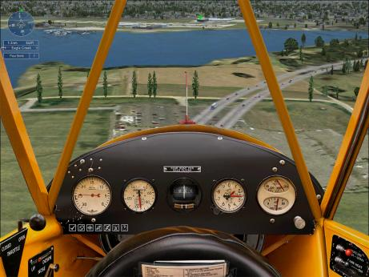
Situational Awareness
This concept originated in the aviation industry.
The industry wanted a procedure to evaluate a pilot’s situational awareness in highly dynamic situations.
Flight personnel stepped into an aviation simulation requiring multiple decision-making opportunities.
At one or more points, the simulations were frozen and subjects were asked a battery of questions related to the three levels of SA. Their responses were compared to objective truth to arrive at a measure of SA.

Slide 6
Situational Awareness Cont.
The ability to perceive elements within the environment (level 1),
to comprehend the meaning of these elements (level 2), and
to project the status of these elements in the future (level 3) (Endsley, 1988).

Slide 7
The Test
Knowledge of operations, market, and competition
Integrative skills – knowledge of all functions
Ability to use of the tools of management to draw important conclusions
Awareness of firm’s SWOT
Ability to anticipate competitor moves and one’s own position in the future
Agreement on firm’s strategy

Slide 8
Question Focus
Questions will focus on your firm’s internal operations, the competition, and the market.
Questions will be asked about your strengths, weaknesses, opportunities, and threats.
Questions will be asked about your position in the market in Q5 and your predictions for Q6. [Note to instructors: Quarter references depend on when the Assessment is administered]
A number of questions will ask you for specific information on your current business.
Several questions will ask you to interpret the various management reports that are available to you.

Slide 9
Conclusions from Prior Tests
Players that know more about their internal operations, the competition, and the market are more likely to perform better in the simulation and in business.

Slide 10
Conclusions (1 of 3)
Some people say that they do not need to know the details because they know where to find the information when they need it.
This is not sufficient: the more that is in your head, the more likely you will be able to make informed decisions, and thus succeed.
If you do not know the details, you need to have retained the key conclusions from having analyzed the information. This is a major focus of the assessment.

Slide 11
Conclusions (2 of 3)
The more cross-functional knowledge a team has, the more likely it will succeed.
It is not enough to know your own area of responsibility.
You need to have a good understanding of the other functions to be successful.

Slide 12
Conclusions (3 of 3)
The more a team shares a common view of the firm's strategy, the more likely it will succeed.
Even if team members have not articulated their strategy in a formal way, the more they think alike in terms of strategy, the more likely they will be successful.

Slide 13
Questions on Strategy
You will be queried about your team’s strategy.
You will receive feedback on the degree to which you and your team members agree.
Your concurrence on your team’s strategy is for your feedback, it will not affect your score on the assessment.

Slide 14
Overall Conclusion
If a team has less business, market, and competitive knowledge and a more diffused strategy than competitors, it is working at a disadvantage.

Slide 15
Mechanics
There will be about 100 questions [Note to instructors: the number of questions depends on the simulation level]
It will take about 40 to 50 minutes to complete [Note to instructors: it may be 30-35 minutes for the most basic simulations like Business Fundamentals]
You need to use a computer to take the assessment during the class time
The assessment will be delivered online via the Marketplace simulation
It is not possible to look at the team software while the assessment is underway
Results will be made available after the Quarter is processed

Slide 16
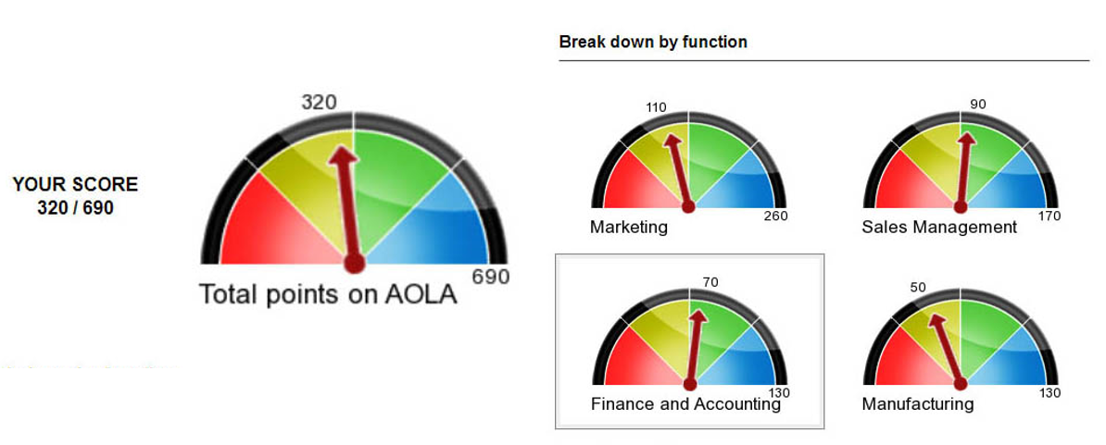
Knowledge Dashboard

Slide 17
Difficulty
The assessment is designed to be challenging. Obtaining a score of 80% correct answers or above is unlikely.
As a result, a normal curve will be used to assign grades for all students.

