Slide 1
Software Project Planning & Estimation
UNIT – II

Slide 2
Contents
Tasks in Project Planning
Work Breakdown Structures (WBS)
Planning Methods
Development Life Cycle Models
A Generic Project Model
Software Estimation
COCOMO Model, Budgeting
Scheduling techniques – PERT, CPM, Gnatt Chart

Slide 3
Project Planning
Project planning is an organized and integrated management process, which focuses on activities required for successful completion of the project.
It prevents obstacles that arise in the project such as changes in projects or organization’s objectives, non-availability of resources, and so on.
Project planning also helps in better utilization of resources and optimal usage of the allotted time for a project.
The other objectives of project planning are listed below.
It defines the roles and responsibilities of the project management team members.
It ensures that the project management team works according to the business objectives.
It checks feasibility of the schedule and user requirements.
It determines project constraints.

Slide 4
Project Planning
For effective project planning, some principles are followed. These principles are listed below.
Planning is necessary: Planning should be done before a project begins. For effective planning, objectives and schedules should be clear and understandable.
Risk analysis: Before starting the project, senior management and the project management team should consider the risks that may affect the project. For example, the user may desire changes in requirements while the project is in progress. In such a case, the estimation of time and cost should be done according to those requirements (new requirements).
Tracking of project plan: Once the project plan is prepared, it should be tracked and modified accordingly.
Meet quality standards and produce quality deliverables: The project plan should identify processes by which the project management team can ensure quality in software. Based on the process selected for ensuring quality, the time and cost for the project is estimated.
Description of flexibility to accommodate changes: The result of project planning is recorded in the form of a project plan, which should allow new changes to be accommodated when the project is in progress.
Project planning comprises project purpose, project scope, project planning process, and project plan. This information is essential for effective project planning and to assist project management team in accomplishing user requirements.

Slide 5
Project Planning Process
The project planning process involves a set of interrelated activities followed in an orderly manner to implement user requirements in software and includes the description of a series of project planning activities and individual(s) responsible for performing these activities. In addition, the project planning process comprises the following.
Objectives and scope of the project
Techniques used to perform project planning
Effort (in time) of individuals involved in project
Project schedule and milestones
Resources required for the project
Risks associated with the project.
Project planning process comprises several activities, which are essential for carrying out a project systematically. These activities refer to the series of tasks performed over a period of time for developing the software. These activities include estimation of time, effort, and resources required and risks associated with the project.

Slide 6
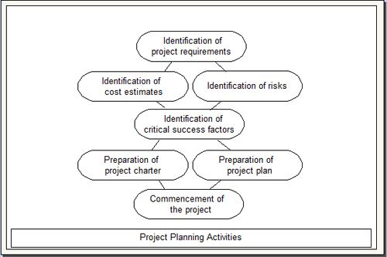
Project Planning Activities

Slide 7
Work Breakdown Structure
Breaking work into smaller tasks is a common productivity technique used to make the work more manageable and approachable.
For projects, the Work Breakdown Structure (WBS) is the tool that utilizes this technique and is one of the most important project management documents. It singlehandedly integrates scope, cost and schedule baselines ensuring that project plans are in alignment.
The Project Management Institute (PMI) Project Management Book of Knowledge (PMBOK) defines the Work Breakdown Structure as a “deliverable oriented hierarchical decomposition of the work to be executed by the project team.”
There are two types of WBS:
Deliverable-Based
Phase-Based.
The most common and preferred approach is the Deliverable-Based approach. The main difference between the two approaches are the Elements identified in the first Level of the WBS.

Slide 8
Deliverable WBS
A Deliverable-Based Work Breakdown Structure clearly demonstrates the relationship between the project deliverables (i.e., products, services or results) and the scope (i.e., work to be executed).
Figure 1 is an example of a Deliverable-Based WBS for building a house.
In Figure 1, the Level 1 Elements are summary deliverable descriptions. The Level 2 Elements in each Leg of the WBS are all the unique deliverables required to create the respective Level 1 deliverable.

Slide 9
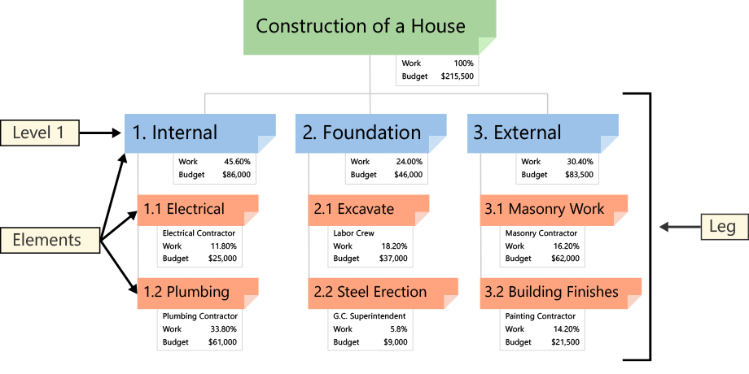
Deliverable WBS

Slide 10
Phase-Based WBS
In Figure 2, a Phase-Based WBS, the Level 1 has five Elements.
Each of these Elements are typical phases of a project.
The Level 2 Elements are the unique deliverables in each phase.
Regardless of the type of WBS, the lower Level Elements are all deliverables. Notice that Elements in different Legs have the same name.
A Phase-Based WBS requires work associated with multiple elements be divided into the work unique to each Level 1 Element.
A WBS Dictionary is created to describe the work in each Element.

Slide 11
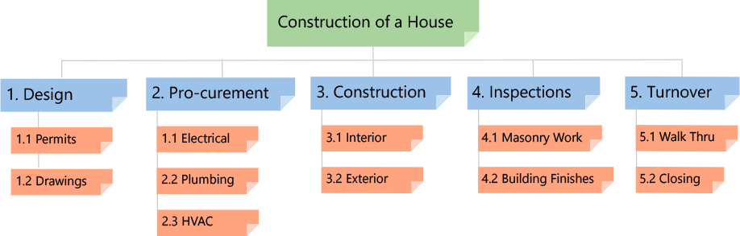
Phase-Based WBS

Slide 12
Quality of a WBS
A well-designed WBS makes it easy to assign elements of the WBS to any project activity. A good WBS should exhibit the following characteristics:
Definable—can be described and easily understood by project participants.
Manageable—a meaningful unit of work where specific responsibility and authority can be assigned to a responsible individual.
Estimateable—duration can be estimated in time required to complete, and cost can be estimated in resources required to complete.
Independent—minimum interface with or dependence on other ongoing elements (i.e., assignable to a single control account, and clearly distinguishable from other work packages).
Integratable—integrates with other project work elements and with higher level cost estimates and schedules to include the entire project.
Measurable—can be used to measure progress; has start and completion dates and measurable interim milestones.
Adaptable—sufficiently flexible so the addition/elimination of work scope can be readily accommodated in the WBS framework.

Slide 13
How to make WBS?
GATHER CRITICAL DOCUMENTS
Gather critical project documents.
Identify content containing project deliverables, such as the Project Charter, Scope Statement and Project Management Plan (PMP) subsidiary plans.
IDENTIFY KEY TEAM MEMBERS
Identify the appropriate project team members.
Analyze the documents and identify the deliverables.
DEFINE LEVEL 1 ELEMENTS
Define the Level 1 Elements. Level 1 Elements are summary deliverable descriptions that must capture 100% of the project scope.
Verify 100% of scope is captured. This requirement is commonly referred to as the 100% Rule.

Slide 14
How to make WBS?
4. DECOMPOSE (BREAKDOWN) ELEMENTS
Begin the process of breaking the Level 1 deliverables into unique lower Level deliverables. This “breaking down” technique is called Decomposition.
Continue breaking down the work until the work covered in each Element is managed by a single individual or organization. Ensure that all Elements are mutually exclusive.
Ask the question, would any additional decomposition make the project more manageable? If the answer is “no”, the WBS is done.
5. CREATE WBS DICTIONARY
Define the content of the WBS Dictionary. The WBS Dictionary is a narrative description of the work covered in each Element in the WBS. The lowest Level Elements in the WBS are called Work Packages.
Create the WBS Dictionary descriptions at the Work Package Level with detail enough to ensure that 100% of the project scope is covered. The descriptions should include information such as, boundaries, milestones, risks, owner, costs, etc.

Slide 15
How to make WBS?
6. CREATE GANTT CHART SCHEDULE
Decompose the Work Packages to activities as appropriate.
Export or enter the Work Breakdown Structure into a Gantt chart for further scheduling and project tracking.

Slide 16
Software Development Life Cycle (SDLC)
SDLC is a systematic process for building software that ensures the quality and correctness of the software built.
SDLC process aims to produce high-quality software that meets customer expectations.
SDLC consists of a detailed plan which explains how to plan, build, and maintain specific software.
Every phase of the SDLC life Cycle has its own process and deliverables that feed into the next phase. S
DLC stands for Software Development Life Cycle and is also referred to as the Application Development life-cycle

Slide 17
Why SDLC?
It offers a basis for project planning, scheduling, and estimating
Provides a framework for a standard set of activities and deliverables
It is a mechanism for project tracking and control
Increases visibility of project planning to all involved stakeholders of the development process
Increased and enhance development speed
Improved client relations
Helps you to decrease project risk and project management plan overhead

Slide 18
SDLC Phases
The entire SDLC process divided into the following stages:
Phase 1: Requirement collection and analysis
Phase 2: Feasibility study:
Phase 3: Design:
Phase 4: Coding:
Phase 5: Testing:
Phase 6: Installation/Deployment:
Phase 7: Maintenance:

Slide 19
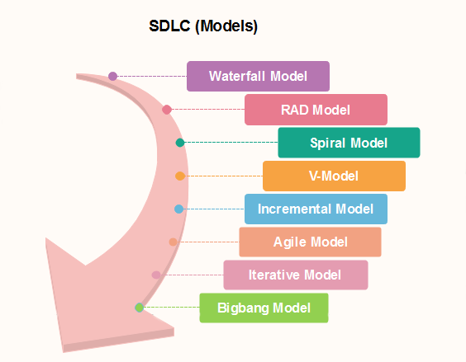
SDLC Models

Slide 20
Waterfall
Waterfall is the oldest and most straightforward of the structured SDLC methodologies — finish one phase, then move on to the next. No going back. Each stage relies on information from the previous stage and has its own project plan. Waterfall is easy to understand and simple to manage.
But early delays can throw off the entire project timeline. And since there is little room for revisions once a stage is completed, problems can’t be fixed until you get to the maintenance stage.
This model doesn’t work well if flexibility is needed or if the project is long term and ongoing.

Slide 21
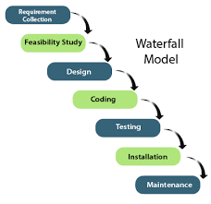
Waterfall Model

Slide 22
V-Shaped Model
Also known as the Verification and Validation model, the V-shaped model grew out of Waterfall and is characterized by a corresponding testing phase for each development stage. Like Waterfall, each stage begins only after the previous one has ended.
This model is useful when there are no unknown requirements, as it’s still difficult to go back and make changes.

Slide 23
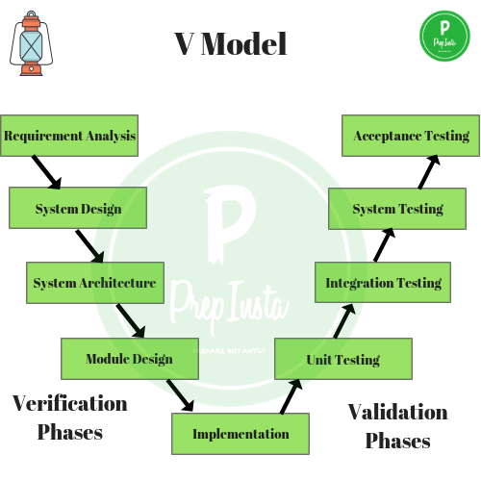
V Model

Slide 24
RAD Model
RAD or Rapid Application Development process is an adoption of the waterfall model; it targets developing software in a short period.
The RAD model is based on the concept that a better system can be developed in lesser time by using focus groups to gather system requirements.
Business Modeling
Data Modeling
Process Modeling
Application Generation
Testing and Turnover

Slide 25
Iterative Model
The Iterative model is repetition incarnate. Instead of starting with fully known requirements, you implement a set of software requirements, then test, evaluate and pinpoint further requirements. A new version of the software is produced with each phase, or iteration. Rinse and repeat until the complete system is ready.
One advantage over other SDLC methodologies: This model gives you a working version early in the process and makes it less expensive to implement changes.
One disadvantage: Resources can quickly be eaten up by repeating the process again and again.

Slide 26
Incremental Model
The incremental model is not a separate model. It is necessarily a series of waterfall cycles. The requirements are divided into groups at the start of the project.
For each group, the SDLC model is followed to develop software. The SDLC process is repeated, with each release adding more functionality until all requirements are met.
In this method, each cycle act as the maintenance phase for the previous software release. Modification to the incremental model allows development cycles to overlap. After that subsequent cycle may begin before the previous cycle is complete.

Slide 27
Big bang model
Big bang model is focusing on all types of resources in software development and coding, with no or very little planning. The requirements are understood and implemented when they come.
This model works best for small projects with smaller size development team which are working together.
It is also useful for academic software development projects. It is an ideal model where requirements are either unknown or final release date is not given.

Slide 28
Spiral Model
The spiral model is a risk-driven process model. The spiral technique is a combination of rapid prototyping and concurrency in design and development activities.
One of the most flexible SDLC methodologies, the Spiral model takes a cue from the Iterative model and its repetition; the project passes through four phases over and over in a “spiral” until completed, allowing for multiple rounds of refinement.
Each cycle in the spiral begins with the identification of objectives for that cycle, the different alternatives that are possible for achieving the goals, and the constraints that exist. This is the first quadrant of the cycle (upper-left quadrant).
The next step in the cycle is to evaluate these different alternatives based on the objectives and constraints. The focus of evaluation in this step is based on the risk perception for the project.
The next step is to develop strategies that solve uncertainties and risks. This step may involve activities such as benchmarking, simulation, and prototyping.
This model allows for the building of a highly customized product, and user feedback can be incorporated from early on in the project. But the risk you run is creating a never-ending spiral for a project that goes on and on.

Slide 29
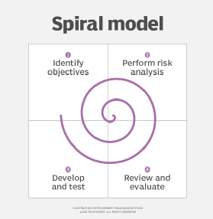
Spiral Model

Slide 30
Agile Model
Agile methodology is a practice which promotes continues interaction of development and testing during the SDLC process of any project. In the Agile method, the entire project is divided into small incremental builds. All of these builds are provided in iterations, and each iteration lasts from one to three weeks.
Any agile software phase is characterized in a manner that addresses several key assumptions about the bulk of software projects:
It is difficult to think in advance which software requirements will persist and which will change. It is equally difficult to predict how user priorities will change as the project proceeds.
For many types of software, design and development are interleaved. That is, both activities should be performed in tandem so that design models are proven as they are created. It is difficult to think about how much design is necessary before construction is used to test the configuration.
Analysis, design, development, and testing are not as predictable (from a planning point of view) as we might like.

Slide 31
Software Project Estimation
Estimation is the process of finding an estimate, or approximation, which is a value that can be used for some purpose even if input data may be incomplete, uncertain, or unstable.
Estimation determines how much money, effort, resources, and time it will take to build a specific system or product. Estimation is based on −
Past Data/Past Experience
Available Documents/Knowledge
Assumptions
Identified Risks
The four basic steps in Software Project Estimation are −
Estimate the size of the development product.
Estimate the effort in person-months or person-hours.
Estimate the schedule in calendar months.
Estimate the project cost in agreed currency.

Slide 32
Software Project Estimation
Estimation need not be a one-time task in a project. It can take place during −
Acquiring a Project.
Planning the Project.
Execution of the Project as the need arises.
Project scope must be understood before the estimation process begins. It will be helpful to have historical Project Data.

Slide 33
Project Size Estimation
Estimation of the size of software is an essential part of Software Project Management. It helps the project manager to further predict the effort and time which will be needed to build the project. Various measures are used in project size estimation. Some of these are:
Lines of Code
Number of entities in ER diagram
Total number of processes in detailed data flow diagram
Function points

Slide 34
Lines of Code (LOC)
As the name suggest, LOC count the total number of lines of source code in a project. The units of LOC are:
KLOC- Thousand lines of code
NLOC- Non comment lines of code
KDSI- Thousands of delivered source instruction
The size is estimated by comparing it with the existing systems of same kind. The experts use it to predict the required size of various components of software and then add them to get the total size.
Advantages:
Universally accepted and is used in many models like COCOMO.
Estimation is closer to developer’s perspective.
Simple to use.
Disadvantages:
Different programming languages contains different number of lines.
No proper industry standard exist for this technique.
It is difficult to estimate the size using this technique in early stages of project.

Slide 35
Number of entities in ER diagram
ER model provides a static view of the project. It describes the entities and its relationships.
The number of entities in ER model can be used to measure the estimation of size of project. Number of entities depends on the size of the project. This is because more entities needed more classes/structures thus leading to more coding.
Advantages:
Size estimation can be done during initial stages of planning.
Number of entities is independent of programming technologies used.
Disadvantages:
No fixed standards exist. Some entities contribute more project size than others.
Just like FPA, it is less used in cost estimation model. Hence, it must be converted to LOC.

Slide 36
Total number of processes in detailed data flow diagram
Data Flow Diagram(DFD) represents the functional view of a software. The model depicts the main processes/functions involved in software and flow of data between them.
Utilization of number of functions in DFD to predict software size. Already existing processes of similar type are studied and used to estimate the size of the process. Sum of the estimated size of each process gives the final estimated size.
Advantages:
It is independent of programming language.
Each major processes can be decomposed into smaller processes. This will increase the accuracy of estimation
Disadvantages:
Studying similar kind of processes to estimate size takes additional time and effort.
All software projects are not required to construction of DFD.

Slide 37
Function Point Analysis (FPA)
Proposed by Albrecht in early 80's, in this method, the number and type of functions supported by the software are utilized to find FPC(function point count).
Function Point Analysis (FPA) technique quantifies the functions contained within software in terms that are meaningful to the software users. FPs consider the number of functions being developed based on the requirements specification.
Function Points (FP) Counting is governed by a standard set of rules, processes and guidelines as defined by the International Function Point Users Group (IFPUG). These are published in Counting Practices Manual (CPM).
Overcomes the shortcomings of LoC

Slide 38
Function Point Analysis (FPA)
Input:
A set of related inputs is counted as one input.
Output:
A set of related outputs is counted as one output.
Inquiries:
Each user query type is counted.
Files:
Files are logically related data and thus can be data structures or physical files.
Interface:
Data transfer to other systems.

Slide 39
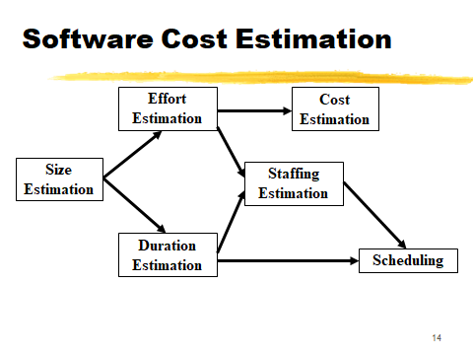
Software Cost Estimation

Slide 40
Project Cost Estimation
Project Cost Estimation is defined as the process of approximating the total expenditure of the project.
The accuracy of the cost estimation depends on the accuracy and details of the project scope, which is the scope baseline. T
he scope will also define any constraints like date, resources or budget. The risk register will help to calculate estimate types of costs, the expenses made behind the contingent action and the expenses made to cope with risks.
The cost of the project can be estimated from various process sources
Creating Work Breakdown Structure (WBS)
Develop Schedule
Plan human resources
Identifying risks

Slide 41
Project Cost Estimation
There are two key types of costs addressed by the cost estimation process:
Direct costs: These are the costs associated with a single area, such as a department or this particular project itself. Examples of direct costs include fixed labor, materials and equipment.
Indirect costs: These are costs incurred by the organization at large, such as utilities and quality control.
Within these two categories, some typical elements that a cost estimation will take into account include:
Labor: the cost of project team members working on the project, both in terms of wages and time.
Materials and equipment: The cost of resources required for the project, from physical tools to software to legal permits.
Facilities: the cost of using any working spaces not owned by the organization.
Vendors: the cost of hiring third-party vendors or contractors.
Risk: the cost of any contingency plans implemented to reduce risk.

Slide 42
COCOMO Model
COCOMO (COnstructive COst MOdel) proposed by Barry Boehm in 1981.
COCOMO predicts the effort and schedule for a software project development based on inputs relating to the size of the software and a number of cost drivers that affect the productivity.
COCOMO has three different models that reflect the complexity
The Basic Model
The Intermediate Model
The Detailed Model

Slide 43
COCOMO Model
For each of the three product categories:
From size estimation (in KLOC), Boehm provides equations to predict:
project duration in months
effort in programmer-months
Boehm obtained these equations:
examined historical data collected from a large number of actual projects.

Slide 44
The Basic COCOMO Model
Applicable to small to medium size software projects
Used for quick and rough estimates
The 3 modes of software development are considered:
Organic
It belongs to small & simple software projects which are handled by a small team with good domain knowledge and few rigid requirements.
Example: Small data processing or Inventory management system.

Slide 45
The Basic COCOMO Model
Semidetached
It is an intermediate (in terms of size and complexity) project, where the team having mixed experience (both experience & inexperience resources) to deals with rigid/nonrigid requirements.
Example: Database design or OS development.
Embedded
This project having a high level of complexity with a large team size by considering all sets of parameters (software, hardware and operational).
Example: Banking software or Traffic light control software.

Slide 46
The Basic COCOMO Model
Gives only an approximate estimation:
Effort = a1 * (KLOC) * a2
Tdev = b1 * (Effort) * b2
KLOC is the estimated kilo lines of source code,
a1,a2,b1,b2 are constants for different categories of software products,
Tdev is the estimated time to develop the software in months,
Effort estimation is obtained in terms of person months (PMs).

Slide 47
Development Time Estimation
Organic:
Tdev = 2.5 * (Effort) * 0.38 Months
Semi-detached:
Tdev = 2.5 * (Effort) * 0.35 Months
Embedded:
Tdev = 2.5 * (Effort) * 0.32 Months

Slide 48
Development Effort Estimation
Organic :
Effort = 2.4 * (KLOC) * 1.05 PM
Semi-detached:
Effort = 3.0 * (KLOC) * 1.12 PM
Embedded:
Effort = 3.6 * (KLOC) * 1.20PM

Slide 49
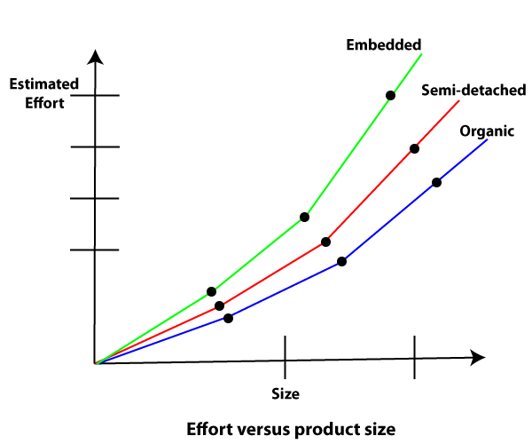
The Basic COCOMO Model
Some insight into the basic COCOMO model can be obtained by plotting the estimated characteristics for different software sizes.
Fig shows a plot of estimated effort versus product size.
From fig, we can observe that the effort is somewhat superliner in the size of the software product.
Thus, the effort required to develop a product increases very rapidly with project size.

Slide 50
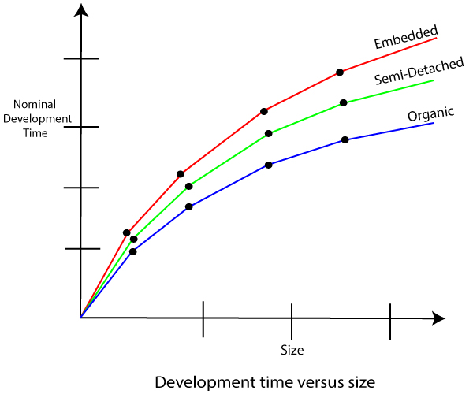
The Basic COCOMO Model
Development time
sublinear function of product size.
When product size increases two times,
development time does not double.
Time taken:
almost same for all the three product categories.
This can be explained by the fact that for larger products, a larger number of activities which can be carried out concurrently can be identified. This reduces the time to complete the project.

Slide 51
The Basic COCOMO Model
Development time does not increase linearly with product size:
For larger products more parallel activities can be identified:
can be carried out simultaneously by a number of engineers.
Development time is roughly the same for all the three categories of products:
For example, a 60 KLOC program can be developed in approximately 18 months
regardless of whether it is of organic, semi-detached, or embedded type.
There is more scope for parallel activities for system and application programs,
than utility programs.

Slide 52
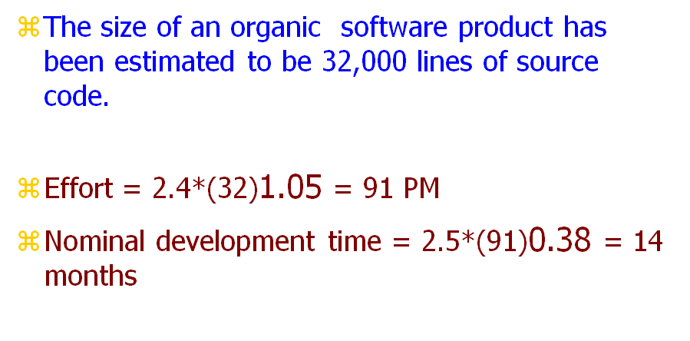
Example 1

Slide 53
Example 2
PROBLEM : Suppose a project was estimated to be 400 KLOC. Calculate the effort and development time for each of the three model i.E., Organic, semi-detached & embedded.
SOLUTION
The basic COCOMO equation takes the form:
Effort=a₁*(KLOC) a₂ PM Tdev=b₁*(efforts)b₂ Months Estimated Size of project= 400 KLOC
(i)Organic Mode
E = 2.4 * (400) * 1.05 = 1295.31 PM D = 2.5 * (1295.31) * 0.38=38.07 M
(ii)Semidetached Mode
E = 3.0 * (400) * 1.12=2462.79 PM D = 2.5 * (2462.79) * 0.35=38.45 M
(iii) Embedded Mode
E = 3.6 * (400) * 1.20 = 4772.81 PM D = 2.5 * (4772.8) * 0.32 = 38 M

Slide 54
Scheduling Techniques
Critical Path Method (CPM) and Program Evaluation and Review Technique (PERT) are the two most commonly used techniques by project managers. These methods are used to calculate the time span of the project through the scope of the project.
For tracking progress and reporting purposes, the Gantt Chart is a visualization technique used in project management.
a. Critical Path Method
Every project’s tree diagram has a critical path. The Critical Path Method estimates the maximum and minimum time required to complete a project. CPM also helps to identify critical tasks that should be incorporated into a project. Delivery time changes do not affect the schedule. The scope of the project and the list of activities necessary for the completion of the project are needed for using CPM. Next, the time taken by each activity is calculated. Then, all the dependent variables are identified. This helps in identifying and separating the independent variables. Finally, it adds milestones to the project.

Slide 55
Scheduling Techniques
b. Program Evaluation and Review Technique (PERT)
PERT is a way to schedule the flow of tasks in a project and estimate the total time taken to complete it. This technique helps represent how each task is dependent on the other. To schedule a project using PERT, one has to define activities, arrange them in an orderly manner and define milestones. You can calculate timelines for a project on the basis of the level of confidence:
Optimistic timing
Most-likely timing
Pessimistic timing
Weighted average duration and not estimates are used by PERT to calculate different timeframes.

Slide 56
Scheduling Techniques
Gnatt Chart
For tracking progress and reporting purposes, the Gantt Chart is a visualization technique used in project management.
It is used by project managers most of the time to get an idea about the average time needed to finish a project.
A project schedule Gantt chart is a bar chart that represents key activities in sequence on the left vs time. Each task is represented by a bar that reflects the start and date of the activity, and therefore its duration. The chart shows all the activities, when they’re set to start and end, how long each activity will last, where there are overlaps of activities, dependencies between activities, which are connected with arrows and the start/end date of the entire project.

Slide 57
Scheduling Techniques
Pros:
Adaptable to all industries and projects
Easy to view progress
Ability to set accurate deadlines and define dependencies
Easily modified
Can be created in Microsoft Excel or in a project management system
Ability to assign tasks to resources
Cons:
If the Gantt chart is not part of a project management system, it is flat
No versioning
Limited collaboration
No progress tracking

