Slide 1

Basic Details of the Team and Problem Statement
Ministry/Organization Name/Student Innovation: All India Council for Technical Education (AICTE)
PS Code: DR718
Problem Statement Title: Online integrated platform for projects taken up by the students of various universities/colleges.
Team Name: Bandersnatch
Team Leader Name: Nupur Parmar
Institute Code (AISHE): U-1056
Institute Name: Netaji Subhas University of Technology
Theme Name: Smart Education

Slide 2
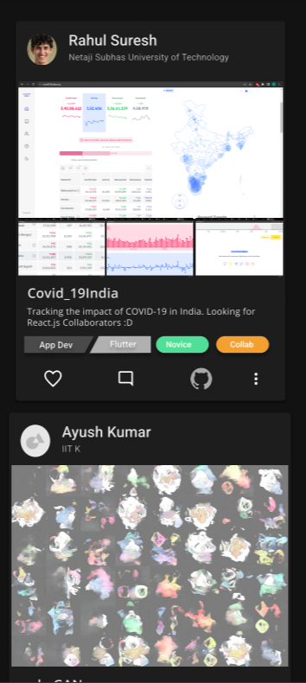
Idea/Approach Details
Describe your idea/Solution/Prototype here:
➢ Exhibit is a a place “to showcase, collaborate and get inspired”. It ​is a platform that welcomes all levels across different domains. Any college student who wants to learn and get experience by application, or is interested in sharing their projects in a community is welcome to do so. Professors can also share relevant research opportunities which students can apply to.
➢ Exhibit ​hosts different ​Kernels​ which cater to different fields. Since a domain like Music can have multiple subdomains in it like composing, production, etc, each ​Kernel ​is divided into specific ​Subkernels. Praise(s) can be given to posts.
➢ Members of ​Subkernels ​can post their projects/ideas with relevant tags such as difficulty of project and time taken to complete it. However, to keep spamming in check, the number of posts per user per day will depend on the level (Role-Based Access Control) of the user.
Machine Learning will be used to give recommendations of posts to users based on tags as well as to filter feed to show most relevant posts.
Describe your Technology stack here:
React, Nest.js
Postgres + TypeORM
Python

Slide 3
Idea/Approach Details
Describe your Use Cases here
Describe your Dependencies/Show stopper here
Help the student community to take up unique/innovative projects from a huge archive based on their expertise level.
Promote cross-functional research between various universities.
Hands-on experience by exploring specific projects.
Keep up with technology and innovations in multiple domains.
Students/Professors can go through Exhibit to look for potential people to collaborate on a project.
Professors can collaborate with students on research based projects
A big enough community needs to be built for the app to become useful:
We are using a Role Based Access Control (RBAC) methodology here, where the users have control depending on their contribution and praise garnered, eliminating the need for any admin authority.
However an admin entity would be required before the user base reaches a certain number.
Exhibit will aim to completely shift to user based self-governance using RBAC. If a sub-kernel reaches ~1k users, we will fully roll out all the privileges of users of different levels.
Tags need to be correct to ensure the usefulness of filtering and sorting in the app.

Slide 4

Team Member Details
Team Leader Name: Nupur Parmar
Branch : BE Stream: ECE Year: IV
Team Member 1 Name: Khushi Prerak
Branch: BE Stream : ECE Year: IV
Team Member 2 Name: Saumya Singh
Branch: BE Stream: ECE Year : IV
Team Member 3 Name: Ayush Kumar Singh
Branch : BE Stream: IT Year: IV
Team Member 4 Name: Pallav Bhardwaj
Branch: BE Stream: IT Year : IV
Team Member 5 Name: Vishesh Bhaskar
Branch: BE Stream: COE Year: IV
Team Mentor 1 Name: MPS Bhatia
Category: Software Engineering Expertise : Operating Systems, Design software, Backend Engineering
Domain Experience (in years): 30+ years
Team Mentor 2 Name: Manu Sheel Gupta
Category : Software Engineering Expertise: UI/UX, Agile Software Engineering and Sustainable Design and Development, PACS automation
Domain Experience (in years): 15+ years

Slide 5
Important Pointers
Please ensure below pointers are met while
Kindly keep the maximum slides limit to 4 pages
All the topics should be utilized for description of your idea
Try to avoid paragraphs and post your idea in points
Keep your explanation precisely and easy to understand
Idea should be unique and novel. If it has a business potential more weightage will be given.
Apart from this PPT abstract of your idea will be asked separately while submitting
You need to save the file in PDF and upload the same on portal. No PPT, Word Doc or any other format will be supported
You can delete this slide (Important Pointers) when you upload the details of your idea on SIH portal.

