Slide 1

Customer Shopping Behavior Analysis
3,900 transactions · 18 features · Revenue, retention & product insights

Slide 2
Dataset at a Glance
3,900
18
Transactions
Features
37
Missing Values
Review Rating only
Demographics · Purchase details · Behavior · Subscription data

Slide 3


Data Preparation in Python
Load & Explore
Clean
pandas, df.info(), df.describe()
Impute Review Rating by category median; snake_case rename
Engineer
Load to DB
age_buckets, purchase_frequency_days; drop redundant promo_code_used
PostgreSQL integration for SQL analysis

Slide 4
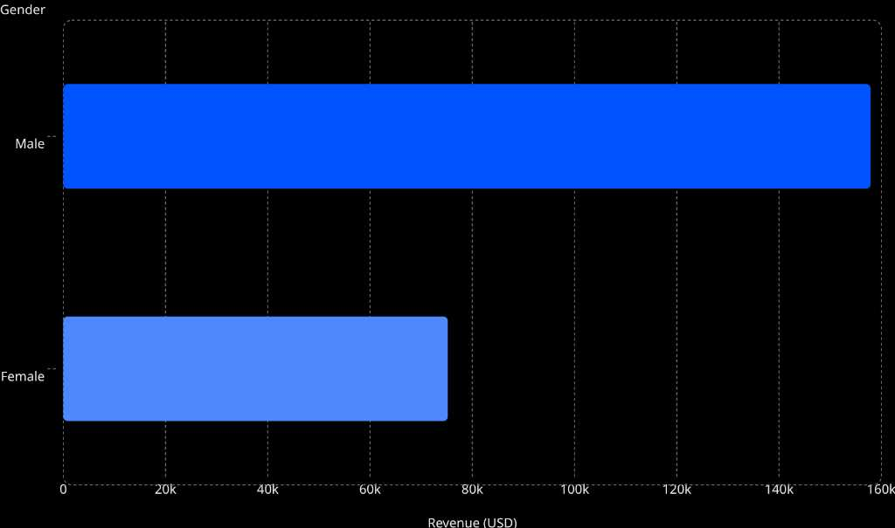

Revenue by Gender
Key Insight
Male customers generate 2.1× more revenue than female customers.
Male: $157.9K · Female: $75.2K
Major opportunity to grow female customer base

Slide 5
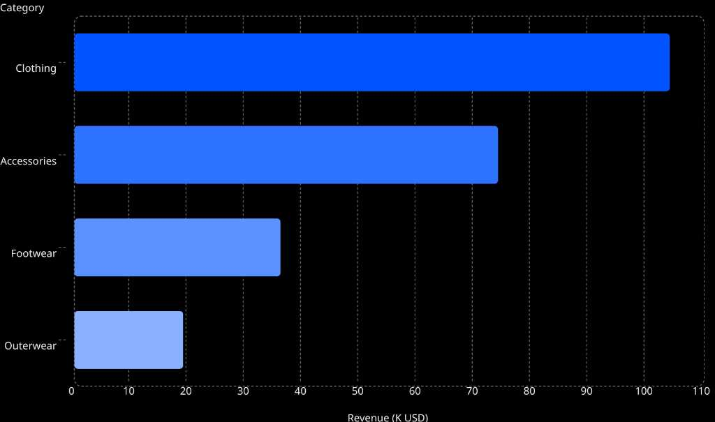
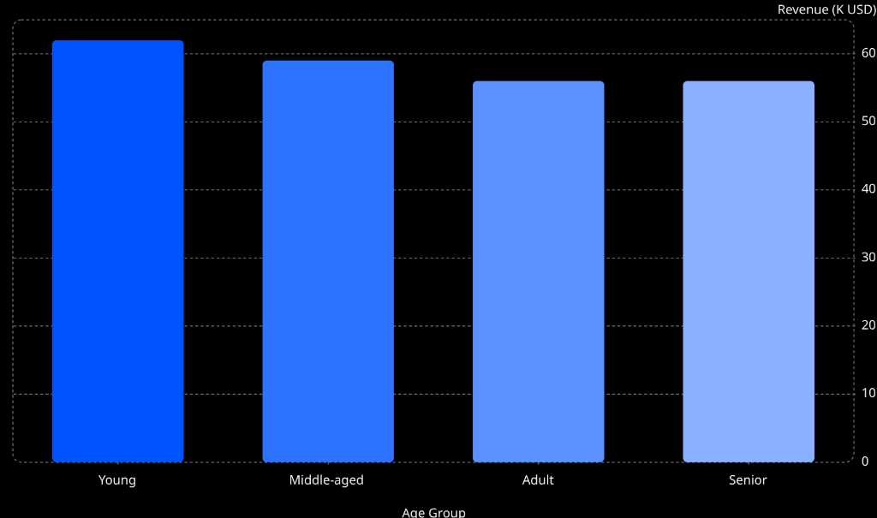
Revenue by Category & Age Group
Revenue by Category
Revenue by Age Group
Clothing dominates at $104K · Young adults lead age groups at $62K

Slide 6

Customer Segmentation
Loyal Customers
3,476 · $59 avg spend
Returning
424 · $60 avg spend
Subscribers
27% of base · $62.6K revenue
New Customers
Only 2.13% of total

Slide 7
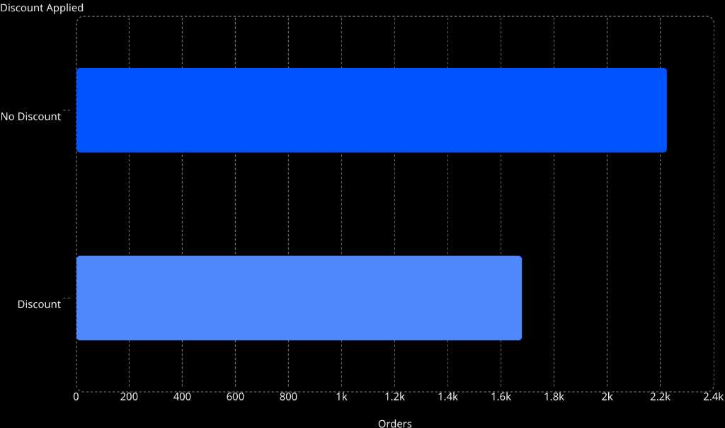

Behavioral Insights
Discount Impact
Key Findings
Discounts: avg spend $59 vs $60 without
Shipping type has minimal rating impact (3.7–3.8)
Purchase frequency: consistent ~$58–$60 across all intervals
Discounts drive volume, not order value

Slide 8
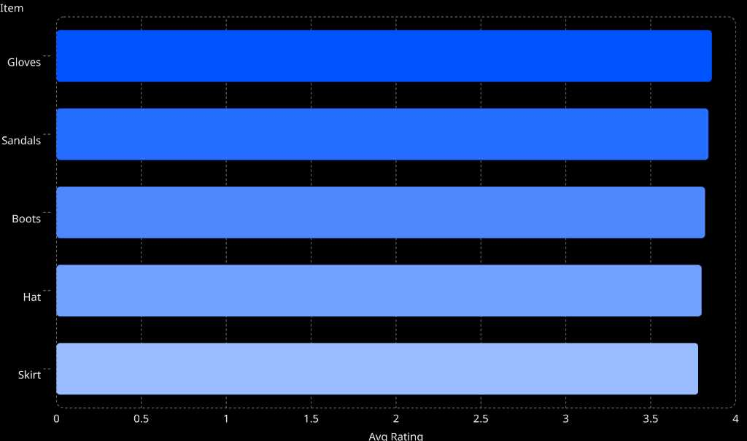
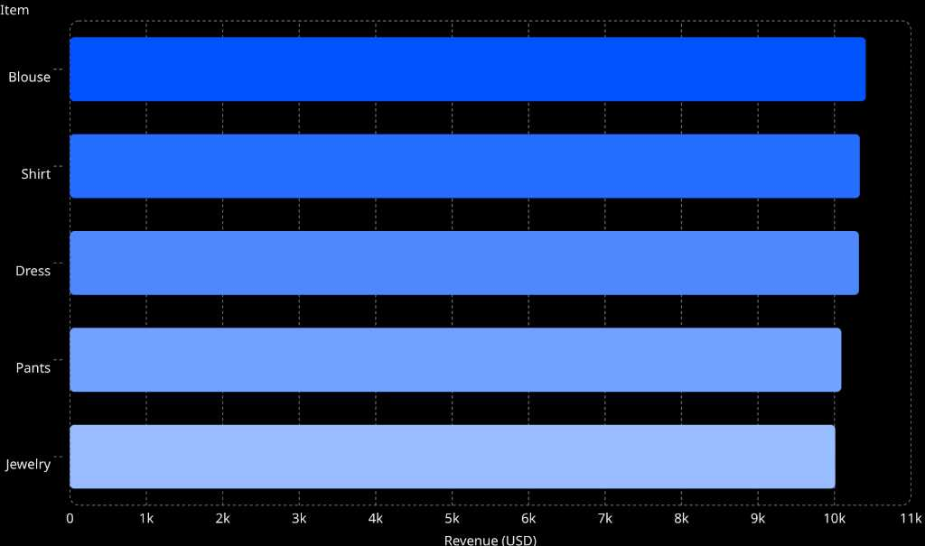
Product Insights
Top Rated Products
Highest Revenue Products

Slide 9

Power BI Dashboard
$233K
Total Revenue
3.9K
Customers
$59.76
Avg Order Value
3.75
Avg Rating
Filters: Category · Gender · Subscription · Shipping · Season

Slide 10
Business Recommendations
Expand Female Base
Boost Retention
Targeted campaigns, style recommendations
Loyalty programs, subscription perks
Smart Discounts
Product Positioning
Cart-value incentives, targeted offers
Promote top-rated items, "Top Rated" tags
Increase AOV
Drive Frequency
Bundles, minimum cart offers, upsells
Re-engagement emails, limited-time offers
Focus High-Revenue
Cost Optimization
Expand top categories, increase marketing spend
Avoid over-investing in fast shipping

