Slide 1

AGRI WEB HUB

Slide 2
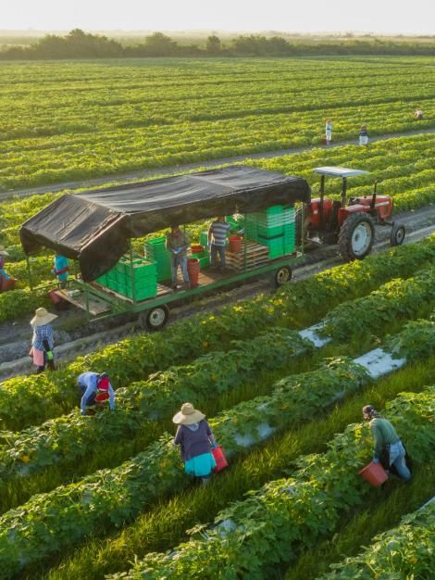
zz
Agriculture is the vital practice of cultivating crops, rearing livestock, and managing natural resources to produce food, fiber, and other essentials. It sustains human life, drives economies, and addresses global challenges like food security and environmental sustainability. Evolving with technology, agriculture remains a cornerstone of human civilization and economic development.

Slide 3

Agriculture Marketing
Agricultural marketing encompasses the multifaceted process of planning, promoting, and distributing farm products to consumers and buyers.
It involves coordinating various stages in the agricultural supply chain, from production to consumption, to ensure the efficient flow of goods
This includes activities such as pricing, packaging, transportation, and advertising, all aimed at connecting producers with consumers.
It contributes to economic growth, food security, and sustainable development by enhancing the availability and accessibility of agricultural products in domestic and international markets.

Slide 4
The Need for Agriculture Marketing Websites:
In the modern era, the agricultural sector is facing various challenges in traditional marketing methods,making the need for agriculture marketing websites increasingly evident.
Traditional methods are often inefficient and confront numerous obstacles, which online platforms can help overcome.
These challenges include limited market access, price fluctuations, information asymmetry, and the dominance of middlemen.

Slide 5
Benefits for the farmers:
Market Access: These platforms connect farmers directly with potential buyers, expanding their market reach beyond local markets.
Fair Pricing: Farmers can receive competitive prices for their products, reducing dependence on intermediaries.
Transparency: Online platforms provide price transparency and market information, empowering farmers to make informed decisions.
Cost & time Savings: Farmers can save on transportation and marketing costs by using online platforms and saving time and effort.
Diverse Customer Base: Access to a wider customer base, including urban consumers and businesses.
Reduced Middlemen: Minimizes the role of intermediaries, increasing the farmer's share of the profit.

Slide 6
Benefits for the buyers:
Access to a Wide Variety of Products:
This variety allows buyers to explore different options, compare products, and choose the ones that best suit their specific needs.
Direct Communication with Farmers:
Buyers can ask questions, seek detailed information about products, and negotiate terms such as pricing and delivery options.This direct interaction fosters transparency and builds trust between buyers and sellers.
Quality Assurance and Reviews:
Agriculture marketing websites often implement features for quality assurance and reviews to help buyers make informed decisions.

Slide 7
Tips for Using Agriculture Marketing Websites
Best Practices for Farmers and Buyers:
Creating a detailed and appealing profile with accurate information.
Providing clear and honest product descriptions, pricing, and terms.
Regularly updating listings to reflect product availability.
Importance of Data Protection:
Emphasize the importance of data protection not only for the users' personal information but also for the integrity of the platform and the trust of all users.
Mention that many agriculture marketing websites have privacy policies and terms of use in place to protect users' data and specify how their information will be used.
Encourage users to familiarize themselves with these policies.

Slide 8
Conclusion :
Agriculture marketing websites have revolutionized the industry, offering benefits for farmers and buyers, including access to a wide variety of products, direct communication with farmers, quality assurance, and reviews.
Challenges like security and trust issues, limited internet access in rural areas, and competition among websites have been identified. These can be addressed through education, infrastructure development, and innovation.
We encourage you to explore these websites, harness their benefits, and contribute to the growth and success of the agricultural community.
Thank you for your attention. For more information or questions, feel free to reach out.

