Slide 1
Transformers
Encoders Decoders Mechanism
https://jalammar.github.io/illustrated-transformer/
Dr Raju Nadimpalli

Slide 2
Transformer Model
A transformer model is a neural network that learns context and thus meaning by tracking relationships in sequential data like the words in this sentence.
Transformer models apply an evolving set of mathematical techniques, called attention or self-attention, to detect subtle ways even distant data elements in a series influence and depend on each other.
First described in a 2017 paper from Google, transformers are among the newest and one of the most powerful classes of models invented to date.
https://arxiv.org/abs/1706.03762

Slide 3
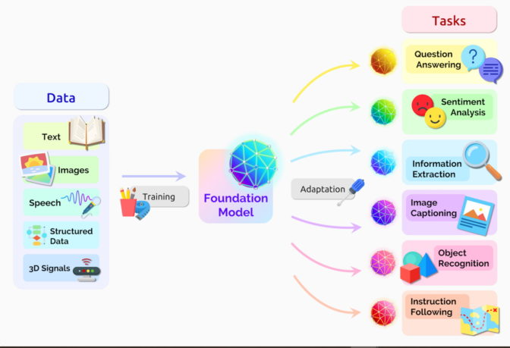

Slide 4
Various transformers by Hugging face
BERT (from Google);
GPT-2 (from OpenAI);
Transformer-XL (from Google/CMU);
XLNet (from Google/CMU);
RoBERTa (from Facebook);
XLM (from Facebook);
DistilBERT (from HuggingFace).

Slide 5
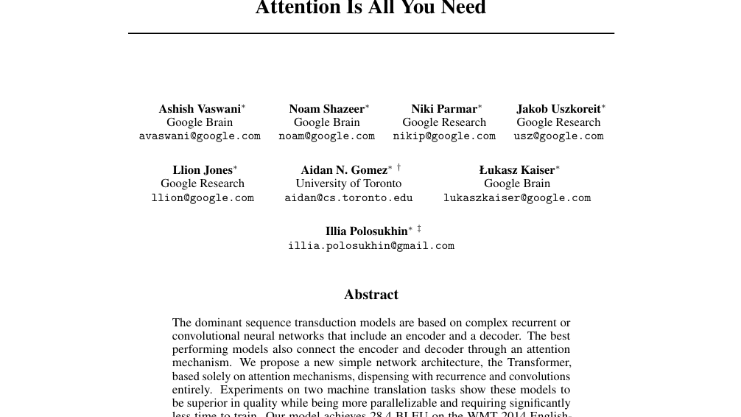

Slide 6
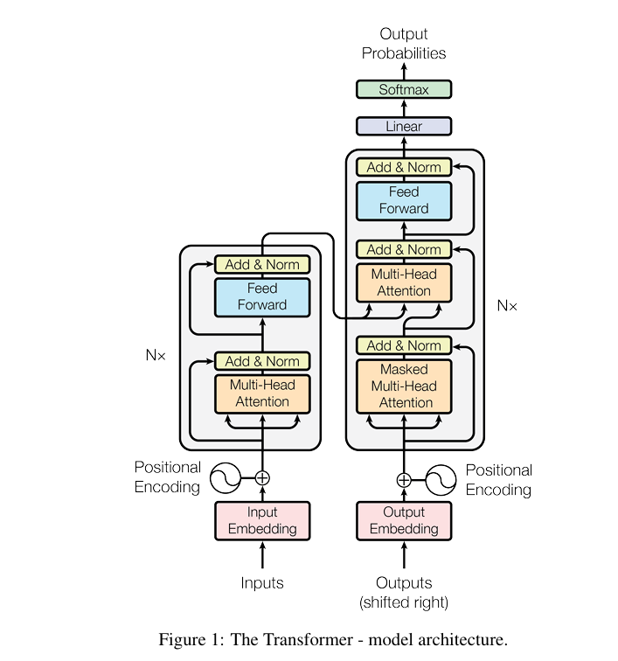

Slide 7
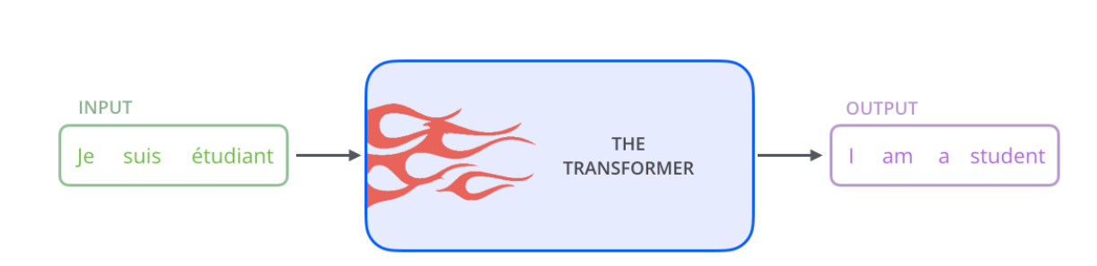

Slide 8
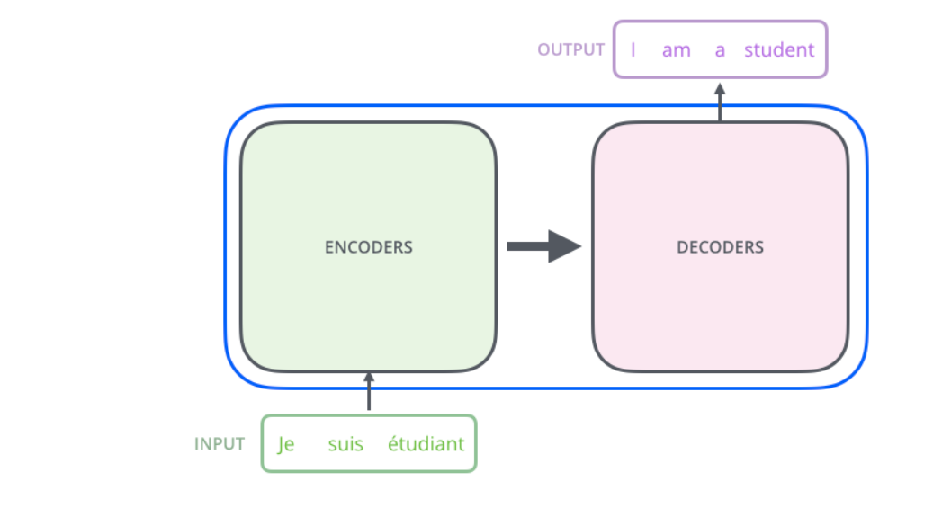

Slide 9
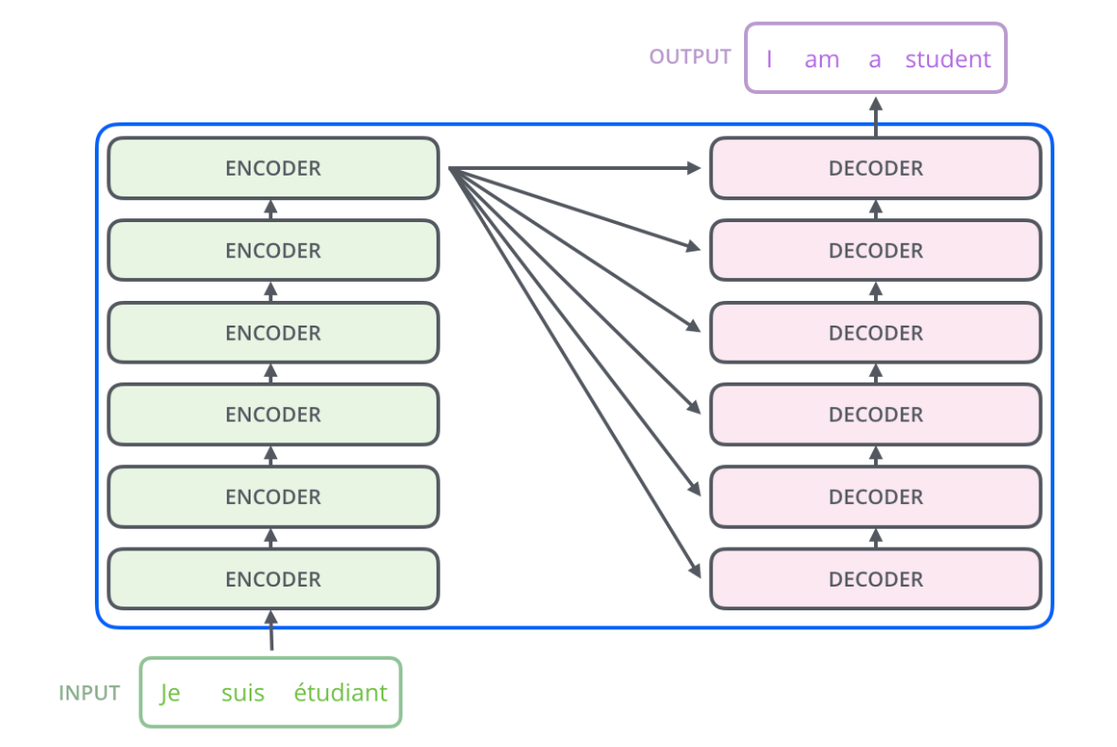

Slide 10
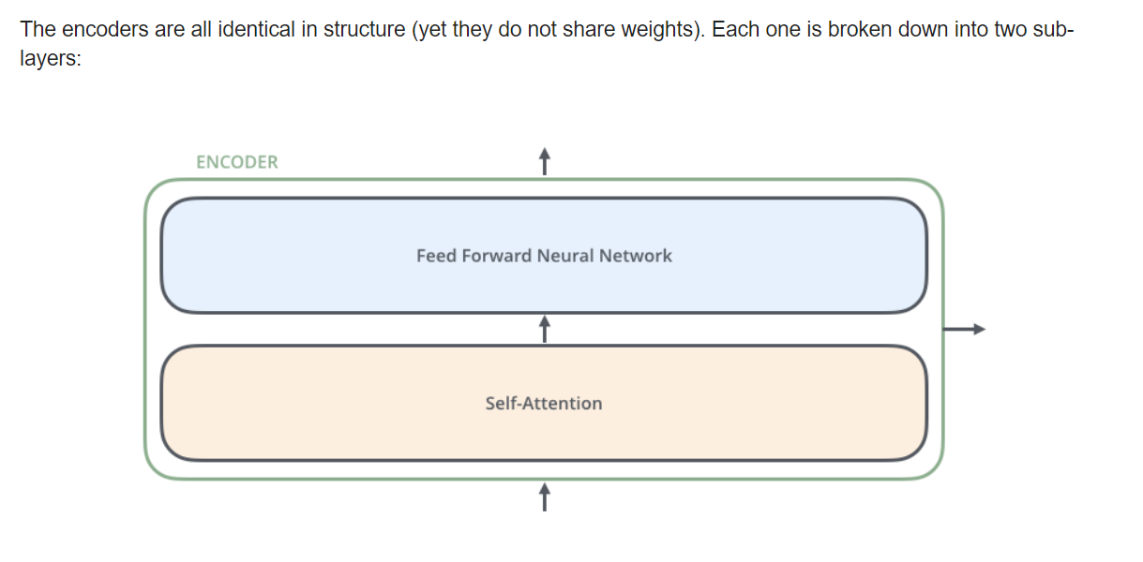

Slide 11
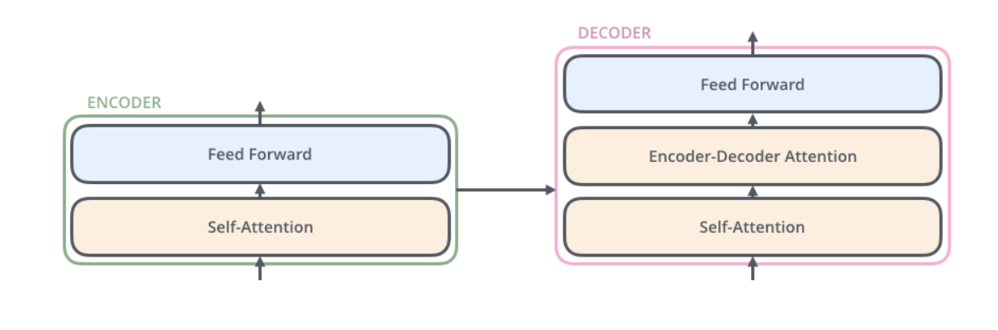

Slide 12
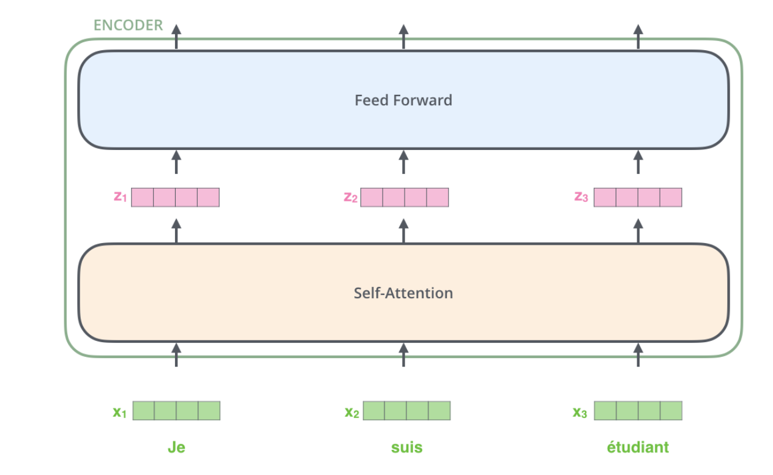

Slide 13
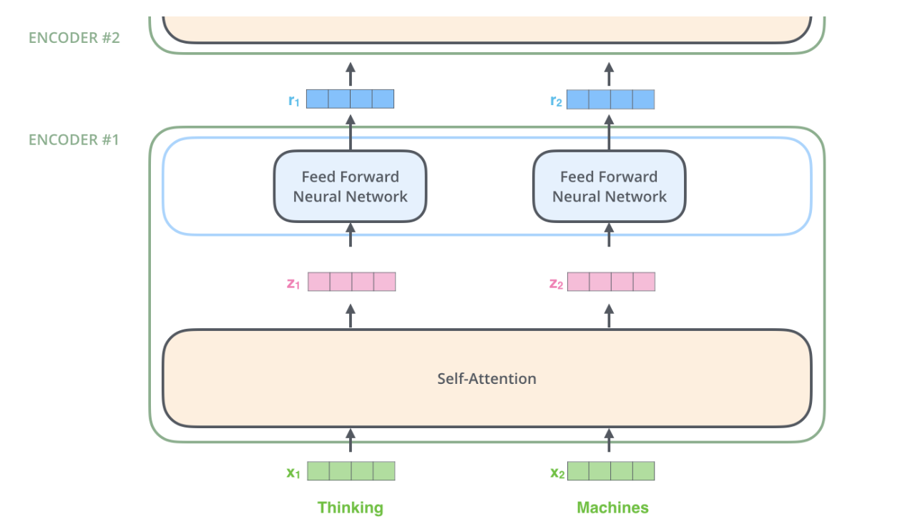

Slide 14
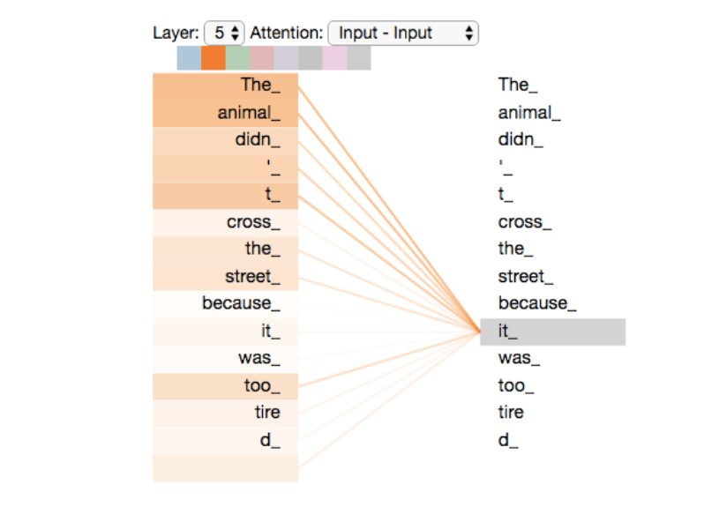
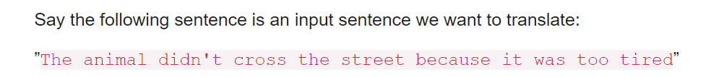

Slide 15
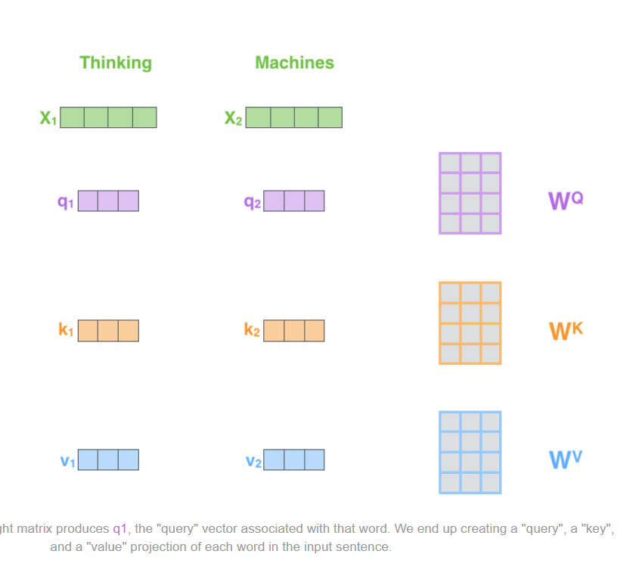
Self Attention Step 1

Slide 16
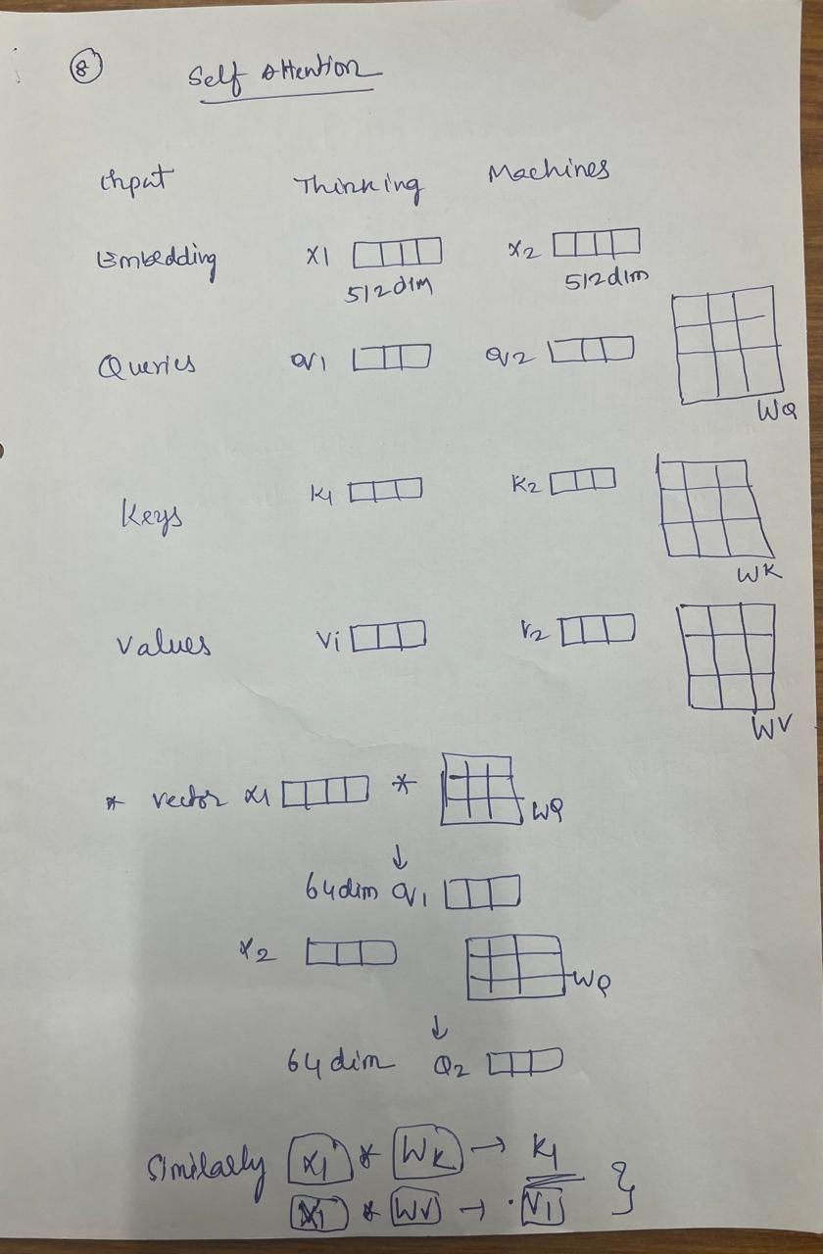

Slide 17
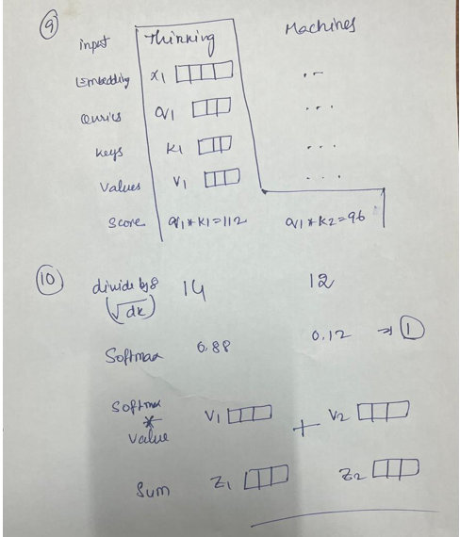

Slide 18
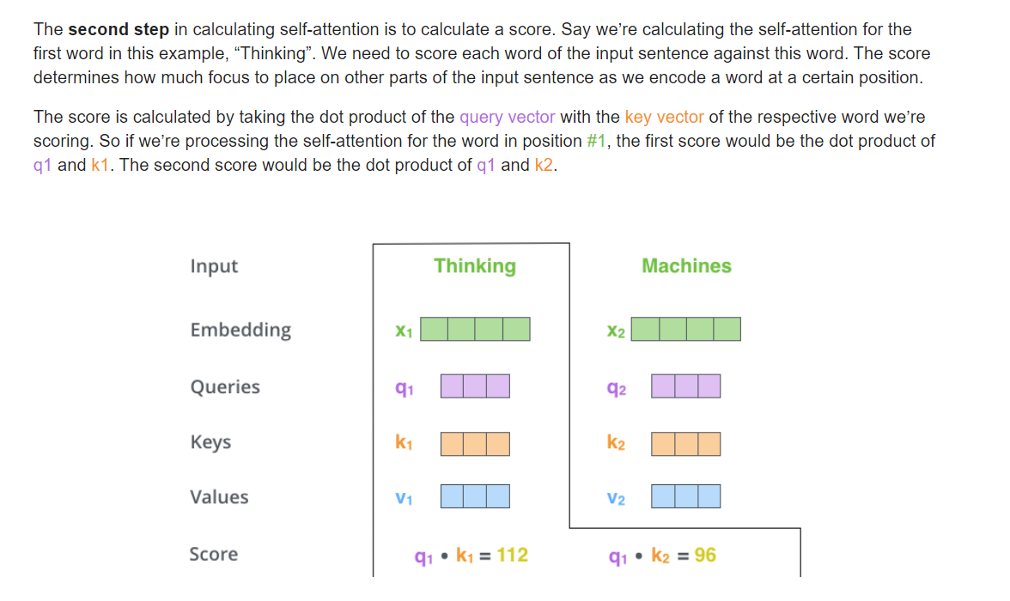

Slide 19
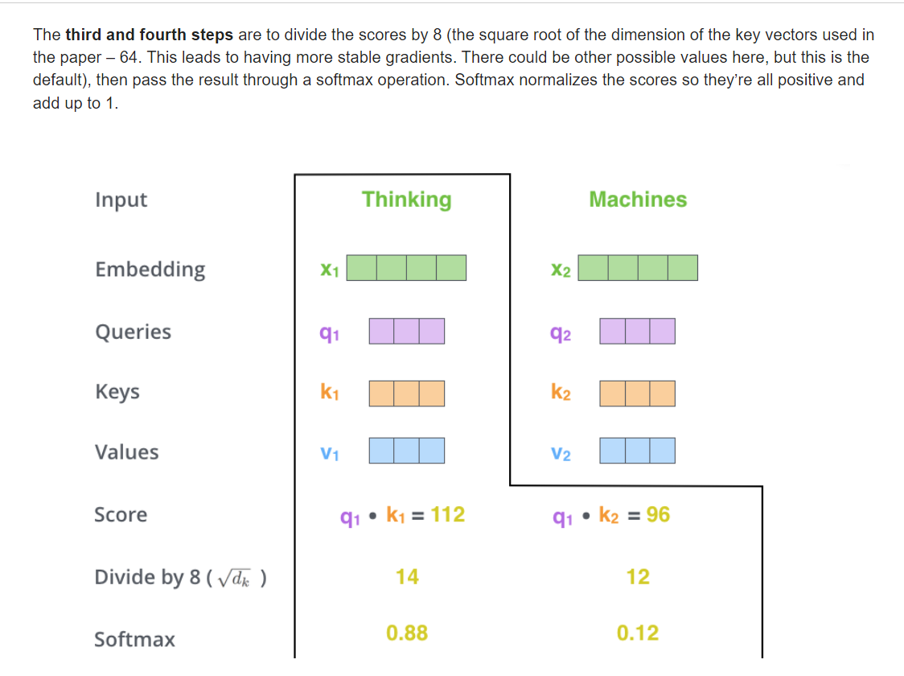

Slide 20
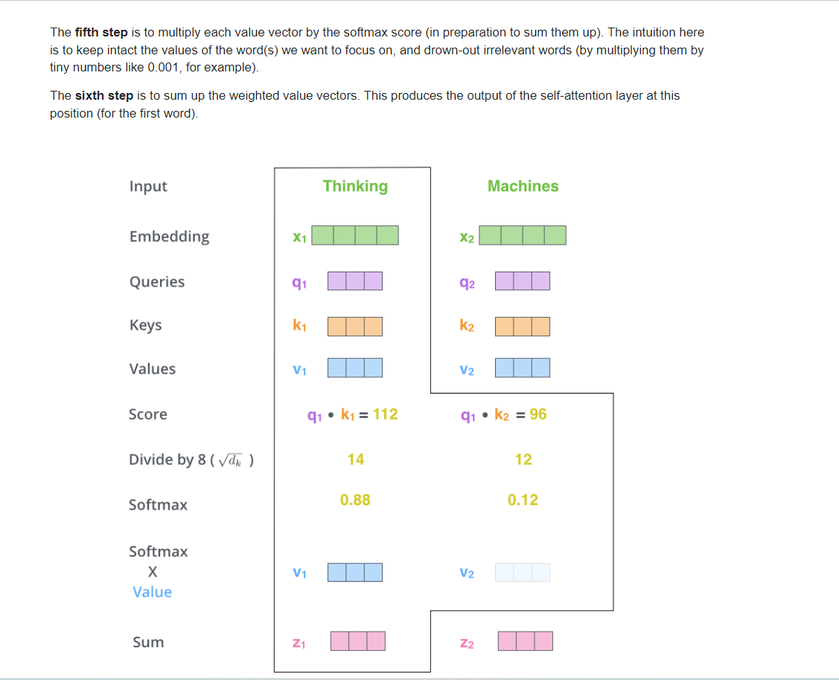

Slide 21
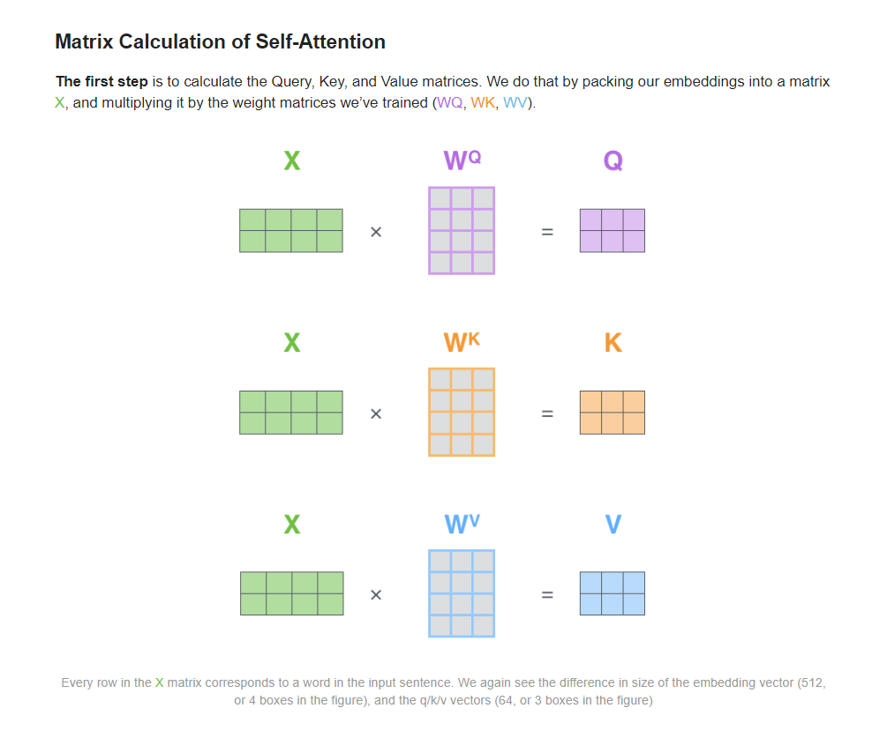

Slide 22
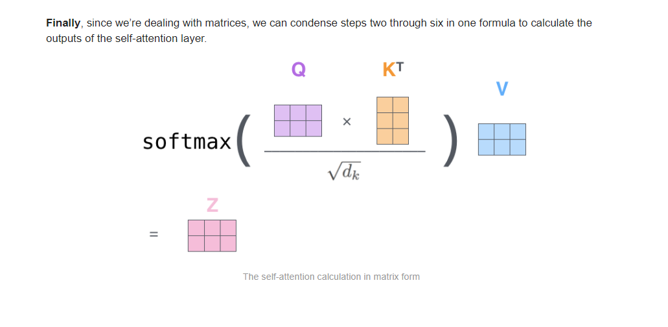

Slide 23
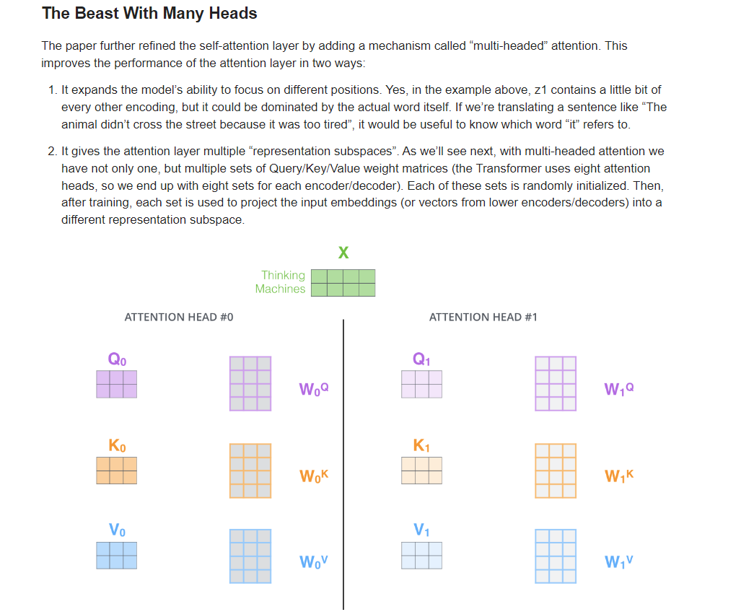

Slide 24
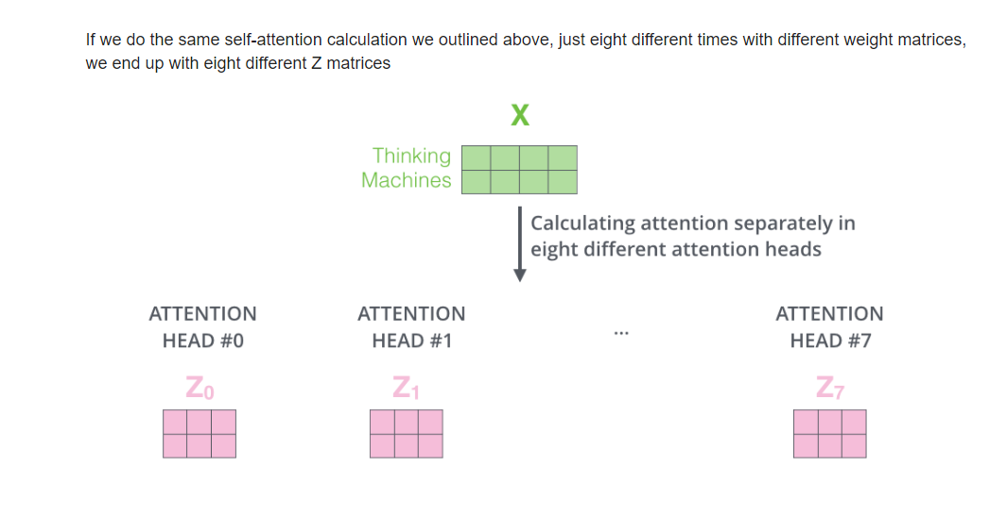

Slide 25
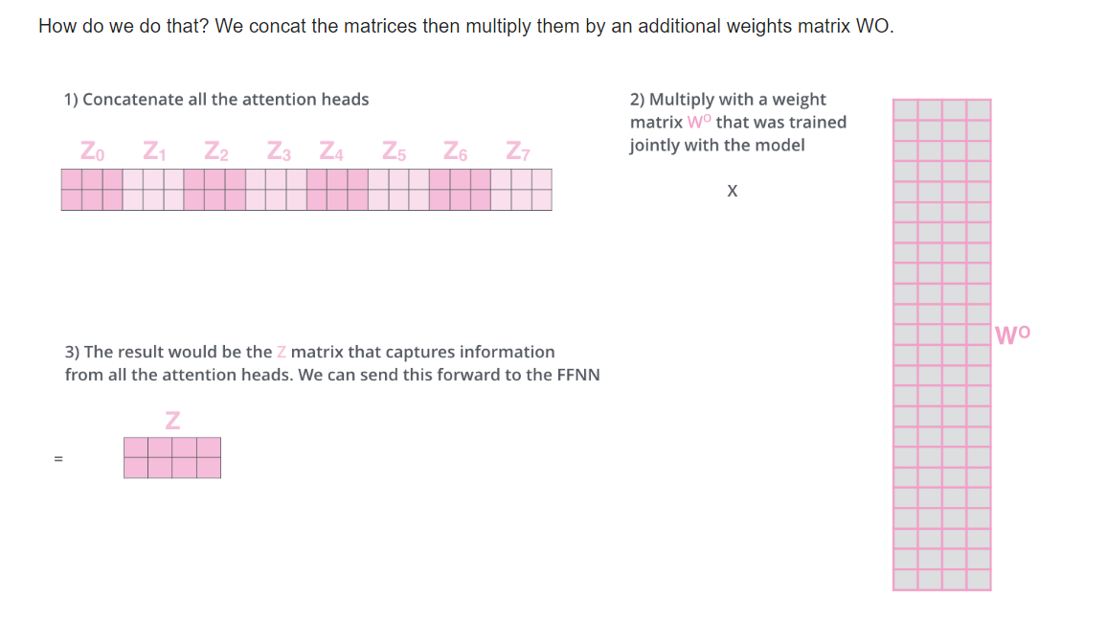

Slide 26
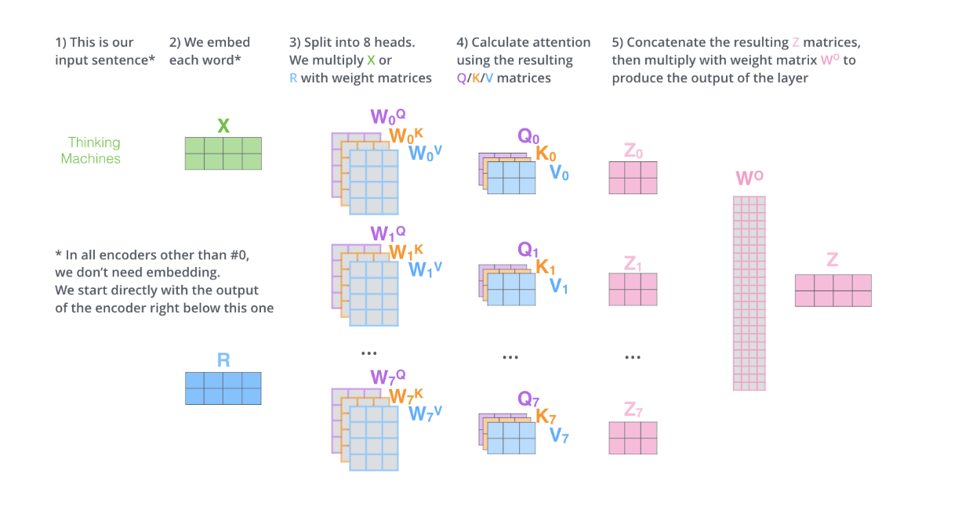

Slide 27
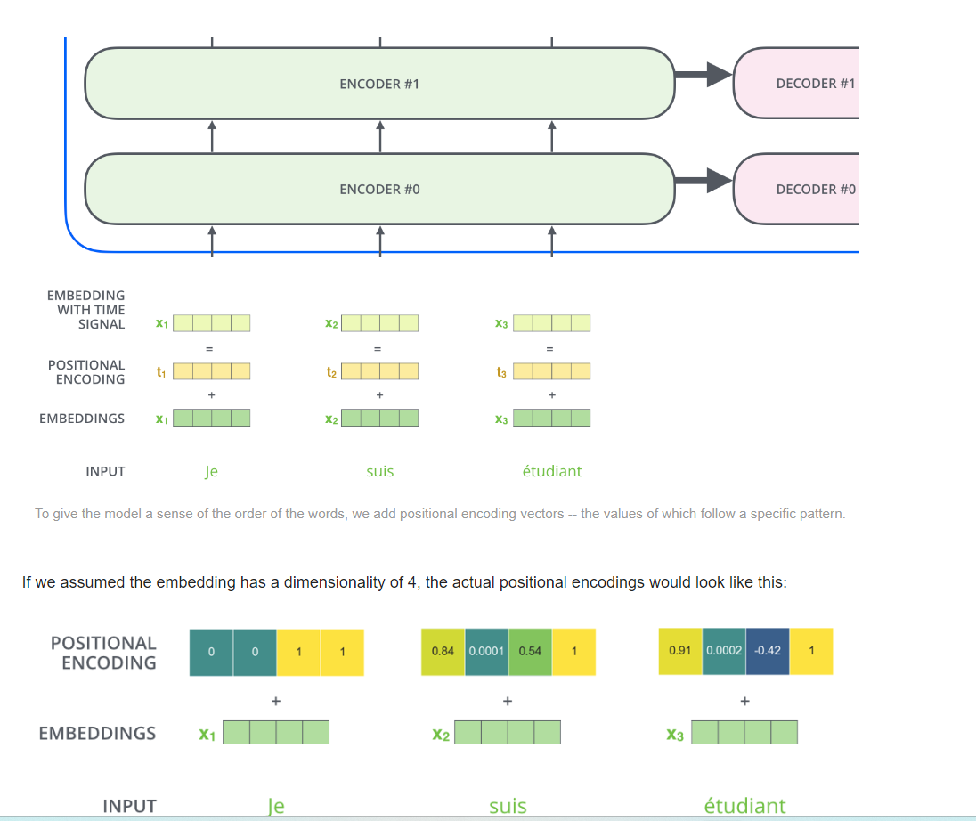

Slide 28
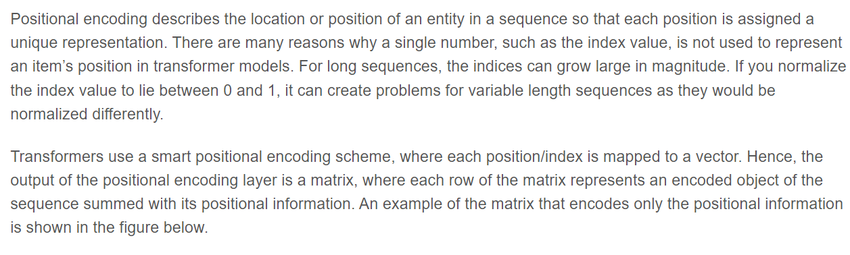
Positional Encoding

Slide 29
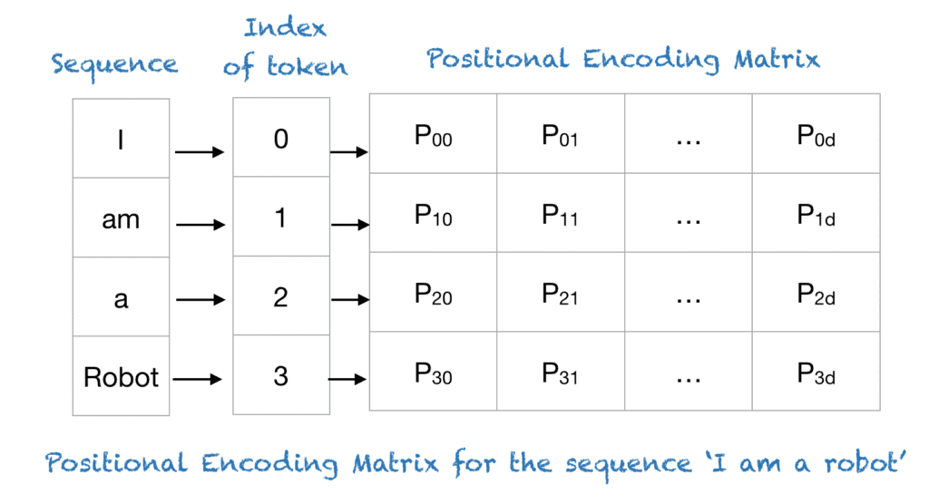

Slide 30
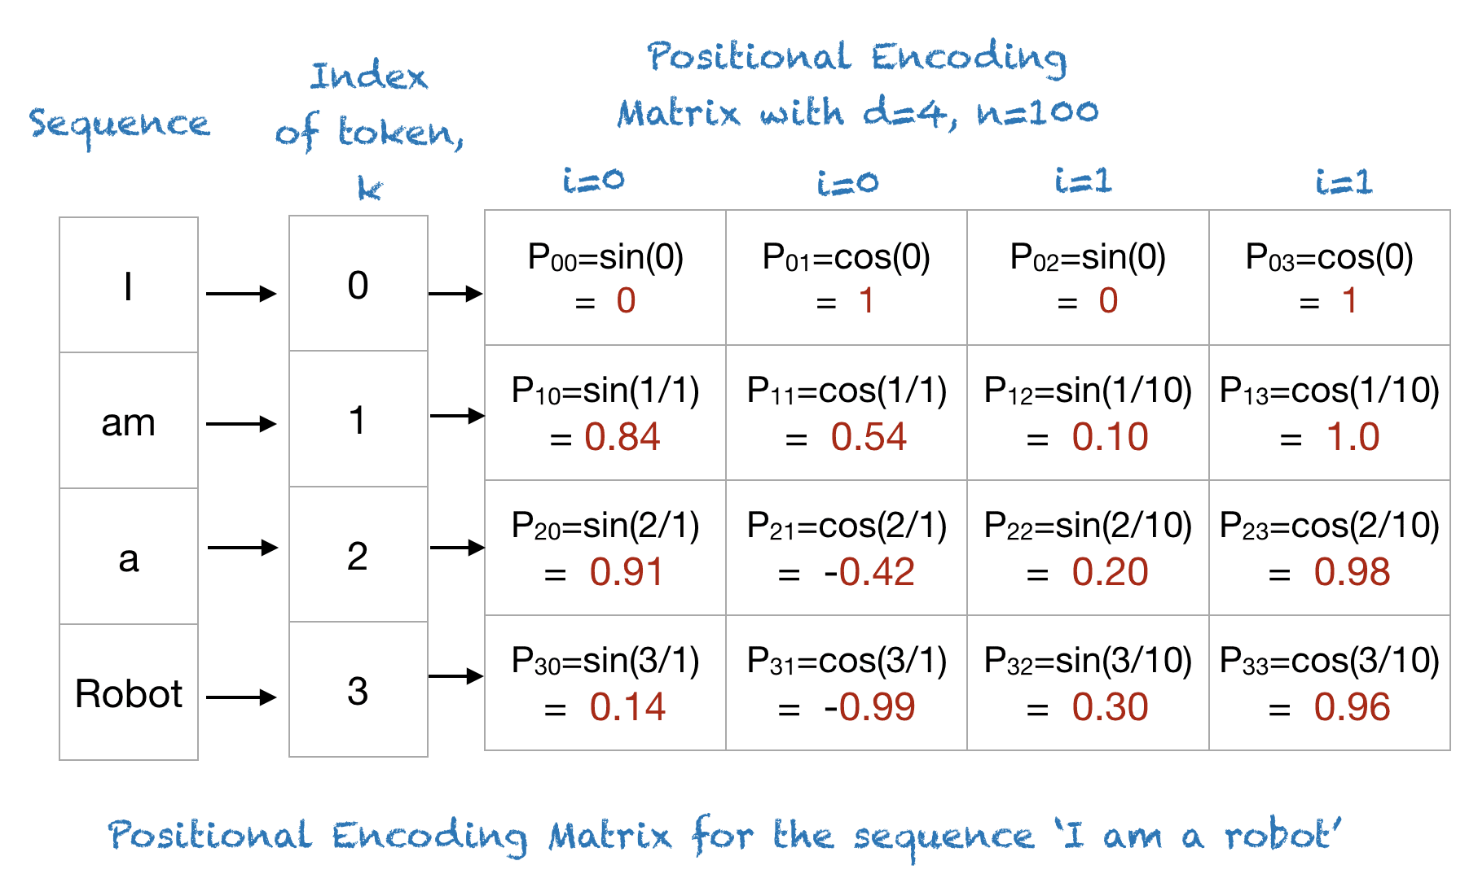

Slide 31
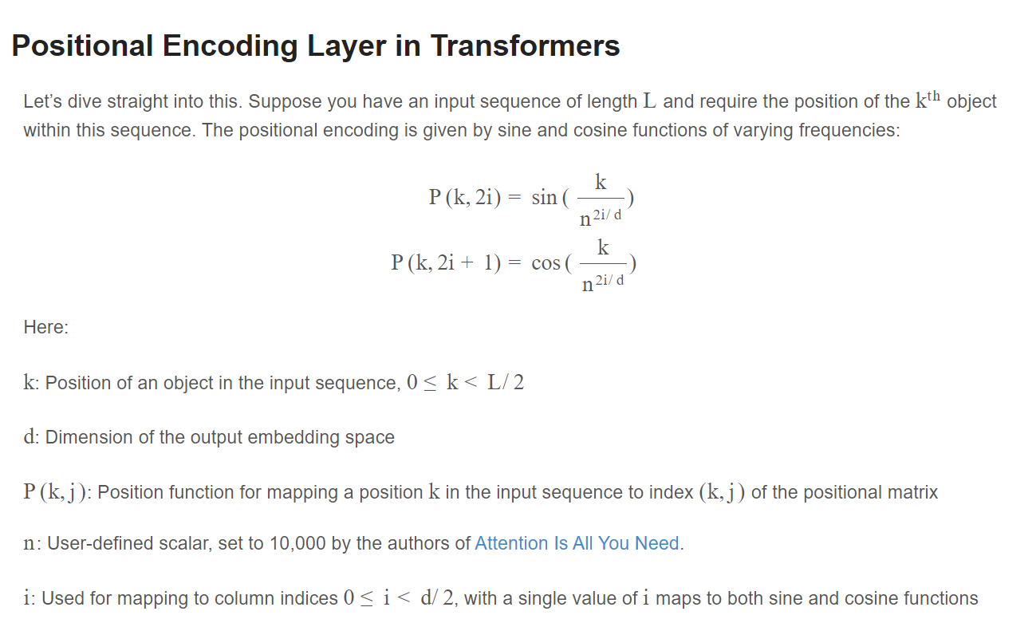

Slide 32

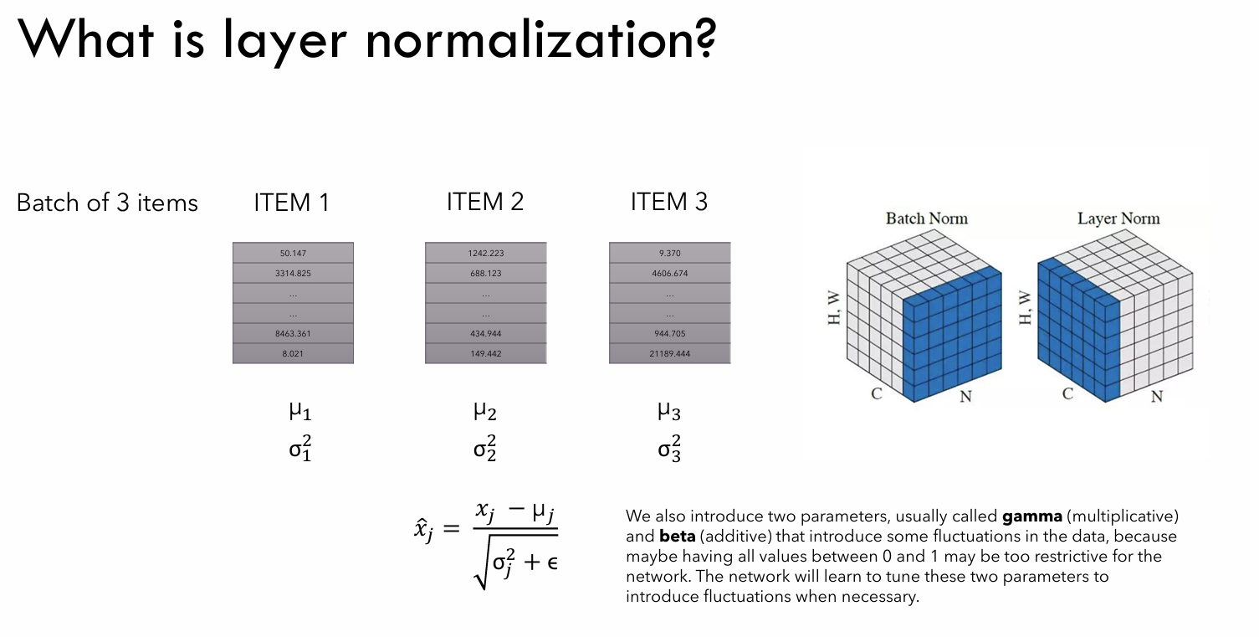


Slide 33
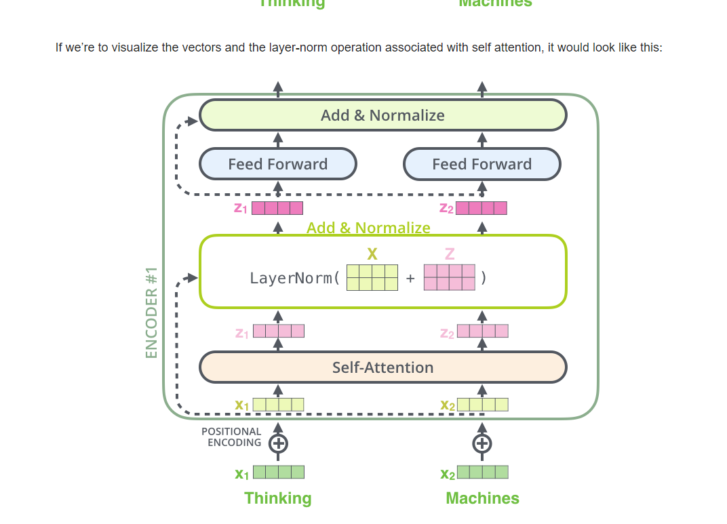

Slide 34
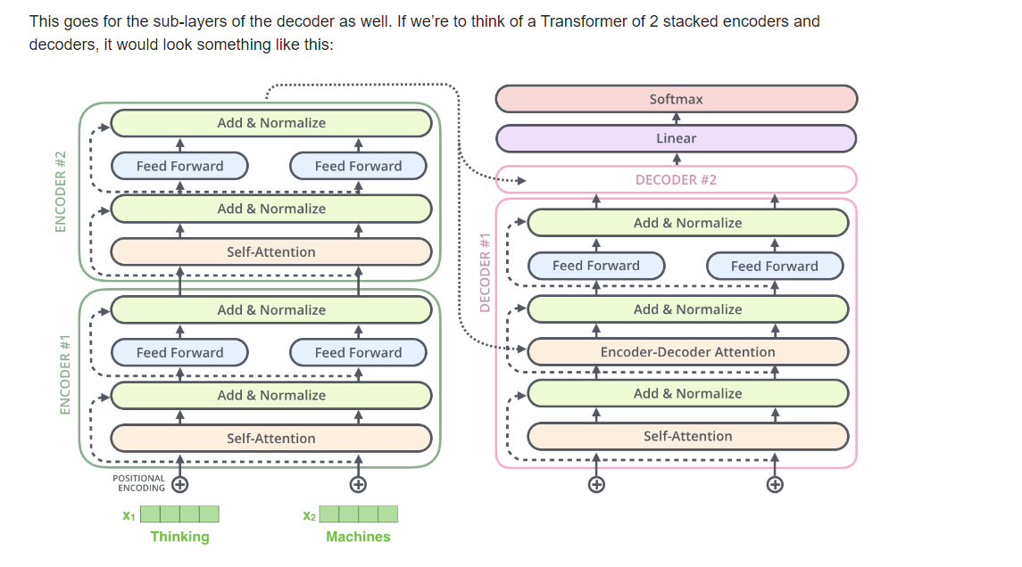

Slide 35
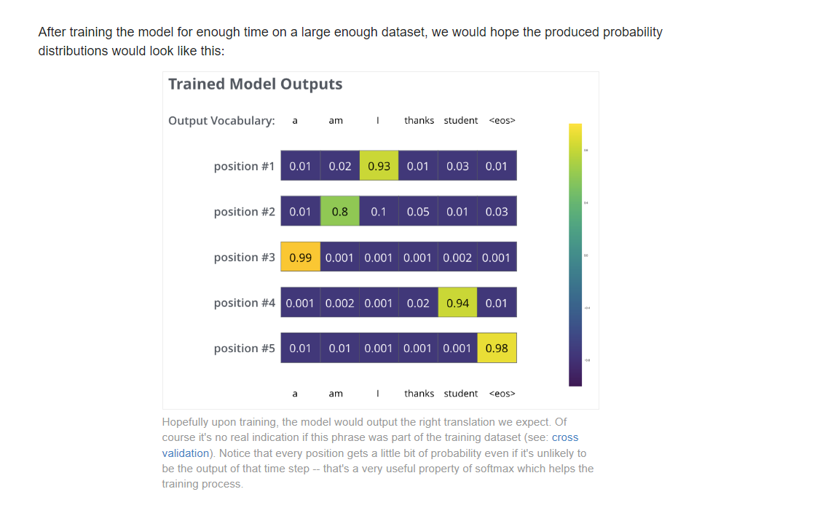

Slide 36
Hugging Face Introduction

Slide 37
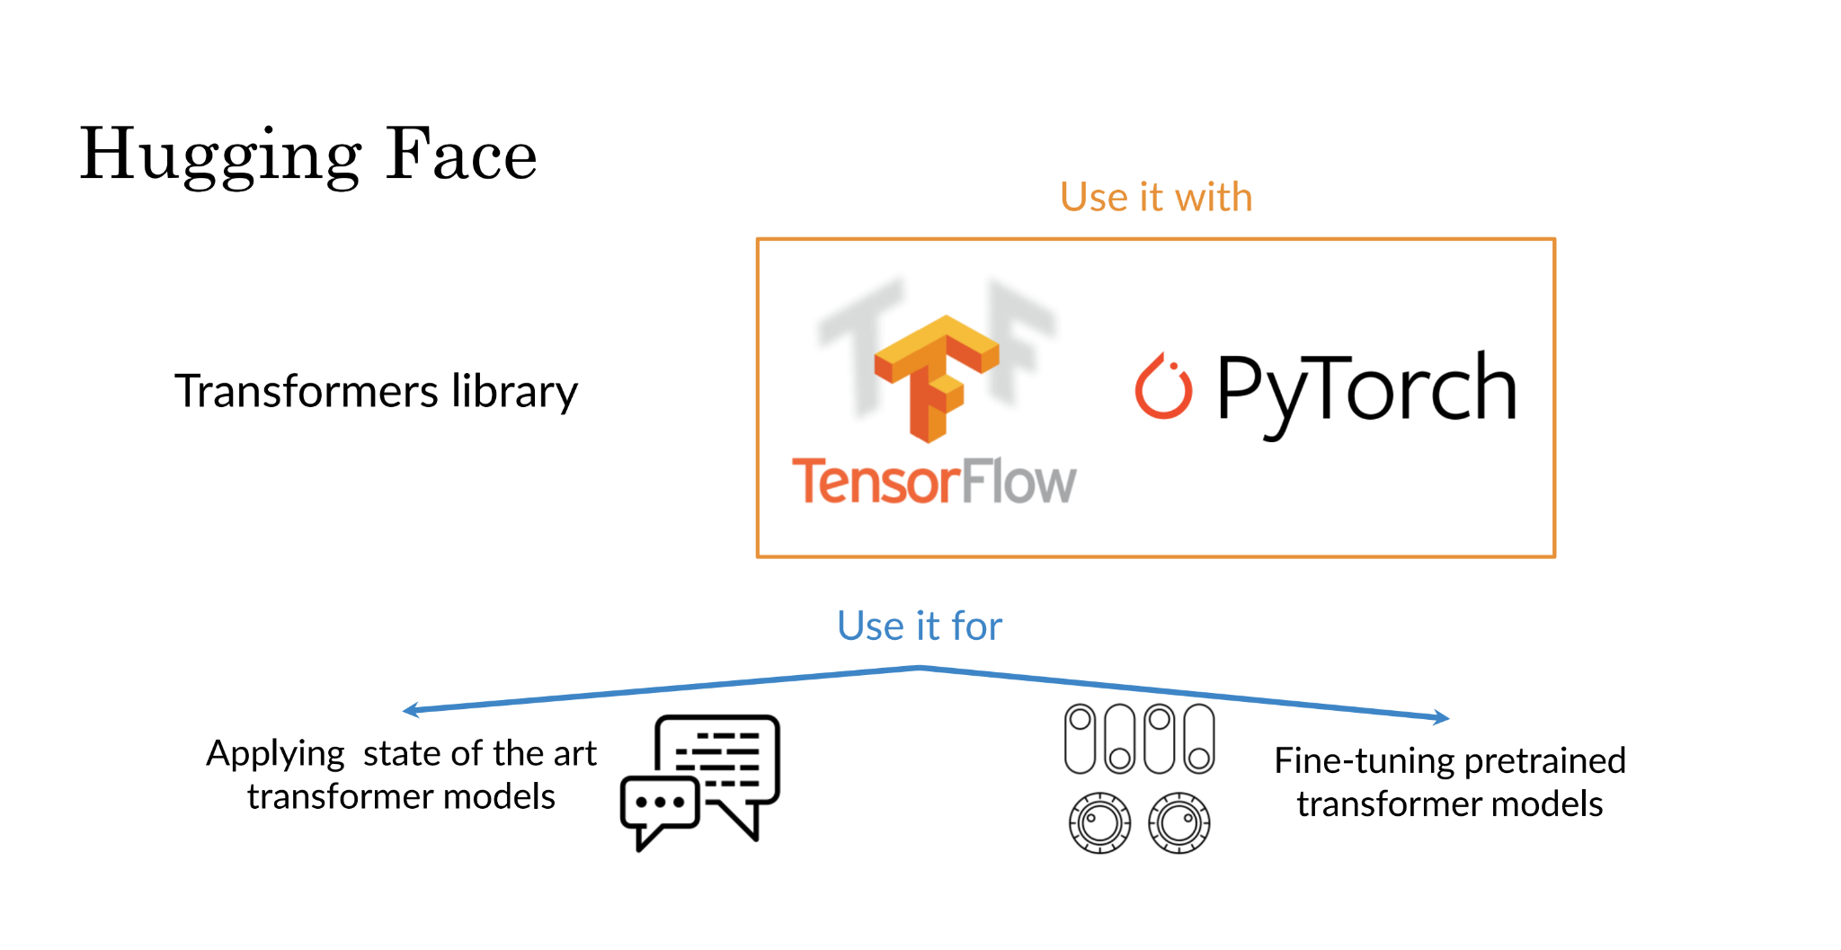

Slide 38
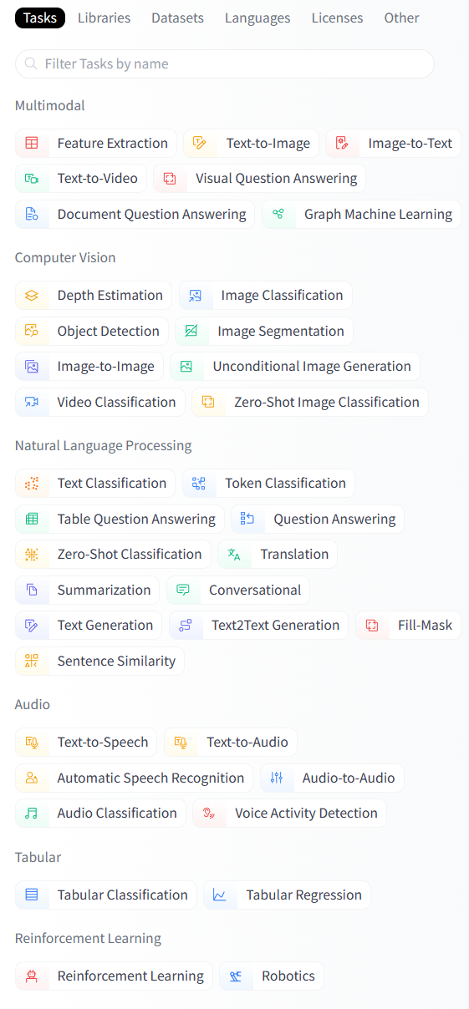
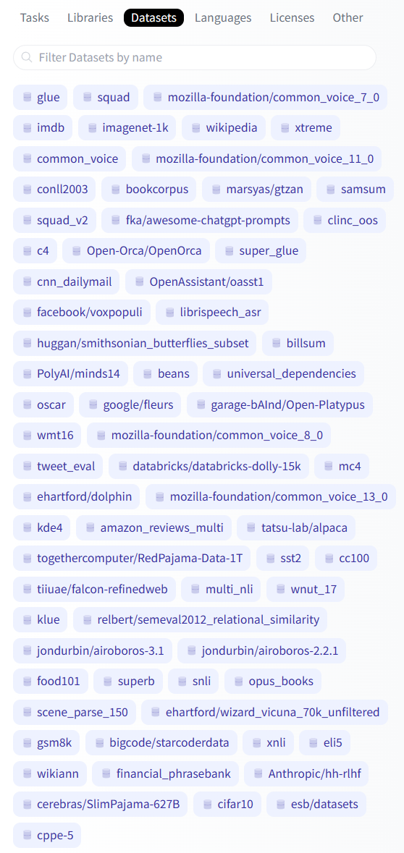
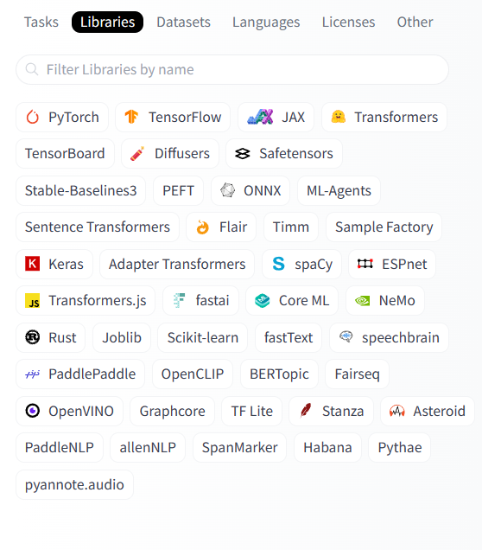
Model Card and Datasets

Slide 39
Summarization
A summarizer does exactly what its name suggests.
It takes a large block of text and condenses it into a shorter version.
This shorter version keeps only the key points.
Think of it as the difference between reading a whole novel and glancing at its back cover.
The aim is to save time while still getting the essence of the content.
Extractive: extract the most relevant information from a document.
Abstractive: generate new text that captures the most relevant information.

Slide 40
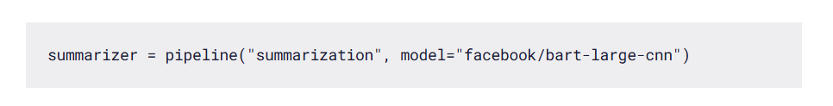
Summarization
Huggingface pipeline to implement summarization model using Facebook’s Bart model.
The BART model is pre-trained in the English language.
It is a sequence-to-sequence model and is great for text generation (such as summarization and translation).
It also works well for comprehension tasks (for example, text classification and question answering).

Slide 41
pipeline: This is a function provided by the Hugging Face transformers library to make it easy to apply different types of Natural Language Processing (NLP) tasks.
"summarization": This is the first argument to the pipeline function and specifies the type of task you want the pipeline to perform.
In this case, "summarization" means that the pipeline will be configured to summarize text.
model="facebook/bart-large-cnn": This argument specifies the pre-trained model to be used for the summarization task.
Here, "facebook/bart-large-cnn" refers to a specific model that has been trained on a large dataset to perform text summarization.
This model is provided by Facebook and is based on the BART (Bidirectional and Auto-Regressive Transformers) architecture, which is effective for tasks that require understanding and generating natural language.
The large-cnn part indicates that this particular model variant is optimized for summarization tasks.

Slide 42
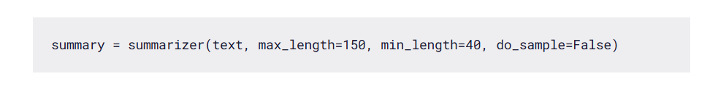
Summarization
summarizer: This is the object initialized previously with the pipeline function.
text: This is the input text that you want to summarize.
max_length=150: This parameter specifies the maximum length of the summary in terms of the number of tokens (words and punctuation marks).
min_length=40: Similarly, this parameter sets the minimum length of the summary.

