Slide 1
SmartEye: The AI Surveillance System

Slide 2
Outline
Problem Statement & Motivation
Objectives
Existing System
Proposed System
System Architecture
Implementation and Testing
Result Analysis and Discussions
Live Demonstration
Conclusion
Future Scope
References

Slide 3
Problem Statement and Motivation
Problem Statement: Traditional CCTV systems only record video and need humans to watch them. Motion sensors give many false alarms. There is no smart system that can detect real intrusions and give instant alerts automatically.
Motivation: To build a low-cost smart system that can detect intruders in real time and reduce false alarms using AI and sensors.

Slide 4
Objectives
To design a cost-efficient, AI-enabled intruder detection system using IoT hardware.
To develop and deploy a TinyML-optimized lightweight model capable of real-time local object detection.
To improve detection accuracy by classifying humans, animals, and vehicles to significantly reduce false triggers.
To evaluate, benchmark, and optimize system performance under real-world environmental conditions.

Slide 5
Existing System
Summary of Literature Survey: Current surveillance systems mainly use CCTV cameras and basic motion sensors. Some recent systems use AI for object detection, but many depend on cloud processing. Most systems either need human monitoring or give many false alarms. They are costly, slow in response, and not fully reliable for real-time security.
Current Solutions / Methods:
CCTV with manual monitoring
PIR or radar based motion sensors
AI-based object detection using deep learning
Cloud-based video analytics systems

Slide 6
Existing System
Limitations :
Need continuous human attention
High false alarms from motion-only systems
High cost of AI cloud systems
Delay in alert due to cloud processing
No proper fusion of sensor and vision in low-cost systems

Slide 7
Existing System
Paper Details (Title, Year) | Approach | Result Analysis | Gaps / Challenges
AI-based CCTV System (2021) | Cloud-based object detection | Good accuracy | High cost, internet dependency
Motion Sensor Alarm (2020) | PIR / Radar sensing | Fast detection | Too many false alarms
Smart Camera System (2022) | Vision-only AI model | Detects humans | Fails in low light, no sensor support
IoT Surveillance (2023) | Camera + Cloud + App | Remote monitoring | High latency, privacy risk

Slide 8
Proposed System
Proposed System – SmartEye
SmartEye is an AI-based surveillance system that detects intruders in real time using a camera and motion sensor. It runs fully on the device, giving fast alerts, better privacy, and fewer false alarms.
Key Features / Novelty:
Real-time object detection
Camera + sensor fusion
On-device AI (no cloud)
Low-cost and low power
Instant alert system

Slide 9
Proposed System
Methodology:
YOLOv8 for object detection
Radar sensor for motion validation
Edge computing on Raspberry Pi
Telegram Bot API for alert communication

Slide 10
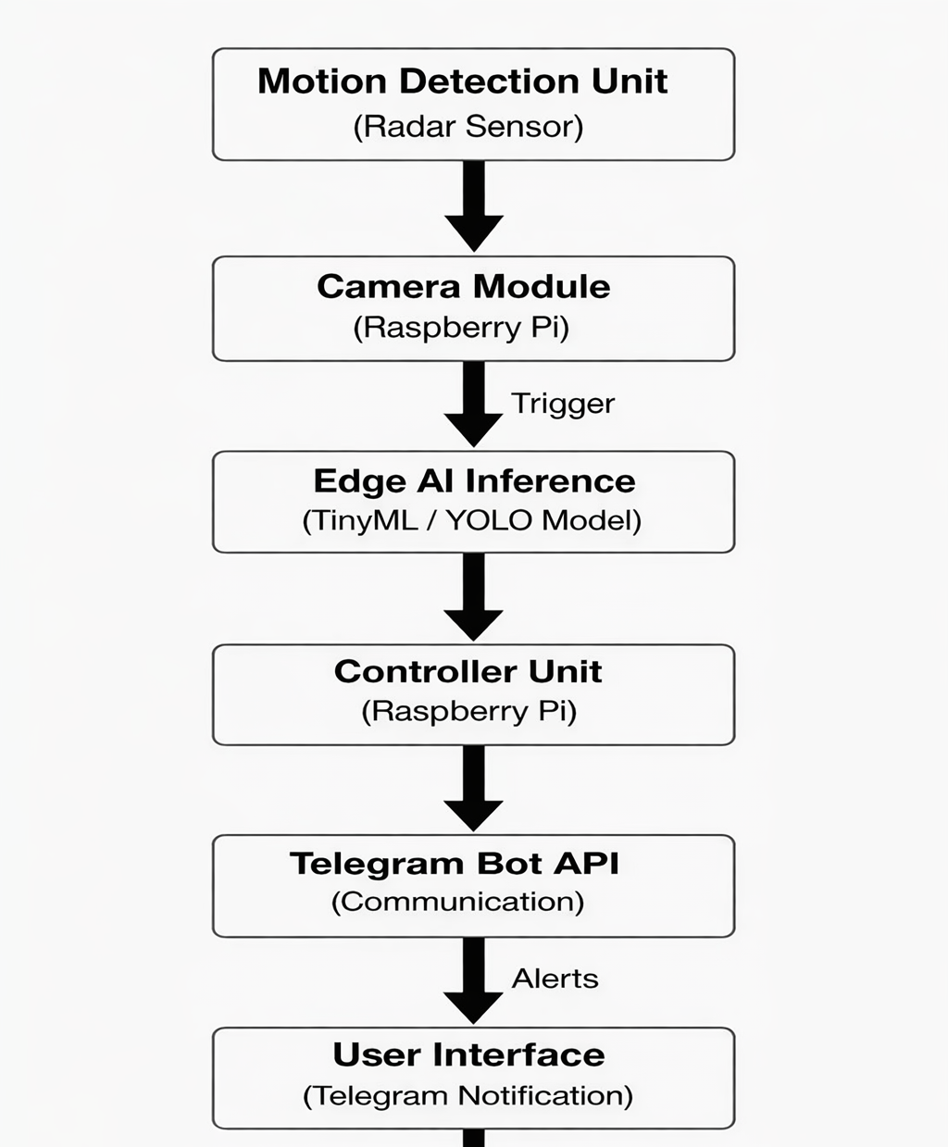
System Architecture/Block Diagram

Slide 11
Implementation
Implementation
Tools, Technologies, Frameworks:
Python, OpenCV
YOLOv8 (TinyML model)
Raspberry Pi 5, Arduino Nano
Camera Module, Radar Sensor
Telegram Bot API, Flask Web Dashboard
Dataset:
COCO pre-trained dataset (for object detection)
Live camera video for real-time testing

Slide 12
Implementation
Key Steps:
Capture video from camera
Run YOLOv8 for object detection
Fuse AI and sensor output
Validate intrusion using sliding window
Send alert using Telegram Bot API and display on dashboard

Slide 13
Testing Approach
Testing and Evaluation
Type of Testing:
Unit Testing (camera, sensor, model)
Integration Testing (AI + sensor + alert)
Performance Testing (speed, accuracy, latency)
Test Scenarios:
Human entry
Animal movement
No-motion case
Low-light condition
Repeated movement

Slide 14
Testing Approach
Metrics Used:
Detection Accuracy
False Alarm Rate
Latency (ms)
FPS
Validation Method: Results from AI detection were verified using sensor confirmation and repeated frame analysis to ensure only true intrusions triggered alerts.

Slide 15
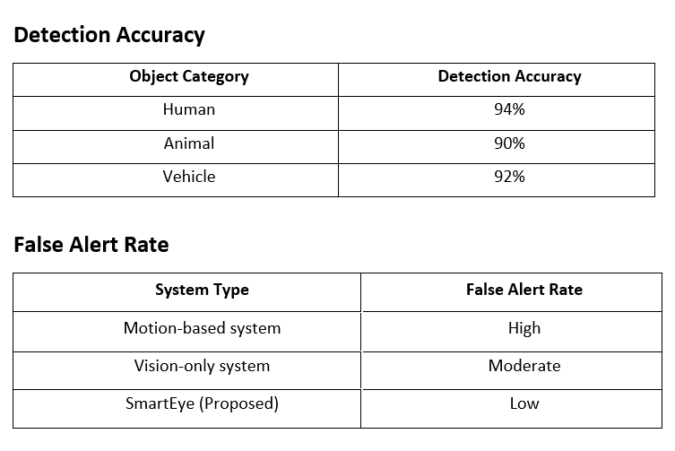
Testing Approach

Slide 16
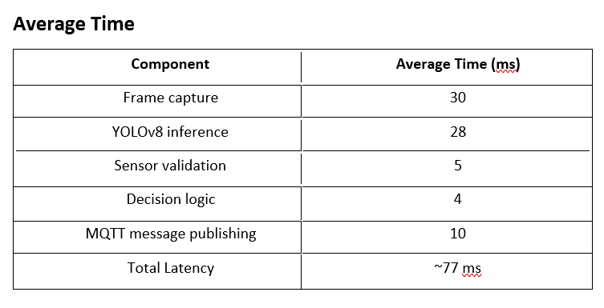
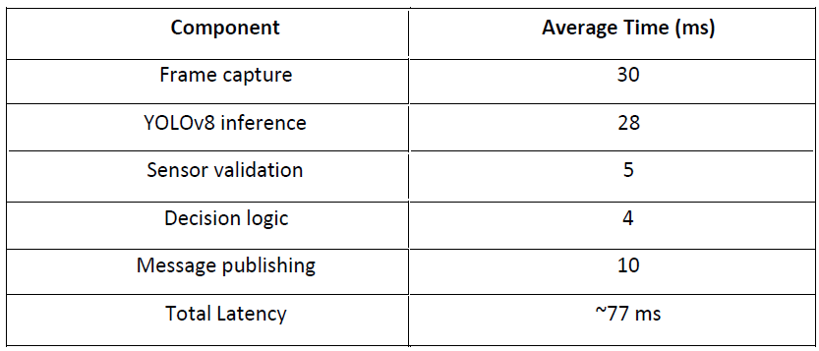
Testing Approach

Slide 17
Result Analysis and Discussions
1. Summary of Results
Human detection accuracy: 94%
Animal detection accuracy: 90%
Vehicle detection accuracy: 92%
False alarms reduced by about 65%
Average system latency: ~77 ms
Real-time performance achieved on Raspberry Pi

Slide 18
Result Analysis and Discussions
2. Interpretation of Results
The system detects intruders accurately in real time.
Sensor fusion reduces false alerts compared to motion-only systems.
Edge-based AI gives fast response without cloud delay.
3. Comparison with Literature
Similar to recent AI surveillance systems, SmartEye shows high detection accuracy.
Unlike cloud-based systems, it works fully on-device with lower cost and latency.

Slide 19
Result Analysis and Discussions
4. Reasons Behind Observations
High accuracy is due to YOLOv8 deep learning model.
Low false alarms are due to camera and radar sensor fusion.
Fast response is achieved because processing is done on the edge device.
5. Limitations
Limited to single camera setup
Performance may drop in very low light
No face recognition in current version

Slide 20
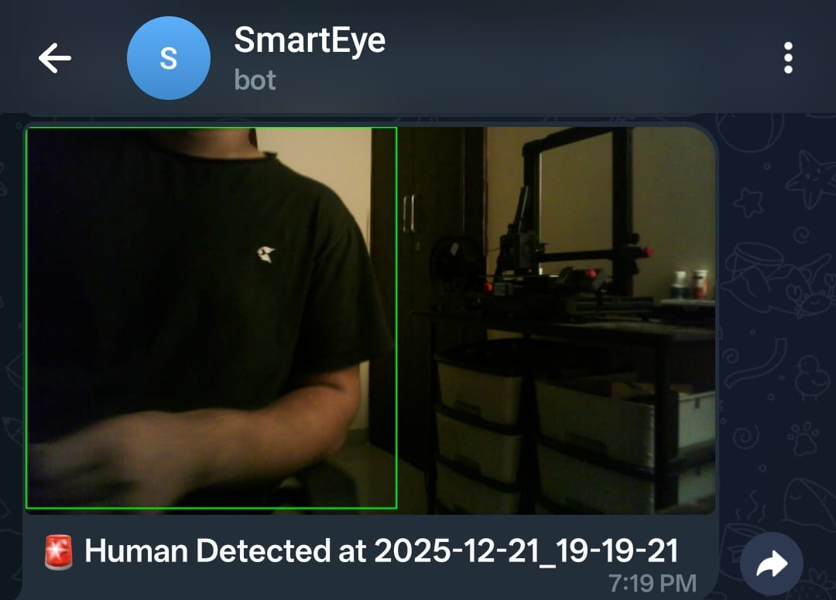
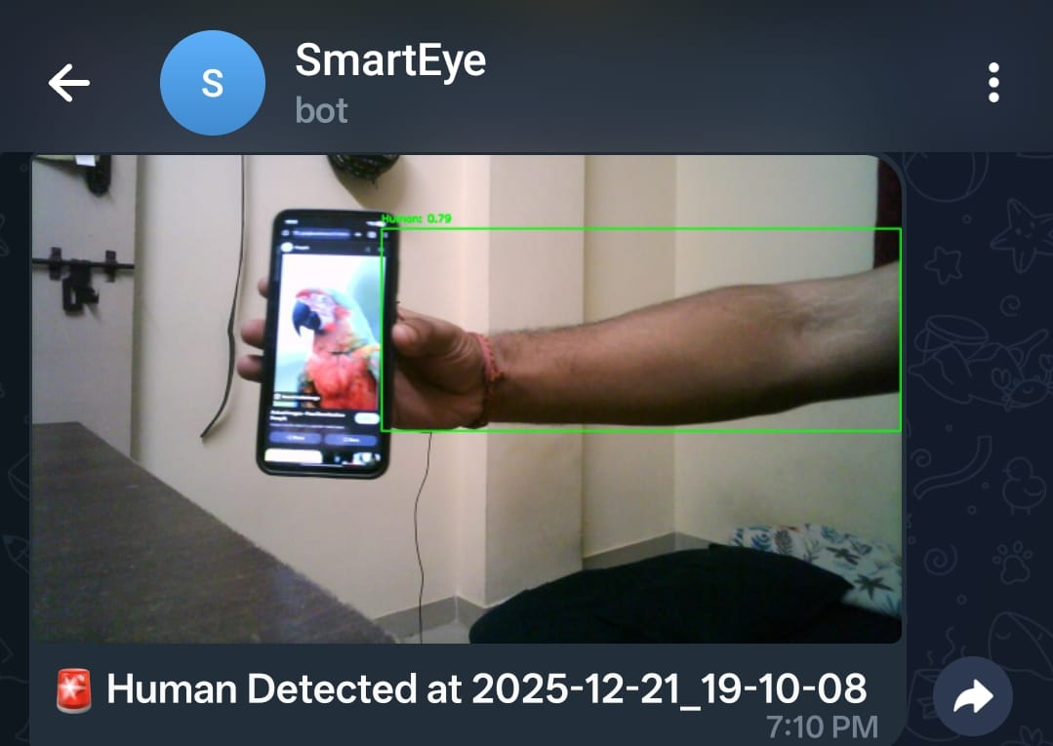
Result analysis
The accuracy of the model is around 80-90%.
Here it is detecting human and sending notification to the phone:

Slide 21
Sustainable Development Goals(SDG)
SDG 11 – Sustainable Cities and Communities: Enhances urban safety using intelligent technology while protecting individual privacy.
SDG 16 – Peace, Justice, and Strong Institutions: Supports safe and secure living environments through smart surveillance systems
SDG 9 – Industry, Innovation, and Infrastructure: Promotes the development of innovative, cost-effective, and secure IoT infrastructure for smarter communities.

Slide 22
Live Demonstration
Live demonstration or walkthrough of the working modules

Slide 23
Conclusion
SmartEye: The AI Surveillance System was designed to provide a simple, low-cost, and reliable solution for real-time intrusion detection. By combining a camera, radar sensor, and an AI model, the system can identify humans, animals, and vehicles and generate alerts only when a true intrusion is detected. This reduces the need for continuous human monitoring and minimizes false alarms.
The use of edge computing allows all processing to be done on the device, which improves response time and protects user privacy by avoiding cloud dependency. The results show that SmartEye achieves good detection accuracy with low latency and stable performance. Overall, the project proves that intelligent surveillance can be implemented effectively using affordable hardware and modern AI techniques

Slide 24
Future Scope
Face Recognition & Identity Tracking: Identifies authorized and unauthorized individuals in restricted areas
Multi-Camera Integration: Enables wider coverage and centralized monitoring
Cloud-Based Analytics: Supports long-term data analysis and predictive security insights
Mobile Application Integration: Provides real-time alerts, live streaming, and remote control
Edge AI Acceleration: Improves inference speed using hardware accelerators for real-time performance

Slide 25
References
[1] X. Liu, Y. Zhang, and H. Li, “Edge AI for Real-Time Surveillance: Challenges and Opportunities,” IEEE Internet of Things Journal, vol. 8, no. 4, pp. 2341–2354, 2021.
[2] H. B. McMahan, E. Moore, D. Ramage, and B. A. Arcas, “Communication-Efficient Learning of Deep Networks from Decentralized Data,” in Proc. 20th Int. Conf. Artificial Intelligence and Statistics (AISTATS), 2017, pp. 1273–1282.
[3] C. Banbury, V. Reddi, and J. Holleman, “Benchmarking TinyML Systems: Challenges and Opportunities,” arXiv preprint arXiv:2003.04821, 2020.
[4] TinyissimoYOLO, “A Quantized Low-Memory TinyML Object Detection Network,” IEEE Access, 2024.
[5] M. David, S. Kumar, and L. Chen, “Real-Time Object Detection on Low-Power Edge Devices Using TinyML,” IEEE Trans. Neural Netw. Learn. Syst., vol. 33, no. 9, pp. 4562–4575, 2022.
[6] N. D. Lane, S. Bhattacharya, and P. Georgiev, “Squeezing Deep Learning into Mobile and Embedded Devices,” IEEE Pervasive Computing, vol. 18, no. 4, pp. 82–88, 2019.
[7] A. G. Howard, M. Zhu, B. Chen, et al., “MobileNets: Efficient Convolutional Neural Networks for Mobile Vision Applications,” arXiv preprint arXiv:1704.04861, 2017.
[8] X. Zhang, X. Zhou, M. Lin, and J. Sun, “ShuffleNet: An Extremely Efficient Convolutional Neural Network for Mobile Devices,” in Proc. IEEE Conf. Computer Vision and Pattern Recognition (CVPR), 2018, pp. 6848–6856.

Slide 26
References
[9] P. Saha and A. Roy, “Integrating Edge AI and IoT for Smart Surveillance Systems,” Sensors, vol. 23, no. 2, pp. 1024–1039, 2023.
[10] V. J. Reddi, C. Banbury, P. Warden, et al., “The TinyML Benchmark Suite,” in Proc. 4th MLSys Conf., 2021, pp. 1–13.
[11] A. Gupta and R. Patel, “Federated Learning for Edge-Based Security Systems,” IEEE Access, vol. 8, pp. 207484–207497, 2020.
[12] Google TensorFlow, “TensorFlow Lite Documentation,” TensorFlow.org, 2024. [Online]. Available:
[13] Espressif Systems, “ESP32-CAM Technical Reference Manual,” Espressif Systems Official Documentation, 2023. [Online]. Available:
[14] Raspberry Pi Foundation, “Edge AI Applications with Raspberry Pi 4,” Raspberry Pi Documentation, 2024. [Online]. Available:
[15] S. K. Verma and R. Mehta, “TinyML for Edge Intelligence: Opportunities and Challenges in Smart IoT Applications,” IEEE Access, vol. 12, pp. 118903–118917, 2024.

Slide 27
Thank You

