Slide 1

Capstone Project – I: Review – 2 on
Blockchain based consent and access log for health records
Presented by the Batch No. : IOT 13
D. Pallavi BU22CSEN0600012 (TL)
D. Divya Sree BU22CSEN0600011
K. Dharmike BU22CSEN0600071
P.Mohammad Rafi BU22CSEN0600116
Under the Guidance of
Dr. Viswa Bharathy A M
Assistant Professor
Department of Artificial Intelligence and Data Science
GITAM School of CSE, GITAM (Deemed to be University),
Bengaluru, Karnataka, INDIA.

Slide 2
CONTENTS
Recap of Capstone Project Introduction Review-1
  Problem Statement
  Objectives
  Feedback from Guide/Reviewers and actions taken after Review–1
Requirement Analysis
Identification of tools/technology/algorithms
Design Strategy (project workflow/ system design/ DFD/UML design)
Conclusion
References

Slide 3
Problem Statement
Patients currently do not have full authority over their healthcare information.
Existing systems lack a reliable way to track who accesses patient records and when.
Decentralized data stores are susceptible to manipulation and unauthorized access.
Current infrastructures do not clearly process or enforce patient consent.
Patients often remain unaware of access to their sensitive medical data, leading to breaches.
A blockchain-based system can ensure secure consent management and maintain an immutable, transparent ledger of all EHR access events.

Slide 4
Objectives
To develop a blockchain-based system that ensures patients have complete control over their health records.
To design smart contracts for granting, revoking, and managing patient consent securely.
To support compliance with healthcare data regulations like HIPAA and GDPR.
To build a secure ecosystem that promotes patient trust and enables safe data sharing for research.

Slide 5
Feedback from Guide/Reviewers and actions taken after Review–1
Feedback from Guide/Reviewers
1. Asked us to discuss with other team who have same project .
2. Identify Indian laws that support medical which is equivalent to HIPAA, GDRP.
Actions taken
1. The difference in our project compared to other team is we are implementing the consent forms.
2. Indian Act- Ministry of Electronics and Information Technology(MeitY) which governs data protection under the Digital Personal Data Protection Act (DPDPA).

Slide 6
CONTENTS
Recap of Capstone Project Introduction Review-1
  Problem Statement
  Objectives
  Feedback from Guide/Reviewers and actions taken after Review–1
Requirement Analysis
Identification of tools/technology/algorithms
Design Strategy (project workflow/ system design/ DFD/UML design)
Conclusion
References

Slide 7
Requirement Analysis
Hardware Requirements
Processor: Intel Core i3 or higher (Recommended: i5/i7)
RAM: Minimum 4GB (Recommended: 8GB or higher)
Storage: Minimum 10GB free (Recommended: 20GB)
Graphics: Integrated or Dedicated GPU
Internet: Stable broadband connection
System Type: 64-bit OS

Slide 8
Requirement Analysis
Software Requirements
Node.js: v22.0.0
npm: v10.0.0
React.js (Vite): v18.3.1 / Vite v5.0+
Axios: v1.6.0
Solidity: v0.8.21
Remix IDE: Web Version
MetaMask: v11.15.0
Visual Studio Code: v1.94.2

Slide 9
CONTENTS
Recap of Capstone Project Introduction Review-1
  Problem Statement
  Objectives
  Feedback from Guide/Reviewers and actions taken after Review–1
Requirement Analysis
Identification of tools/technology/algorithms
Design Strategy (project workflow/ system design/ DFD/UML design)
Conclusion
References

Slide 10
Identification of tools/technology/algorithms
Tools and Technologies Used:
Frontend Development: React.js
Backend Development: Node.js
Blockchain Layer: Solidity
Database: MySQL
Authentication: MetaMask Wallet
File Handling: Multer
Environment Configuration: Remix IDE
HTTP Requests: Axios

Slide 11
CONTENTS
Recap of Capstone Project Introduction Review-1
  Problem Statement
  Objectives
  Feedback from Guide/Reviewers and actions taken after Review–1
Requirement Analysis
Identification of tools/technology/algorithms
Design Strategy (project workflow/ system design/ DFD/UML design)
Conclusion
References

Slide 12
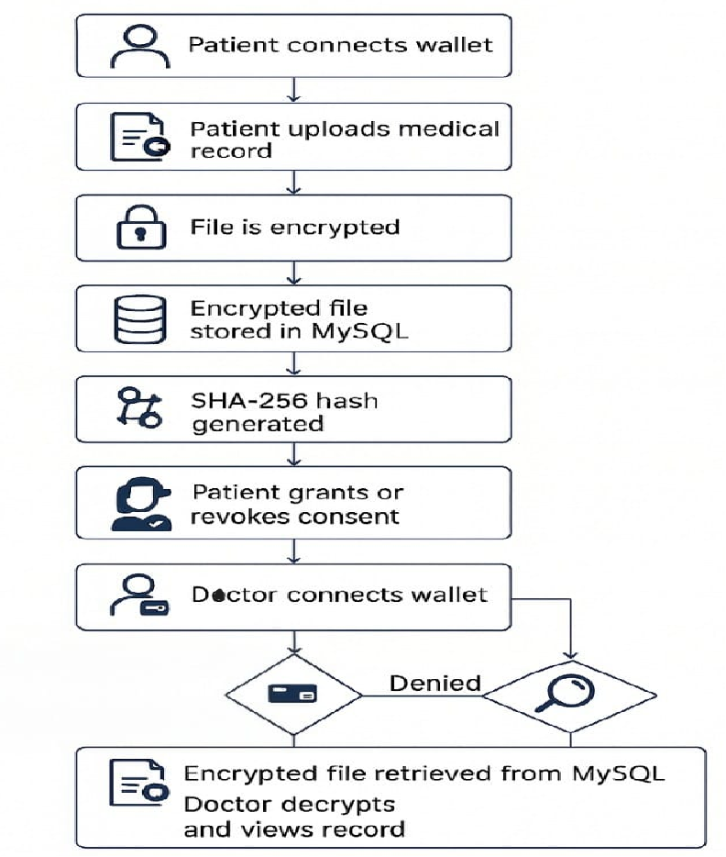
Design Strategy
Project Workflow

Slide 13
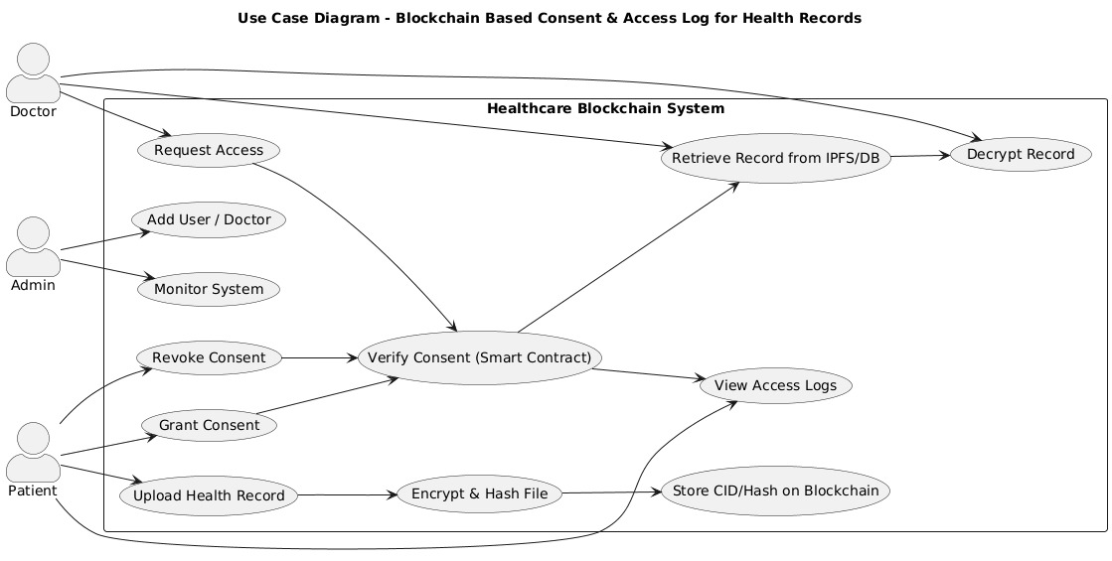
UML DIAGRAMS
Use Case Diagram

Slide 14
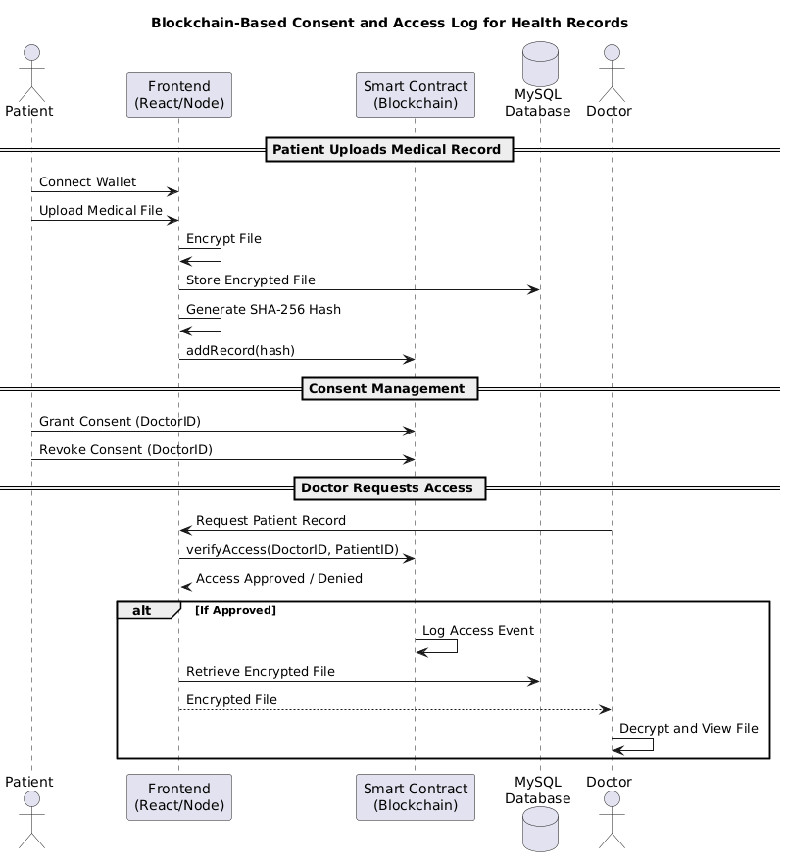
Sequence Diagram

Slide 15
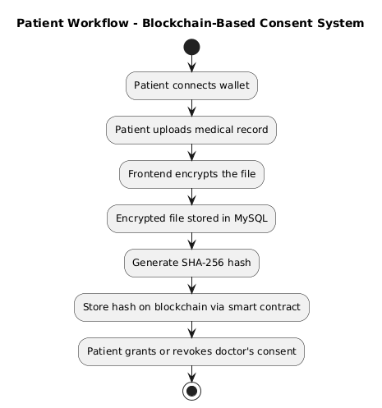
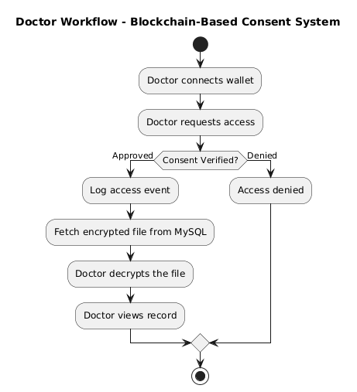
Activity Diagram

Slide 16
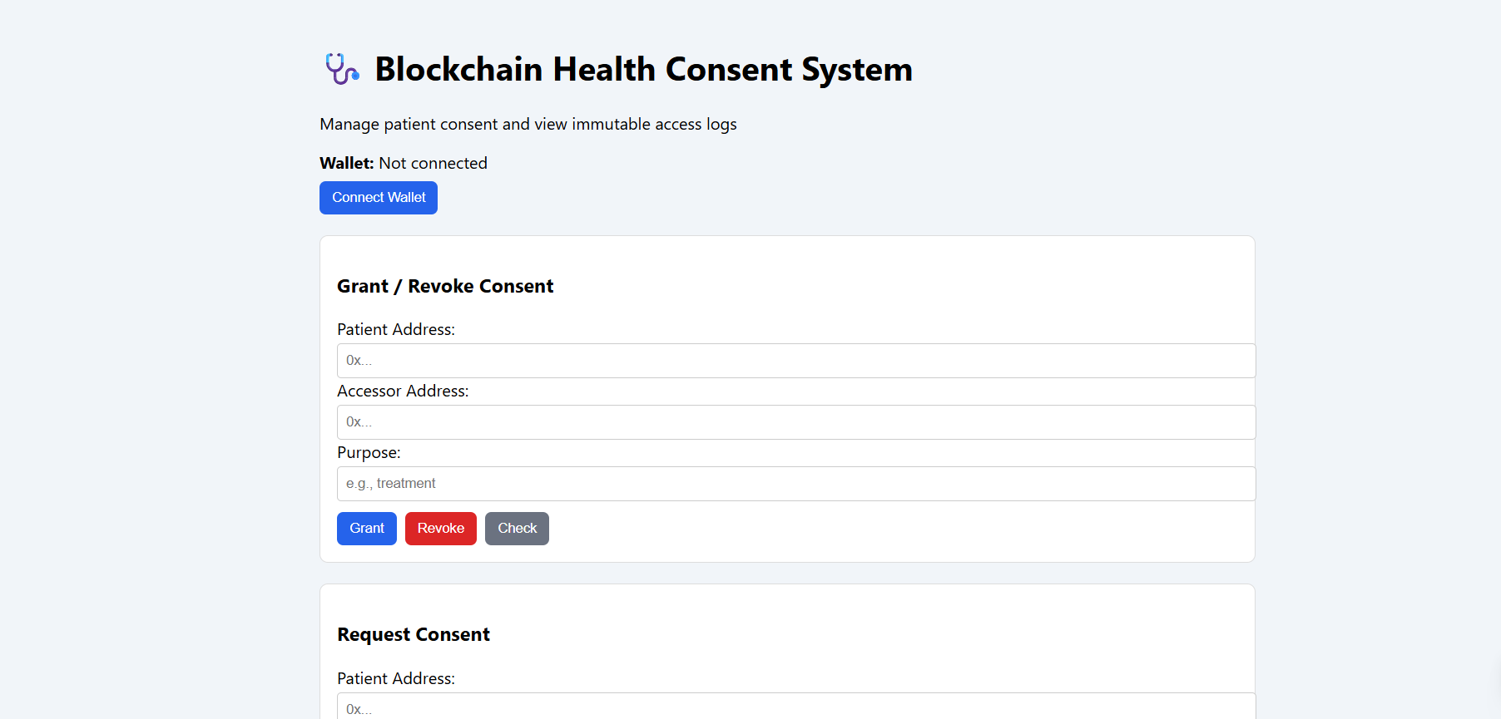
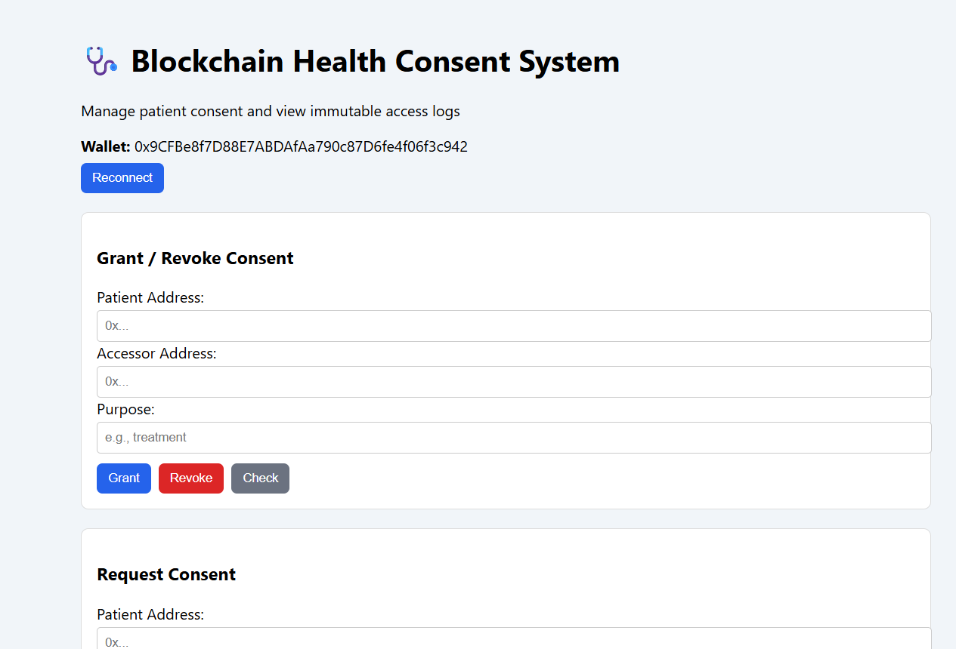
Raw Outcomes

Slide 17
CONTENTS
Recap of Capstone Project Introduction Review-1
  Problem Statement
  Objectives
  Feedback from Guide/Reviewers and actions taken after Review–1
Requirement Analysis
Identification of tools/technology/algorithms
Design Strategy (project workflow/ system design/ DFD/UML design)
Conclusion
References

Slide 18
Conclusion
The project uses blockchain and smart contracts to enable secure and patient-controlled medical record access.
Decentralized storage ensures privacy, transparency, and tamper-proof data handling.
Current progress reflects strong teamwork and solid technical understanding.
The next step is connecting the database with the smart contract to strengthen data security.
The system is expected to improve trust, prevent unauthorized access, and enhance the privacy of healthcare data sharing.

Slide 19
CONTENTS
Recap of Capstone Project Introduction Review-1
  Problem Statement
  Objectives
  Feedback from Guide/Reviewers and actions taken after Review–1
Requirement Analysis
Identification of tools/technology/algorithms
Design Strategy (project workflow/ system design/ DFD/UML design)
Conclusion
References

Slide 20
References
[1] Jakhar, Amit Kumar, et al. "A blockchain-based privacy-preserving and access-control framework for electronic health records management." Multimedia Tools and Applications 83.36 (2024): 84195-84229.
[2] D. Tith et al., “Application of blockchain to maintaining patient records in electronic health record for enhanced privacy, scalability, and availability,” Healthc. Inform. Res., vol. 26, no. 1, pp. 3–12, 2020, doi: 10.4258/hir.2020.26.1.3.
[3] Al Mamun, Abdullah, Sami Azam, and Clementine Gritti. "Blockchain-based electronic health records management: a comprehensive review and future research direction." IEEE Access 10 (2022): 5768-5789.
[4] Marichamy, V. Santhana, and V. Natarajan. "Blockchain based securing medical records in big data analytics." Data & Knowledge Engineering 144 (2023): 102122.

Slide 21
References
[5] Yaqub, Nadeem, et al. "Blockchain enabled policy-based access control mechanism to restrict unauthorized access to electronic health records." PeerJ Computer Science 11 (2025): e2647.
[6] Masood, Isma, et al. "A blockchain-based system for patient data privacy and security." Multimedia Tools and Applications 83.21 (2024): 60443-60467.
[7] Tahir, Noor Ul Ain, et al. "Blockchain-based healthcare records management framework: Enhancing security, privacy, and interoperability." Technologies 12.9 (2024): 168.
[8] Tawfik, Ahmed M., et al. "Blockchain-based access control and privacy preservation in healthcare: a comprehensive survey." Cluster Computing 28.8 (2025): 529.

