Slide 1
TripMind_Agent
CAPSTONE PROJECT
Presented By: Pallavi Ramesh Bansi
Student name :Pallavi Ramesh Bansi
College Name: MIT Academy of Engineering ,Alandi Pune
Department : Electronics & Telecommunication

Slide 2
OUTLINE
Problem Statement
Technology used
Wow factor
End users
Result
Conclusion
Git-hub Link
Future scope
IBM Certifications

Slide 3
Problem Statement
Modern travelers face an overwhelming task — switching between apps and websites to plan every part of their trip. From finding the right destinations to booking stays, tracking weather, and managing last-minute changes, the process is chaotic, time-consuming, and often confusing. Personalization is rare, and real-time updates are scattered.
Proposed Solution:
TripMind_Agent is an intelligent travel planning assistant that brings everything together in one place. Using AI and real-time data, it builds tailored travel itineraries, suggests transport and lodging options, tracks live weather and maps, handles bookings, and updates plans on the go — turning a stressful process into a seamless experience.

Slide 4
Technology used
IBM Watson Assistant – Conversational AI for travel queries
IBM Cloud Services – Hosting and integration
IBM Granite model

Slide 5
IBM cloud services used
IBM Cloud Watsonx AI Studio
IBM Cloud Watsonx AI runtime
IBM Cloud Agent Lab
IBM Granite foundation model

Slide 6
Wow factors
This intelligent travel assistant transforms the way journeys are organized by streamlining the entire itinerary process. It empowers users to plan effectively, stick to their budget, and explore new destinations with confidence through smart, real-time suggestions.
Key Features & Capabilities:
Builds customized travel itineraries based on your budget, trip length, and personal interests
Provides live weather and travel insights to support smarter decisions
Recommends destinations and activities that align with user preferences
Integrates flight and hotel booking options through connected APIs
Tracks and manages travel expenses with precision and cost-saving tips
Enables smooth interactions using natural, multilingual communication for broader accessibility

Slide 7
End users
Individual Travelers
Travel Agencies
Tourism Companies
Corporate Event Planners

Slide 8
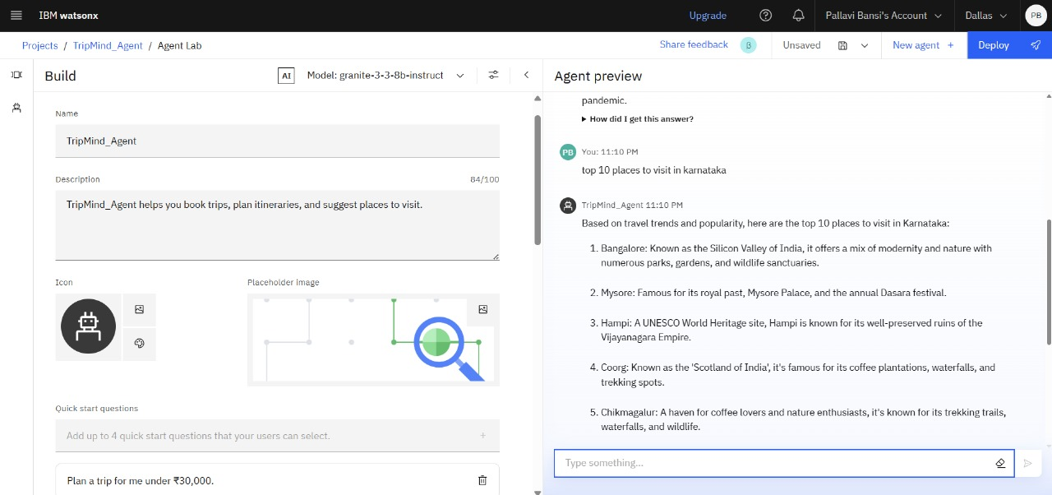
Results

Slide 9
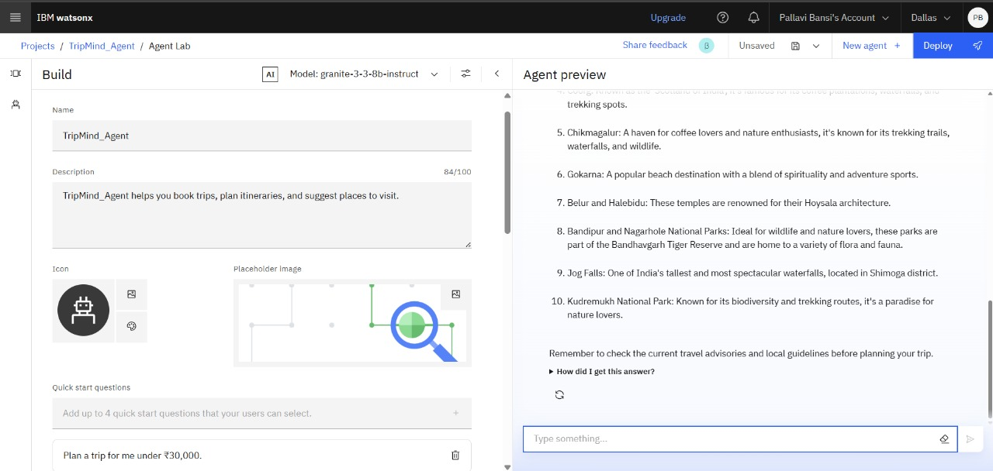
Results

Slide 10
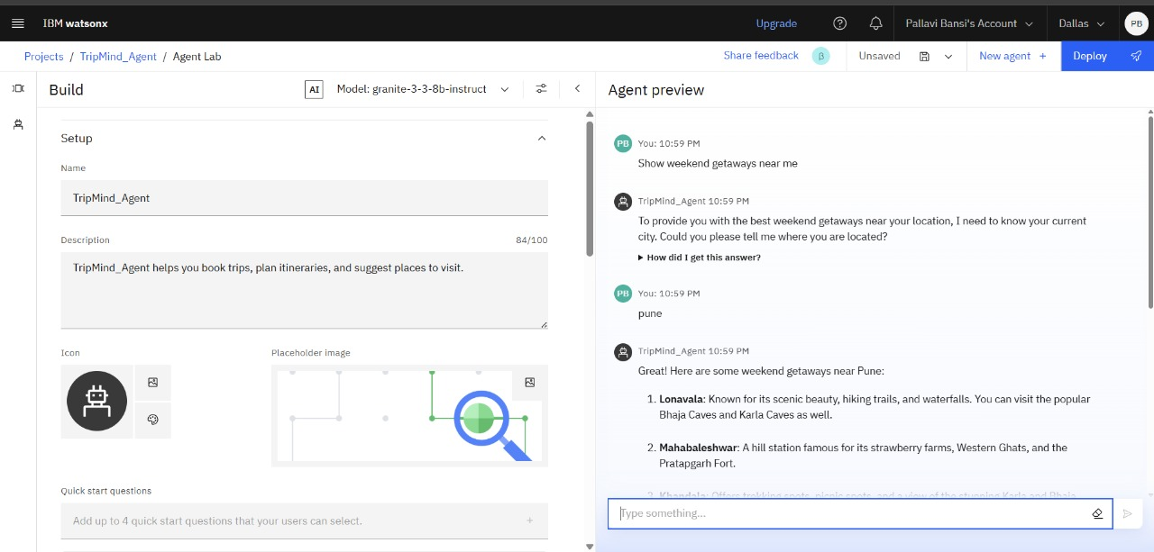
Results

Slide 11
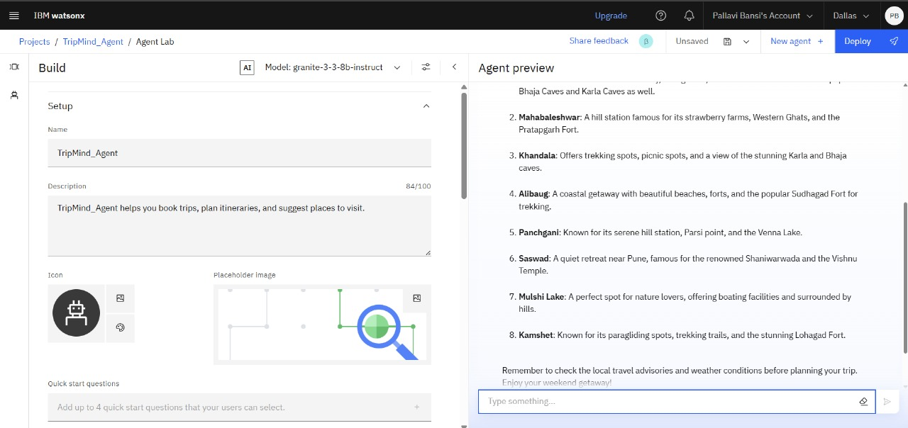
Results

Slide 12
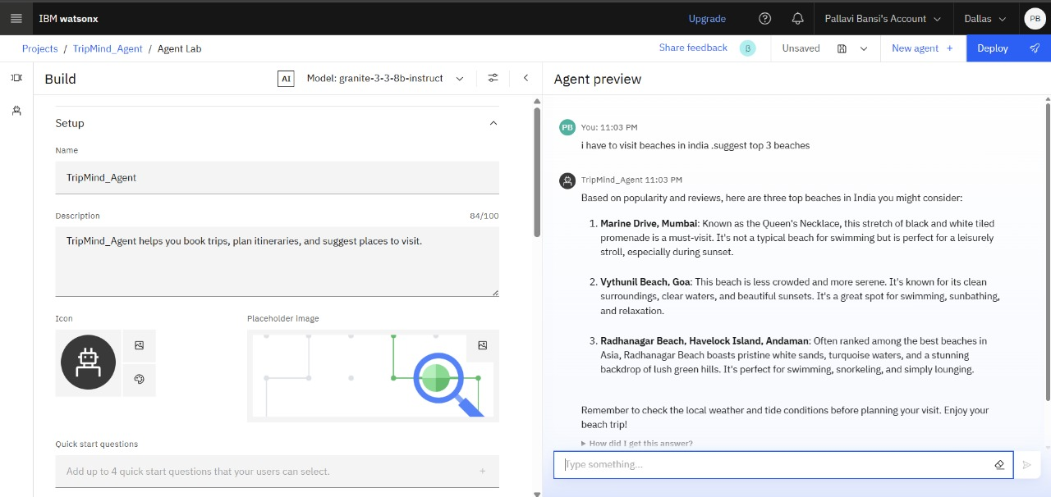
Results

Slide 13
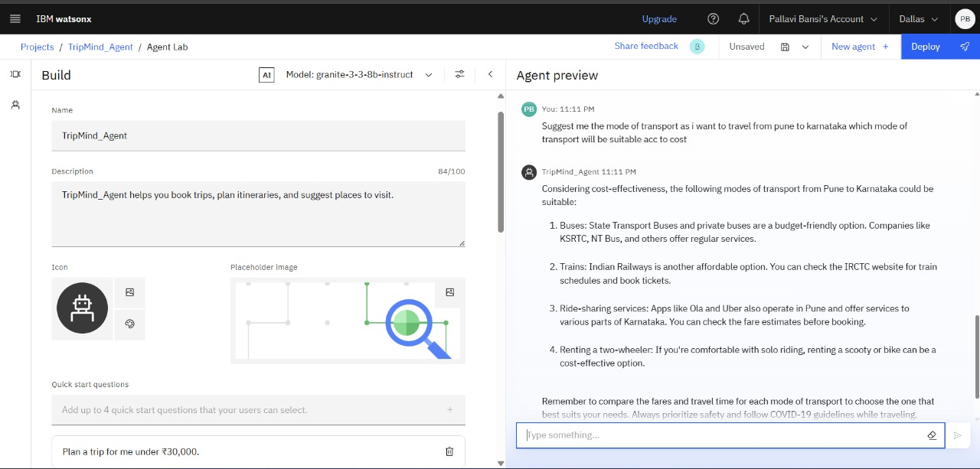
Results

Slide 14
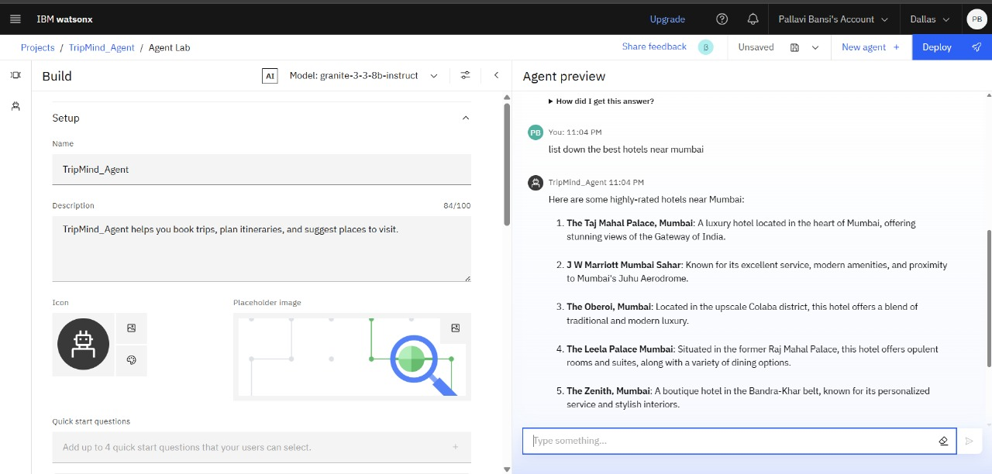
Results

Slide 15
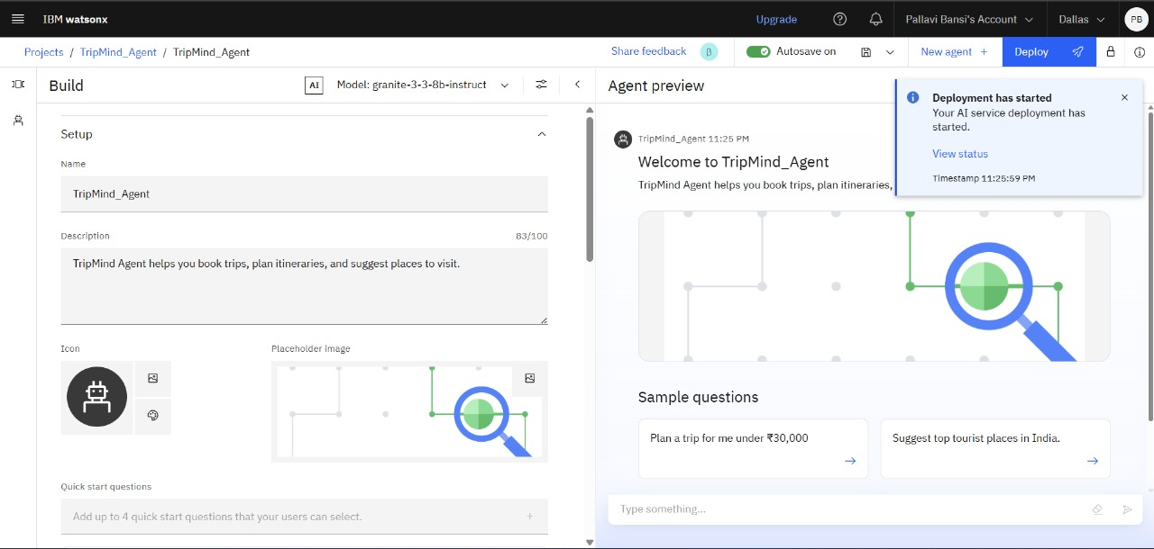
Results

Slide 16
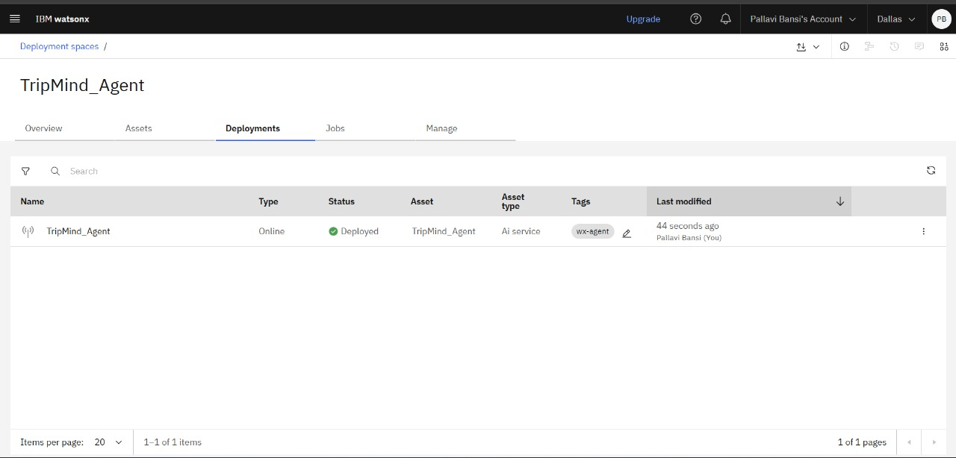
Results
Deployed AI Agent

Slide 17
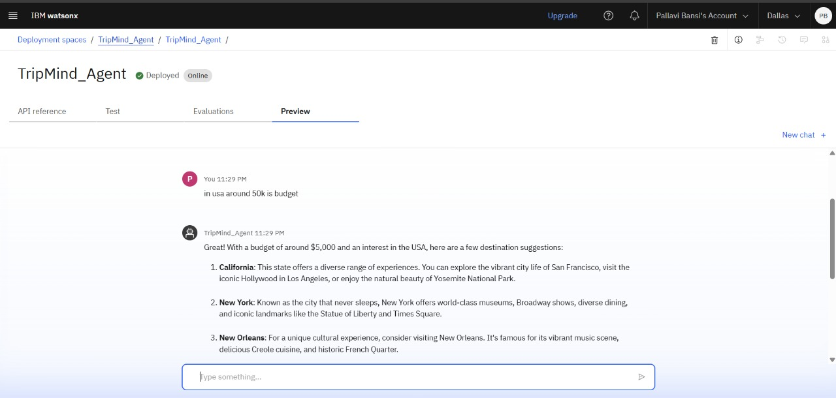
Results
Deployed AI Agent

Slide 18
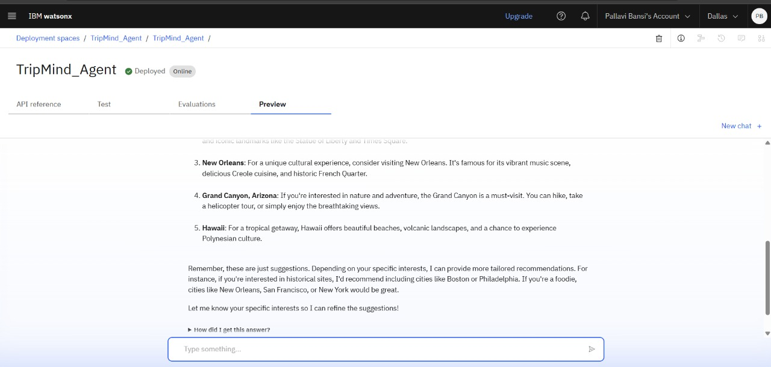
Results
Deployed AI Agent

Slide 19
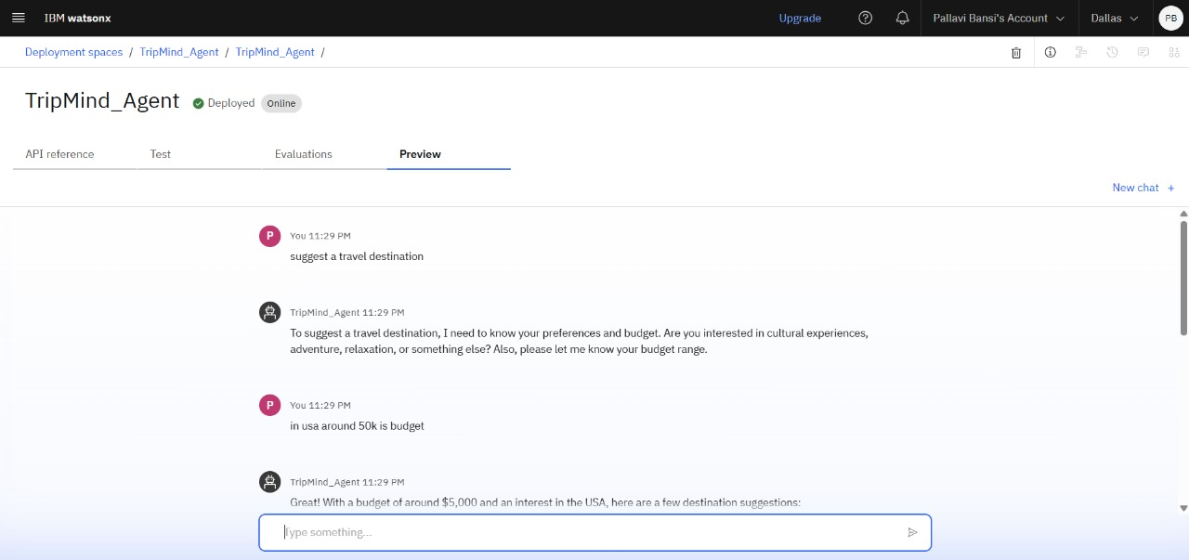
Results
Deployed AI Agent

Slide 20
Results
Deployed AI Agent

Slide 21
Conclusion
TripMind_Agent transforms travel planning by leveraging AI and cloud technologies.
Combines all trip-related tasks into one intelligent and unified platform.
Provides personalized itineraries, real-time travel updates, and smart recommendations
via a conversational interface.
Eliminates the need to use multiple websites or apps during trip planning.
Helps users plan more efficiently, save time, and reduce travel-related stress.
Serves as a valuable solution for individual travelers as well as travel agencies
and professionals.

Slide 22
Future scope
Integration with more travel service providers for diverse booking options
Predictive analytics to anticipate delays and price changes
Support for group trip planning with collaborative features
Sustainable travel suggestions promoting eco-friendly choices
Health and safety alerts for informed travel decisions

Slide 23
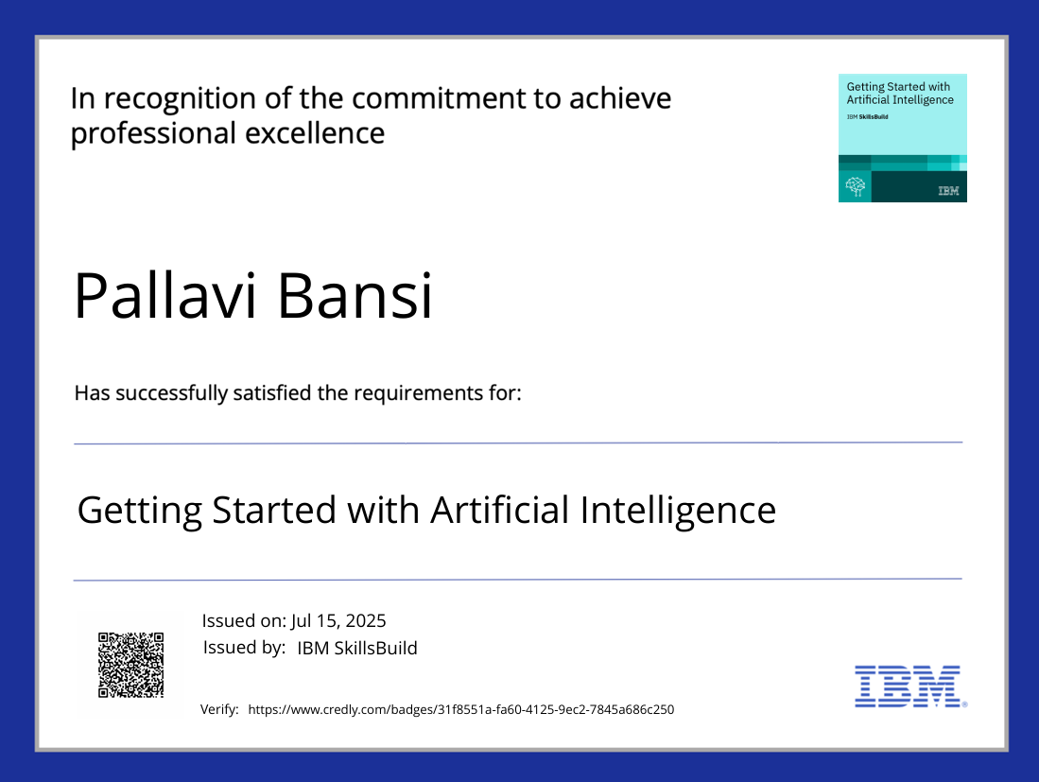
IBM Certifications
Screenshot/ credly certificate( getting started with AI)

Slide 24
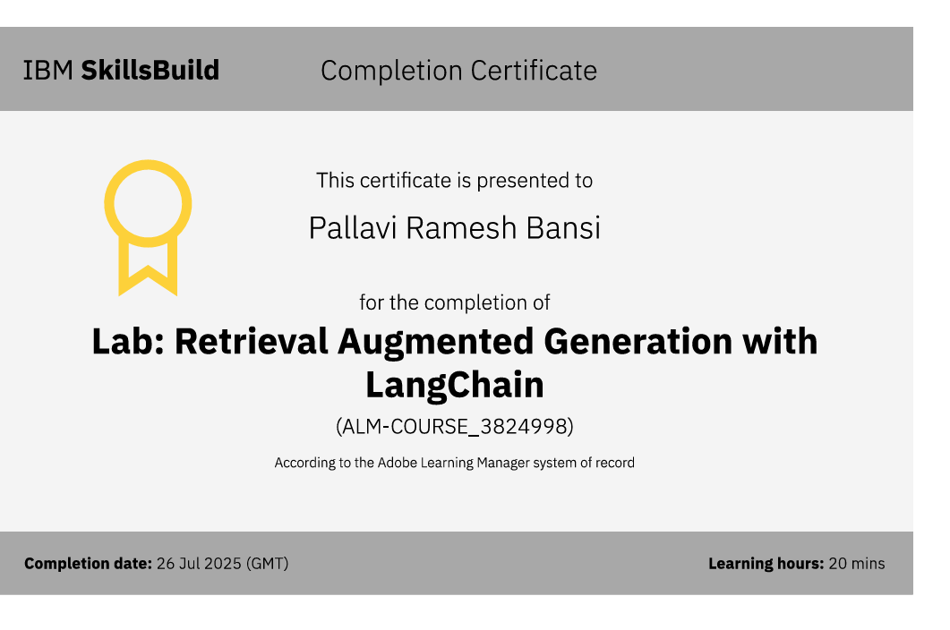
Attach your RAG LAB certificate here

Slide 25
Github Link: https://github.com/PallaviBansi/tripmind_agent_smart_travel-

Slide 26
THANK YOU

