Slide 1
Seismic Simulation
Simulation of aftershock using a wavelet-based description of the time frequency characteristics of a class of earthquake accelerograms and proposes three-parameter models for the modulation of wavelet coefficient envelopes of different frequency bands.

Slide 2
Motivation
The Earth’s crust is floating on the molten metal Mantle.
The crust is made up of parts called as tectonic plates.
When these collide into each other, it causes various types of faults.
Accompanying these collision a tremors that travel the Earth’s surface laterally.
When these tremors are of large magnitude, they perpetuate as Earthquakes.

Slide 3
Motivation
These quakes can wreak havoc, causing large-scale damage life and property.
In contemporary times, we are trying to construct buildings which are Earthquakes.
The design philosophy, can resists earthquakes which are pretty high on the Richter scale.
However the philosophy usually ignores the damage caused by the following aftershocks.

Slide 4
Motivation
This was pretty evident in the case of the destruction of the Basilica of St. Francis in Assisi during the Umbria-Marche earthquake.
The structure which was pretty heavily damaged during the main tremors, was still standing.
However the cumulative effect of the following aftershocks caused the complete annihilation of the building.
So, the drive is to shift our paradigm and consider the effects of aftershock damaged in updated design philosophies.

Slide 5
Abstract
This project considers a wavelet-based description of the time–frequency characteristics of a class of earthquake accelerograms.
It proposes a three-parameter model for the modulation of wavelet coefficient envelopes of different frequency bands.
Estimation of the modulation parameters is attempted through simple scaling models using seismological and site parameters and the data from 1999 Chi-Chi earthquake and its aftershocks.

Slide 6
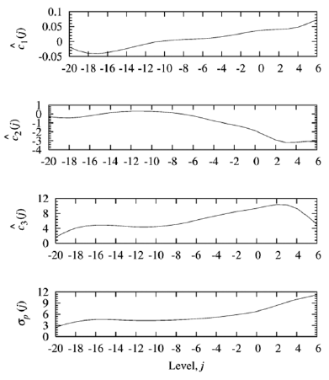
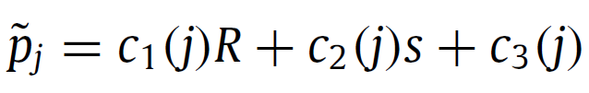
Estimation of Shift Parameter
Using the regression analysis data, the parameters – c₁, c₂, c₃ are extracted, which are used to calculate the value of p_{j}
Here R is the epi-central distance, and s is the local site classification.

Slide 7
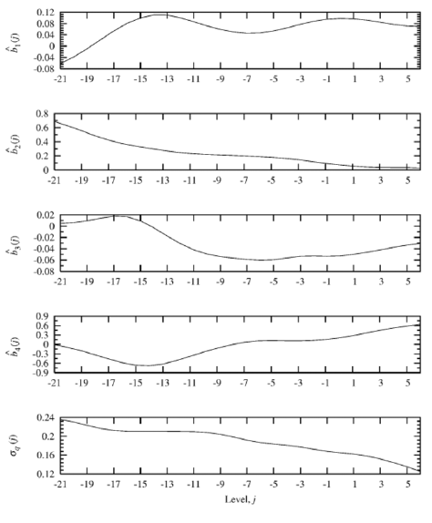
Estimation of Length Parameter
Using the regression analysis data, the parameters – b₁, b₂, b_{3,} b₄ are extracted, which are used to calculate the value of q_{j}
Here M is the local magnitude of the event, R is the epi-central distance, and s is the local site classification.

Slide 8
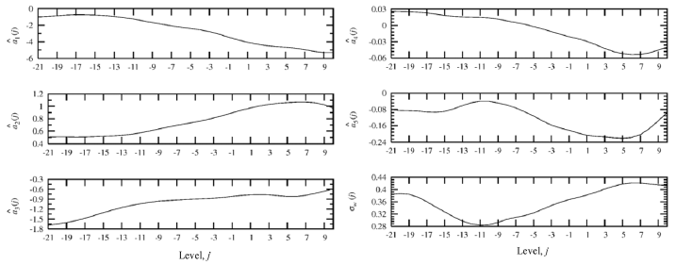
Estimation of Strength Parameter
Using the regression analysis data, the parameters – a₁, a₂, a_{3,} a₄ ,a₅ are extracted, which are used to calculate the value of W_{j.}
Here the M, R, s have the same meaning and h is the focal distance.

Slide 9
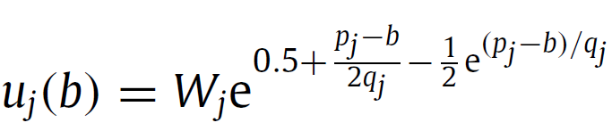
Calculation of Modulating Function
We need to calculate the values of modulating coefficient, u_{j} , using the values of p_{j} and q_{j} with respect to varying b from -20 to 160 at an interval 0.02.

Slide 10
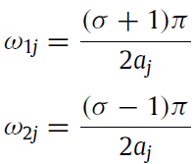
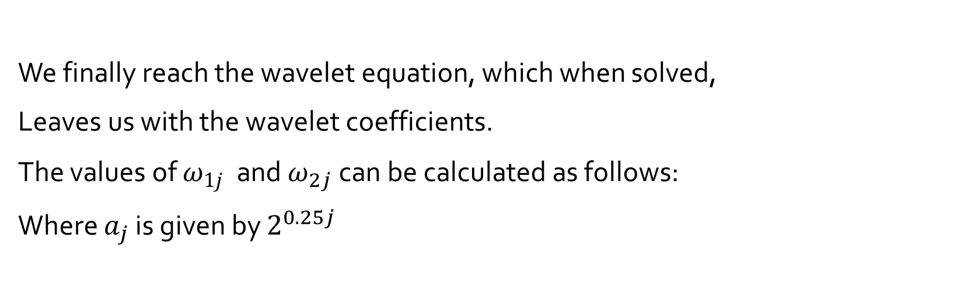
Generating the Wavelet Coefficients
We finally reach the wavelet equation, which when solved,
Leaves us with the wavelet coefficients.
The values of $ω_{1j}$ and $ω_{2j}$ can be calculated as follows:
Where $a_{j}$ is given by $2^{0.25j}$

Slide 11

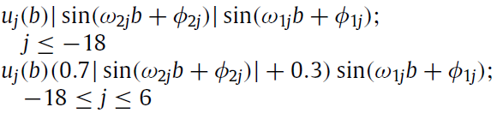

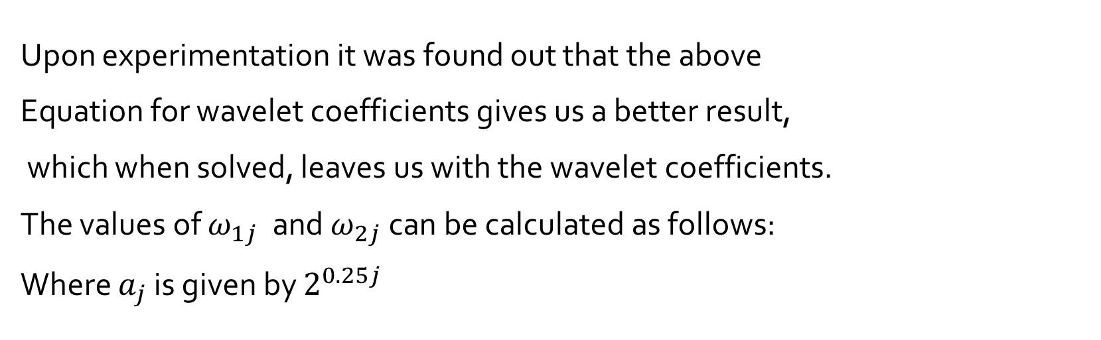
Generating the Wavelet Coefficients
Upon experimentation it was found out that the above
Equation for wavelet coefficients gives us a better result,
which when solved, leaves us with the wavelet coefficients.
The values of $ω_{1j}$ and $ω_{2j}$ can be calculated as follows:
Where $a_{j}$ is given by $2^{0.25j}$

Slide 12
CALCULATION OF PHASE ANGLES
The value of the phase angles is calculated such that one of the peaks of both sin(ω1jb + φ1j) and | sin(ω2jb + φ2j)| coincides with the peak in the idealized uj(b).

Slide 13
VALUE OF j
For levels 7, 8, 9, 10 it is observed that uj(b)/Wj may be approximated as unity. The energy usually available in the component time-histories at these levels is too small for this approximation to significantly affect the decaying nature of the reconstructed accelerogram at both ends.
Therefore for levels, j = 7, 8, 9 and 10, since there is no information about the peaks in uj(b), they are not considered in the calculation.

Slide 14



Fourier and Inverse Fourier Transform of Basis Function
psi(t) = basis function
psihat(t) is the inverse Fourier transform of psi(t)
Value of parameter sigma is 2^{1/4}

Slide 15



Fourier and Inverse Fourier Transform of Basis Function
On discretizing and taking a_{j} (=σ^{j}) and b_{i} = (i −1)(delta)b as the discretized values of a and b, respectively, f (t) can be reconstructed from its wavelet coefficients.
Where K is a constant calculated through experimentation.
Value of (delta)b = 0.02s.

Slide 16
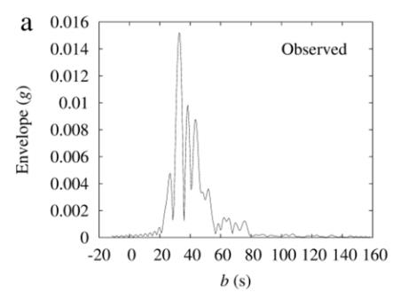
Estimation of the Wavelet Coefficients
Observed envelope of the wavelet coefficients for level j = −7

Slide 17
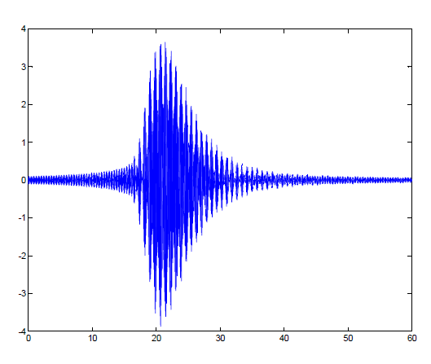
Generated Accelograms
CASE 1-
M = 7
h = 10 km,
s = 0
R = 10 km

Slide 18
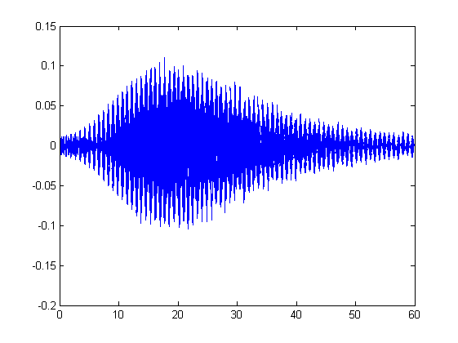
Generated Accelerograms
CASE 2-
M = 7
h = 10 km
s = 0
R = 100 km

Slide 19
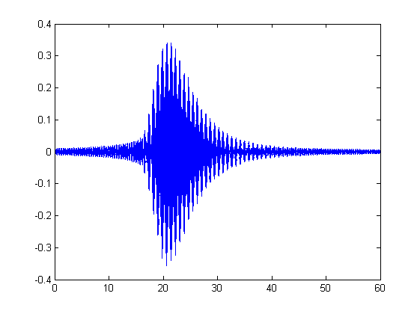
Generated Accelerograms
CASE 3-
M = 5
h = 10 km
s = 0
R = 10 km

Slide 20
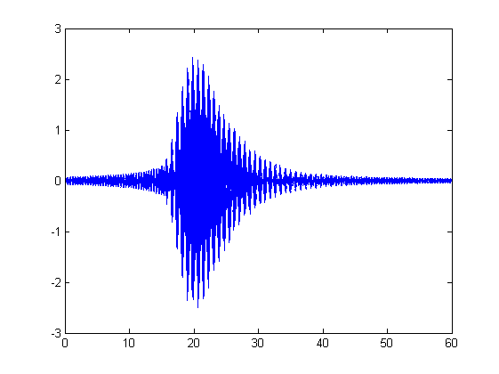
Generated Accelerograms
CASE 4-
M = 7
h = 10 km
s = 2
R = 10 km

Slide 21
Thank you!

