Slide 1
Credit Card Users Churn Prediction Project
Advanced Machine Learning

Slide 2
Contents / Agenda
Executive Summary
Business Problem Overview and Solution Approach
EDA Results
Data Preprocessing
Model performance summary for hyperparameter tuning.
Appendix

Slide 3
Executive Summary
Total Transaction Count, Total Revolving Balance, Total Transaction Amount, and Total Relationship Count are the key characteristics of the customers that have a huge impact on attrition
Having low transactions is a key factor in the attrition of a customer. The bank should provide fee waivers, discounts, cashback offers, increasing credit limit etc. to engage the customers and motivate them to use their cards.
Customers who are invested in 1 to 2 products account for almost 55% of the customers. Bank should get feedback from the customers regularly to identify the root cause of attrition in relation to those products.
Customers who pay their balances back regularly and on time attrite more than others. Bank should get feedback from these customers and provide discounts and other benefits to these customers to motivate them to continue to stay with the bank.
Married and Female customers should be targeted by the bank to market their products as these were among the highest number of credit card users.

Slide 4
Business Problem Overview
Thera bank has seen a sharp decline in the number of credit card customers. Since credit cards are good source of income for the banks, Thera bank wants to analyze and identify the potential customers who are most likely to discontinue the usage of their credit card services and their reasons for doing so.
The goal is to predict which customers are likely to churn in the near future along with the reasons for them renouncing the bank’s services. This will help the bank improve its services based on the identified issues.

Slide 5
Solution Approach
The solution that will help bank improve its services so that customers do not renounce their credit cards would include -
Exploring and visualizing the bank’s dataset.
Building a classification model to predict if the customer is going to churn or not
Optimizing the model using appropriate techniques
Generating a set of insights and recommendations that will help the bank to figure out the factors driving attritions

Slide 6
EDA Results
There are 10127 rows and 21 columns
All columns except 6 are numerical columns, Attrition_Flag, Gender, Education_Level, Marital Status, Income_Category, Card_Category have object data type
Income Category has 10127 values with the majority value of "Less than 40k"
Card Category has 10127 values with the majority value of "Blue"
Attrition Flag has 10127 values with the majority value of "Existing Customer"
Gender has 10127 values with the majority value of "F"
Education Level has 8608 values with majority of"Graduate". Null values were found and will be imputed to avoid data leakage
Marital Status has 9369 values with majority value of "Married". Null values were found and will be imputed to avoid data leakage

Slide 7
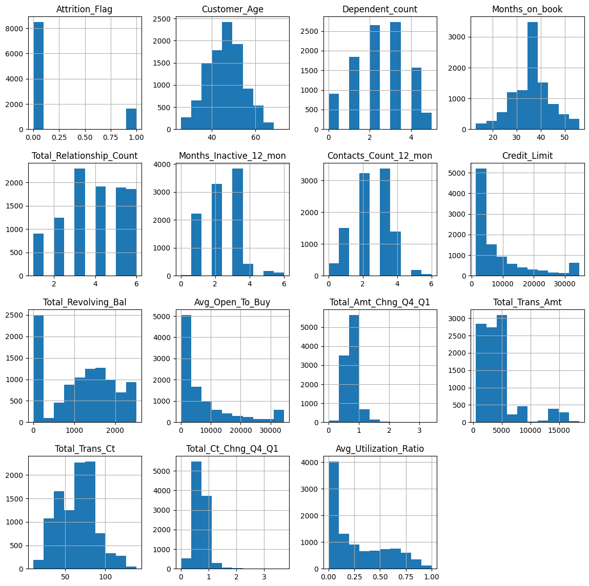
EDA Results - Univariate Analysis
Customer Age: It is normally distributed with the mean of 46 years
Dependent Count: Majority of the customers have 2 to 3 dependents
Months on book: It is normally distributed with a very high frequency of the mode of 36
Total Relationship Count: Customers who avail 4 or 5 products have the same count
Months Inactive 12 months: Few customers were inactive for more than 3 months
Contacts Count 12 months: Majority of the customers contacted the bank more than 4 times
Credit Limit: Quite a few customers with a maximum limit of $35000
Total Revolving Balance: Majority of the customers paid their balance every month
Avg Open to buy: Most customers used a large amount of their limit
Total Amount Change Q4 Q1: Data is slightly right skewed
Total Trans Amt: Data is right skewed with few customers between $10000 and $15000
Total Trans Count: Majority of the transactions are between 40 and 80
Total Count Change Q4 Q1: Data is slightly right skewed
Avg Utilization Ratio: Most customers don't use their credit amount

Slide 8
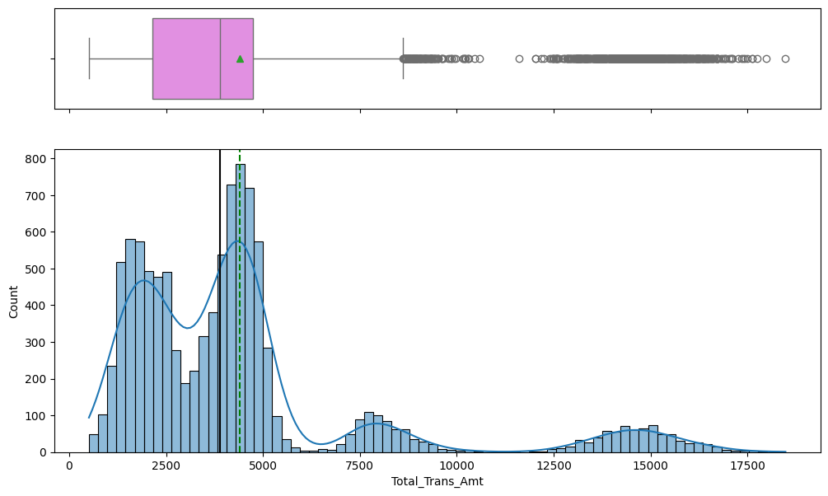
EDA Results - Multivariate Analysis - Total Transaction Amount
Total revolving balance data is right skewed
Majority of the transaction amounts are around the 2 peaks seen at approx. $2000 and $4500

Slide 9
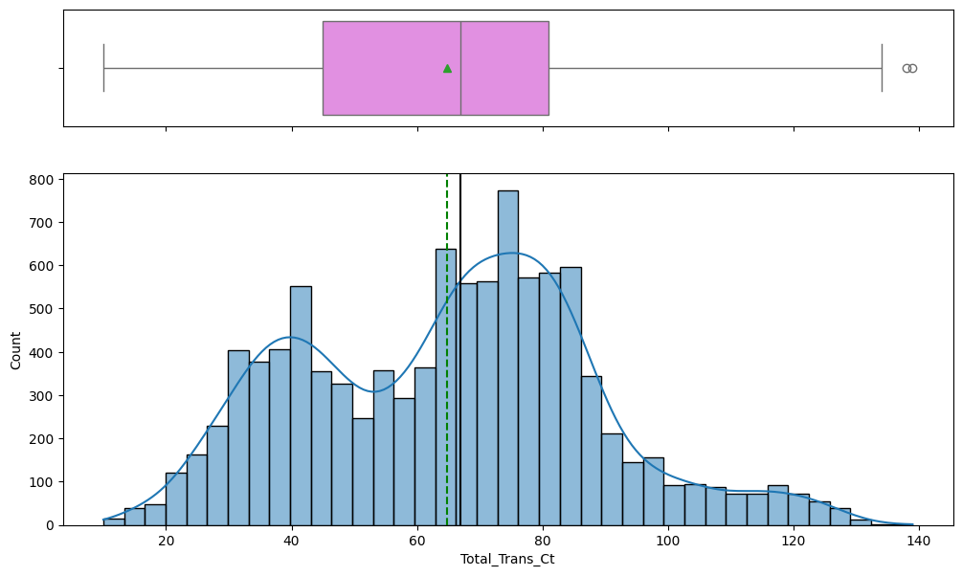
EDA Results - Multivariate Analysis - Total Transaction Count
Total revolving balance data is right skewed
The data distribution shows 2 peaks at 40 and 80 transaction counts

Slide 10
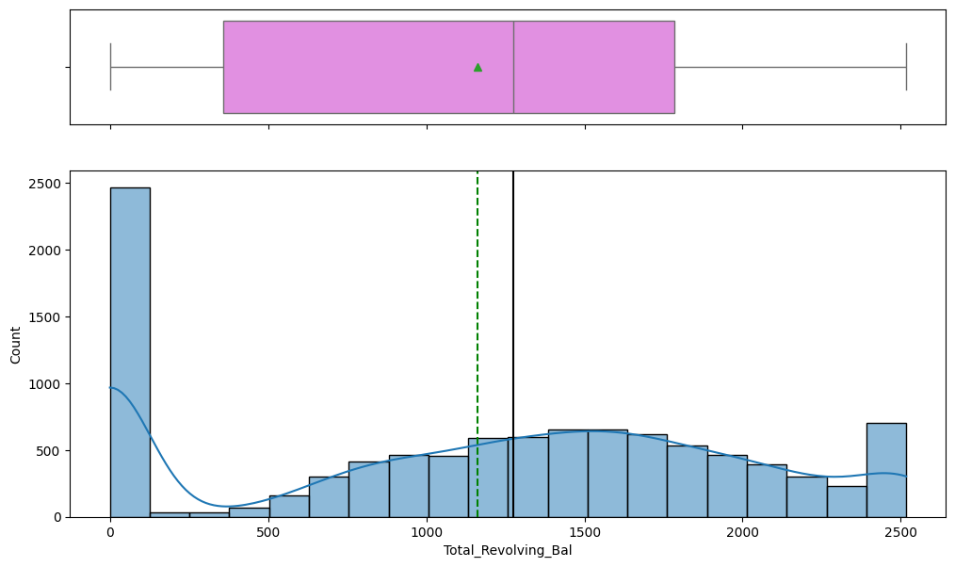
EDA Results - Univariate Analysis - Total Revolving Balance
Total revolving balance data is slightly left skewed
A large number of customers have balance near zero, meaning they pay off their balance every month

Slide 11
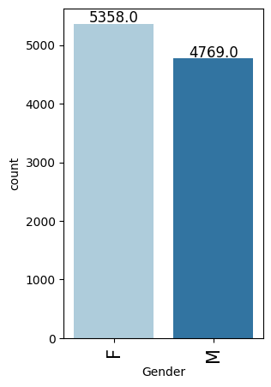
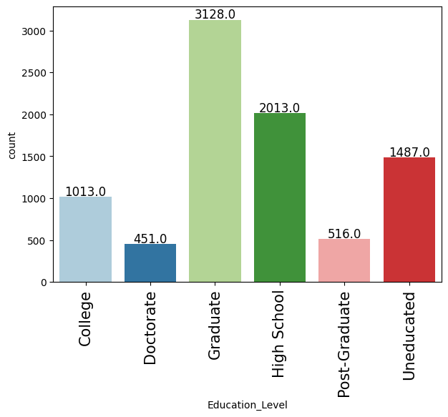
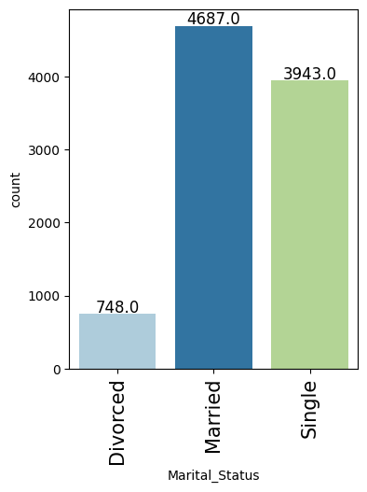
EDA Results - Categorical Data
There are slightly more female customers than male customers
Around 30.9% of the customers are graduates followed by high school graduates and uneducated customers
Majority of the customers are married or single, very few are divorced

Slide 12
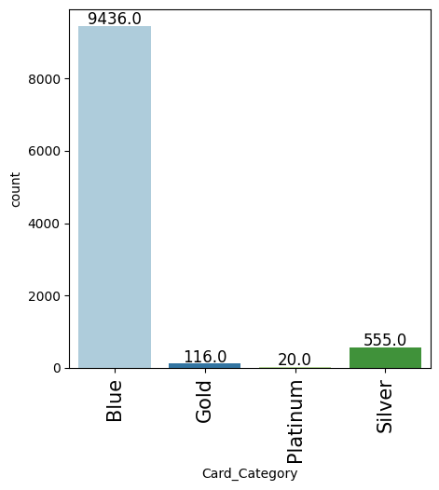
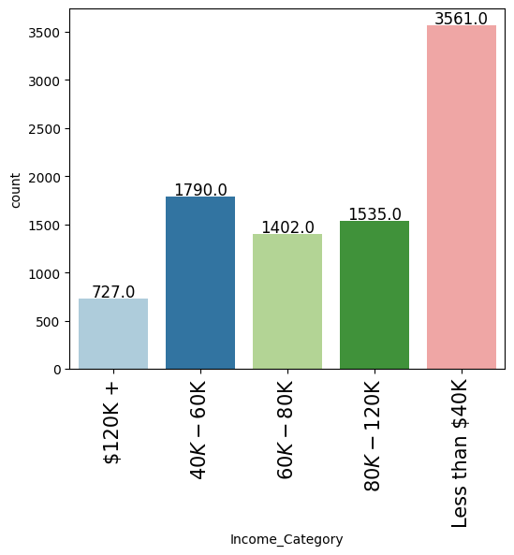
EDA Results - Categorical Data
Majority of the customers have Blue card type
Majority of the customers earn less than $40,000

Slide 13
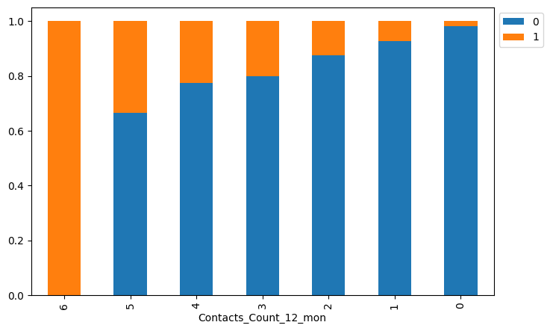
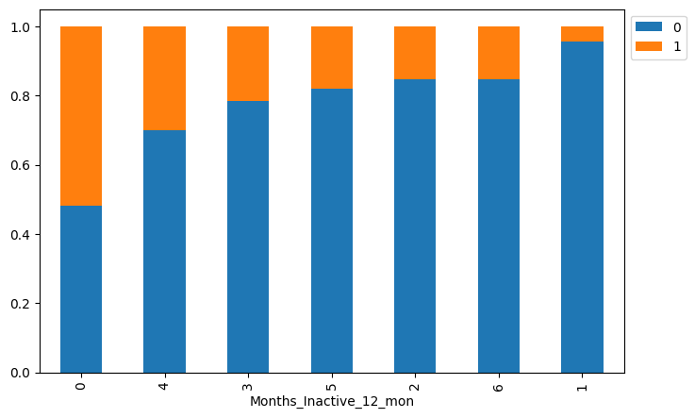
EDA Results - Bivariate Analysis - Attrition Indicators
Customers who contacted the bank the most and also in the recent past (less than 6 months) also dropped their cards
An increase in inactivity shows increase in attrited customers

Slide 14
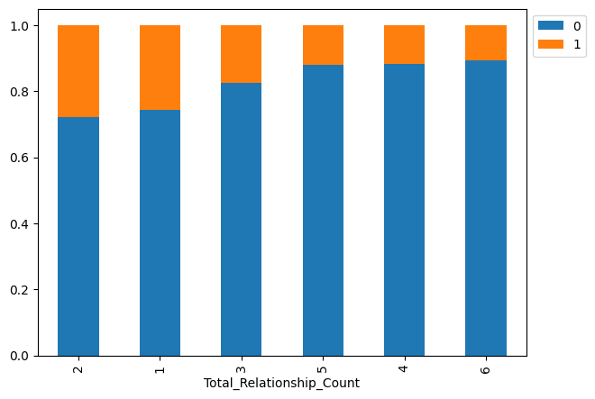
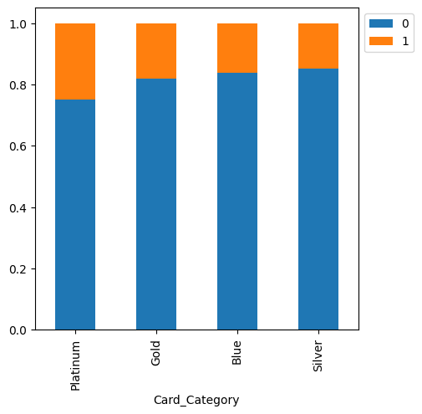
EDA Results - Bivariate Analysis - Attrition Indicators
Number of products a customer has does not seem to have a huge impact on attrition
Platinum card holders attrited a little more than other card categories

Slide 15
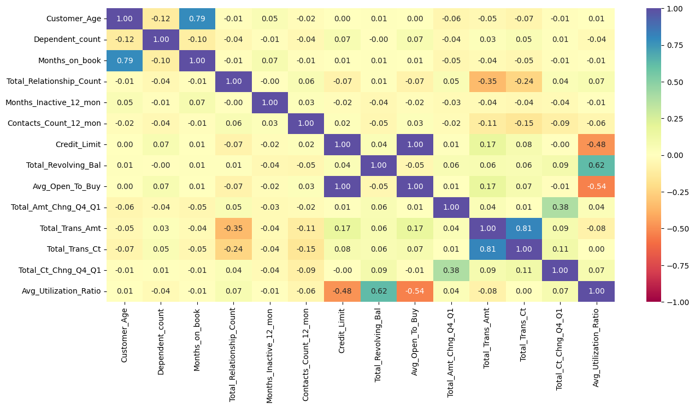
EDA Results - Heatmap
There is strong positive correlation between months on the book and Customer Age, Total Revolving Balance and Avg Utilization ratio, Total Transaction Amount and Total Transaction Count
There is negative correlation between Credit Limit and Avg Utilization Ratio, Total Transaction Amount and Total Relationship Count and Avg Open to Buy and Avg Utilization Ratio

Slide 16
Data Preprocessing
All columns except Attrition_Flag, Gender, Education_Level, Marital_Status, Income_Category, Card_Category have object data type and will be treated as categorical values and encoded
Income Category has a value of ‘abc’, which will be treated as null and imputed after splitting the data
1519 Education_Level column values and 749 Marital_Status column values are null, which will be imputed after splitting data
Outliers are present but will not be treated and will be included in the analysis
There are no duplicate values
Data will be split into train set, validation set and test set
The data is highly imbalance, with around 84% of the entries as not attrited and remaining as attrited. Undersampling and oversampling techniques will be used to balance the data

Slide 17
Model Performance Summary
XGBoost, Gradient Boost and AdaBoost are the 3 models that have performed well with undersampled data
The models were tuned with both original and undersampled data to avoid overfitting
Gradient Boost with original data performed better overall compared to XGBoost and AdaBoost
Metrics | XGBoost trained with Undersampled data | XGBoost trained with Original data | Gradient boosting trained with Undersampled data | Gradient boosting trained with Original data | AdaBoost trained with Undersampled data | AdaBoost trained with Original data
Accuracy | 0.818 | 0.930 | 0.947 | 0.947 | 0.935 | 0.969
Recall | 0.988 | 0.960 | 0.954 | 0.954 | 0.963 | 0.871
Precision | 0.469 | 0.710 | 0.770 | 0.770 | 0.725 | 0.934
F1 | 0.636 | 0.816 | 0.852 | 0.852 | 0.827 | 0.902

Slide 18
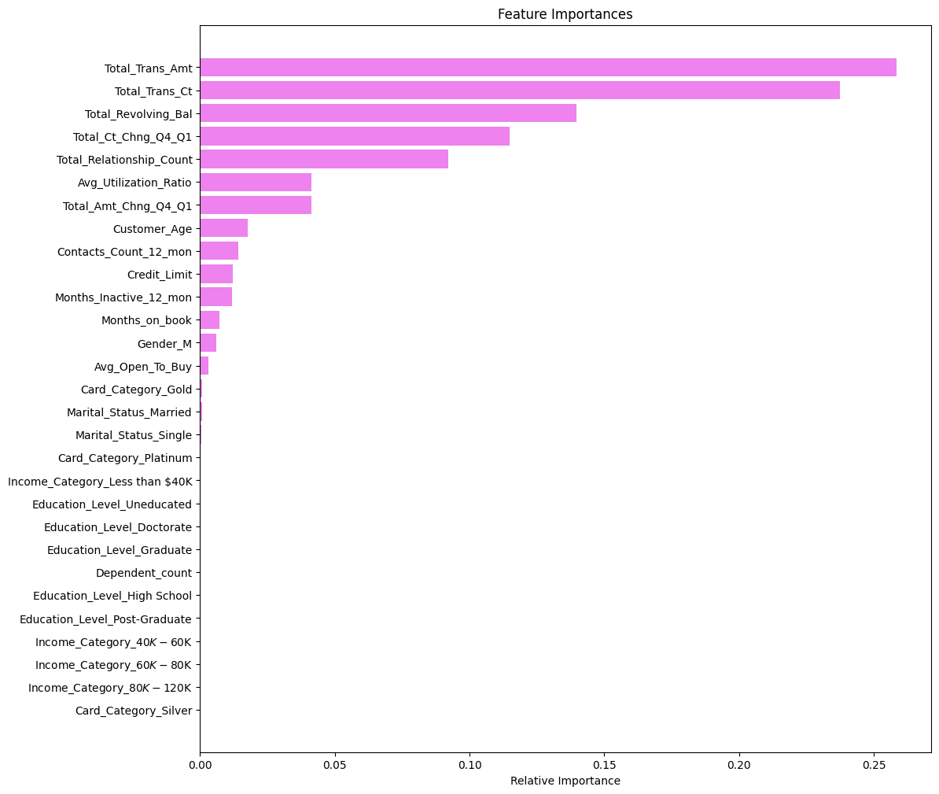
Feature Importances
Total_Trans_Amt is the most important characteristic in predicting the customer who will attrite followed by Total Revolving Balance, Total Transaction Count, Total Relationship Count, and Total Count Change Q4 Q1

Slide 19
APPENDIX

Slide 20
Model Performance Summary (original data)
XG Boost has better performance than AdaBoost and XGBoost models,
Metrics | Training Set Recall Score | Validation Set Recall Score
Bagging | 0.985655737704918 | 0.8128834355828221
Random Forest | 1.0 | 0.7975460122699386
Ada Boost | 0.826844262295082 | 0.852760736196319
Gradient Boost | 0.875 | 0.8558282208588958
XG Boost | 1.0 | 0.8834355828220859

Slide 21
Model Performance Summary (oversampled data)
SMOTE technique was used to generate oversampled data
Adaboost has the best performance on validation followed by XGB
Metrics | Training Set Recall Score | Validation Set Recall Score
Bagging | 0.9974504804863699 | 0.8496932515337423
Random Forest | 1.0 | 0.8680981595092024
Ada Boost | 0.9690135320651108 | 0.901840490797546
Gradient Boost | 0.980976662090606 | 0.8926380368098159
XG Boost | 1.0 | 0.8987730061349694

Slide 22
Model Performance Summary (undersampled data)
AdaBoost model has the best performance followed by XgBoost model
Metrics | Training Set Recall Score | Validation Set Recall Score
Bagging | 0.9907786885245902 | 0.9294478527607362
Random Forest | 1.0 | 0.9386503067484663
Ada Boost | 0.9528688524590164 | 0.9601226993865031
Gradient Boost | 0.9805327868852459 | 0.9570552147239264
XG Boost | 1.0 | 0.9570552147239264

