Slide 1
Plant Seedling Image Identification using CNN
Computer Vision
11/11/2024

Slide 2
Contents / Agenda
Executive Summary
Business Problem Overview and Solution Approach
EDA Results
Data Preprocessing
Model Performance Summary
Conclusion
Appendix

Slide 3
Executive Summary
With the input of small images and imbalanced data, the final model with accuracy of 72.63%, produced fairly good results. If this satisfies the requirement, the company can use it to classify different images taken to reduce manual labor
In order to further improve the performance and prediction of the model, the following options can be explored -
Providing a confidence score along with the prediction will be helpful in making decisions
Using a pretrained model or another model architecture can be explored to improve the accuracy

Slide 4
Business Problem Overview and Solution Approach
Problem Statement
Agricultural processes are manual labor-intensive
Plant and weed identification is very time consuming
There have been limited technological advancements
Opportunity
$1 trillion+ industry ripe for innovation
AI and Deep Learning can transform agriculture
Benefits
Reduce manual labor and enhance efficiency
Improve crop yield
Promotes sustainable environmental practices

Slide 5
Business Problem Overview and Solution Approach
Solution Approach
Develop a Convolutional Neural Network (CNN) model to classify plant seedlings into 12 categories
Performing exploratory data analysis by means of Python visualization to understand the gaps in the data set
Pre-processing the data to improve overall performance of the classification model
Using Convolutional Neural Networks as means of classification, training the model and improving performance and reduce overfitting using data augmentation techniques
Use the trained model to derive actionable insights for informed decision making
Explore options to improve performance and accuracy of the model

Slide 6
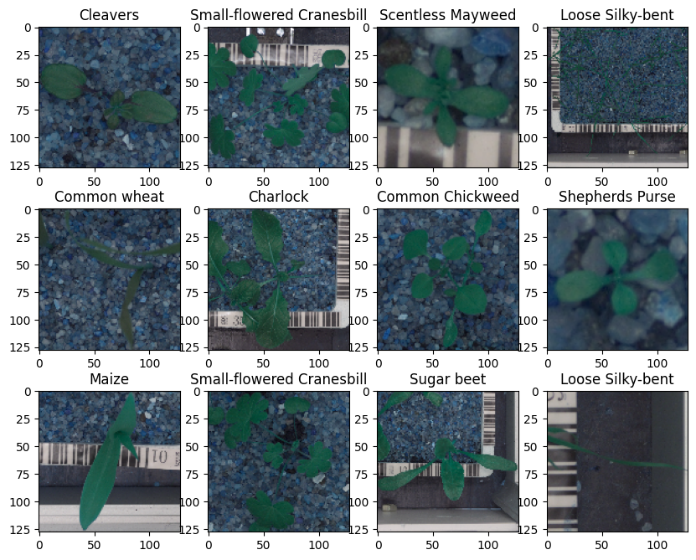
EDA Results
There are 12 types of plant seedling, 'Black-grass', 'Charlock', 'Cleavers', 'Common Chickweed', 'Common wheat', 'Fat Hen', 'Loose Silky-bent', 'Maize', 'Scentless Mayweed', 'Shepherds Purse', 'Small-flowered Cranesbill', 'Sugar beet'.
There are a total of f 4750 plant image, and each image is of shape 128 X 128
As the number of channels is 3, images are in RGB (Red, Blue, Green)

Slide 7
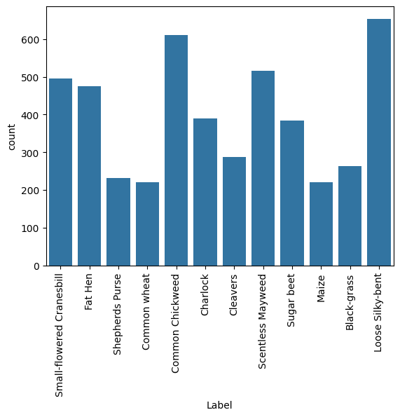
EDA Results
The highest number of samples are of plant type "Loose Silky bent" compared to other plant types
“Common Wheat", "Maize" have the lowest count of samples

Slide 8
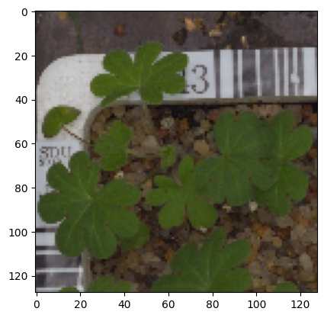
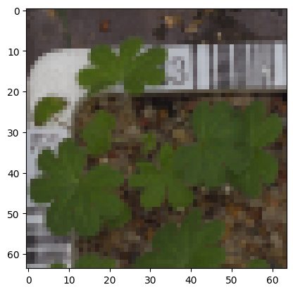
Data Preprocessing
Converted BGR images to RGB format
The images were resized from 128 to 64 in order to reduce computational costs
Dataset is split into 3 parts, train (80%), validation (10%) and test (10%) datasets
All plant labels are encoded using lableBinarizer
Data is normalized using scaling technique to modify the pixel value range of 0 to 255 to a 0 to 1 range, by dividing it by 255
Before resizing
After resizing

Slide 9
Model Performance Summary
The classifier used is a CNN (Convolutional Neural Network) model which is most commonly used for image processing, including classification
Performance improvements were made to reduce loss and data augmentation techniques
The improved model performed better than the base model. It has nearly 12% higher accuracy value, and a lower loss value, hence this can be used for plant seedling identification
Model | Accuracy | Loss | Precision (wtd. avg.) | Recall (wtd. avg.) | F1-Score (wtd. avg.)
Base Model (CNN) | 0.6189 | 1.1928 | 0.62 | 0.62 | 0.57
Improved Model (CNN + Data Augmentation & loss reduction) | 0.7263 | 0.8738 | 0.72 | 0.73 | 0.71

Slide 10
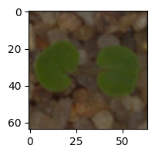
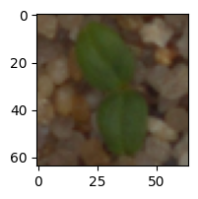
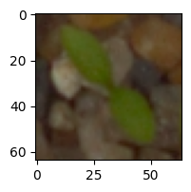
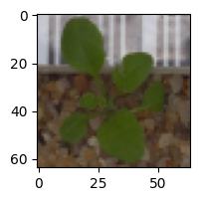



Model Performance Summary
Final Prediction for some input images were correctly predicted as shown below
However the model has a high loss value

Slide 11
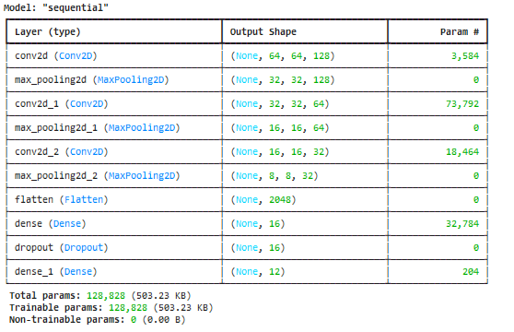
Model Performance Summary - Base Model
The classifier used is a CNN (Convolutional Neural Network) model which is most commonly used for image processing, including classification.
A base sequential model with stacked layers consisting of three sets of Conv and Maxpool layers, followed by flattening, dropout and output layers is built and trained with the training dataset
The last layer has 12 outputs for 12 categories of plant types

Slide 12
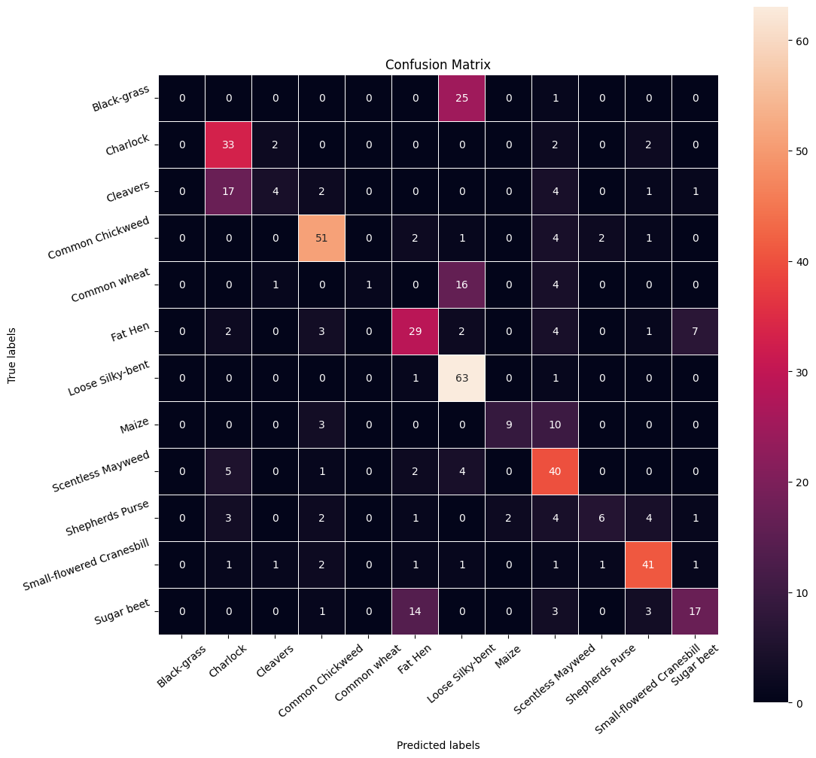
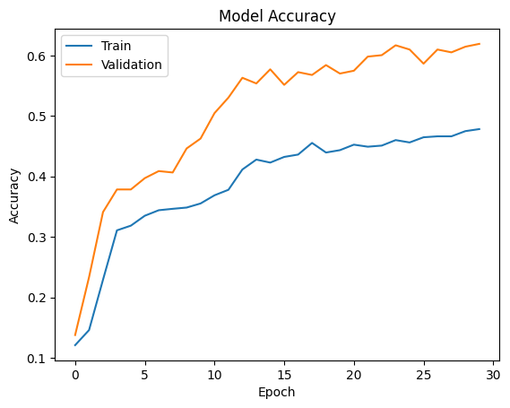
Model Performance Summary - Base Model
Model accuracy plot shows that both training and validation values are close
The confusion matrix shows some incorrect predictions for Fat Hen. Loosely-Silky Bent
Model evaluation was done using accuracy as it is most used metric for classification
The base model has an accuracy of 0.6189 and loss of 1.1928 on test data

Slide 13
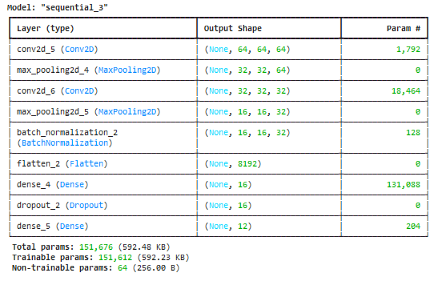
Model Performance Summary - Improved Model
The base model’s performance was improved by
Reducing learning rate by using ReduceLRonPlateau function
Data augmentation was applied by generating new images, and rotation of images
This improved model has an increased accuracy of 0.6779 with a reduced loss of 1.0513 on test data

Slide 14
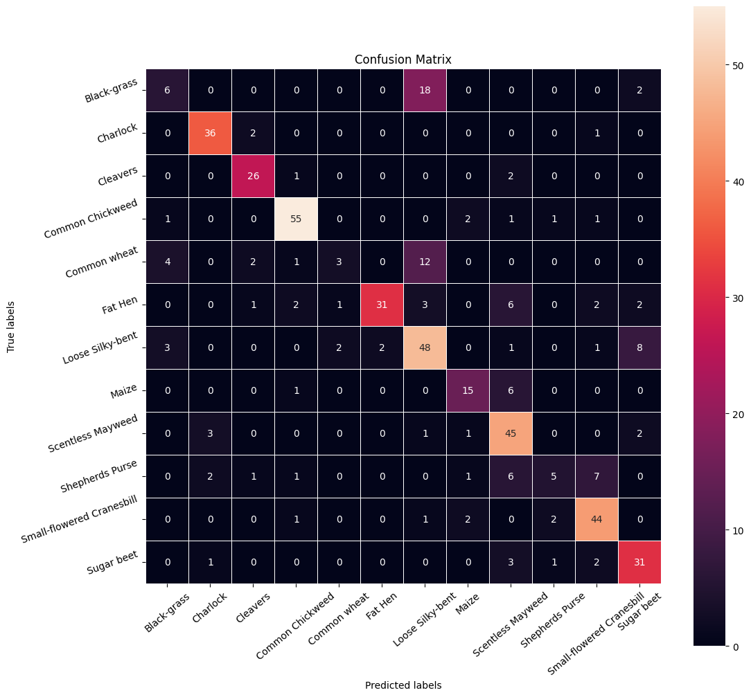
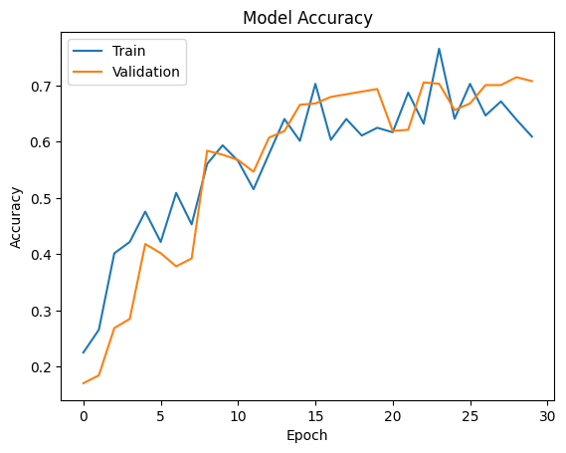
Model Performance Summary - Improved Model
The model performances better than base model on train and validation datasets
The confusion matrix shows improvement in predictions made with fewer false positives
The improved model has an accuracy of 0.7263 and loss of 0.8738 on test data

Slide 15
Conclusion
Using CNN-model to predict the class of a plant, which works well for image classification
CNN with Batch Normalization, Maxpooling, Flattening, Dropouts and Dense layers is a good combination for image classification
Model performance can be enhanced using loss reduction and data augmentation techniques

Slide 16
APPENDIX

Slide 17
Data Background and Contents
CNN model was chosen as it is extremely effective for image classifications
The dataset was divided into three parts such as training (80%) and validation (10%) and test (10%) sets
The data was pre-processed using -
Data normalization, Image resizing, Label encoding, Converting from BGR to RGB format
Model performance was improved using -
Image augmentation, loss reduction, adding dropout layer to reduce overfitting
The model was evaluated by comparing training and validation performances using -
Classification Report
Confusion Matrix

