Slide 1
Personal Loan Campaign
Machine Learning
8/11/2024

Slide 2
Contents / Agenda
Executive Summary
Business Problem Overview and Solution Approach
EDA Results
Data Preprocessing
Model Performance Summary
Appendix

Slide 3
Executive Summary
Personal Loan campaign data was analyzed and Decision Tree Classifier model was used to build a likelihood of Customer buying Loan. Decision tree can easily overfit, so pre-pruning and post-pruning was used to improve performance. The Post Pruned Decision tree can predict the outcome correctly 98% of the time. The goal was to have minimal false positives as that would lead to loss of money by targeting wrong customers.
In the analysis phase, it was identified that Income, Education, Family, and Credit Card usage are the most important features that impact the prediction of potential loan customers. Of these Income had the highest impact on the potential of a customer applying for a Personal Loan.
Customers with an income higher than 98K and with an advanced education level greater than or equal to 3 are most likely to apply for a personal loan.
Targeting high profile customers, those who have high incomes and spending habits, and are highly educated with bigger families, by launching a marketing campaign to provide them with a personalized experience both online and in person and quoting competitive interest rates.
Other potential customers can be attracted by pre qualifying them for loans and convert them to asset customers.

Slide 4
Business Problem Overview and Solution Approach
AllLife Bank is a US bank that has a growing customer base. Majority of the customers are depositors. The number of borrowers is small. The bank is interested in expanding this base rapidly to bring in more loan business and in the process, earn more through the interest on loans. In particular, the management wants to explore ways of converting its liability customers to personal loan customers (while retaining them as depositors).
The bank is interested in identifying the potential customers who have a higher probability of purchasing the loan, predict whether a liability customer will buy personal loans, to understand which customer attributes are most significant in driving purchases, and to identify which segment of customers to target more.

Slide 5
Business Problem Overview and Solution Approach
In order to help the company enhance the customer experience and boost sales and revenue to improve the business, the approach to find the answers can be done by -
Analyzing the data collected to gain key insights about the consumer demand
Performing exploratory data analysis by means of Python visualization and identify areas for growth and improvement.
Using decision trees as means of classification, training the model and improving performance using pruning techniques.
Use the trained model to derive actionable insights for informed decision making.

Slide 6
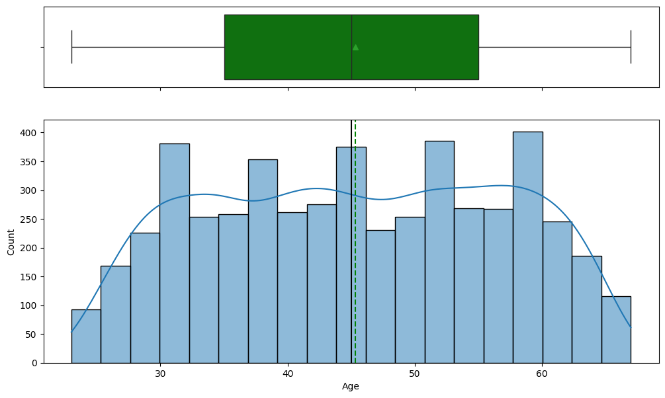
EDA Results - Univariate Analysis - Age
Average age is about 45 years old.
The distribution is uniform.

Slide 7
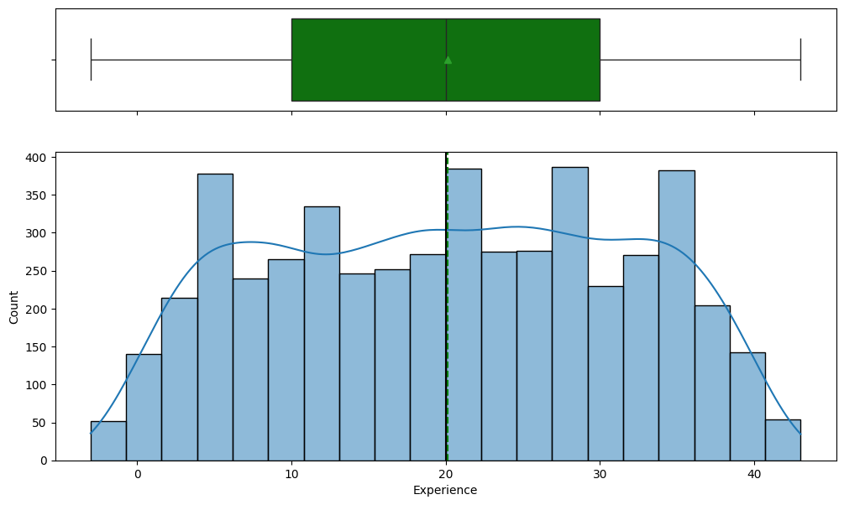
EDA Results - Univariate Analysis - Experience
The average Experience is around 20 years.
The distribution of is uniform.

Slide 8
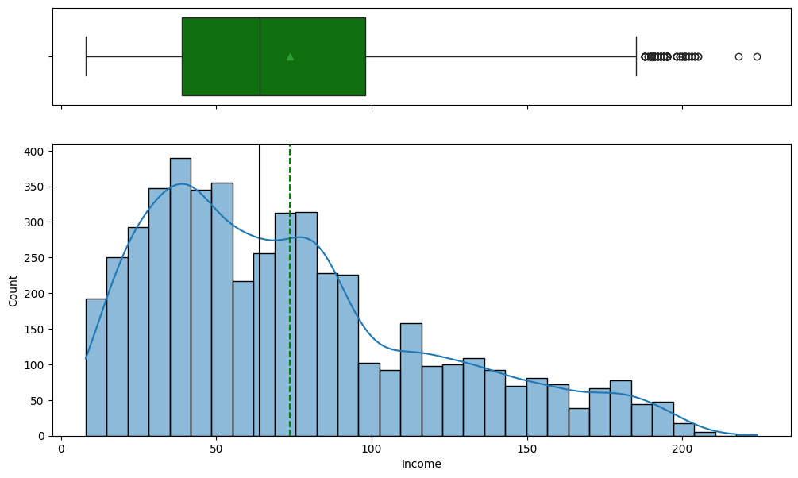
EDA Results - Univariate Analysis - Income
Income has many outliers that have high incomes.
Average income is around 60K.
The distribution is right skewed.

Slide 9
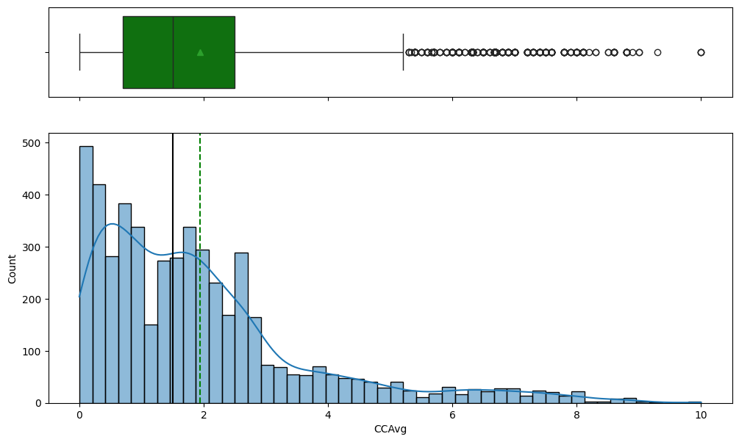
EDA Results - Univariate Analysis - CCAvg
CCAvg has many outliers
There are high number of customers with 0 credit card usage value.
The distribution is right skewed.

Slide 10
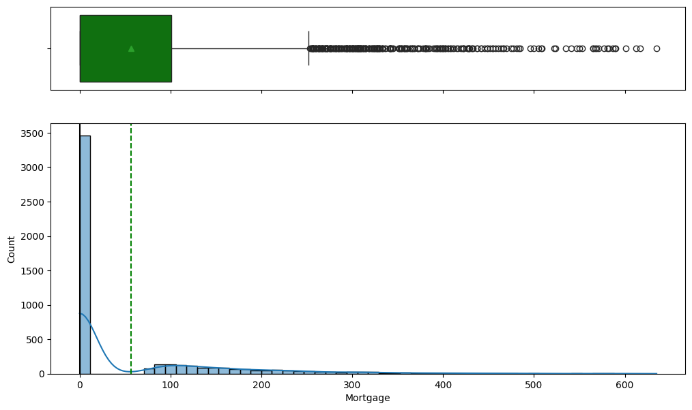
EDA Results - Univariate Analysis - Mortgage
Mortgage has many outliers.
There are many mortgages that have value of 0.
The distribution is right skewed.

Slide 11
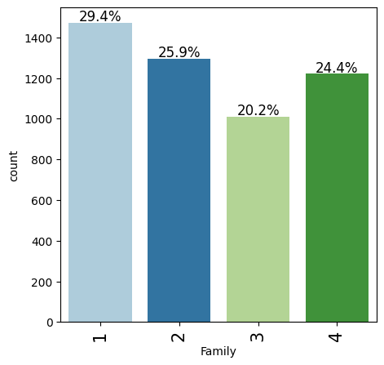
EDA Results - Univariate Analysis - Family
There are higher number of customers with family of 1 followed by 4, 2 and 3.

Slide 12
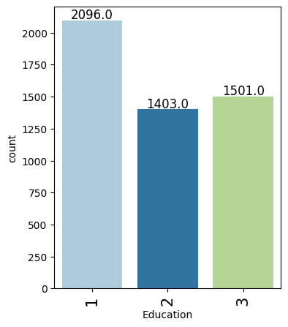
EDA Results - Univariate Analysis - Education
There are a larger number of customers with Education ‘1’ as compared to ‘2’ and ‘3’.

Slide 13
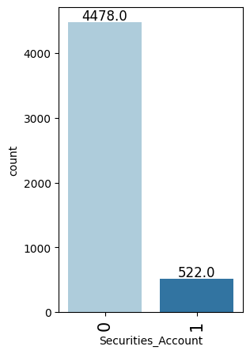
EDA Results - Univariate Analysis - Securities Account
There are a large number of customers without securities account.

Slide 14
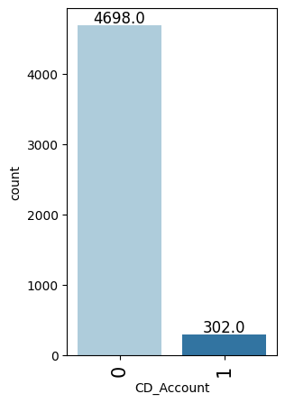
EDA Results - Univariate Analysis - CD Account
There are a large number of customers without CD account.

Slide 15
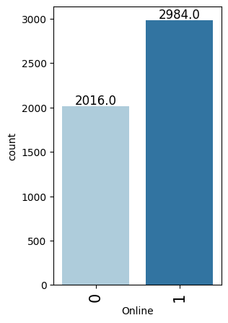
EDA Results - Univariate Analysis - Online
There are higher number of customers without that have online accounts.

Slide 16
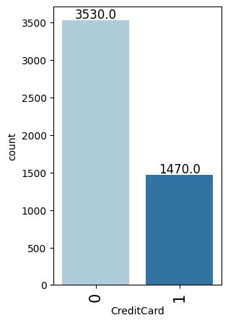
EDA Results - Univariate Analysis - Credit Card
There are higher number of customers without Credit Cards.

Slide 17
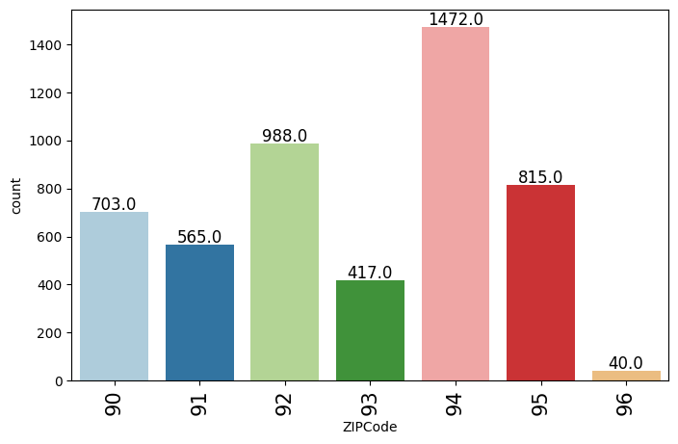
EDA Results - Univariate Analysis - Zipcode
There are higher number of customers in 94 Zip Codes.

Slide 18
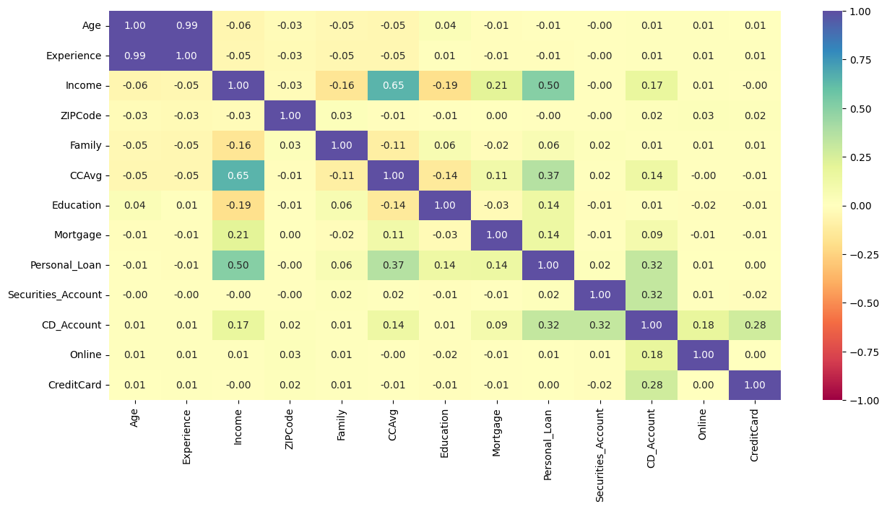
EDA Results - Bivariate Analysis - Heatmap
There is a strong correlation between age and experience.
Credit card usage and income are highly correlated with each other.

Slide 19
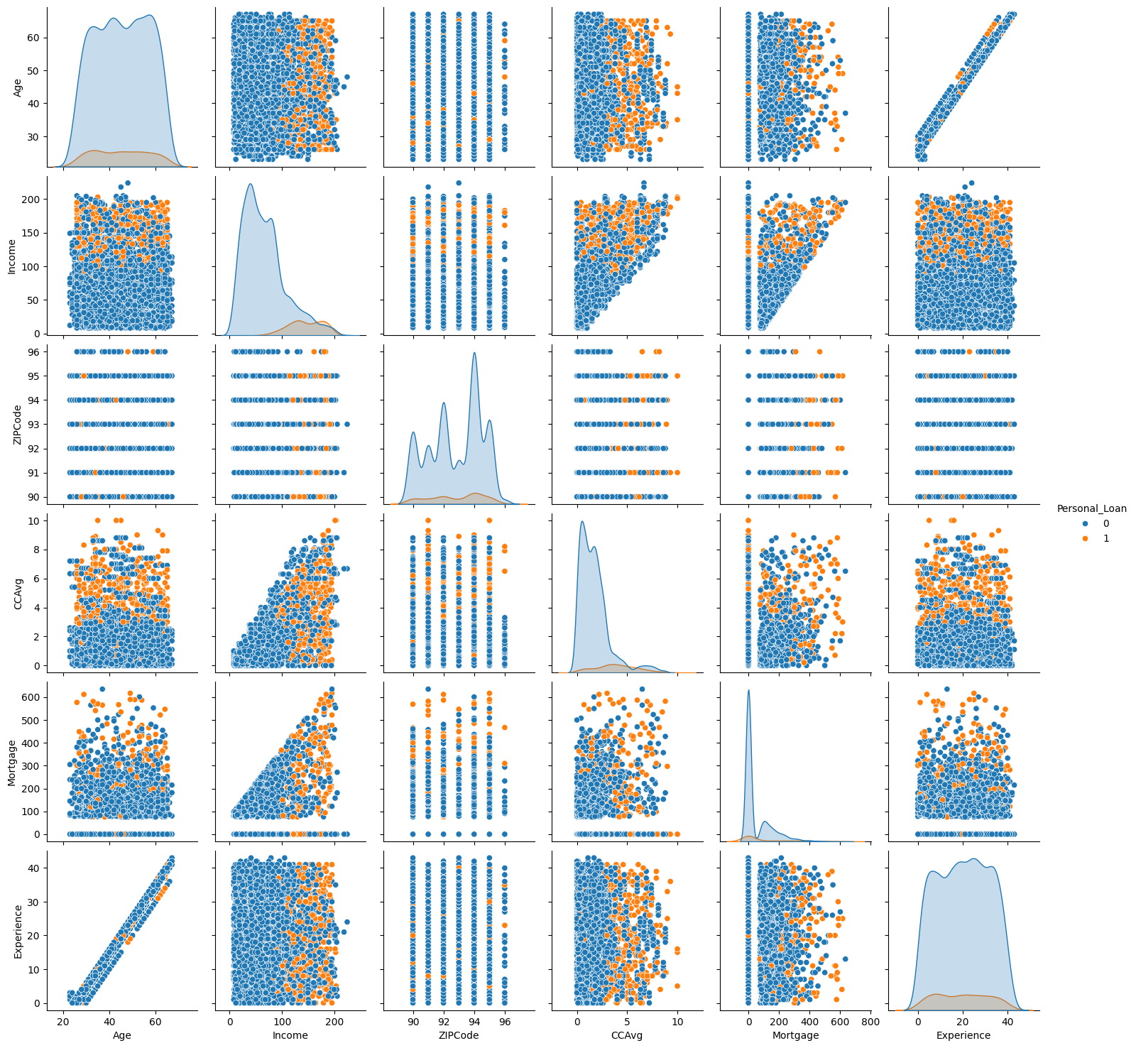
EDA Results - Bivariate Analysis - PairPlot
Customers with personal loans have higher income.

Slide 20
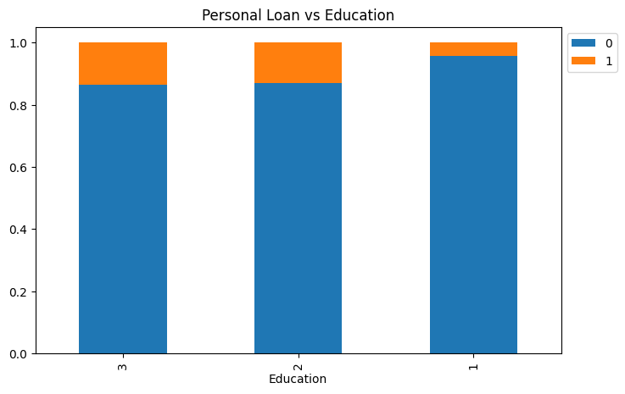
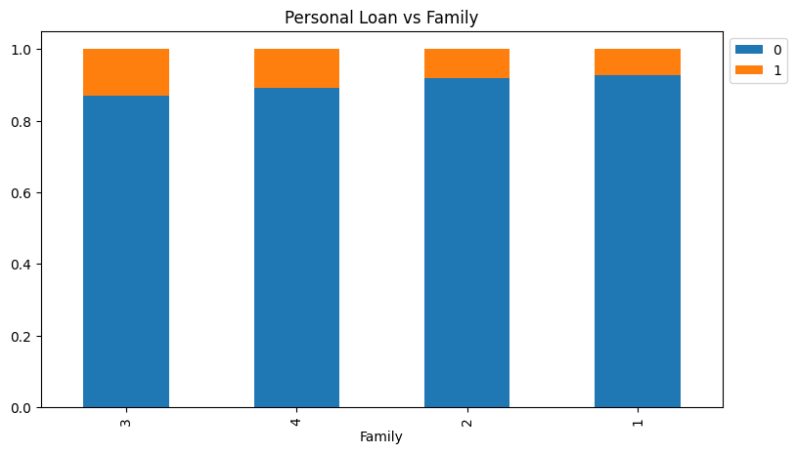
EDA Results - Bivariate Analysis
Those customers with an education of '2' and '3' have higher percentage of personal loans that those with education of '1'.
Those customers with a family of 3 have a higher percentage of personal loans than the other families followed by family of 4, 2 and 1 respectively.

Slide 21
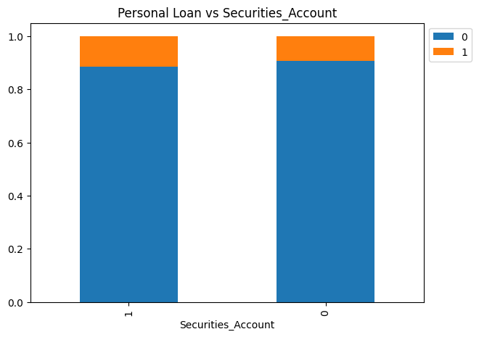
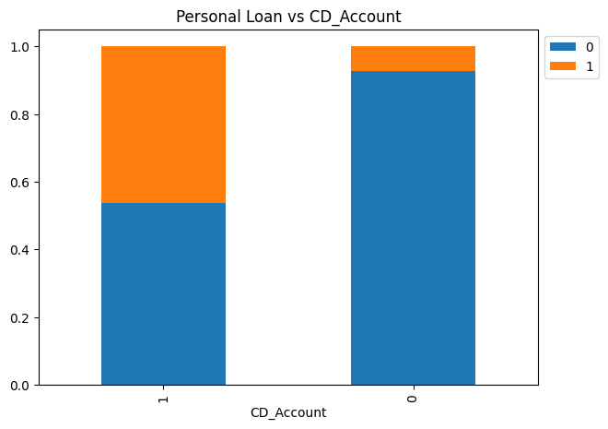
EDA Results - Bivariate Analysis
Having a Securities account does not have a significant impact on personal loan.
Customers who have CD account also have higher number of personal loans as compared to the customers who don’t have CD account.

Slide 22
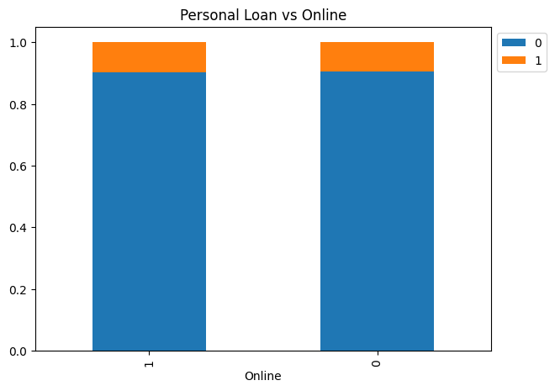

EDA Results - Bivariate Analysis
Online customers have no significant impact on personal loans.
Credit Card holders have no significant impact on personal loans.

Slide 23
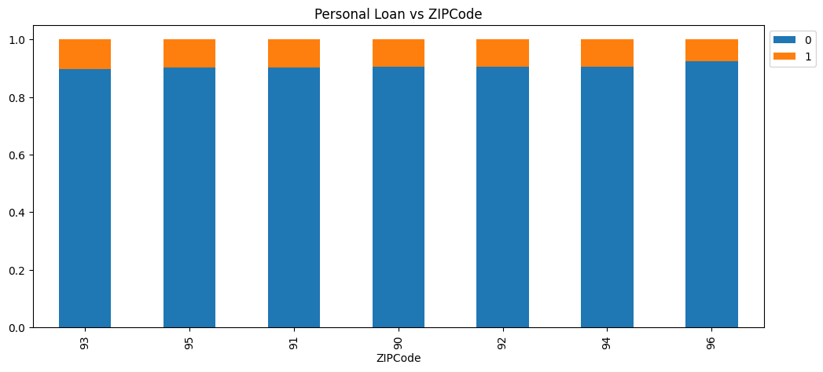
EDA Results - Bivariate Analysis
Customers across different Zip Codes have no significant impact on personal loans.

Slide 24
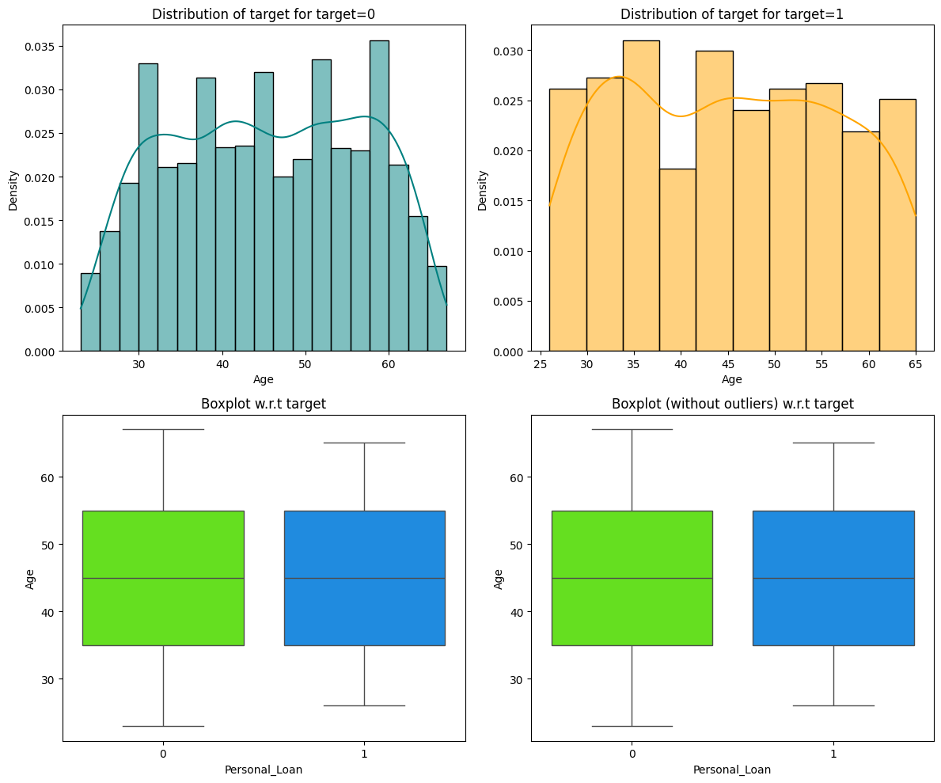
EDA Results - Bivariate Analysis - Target Age
Customers with higher age have a little impact on personal loans.

Slide 25
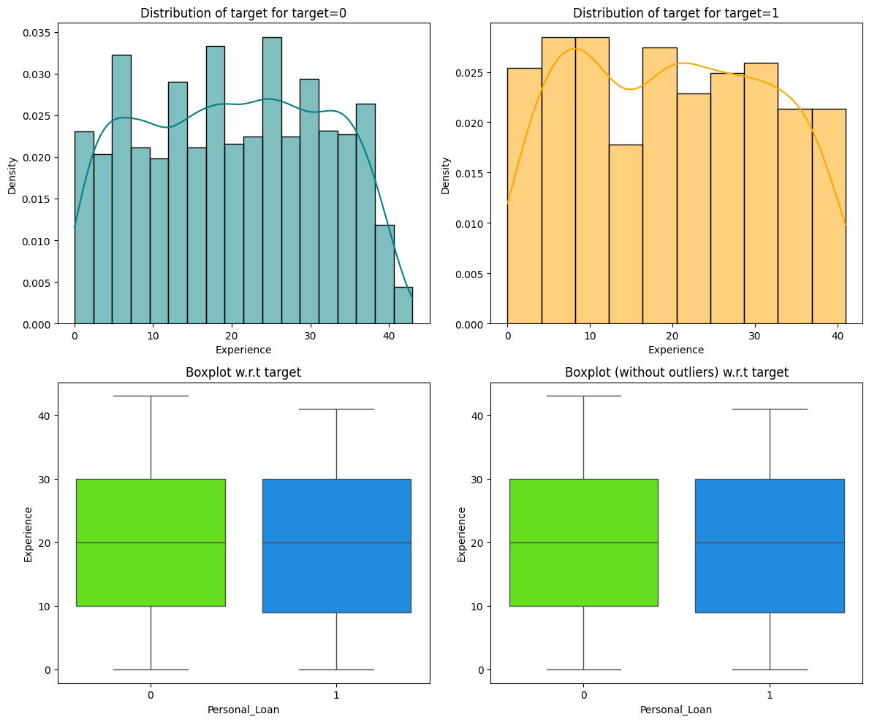
EDA Results - Bivariate Analysis - Target Experience
Experience of customer does not have a significant impact on Personal Loans.

Slide 26
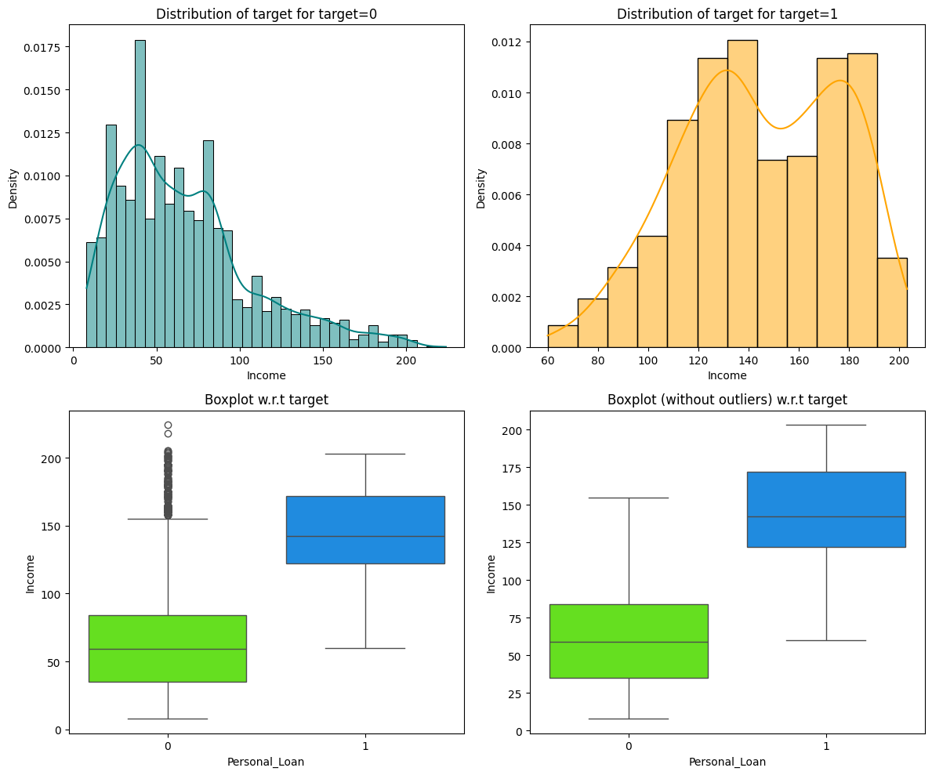
EDA Results - Bivariate Analysis - Target Income
On an average Customers with higher incomes have personal loans.

Slide 27
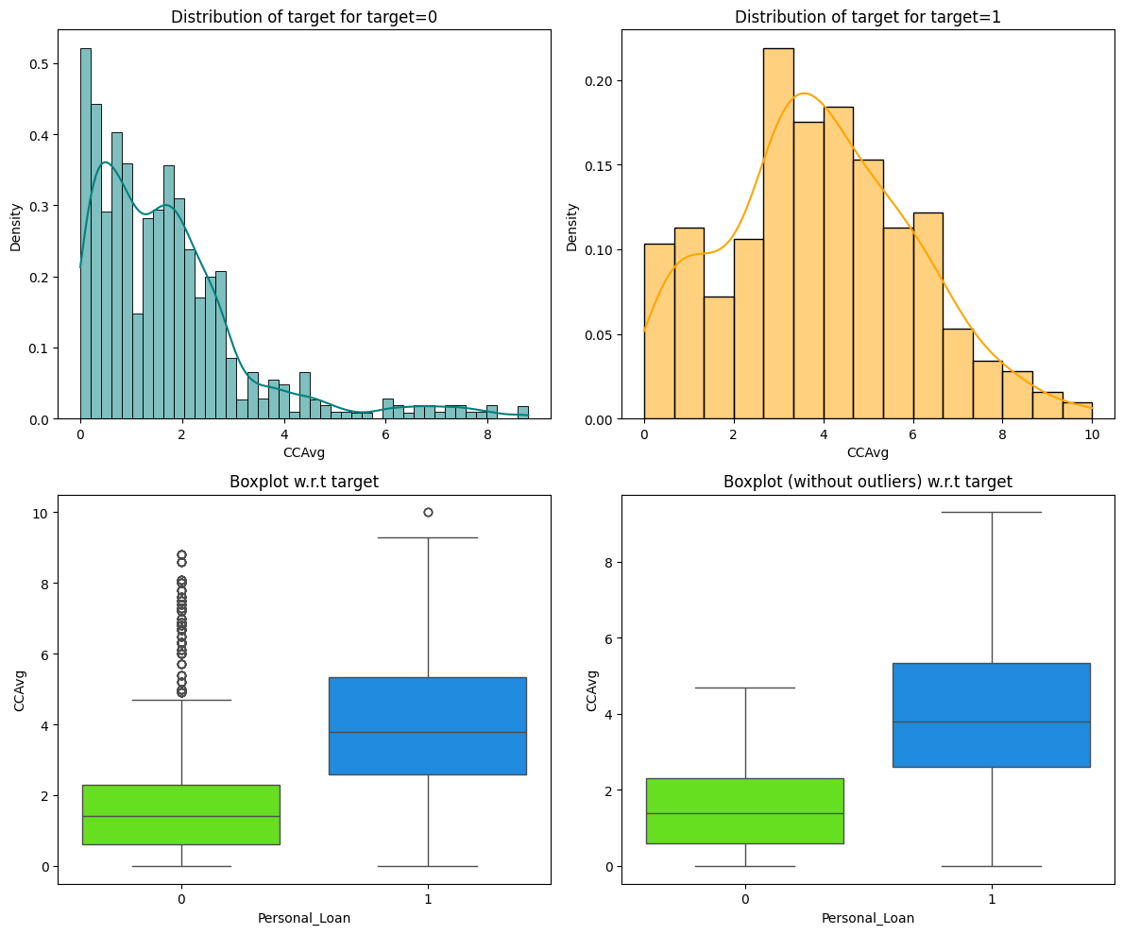
EDA Results - Bivariate Analysis - Target CCAvg
Credit card usage has a high impact on personal loans.

Slide 28
Data Preprocessing
There are no duplicate values.
There are no missing values. There are lot of Mortgage values that are 0, which is not treated as missing value.
Some field values such as Education, Personal_Loan, Securities_Account, CD_Account, Online, CreditCard, ZIPCode are updated to be categorical values.
Experience values are negative so we take absolute values for analysis.
Dropped the ‘Experience’ variable as it was perfectly correlated with Age.
Education has unique values of 1, 2 and 3.
Income, CCAvg and Mortgage are heavily skewed.

Slide 29
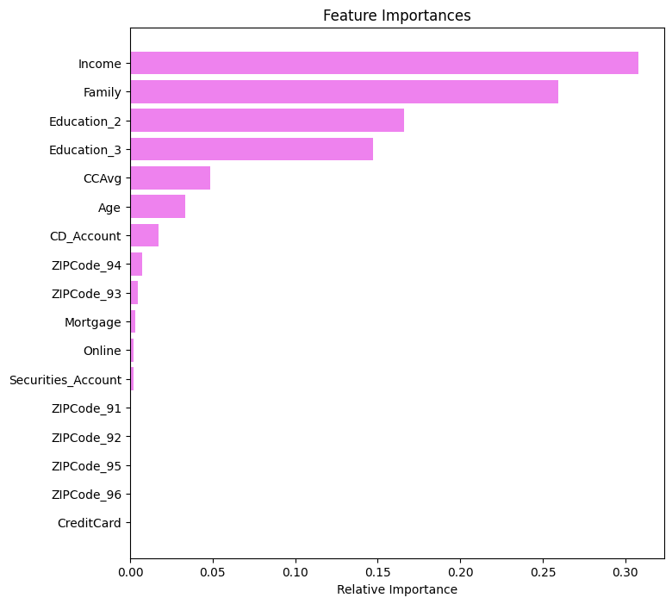
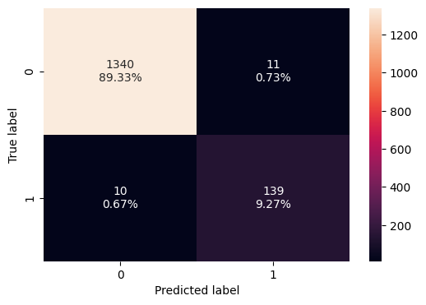
Model Building - Initial Model
Model was built using DecisionTreeClassifier
Accuracy is not a good metric to evaluate, as around 10% of positive classes, even if all cases were set to negative, the accuracy would still be 90%.
Model is too complex and we are overfitting the model.

Slide 30
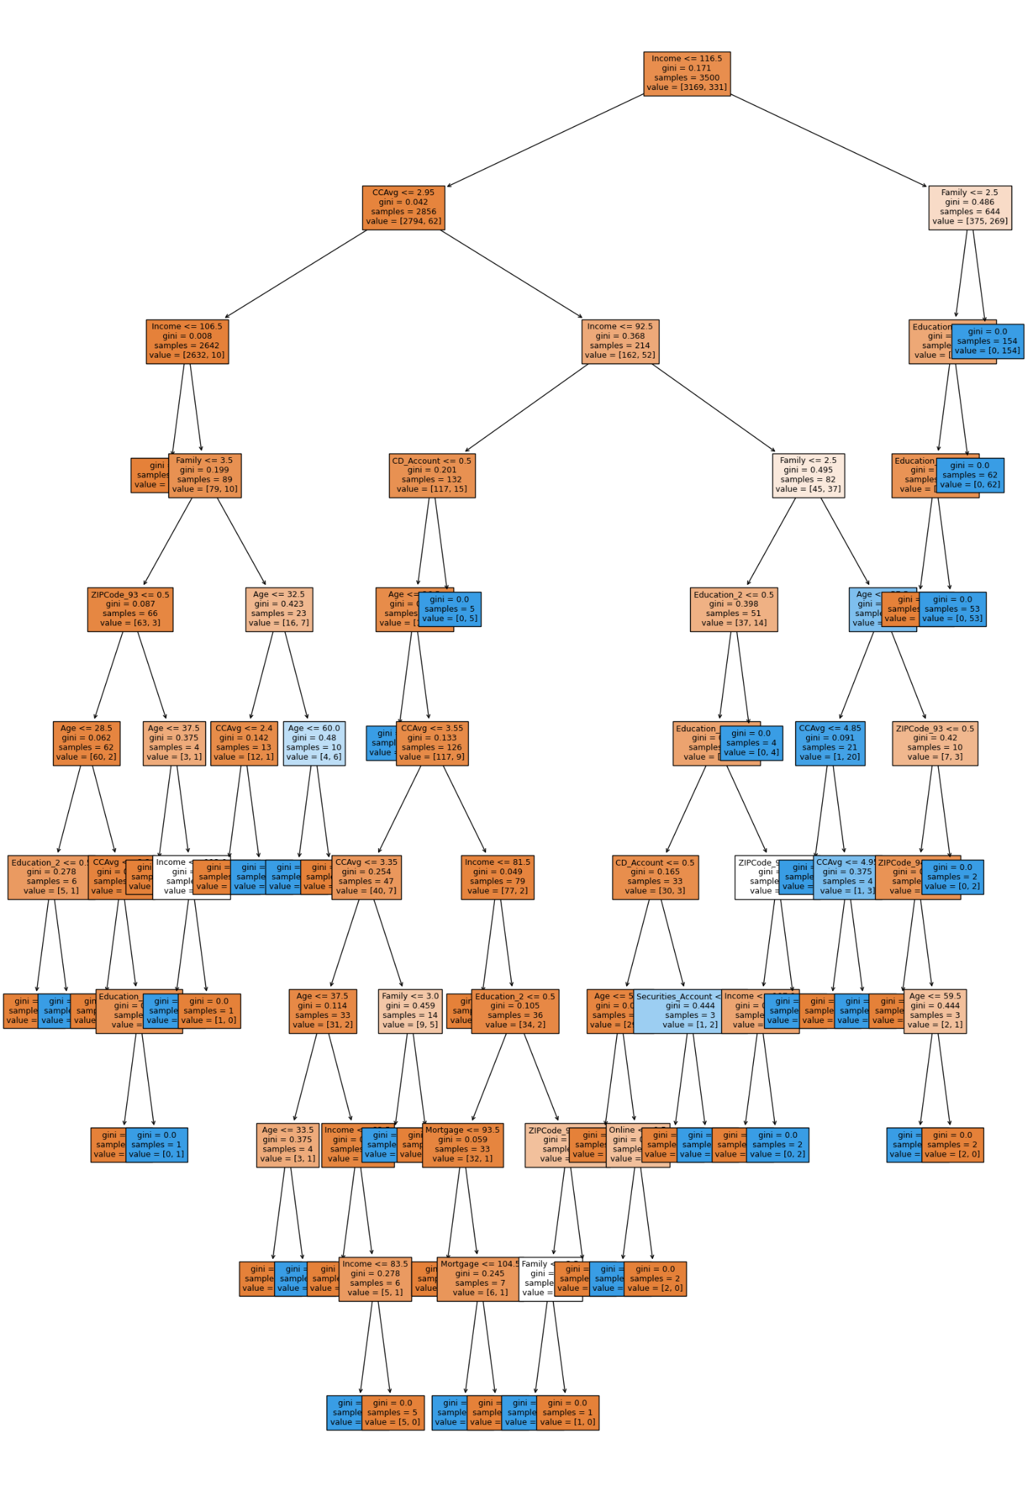
Model Building - Initial Model
Visualization of initial decision tree shows that is hard to interpret and analyze.

Slide 31
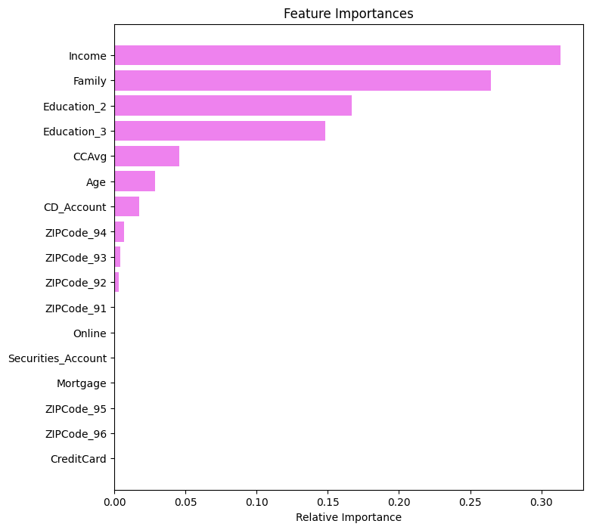
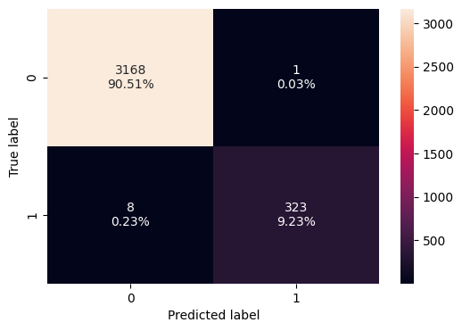
Model Performance - Pre Pruning
To improve performance, decision tree was pre-pruned based on the Gini importance of the features.
The recall scores for the test set is 0.91.
Income is the most important feature, followed by Family, Education, CCAvg and Age.

Slide 32
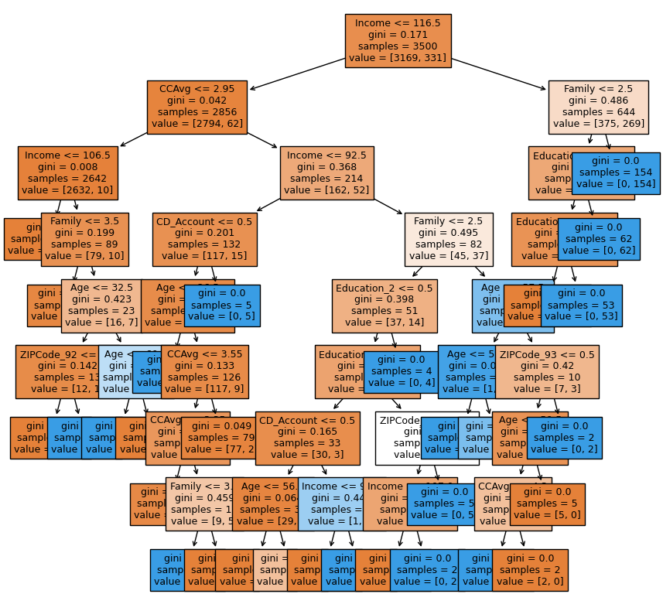
Model Performance - Pre Pruning
Visualized of a pre-pruned decision tree shows its easier to interpret and is not overfit.

Slide 33
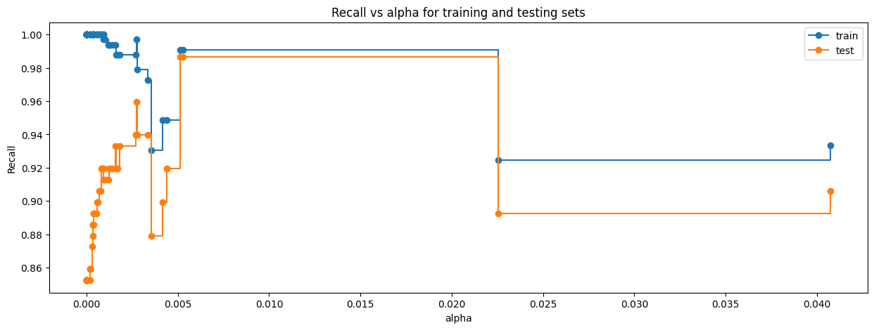
Model Performance - Cost Complexity Pruning
When alpha value is between .006 and 0.225 the recall value for both train and test are high.
So we will use the alpha value of 0.01 to get high recall values.

Slide 34
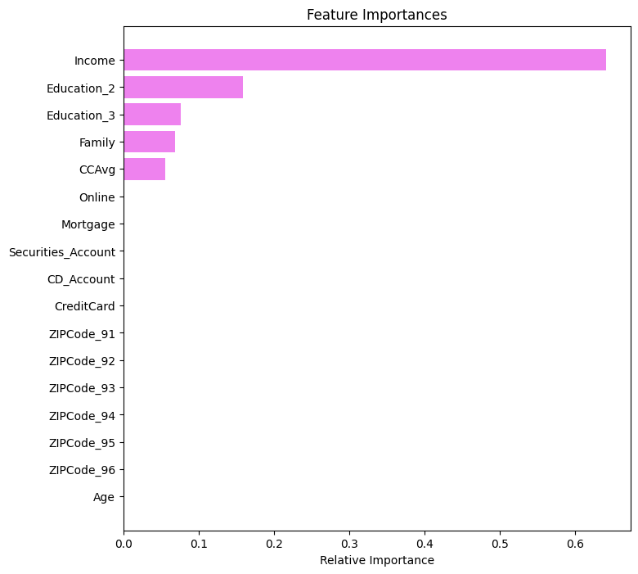
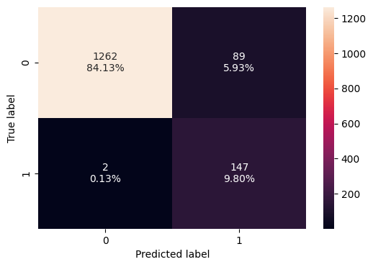
Model Performance - Post Pruning
We built our model using the DecisionTreeClassifier and set our ccp_alpha parameter to 0.01.
Features that impacted the results were Income, Education, Family, and CCAvg.
The recall values for training set was 0.99 and the test set was 0.98.
There is no overfitting of the model

Slide 35
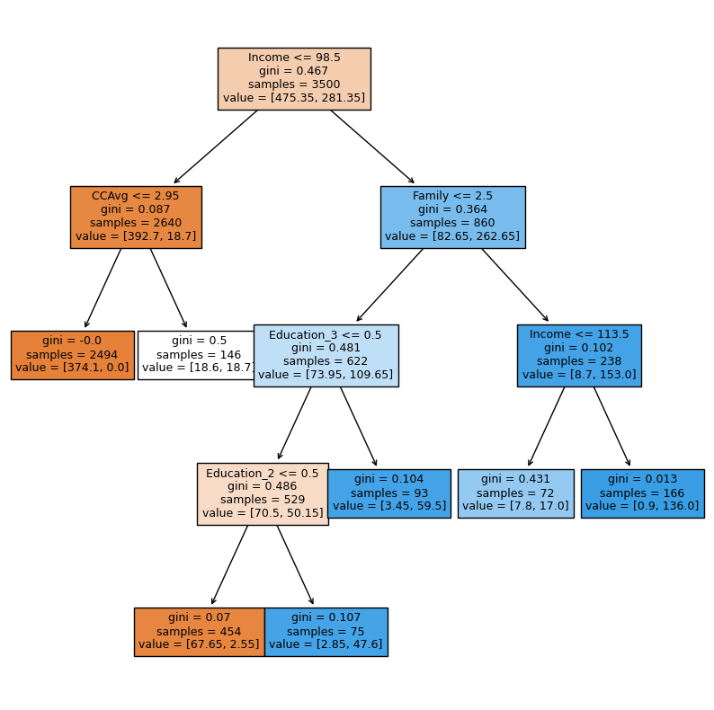
Model Performance - Post Pruning
Visualization of the decision tree alpha value of 0.01.
We get a tree that is not overfitted and easy to read.

Slide 36
Model Performance Summary
Pre pruning the decision tree improved the performance of the initial tree by reducing the feature complexity with a train and test recall value of 0.95 and 0.91 respectively.
However post pruning the tree significantly improved the performance with a train and test recall value of 0.99 and 0.98 respectively.
Income has a significant impact on the results, followed by Education, Family and Credit Card usage.
Model | Description | Train_Recall | Test_Recall
0 | Initial decision tree model | 1.00 | 0.91
1 | Pre-Pruned Decision tree | 0.95 | 0.91
2 | Post-Pruned Decision tree | 0.99 | 0.98

Slide 37
APPENDIX

Slide 38
Data Background and Contents
https://olympus.mygreatlearning.com

