Slide 1
Stock Market Sentiment Analysis and Summarization
NLP Project
1/1/2025

Slide 2
Contents / Agenda
Executive Summary
Business Problem Overview and Solution Approach
EDA Results
Data Preprocessing
Model Performance Summary
Appendix

Slide 3
Executive Summary
The solution developed will help the analysts to gauge the market sentiment quickly and make data driven and informed decisions
Financial advisors can grow their business by assisting clients and investors by making data driven decision, and day to day tasks such as data analysis, market prediction, trend analysis, portfolio optimization, risk assessment etc.
It is recommended to try other classifiers and hyperparameters to tune the model to improve accuracy and overall performance
It is also recommended to collect more data to train the model better to handle new data efficiently

Slide 4
Business Problem Overview
Market Sentiment Analysis in the Financial Industry
Multiple influencing factors
Company financial performance, innovations and collaborations and market sentiment
Challenges
Large volumes of news and opinions from diverse sources
Rapid impact of news on investor perception and stock prices
Difficult staying updated and accurately interpreting market sentiment
Business need for sophisticated tools
Analyze market sentiment from various sources, integrate insights into investment strategies and enable informed decision-making in a competitive market

Slide 5
Solution Approach
Objective
Develop an AI driven sentiment analysis system to gauge market sentiment, enhance stock price prediction accuracy, and optimize investment strategies.
Key Components
Data Collection
Historical daily news, stock price, and trade volumes for a NASDAQ listed company
Sentiment Analysis
AI-driven system to automatically process and analyze news articles
Weekly News Summarization
Enhance accuracy of stock price predictions and optimize investment strategies
Benefits
Data driven actionable insights to empower financial analysts
Informed Investment decisions to improve client outcomes and optimize investment strategies

Slide 6
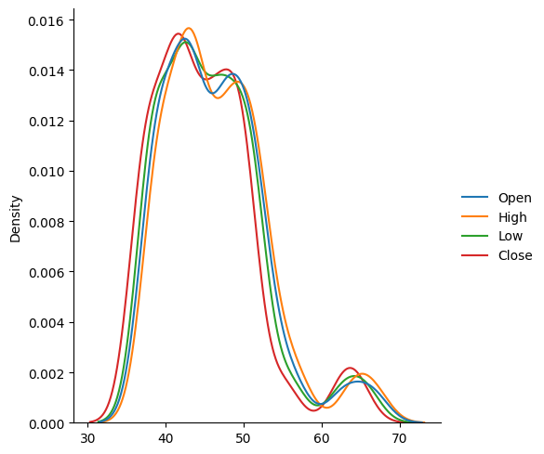
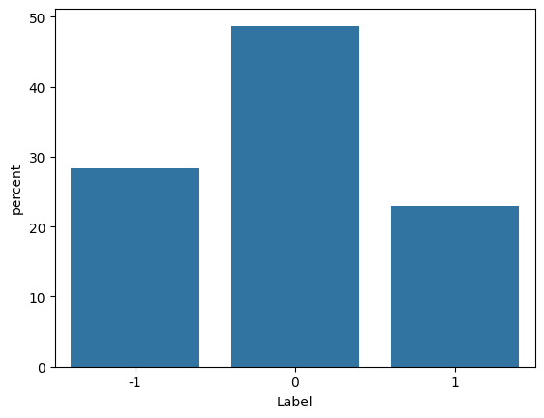
EDA Results
The sentiment data has 49% Neutral (0), 23% Positive (1), 28% Negative (-1)
Open, High, Low and Close values have similar distribution with a slight right skew

Slide 7
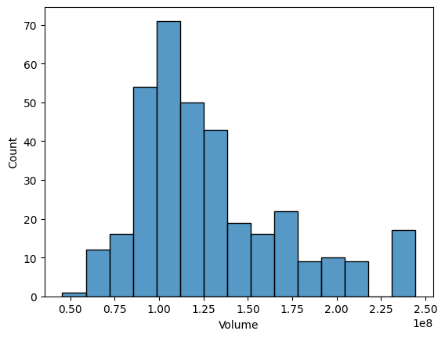
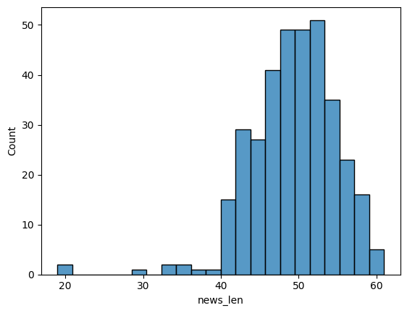
EDA Results
Volume of the news articles is right skewed
Length of news articles is left skewed with majority of the data between 40 to 60 range

Slide 8
EDA Results
Following are the features of the stock news dataset -
The dataset has a total of 349 news articles
Average length of the news articles is around 49 words
Standard deviation of the length is around 6 words and the median is around 50 words
Minimum length of the article is 19 words, while maximum has 61 words
The 25th and 75th percentiles are 46 and 53 words respectively

Slide 9
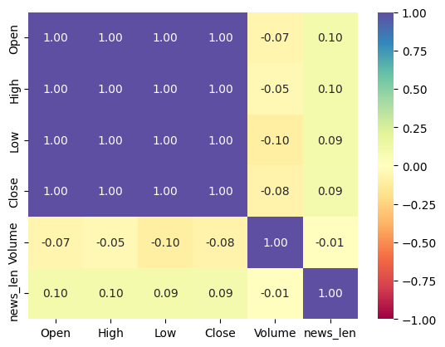
EDA Results
Open, High, Low, and Close are very highly correlated with each other
News length and Volume are negatively correlated with Open, Close, Low and High

Slide 10
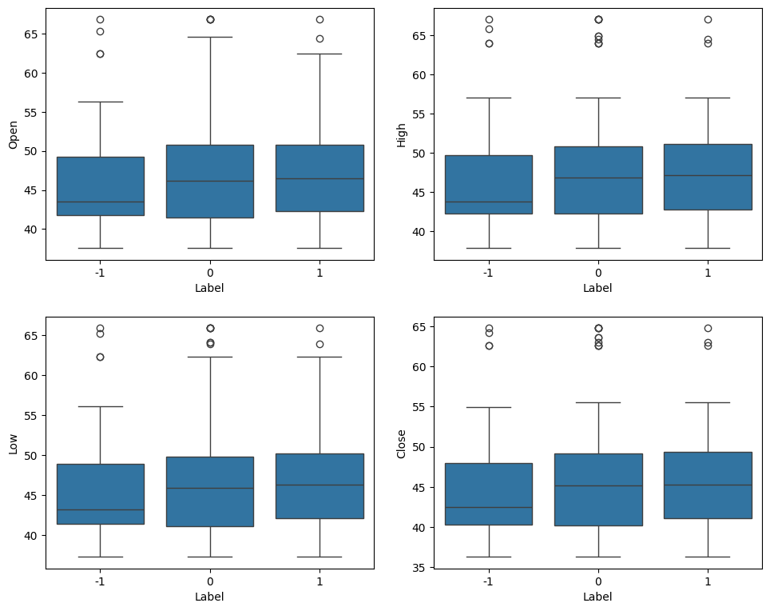
EDA Results
Open, High, Low and Close values have similar distributions with respect to the sentiments

Slide 11
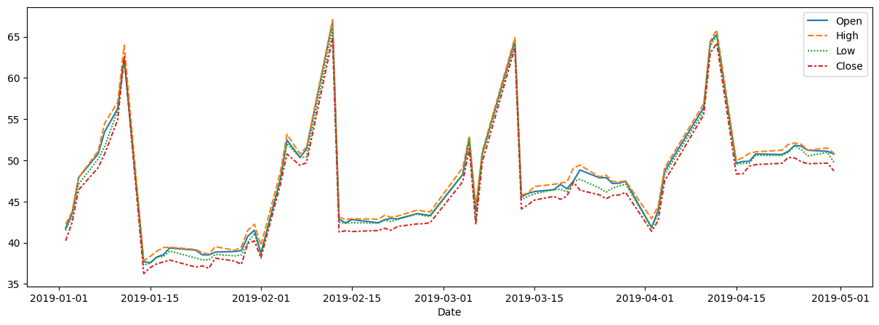
EDA Results
All the data is from the year 2019 and the distribution every month is similar
Open, High, Low and Close values have similar distributions with respect to dates
Majority of the data is in the first four months of the year 2019

Slide 12
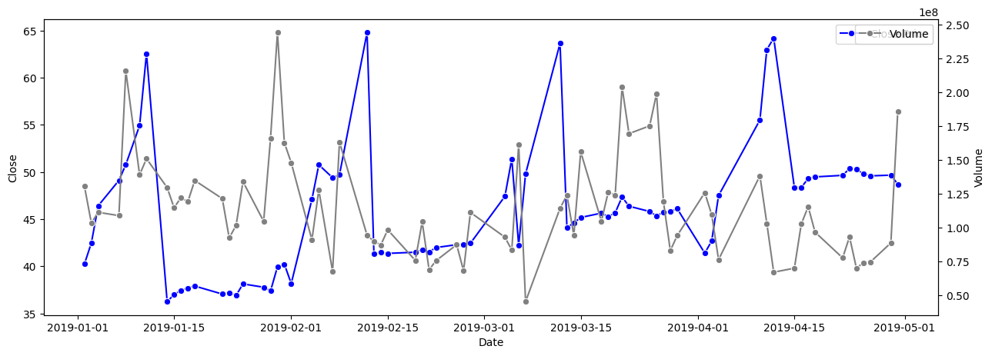
EDA Results
The distribution of Volume is different from that of the Close values
The distribution of Volume every month varies, as compared to Close, which has similar pattern every month

Slide 13
Data Preprocessing
There are no duplicates found
There are no null values found
Since the bulk of the data is found in the first 4 months of the year 2019, it has been used to split the data into test (after 2019-04-16), validate (2019-04-01 to 2019-04-16) and train (before 2019-04-01) sets
Data has been vectorized using
Word2Vec with the length of the vocabulary as 4682 and 300 vectorized documents in each data set
GloVe model with the length of the vocabulary as 400000 with the vector size of 100 in each data set
Sentence transformer model, resulting in each piece of news content converted into a 384-dimensional vector in each data set

Slide 14
Sentiment Analysis - Model Evaluation Criterion
The models are evaluated based on comparing the Accuracy, Recall, Precision, F1-score performance metrics of each model
Use a classification model like GradientBoostingClassifier
Independent variables are used for prediction
Identify true labels for dependent variables for final results
A confusion matrix will be used to plot and visualize the performance of a classification model
Models will be tuned further to enhance the performance as required and compared again to identify the final model

Slide 15
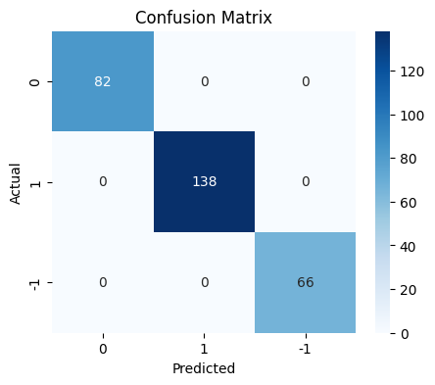
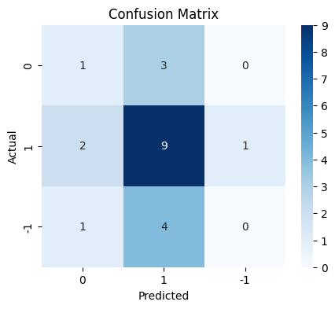
Sentiment Analysis - Model Building
A base Word2Vec model was built using Gradient Boost Classifier
The model achieves perfect scores (1.0) for accuracy, recall, precision, and F1 on the training data as compared to validation data that has an accuracy and recall of around 0.47, precision of 0.36 and F1 score of 0.41
Training Data
Validation Data

Slide 16
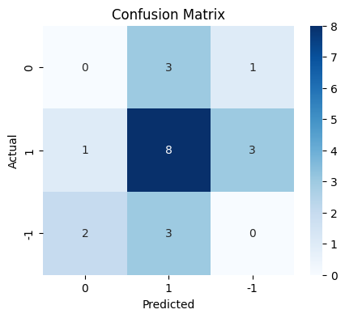
Sentiment Analysis - Model Building
A base GloVe model was built using Gradient Boost Classifier
The model achieves perfect scores (1.0) for accuracy, recall, precision, and F1 on the training data as compared to validation data that has an accuracy and recall of around 0.38, precision of 0.32 and F1 score of 0.35
Training Data
Validation Data

Slide 17
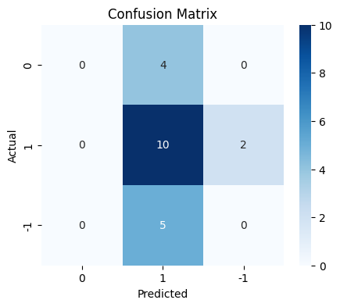
Sentiment Analysis - Model Building
A base Sentence Transformer model was built using Gradient Boost Classifier
The model achieves perfect scores (1.0) for accuracy, recall, precision, and F1 on the training data as compared to validation data that has an accuracy and recall of around 0.47, precision of 0.30 and F1 score of 0.36
Training Data
Validation Data

Slide 18
Sentiment Analysis - Training Data
A base Word2Vec, GloVe, and Sentence Transformer model was built using Gradient Boost Classifier
All the base models performed similarly across different models
Training Data
Metric | Base Model (Word2Vec) | Base Model (GloVe) | Base Model (Sentence Transformer)
Accuracy | 1.0 | 1.0 | 1.0
Recall | 1.0 | 1.0 | 1.0
Precision | 1.0 | 1.0 | 1.0
F1 | 1.0 | 1.0 | 1.0

Slide 19
Sentiment Analysis - Validation Data
Both Word2Vec and Sentence Transformer model had the same Accuracy and Recall values of 0.47
Word2Vec model performed well compared to GloVe and Sentence Transformer with regards to Precision and F1 score
Validation Data
Metric | Base Model (Word2Vec) | Base Model (GloVe) | Base Model (Sentence Transformer)
Accuracy | 0.47619 | 0.380952 | 0.47619
Recall | 0.47619 | 0.380952 | 0.47619
Precision | 0.369048 | 0.326531 | 0.300752
F1 | 0.414966 | 0.351648 | 0.368664

Slide 20
Sentiment Analysis - Model Improvement
As noticed from the metrics of the base models, the performance can be improved further to adapt well to new unseen data
Hyperparameter grid
Max_depth was set to a max of 7
Min_samples_split at each node was set to (5,12,2)
Max_features was set to (log2', 'sqrt', 0.2, 0.4)
Based on the metrics observed training data values was 1.0 across all the models, however validation data overall performed poorly with Word2Vec outperforming the GloVe and Sentence Transformer models
All the models will be tuned using hyperparameters and the metrics will be compared to select the final model

Slide 21
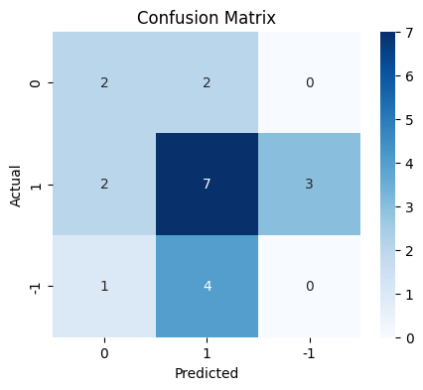
Sentiment Analysis - Model Improvement
Word2Vec base model was tuned to adapt better to new data using hyperparameters max_depth=4, max_features=0.4, min_samples_split=9
The tuned model achieves perfect scores (1.0) for accuracy, recall, precision, and F1 on the training data as compared to validation data that has an accuracy and recall of around 0.42, precision of 0.38 and F1 score of 0.40
Training Data
Validation Data

Slide 22
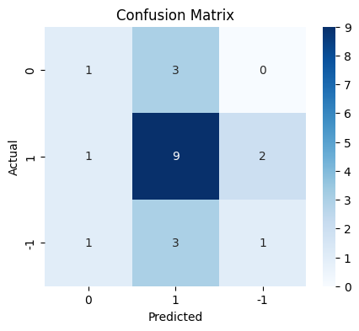
Sentiment Analysis - Model Improvement
GloVe base model was tuned to adapt better to new data using hyperparameters of max_depth=6, max_features=0.4, min_samples_split=9
The tuned model achieves perfect scores (1.0) for accuracy, recall, precision, and F1 on the training data as compared to validation data that has an accuracy and recall of around 0.42, precision of 0.38 and F1 score of 0.40
Training Data
Validation Data

Slide 23
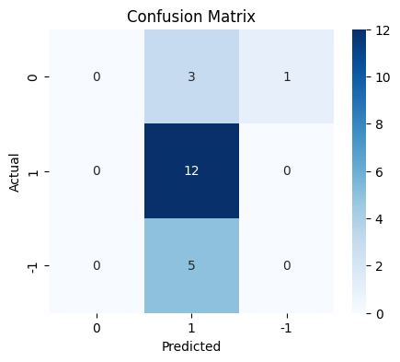
Sentiment Analysis - Model Improvement
Sentence Transformer base model was tuned to adapt better to new data using hyperparameters of max_features='log2', min_samples_split=9
The tuned model achieves perfect scores (1.0) for accuracy, recall, precision, and F1 on the training data as compared to validation data that has an accuracy and recall of around 0.42, precision of 0.38 and F1 score of 0.40
Training Data
Validation Data

Slide 24
Sentiment Analysis – Model Performance Comparison
Training data performance In the tuned models was same as that of the base models
Training Data
Metric | Tuned Model (Word2Vec) | Tuned Model (GloVe) | Tuned Model (Sentence Transformer)
Accuracy | 1.0 | 1.0 | 1.0
Recall | 1.0 | 1.0 | 1.0
Precision | 1.0 | 1.0 | 1.0
F1 | 1.0 | 1.0 | 1.0

Slide 25
Sentiment Analysis – Model Performance Comparison
The tuned models performance was overall much better than the base models
Sentence Transformer model had the highest value of accuracy and recall where as GloVe model seemed to have better overall values of accuracy and recall of 0.52 and precision of 0.48 and F1 score of 0.49
Tuned Word2Vec did not perform as well as it did with the base model
Validation Data
Metric | Tuned Model (Word2Vec) | Tuned Model (GloVe) | Tuned Model (Sentence Transformer)
Accuracy | 0.428571 | 0.52381 | 0.571429
Recall | 0.428571 | 0.52381 | 0.571429
Precision | 0.383883 | 0.485714 | 0.342857
F1 | 0.404656 | 0.494898 | 0.428571

Slide 26
Sentiment Analysis – Final Model
All the models performed better than the base models on the validation data
Based on the performance metrics, the tuned GloVe model generally performed better than other models across all the performance metrics observed
The RandomForestClassifier with tuned GloVe model performed better in adapting to new unseen data
Validation Data
Metric | Base Model (Word2Vec) | Base Model (GloVe) | Base Model (Sentence Transformer) | Tuned Model (Word2Vec) | Tuned Model (GloVe) | Tuned Model (Sentence Transformer)
Accuracy | 0.47619 | 0.380952 | 0.47619 | 0.428571 | 0.52381 | 0.571429
Recall | 0.47619 | 0.380952 | 0.47619 | 0.428571 | 0.52381 | 0.571429
Precision | 0.369048 | 0.326531 | 0.300752 | 0.383883 | 0.485714 | 0.342857
F1 | 0.414966 | 0.351648 | 0.368664 | 0.404656 | 0.494898 | 0.428571

Slide 27
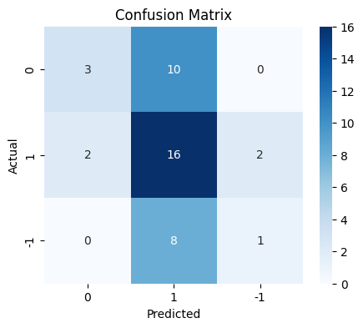
Sentiment Analysis - Test Data Performance
The test data was tested using tuned GloVe model
The accuracy and recall was 0.476, precision of 0.48 and F1 score of 0.42
Metric | Tuned Model (GloVe)
Accuracy | 0.47619
Recall | 0.47619
Precision | 0.481232
F1 | 0.421076

Slide 28
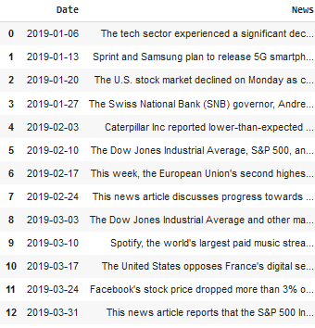
Content Summarization – Data Preprocessing
Using large language model Llama from Hugging Face model hub and training it using the stock news dataset
Once the model is trained records are aggregated on a weekly basis based on the date and the content is concatenated in the News field separated by ‘||’
The aggregated data has 18 rows and 2 output columns
Sample Data

Slide 29
Content Summarization – Modeling Approach
A large language model which is a generative text model from the Hugging Face Hub was used as an assistant like chat use cases
The model was trained using the stock news dataset
The Large Language Model was tuned using the following parameters
The max_tokens parameter was set to 1024
The temperature (randomness) was set to 0.7
The top_p parameter was set to 0.9
The top_k parameter was set to 50
The model took around 50 minutes to get the sample output

Slide 30
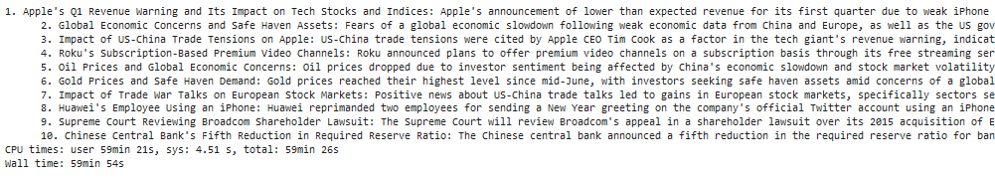
Content Summarization – Sample Input/Output
The sample input prompt used was “List the top ten topics”
The sample output generated was as shown below in the screenshot
It took a significant amount of time of 60 minutes to generate the output after multiple tries

Slide 31
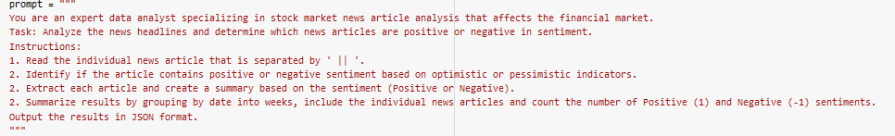
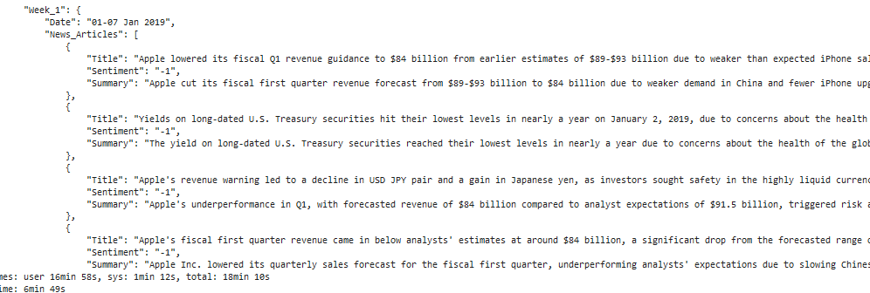
Content Summarization – Sample Input/Output
This was the prompt used for the second time -
The JSON output was generated relatively faster this time and below is the snapshot of the output

Slide 32
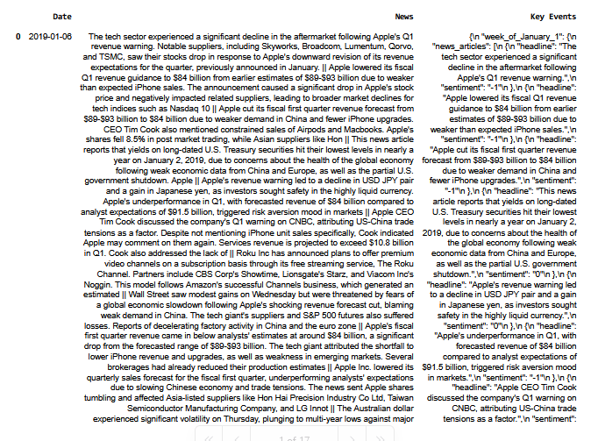
Content Summarization – Raw Model Output
The partial snapshot of the resultant dataframe with raw data is shown below

Slide 33
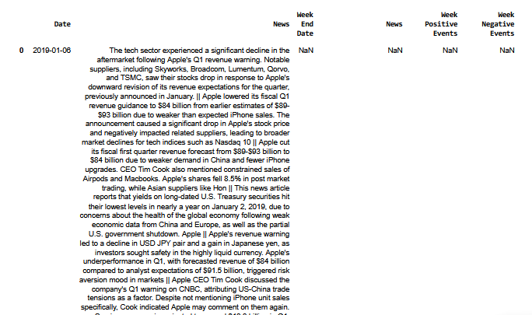
Content Summarization – Final Output
The final formatted output was generated using the following steps
JSON Content was extracted and parsed
The parsed content was normalized
The data was finally parsed into 'Week End Date', 'News', 'Week Positive Events', 'Week Negative Events' columns

Slide 34
APPENDIX

Slide 35
Data Background and Contents
The tuned GloVe model was chosen as it performed the best compared to Word2Vec and Sentence Performer
The dataset was divided into three parts such as training, validation and test sets based on the first 4 months of the year 2019
The data was vectorized using Word2Vec, GloVe and Sentence Transformer models
The model was evaluated by comparing training and validation performances using
Performance metrics that included Accuracy, Recall, Precision and F1 score
Confusion Matrix

