Slide 1

FeedMeRight Recipe Recommender System
Pallavi Chavan, MSCS
Advisor: Dr. Brian Thoms
Department of computer Science
MSCS Graduate 2018-2020
June 8, 2020

Slide 2
Content
Motivation
Background
Objective
Implementation
Results
Conclusion
Future Work

Slide 3
Motivation

Slide 4
Recommender System
Motivation
Background
Objective
Implementation
Results
Conclusion
Future Work
BigData is a driving force behind recommender systems.
Recommender systems are information filtering systems that provide a solution for the problem of information overload.
Applications of Recommender Systems –
Amazon – E-commerce
Netflix – Entertainment
News

Slide 5
Health Factor
Motivation
Background
Objective
Implementation
Results
Conclusion
Future Work
According to World Health Organization (WHO), 39% over-weighted and 13% obese adults were till 2016.
Overweight and obesity can cause chronic diseases.
Busy lifestyle deprives people from choosing healthy eating options.
Information overload makes it harder to understand -
“What should I eat?”
Recommender systems can narrow down information considering user’s eating history and health.

Slide 6
Background

Slide 7
Literature Review
Motivation
Background
Objective
Implementation
Results
Conclusion
Future Work
The research of Freyne and Berkovsky used content based technique to predict rating of unrated recipes based on the ingredients.
Morgan Harvey considered +ve and -ve weighting factors for ingredients to imply strong likes and dislikes.
Chun-Yuen Teng, Yu-Ru Lin, and Lada A. Adamic’s experiment shows one way to bring healthy factor by substituting ingredients.
Elahi proposed a system with matrix factorization and active learning with ratings and tags that takes user feedback from an application.
Mouzhi Ge, Francesco Ricci, and David Massimo extended Elahi’s work by incorporating calorie count.

Slide 8
Objective

Slide 9
Motivation
Background
Objective
Implementation
Results
Conclusion
Future Work
Objective
Perform comparative analysis on recommender approaches in food domain and design and develop varying recipe recommender by considering user’s preferences and health requirements.

Slide 10
Implementation

Slide 11
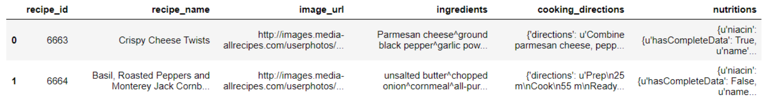
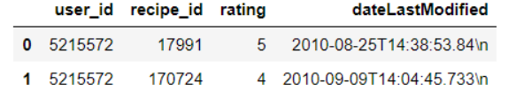
Data Source
Motivation
Background
Objective
Implementation
Results
Conclusion
Future Work
‘core-data-recipe.csv’ provides detailed information about recipes.
merged file from ‘core-data-train-rating.csv’ and ‘core-data-test-rating.csv’ provides information about all user interactions.
Data Statistics:
# of recipes | 43,922
# of users | 20,000
# of interactions | 655,609

Slide 12
Features Extraction

Slide 13
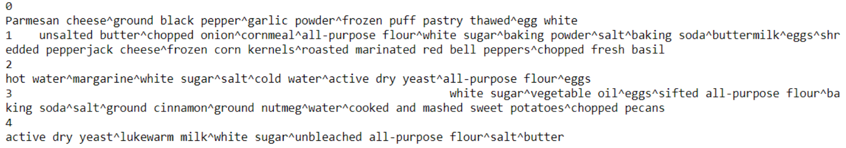
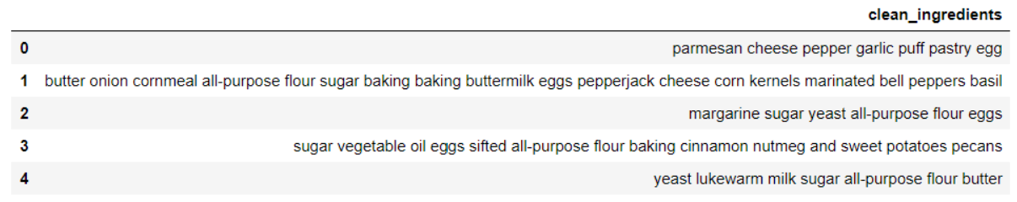
Ingredients Extraction
Motivation
Background
Objective
Implementation
Results
Conclusion
Future Work
Pre-Processed Ingredients
Post-Processed Ingredients after application of NLTK and recipe stopwords
Post-Lemmatized Ingredients

Slide 14
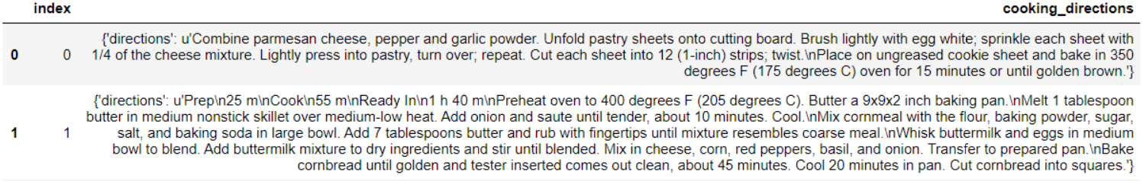
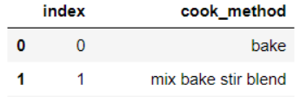
Cook Method Extraction
Motivation
Background
Objective
Implementation
Results
Conclusion
Future Work
Cooking directions are combination of cooking method and ingredients.
Extracted cook methods from cooking directions with reference to predefined glossary of cook methods.

Slide 15
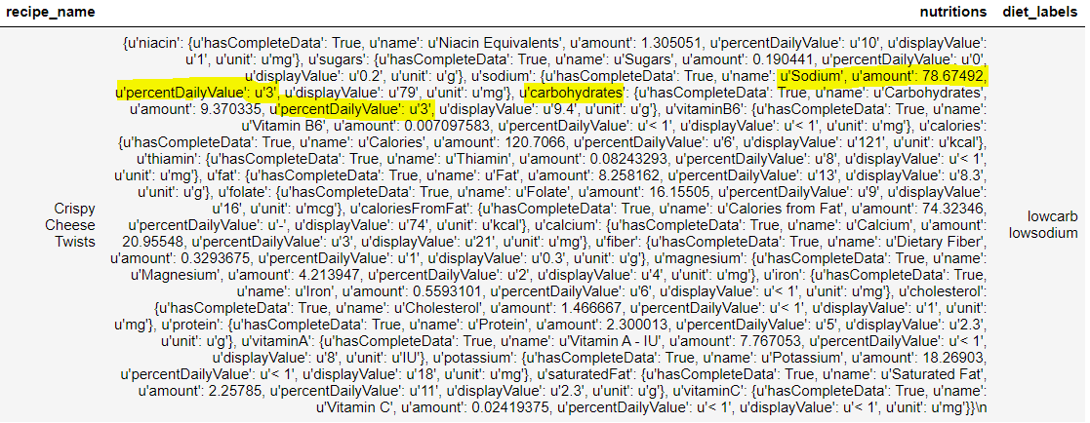
Diet Labels Extraction
Motivation
Background
Objective
Implementation
Results
Conclusion
Future Work
5 % DV or less of nutrient per serving is considered low.
20 % DV or more of nutrient per serving is considered high.
Nutrient categories – 1. High-Protein 2. High-Fiber 3. Low-Fat 4. Low-Carb 5. Balanced.

Slide 16
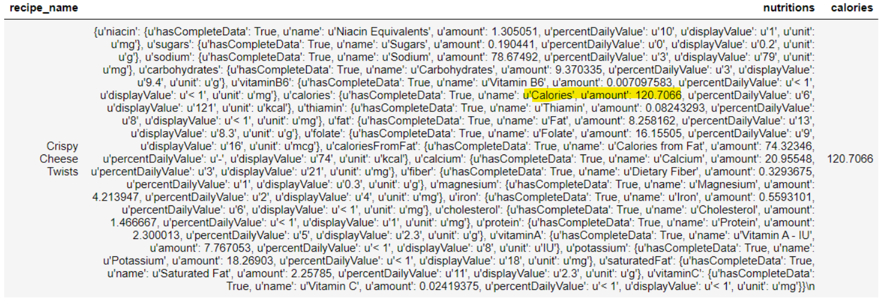
Calorie Extraction
Motivation
Background
Objective
Implementation
Results
Conclusion
Future Work

Slide 17
User Information
Motivation
Background
Objective
Implementation
Results
Conclusion
Future Work
User attributes : 1. Height in inches 2. Weight in lb 3. Age 4. Gender 5. Activity
Activity categories: 1. Sedentary 2. Lightly Active 3. Moderately Active 4. Very Active 5. Extra Active
The Harris-Benedict equation –
BMR (male) = 66+(6.3 * Weight-lb) + (12.9 * Height-inch) - (6.8 * age)
BMR(Female) = 655 + (4.3 * Weight-lb) + (4:7 * Height-inch) - (4.7 * age)
User’s Activity Level | User’s calorie intake per day
Sedentary | BMR * 1.2
Lightly Active | BMR * 1.375
Moderately Active | BMR * 1.55
Very Active | BMR * 1.725
Extra Active | BMR * 1.9
User’s calorie intake per meal:
= Calorie intake per day / 3

Slide 18
Content-Based Filtering Workflow
Motivation
Background
Objective
Implementation
Results
Conclusion
Future Work
User Ratings
User-id
User Rated Recipes
document-term matrix for all recipes using TF-IDF
Recipes
recipe-ids
Content-based filtering uses item features to consider user’s preferences.
The aim of content-based filtering is to create user profile and item profiles in order to find similar items that reflects user’s taste.
User-recipes profiles
recipe-profiles
Weighted average of recipes profiles by the ratings of a user
Filter out recipe calories <= user’s calorie intake
Recipe recommendations for a user
User-recipe similarity
normalize
Construct a user profile

Slide 19
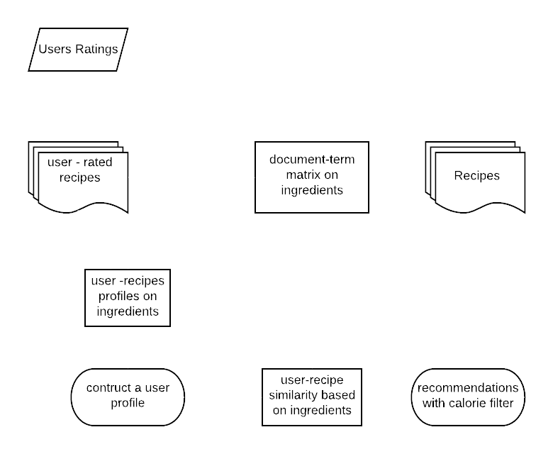
Content-Based (CB) CB Using Ingredients
Motivation
Background
Objective
Implementation
Results
Conclusion
Future Work
‘Ingredients’ feature is used to calculate recipe profiles.
‘Ingredients’ feature is used to calculate user profile.

Slide 20
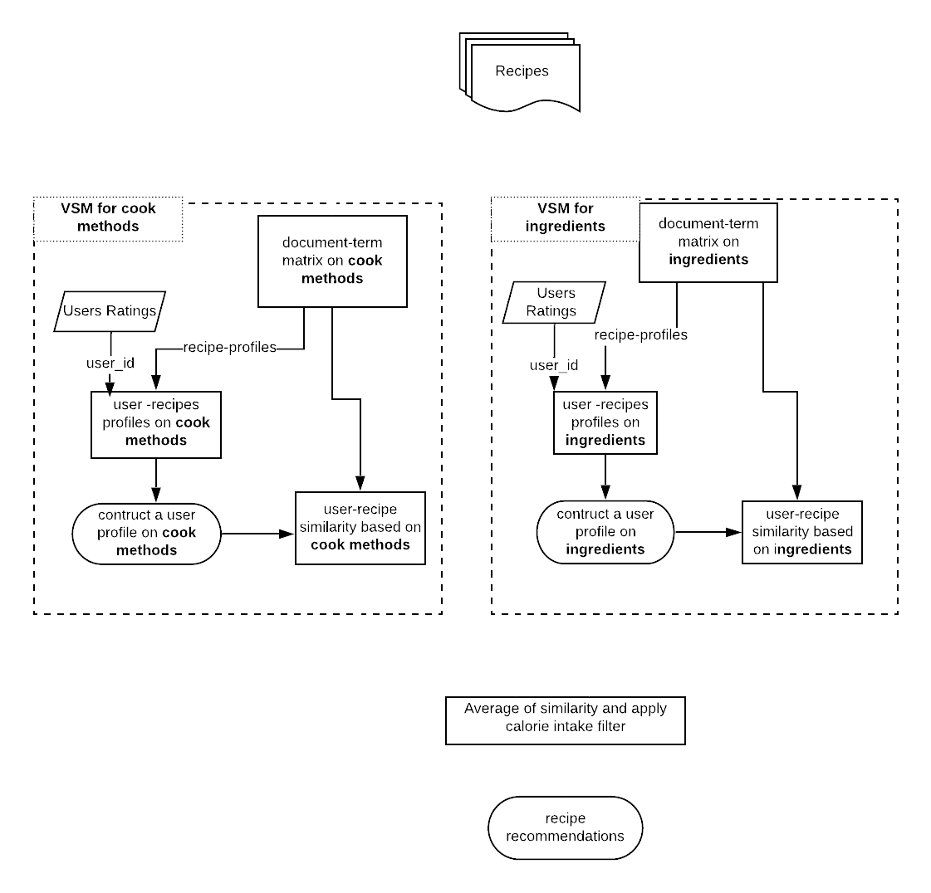
Content-Based (CB) CB Using Ingredients & Cook Methods
Motivation
Background
Objective
Implementation
Results
Conclusion
Future Work
‘Ingredients’ feature is used to calculate user and recipe profiles.
‘Cook Methods’ feature is used to calculate user and recipe profiles.
Average of user-recipe similarity on ingredients and cook methods is considered in this approach.

Slide 21
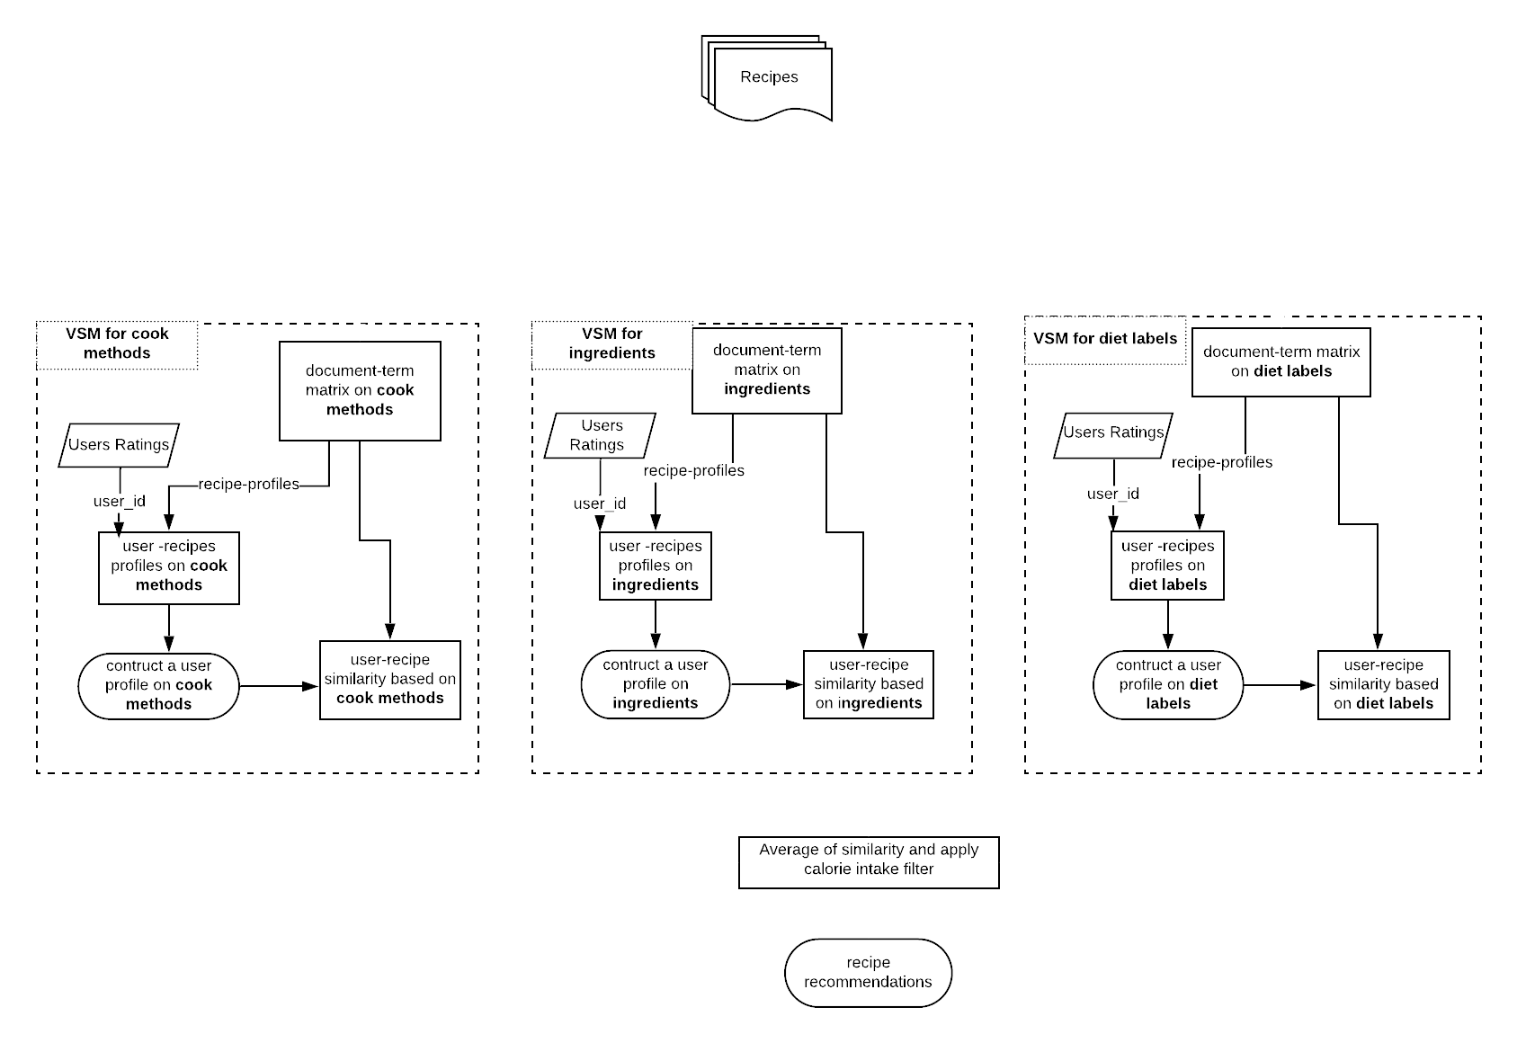
Content-Based (CB) CB Using Ingredients, Cook Methods & Diet Labels
Motivation
Background
Objective
Implementation
Results
Conclusion
Future Work

Slide 22
Content-Based Experiments Results
Model Name | Recall at 10 | Precision at 10 | Accuracy at 10
CB using ingredients | 0.078617241 | 0.024154169 | 0.024236065
CB using ingredients and cook methods | 0.105738164 | 0.032184732 | 0.032312734
CB using ingredients cook methods and diet labels | 0.111494599 | 0.035216746 | 0.035334459

Slide 23
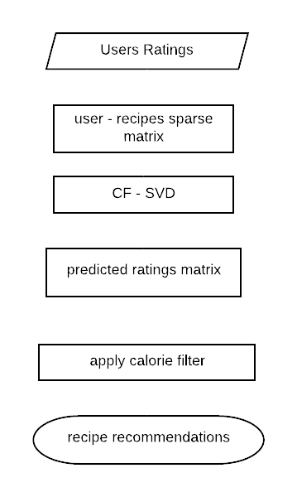
Collaborative Filtering (CF) CF Using SVD
Motivation
Background
Objective
Implementation
Results
Conclusion
Future Work
CF is independent of contents or features of an item.
User-rating matrix act as an input to SVD algorithm.

Slide 24
Motivation
Background
Objective
Implementation
Results
Conclusion
Future Work
Limitations of Traditional Algorithms
Recommending perfect item is difficult with empty user profile.
Recommending item with no ratings is difficult in CF.
New recipe will not get recommended due to absence of rating.
Content-based method provides a limit of novelty.
Notes:
There are limitations with content based and collaborative filtering. If we add new user who has not rated any recipe yet, then these systems can not generate recommendations for this new user. Thi problem is know as new user cold start problem. If any new recipe is added in dataset which is not rated by any user yet, collaborative will not recommend it to new user. And its new recipe cold start problem.. Content based recommends only similar items with not much variety in it.
And we can overcome those limitations by this hybrid approach.

Slide 25
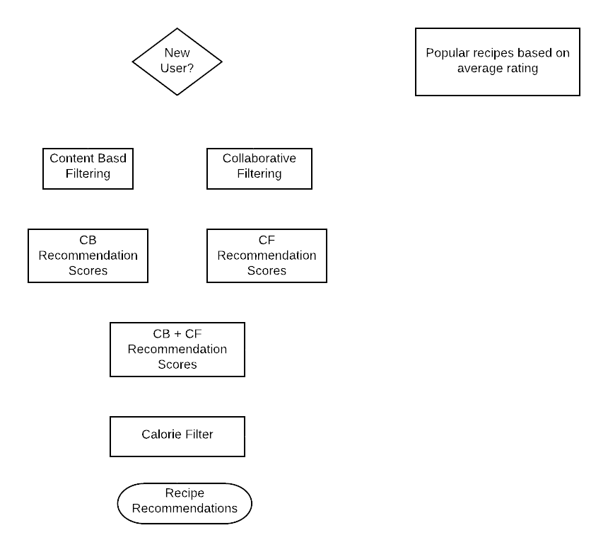
Hybrid Approach
Motivation
Background
Objective
Implementation
Results
Conclusion
Future Work
Hybrid approach is a combination of CB & CF approaches.
‘New recipe’ cold start in CF can be solved by CB.
‘New user’ cold start problem of CB and CF is solved using popular items.
Provides best out of both systems.

Slide 26
Results

Slide 27
Results Comparison
Motivation
Background
Objective
Implementation
Results
Conclusion
Future Work
Model Name | Recall at 10 | Precision at 10 | Accuracy at 10
Content – Based | 0.111494599 | 0.035216746 | 0.035334459
Collaborative Filtering | 0.376785432 | 0.204567584 | 0.166999335
Hybrid | 0.43370876 | 0.203729964 | 0.183965403
Notes:
If we look at the results, the recall and accuracy values of content-based, collaborative and hybrid, we can see that, collaborative performed very well compare to content-based. As we were expecting hybrid has improved the performance.Hybrid model actually outperformed these traditional algorithms.
Surprisingly precision value for hybrid is bit less than collaborative
but with benefits that we are getting wih hybrid and with higher recall value – where recall refers to % of correctly classifying relevant items, I think, trade-off between recall and precision can be accepted.

Slide 28
Conclusion
Motivation
Background
Objective
Implementation
Results
Conclusion
Future Work
Health factor can be achieved by incorporating calorie restrictions.
User preferences can be achieved using hybrid approach that combines content-based and collaborative.
Hybrid approach overcomes limitations of these traditional approaches.
Hybrid approach solves cold start problem with better performance.
User’s taste is considered with variety of options using hybrid approach.
Notes:
The aim of this thesis is to recommend healthy recipes to users by considering their preferences. By incorporating calorie restrictions we can achieve healthy factor. We can achieve user’s preferences very well, by using hybrid approach that uses content-based as well as collaborative filtering. Because by using hybrid model we can solve cold start problems and we can overcome limitations in traditional approaches. So, this hybrid model with calorie restriction can be represent as a solution to recommend healthy recipes.

Slide 29
Future Work
Motivation
Background
Objective
Implementation
Results
Conclusion
Future Work
Recipe diversity can be added as a feature in content-based filtering.
Along with calorie balance more nutrition can be considered.
User’s health information can be gathered such as cholesterol, blood sugar levels to recommend healthier recipes.

Slide 30
Thank You! Questions?

