Slide 1
Mushroom Classification Team 3 (P225)
Himavath 07/05/2023

Slide 2
Business Problem
To classify if the mushroom is edible or poisonous.

Slide 3
Objective
Mushrooms are not just good to taste, but they have some medicinal properties as well. A research center would like to explore the different types of mushrooms, to understand which of them are edible, and which are not, so that they could discover some of the hidden properties of mushrooms, which could possibly heal certain terminal illnesses.
Using the above information & the dataset and applying the different machine learning techniques to classify if the mushroom is edible or poisonous.

Slide 4
Project Flow
EDA
Feature Engineering
Model Building
Model deployment

Slide 5
The dataset used in this project is mushrooms.csv that contains 8124 instances of mushrooms with 23 features like cap-shape, cap-surface, cap-color, bruises, odor, etc.
The python libraries and packages we’ll use in this project are namely:
NumPy
Pandas
Seaborn
Matplotlib
We’ll use the specifications like cap shape, cap color, gill color, etc. To classify the mushrooms into edible and poisonous.

Slide 6
Exploratory Data Analysis (EDA) and Feature Engineering
Many of the features were in the form of object because of addition of the symbols and punctuations in order to convert to int\float data types we have to carry over pre-processing using regular expression.

Slide 7
Data set details
This dataset includes descriptions of samples corresponding to 23 species of gilled mushrooms in the Agaricus and Lepiota Family Mushroom drawn from The Audubon Society Field Guide to North American Mushrooms (1981). Each species is identified as definitely edible, definitely poisonous, or of unknown edibility and not recommended. This latter class was combined with the poisonous one. The Guide clearly states that there is no simple rule for determining the edibility of a mushroom; no rule like "leaflets three, let it be'' for Poisonous Oak and Ivy.

Slide 8
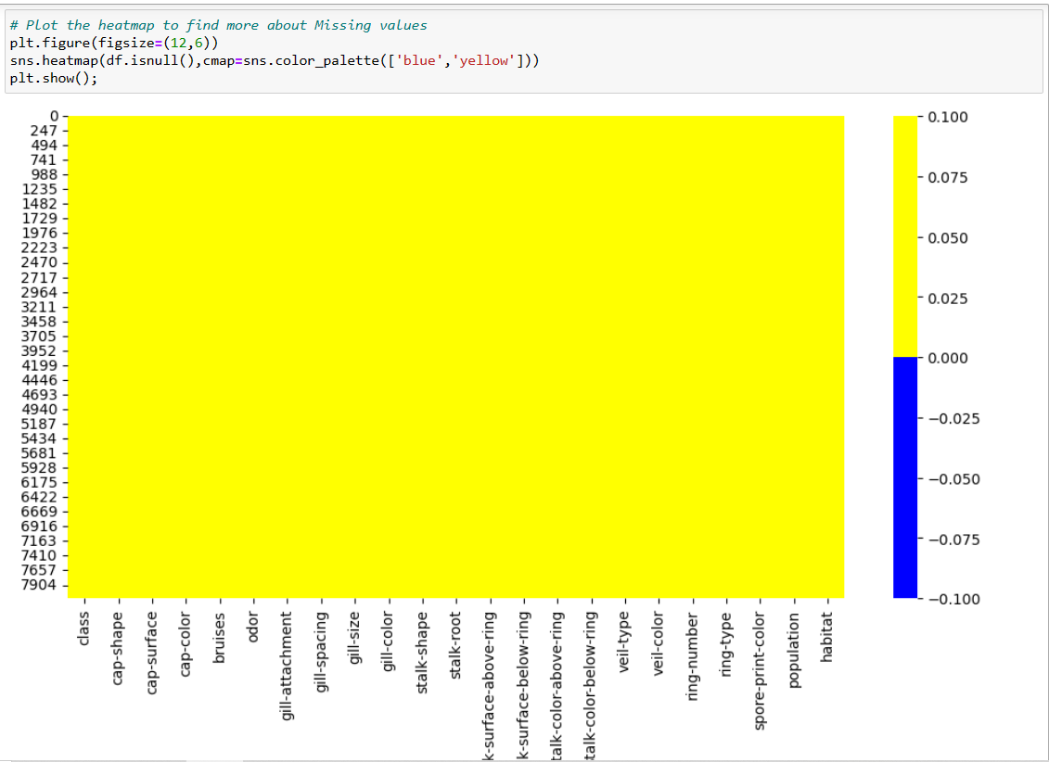
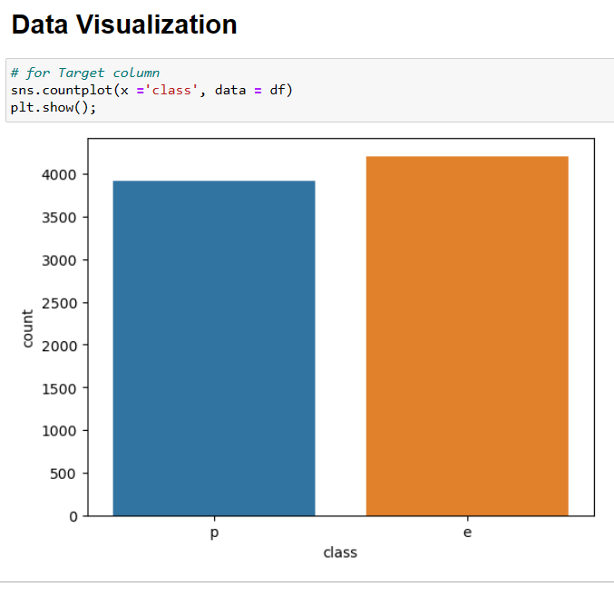
Exploratory Data Analysis (EDA) Removed the class imbalance in the data. Imputed the missing values, impossible values, and patterns ,similarities, distributions etc.

Slide 9
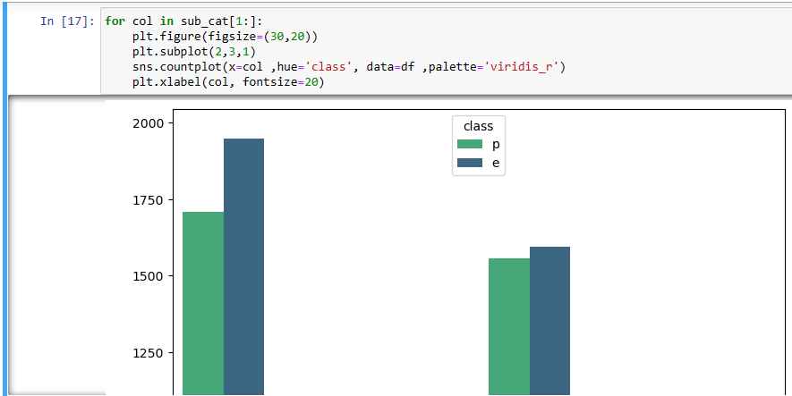
Multi Variant
1.Most of the knobbed mushrooms in our dataset are poisonous.
2.Most fibrous cap surface are edible.
3.Most white cap colored mushrooms are edible while most yellow cap colored mushrooms are poisonous.
4.Bruised mushrooms are usually edible while unbruised ones are usually the opposite.

Slide 10
FEATURE ENGINEERING
One hot encoding
Removal of unnecessary features
Label encoding

Slide 11
FEATURE ENGINEERING
The following columns are not needed so we dropped them: gill-attachment, stalk-surface-below-ring, stalk-color-below-ring, veil-type, veil-color, ring-number.
In terms of categorical features, an outlier can be considered a category with little observations' here we group together categories who's contribution is below 5%,under new category name 'Other ‘.
For Feature columns- Applying OHE
For Target column - Applying Label encoding

Slide 12
Model Building
The Process of Modeling the Data:
1.Importing the model
2.Fitting the model
3.Predicting Mushroom types
4.Classification metrics –
Score Metrics for Classification:
Accuracy= (TP+TN/(TP+TN+FP+FN)
Precision = (TP)/(TP+FP)
Recall = (TP)/(TP+FN)
f1 score
A number between 0 and 1, the harmonic mean of precision & recall.

Slide 13
Models we used:
Logistic Classification
Decision Tree Classifier
Random Forest Regressor
Bagging Classifier
AdaBoost Voting Classifier
XGBoost Classifier
Support Vector Machines
K-Nearest Neighbors(KNN)
Naive Bayes

Slide 14
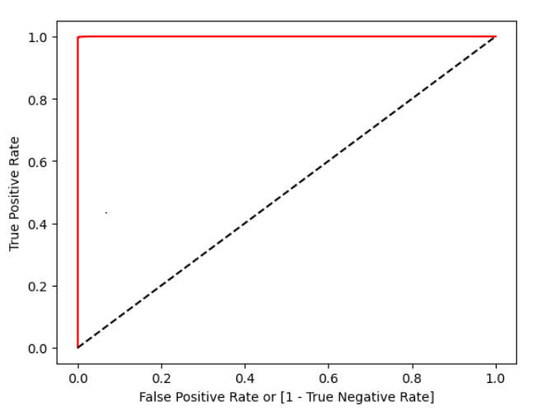
Logistic Regression
This plot shows a very good classifier, with the ROC curve closer to the axes and the "elbow close to the coordinate (0,1).

Slide 15
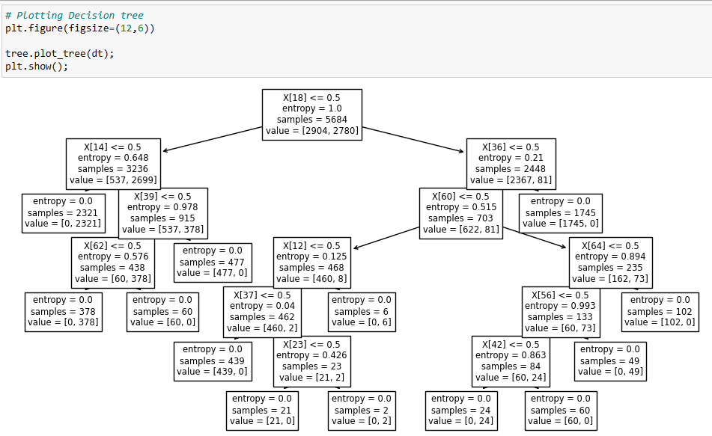
Decision Tree
We applied decision tree using entropy
and Gini criteria.

Slide 16
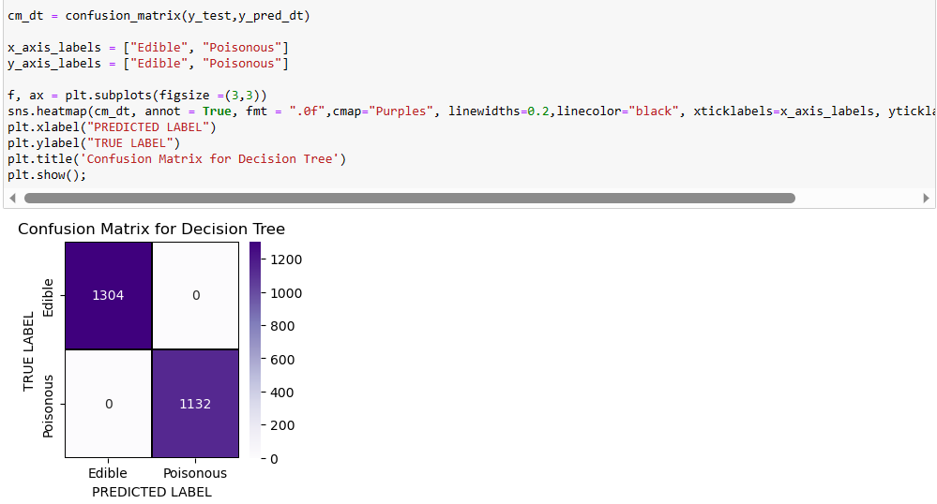
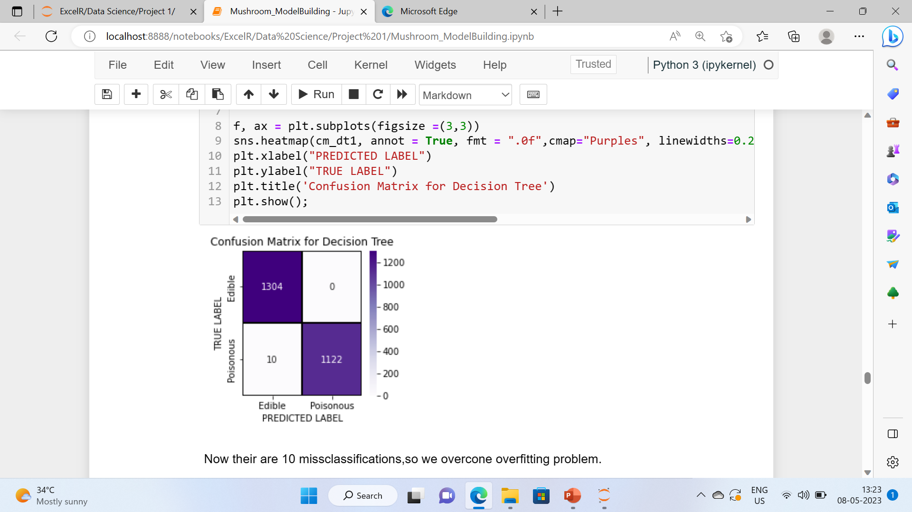
Overfitting problem
No misclassifications
10 misclassifications
By changing maximum length from 6 to 5.

Slide 17
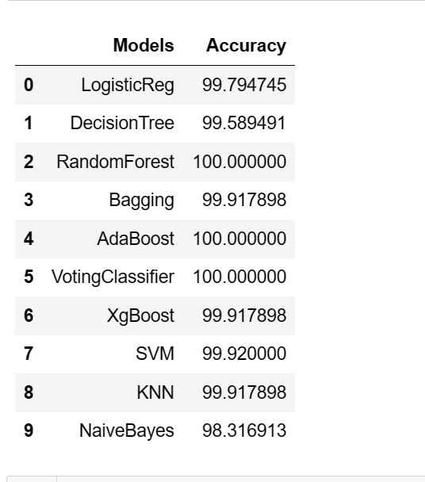
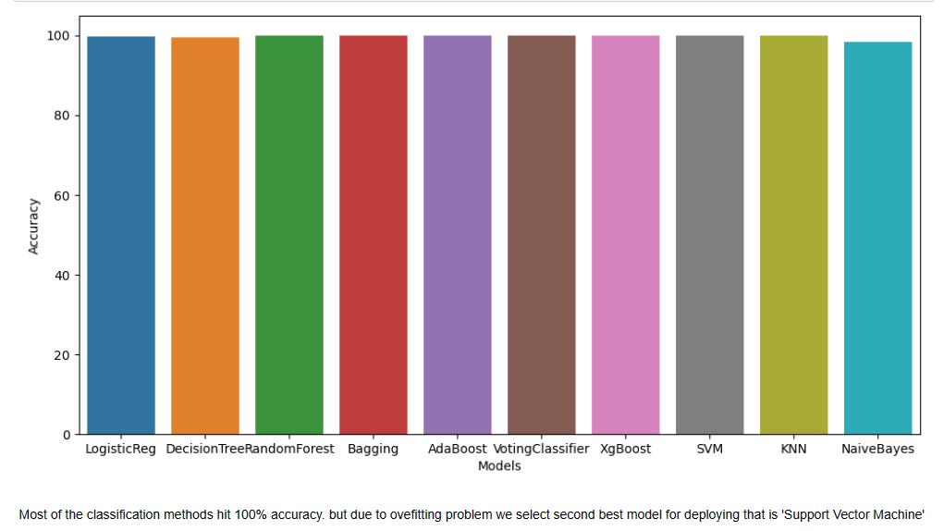
Support vector Machine
Most of the classification methods hit 100% accuracy. but due to overfitting problem we select second best model for deploying that is 'Support Vector Machine' which allows some Misclassifications.

Slide 18
Model Deployment using Streamlit

