Slide 1
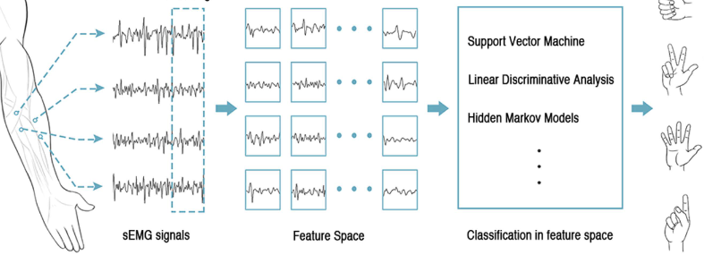
Comparing performance of classifier methods on EMG Hand Gesture Signals using Python
By,
Pallavi Kulkarni
Notes:
Hello Everyone, I am Pallavi Kulkarni. My term project is based on Comparing performance of different classifier methods on HDEMG Hand Gesture signals implemented using Python coding.
Since we had learnt the basic implementation of the same using Matlab in the class, I chose to implement using Python as a extension of my learning from Human Machine Interface class.

Slide 2
Overview
Use publicly available HDEMG Gesture data to predict gestures.
Using Python implementation of ML methods.
Performance comparison of both Shallow and Deep Learning classifier methods.
Understanding effect of more number of HDEMG sensor usage.
Notes:
1. The prediction of gestures from EMG data is an active area of research. Such a capability assists amputees, stroke patients, physicians, and humans to control Robotic arms.
2. All the implementation is being done using Python programming language using Scikit learn for shallow learning ML models and Tensorflow with Keras library for Neural Network model implementation.
3. This project focuses on comparing the performance of different Classifier methods, including both shallow learning and deep learning methods.
4. The publicly available CSL-HDEMG’s, raw EMG data is used for this study.

Slide 3
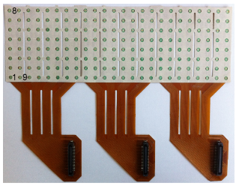
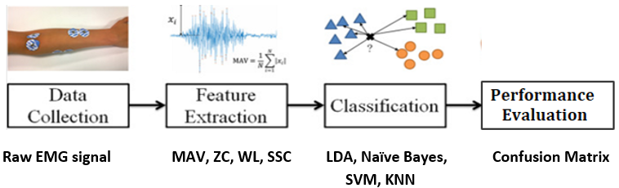
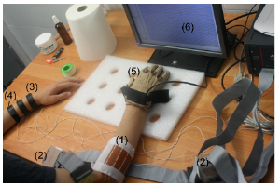
Block Diagram and Hardware Setup
Fig 2. Electrode array used has 8x24 grid arrangement with an inter-electrode distance of 10mm.
Fig 3. Picture of the actual setup used:
Electrode array,
preamplifier,
(3) Reference electrode
Fig 1. Block Diagram
Notes:
As shown in the block diagram –
The publicly available raw CSL-HDEMG data is sourced from a set up which uses an 8x24 grid electrode array resulting in equivalent to 192 single electrodes with an 10 mm inter-electrode distance for a duration of 3sec sampled at a frequency of 2048Hz.
Fig3 shows the actual setup used for data collection and also the placing of Electrode array strip on the arm.
Feature extraction step involves input generation for two classes of learning methods.
For shallow learning methods 4 time domain features are computed
For deep learning method – the raw EMG data is to be reformatted to an image.
For classification
Under shallow learning – the classic classifier methods like SVM, KNN, Naïve Bayes and LDA
Under deep learning – the simplest MLP (Multi Layer Perceptron)
Is being used for the study.
5. Output of the classifier methods is the prediction of the gestures. Confusion matrix along with prediction accuracy is used as the performance metric.

Slide 4
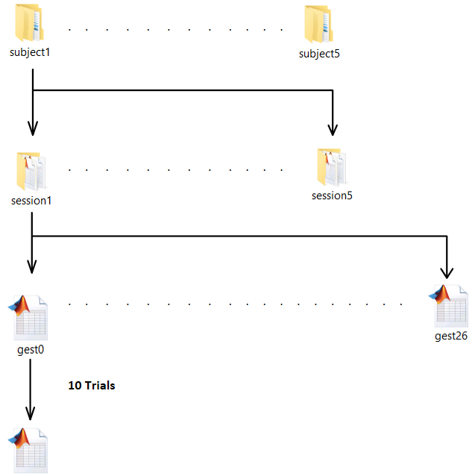
Data setup Critical aspects
Electrode array
Time domain features
Shallow learning methods
Deep learning
Confusion matrix
Fig 4. 5 subjects, 5 Sessions, 27 Gestures 10 trials.
Notes:
Source: Fig 4 gives the data setup of the CSL dataset. The data set has the sEMG raw data acquired from 5 subjects, each subject has performed 5 sessions. Each session has 27 gestures. Each gesture has 10 trials.
Following are the Critical aspects of project
Electrode array – the dataset was chosen because of the acquisition setup specifically the use of electrode array and its placement on the arm which gives realistic representation of neural signals
Time domain features – chosen due to low computational cost, robustness
Shallow learning methods – have shown to be among the best performing for gesture recognition
Deep learning -- for it being an active area of research
Confusion matrix – because of its robustness and simplicity to evaluate the performance.

Slide 5
Proposed for realization
Time Domain Features
Mean Absolute Value(MAV)
Zero Crossing (ZC)
Sign Slope Count(Turns Count/TC)
Willison Amplitude Value(WAV)
Classifiers
Shallow Learning classifiers
SVM
LDA
Naïve Bayes
KNN
Deep Learning classifiers
MLP
Notes:
The data is split into training and testing set in the ratio of 80 to 20.
For shallow learning classifier methods like SVM, KNN, Naïve Bayes and LDA 4 time domain features -- Mean absolute value, Zero crossing, Sign Slope count, Willison Amplitude Value were computed on the training data set.
The transformed dataset is used to train the simplest MLP (Multi Layer Perceptron) under deep learning method.
The testing data are being similarly transformed and provided as inputs to the methods to compute and evaluate the performance.

Slide 6

Expected Outcome Demo with Output achieved
Studying the performance evaluation using confusion matrix
Comparing accuracy of proposed classifier methods
Subj*Sess*Gest*Trial *(168*6144) | SVM | KNN | LDA | NB | MLP
5 * 5 * 2 * 9 | 98.89% | 96.67% | 98.89% | 97.78% | 98.89%
2 * 2 * 2 * 1 | 0% | 0% | 0% | 0% | 0%
2 * 2 * 2 * 9 | 93.33% | 60% | 66.67% | 80% | 93.33%
5 * 5 * 2 * 1 | 40% | 20% | 70% | 10% | 40%
Notes:
The scope of this project is limited to the performance evaluation of classifier methods.
With the help of confusion matrix, the performance evaluation of the classifier methods is studied. As for the expected outcome, comparing the accuracy of various classification methods is successfully achieved with SVM, LDA and MLP achieving an accuracy of 98.89% and 96.67 accuracy from KNN and while Naïve Bayes generated an accuracy of 97.78 for a data set from 5 subjects, 5 sessions, 2 Gestures and 9 trials.
The performance turned out very poor from all the classifier methods with a dataset from 2 subjects, 2 sessions and 2 Gestures.
Thus concluding that increasing the number of dataset will in turn increases prediction performance.
Following is the demo of my project.

Slide 7
Future Work and References
Might be able to demonstrate
CNN
References
Amma, Christoph; Krings, Thomas; Böer, Jonas; Schultz, Tanja (2015). [ACM Press the 33rd Annual ACM Conference - Seoul, Republic of Korea (2015.04.18-2015.04.23)] Proceedings of the 33rd Annual ACM Conference on Human Factors in Computing Systems - CHI '15 - Advancing Muscle-Computer Interfaces with High-Density Electromyography, (), 929–938. https://dl.acm.org/doi/abs/10.1145/2702123.2702501
CSL-HDEMG -- https://www.uni-bremen.de/en/csl/research/motion-recognition
C R. N. Khushaba and S. Kodagoda, “Electromyogram (emg) feature reduction using mutual components analysis for multifunction prosthetic fingers control,” in Control Automation Robotics & Vision (ICARCV), 2012 12th International Conference on. IEEE, 2012, pp. 1534–1539
Chowdhury RH, Reaz MBI, Ali MABM, Bakar AAA, Chellappan K, Chang TG. Surface Electromyography Signal Processing and Classification Techniques. Sensors. 2013; 13(9):12431-12466. https://doi.org/10.3390/s130912431

