Slide 1


Section : 2
Group No : 12
Your health, Our Priority
FInal Presentation
Group Members :
Pallavi Ravikumar Menon
Sonia Rajput
Alok Suresh Chilka
Guide : Professor Muhammad Shahid

Slide 2


Overview: Objective for Each Phase:
Demographic Mapping
Provide details about nearby suppliers for health facility for province of Ontario.
Demographic Mapping
Monitor supply
01
01
02
Make a data visualization tool for the province of Alberta for chronic disease.
Data Visualization Tool
Data Tool
Prediction Model
03
Disease Prediction Model
Build a prediction model for Heart Disease based on parameters of interest.

Slide 3
Cleaning/EDA links for Each Phase
Monitor Supply
Data Tool
Prediction Model
Links For Cleaning/EDA
Links For Cleaning/EDA
Links For Cleaning/EDA
Merge & Save Supplier Data
Cleaning Of Supplier Data
Cleaning & EDA of Health Providers
DataTool_Alberta
HeartData_EDA
DataTool_Alberta

Slide 4
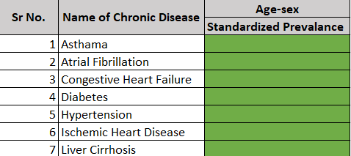
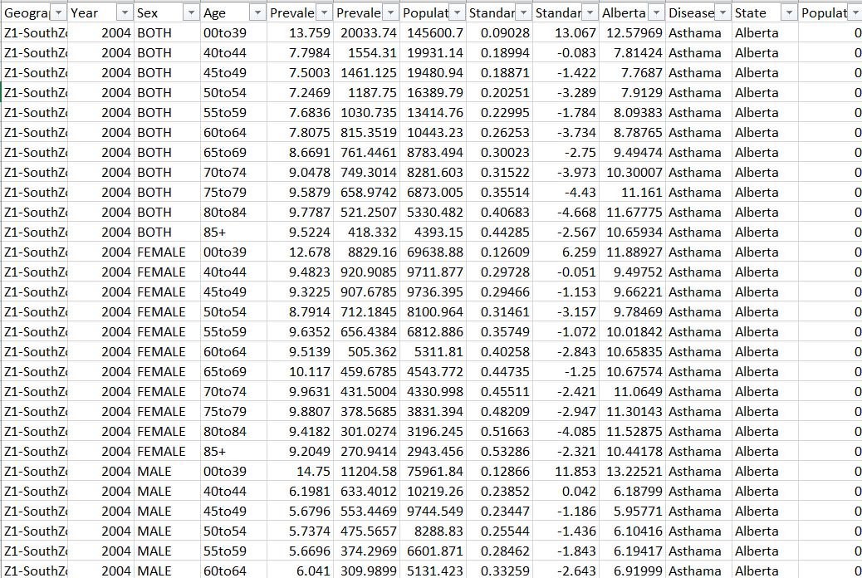
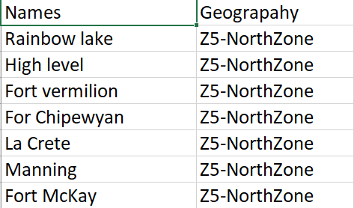
Visualization: Alberta Health Tool (1/2)
2
1
Cleaned & Collated all CSV in Jupyter Notebook
Chronic Diseases For Visualizations
3
Made excel containing city names for Healthzones in Alberta
Loaded in Tableau for visualization

Slide 5
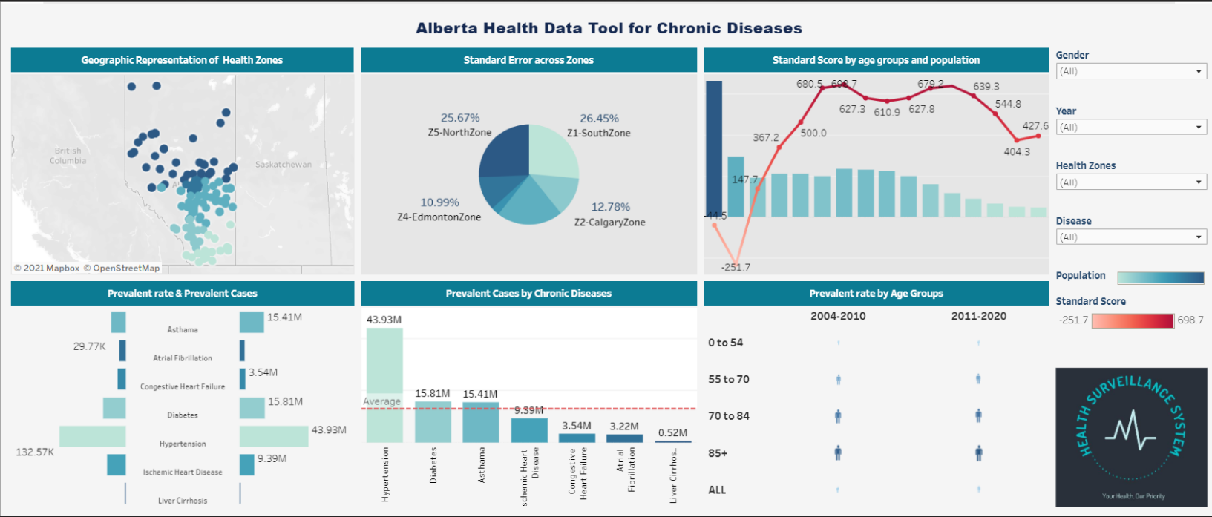
Visualization : Alberta Health Tool (2/2)

Slide 6
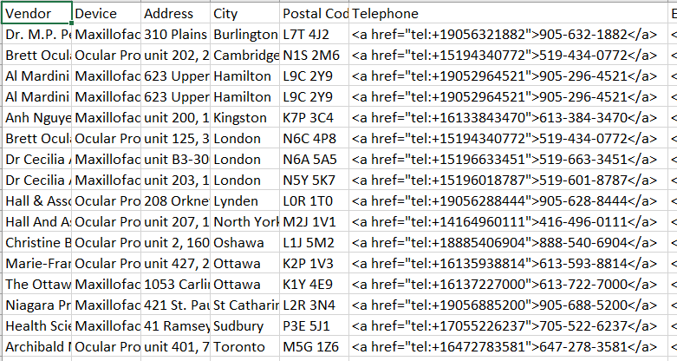
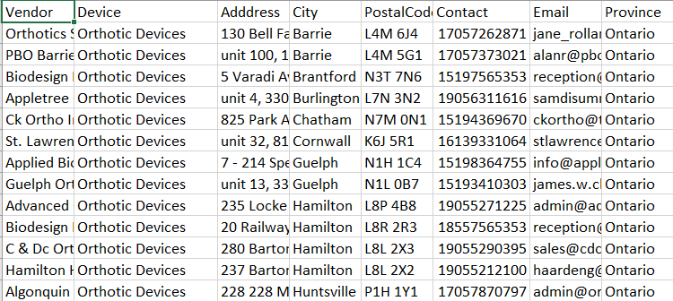
Visualization : Ontario Medical Device Suppliers (1/2)
1
2
Unclean Data for particular medical device
Cleaned & Collated all CSV in Jupyter Notebook
Loaded in Tableau for visualization

Slide 7
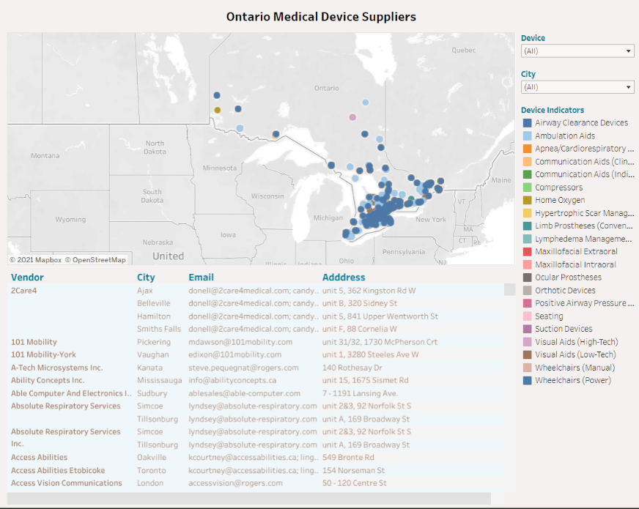
Visualization : Ontario Medical Device Suppliers (2/2)

Slide 8
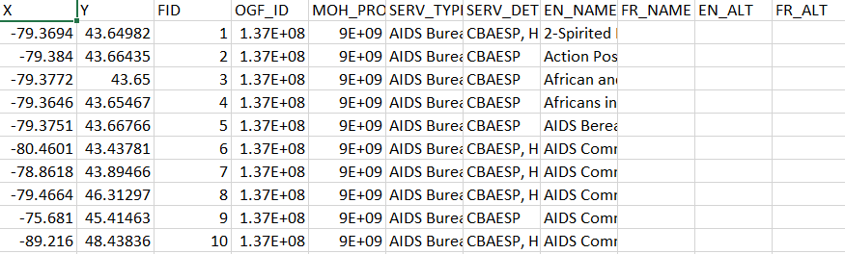
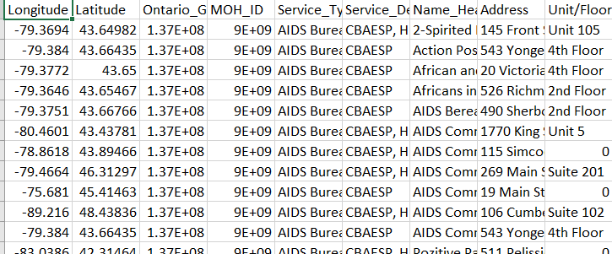
Visualization : Ontario Health Providers(1/2)
1
2
Unclean Data for particular medical device
Cleaned & Collated all CSV in Jupyter Notebook
Loaded in Tableau for visualization

Slide 9
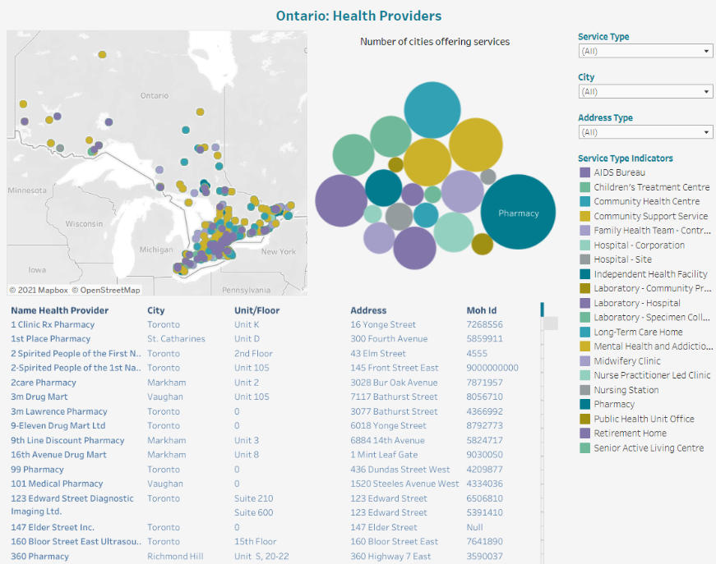
Visualization : Ontario Health Providers(2/2)

Slide 10


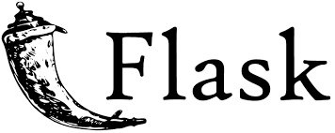
Process Flow: Phase 1
CSV / Excel / API
Dataset Source 1
Dataset Source 2
Cleaning /
Pre processing
Dataset Source 3

Slide 11
Process Flow: Phase 2
Data Source
Alberta Province Diseases
Locations
Health Service Providers
Medical Device Providers
CHD Dataset
Cleaning /
Pre processing
API / Business Logic
Flask Framework
ngrok.io
Dataset
View
Demographic View
Prediction View
localhost

Slide 12
Prediction Model: Heart Disease
Cardiovascular disease is one of the most fatal conditions in the present world.
Statistical data display the lethalness of Cardiovascular disease by revealing the percentage of deaths worldwide caused due to heart attacks. Thus, there is an implicit necessity to predict the condition at the earliest.
By utilizing the patients medical records, a new system is proposed to predict the chances of a person contracting heart attack. Attributes such as age, blood pressure, thickness of the artery etc. are fed into the Logistic regression used to predict risk of heart attack in a person.
Neural networks are composed of a series of computational nodes structured into several layers.
The models have been tested on a very limited and small patient database. Later it can be tested rigorously on large patient database.
The proposed model for predicting the Heart disease would assist doctors in the diagnosis of disease.
Accuracy of the model with Logistic Regression is 87% and with Tabnet classifier its 71%

Slide 13
Thank you
Thank you

