Slide 1
WELCOME

Slide 2
KRITTER ASSIGNMENT
Village Economic
Growth Intelligence
Identifying India's Top 100 Fastest Growing Districts
Using Satellite Data (2019 – 2024)
Tools: Google Earth Engine | Python | Google Colab

Slide 3
THE PROBLEM
📊
📅
💸
No Real-Time GDP Data
Outdated Census
Surveys are Expensive
Village & district-level GDP is not published or tracked in India in real-time
Last Census published in 2011 — over 14 years of missing ground-level data
Traditional surveys are slow, costly, and cover only a fraction of India's 640,000+ villages
Solution: Satellite imagery captures economic signals -lights, construction, vegetation -continuously, for free, across all of India

Slide 4
DATA SOURCES & WHY WE CHOSE THEM
Signal
Dataset
Source
Why Used
Nighttime Lights
NOAA VIIRS DNB Monthly
Google Earth Engine
Best proxy for economic activity & electrification
Vegetation (NDVI)
MODIS MOD13A3
NASA / GEE
Measures agricultural productivity & land use change
Built-up Area
JRC GHSL Built Surface
EU Joint Research Centre
Tracks construction growth & urbanization
District Boundaries
FAO GAUL Level 2
FAO / GEE Built-in
640 Indian districts — base geographic unit
⏱ Time Period: January 2019 → December 2024 (5-year change) | Platform: Google Earth Engine (free, browser-based)

Slide 5
METHODOLOGY & SCORING FRAMEWORK
Satellite
Data (GEE)
→
Extract per
District
→
Normalize
(0 → 1)
→
Weighted
Score
→
Rank
Top 100
Growth Score = (NTL Change × 0.50) + (NDVI Change × 0.25) + (Built-up Change × 0.25)
50%
25%
25%
Nighttime Lights
NDVI Vegetation
Built-up Area
Strongest proxy — directly reflects electricity use, commerce & activity
Agriculture is primary livelihood in rural India — crop health = income
Construction = investment flowing into a region — urbanization signal

Slide 6
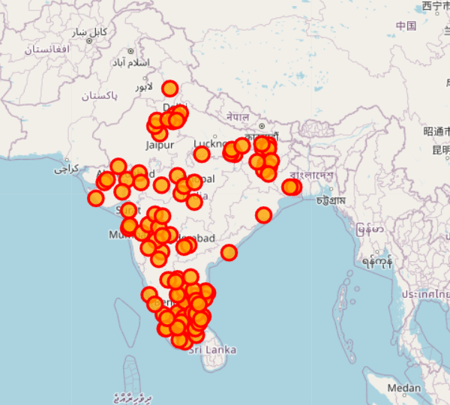
KEY FINDINGS
🗺️
Paste your map screenshot here
(top100_map screenshot)
Top 10 Fastest Growing Districts
#
District
State
Score
1
Mumbai_City
Maharashtra
0.65
2
Daman
Daman & Diu
0.50
3
Chandigarh
Chandigarh
0.44
4
Mumbai Suburban
Maharashtra
0.39
5
Bangalore Urban
Karnatakata
0.38
6
Gautam Buddha Nager
Uttar Pradesh
0.37
7
Salem
Tamil Nadu
0.365
8
Chennai
Tamil Nadu
0.362
9
Varanasi
Uttar Pradesh
0.33
Most growth concentrated in Southern & Western India — Tamil Nadu, Maharashtra, and Karnataka lead
10
Namakkal
Tamil Nadu
0.32

Slide 7
REGIONAL DISTRIBUTION OF GROWTH
🥇
Tamil Nadu
26 districts
Dominates top 100 — strong NTL & built-up growth
🥈
Maharashtra
12 districts
Mumbai corridor driving industrial growth
🥉
Karnataka
8 districts
Bengaluru tech hub radiating outward
⚡
Bihar & Jharkhand
10 districts
Rapid catch-up growth in lagging states

Slide 8
LIMITATIONS & NEXT STEPS
⚠ LIMITATIONS
✅ NEXT STEPS
⚠ District level used — village-level data not freely available
✅ Obtain village-level boundaries (600,000+ villages)
⚠ Proxy signals, not actual GDP or income measurements
✅ Add road network growth as an additional signal
⚠ Tamil Nadu has more districts — may inflate its ranking count
✅ Add hospital & school density change indicators
⚠ Cloud cover affects satellite readings in some regions
✅ Validate findings with PMGSY & MNREGA ground data
⚠ MODIS resolution (1 km) may miss small village-scale changes
✅ Use Machine Learning instead of manual weighted scoring
"With more time, a village-level ML pipeline could provide near real-time economic intelligence for all of India"

Slide 9
THANK YOU

