Slide 1
Process

Slide 2
Course Objective
What is a process?
Business Workflow
Process lifecycle
Functionalities
Setup
Summary

Slide 3
Session Plan
What is a process?
Business Workflow
Functionalities
Setup
  Routing Configuration Setup
  Escalation Configuration Setup
Summary

Slide 4
What is a process?

Slide 5
What is a process?
Process
  Collection of tasks that are started for achieving a specific purpose
  Laid Down procedures or steps for performing an activity
  One step or a series of steps
  Ensures that a standard practice is followed across the bank by all the bank users
Process – “A process is a well defined sequence of process stages”

Slide 6
Business Workflow

Slide 7
Business Workflow
Process Definition
Routing – Assign users for process steps
Attaching SLA as a part of a process
Process validation
Process Deployment

Slide 8
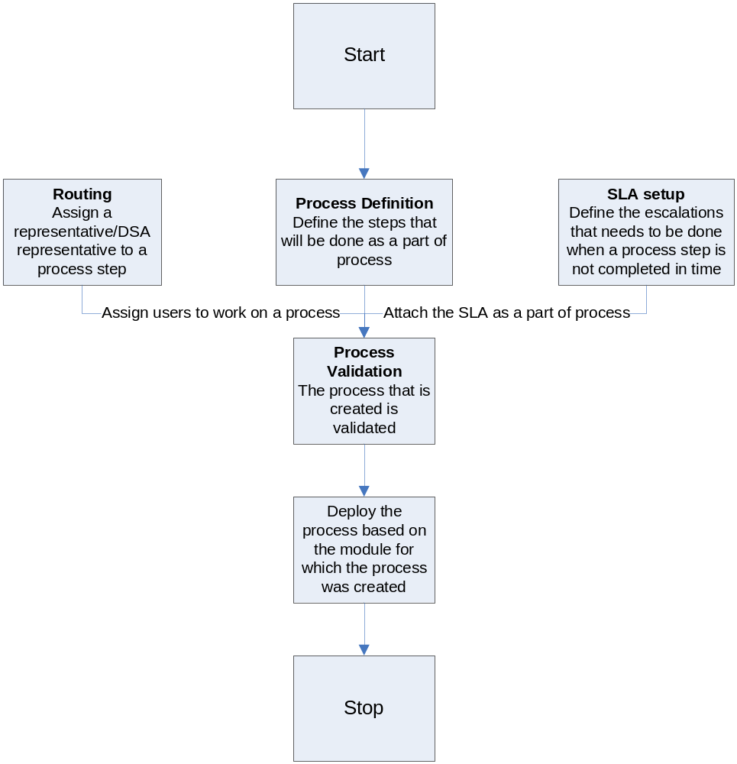
Continued…

Slide 9
Process Lifecycle
Let us create a Process for a Loan application which has the below mentioned process steps.
Step No | Process Stage | Next Process Step No
1 | Submit Application | 2
2 | Eligibility Calculation | Pass - 3, Fail – 4, Refer - 2
3 | Approval Letter | 4
4 | File Close | Stop

Slide 10
Functionalities

Slide 11
Functionalities
Process Definition
  Identifying process steps that would be a part of the process
  Specifying the module in which the process would be used.
  Sequencing the process steps
    Specifying which steps would be called next
  Configure the process to run either sequentially or randomly
  Configure the next step to be called based on the success or failure of current step
  Automating a process step
    No manual intervention needed
    Runs as a daemon process

Slide 12
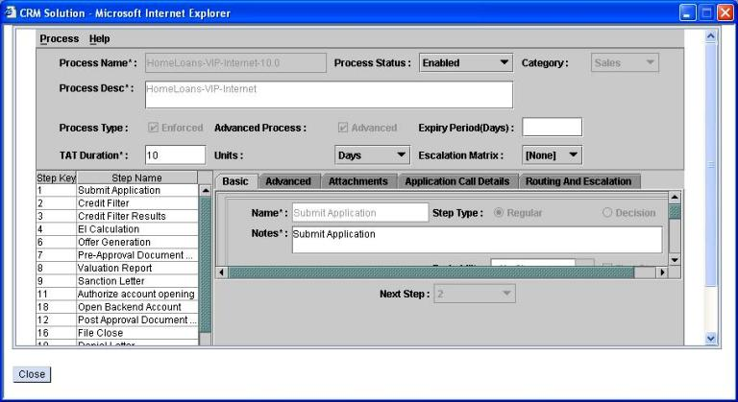
Functionalities Contd.

Slide 13
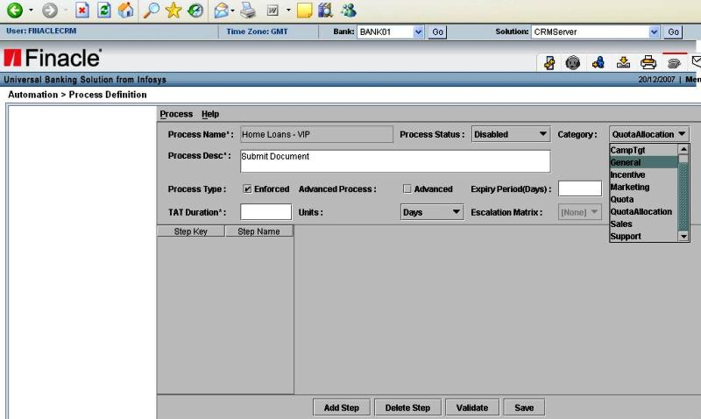
Module Specific Process

Slide 14
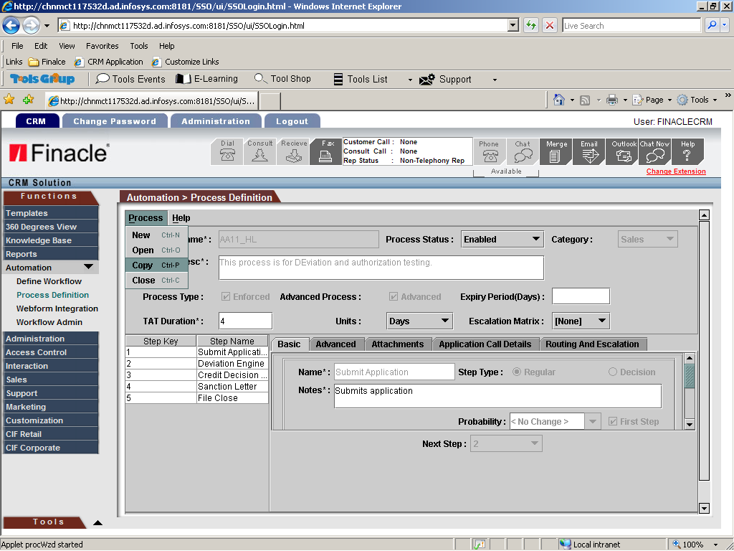
Copy

Slide 15
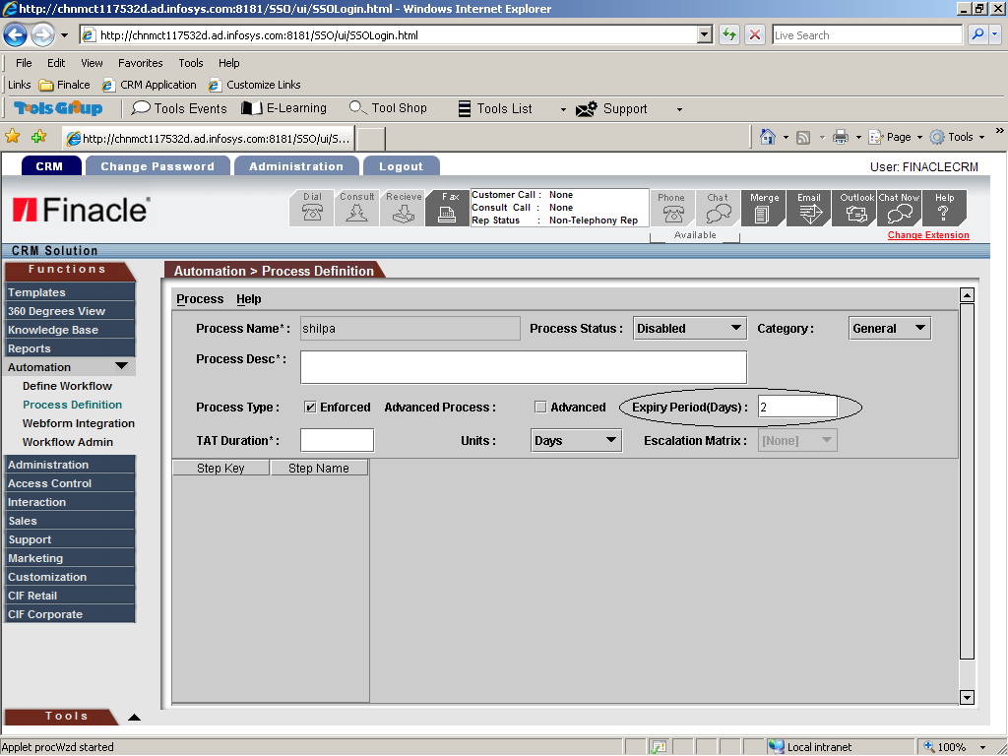
Expiry Date

Slide 16
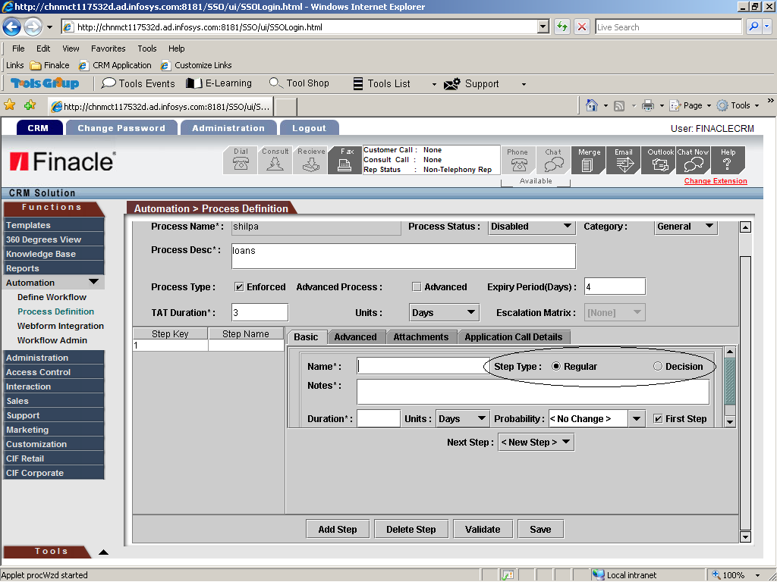
Regular step- Normal transfer of process

Slide 17
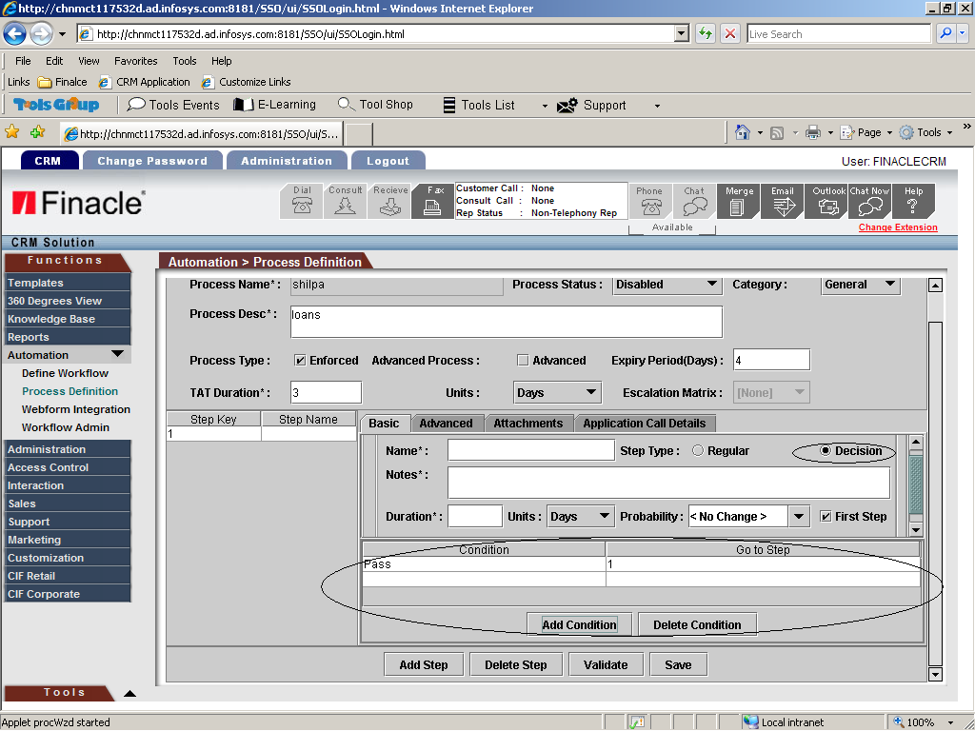
Decision step- Conditional transfer of process

Slide 18
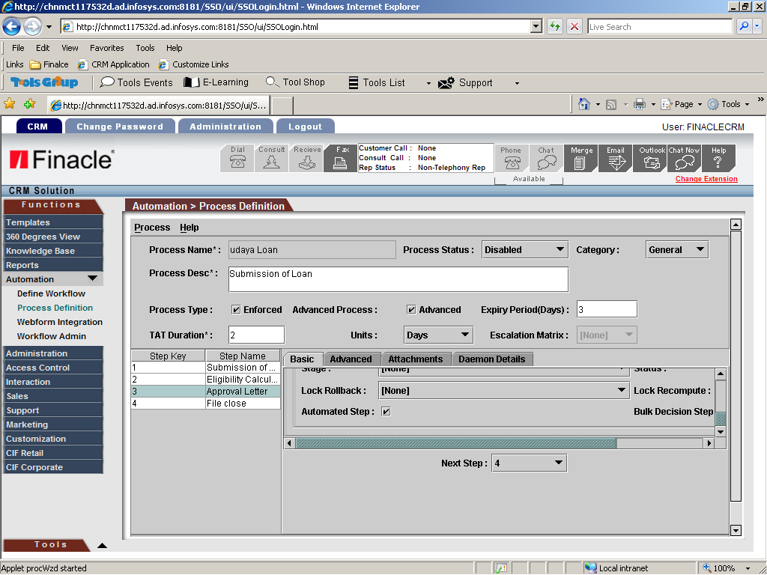
Automated Step

Slide 19
Functionalities Contd.
Process Definition
  Assigning a process step to a representative/DSA
  Set a TAT for completion of a process
    The time within which a particular process step must be completed
    Can be in terms of days or hours or minutes or week.
  Escalation when TAT is not met
Process Validation
  Validate the process and check whether the process steps are proper
  Only validate processes can be enabled for deployment
Process Enabling
  Enable the process for deployment in the application

Slide 20
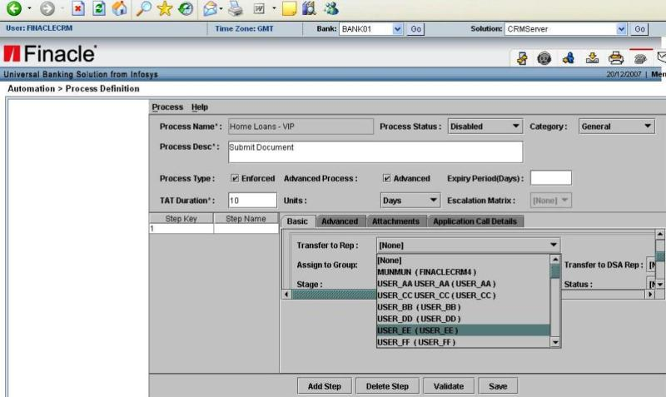
Functionalities Contd.
Assigning a process step to a representative

Slide 21
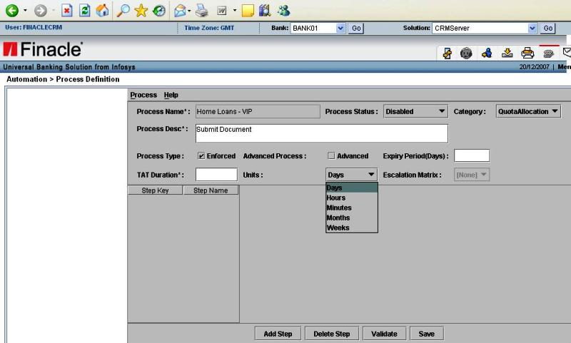
Functionalities Contd.
Setting a TAT for a process step

Slide 22
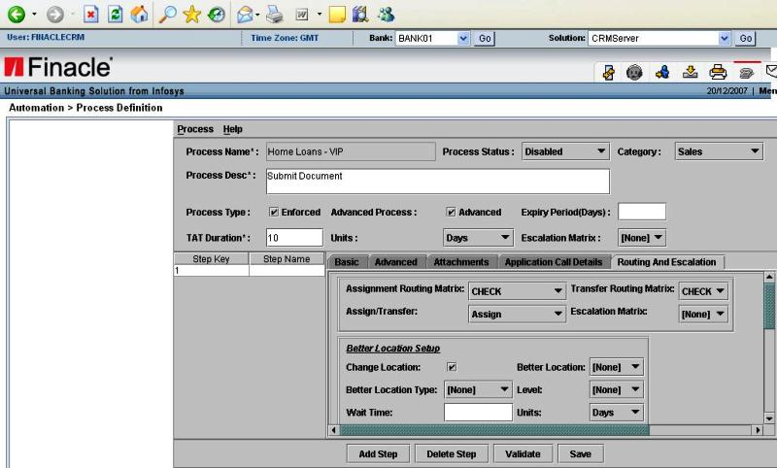
Escalation

Slide 23
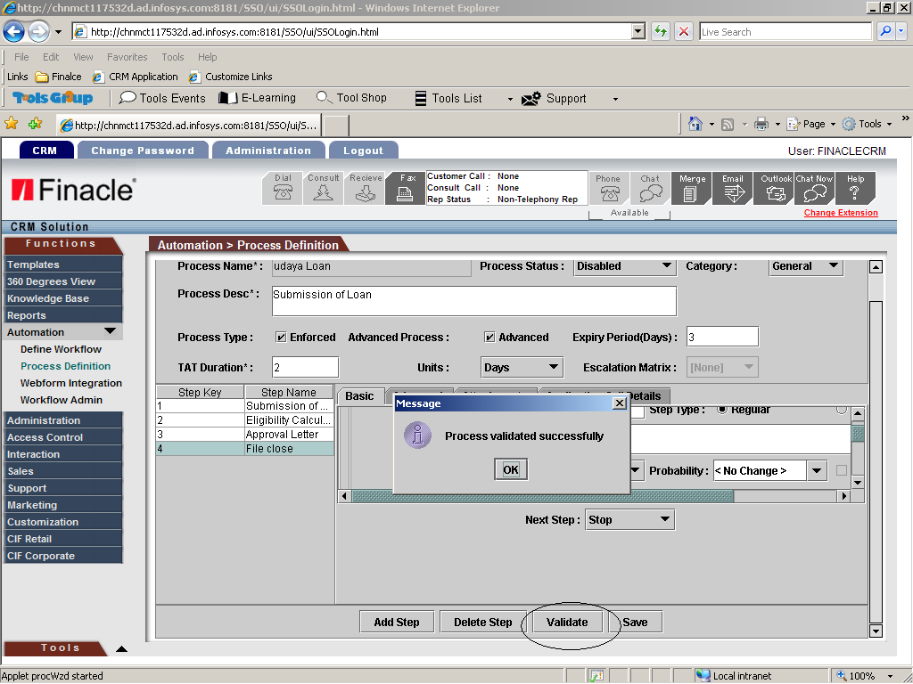
Validate

Slide 24
Functionalities Contd.
Process Deployment
  Linking the process to the specific purpose for which it was created like campaign approval, loan application processing

Slide 25
Features
Category wise Process definition i.e, module specific process (CIF, Sales, Support and General)
Maintenance of process (Modification and Copy of Process)
Attachment of Routing logic for each process step
Attachment of Escalation logic for each process step
Turn around Time for Process/Process Step
Classification of each process step as Manual or Automatic
Turn Around Time based on SLA Attribute
Classification of each process step as Manual or Automatic
Classification of steps as Regular and Decision making steps
Validation of Process before enabling it for use

Slide 26
Setup

Slide 27
Setup
Creation of Reps, Groups, DSA, DSA Reps, Assigning Reps, DSA Reps to Groups, Functional Privileges.
Business centre, Business centre Group, Business centre Type, Holiday master set up.
Template Creation – Templates for e-mails in case of escalation, Sanction letters, denial letters and offer letters.
Routing Matrix – Selection of User/group for transfer/assignment of process steps.
Escalation matrix – Configuring escalation rule incase of noncompliance with TAT.

Slide 28
Routing Configuration setup
Rule for assigning users/groups for transfer/assignment of process steps
Logic defined to allocate the CIF entities, incidents or opportunities to the most appropriate user or group available in the bank.

Slide 29
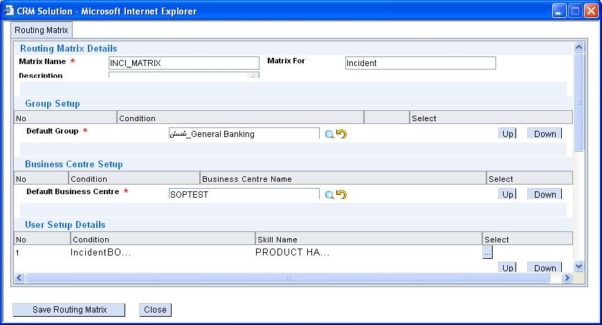
Routing Configuration setup

Slide 30
Escalation Configuration setup
Setup a logic for handling escalation when a specific process step is not completed within a specified time frame.
Escalations can be triggered in the event of exceeding predefined number of transfers and assignments within a process step
Escalation only through e-mail
Escalation upto a maximum of 6 levels based on TAT

Slide 31
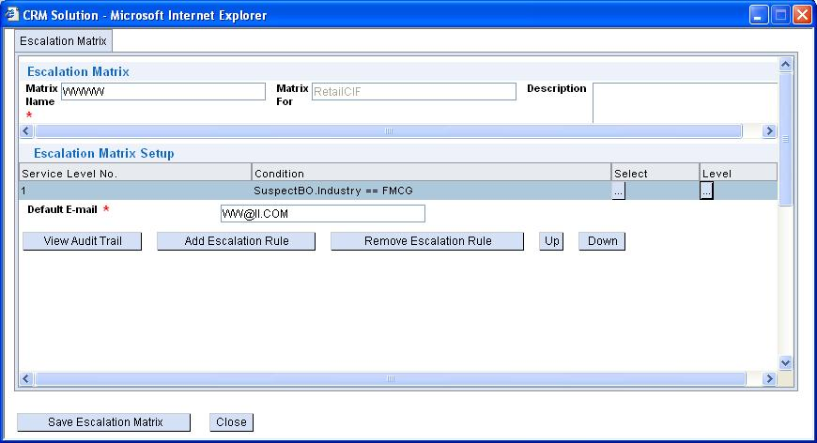
Escalation Configuration setup

Slide 32
Summary

Slide 33
Summary
Configuration of multiple process definition
Category wise Process definition – Processes can be defined for the category for which they are created (e.g. Marketing, Sales, General)
Classification of each process step as Manual or Automatic
Configuration of steps in a Random manner or Sequential Manner
Turn around time for process – The time duration within which the process needs to be completed.
Turn around Time for Process Step
Manual routing a specific user/group
Routing based on a rule to specific users/groups
Maintenance of process (Modification and Copy of Process)
Switching over to single/multiple steps from a process step based on step definition
Validation of Process before enabling it for use

Slide 34
Thank You

