Slide 1

BANK MARKETING
PALLAVI THATTI

Slide 2
Problem statement… Our Understanding
The data is related with direct marketing campaigns of a Portuguese banking Institution. The Market campaigns were based on phone calls. Often, more than one contact to the same client was required, in order to access if the product (bank term deposit) would be(‘yes’) or not(‘no’) subscribed.
Objective: To predict whether the client will subscribe a term deposit or not (variable y).
    Yes (1)
    No (0)

Slide 3
Data Characteristics
Type of Problem : Classification
No of Records : 41188
No of Attributes : 21
Type of Target Attribute : Binary(yes or no)
Type of Variables: Factor and Numerical

Slide 4
Data characteristics continued….
Class Imbalance(80-10)
Error Metrics : Sensitivity
Going to predict the client is subscribed for term deposit.

Slide 5
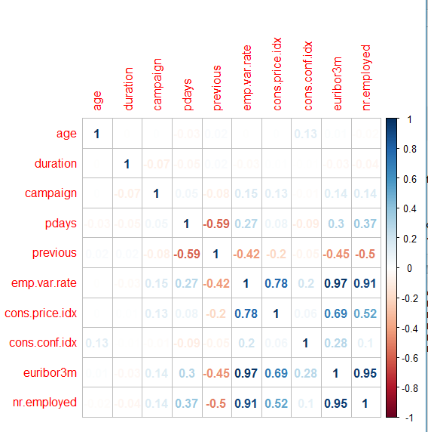
Correlation Plot

Slide 6
-> No of missing values observed :12178
-> Hence central imputation is required
-> Using SMOTE for class balance
-> Library used : Caret
Pre-Processing

Slide 7
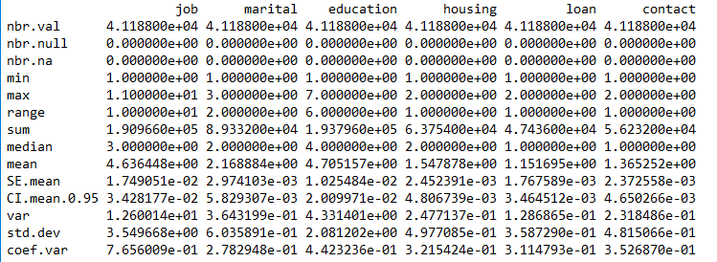
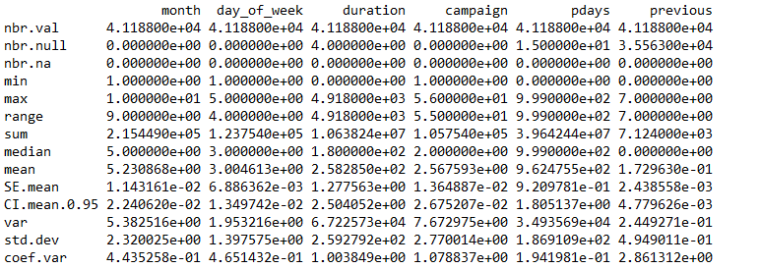
Descriptive Statistics

Slide 8
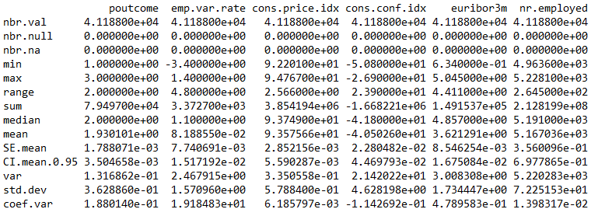
Descriptive statistics continued…

Slide 9
Analysis for selecting the model
Models without PCA consideration
  Logistic regression
  Random Forest
  SVM
  KNN
  Decision trees
  Bagging
  GBM
Feature reduction
  PCA

Slide 10
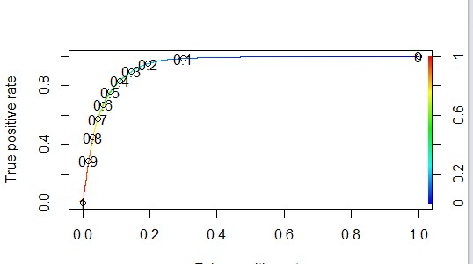
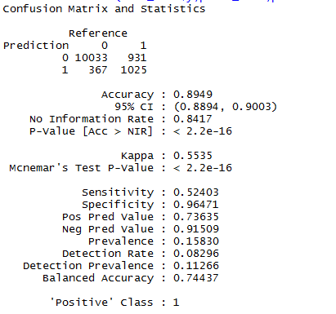
Logistic regression – ROC curve
AUC-0.94

Slide 11
Confusion matrix of all models
Model | Accuracy | Sensitivity | Specificity | Kappa
Random Forest | 0.91 | 0.54 | 0.96 | 0.54
SVM(kernel=linear) | 0.89 | 0.76 | 0.91 | 0.56
SVM(kernel=tanhdot) | 0.75 | 0.77 | 0.50 | 0.18
Random Forest(with smote data) | 0.91 | 0.72 | 0.93 | 0.58
KNN | 0.89 | 0.47 | 0.94 | 0.42
Decision Trees | 0.89 0.90 | 0.75 0.66 | 0.91 0.93 | 0.55 0.53
Bagging | 0.85 | 0.84 | 0.85 | 0.48
GBM | 0.87 | 0.91 | 0.86 | 0.54

Slide 12
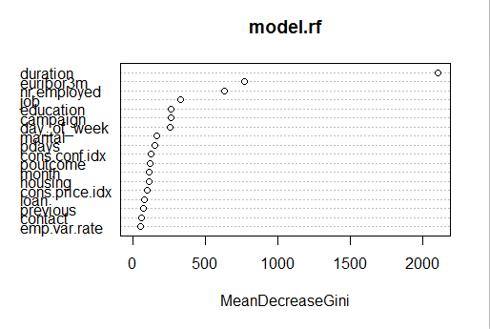
Random Forest

Slide 13
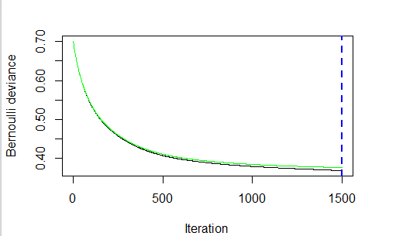
GBM Observations

Slide 14
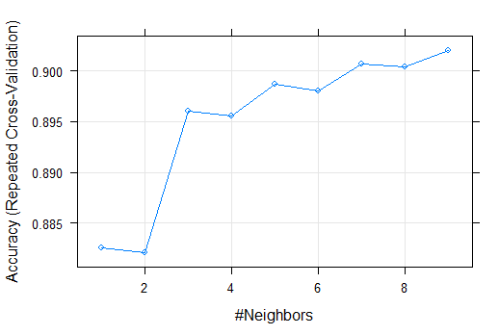
KNN-Cross-Validation-Without PCA

Slide 15
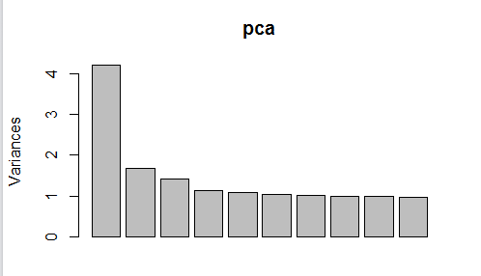
PCA Components

Slide 16
Analysis for selecting the model
Models with PCA consideration
  Logistic regression
  Random Forest
  SVM
  KNN
  Decision trees
  Bagging
  GBM

Slide 17
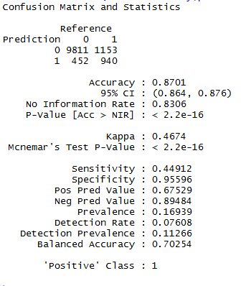
Logistic regression – ROC curve
AUC-0.89

Slide 18
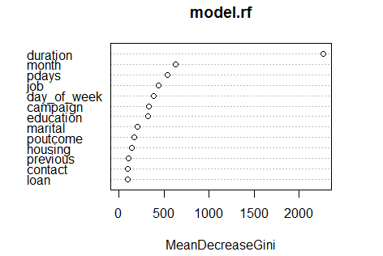
Random forest with PCA

Slide 19
Confusion matrix of all models with PCA
Model | Accuracy | Sensitivity | Specificity | Kappa
Random Forest | 0.87 | 0.39 | 0.96 | 0.48
SVM(kernel=linear) | 0.89 | 0.62 | 0.92 | 0.56
SVM(kernel=tanhdot) | 0.75 | 0.62 | 0.92 | 0.49
Random Forest(with smote data) | 0.92 | 0.68 | 0.93 | 0.58
KNN | 0.89 | 0.47 | 0.94 | 0.34
Decision Trees | 0.89 0.90 | 0.75 0.66 | 0.91 0.93 | 0.55 0.53
Bagging | 0.85 | 0.84 | 0.85 | 0.48
GBM | 0.80 | 0.79 | 0.90 | 0.41

Slide 20
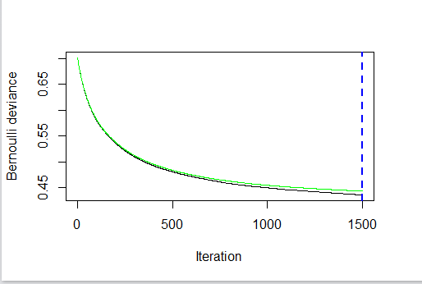
GBM model with PCA

Slide 21
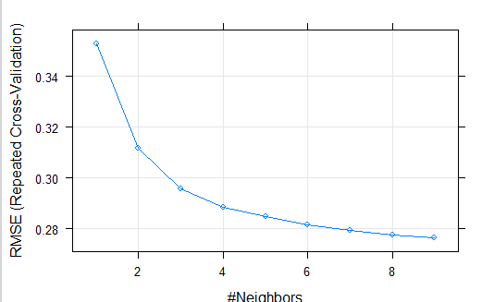
KNN Cross-Validation model with PCA

Slide 22
Future Enhancements for model
Try Ensemble techniques (stacking)
ANN
XG Boosting

Slide 23
Thank you any questions!??
SUGGESTIONS PLEASE..

