Slide 1
Early Detection of Wheat Diseases
CSE7302- University Project
Review-2
Batch Number:ISE-4
Under the Supervision of:
Dr.Yamanappa
Assistant Professor
School of Computer Science and Engineering
Presidency University
Roll Number | Student Name
20221ISE0109 | Pallavi J
20221ISE0117 | Ganavi HR
20221ISE0135 | Chandrakala KT
Name of the Program: Btech Information Science and Engineering
Name of the HoD: Dr. Gopal Shyam
Name of the Program Project Coordinator: Ms. Suma NG
Name of the School Project Coordinators: Dr. Sampath A K , Dr. Geetha A

Slide 2
Problem Statement Number: SIH25268
Organization: Ministry of Agriculture & Farmers Welfare- Government of India
Category :Software
Problem Description:
Wheat is one of the most important staple crops in India, and its productivity is significantly
affected by diseases such as leaf rust, brown rust, and leaf blight. Early identification of these
diseases is challenging for farmers due to lack of expert knowledge, delayed field inspections, and
limited access to agricultural advisory services. Late detection often leads to severe crop damage,
reduced yield, and economic loss for farmers. There is a need for an automated and reliable system
to assist farmers in the early detection of wheat diseases.

Slide 3
Abstract
Wheat is a major staple crop in India, and its yield is significantly affected by diseases such as leaf rust, brown rust, and leaf blight. Early detection of these diseases is difficult for farmers due to lack of expert knowledge and delayed field inspections. This project proposes an AI-based early detection system that analyzes wheat leaf images using deep learning techniques to identify disease presence at an early stage. The system provides prediction results along with advisory suggestions to assist farmers in preventive measures. The approach focuses on image classification, accuracy analysis, and visualization of disease trends using a simple and cost-effective software solution developed in Python using Google Colab/VS Code

Slide 4
Literature Survey
Mohanty et al. (2016) – Demonstrated deep CNN for plant disease detection using PlantVillage dataset with high accuracy.
Ferentinos (2018) – Used deep learning architectures for crop disease classification and achieved strong performance.
Too et al. (2019) – Compared multiple CNN models for agricultural image classification.
Sladojevic et al. (2016) – Proposed deep neural networks for automatic plant disease recognition.
Brahimi et al. (2017) – Applied CNN for leaf disease detection and classification.
Zhang et al. (2020) – Used transfer learning for crop disease identification.
Picon et al. (2019) – Applied computer vision techniques for wheat disease detection.
Kamilaris & Prenafeta (2018) – Reviewed deep learning applications in agriculture.
Barbedo (2018) – Surveyed image-based plant disease detection methods.
Liu et al. (2017) – Implemented deep learning for crop health monitoring.
Observation: Most research uses CNN and transfer learning; however, many systems lack advisory support and real-time usability for farmers. Our project focuses on early detection plus advisory output with simplified implementation.

Slide 5
Objective:
To develop an automated system for early detection of wheat diseases
To assist farmers in identifying crop health conditions using image analysis
To reduce crop loss through timely disease detection
To provide advisory support for preventive actions
To enable data-driven monitoring of disease patterns

Slide 6
Existing Methods and Drawbacks
Existing Methods
Manual inspection by agricultural experts.
Laboratory testing of crop samples.
Basic computer vision techniques without deep learning.
Drawbacks
Time-consuming and expensive.
Limited accessibility for rural farmers.
Human error and delayed detection.
Lack of automation and analytics support.

Slide 7
Proposed Method & Feasibility Study
Proposed Method
The system uses Convolutional Neural Networks (CNN) to analyze wheat leaf images. Images are preprocessed, normalized, and fed into a trained deep learning model. The model predicts disease type and displays advisory suggestions. Accuracy graphs and visualization charts are generated to monitor performance.
Feasibility Study
Technical Feasibility:Uses open-source tools (Python, TensorFlow, Google Colab) requiring no paid infrastructure.
Economic Feasibility: Low cost since datasets and tools are free.
Operational Feasibility: Easy to operate; only image input required.
Resource Feasibility: Runs on standard laptops or cloud notebooks.

Slide 8
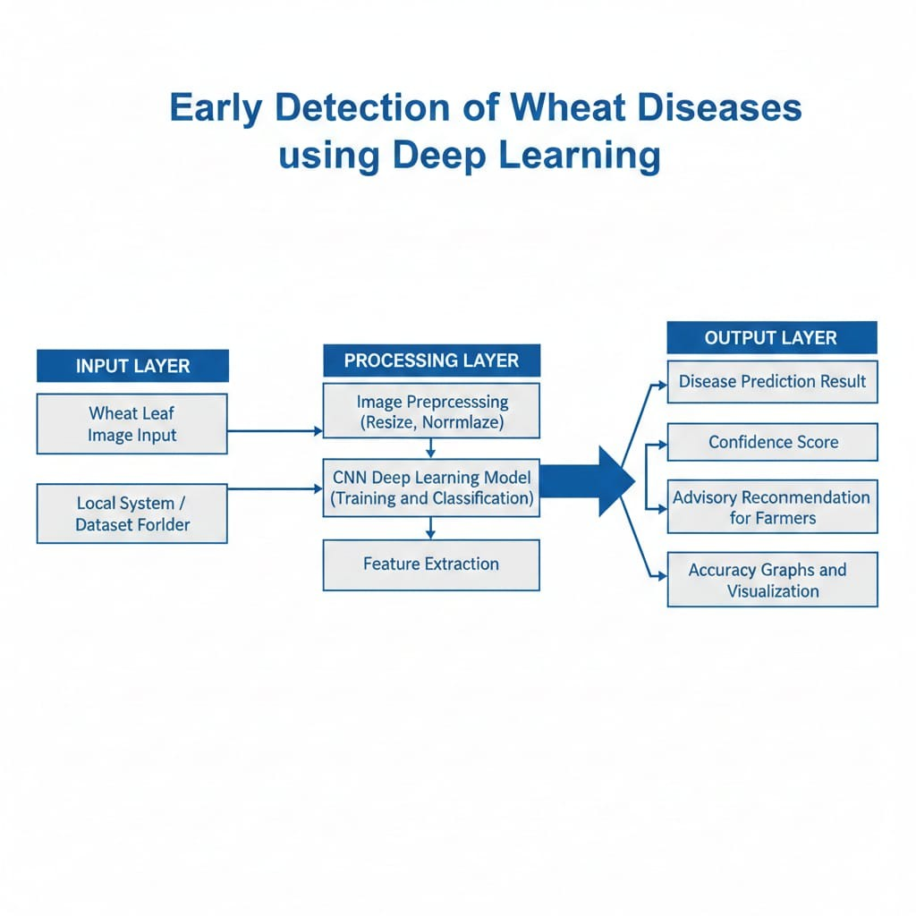
Architecture Diagram
Input Layer: Wheat leaf image upload. Processing Layer: Image preprocessing, CNN model training and classification. Output Layer: Disease prediction, confidence score, advisory message, and visualization graphs.

Slide 9
Modules
Image Input Module – Uploads wheat leaf images.
Preprocessing Module – Resizes and normalizes images.
Model Training Module – CNN training using dataset.
Prediction Module – Classifies disease type.
Advisory Module – Displays preventive suggestions.
Analytics Module – Accuracy graphs and trend visualization.

Slide 10
Technology Stack Components
Hardware
Laptop/Desktop (8GB RAM recommended)
Internet connection (for dataset download)
Software
Python
Google Colab / VS Code
TensorFlow / Keras
NumPy, Pandas, Matplotlib
PlantVillage Dataset

Slide 11
Github Link
GitHub Link:
https://github.com/Pallavijagadish/Early-wheat-disease-detection

Slide 12
Timeline of the project
Review 1
Problem identification
Literature survey
Dataset collection and analysis
Review 2
Model architecture design
Image preprocessing implementation
Initial model training
Review 3
Model optimization and testing
Accuracy and performance evaluation
Visualization and analytics development
Review 4
Final testing and validation
Documentation and report preparation
Project demonstration

Slide 13
References :
[1] S. Mohanty, D. Hughes, and M. Salathé, “Using Deep Learning for Image-Based Plant Disease Detection,” Frontiers in Plant Science, 2016. [2] K. P. Ferentinos, “Deep Learning Models for Plant Disease Detection,” Computers and Electronics in Agriculture, 2018. [3] A. Kamilaris and F. Prenafeta-Boldú, “Deep Learning in Agriculture,” Computers and Electronics in Agriculture, 2018.

Slide 14


