Slide 1
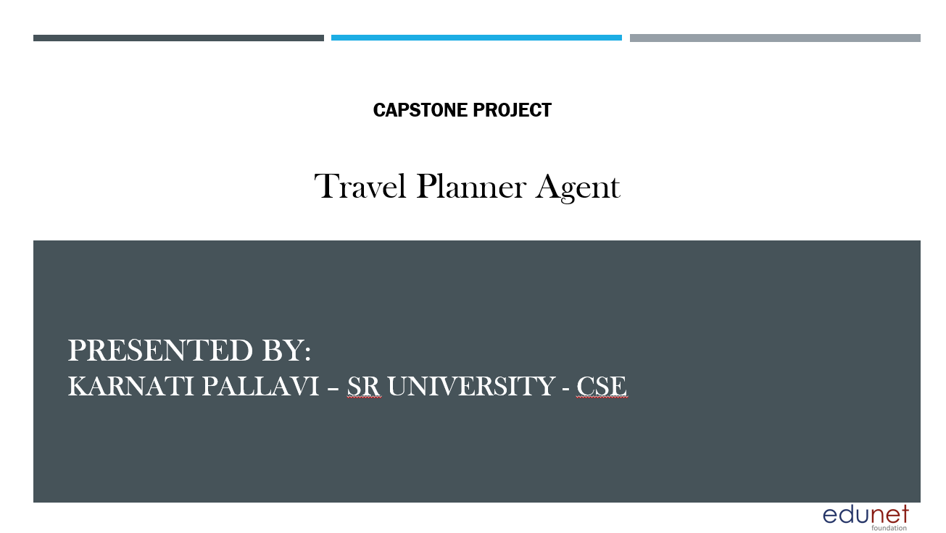

Slide 2
OUTLINE
1. Problem Statement
2. Proposed System/Solution
3. System Development Approach (Technology Used)
4. Algorithm & Deployment
5. Result (Output Image)
6. Conclusion
7. Future Scope
8. References

Slide 3
Problem Statement
Modern travelers face challenges in planning trips efficiently and smartly. Searching for destinations, booking transport and accommodation, and managing updates manually is time-consuming and complicated. Travelers often struggle to find options that fit their preferences, budgets, and schedules, leading to stress and last-minute changes.
There is a need for an AI-powered assistant that understands user preferences and constraints, uses real-time data, and provides personalized travel planning with destination suggestions, tailored itineraries, recommended bookings, and smart alerts for a smooth travel experience.

Slide 4
Proposed Solution
Travel Planner Agent helps users plan trips using IBM Cloud services.
Key features:
• Suggest destinations by interest & budget
• Build personalized itineraries
• Recommend transport & hotels
• Integrate maps & weather updates
• Manage bookings & alerts
• Optimize schedules dynamically

Slide 5
System Development Approach
System Requirements:
- IBM Cloud Lite
- Watsonx Assistant
- Watson Discovery
- IBM Granite Model
Libraries/Services:
- Retrieval (Discovery)
- Generation (Granite LLM)
- Maps/Weather API
- Chat interface (Watsonx Assistant)
Architecture:
Input → Preferences → Retrieve → Generate Itinerary → Display & Update

Slide 6
Algorithm & Deployment
Input: The traveler provides trip details (destination type, dates, budget, interests, constraints).
Retrieval: Watson Discovery searches for suitable destinations, transport, and accommodation based on input and real-time conditions (weather, events, travel alerts).
Generation: Granite LLM generates a personalized day-by-day itinerary with recommended activities, places, and travel tips.
Deployment: The system is deployed using IBM Cloud Lite with a Watsonx Assistant chatbot interface for interaction.

Slide 7
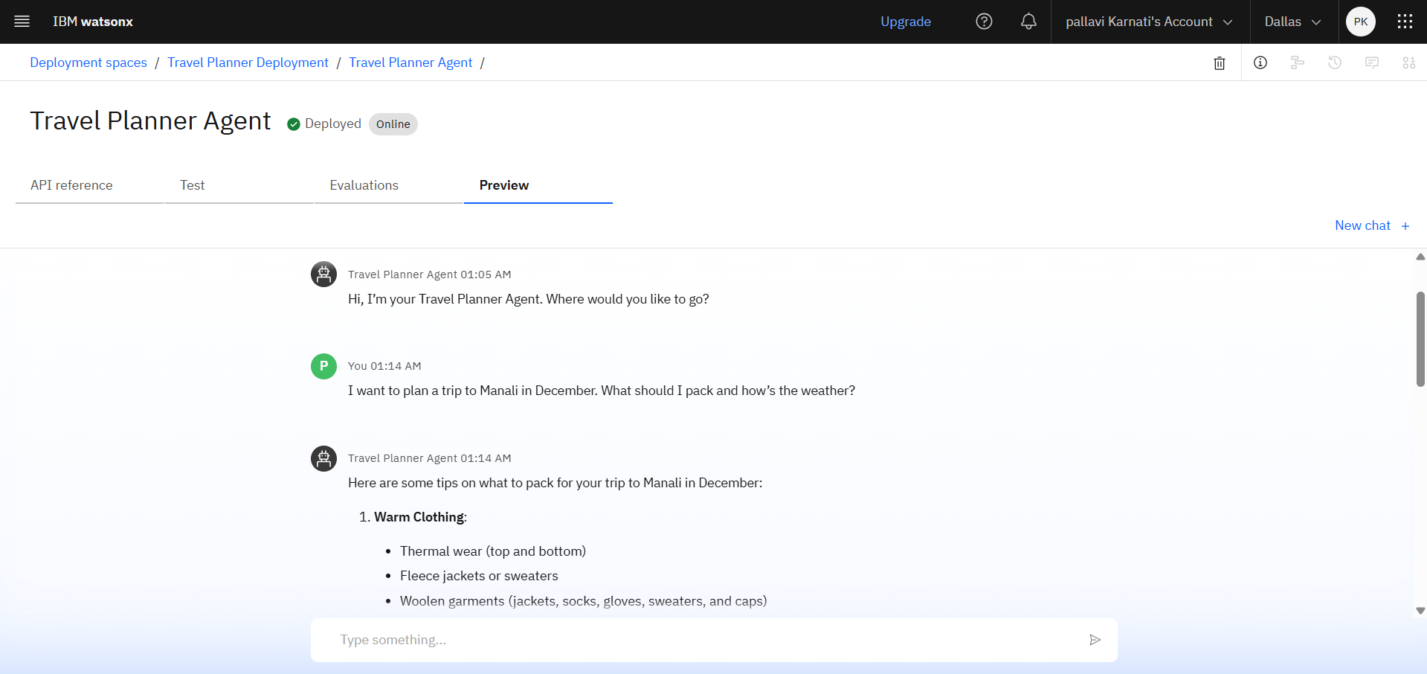
Result
The Travel Planner Agent successfully creates smart, personalized, and real-time optimized travel plans for users.

Slide 8
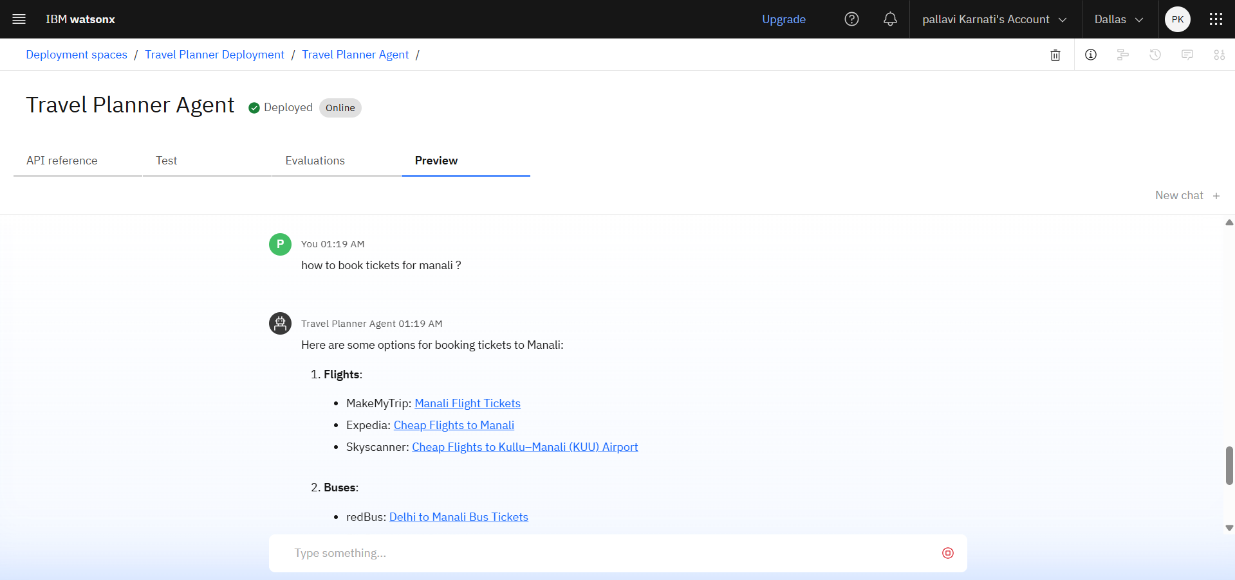
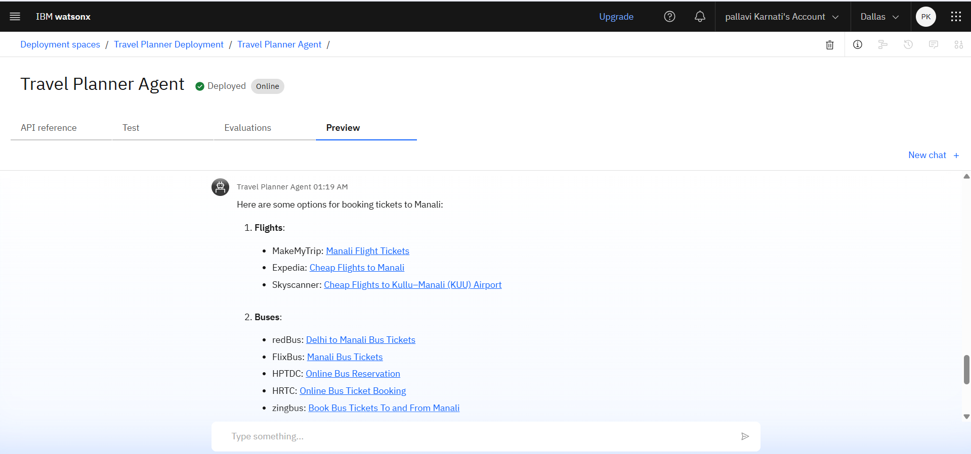

Slide 9
Conclusion
The Travel Planner Agent transforms the way people plan their trips by making the process smart, personalized, and effortless. Using IBM Cloud Lite, Watsonx Assistant, Watson Discovery, and Granite LLM, the system combines AI-powered data retrieval and generation to deliver custom travel plans that save time and reduce stress for travelers.
By understanding user preferences, budgets, and constraints, the agent suggests destinations, builds itineraries, provides booking help, and updates plans dynamically with real-time information. Overall, the project demonstrates how AI can make complex travel planning simple, efficient, and user-friendly for everyone.

Slide 10
Future Scope
Integrate real-time flight, train, and hotel booking APIs for direct reservations.
Add local event recommendations and personalized travel deals.
Expand to support multiple languages for global travelers.
Include cost estimation and budget tracking tools.
Develop a mobile app version for easy on-the-go planning.
Integrate voice-based interaction for hands-free use.

Slide 11
References
1. IBM Cloud Docs
2. Watsonx Assistant Docs
3. Granite Model Docs
4. Maps/Weather API Docs

Slide 12
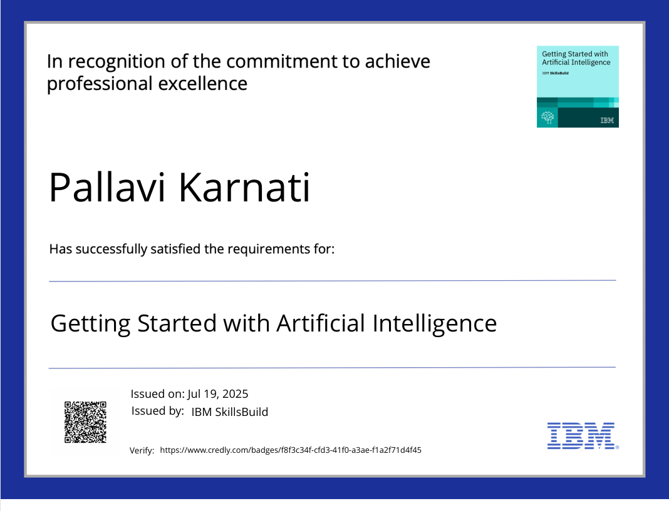
Ibm certifications

Slide 13
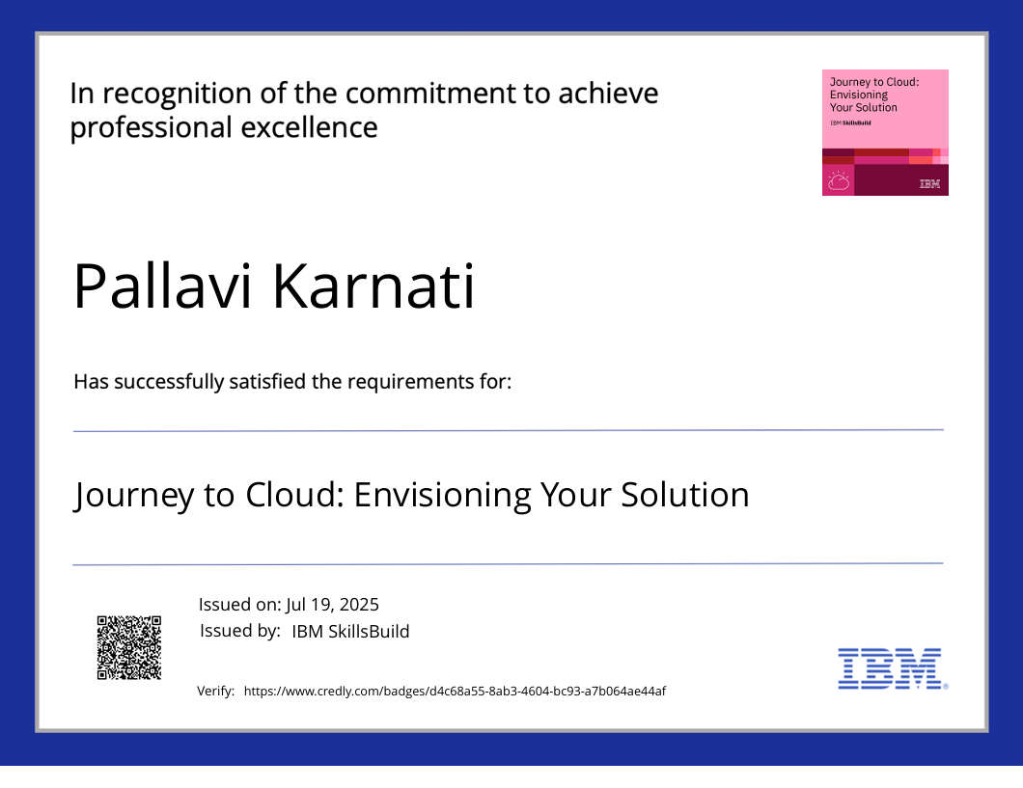
Ibm certifications

Slide 14
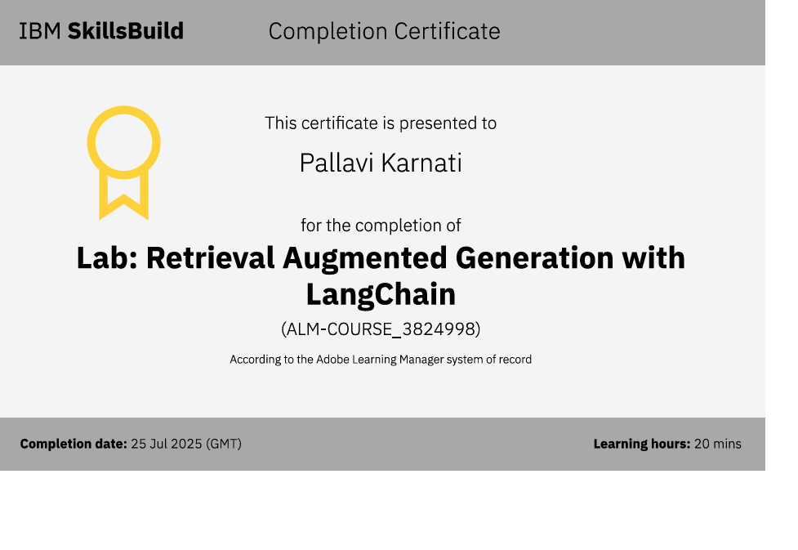
Ibm certifications

Slide 15
THANK YOU!

