Slide 1

Time-Series Signal Generation Using Time Transformer
Department of Electronics and Communication Engineering
Generative AI PROJECT
SL.NO. | NAME | USN | ROLL NO.
01 | Akash Potdar | 02FE22BEC003 | 06
02 | Ayan Kudachi | 02FE22BEC013 | 15
03 | Pallavi Lad | 02FE22BEC046 | 44
04 | Vaibhavi Patil | 02FE22BEC048 | 46
Under the Guidance of
Dr . Arun S Tigadi

Slide 2
Content
Introduction
Problem Statement
Block Diagram
Methodology
Transformer
Results
Conclusion /References

Slide 3
Introduction
In today’s wireless communication systems, the generation of realistic modulated signals is critical for tasks such as system design, testing, and AI-based signal classification. Traditional methods rely on modulation techniques that may lack robustness and adaptability in changing channel conditions.

Slide 4
Problem Statement
Our project introduces a Time Transformer-based generative AI framework that can synthesize realistic modulated signals (like BPSK, QPSK, QAM) using input base signals. This technique enhances data augmentation and improves the robustness of modulation classifiers, supporting AI-driven communication systems

Slide 5
Objectives
Develop a Time Transformer-based generative model to create realistic modulated signal samples.
Automatically detect and apply suitable modulation schemes (BPSK, QPSK, QAM, etc.) based on the nature of the input time-series signal.
Enhance signal realism under various channel conditions for better training and classification

Slide 6
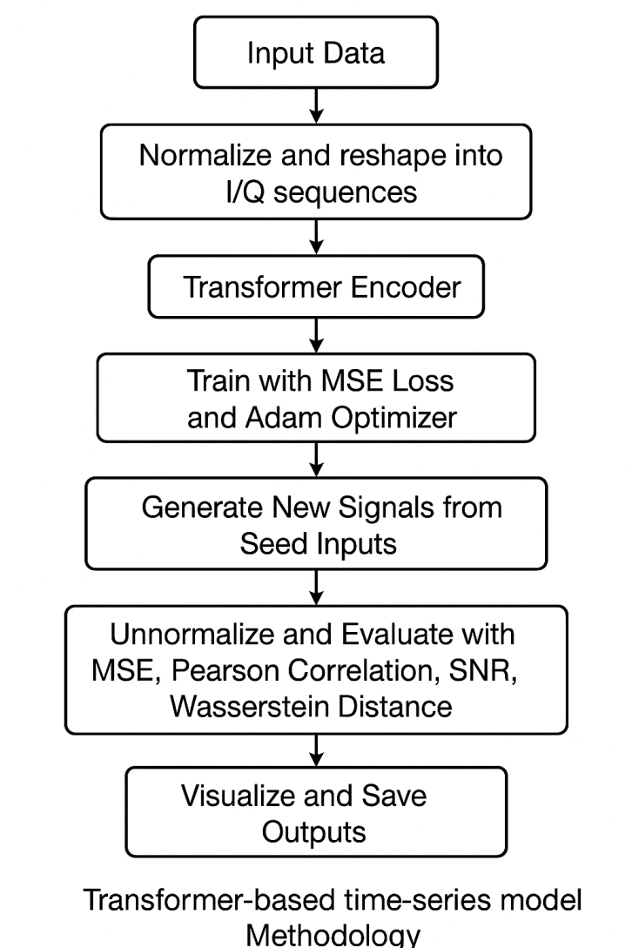
Block Diagram

Slide 7
Methodology
Input Data: Raw I/Q signal data from the RadioML dataset.
Preprocessing: Normalize and reshape the data into In-phase (I) and Quadrature (Q) sequences.
Transformer Encoder: Process the time-series with a transformer-based encoder.
Training: Model trained using MSE Loss and Adam Optimizer.
Generation: Generate new signal samples from learned patterns using seed inputs.
Evaluation: Use metrics like MSE, Pearson Correlation, SNR, and Wasserstein Distance to evaluate realism.
Output: Un normalize and visualize the synthesized signals for interpretation

Slide 8
Transformer
Approach and model architecture:
Dataset: RadioML
Model: Time Transformer
Implementation: Implemented using time transformer model
Evaluation: MSE, Pearson Correlation, SNR, Wasserstein Distance
Transformer Model Details:
The Time Transformer architecture integrates both local and global features of time-series data using self-attention mechanisms. Unlike RNNs or CNNs, Transformers can handle long-range dependencies efficiently without vanishing gradients.
Positional Encoding helps retain sequence information.
Multi-head self-attention allows the model to focus on different parts of the signal simultaneously.
This enables better generalization and more realistic signal generation across modulation types.

Slide 9
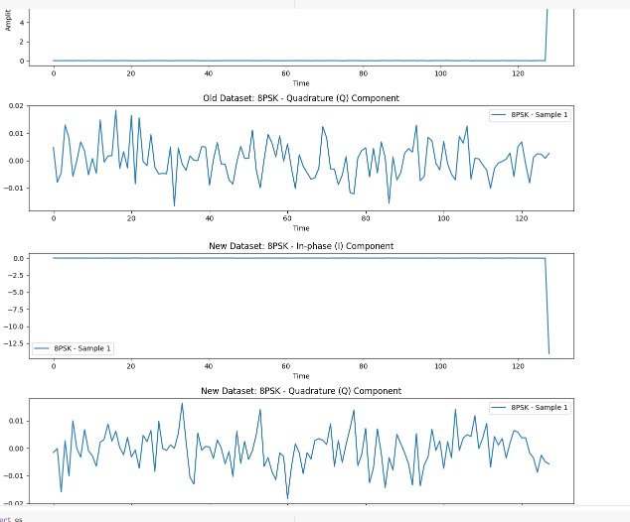
Results

Slide 10
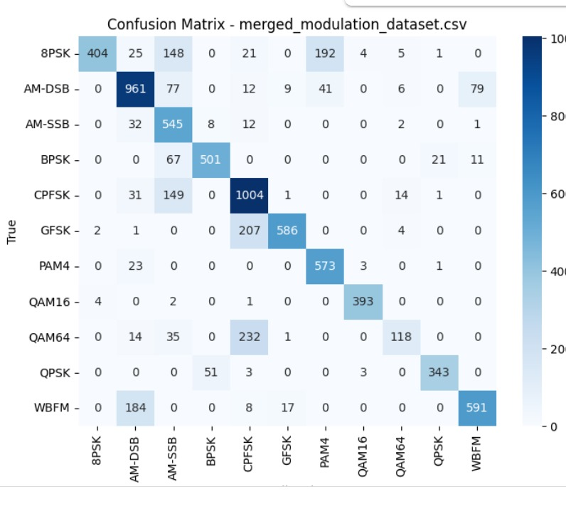
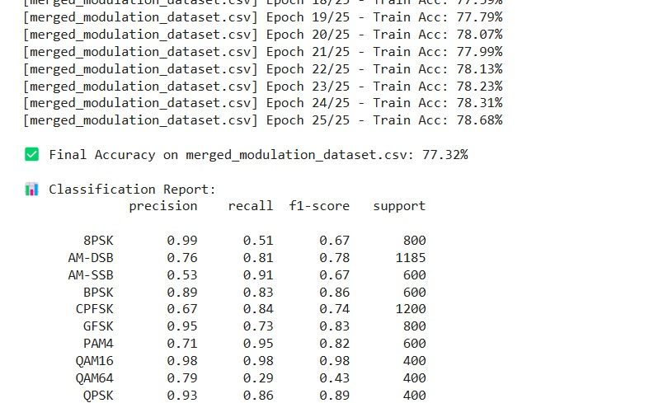

Slide 11
Conclusion
Our model successfully synthesizes realistic and diverse modulation signals using a Transformer-based architecture.
It enhances the quality and diversity of training data for classifiers, potentially improving real-world modulation classification.
This approach opens up new avenues for AI-enhanced communication systems, especially for tasks like signal simulation, testing, and classification.

Slide 12
References
[1] G. Arulampalam, V. Ramakonar, A. Bouzerdoum, and D. Habibi. Classification of digital modulation schemes using neural networks. In ISSPA ’99. Proceedings of the Fifth International Symposium on Signal Processing and its Applications (IEEE Cat. No.99EX359), volume 2, pages 649–652 vol.2, 1999.
[2] Omar S. Mossad, Mustafa ElNainay, and Marwan Torki. Deep convolutional neural network with multi-task learning scheme for modulations recognition. In 2019 15th International Wireless Communications Mobile Computing Conference (IWCMC), pages 1644–1649, 2019.
[3] Ibrahim Yildirim, Ertugrul Basar, and Ibrahim Altunbas. Quadrature channel mod ulation. IEEE Wireless Communications Letters, 6(6):790–793, 2017.

