Slide 1

Advanced Cruise Control System
Department of Electronics and Communication Engineering
MINOR PROJECT
SL.NO. | NAME | USN | ROLL NO.
01 | Akash Potdar | 02FE22BEC003 | 06
02 | Ayan Kudachi | 02FE22BEC013 | 15
03 | Pallavi Lad | 02FE22BEC046 | 44
04 | Vaibhavi Patil | 02FE22BEC048 | 46
Under the Guidance of
Dr . Arun S Tigadi

Slide 2
Content
Introduction /Problem Statement
Objectives
Block Diagram
Literature Survey
Gantt Chart
Work Break Down
Components Specifications
Input and Output Parameters
Simulation/Hardware Implementation
Results
Conclusion/ References

Slide 3
Introduction
The vehicle cruises at 60 km/h when a slower object is detected ahead. The camera and ultrasonic sensor identify the obstacle and measure the distance. When the object is within 20 meters, the system automatically reduces speed to maintain a safe gap. If the object moves away, speed is gradually restored. In emergencies, the system stops the vehicle. This showcases real-time speed adjustment and improved road safety.

Slide 4
Problem Statement
Driving long distances on highways requires constant acceleration control, leading to driver fatigue and potential safety risks. This project focuses on developing an Advanced Cruise Control (ACC) system that dynamically adjusts speed, decelerates when an object is detected, and reaccelerates once the path is clear, ensuring driver comfort and road safety.

Slide 5
Objectives
Design an Advanced Cruise Control (ACC) system to regulate speed based on vehicle distance.
Integrate Raspberry Pi, camera, ultrasonic sensor, and DC motor for real-time response.
Develop a Simulink simulation to validate control logic.
Ensure automatic deceleration and acceleration based on obstacle detection
Demonstrate intelligent driver assistance using embedded control and simulation

Slide 6
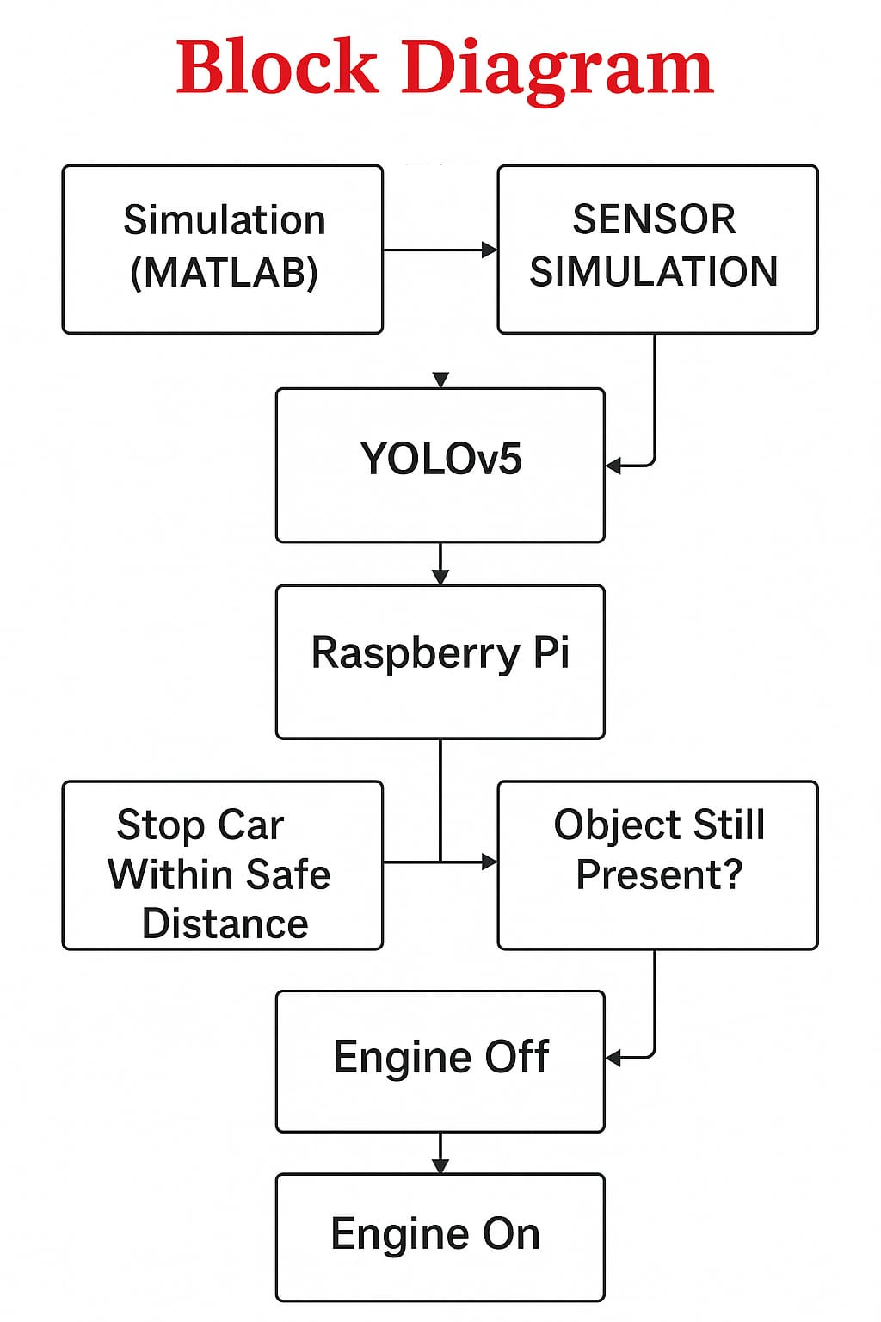
Block Diagram

Slide 7
Literature Survey
Paper Title | Methodology | Key Points | Gaps
ADAS System Integrated with New Architecture for V2X in Adaptive AUTOSAR | This paper proposes a novel system architecture integrating ADAS with V2X communication, using Adaptive AUTOSAR as the base platform. The methodology includes design of V2X stack as a service-oriented cluster, adaptive applications like object detection with YOLOv5, lane and sign recognition, and integration with a flexible execution platform. | - Utilizes Adaptive AUTOSAR for high-performance computation. - Implements ADAS features using object detection, lane detection, and forward collision avoidance. - Introduces a modular, thread-based V2X stack. - Focuses on real-time data sharing for enhanced situational awareness. | - No real-world validation or hardware implementation discussed. - Limited discussion on safety certification or compliance with functional safety standards.
Adaptive Speed Controller for Electric Vehicle using ADAS Technology | This study uses a simulated environment in MATLAB Simulink to demonstrate the integration of Adaptive Cruise Control (ACC) for electric vehicles. It includes sensor fusion from RADAR, LIDAR, and camera to control vehicle speed and braking. | - Focuses on electric vehicle integration with ADAS. - Implements ACC using sensor inputs and decision algorithms. - BLDC motor control simulated with inverter interfacing. | - Primarily simulation-based with no real-time test cases. - Limited analysis on sensor fusion accuracy or latency handling.

Slide 8
An Adaptive Cruise Control System for on-Road Vehicles – A Simulation Study | This paper compares PID, Fuzzy Logic, and Fuzzy-PID controllers for implementing Adaptive Cruise Control (ACC) using MATLAB/Simulink. The system maintains safe vehicle distance by dynamically adjusting speed based on lead vehicle behavior. | - Detailed comparison of three control strategies for ACC. - Fuzzy-PID shows improved robustness and performance. - Incorporates longitudinal vehicle dynamics and control modelling. | - Lacks implementation on actual vehicle platforms. - Does not integrate with broader ADAS systems or V2X.
An Analysis on the Impact of 5G in Advanced Driver Assistance Systems (ADAS) | Explores how 5G communication enhances ADAS performance through real-time ECU data transmission and low-latency networking. Includes object detection, traffic sign recognition, and automatic parking using sensors interfaced via Raspberry Pi. | - Highlights the role of 5G in enhancing ADAS through low latency. - Uses MQTT over 5G for real-time data communication. - Emphasizes modular hardware-software integration using Raspberry Pi. | - Focuses on conceptual and hardware prototyping without standardized evaluation. - Scalability and deployment strategies in urban traffic scenarios are not detailed.

Slide 9
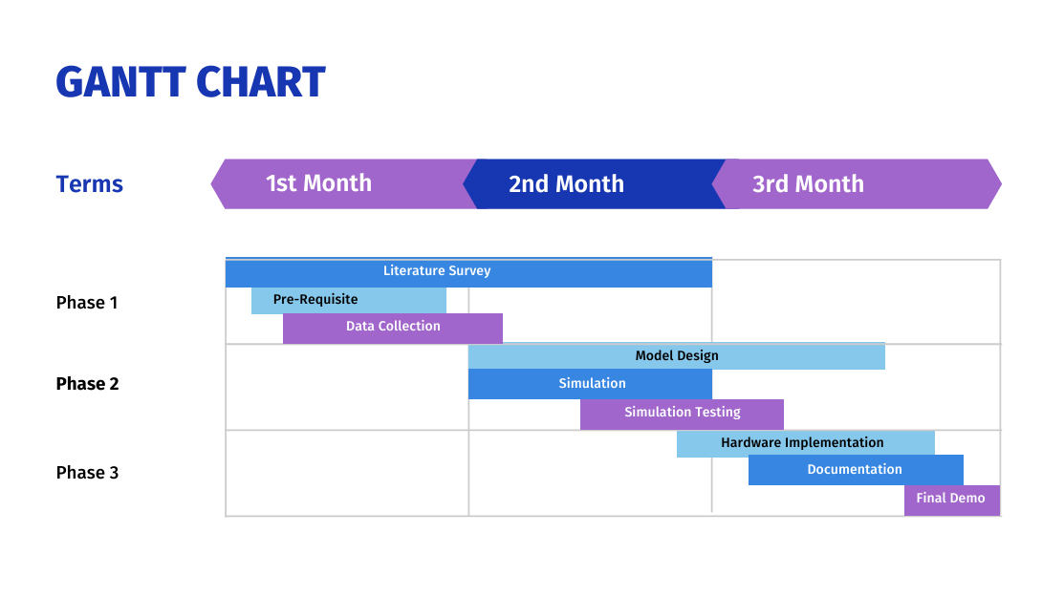
Gant chart

Slide 10
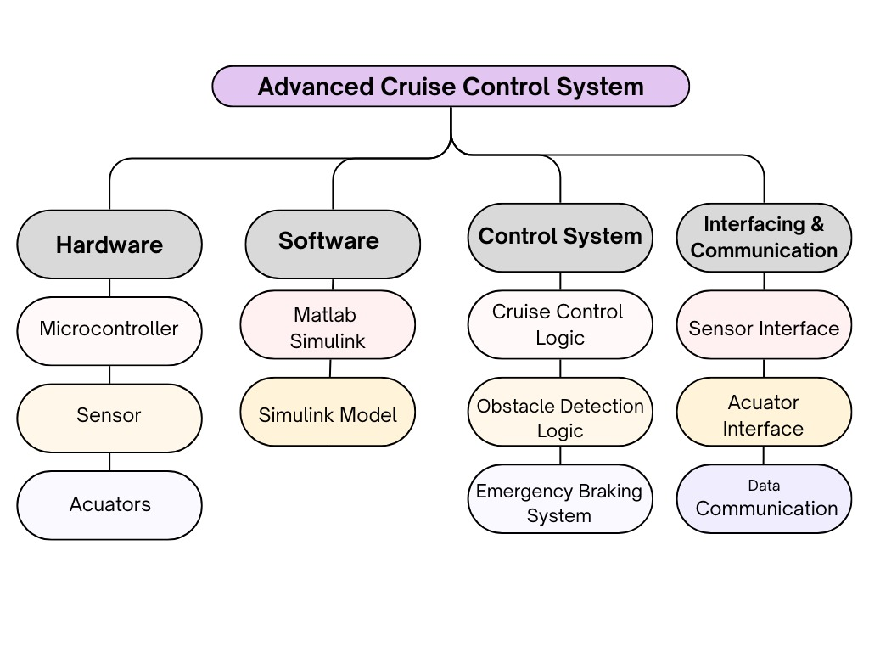
Work Break Down

Slide 11
Components Specification
Raspberry pi
Camera Module
Ultrasonic Sensor
DC Motor

Slide 12
Input and Output Specifications
Input Specifications :-
Sensor Inputs
Object detection – Distance from the object Speed
Speed Sensor – Current speed of the vehicle
Set Speed (Cruise Speed)-User-defined or default cruise speed set by the system
Output Specifications :-
Actuator Controls
Controls Throttle Control – Increase or decrease speed
Brake Signal – Apply brakes when obstacle is detected

Slide 13
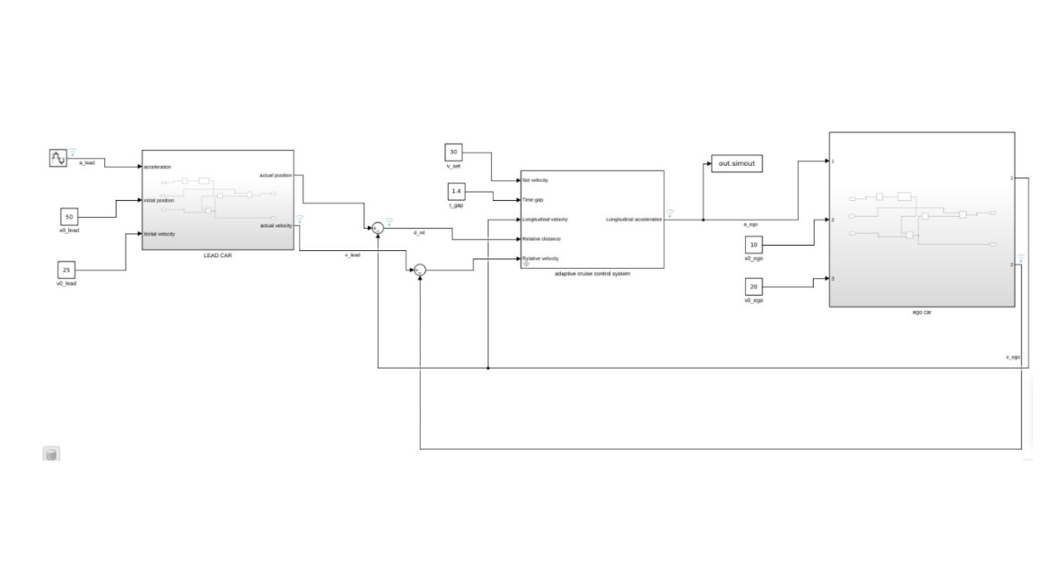
ACC Simulation

Slide 14
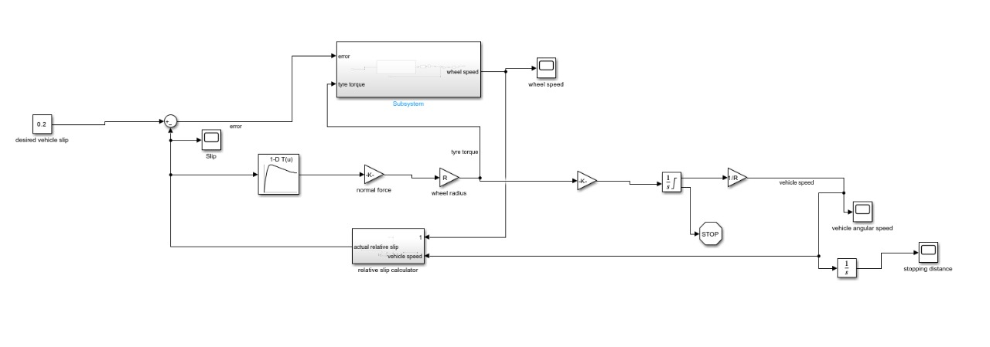
Simulation(Braking System)

Slide 15
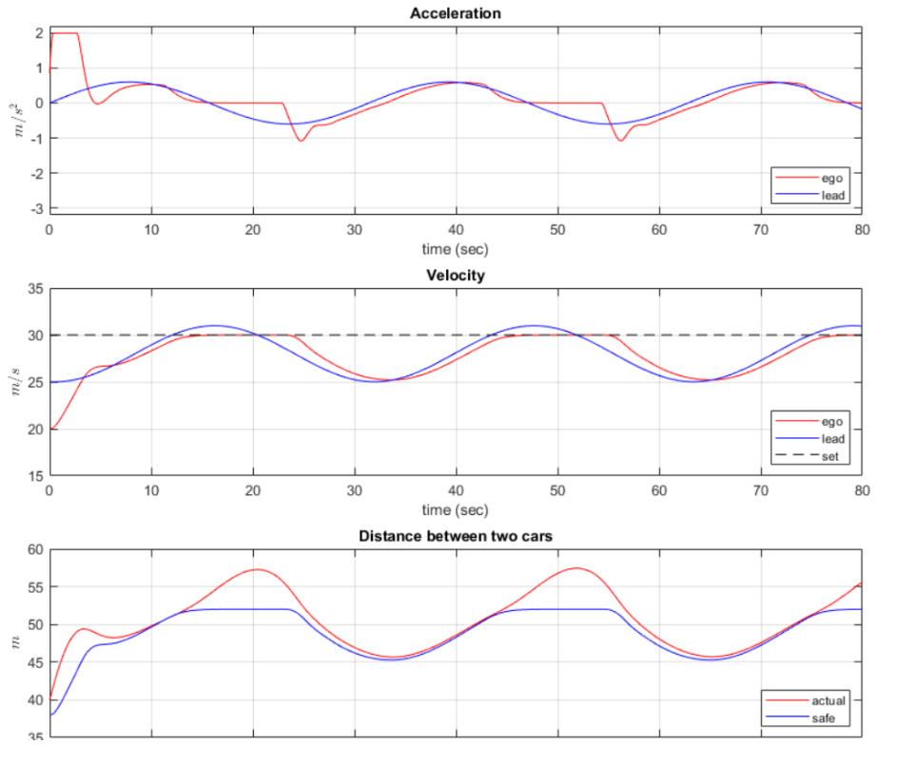
Results (ACC Simulation )

Slide 16
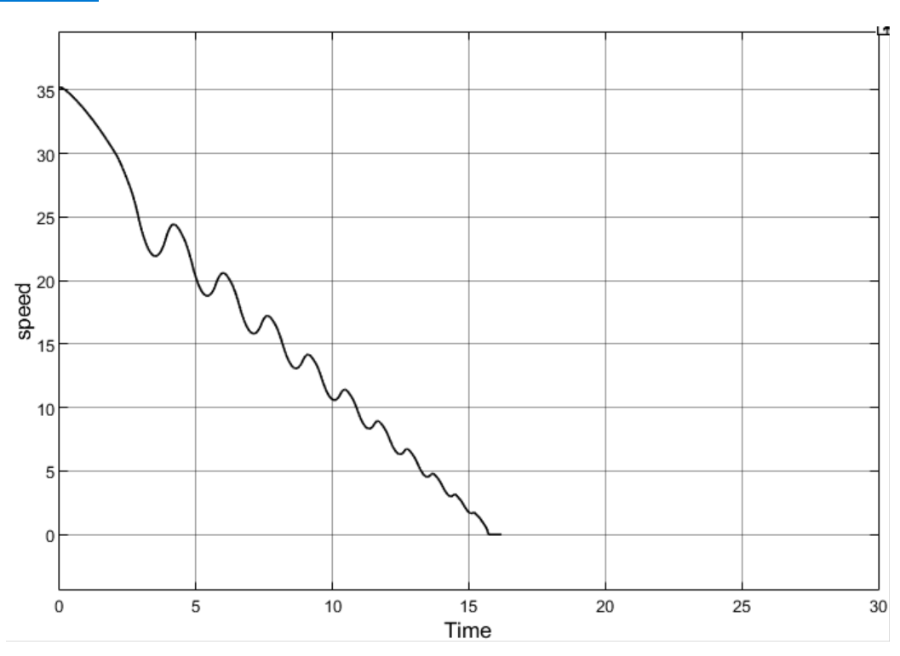
Braking System

Slide 17
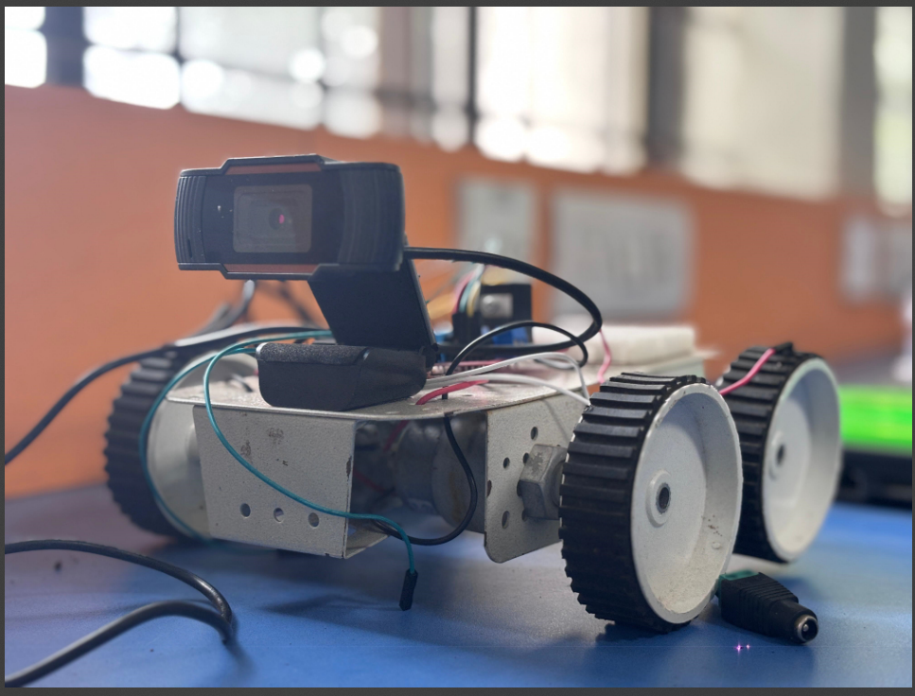
Hardware

Slide 18
References
Y. G. Dantas et al., "A Formal Security Assessment Framework for Cooperative Adaptive Cruise Control," VNC 2020
W. Yi et al., "Enhanced Adaptive Cruise Control Strategy for Driving Safety in Connected Vehicles," ICTIS 2021, pp. 805-810
S. R. Kristalniy et al., "Joint Interaction of Automatic Emergency Braking and Adaptive Cruise Control," IEEE Conf. 2022
T. Acarman et al., "Intelligent Cruise Control Stop and Go With and Without Communication," ACC 2020
DESIGN OF AN ADAPTIVE CRUISE CONTROL SYSTEM USING PID CONTROL METHOD ON ELECTRIC VEHICLE PROTOTYPES 1st Joko Slamet Saputro
An Analysis on the Impact of 5G in Advanced Driver Assistance Systems (ADAS) S.P. Vimal
Advanced Driver Assistance System (ADAS) in Autonomous Vehicles: A Complete Analysis Srinivasan C

Slide 19
Adaptive Speed Controller for Electric Vehicle using ADAS Technology Sathiyanarayana R V
An Adaptive Cruise Control System for on-Road Vehicles – A Simulation Study Swetha K, K Sireesha
LiDAR Sensing – Based Exponential Adaptive Cruise Control and Steering Assist for ADAS AbhishekThaku
ADAS and 5G/6G-V2X implementation for Sustainable and Intelligent Transport nis Jouini
ADAS System Integrated with New Architecture for V2X in Adaptive AUTOSAR ona Helmy
Feasibility of Emergency Steering Function for Semi-trailer Trucks in the Presence of Actuator Limitations 1st Berke Konca
Enhancing Safety in Automotive Systems: A Comprehensive Analysis of 77 GHz Radar Performance for Pedestrian and Vehicle Detection A Usha Rani

Slide 20
Thank You

