Slide 1

Marketing Mix Modeling (MMM)
Project Analysis — Detailed Insights, Visuals & Recommendations
Prepared by: Pallavi Nardekar | Date: September 13, 2025

Slide 2
Aim of the Project
The aim of this project is to build a Marketing Mix Model (MMM) that explains and quantifies the impact of different marketing channels on sales (kpi_val_sales_mn). The model also derives Return on Investment (ROI) and provides recommendations for future budget allocation.

Slide 3
Objectives
The key objectives of the MMM analysis were: • To explore the dataset through detailed Exploratory Data Analysis (EDA). • To check modeling assumptions including multicollinearity, heteroscedasticity, and stationarity. • To apply Adstock and Saturation (Hill function) transformations for marketing spends. • To fit an Ordinary Least Squares (OLS) regression model and evaluate its performance. • To derive channel-level contributions, ROI, and marginal ROI. • To generate response curves and provide actionable recommendations for budget reallocation.

Slide 4
Procedure
The MMM analysis was carried out in the following steps: 1. Data Preparation: Loaded the dataset from Excel (48 rows, 41 columns). Identified the dependent variable (kpi_val_sales_mn), media variables, and control variables. 2. Exploratory Data Analysis (EDA): Generated descriptive statistics, missing value counts, and correlation analysis. This helped understand distribution, variability, and initial relationships. 3. Assumption Checking: • Variance Inflation Factor (VIF) was used to identify multicollinearity among predictors. • Augmented Dickey-Fuller test was conducted for stationarity of the dependent variable. • Breusch-Pagan test checked heteroscedasticity of residuals. 4. Data Transformation: Applied Adstock to capture carryover effects and Hill function (saturation) to model diminishing returns in marketing spends. 5. Model Building: Built an OLS regression model with robust (HC3) standard errors after iterative VIF filtering.

Slide 5
Procedure
6. Model Evaluation: R-squared and Adjusted R-squared were computed. Final model achieved R² ≈ 0.478 and Adjusted R² ≈ -0.021. 7. Contributions & ROI: Derived channel-level contributions to sales and calculated ROI for each channel. 8. Response Curves: Generated curves showing predicted sales response vs. spend for top media channels. Due to adstock + saturation, curves exhibit diminishing returns. 9. Recommendations: Computed marginal ROI and proposed reallocation of 10% budget from least efficient channel to most efficient channel.

Slide 6
Results & Key Insights
The model explains ~47.8% of variance in sales, though Adjusted R² is negative, reflecting the small dataset and many predictors relative to observations. Several media channels show concave response curves, indicating diminishing returns after certain spend levels. ROI varies significantly across channels, with some channels providing higher marginal ROI than others. Marginal ROI analysis suggested reallocating budget from low-performing channels to higher-performing ones to maximize impact.

Slide 7
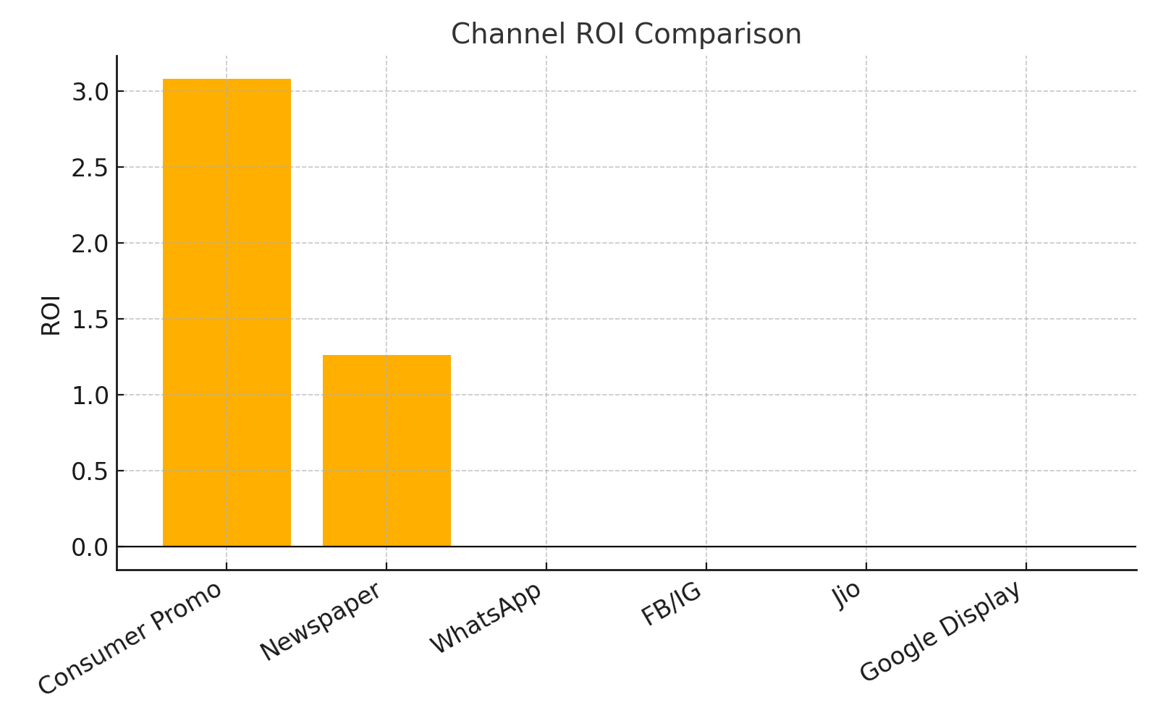
Channel ROI Comparison
Consumer Promo shows the highest ROI (~3.08), indicating that for each unit spent the expected return is ~3.08 units of KPI.
Newspaper provides moderate ROI (~1.26) — positive but lower than Consumer Promo.
Digital channels (FB/IG, Google Display, Jio clicks) show very low or negative ROI in this model — investigate data quality and attribution.
Implication: Prioritize incremental budgets toward channels with higher ROI while validating digital channel measurement.
Notes:
Use this slide to explain that ROI rankings were computed from model-derived contributions and spend. Mention caution due to small sample size.

Slide 8
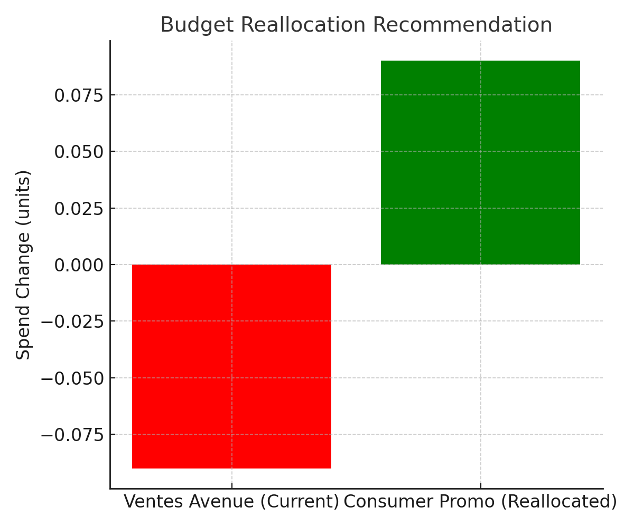
Budget Reallocation
Recommendation: Reallocate ~10% of total spend (model used ~0.09 units as an example) from 'Ventes Avenue' to 'Consumer Promo'.
Model-based expected uplift in KPI: ~0.46 (total across dataset period).
Implication: Small reallocation toward higher-marginal-ROI channels yields positive uplift, but validate with test & learn before full rollout.
Notes:
Mention that uplift is model-estimated and approximate. Recommend A/B test or phased reallocation to confirm.

Slide 9
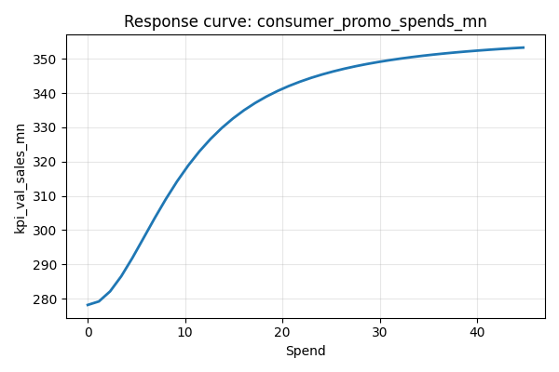
Response Curve - Consumer Promo
Curve shape: concave / saturating — steep initial slope indicates high marginal returns at low spend.
Current mean spend: ~5.05 units; marginal ROI per additional unit (model) ≈ 5.09.
Implication: Consumer Promo has strong marginal ROI; consider incremental spend here while monitoring diminishing returns.
Notes:
Explain concavity/saturation and mention marginal ROI/current spend numbers (from model).

Slide 10
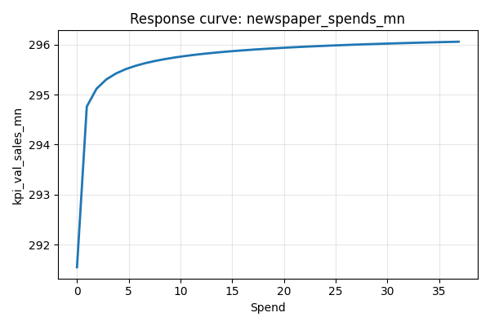
Response Curve - Newspaper
Curve shows diminishing returns. Current mean spend ≈1.73 units; marginal ROI per additional unit ≈0.27.
Implication: Newspaper is effective but with lower incremental benefit compared to Consumer Promo.
Notes:
Explain diminishing returns and relative marginal ROI vs Consumer Promo.

Slide 11
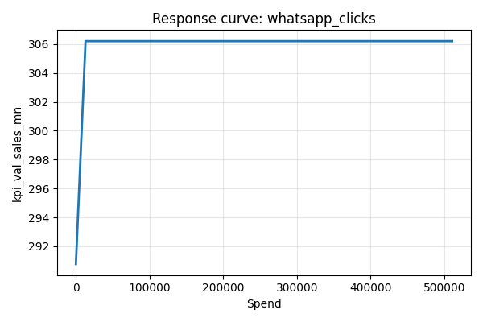
Response Curve - WhatsApp
Curve shows very small incremental impact in the model. Current spend ~7094 (clicks) — marginal ROI effectively ~0. Implication: Re-evaluate measurement (clicks vs conversions) and data alignment for WhatsApp; may need better tracking.
Notes:
Discuss potential measurement issues for WhatsApp (clicks vs conversions) and recommend improved tracking.

Slide 12
Appendix - VIF Table
feature | VIF
trade_promo_spends_mn | 27.9454
consumer_promo_spends_mn | 5.5431
newspaper_spends_mn | 282.4711
newspaper_impressions | 336.5546
tv_total_grp | 198.2197
tv_spots | 62.90666
tv_total_spends_mn | 102.6735
competition1_newspaper_spends_mn | 52.37435
competition1_newspaper_impressions | 48.15888
competition1_tv_total_grp | 81.28798
competition1_tv_spots | 28.67062
competition1_tv_total_spends_mn | 98.94257
Notes:
Appendix table: Appendix - VIF Table

Slide 13
Appendix - VIF Table
feature | VIF
competition2_newspaper_spends_mn | 141.0236
competition2_newspaper_impressions | 95.44543
competition2_tv_total_grp | 52.14183
competition2_tv_spots | 60.57138
competition2_tv_total_spends_mn | 101.0587
Notes:
Appendix table: Appendix - VIF Table

Slide 14
Appendix - Model Coefficients
feature | coefficient | pvalue | std_err
const | 293.6672 | 8.45E-06 | 65.94235
consumer_promo_spends_mn_trans | 78.85836 | 0.32527 | 80.16616
newspaper_spends_mn_trans | 4.884058 | 0.937159 | 61.94762
google_display_clicks_trans | -2.16319 | 0.975664 | 70.91238
google_display_spends_mn_trans | -35.535 | 0.895309 | 270.0452
fb_ig_clicks_trans | -13.3017 | 0.851665 | 71.13419
fb_ig_spends_mn_trans | -16.3823 | 0.908593 | 142.686
whatsapp_clicks_trans | 15.42407 | 0.861353 | 88.31309
whatsapp_impressions_mn_trans | -115.868 | 0.397915 | 137.0646
jio_clicks_trans | -26.7048 | 0.533537 | 42.8912
jio_impressions_mn_trans | -69.9107 | 0.407407 | 84.38571
hotstar_impressions_mn_trans | -33.3412 | 0.617601 | 66.78215
Notes:
Appendix table: Appendix - Model Coefficients

Slide 15
Appendix - Model Coefficients
feature | coefficient | pvalue | std_err
ventes_avenue_spends_mn_trans | -180.407 | 0.528738 | 286.3911
Notes:
Appendix table: Appendix - Model Coefficients

Slide 16
Appendix - Channel ROI & Marginal ROI
channel | curr_spend_mean | marginal_ROI_per_unit
consumer_promo_spends_mn | 5.047986 | 5.091954
newspaper_spends_mn | 1.728549 | 0.267356
whatsapp_clicks | 7094.146 | 3.78e-09
fb_ig_clicks | 77321.13 | -1.2e-14
jio_clicks | 82520.08 | -4.2e-14
google_display_clicks | 1930.708 | -2.6e-08
fb_ig_spends_mn | 0.453267 | -8.60387
hotstar_impressions_mn | 0.671736 | -19.5015
google_display_spends_mn | 0.010879 | -200.962
Notes:
Appendix table: Appendix - Channel ROI & Marginal ROI

Slide 17
Appendix - Model Diagnostics
test | statistic / pvalue
Breusch-Pagan (LM) p-value | 0.204019
Breusch-Pagan (F) p-value | 0.164731
Shapiro-Wilk statistic | 0.97685
Shapiro-Wilk p-value | 0.455178
R2 | 0.478412
Adj_R2 | -0.02144
Notes:
Appendix table: Appendix - Model Diagnostics

Slide 18
Conclusion
The MMM project successfully demonstrated the use of Adstock and Saturation transformations in a regression-based framework. While the R² is moderate and Adjusted R² is negative due to data constraints, the model still provides useful directional insights into channel effectiveness, ROI, and budget allocation strategies. The analysis highlights the importance of data scale and quality in MMM and suggests that with more observations and refined feature engineering, stronger explanatory power can be achieved.

Slide 19
Recommendations
• Focus incremental budgets on channels with higher marginal ROI (steeper response curve at current spend levels). • Reduce spend in saturated channels where additional investments yield minimal incremental sales. • Periodically re-estimate the model as new data becomes available, to capture changing media effectiveness. • Consider combining MMM with digital attribution models for more granular insights. • Improve data quality and increase observation periods for more reliable model estimates.

Slide 20
Limitations
• Small sample size (48 observations) limits model robustness and increases risk of overfitting. • Adjusted R² being negative indicates that the predictors added limited explanatory power relative to the mean. • Model assumes linear-additive structure after transformations, which may oversimplify real-world dynamics. • External factors (seasonality, macroeconomic shocks, competitor actions) may not be fully captured. • The greedy parameter search for Adstock and Hill parameters may not find the global optimum.

