Slide 1

WELCOME TO QUALITY EXPERTS GROUP
Software Training Institute & Consultancy

Slide 2

JAVA PROGRAMMING BASICS
Keywords
Primitive Data Types
Variable declaration and initialization
Constants
Final Keyword

Slide 3
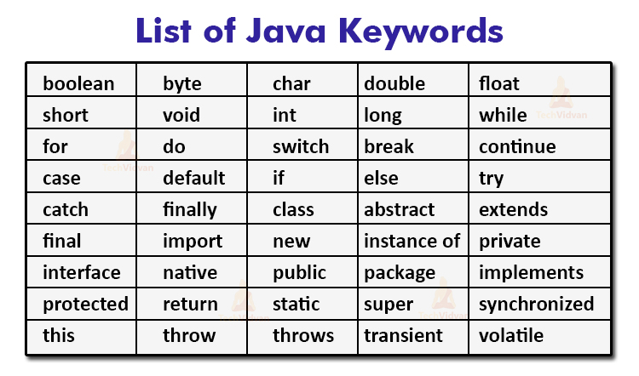
KEYWORDS
Reserved words
Keywords has predefined meaning in the programming language
As it has predefined meaning we can not use these keywords as names for the variables, methods, classes or as any other identifier
All keywords in Java must be written in small letters only.

Slide 4
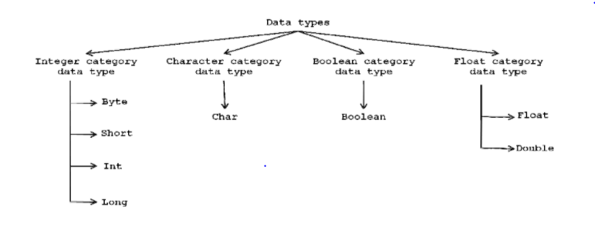
PRIMITIVE DATA TYPES
In JAVA, we have eight primitive data types with four groups
Integer category data types
Float category data types
Boolean category data types
Character category data types

Slide 5
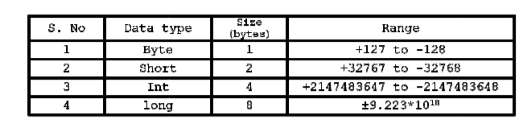
INTEGER CATEGORY DATA TYPES
This category of data type contains 4 data types (byte, short, int, long)
Whatever the data type we use that should not exceed predefined value.
Range of any data type is 2 power number of bits occupied.
Example: 2^8
1 to 256
0 to 255
0 to (255/2)
(127.5 – 0.5 = +127) (127.5 + 0.5 = -128)

Slide 6
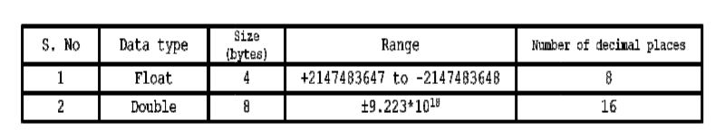
FLOAT CATEGORY DATA TYPES
This category data types are used for representing float values(numbers with decimal places).
This category of data type contains 2 data types (float, double)

Slide 7

CHARACTER CATEGORY DATA TYPE
A character is an identifier which is enclosed within single quotes.
To represent character data, we use data type called char

Slide 8
BOOLEAN CATEGORY DATA TYPE
Boolean character data type used for representing logical values(True/false).
To represent logical values, we use keyword called Boolean.

Slide 9
VARIABLES
A variable is an identifier whose value will be changed during execution of the program
Rules for writing variables:
First letter must be an alphabet
The length of variable should not exceed more than 32 characters
No special symbols are allowed except underscore and dollar sign
No keywords should use as variable names
Variable names are case-sensitive
Types of variables in Java
Local variables 2. Instance variables 3. Static variables

Slide 10
VARIABLES
Declaring and Assigning variable
DataType variablename = expression;
Examples:
int id = 10;
double price = 10.30;
boolean active = true;
When we declare a variable Java will set aside enough bits in memory for that type and associates the memory location with the name we used.
Multiple variables can be declared on a single line.
Example:
int id, len, count;
Multiple variables can be initialized at the same time.
Example:
int x = 5, y= 10;

Slide 11
DATATYPE, VARIABLE DECLARE AND INIITIALIZE
Examples:
byte myNum = 100;
short myNum = 5000;
int myNum = 100000;
long myNum = 1500000000;
float myNum = 5.75f; (Note that you should end the value with an "f“)
double myNum = 19.999;
boolean myFlag = true;
char myGrade = ‘A’; char a = 65;

Slide 12
CONSTANTS
Constant is an identifier whose value cannot be changed during execution of the program.
In Java to make the identifiers are as constants we use a keyword called final.
When we don’t want to change the value of the variable , then the value must be declared as final.
Final is the keyword which is playing import role in 3 levels(Variable level, Method level, Class level).
Whenever a final variable is declared first time assignment is possible and no more modification and further assignments are possible. Hence, final variables cannot be modified.
Example:
final float pi = 3.14f;
pi = 5.8f; // invalid
Pi = pi+6; //invalid

Slide 13



MAILING ADDRESS
226/149 Nelson Street,
Auckland - 1010
REACH OUT
EMAIL ADDRESS
info@qexg.co.nz
PHONE NUMBER
0276410321 | 02108228425

