Slide 1
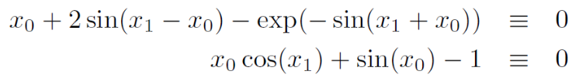

Lecture 7 - Tips
Visualise the system of equations (maybe plot it)
Understand chapter 9.6 and 9.7
Pages 477-482 explain the Newton method from Henrik’s slides
Find solvers in ‘roots_multidim.h’
Insert in own code

Slide 2
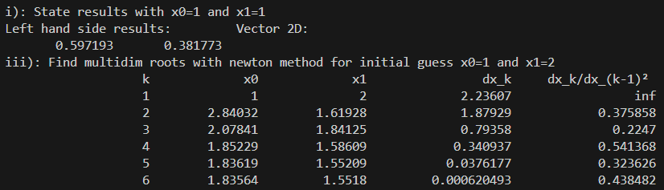
Lecture 7

Slide 3
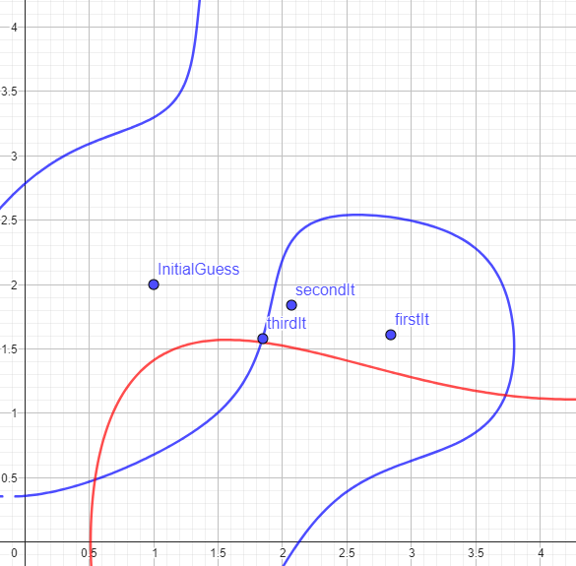
Lecture 7

Slide 4
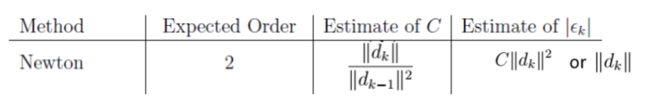
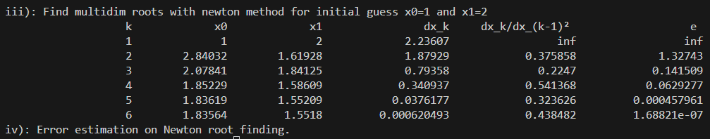
Lecture 7

