Slide 1

Integration and Comparison of Vision Models for Smart Inspection Cell
Case Study
Intelligent Systems in Production
Technische Hochschule Deggendorf
Campus Cham
Date : 15.01.2026
Group members:
Sai Prasanth Parnambedu Yaswitha Pallela Rakshith Thatikonda Prarthana Shenoy Chandrika Tirukkovalluri
(Mt no : 12502673) (Mt no : 12504195) (Mt no : 12503565) (Mt no : 12504810) (Mt no : 12502673)
Guided by
Prof. Hamidreza Heidari

Slide 2
Contents
Problem statement
Project Workflow
Results and validation
Future scope
References

Slide 3
Problem Statement
Surface defects in automotive spur gears (scratch, dent, crack, pitting) can reduce drivetrain reliability.
Manual and rule-based inspection methods are subjective and do not scale well for high production volumes.
There is a need for a data-driven vision system that ensures accurate defect detection under real-time inference constraints.
This work evaluates deep learning models for defect classification and detection, focusing on accuracy, robustness, and inference latency.

Slide 4
Objectives
Train an object detection model (YOLOv8) to detect defects and localize them with bounding boxes.
Train an image classification model (MobileNetV2) to classify images into: good, scratch, dent.
Compare both approaches using:
Accuracy / Precision / Recall / F1-score (classification)
mAp50 / mAp50-95(detection)
Inference latency for real-time suitability
Productivity rate

Slide 5
Workflow
Overview:
This project follows an end-to-end engineering methodology covering data creation, model development and performance validation to integrate into an industrial AI-based inspection system.
1. Data Preparation
CAD-based synthetic spur gear dataset
Defects added: scratches, dents, voids
Variations in lighting, orientation, camera angle
Dataset split: 80% train | 10% val | 10% test
2. Annotation & Quality Assurance
Manual annotation in YOLO format
Bounding box verification using Python scripts
Ensured clean, reliable training data

Slide 6
Workflow
3. Model Development
YOLOv8 → Defect detection & localization, MobileNetV2 → Lightweight defect classification
Training strategy:
  Transfer learning
  Hyperparameter tuning
  Data augmentation
  Early stopping
4. Evaluation & Validation
Tested on unseen dataset
Cross-validated using both models for reliability
Metrics: Accuracy, Precision, Recall, F1, mAP@50, Latency, Productivity Rate
5. Future Work - Hardware Integration
RoboDK for robotic inspection cell simulation
SimPy for inspection workflow logic
Workflow:
Conveyor → Image Capture → AI Inference → Accept/Reject Sorting

Slide 7
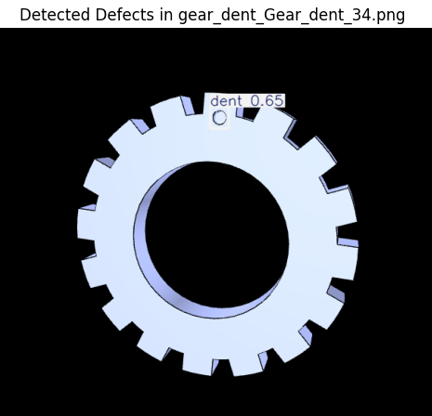
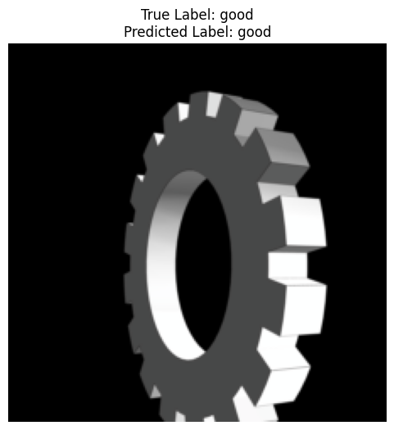
Image classification results
Results from YOLOv8
Results from MobileNetV2

Slide 8
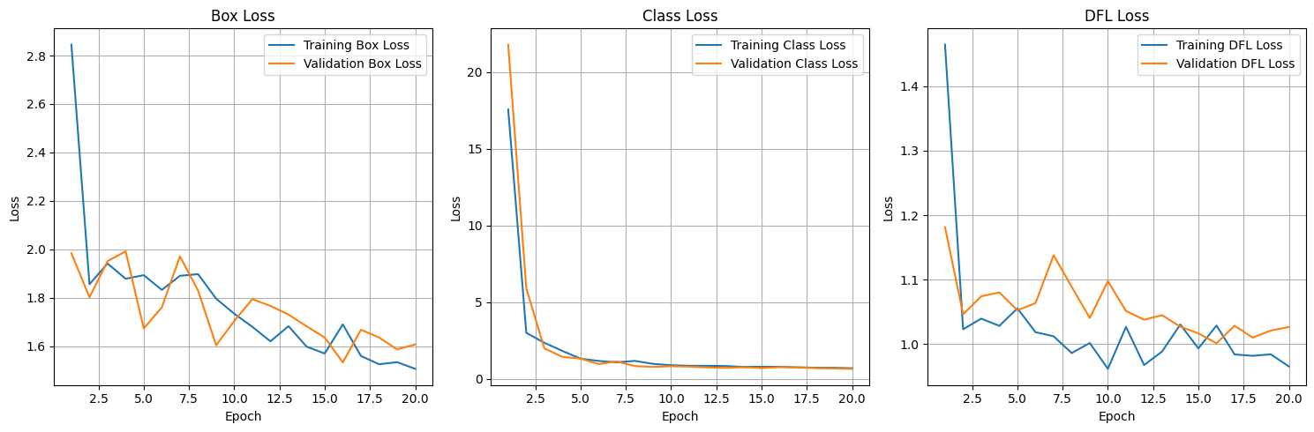
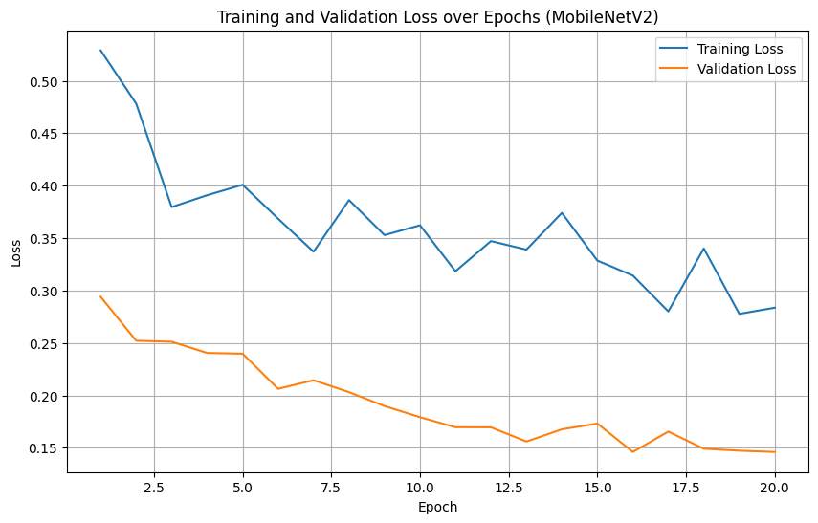
Loss Curves
Loss curve for YOLOv8
Loss curve for MobileNetV2

Slide 9
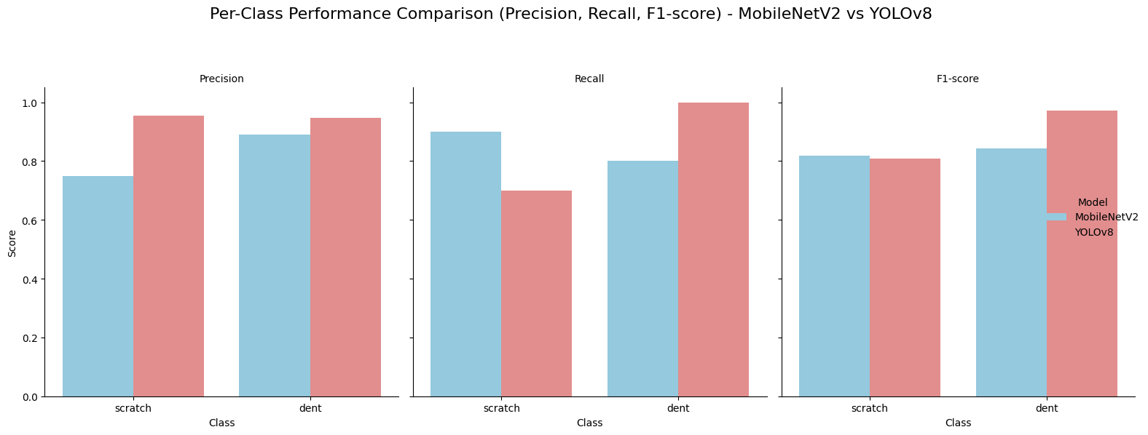
Model Performance Comparison
Model | Class | Precision | Recall | F1-score
MobileNetV2 | Scratch | .75000 | 0.9 | .81818
MobileNetV2 | Dent | .88888 | 0.8 | .84210
YOLOv8 | Scratch | .95400 | 0.7 | .80749
YOLOv8 | Dent | .94600 | 1.0 | .97225

Slide 10
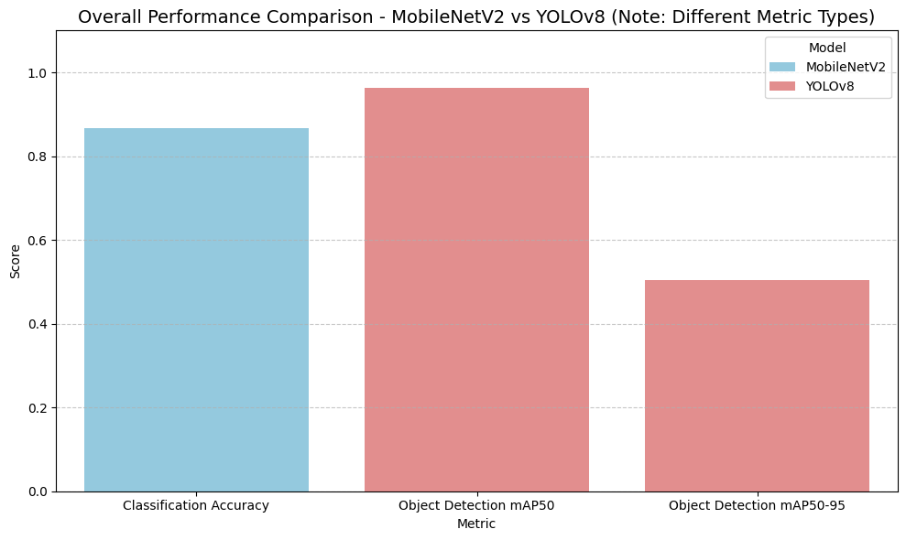
Model Performance Comparison
Model | MobileNetV2 | YOLOv8
Test Accuracy | .86666 | NaN
mAP50 | NaN | .964
MAP50-95 | NaN | .505

Slide 11
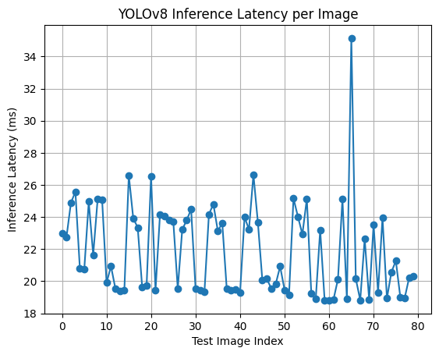
YOLOv8 Inference Latency
Latency measured on GPU (Tesla T4, Colab) with warm-up runs, then multiple timed inferences.
Result :
Avg Latency: 21.87 ms ;
Std Latency: 2.83 ms

Slide 12
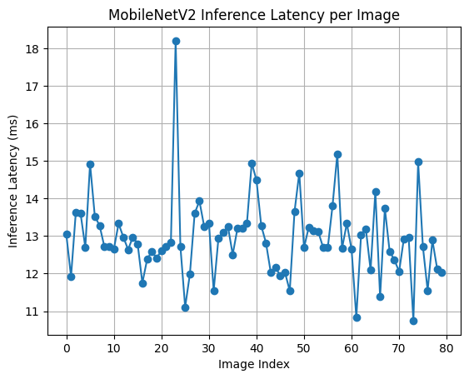
MobileNetV2 Inference Latency
Latency stays consistent across test images with small variations.
Most predictions fall around 12–13 ms, with rare spikes.
Indicates efficient deployment potential for edge/production use.

Slide 13
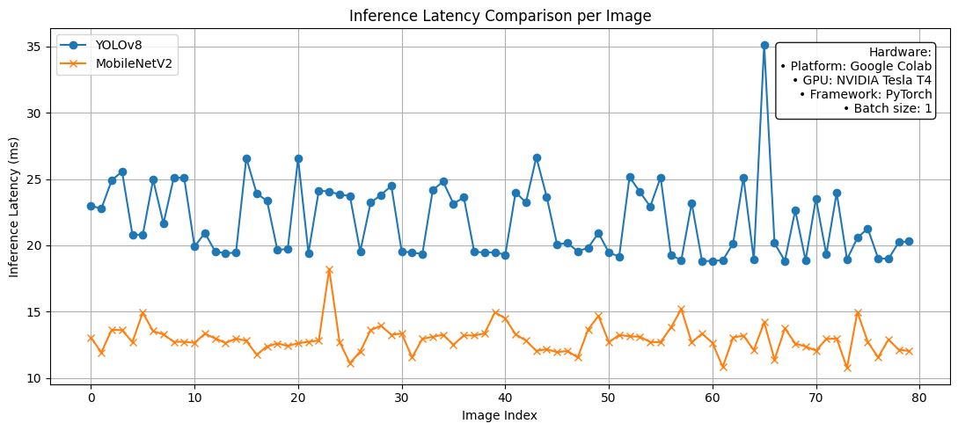
Inference Latency Comparison
MobileNetV2 is consistently faster (~12–13 ms/image) than YOLOv8 (~20–25 ms/image)
Productivity of MobileNetV2: 80 images/sec, YOLOv8: 45 images/sec
YOLOv8 shows higher variance and occasional spikes, due to detection + post-processing overhead.

Slide 14
Conclusion
YOLOv8 achieves higher detection quality (mAP50 ≈ 0.964, mAP50–95 ≈ 0.505) and provides bounding-box localization.
MobileNetV2 gives strong classification performance (accuracy ≈ 0.867) and is faster (~12–13 ms/image) than YOLOv8 (~22 ms/image).
Trade-off: YOLOv8 is best when defect location matters; MobileNetV2 is best for fast screening.

Slide 15
Future Scope
Validate models on real camera data
Optimize inference latency for edge devices
Extend to multi-view and multi-defect inspection
Enable real-time integration with automated systems

Slide 16
Reference
Xiang Wan, Xiangyu Zhang and Lilan Liu, "An Improved VGG19 Transfer Learning Strip Steel Surface DefecRecognition Deep Neural Network Based on Few Samples and Imbalanced Datasets", https:// doi.org/10.3390/app11062606
K. Khurana, R. Kumar, and S. Singh, “Molo: Hybrid model using mobilenetv2 and yolov8 for edge devices,” Discover Artificial Intelligence, vol. 5, no. 1, pp. 1–15, 2025
R. Yan, H. Liu, Q. Zhao, and Y. Chen, “Stms-yolov5: A lightweight algorithm for gear surface defect detection,” Sensors, vol. 23, no. 12, p. 5581, 2023
H. Nguyen, “Mobilenetv2 + enhanced feature pyramid for fast object detection,” Journal of Theoretical and Applied Information Technology, vol. 98, no. 21, pp. 3341–3352, 2020
M. Sandler, A. Howard, M. Zhu, A. Zhmoginov, and L.-C. Chen, “Mobilenetv2: Inverted residuals and linear bottlenecks,” in Proceedings of the IEEE Conference on Computer Vision and Pattern Recognition (CVPR), 2018, pp. 4510–4520

Slide 17
Thank You
https://github.com/Pallelayaswitha1/Integration-and-Comparison-of-vision-models-for-smart-inspection-cell/tree/main

