Slide 1

Integration and Comparison of vision models for smart inspection cell
Team Members:
Sai Prasanth Parnambedu Concept Presentation
Yaswitha Pallela
Rakshith Thatikonda
Prarthana Shenoy Guided by​:
Chandrika Tirukkovalluri Prof. Hamidreza Heidari

Slide 2
Introduction:
Automated inspection plays a crucial role in modern manufacturing, ensuring product quality while reducing manual labor and human error. With advances in computer vision and deep learning, industries now rely on AI-based systems to detect even the smallest surface defects in real time.
Key motivations:
Improve defect detection accuracy and speed
Reduce dependence on manual quality checks
Enable smart factory integration using AI and simulation tools

Slide 3
Project Scope:
Aim: This project aims to explore how state-of-the-art vision models—YOLOv8 and MobileNetV2—can be integrated and compared for defect detection in a simulated smart inspection cell
Includes:
Data annotation and preprocessing
Training YOLOv8 and MobileNetV2 models
Integration with conveyor simulation (RoboDK, SimPy)
Real-time defect routing and decision logic
Model performance evaluation using standard metrics
Out of Scope (Current Phase):
Real hardware deployment
Integration with physical sensors or robotic arms

Slide 4
Objectives:
Train YOLOv8 and MobileNetV2 models for defect detection.
Integrate the trained models into a conveyor simulation.
Compare performance to identify the most efficient model for future deployment.
Evaluate models based on accuracy, precision, recall, and throughput.

Slide 5
Technology Stack:
Process | Tool / Framework | Purpose
Data Annotation | CVAT | Labeling defects on metal surfaces
Model Training | PyTorch (YOLOv8, MobileNetV2) | Deep learning model development
Simulation | RoboDK, SimPy | Conveyor and process simulation
Evaluation | pandas, scikit-learn | Metric analysis and validation
Visualization | matplotlib | Graphical result representation
(Optional Deployment) | FastAPI / ONNX | Model deployment on edge or web
Process | Tool / Framework | Purpose
Data Annotation | CVAT | Labeling defects on metal surfaces
Model Training | PyTorch (YOLOv8, MobileNetV2) | Deep learning model development
Simulation | RoboDK, SimPy | Conveyor and process simulation
Evaluation | pandas, scikit-learn | Metric analysis and validation
Visualization | matplotlib | Graphical result representation
(Optional Deployment) | FastAPI / ONNX | or web

Slide 6
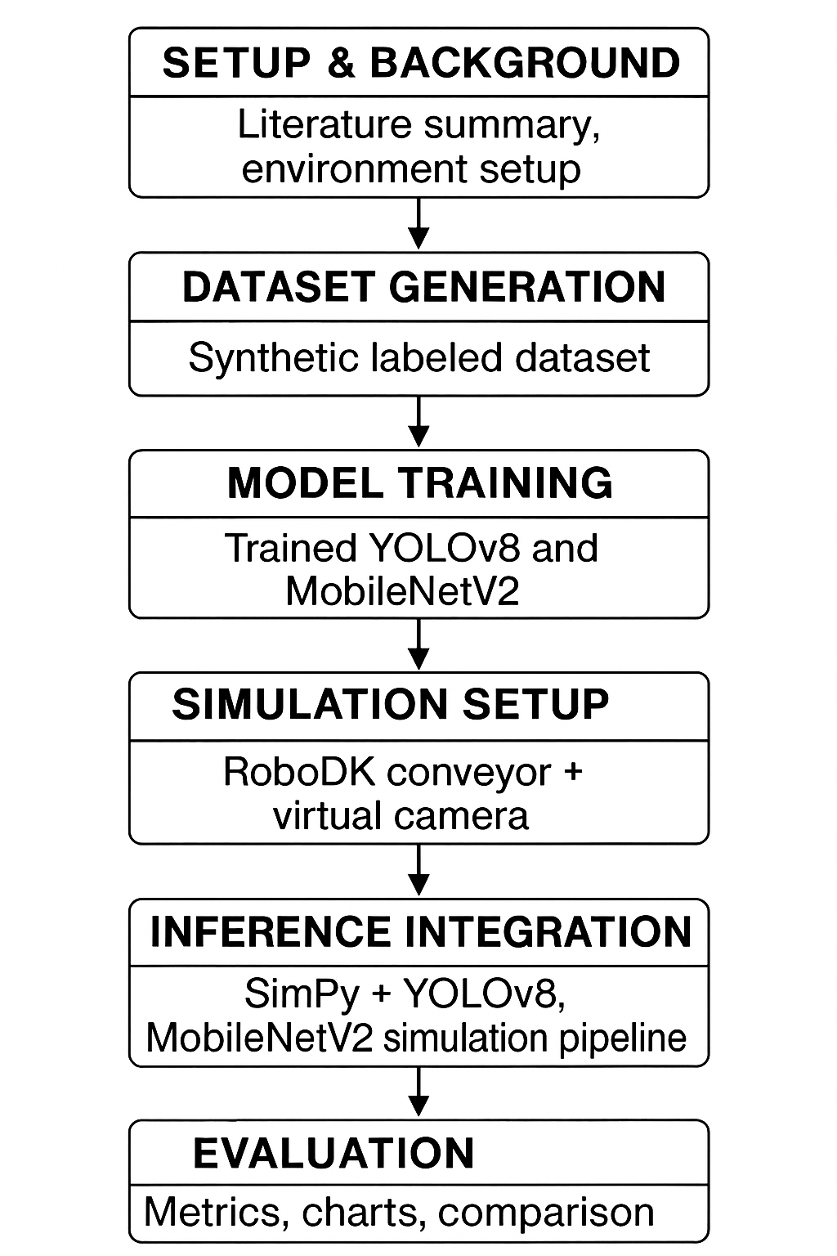
Project flow chart:

Slide 7
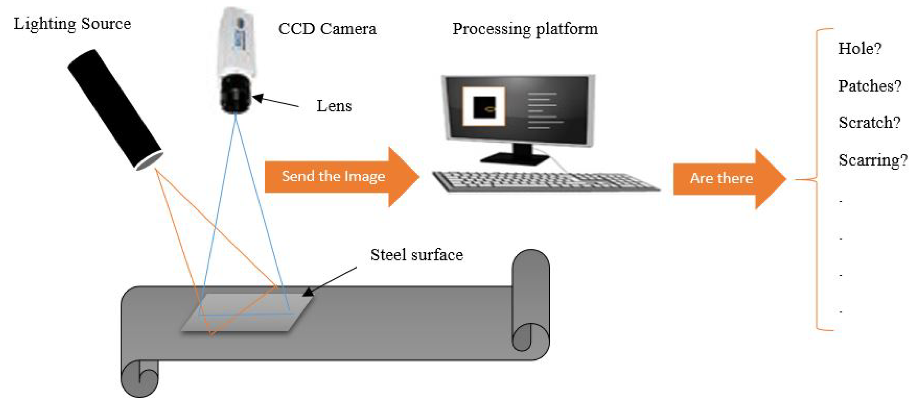
Working Methodology:
Step 1: Data Preparation
Collected metal surface images (defective & non-defective).
Annotated defects (scratches) using CVAT.
Applied data augmentation and split data into train, validate, test sets.
Step 2: Model Development
Trained YOLOv8 (object detection) and MobileNetV2 (classification).
Used transfer learning and tuned key parameters for better accuracy.
Step 3: Simulation Integration
Simulated conveyor and inspection setup using RoboDK.
Integrated models via SimPy for decision routing.
Defective items are virtually sorted into a rejection bin.
Step 4: Evaluation and Comparison
Analyzed accuracy, precision, recall, F1-score, and throughput.
Compared both models to identify the best-performing one for future hardware deployment.

Slide 8
Bill of Materials(BOM):
Component | Specifications | Quantity | Cost
GPU access (colab Pro) | Cloud Training | 3 months | 30 euros
Data set | Neu-metal-surface-defects-data | 1 | Free
Software | Open sourse | - | Free

Slide 9
Expected Outcomes:
Successfully trained YOLOv8 and MobileNetV2 models for defect detection
Functional smart inspection cell simulation with conveyor routing
Comparative performance metrics for both models
Identification of the most efficient model for potential edge deployment

Slide 10
Safety & Ethical Checklist:
Simulation-only environment; no physical machinery risk
Dataset is synthetic/anonymized (no personal data)
Ethical AI principles followed: transparency, fairness, accountability
Avoid dataset bias and ensure reproducibility of results

Slide 11
Future Work:
Integrate robotic sorting arm for real-time defect handling
Deploy best model on Jetson Nano or other edge devices
Expand dataset to include diverse components and textures
Add predictive maintenance and real-time monitoring modules

Slide 12
Bibliography
Ultralytics YOLOv8 Documentation (2024)
Zhang et al., “Deep Learning for Visual Surface Defect Detection,” IEEE Access, 2023
SimPy Documentation (2024)
OpenCV API Reference (2024)

Slide 13
Milestones:​
 | (Oct)Week42 | Week43 | Week44 | (Nov)Week45 | Week46 | Week47 | Week48 | (Dec)Week49 | Week50 | Week51 | Week 52 | (Jan)Week 01 | Week 02
Dataset EDA & annotation
Model training​
Simulation & integration
Final presentation & report

Slide 14
Thank You
Repository link

