Slide 1
Sales Data Analytics Project
End-to-End Online Retail Sales Analysis
Python • EDA • Data Visualization • Power BI • Git & GitHub
Presented by: Suhail Pallemeera
Final Data Analytics Capstone Project
FINAL DATA ANALYTICS CAPSTONE
Sales Data Analytics Project • 1
1

Slide 2
1. Project Overview
Analyzed real-world online retail transaction data to understand sales performance.
Identified sales trends, top-performing products, major markets, and business opportunities.
Built a complete analytics workflow from raw data preparation to interactive Power BI reporting.
Used Git and GitHub to document and version the project professionally.
2
Sales Data Analytics Project • 2

Slide 3
2. Problem Statement & Dataset
Business questions: Which products generate the highest sales?
Which countries contribute the most revenue, and how do sales change over time?
What relationship exists between quantity and sales, and what actions can improve performance?
Dataset: UCI Online Retail Dataset — 541,909 original records, 8 columns.
Period: December 2010 to December 2011; mainly United Kingdom with international transactions.
3
Sales Data Analytics Project • 3

Slide 4
3. Data Cleaning & Preparation
Inspected columns, data types, missing values, duplicates, and invalid transaction values.
Removed duplicate records and rows with missing product descriptions or CustomerID.
Removed transactions with non-positive quantities and non-positive unit prices.
Converted CustomerID to integer format and created TotalSales = Quantity × UnitPrice.
Result: 392,692 cleaned records with no remaining duplicates and important missing values handled.
Original records 541,909
Cleaned records 392,692
Records removed 149,217
4
Sales Data Analytics Project • 4

Slide 5
4. Exploratory Data Analysis
Total Sales: approximately £8.89M
Total Orders: 18,532
Total Customers: 4,338
Average Order Value: approximately £479.56
Quantity vs TotalSales correlation: 0.914 — a strong positive relationship.
Extreme values in Quantity, UnitPrice and TotalSales were reviewed rather than automatically removed because they may represent genuine transactions.
5
Sales Data Analytics Project • 5

Slide 6
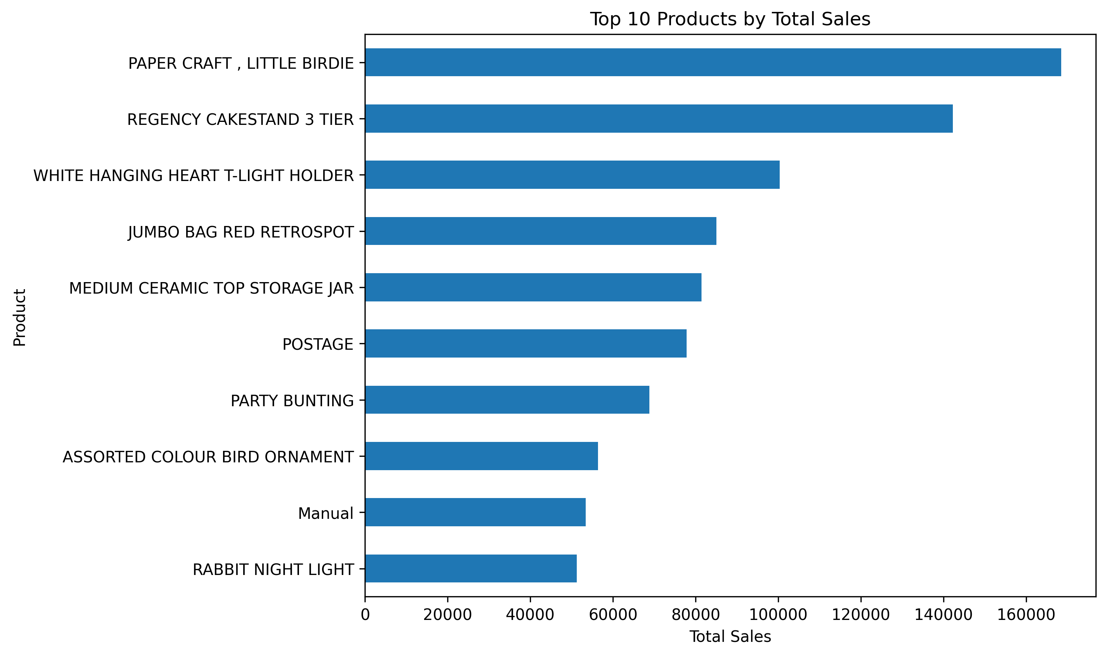
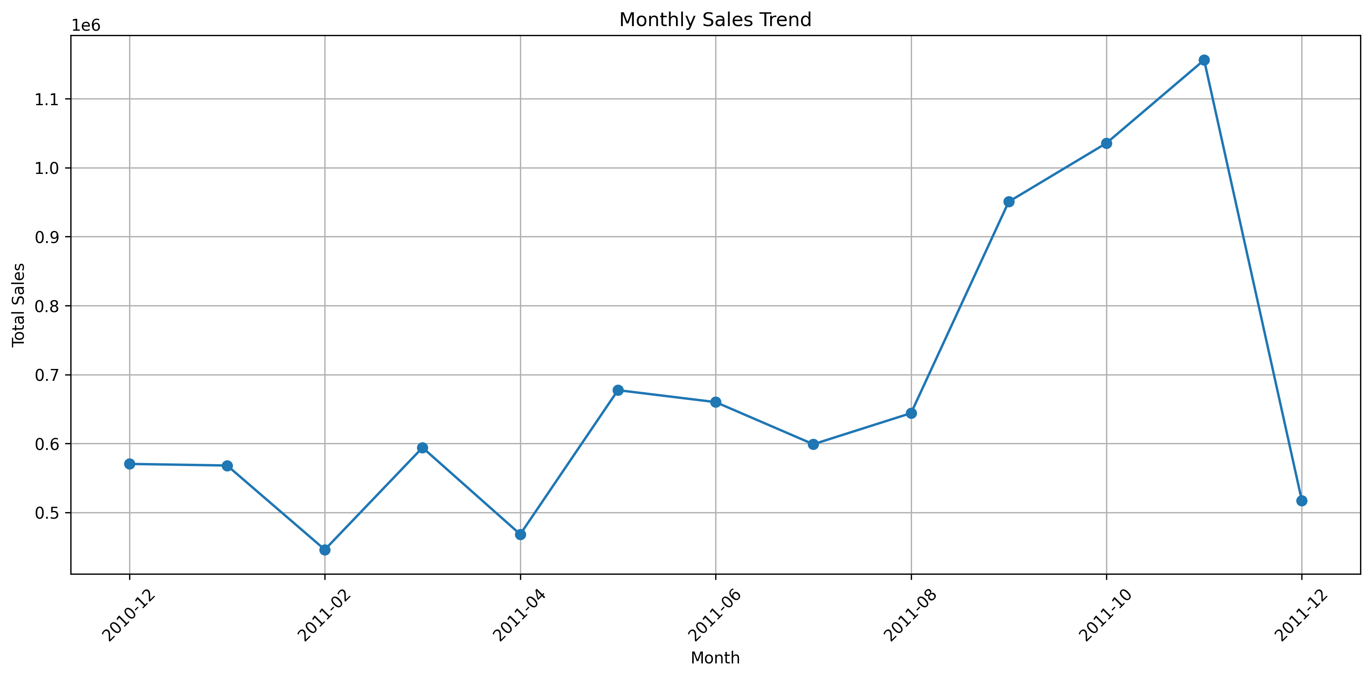
5. Data Visualizations
Five Python/Matplotlib visualizations were created to communicate key patterns.
Top 10 Products
Product performance
Monthly Sales Trend
Seasonality and growth
Sales Data Analytics Project • 6
6

Slide 7
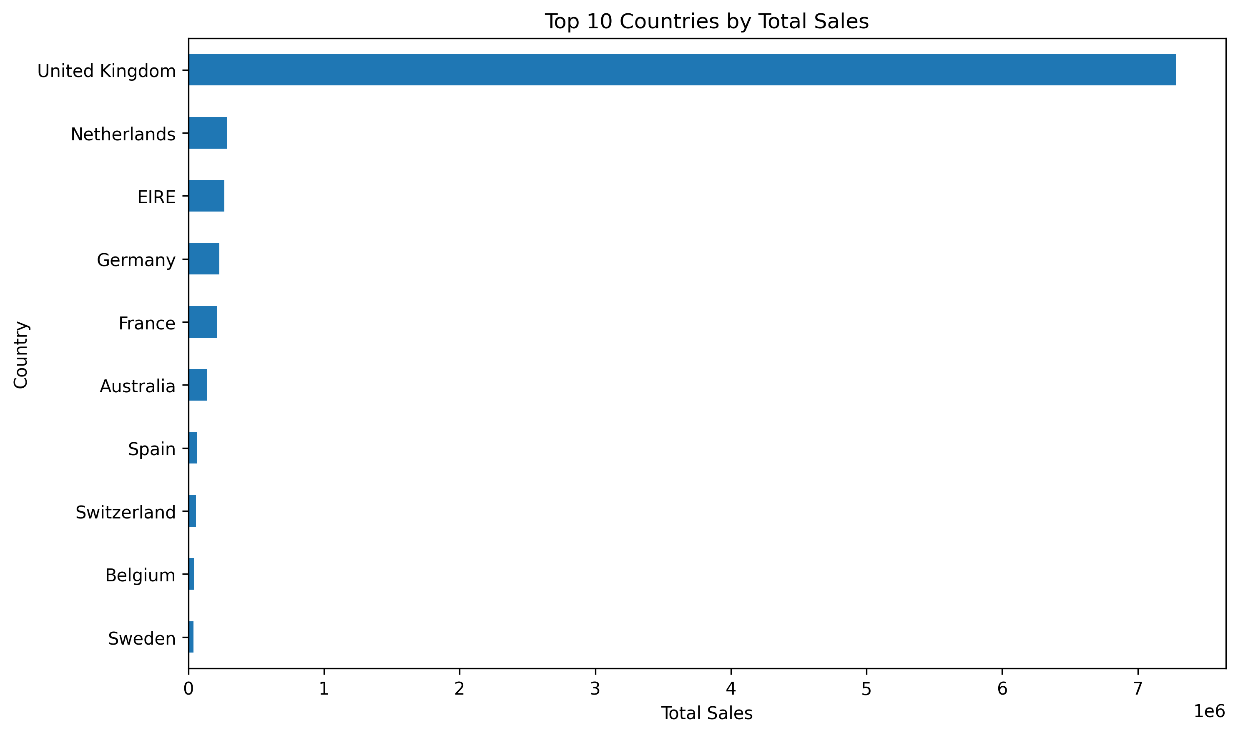
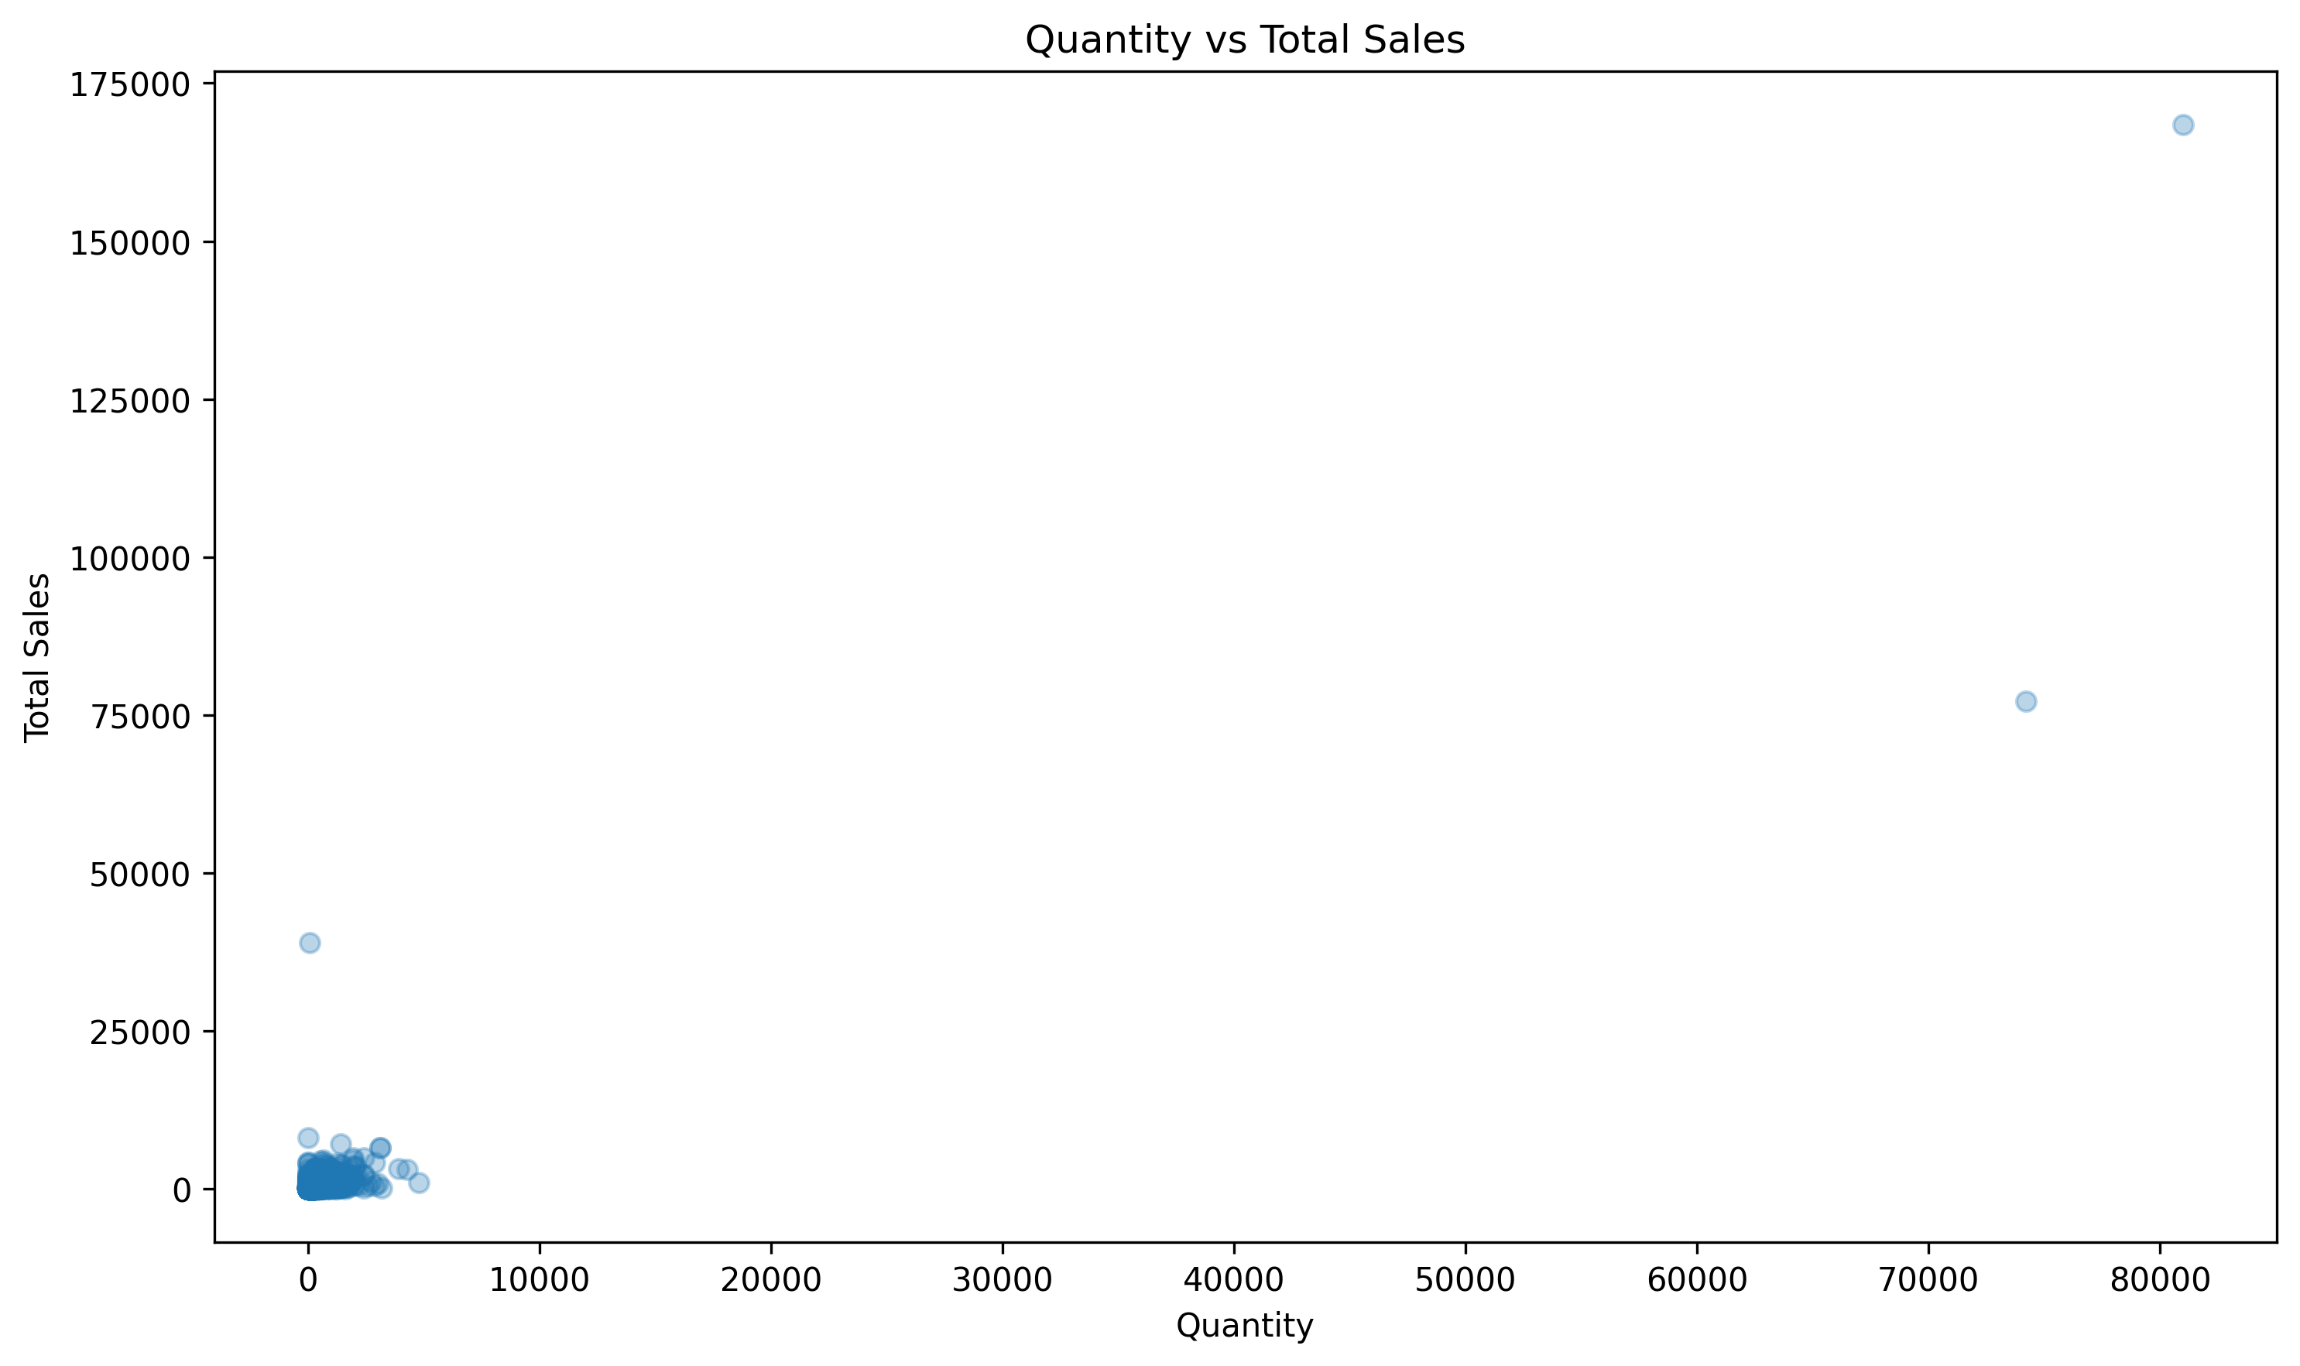
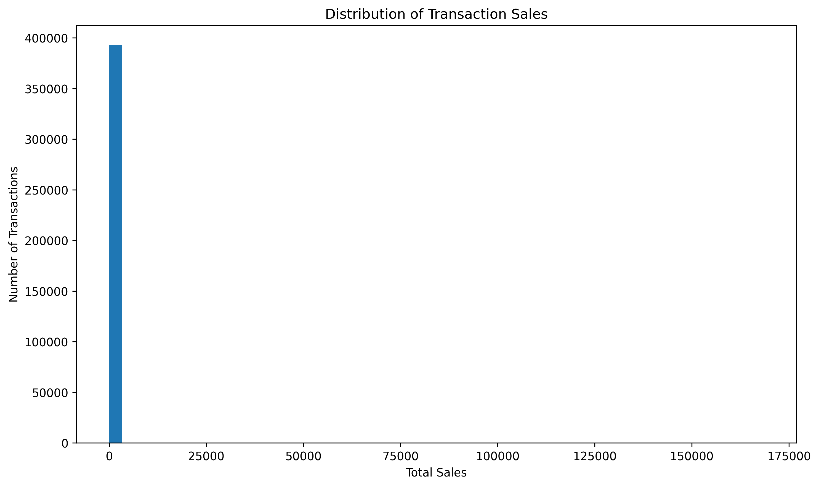
Top 10 Countries
Market performance
Quantity vs Total Sales
Relationship analysis
Sales Distribution
Transaction distribution
Sales Data Analytics Project
7

Slide 8
6. Key Findings
United Kingdom is the dominant market, generating approximately £7.29M in sales.
November 2011 was the strongest month at approximately £1.16M.
October 2011 generated approximately £1.04M; September reached approximately £950.69K.
PAPER CRAFT, LITTLE BIRDIE was the top-selling product by total sales at approximately £168.47K.
Sales increased significantly toward the end of 2011, indicating a strong seasonal demand period.
8
Sales Data Analytics Project • 7

Slide 9
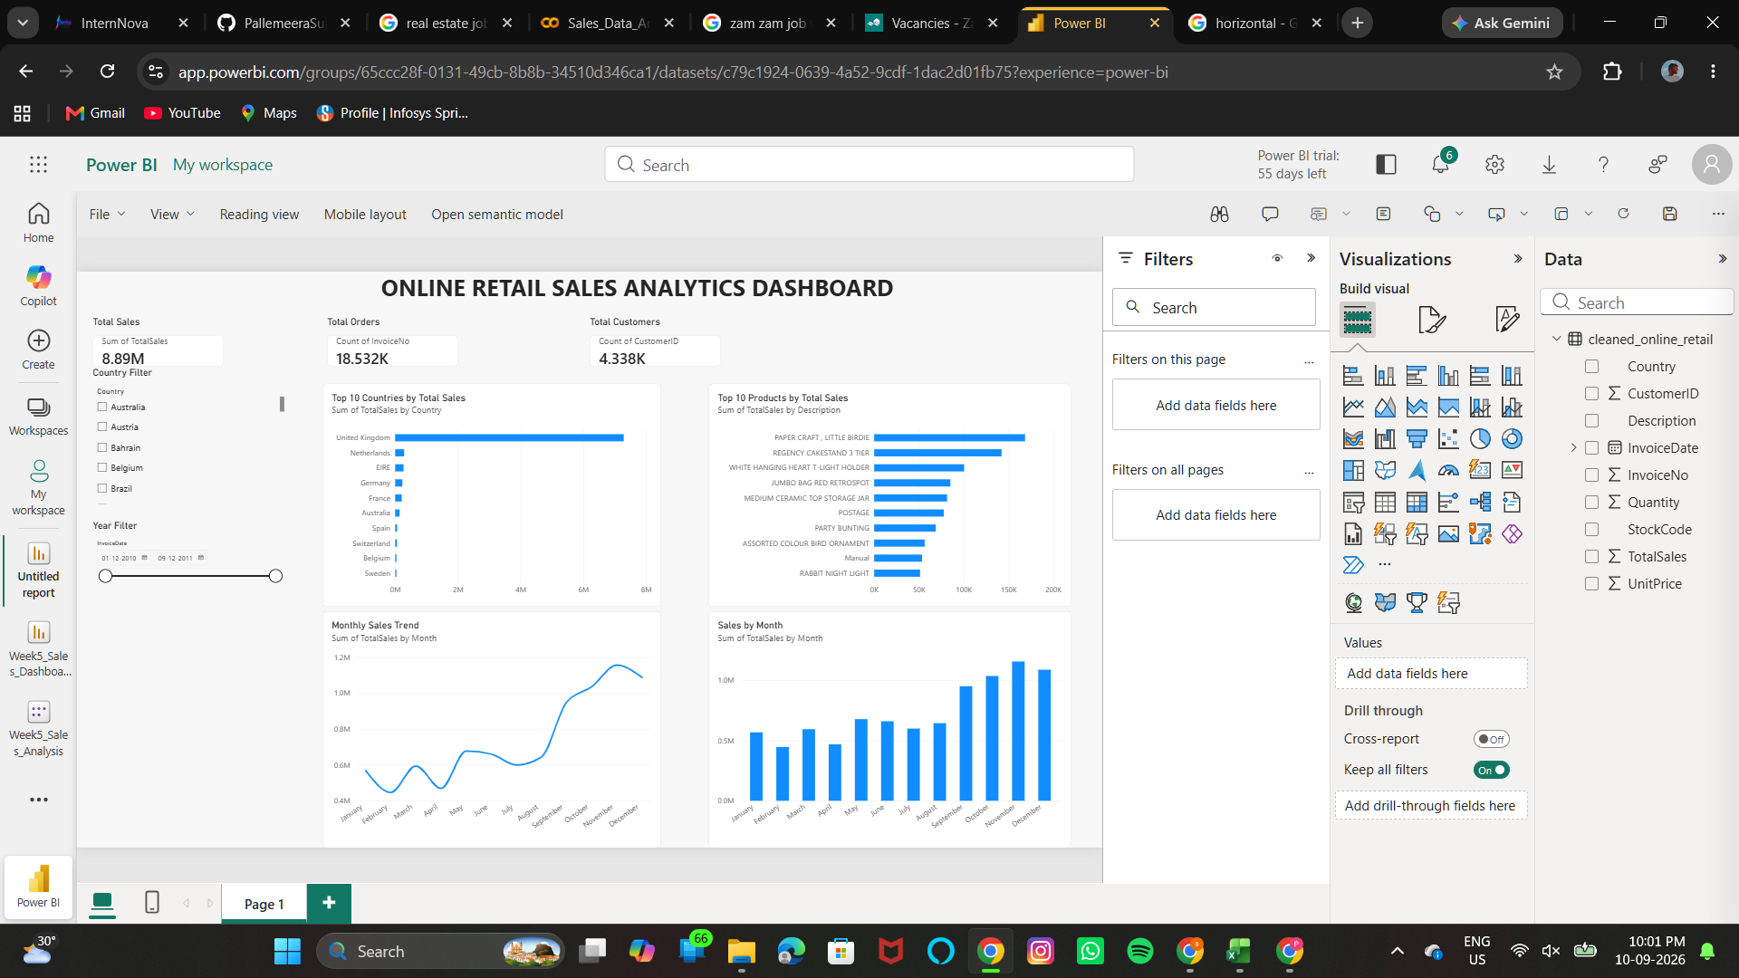
7. Power BI Dashboard
Interactive dashboard created to monitor the most important sales metrics.
KPI Cards: Total Sales £8.89M • Total Orders 18.53K • Total Customers 4.34K
Visuals: Monthly Sales Trend, Top 10 Products, Top 10 Countries, and Sales by Month.
Filters: Country and Year.
Dashboard supports interactive exploration of sales performance and business trends.
9
Sales Data Analytics Project • 8

Slide 10
8. Business Insights & Recommendations
Prioritize marketing and inventory planning for the strongest products and major markets, especially the UK.
Increase inventory readiness before the September–November high-demand period.
Use seasonal campaigns ahead of peak months to capture additional demand.
Monitor product and country performance through the Power BI dashboard to support faster decisions.
Investigate opportunities to grow strong international markets beyond the UK.
Sales Data Analytics Project • 9
10

Slide 11
9. Conclusion
The project demonstrates a complete data analytics workflow using Python, EDA, visualization, Power BI, Git, and GitHub.
The analysis revealed strong sales concentration in the UK, high-performing products, and a clear late-year increase in demand.
The findings can support inventory planning, targeted marketing, sales monitoring, and future forecasting.
The final repository provides the dataset, notebook, Power BI dashboard, visualizations, and documentation for portfolio use.
Thank You
11
Sales Data Analytics Project • 10

