Slide 1
PML • CLASSROOM
K-MEANS
CLUSTERING
From centroids to choosing K
A complete step-by-step lesson with one consistent
6-point example, calculations, graphs and classroom exercises.
Notes:
Introduce the session. Tell students the same six observations will be used for every numerical calculation.

Slide 2
LESSON MAP
What students will learn
The sequence follows how K-Means is actually used.
01
Form the clusters
Initialization → assignment → centroid update → convergence
02
Measure compactness
WCSS: squared distances to cluster centroids
03
Choose K with Elbow
Compare the reduction in WCSS as K increases
04
Validate with Silhouette
Compare cohesion and separation using a(i) and b(i)
PML / K-MEANS CLUSTERING
02
Notes:
Ask students which part they already know. The last two parts are the focus of selection and evaluation.

Slide 3
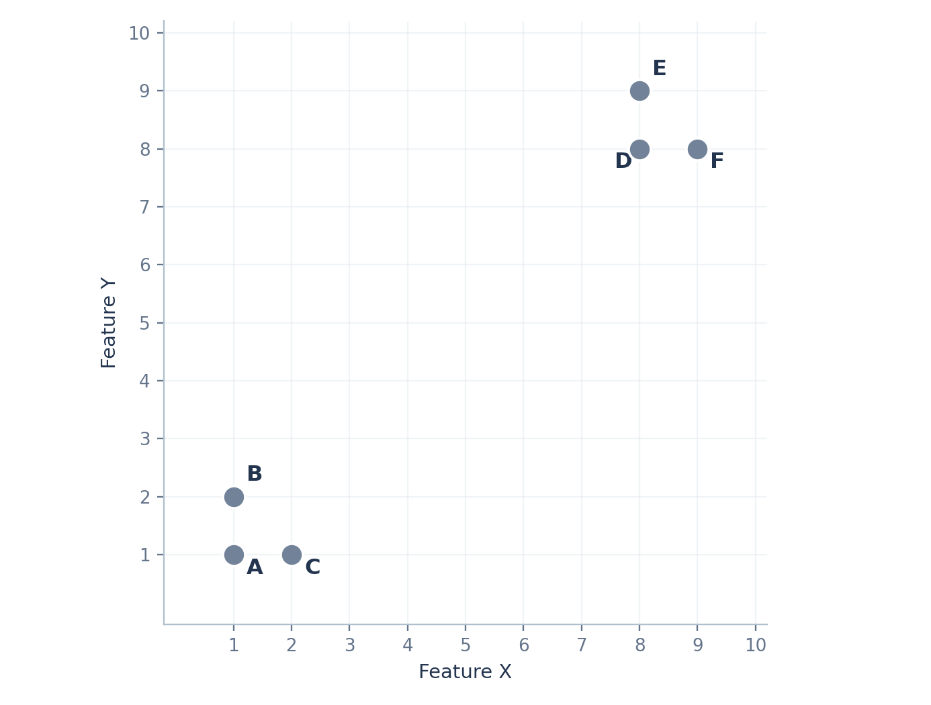
WORKED EXAMPLE
Our six-point dataset
Two numerical features; cluster labels are initially unknown.
Point
X
Y
A
1
1
B
1
2
C
2
1
D
8
8
E
8
9
F
9
8
ASK STUDENTS What groups would you expect if K = 2?
PML / K-MEANS CLUSTERING
03
Notes:
Read coordinates from table rather than eyeballing the graph alone.

Slide 4
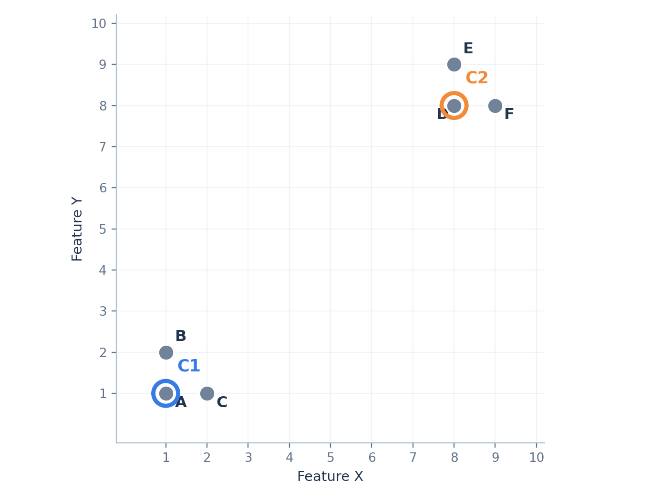
K-MEANS / 1
Choose K and initialize centroids
We will deliberately choose simple starting centers for hand calculations.
NUMBER OF CLUSTERS
K = 2
INITIAL CENTROID 1
C1 = A = (1, 1)
INITIAL CENTROID 2
C2 = D = (8, 8)
ASK STUDENTS A centroid is a mean; must it remain an actual data point?
PML / K-MEANS CLUSTERING
04

Slide 5
K-MEANS++
Why initialization matters
Different starting centers can lead to different local solutions.
Unhelpful starting choice
K-Means++ approach
Both initial centers may fall in the same natural group.
Example: A(1,1) and B(1,2).
Choose first center randomly. Then favor points far from their nearest chosen center.
ORIGINAL K-MEANS++ SELECTION WEIGHT
Probability ∝ D² to nearest chosen centroid
PML / K-MEANS CLUSTERING
05
Notes:
K-Means++ is only initialization. Standard assignment/update follows after the centers are chosen. scikit-learn uses greedy k-means++.

Slide 6
K-MEANS++
Calculate the chance of choosing the next center
Assume the first center is A = (1, 1).
Candidate
Squared distance D²
Selection chance
TOTAL SQUARED DISTANCE
A
0
0.00%
0 + 1 + 1 + 98 + 113 + 113 = 326
B
1
0.31%
C
1
0.31%
EXAMPLE: D
P(D) = 98 / 326 ≈ 30.06%
D
98
30.06%
E
113
34.66%
Farther means more likely,
not guaranteed.
F
113
34.66%
PML / K-MEANS CLUSTERING
06
Notes:
These probabilities illustrate the original K-Means++ D-squared sampling. scikit-learn uses a greedy variant, so exact choices need not follow these probabilities.

Slide 7
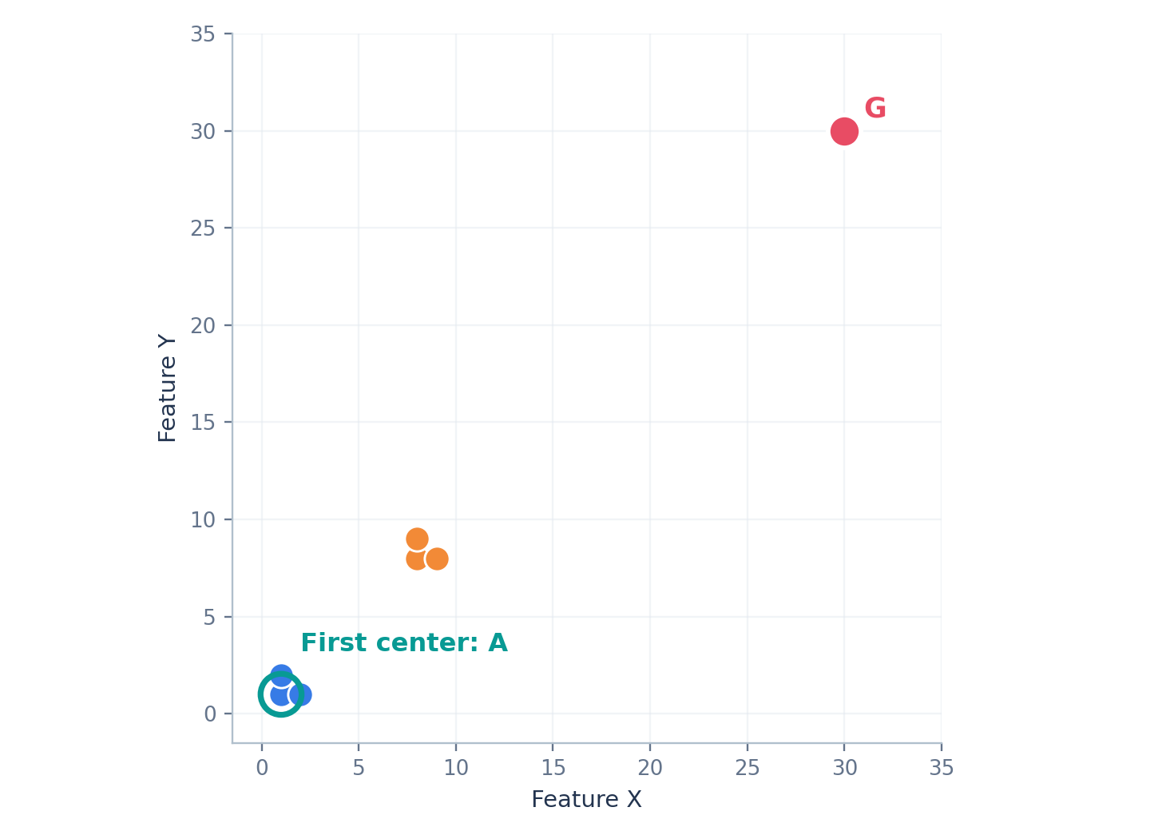
IMPORTANT LIMITATION
Can K-Means++ choose an outlier?
Yes. Very distant outliers can receive a large selection probability.
NEW OUTLIER G
G = (30, 30)
DISTANCE FROM A
D²(A,G) = 29² + 29² = 1,682
ORIGINAL K-MEANS++ PROBABILITY
P(G) = 1,682 / 2,008 ≈ 83.8%
K-Means++ improves initialization; it does NOT make K-Means robust to outliers.
PML / K-MEANS CLUSTERING
07
Notes:
This slide illustrates a limitation and uses the vanilla sampling formula. If outlier becomes singleton, its centroid remains at the point after update.

Slide 8
K-MEANS / 2
Assign each point to its nearest centroid
Use Euclidean distance; squared distance gives the same nearest center.
POINT B TO CENTROID 1
Point
d to C1
d to C2
Assign
d(B,C1) = √[(1−1)² + (2−1)²] = 1
A
0.00
9.90
1
POINT B TO CENTROID 2
B
1.00
9.22
1
d(B,C2) = √[(1−8)² + (2−8)²] = 9.22
C
1.00
9.22
1
D
9.90
0.00
2
B is closer to C1, so B belongs to Cluster 1.
E
10.63
1.00
2
F
10.63
1.00
2
PML / K-MEANS CLUSTERING
08

Slide 9
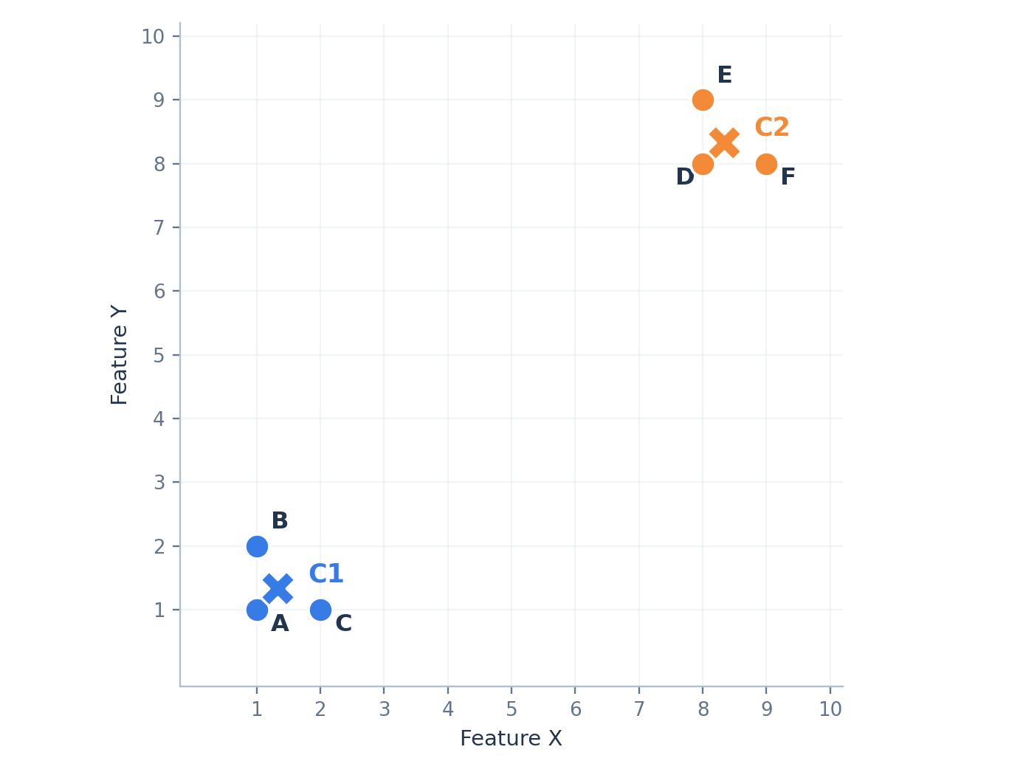
K-MEANS / 3
Update each centroid using the mean
Centroids can move to positions where no data point exists.
CLUSTER 1: A, B, C
C1 = [(1+1+2)/3, (1+2+1)/3]
NEW CENTROID 1
C1 = (1.33, 1.33)
CLUSTER 2: D, E, F
C2 = [(8+8+9)/3, (8+9+8)/3]
New C2 = (8.33, 8.33)
PML / K-MEANS CLUSTERING
09

Slide 10
K-MEANS / 4
Reassign, update and test convergence
Use the new centroids to calculate distances again.
Check
Cluster 1
Cluster 2
New centroids
(1.33, 1.33)
(8.33, 8.33)
Assigned points
A, B, C
D, E, F
After reassignment
A, B, C
D, E, F
After update
(1.33, 1.33)
(8.33, 8.33)
No points change clusters → centroids remain unchanged → CONVERGED.
ASK STUDENTS Does convergence guarantee the clusters are meaningful?
PML / K-MEANS CLUSTERING
10
Notes:
Also mention tol and max_iter practical stop conditions. Convergence is not proof of global optimality.

Slide 11
K-MEANS / RECAP
The complete K-Means loop
The initialization stage ends; the ordinary iterative algorithm begins.
1
Select K and initial centers
2
Assign each point to nearest center
3
Recalculate each centroid as a mean
4
Repeat until stable or stopping criterion
PML / K-MEANS CLUSTERING
11
Notes:
For many samples, iterations run until center movement < tolerance, max_iter, or no assignments change.

Slide 12
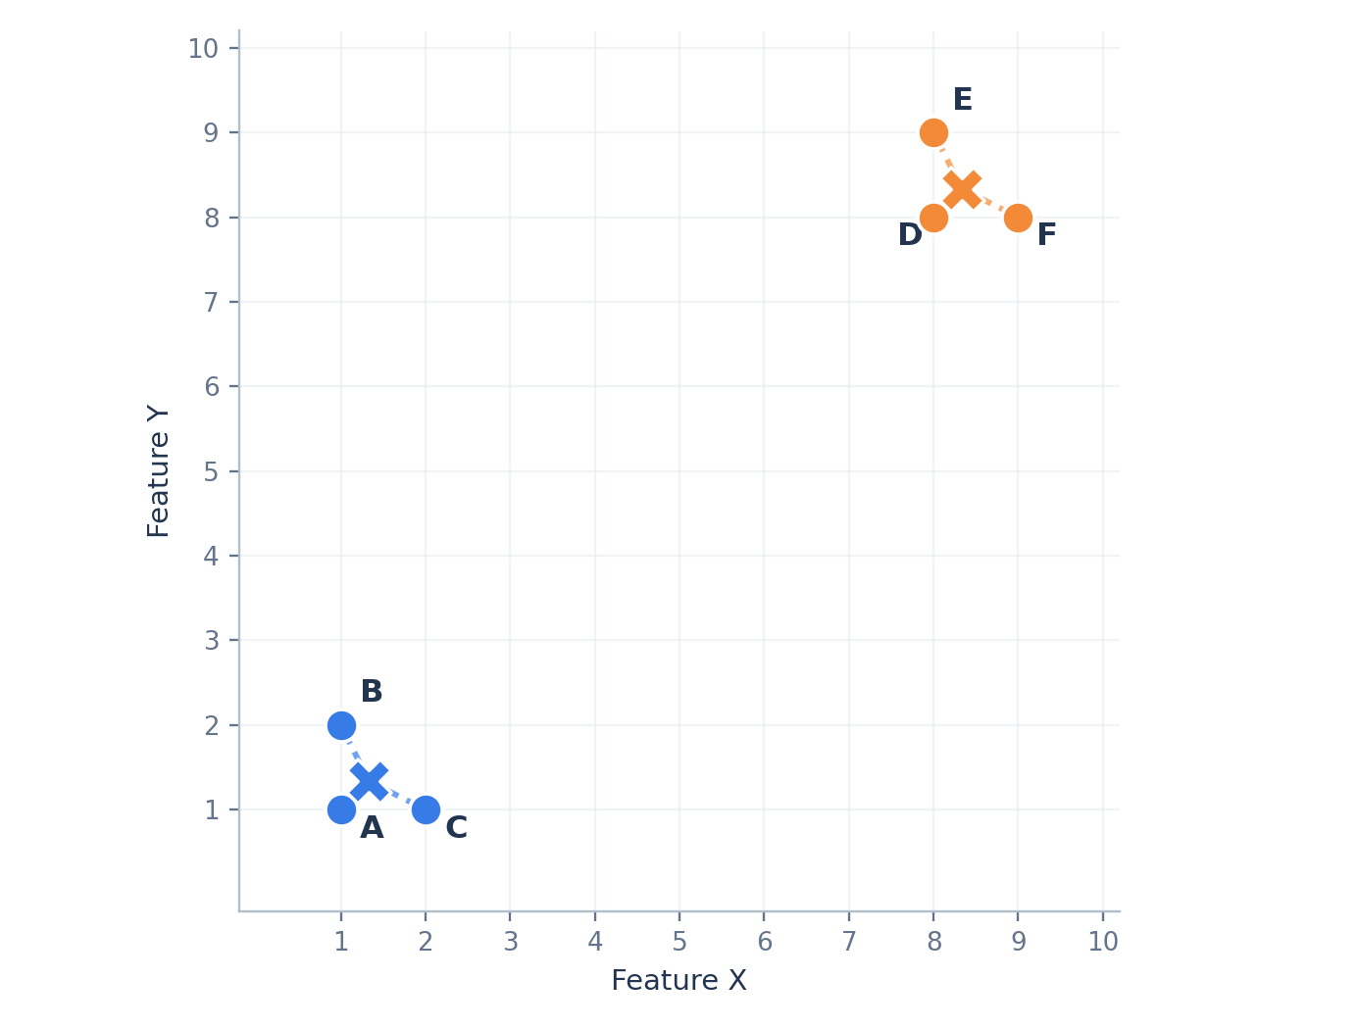
CLUSTER QUALITY
What is K-Means trying to minimize?
WCSS measures how tightly points gather around their own centroid.
OBJECTIVE
WCSS = Σ squared distance to assigned centroid
Interpretation
Lower WCSS means points are, overall, closer to the centers.
ASK STUDENTS Are the dashed distances centroid distances or inter-point distances?
PML / K-MEANS CLUSTERING
12

Slide 13
WCSS / WORKED EXAMPLE
Calculate squared distance for Point A
Use the final Cluster 1 centroid C1 = (4/3, 4/3).
SQUARED EUCLIDEAN DISTANCE
d²(A,C1) = (1 − 4/3)² + (1 − 4/3)²
SIMPLIFY
= 1/9 + 1/9
RESULT
d²(A,C1) = 2/9 = 0.2222
WCSS adds squared distances. It does not take the square root.
PML / K-MEANS CLUSTERING
13

Slide 14
WCSS / FINAL TOTAL
Calculate WCSS for both clusters
Using exact centroid means avoids unnecessary rounding error.
Cluster 1
Squared distance
Cluster 2
Squared distance
A
0.2222
D
0.2222
B
0.5556
E
0.5556
C
0.5556
F
0.5556
WCSS 1
1.3333
WCSS 2
1.3333
TOTAL INERTIA
WCSS = 1.3333 + 1.3333 = 2.6667
PML / K-MEANS CLUSTERING
14
Notes:
The scikit-learn attribute inertia_ is total within-cluster squared Euclidean distance.

Slide 15
CHOOSING K
Why not choose the lowest WCSS?
With more clusters, WCSS usually becomes smaller, even if grouping is less useful.
K
Best WCSS
What it means
1
149.667
All six points share one centroid
2
2.667
Two compact natural groups
3
1.833
One group is split
4
1.000
Further fragmentation
5
0.500
Several singleton clusters
6
0.000
One point per cluster
Zero WCSS at K = 6 does not mean six useful segments.
PML / K-MEANS CLUSTERING
15

Slide 16
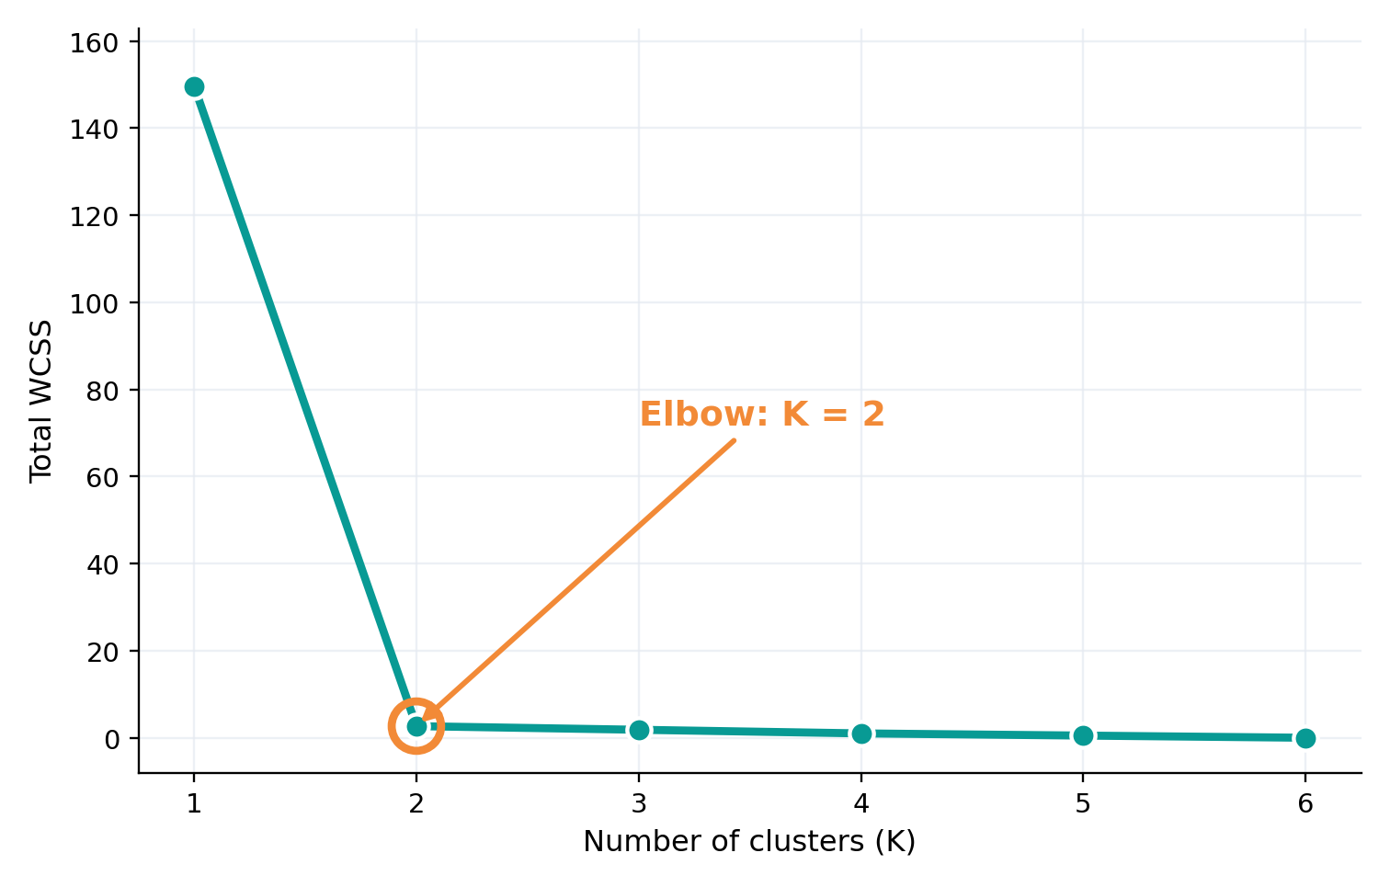
ELBOW METHOD
Plot total WCSS against K
Choose a point where adding clusters gives diminishing returns.
Step 1
Run K-Means for several K values.
Step 2
Plot K vs total WCSS and look for a bend.
For our six points: the elbow is at K = 2.
PML / K-MEANS CLUSTERING
16

Slide 17
ELBOW / INTERPRETATION
Why the elbow is K = 2
Compare how much WCSS falls when an additional cluster is introduced.
Change in K
WCSS decrease
THE MAIN INSIGHT
1 → 2
147.000
1 → 2 is a huge improvement.
2 → 3
0.833
AFTER K = 2
3 → 4
0.833
Only small gains remain.
4 → 5
0.500
5 → 6
0.500
Elbow is a heuristic, not a mathematical proof.
PML / K-MEANS CLUSTERING
17

Slide 18
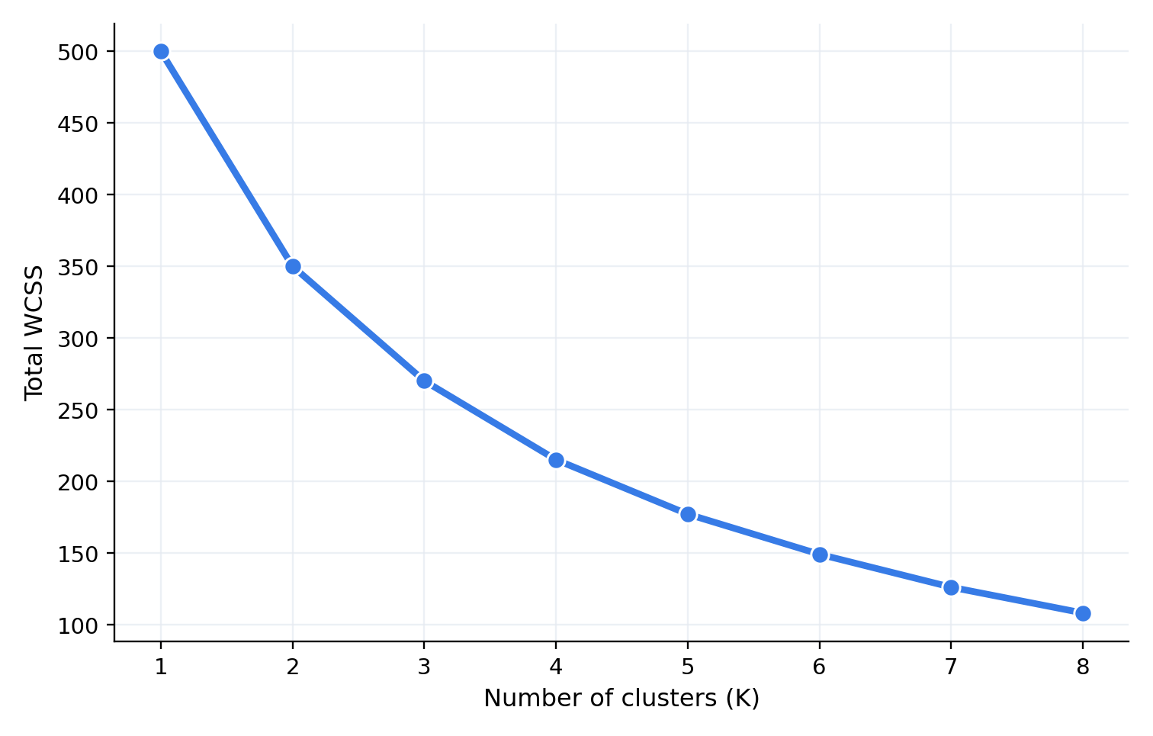
ELBOW / LIMITATION
What if there is no obvious elbow?
In real datasets WCSS may decline gradually instead of bending sharply.
PML / K-MEANS CLUSTERING
18

Slide 19
SILHOUETTE / IDEA
Two questions for every data point
A good cluster is compact inside and separate from the other clusters.
a(i): cohesion
b(i): separation
Average distance from point i to OTHER points in its OWN cluster.
Smaller is better.
Smallest average distance from point i to points in ANOTHER cluster.
Larger is better.
Well-separated point → a(i) < b(i)
ASK STUDENTS Which should be smaller for a well-clustered point: a(i) or b(i)?
PML / K-MEANS CLUSTERING
19

Slide 20
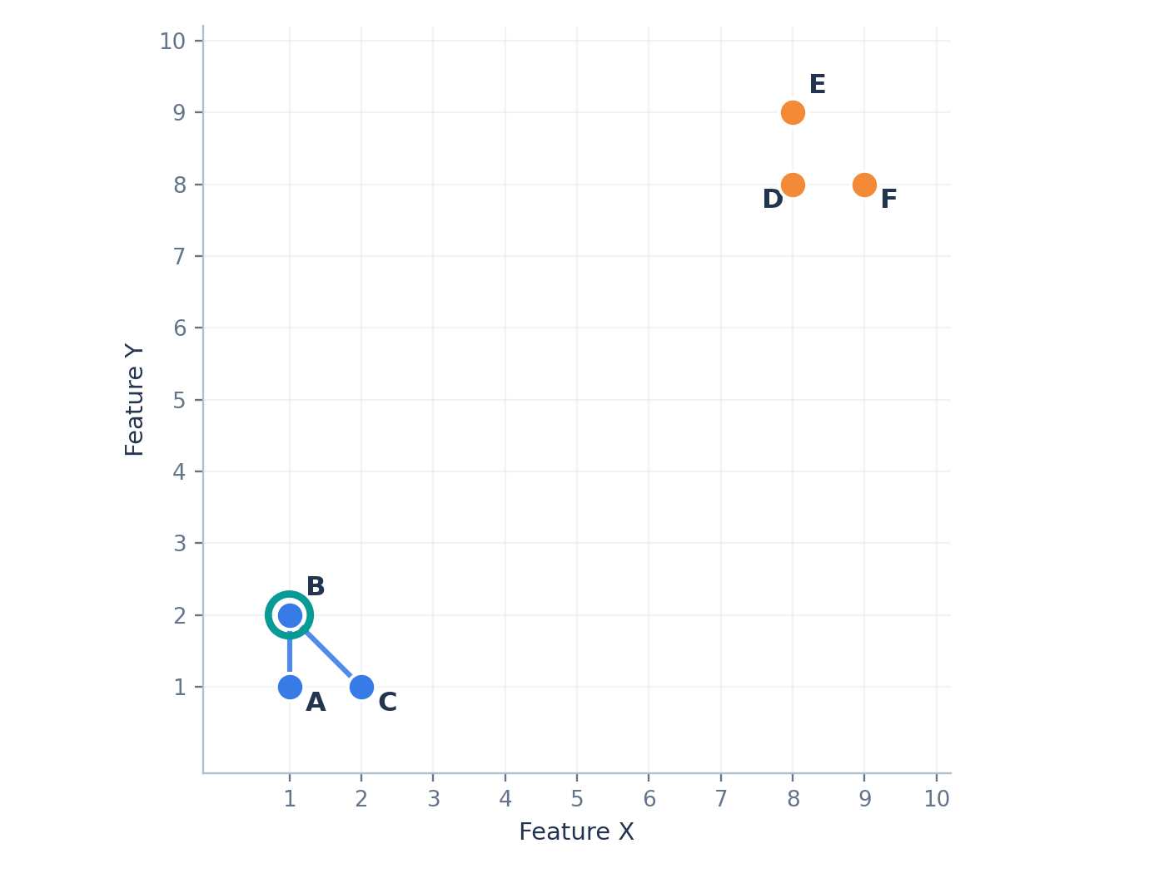
SILHOUETTE / A(I)
Calculate a(B): distance to own cluster
Point B = (1, 2); own cluster contains A, B and C.
DISTANCE B → A
1.000
DISTANCE B → C
√2 = 1.414
AVERAGE (EXCLUDE B ITSELF)
a(B) = (1 + 1.414)/2 = 1.207
PML / K-MEANS CLUSTERING
20
Notes:
a(i) excludes the distance from the point to itself.

Slide 21
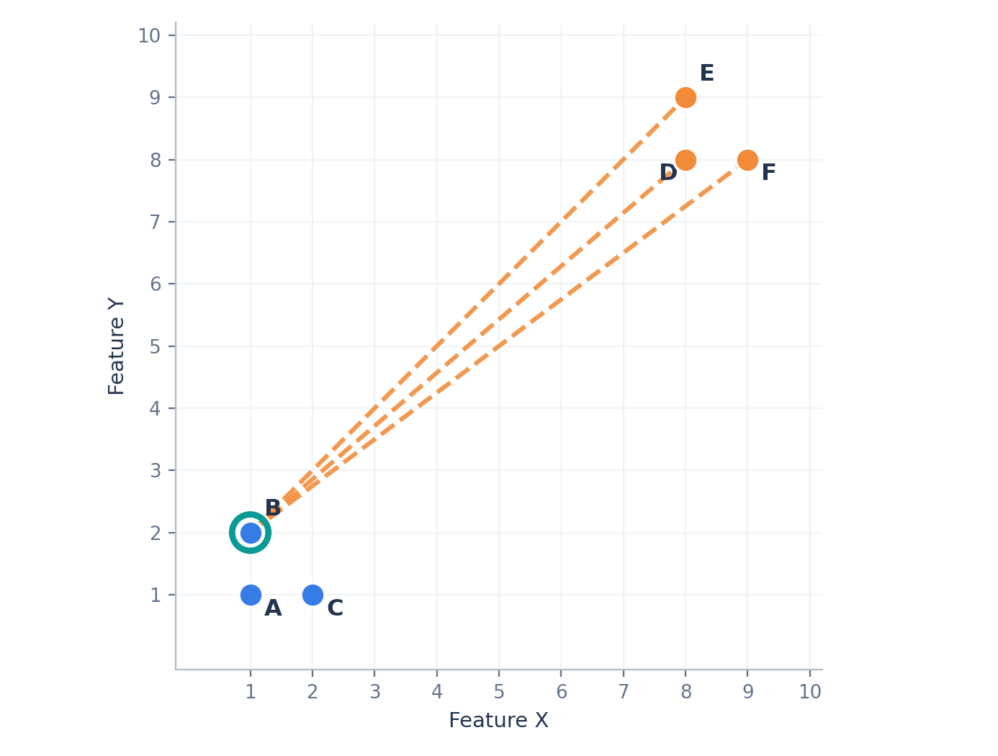
SILHOUETTE / B(I)
Calculate b(B): distance to the other cluster
For K = 2, there is only one alternative cluster: D, E and F.
Distance
Value
B → D
√85 = 9.220
B → E
√98 = 9.899
B → F
10.000
AVERAGE DISTANCE
b(B) = (9.220+9.899+10)/3 = 9.706
PML / K-MEANS CLUSTERING
21
Notes:
Contrast with WCSS: silhouette uses inter-point distances, NOT distances from points to centroids.

Slide 22
SILHOUETTE / FORMULA
Calculate the Silhouette Score for Point B
Combine within-cluster compactness and distance to the nearest alternative cluster.
SILHOUETTE COEFFICIENT
s(i) = [b(i) − a(i)] / max[a(i), b(i)]
a(B) — OWN CLUSTER
b(B) — OTHER CLUSTER
s(B) — RESULT
1.207
9.706
0.876
SUBSTITUTE
s(B) = (9.706 − 1.207) / 9.706 ≈ 0.876
PML / K-MEANS CLUSTERING
22

Slide 23
SILHOUETTE / INTERPRETATION
What does a Silhouette Score mean?
The coefficient ranges from −1 to +1.
Near +1
Near 0
Negative
Point is much closer to its own cluster than the nearest other cluster.
Average distance to its own cluster is similar to another cluster.
Another cluster is closer on average; assignment may be questionable.
EXAMPLE: NEGATIVE SCORE
a = 8, b = 3 → s = (3 − 8)/8 = −0.625
A score close to 0 suggests overlap / boundary; it does not prove an exact geometric boundary.
PML / K-MEANS CLUSTERING
23

Slide 24
SILHOUETTE / IMPORTANT DETAIL
What does b(i) mean if K > 2?
Choose the smallest mean distance across all OTHER clusters.
Cluster 1
Cluster 2
Cluster 3
Point i lives here
Mean distance = 4.5
Mean distance = 8.2
TAKE THE CLOSEST ALTERNATIVE CLUSTER
b(i) = min(4.5, 8.2) = 4.5
Do NOT average distances across all other clusters together.
PML / K-MEANS CLUSTERING
24

Slide 25
SILHOUETTE / MODEL SCORE
From individual scores to one model score
Calculate one score per point, then take their mean.
Point
Cluster
a(i)
b(i)
s(i)
AVERAGE SILHOUETTE
A
1
1.000
10.387
0.904
(0.904 + 0.876 + 0.876 + 0.894 + 0.881 + 0.881)/6
B
1
1.207
9.706
0.876
C
1
1.207
9.706
0.876
RESULT
D
2
1.000
9.446
0.894
0.885
E
2
1.207
10.177
0.881
F
2
1.207
10.177
0.881
High: well-defined groups.
PML / K-MEANS CLUSTERING
25

Slide 26
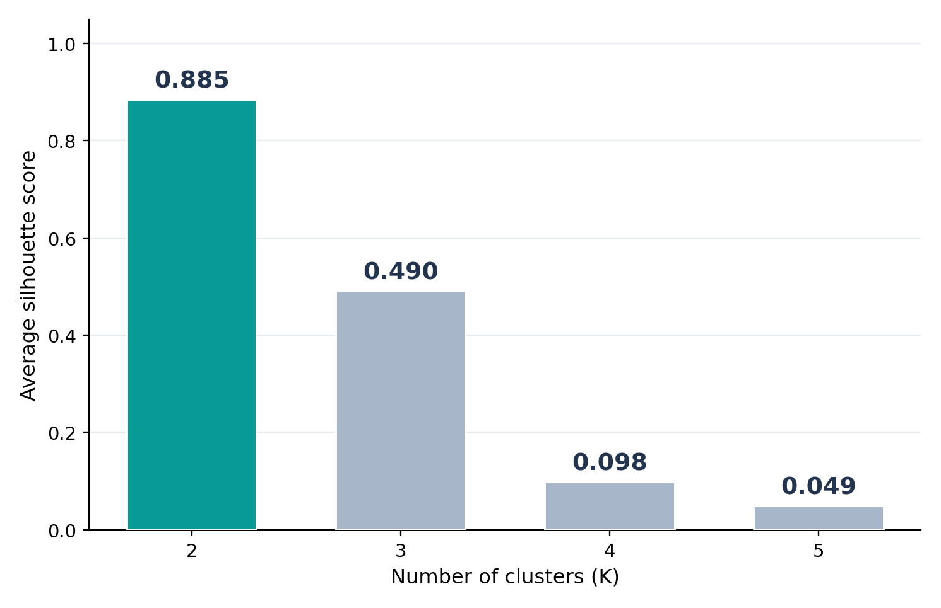
SILHOUETTE / SELECTING K
Compare the average score across K values
Higher mean Silhouette Score usually indicates better cohesion and separation.
K
Avg. score
2
0.885
3
0.490
4
0.098
5
0.049
Best of tested K: 2
PML / K-MEANS CLUSTERING
26
Notes:
At K=4 and K=5, singleton clusters appear. scikit-learn assigns their sample silhouettes 0. The overall coefficient is undefined for K=1 or K=n.

Slide 27
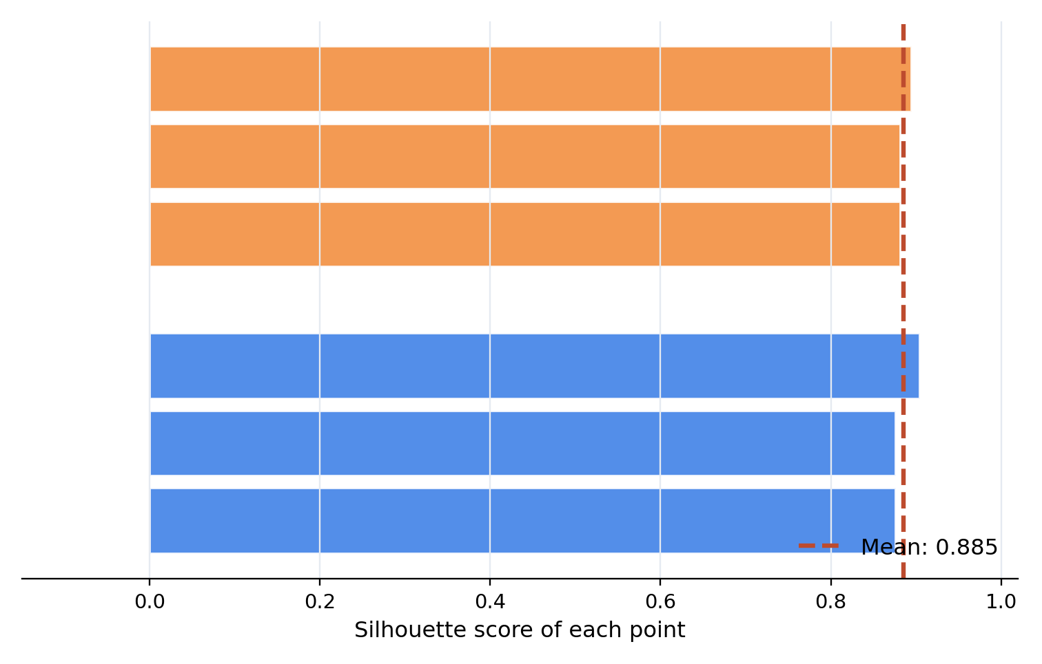
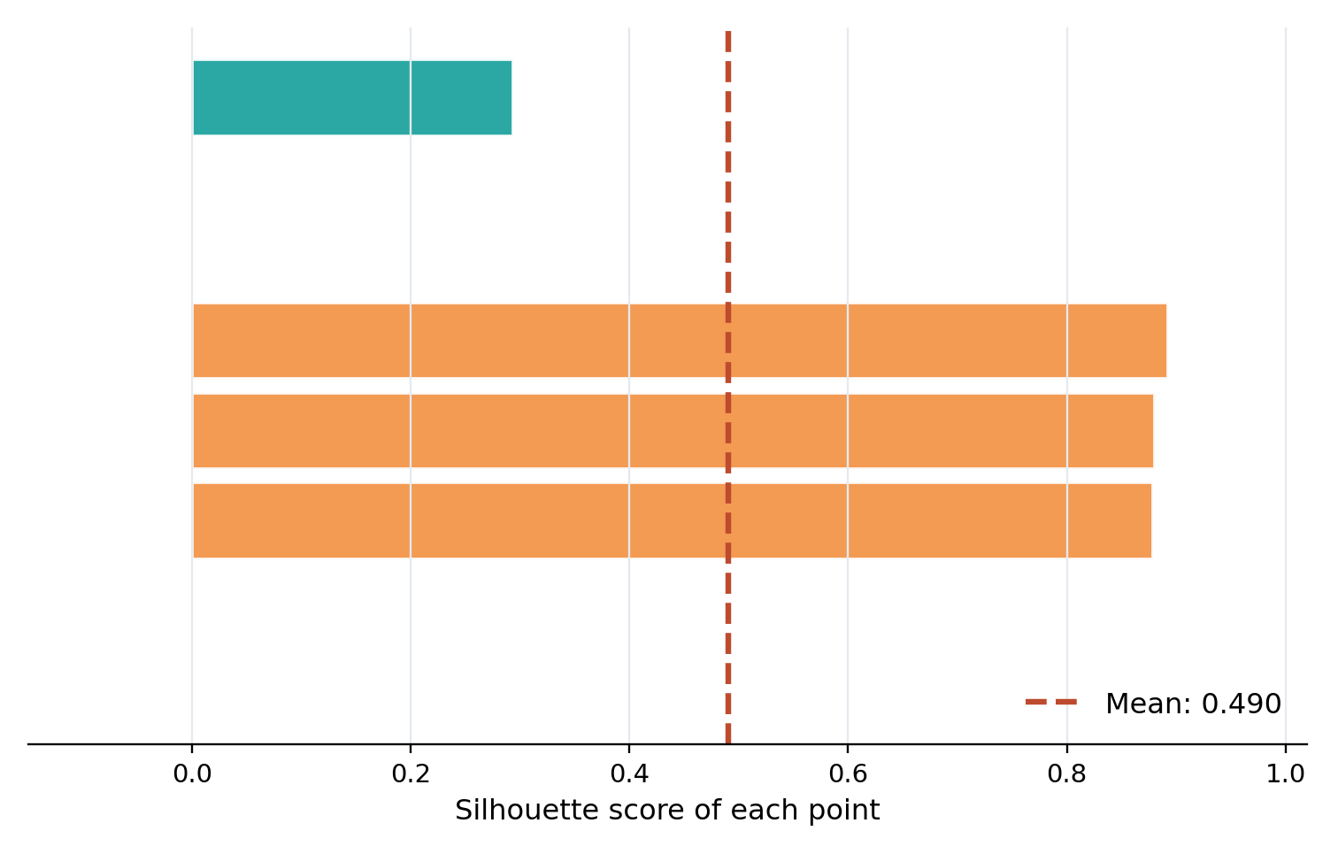
SILHOUETTE / DIAGNOSING CLUSTERS
Look beyond the average: per-point profiles
A silhouette plot shows the scores of individual samples within each cluster.
K = 2 • mean 0.885
K = 3 • mean 0.490
More consistent positive scores at K = 2 indicate a clearer grouping for this dataset.
PML / K-MEANS CLUSTERING
27

Slide 28
CHOOSING K / SYNTHESIS
Elbow vs Silhouette Score
Both help choose K, but they answer different questions.
Question
Elbow Method
Silhouette Score
What is measured?
Total WCSS / inertia
Cohesion and separation
Direction
Find a bend in decreasing WCSS
Higher average is better
Weakness
Elbow can be ambiguous
Can favor smaller/uneven clusters
Our six points
Suggests K = 2
Highest score at K = 2
GOOD PRACTICE
Use both — then inspect sizes, plots and business meaning.
PML / K-MEANS CLUSTERING
28

Slide 29
PYTHON / IMPLEMENTATION
Fit K-Means and inspect its results
Clean scikit-learn code using the same six-point coordinates.
import numpy as np
from sklearn.cluster import KMeans
X = np.array([[1,1], [1,2], [2,1],
[8,8], [8,9], [9,8]])
model = KMeans(n_clusters=2, init="k-means++",
n_init=10, random_state=42)
labels = model.fit_predict(X)
print(model.cluster_centers_)
print(model.inertia_)
CLUSTER CENTERS
(1.33,1.33)
SECOND CENTER
(8.33,8.33)
WCSS / INERTIA
2.667
PML / K-MEANS CLUSTERING
29
Notes:
Cluster IDs 0/1 may be interchanged without changing the partition.

Slide 30
PYTHON / EVALUATION
Run the Elbow and Silhouette comparisons
Keep the data and random seed consistent across candidate K values.
from sklearn.cluster import KMeans
from sklearn.metrics import silhouette_score
wcss, scores = [], []
for k in range(1, 7):
km = KMeans(n_clusters=k, n_init=10,
random_state=42)
labels = km.fit_predict(X)
wcss.append(km.inertia_)
if 2 <= k < len(X):
scores.append((k, silhouette_score(X, labels)))
print('WCSS:', wcss)
print('Silhouette:', scores)
Elbow
K = 1…6
Silhouette
K = 2…5
K=1 and K=6: not defined.
PML / K-MEANS CLUSTERING
30

Slide 31
IMPLEMENTATION / CHECKS
Important practical considerations
Good mathematical clustering is not automatically useful clustering.
Scale features
Check outliers
Large-scale variables can dominate Euclidean distances.
K-Means and K-Means++ remain sensitive to extreme points.
Use multiple starts
Interpret segments
Explicit n_init=10 explores different seeds; compare inertia.
Check size, feature profiles, stability and domain meaning.
scikit-learn KMeans defaults to K-Means++ initialization; n_init is explicitly set here for reproducibility.
PML / K-MEANS CLUSTERING
31

Slide 32
STUDENT EXERCISE
Check your understanding
Discuss first; reveal the answer slide only after students respond.
Q1
For B = (1,2), why is a(B) computed from A and C, not the centroid?
Q2
If a(i) = 6 and b(i) = 3, what is its Silhouette Score?
Q3
If WCSS keeps decreasing as K increases, why not choose K = n?
Q4
Which method would you use if the elbow graph has no clear bend?
PML / K-MEANS CLUSTERING
32
Notes:
Encourage students to explain in words before evaluating formulas.

Slide 33
TRAINER KEY
Suggested answers to the student exercise
Use for discussion or retain as a hidden teacher slide.
A1
Silhouette uses distances to other samples in the cluster; WCSS uses centroids.
A2
(3 − 6) / max(6,3) = −3/6 = −0.5. The point may fit better elsewhere.
A3
At K = n each point is its own cluster and WCSS = 0; segmentation is unhelpful.
A4
Compare candidate average Silhouette Scores and inspect cluster sizes/profiles.
PML / K-MEANS CLUSTERING
33

Slide 34
FINAL RECAP
Five ideas to remember
Students should be able to explain each concept without looking at the slides.
1
K-Means
Assign → mean update → repeat
2
K-Means++
Better starting centers, not outlier protection
3
WCSS
Sum of squared distances to centroids
4
Elbow
Look for diminishing WCSS improvements
5
Silhouette
Compare average own-cluster and nearest-cluster distances
References: scikit-learn KMeans and silhouette_score documentation
PML / K-MEANS CLUSTERING
34

