Slide 1
UNSUPERVISED LEARNING
Hierarchical
Clustering
SINGLE-LINKAGE TREE
CUT → 2 GROUPS
From distances and merges to
dendrograms and choosing a cut
WORKED EXAMPLES
PYTHON + SCIKIT-LEARN
A
B
C
D
PRACTICAL MACHINE LEARNING

Slide 2
LESSON MAP
What will we learn?
One continuous example, then a real dataset.
Start with points
01
Calculate distances
02
Merge using linkage
03
Each point is its own cluster.
Build a distance matrix.
Combine the closest clusters.
Read dendrogram
04
Choose K and apply
05
See which groups merged and when.
Select K; implement with Python.
GOAL
Interpret a dendrogram and select meaningful groups.
PRACTICAL MACHINE LEARNING / HIERARCHICAL CLUSTERING
02

Slide 3
INTUITION
Hierarchical clustering builds a tree of groups
Agglomerative clustering repeatedly merges the nearest clusters.
START · 4 CLUSTERS
MERGE · 2 CLUSTERS
FINAL · 1 CLUSTER
A, B
A
B
A, B, C, D
C
D
C, D
Final merge at 6
Merges at 1 and 2
REMEMBER
Bottom-up: begin with individual points, then merge clusters.
PRACTICAL MACHINE LEARNING / HIERARCHICAL CLUSTERING
03

Slide 4
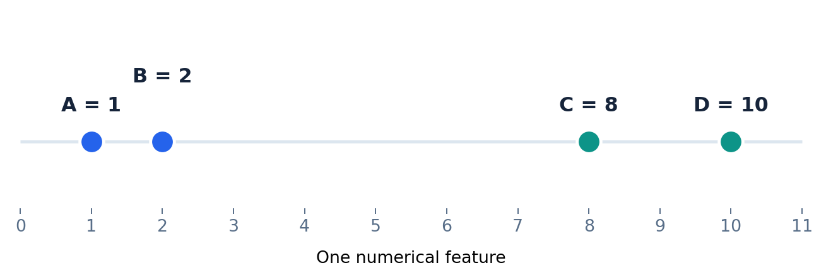
WORKED EXAMPLE
Use the same four points throughout
One numerical feature keeps our first calculations simple.
Point
Value
A
1
B
2
C
8
D
10
FIRST
Each point starts as its own cluster: A | B | C | D.
PRACTICAL MACHINE LEARNING / HIERARCHICAL CLUSTERING
04

Slide 5
DISTANCES
Calculate the distance between each pair
For one feature, distance = absolute difference between values.
A (1)
B (2)
C (8)
D (10)
A to B
A (1)
0
1
7
9
|1 - 2| = 1
B (2)
1
0
6
8
C to D
C (8)
7
6
0
2
|8 - 10| = 2
D (10)
9
8
2
0
OBSERVE
The closest pair is A and B (distance 1).
PRACTICAL MACHINE LEARNING / HIERARCHICAL CLUSTERING
05

Slide 6
MERGE 1
Merge A and B at distance 1
Always merge the closest two current clusters.
A
B
A, B
Calculation
Clusters remaining
Distance(A, B) = |1 - 2| = 1
(A, B) | C | D
STATUS
4 clusters become 3 clusters.
PRACTICAL MACHINE LEARNING / HIERARCHICAL CLUSTERING
06

Slide 7
MERGE 2
Next, merge C and D at distance 2
Compare distances between the three remaining clusters.
Remaining cluster pair
Single-linkage distance
(A, B) to C
min(7, 6) = 6
(A, B) to D
min(9, 8) = 8
C to D
|8 - 10| = 2
Cluster 1: A, B
Cluster 2: C, D
STATUS
3 clusters become 2 clusters.
PRACTICAL MACHINE LEARNING / HIERARCHICAL CLUSTERING
07

Slide 8
BETWEEN CLUSTERS
How far apart are Cluster 1 and Cluster 2?
Cluster 1 = A, B | Cluster 2 = C, D
Cross-cluster pair
Calculation
Distance
Single Linkage
A to C
|1 - 8|
7
Choose the minimum distance.
min(7, 9, 6, 8) = 6
A to D
|1 - 10|
9
B to C
|2 - 8|
6
B to D
|2 - 10|
8
RESULT
The two clusters merge at distance 6 using Single Linkage.
PRACTICAL MACHINE LEARNING / HIERARCHICAL CLUSTERING
08

Slide 9
LINKAGE METHODS
Different methods define cluster distance differently
Use the same four cross-cluster distances: 7, 9, 6, 8.
Single Linkage
Complete Linkage
Average Linkage
Nearest pair
min(7, 9, 6, 8)
Distance = 6
Farthest pair
max(7, 9, 6, 8)
Distance = 9
Mean of all pairs
(7 + 9 + 6 + 8) / 4
Distance = 7.5
WHY IT MATTERS
Linkage can change merge heights and sometimes cluster membership.
PRACTICAL MACHINE LEARNING / HIERARCHICAL CLUSTERING
09

Slide 10
WARD LINKAGE
Ward uses a different merging rule
Select the merge causing the smallest increase in within-cluster sum of squares.
Single / Complete / Average
Ward
Measure separation using point-to-point distances between clusters.
Prefer compact clusters by limiting the increase in within-cluster variation.
In scikit-learn, Ward requires Euclidean distance.
NOTE
Ward heights are not the same as shortest-pair distances.
PRACTICAL MACHINE LEARNING / HIERARCHICAL CLUSTERING
10

Slide 11
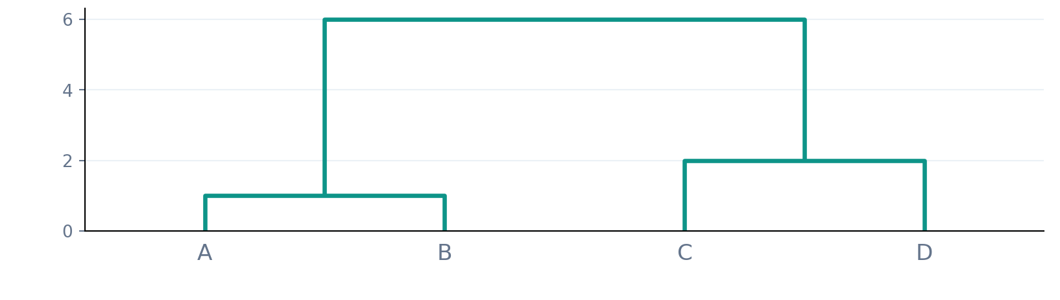
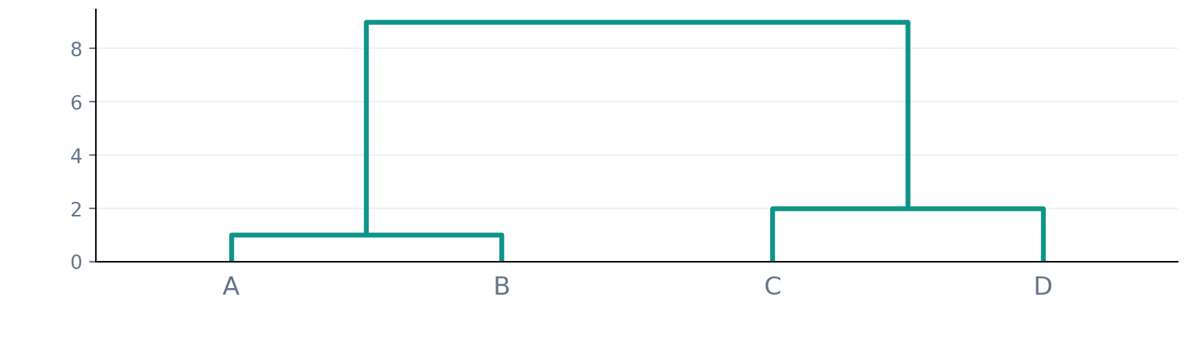
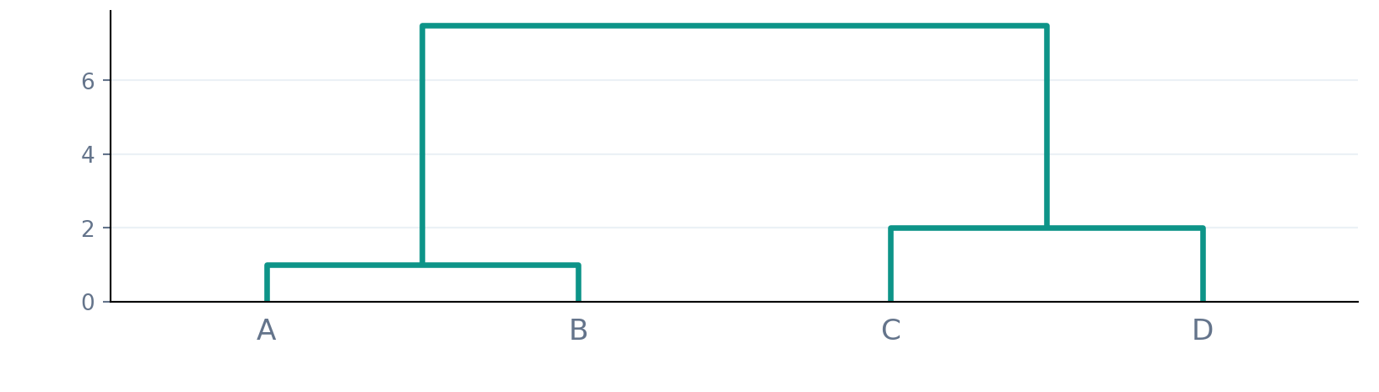
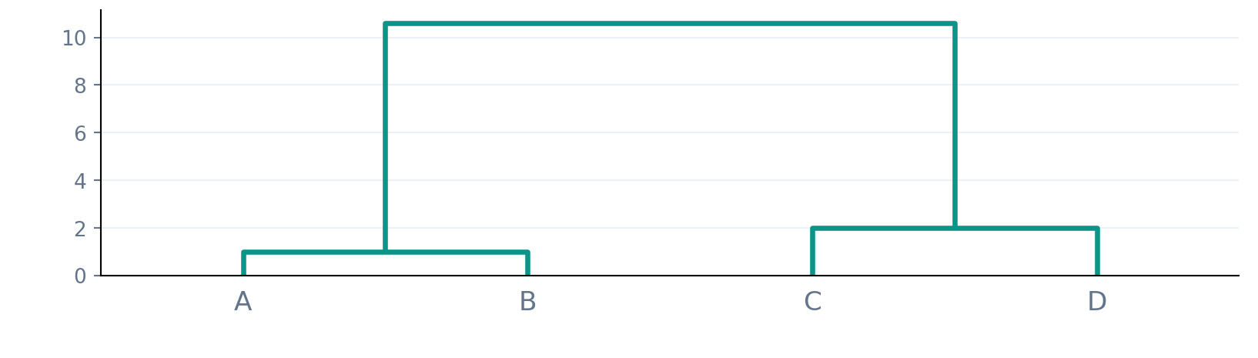
COMPARE
The same dataset gives different merge heights
Four-point example, using four linkage methods.
Single linkage
Complete linkage
Final height: 6
Final height: 9
Average linkage
Ward linkage
Final height: 7.5
Final height: 10.61
PRACTICAL MACHINE LEARNING / HIERARCHICAL CLUSTERING
11

Slide 12
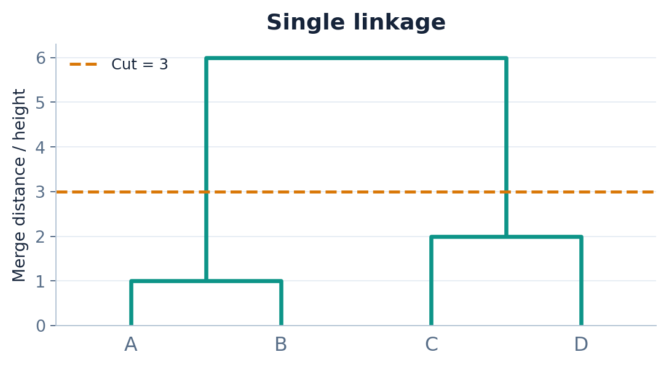
READ THE TREE
A dendrogram records every merge
Merge height = distance reported by the chosen linkage method.
Read from the bottom
A + B: height 1
C + D: height 2
Two groups: height 6
INTERPRET
A cut strictly between heights 2 and 6 gives two clusters.
PRACTICAL MACHINE LEARNING / HIERARCHICAL CLUSTERING
12

Slide 13
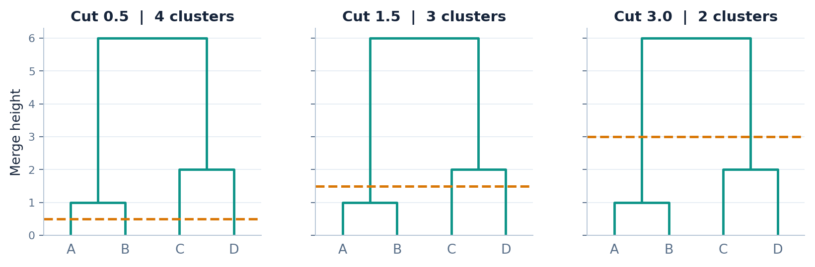
CHOOSE THE CUT
Lower cut → more clusters; higher cut → fewer
A horizontal line decides which merges are included.
RULE
Count the branches crossed by the horizontal cut line.
PRACTICAL MACHINE LEARNING / HIERARCHICAL CLUSTERING
13

Slide 14
CUT STRATEGY 1
Look for a large jump in merging distances
For the four-point data: 1 → 2 → 6.
Merge
Height
Jump from previous
Choose a cut
A with B
1
—
Cut at height 3
Result: 2 clusters
C with D
2
1
(A, B) with (C, D)
6
4
Largest gap is between heights 2 and 6.
CAUTION
A large jump is a useful clue, not a guarantee.
PRACTICAL MACHINE LEARNING / HIERARCHICAL CLUSTERING
14

Slide 15
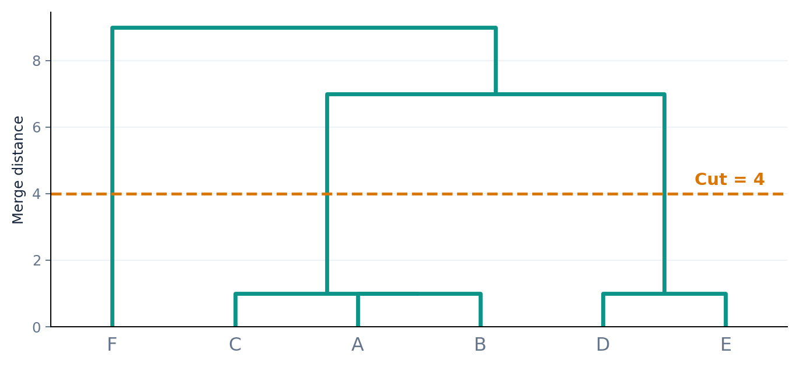
WORKED EXAMPLE 2
Six points: where should we cut?
Values: A=1, B=2, C=3, D=10, E=11, F=20.
Observe the gap
Merge heights:
1, 1, 1, 7, 9
Cut at 4
→ 3 clusters
GROUPS
Cluster 1: A, B, C | Cluster 2: D, E | Cluster 3: F
PRACTICAL MACHINE LEARNING / HIERARCHICAL CLUSTERING
15

Slide 16
CUT STRATEGY 2
What if we already know the number of clusters?
Choose a horizontal cut that crosses exactly K branches.
Business requirement: K = 3
Cut height for six-point data
Clusters
4
A,B,C | D,E | F
8
A,B,C,D,E | F
10
A,B,C,D,E,F
DECISION
For K = 3, choose any cut strictly between heights 1 and 7.
PRACTICAL MACHINE LEARNING / HIERARCHICAL CLUSTERING
16

Slide 17
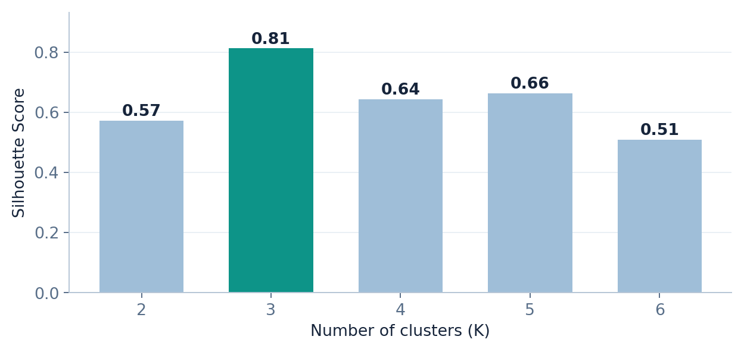
CUT STRATEGY 3
When the right K is not obvious, evaluate it
Silhouette Score compares separation and cohesion (higher is generally better).
Example result
K = 3
Silhouette = 0.81
Best among K = 2 to 6
VALIDATE
Compare scores and check if the clusters make practical sense.
PRACTICAL MACHINE LEARNING / HIERARCHICAL CLUSTERING
17

Slide 18
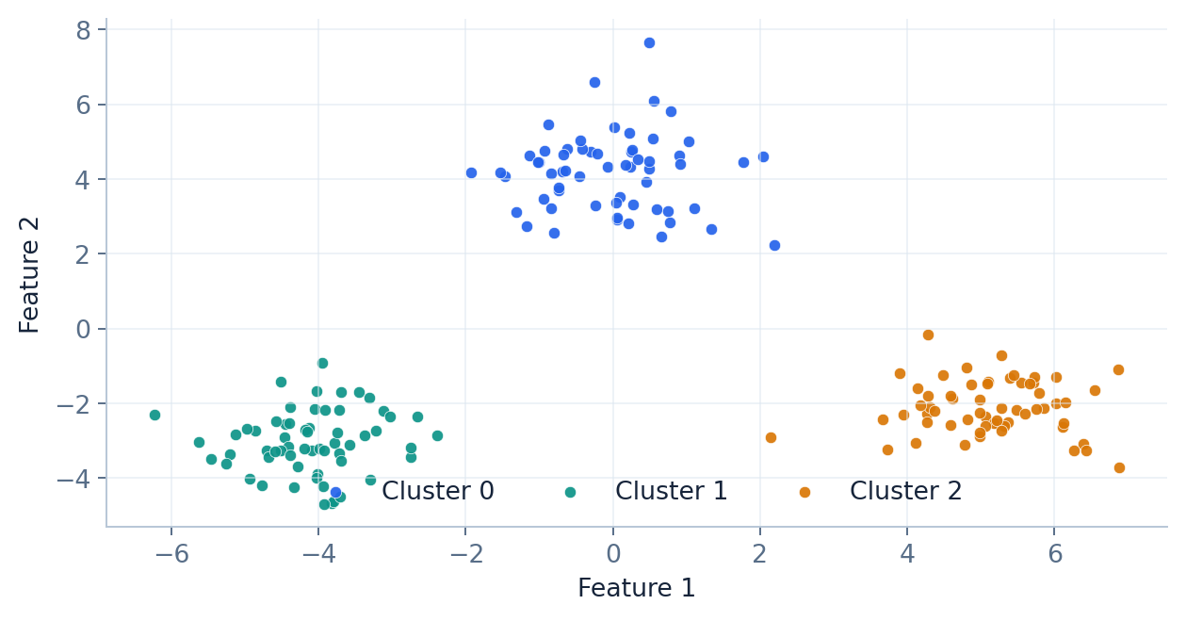
2D DATA
Agglomerative clustering also works with many features
Here, Ward linkage forms three groups in a synthetic two-feature dataset.
In practice
1. Scale features if needed
2. Choose linkage
3. Choose K or cut height
4. Interpret the groups
RECALL
No centroids need to be updated as in K-Means.
PRACTICAL MACHINE LEARNING / HIERARCHICAL CLUSTERING
18

Slide 19
PYTHON
Fit an Agglomerative Clustering model
The notebook includes the full runnable workflow.
from sklearn.cluster import AgglomerativeClustering
model = AgglomerativeClustering(
n_clusters=3,
linkage="ward"
)
labels = model.fit_predict(X_scaled)
OUTPUT
labels contains a cluster assignment for every row.
PRACTICAL MACHINE LEARNING / HIERARCHICAL CLUSTERING
19

Slide 20
PYTHON
Build and plot a dendrogram with SciPy
The linkage matrix captures the merge history; dendrogram() displays it.
from scipy.cluster.hierarchy import linkage, dendrogram
import matplotlib.pyplot as plt
Z = linkage(X_scaled, method="ward")
dendrogram(Z, truncate_mode="lastp", p=15)
plt.show()
TIP
For many rows, show only the last few merges for readability.
PRACTICAL MACHINE LEARNING / HIERARCHICAL CLUSTERING
20

Slide 21
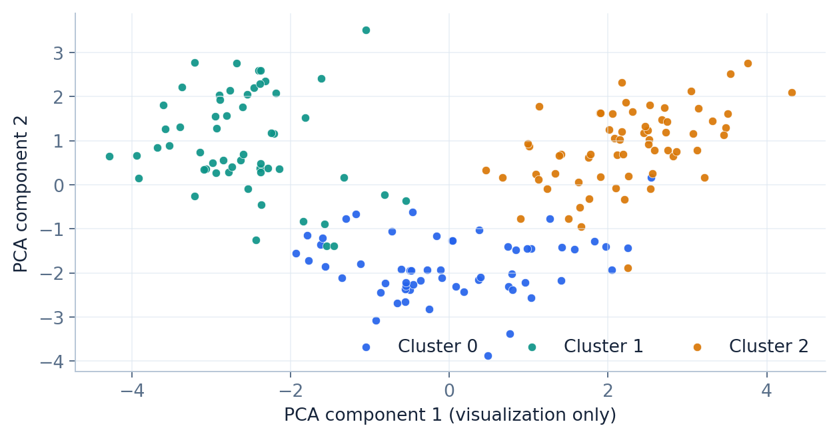
STANDARD DATASET
Apply to the Wine dataset
178 samples, 13 numerical features. Do not use known class labels to train clusters.
Notebook workflow
1. Load Wine features
2. Standardize
3. Ward clustering
4. Score K = 2 to 6
5. Plot with PCA
IMPORTANT
PCA is used here for visualization, not as the clustering input.
PRACTICAL MACHINE LEARNING / HIERARCHICAL CLUSTERING
21

Slide 22
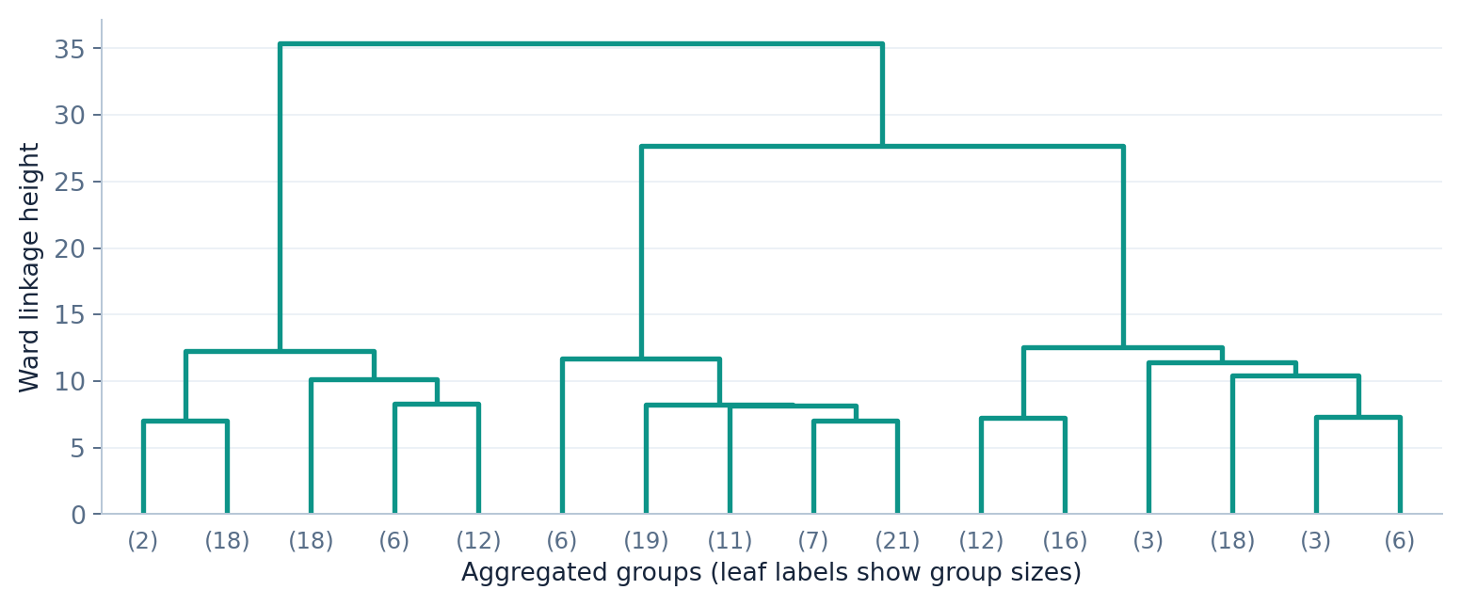
LARGE DATASETS
Why do we truncate a dendrogram?
A full dendrogram for 178 samples is crowded; the last merges are easier to read.
INTERPRET
Heights show Ward linkage values; leaves can represent many samples.
PRACTICAL MACHINE LEARNING / HIERARCHICAL CLUSTERING
22

Slide 23
QUICK COMPARISON
Hierarchical Clustering vs K-Means
Both are unsupervised; their grouping mechanisms differ.
Aspect
K-Means
Agglomerative Clustering
Basic operation
Assign to centroids
Repeatedly merge clusters
Choose K
Before model fitting
Choose K or dendrogram cut
Main visual
Centroids / assignments
Dendrogram
Scalability
Often faster for large N
Can be expensive for large N
Output
Flat clusters
Hierarchy + selected grouping
TRADE-OFF
Hierarchical methods show relationships, but can be costly on large data.
PRACTICAL MACHINE LEARNING / HIERARCHICAL CLUSTERING
23

Slide 24
CLASS ACTIVITY
Try the clustering by hand
Use Single Linkage for values A=1, B=2, C=4, D=9, E=10.
Point
A
B
C
D
E
Value
1
2
4
9
10
Student tasks
1. Identify the first two merges.
2. Write all four merge distances.
3. Cut the tree at height 3: how many clusters remain?
EXERCISE
Explain your cut using the merge heights.
PRACTICAL MACHINE LEARNING / HIERARCHICAL CLUSTERING
24

Slide 25
ACTIVITY ANSWER
Check the merge sequence
Single Linkage; tie order may vary without changing the final grouping.
Merge
Height
Clusters remaining
A + B
1
4
D + E
1
3
(A, B) + C
2
2
(A, B, C) + (D, E)
5
1
Cut at height 3 → 2 clusters: (A, B, C) and (D, E)
PRACTICAL MACHINE LEARNING / HIERARCHICAL CLUSTERING
25

Slide 26
TAKEAWAYS
Remember the workflow
Clustering decisions are about distance, linkage, cut and interpretation.
01
Compute distances
Start from numeric features (scale if needed).
02
Choose linkage
Single, Complete, Average, Ward.
03
Merge clusters
Each step reduces the cluster count by one.
04
Read dendrogram
Look at branch structure and merge height.
05
Choose K
Use gaps, requirements and Silhouette Score.
NEXT
Practice the complete workflow in the companion Jupyter notebook.
PRACTICAL MACHINE LEARNING / HIERARCHICAL CLUSTERING
26

