Slide 1
Practical machine learning
ROC curve
and AUC
One example. Ten patients.
Every number explained.
Actual ROC curve
Dotted line = random baseline
AUC = 0.80 · what does it actually mean?

Slide 2
STEP 1 · MODEL SCORES
A threshold converts scores into predictions
Orange circles = actually sick · Blue squares = actually healthy
Threshold = 0.50
0.10
0.20
0.35
0.40
0.55
0.60
0.70
0.80
0.85
0.95
0
0.25
0.5
0.75
1
PREDICTED HEALTHY
PREDICTED SICK
Model score
Decision rule
A larger score means the model considers sickness more likely.
Score ≥ 0.50 → predict sick. Score < 0.50 → predict healthy.
ROC curve and AUC · One worked example
02 / 10

Slide 3
STEP 2 · CONFUSION MATRIX
At threshold 0.50, count the four outcomes
5 patients actually sick · 5 actually healthy
Predicted sick
Predicted healthy
TP = 4
FN = 1
TPR = 4 / 5 = 0.80
Actually sick
Caught sick patients
Missed sick patient
Share of sick patients caught
FP = 2
TN = 3
FPR = 2 / 5 = 0.40
Actually healthy
False alarms
Correctly healthy
Share of healthy patients flagged
One ROC point = (FPR, TPR) = (0.40, 0.80)
ROC curve and AUC · One worked example
03 / 10

Slide 4
STEP 3 · CHANGE THE THRESHOLD
Different thresholds produce different ROC points
A lower threshold catches more sick patients but can also trigger more false alarms.
Threshold
Sick caught TP
Healthy flagged FP
TPR
FPR
0.75
2 of 5
1 of 5
0.40
0.20
0.50
4 of 5
2 of 5
0.80
0.40
0.30
5 of 5
3 of 5
1.00
0.60
Each threshold gives a coordinate (FPR, TPR): (0.20, 0.40) · (0.40, 0.80) · (0.60, 1.00)
ROC curve and AUC · One worked example
04 / 10

Slide 5
STEP 4 · DRAW THE ROC CURVE
Plot FPR on the x-axis and TPR on the y-axis
For 10 patients, the complete curve is a staircase as we change the threshold.
True Positive Rate (TPR)
1.0
At threshold 0.75
(FPR, TPR) = (0.20, 0.40)
0.8
At threshold 0.50
0.6
(FPR, TPR) = (0.40, 0.80)
0.4
At threshold 0.30
0.2
(FPR, TPR) = (0.60, 1.00)
0.0
The remaining corners come from the other patient scores.
0.0
0.2
0.4
0.6
0.8
1.0
False Positive Rate (FPR)
ROC curve and AUC · One worked example
05 / 10

Slide 6
STEP 5 · DOTTED DIAGONAL
What does the dotted diagonal mean?
It is the random-guessing reference line - not our model's ROC curve.
True Positive Rate (TPR)
Dotted line: random baseline
1.0
At FPR = 0.40, its TPR is 0.40.
0.8
Orange staircase: our model
0.6
At threshold 0.50: FPR = 0.40, TPR = 0.80.
0.4
Random: (0.40, 0.40)
Ideal ROC point: (0, 1)
0.2
TPR = 1: catch all sick. FPR = 0: no false alarms.
0.0
0.0
0.2
0.4
0.6
0.8
1.0
Random baseline AUC = 0.50
False Positive Rate (FPR)
ROC curve and AUC · One worked example
06 / 10

Slide 7
STEP 6 · INTERPRET THE ROC CURVE
How do we read the ROC curve?
Read one point first. Then judge how the whole curve behaves.
True Positive Rate (TPR)
1.0
Ideal (0, 1)
1 Read the x-axis: FPR = 0.40
t = 0.50
2 of 5 healthy patients are wrongly flagged.
0.8
0.6
2 Read the y-axis: TPR = 0.80
4 of 5 sick patients are correctly caught.
0.4
3 Judge the curve's position
0.2
Near (0, 1) = stronger classification.
Above the diagonal = better than random.
0.0
0.0
0.2
0.4
0.6
0.8
1.0
False Positive Rate (FPR)
Top-left is ideal; the best practical threshold also depends on the cost of each mistake.
ROC curve and AUC · One worked example
07 / 10

Slide 8
STEP 7 · AREA UNDER THE CURVE
AUC = add the three shaded rectangles
AUC is the area under the full ROC staircase - not just the three example points.
True Positive Rate (TPR)
Rectangle 1
1.0
0.20 × 0.40 = 0.08
0.8
Rectangle 2
0.20 × 0.60 = 0.12
0.6
0.60
Rectangle 3
0.4
0.60 × 1.00 = 0.60
0.12
0.2
0.08
AUC = 0.08 + 0.12 + 0.60 = 0.80
0.0
0.0
0.2
0.4
0.6
0.8
1.0
False Positive Rate (FPR)
ROC curve and AUC · One worked example
08 / 10

Slide 9
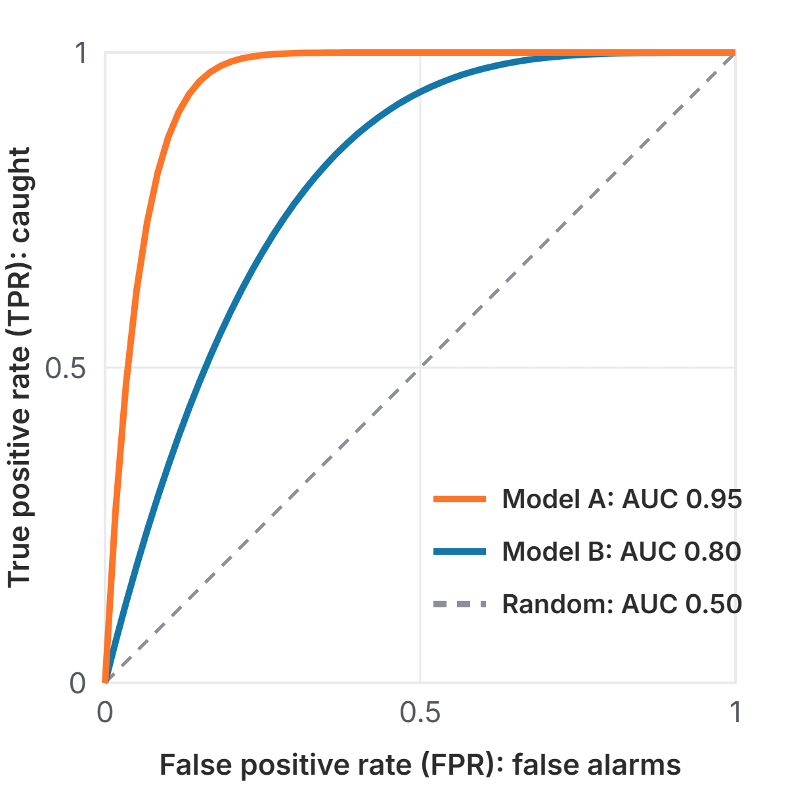
Comparing models with ROC and AUC
Using ROC and AUC
Closer to the top-left wins
Model A's curve is above Model B's everywhere, so A is better at every threshold. Its larger AUC says the same in one number.
AUC picks the model, not the threshold
After choosing a model, pick the threshold on its curve that fits the cost of each mistake.
ROC and AUC · Practical machine learning
Notes:
The figure shows illustrative curves, not real models. Model A bends sharply toward the top-left, Model B less so, and the dashed line is random guessing. When one curve is above another everywhere, that model is better at every threshold. When curves cross, AUC still gives an overall winner, but check the region of the curve you will actually use. Two practical points to finish with. First, AUC helps you choose between models; you still choose the threshold separately, based on which mistake is more costly. Second, with very rare positives a high AUC can hide many false alarms in absolute numbers, so look at precision as well.

