Slide 1
PRACTICAL MACHINE LEARNING
Regression, From the Ground Up
Practical Machine Learning · Linear, Polynomial and Regularised Regression
CDAC Kharghar, Mumbai · PML · 26 October 2026 · 7 instructional hours
Notes:
EXPLAIN: Welcome the group. Today is a mathematics-first day: every algorithm is derived, calculated by hand on a tiny dataset, and only then coded.
HOW TO INTRODUCE: Tell them: 'By 5 pm you will be able to compute a regression line with a calculator, explain where the formula comes from, and say when it will fail.'
ASK: Who has used LinearRegression().fit() before? Who could explain what it computes?
EXPECTED RESPONSES: Many hands for the first, few for the second — that gap is today's goal.
TIME: 2 min
TRANSITION: Show the day's map.

Slide 2
Seven hours, one storyline
ROADMAP
Hour | Topic | You will be able to…
1 | Simple Linear Regression | read slope, intercept and residuals; compute a best-fit line by hand
2 | OLS and Gradient Descent | derive the OLS formulas; run gradient-descent updates manually
3 | Evaluation + Multiple Regression | compute MAE, MSE, RMSE, R²; interpret several coefficients
4 | Polynomial + Regularisation | explain over/underfitting, bias–variance, Ridge and Lasso penalties
5 | Guided Lab 1 | build simple and multiple regression models (A1–A7)
6 | Guided Lab 2 | compare polynomial degrees and regularised models (A8–A10)
7 | Challenge + Assessment | build, evaluate and defend a model independently (A11)
Hours 1–4 are theory with short live demos; hours 5–7 are hands-on. Breaks are not counted in the 7 hours.
Notes:
EXPLAIN: Walk the table quickly. Point out the pattern: four theory hours build exactly the tools the three lab hours use.
HOW TO INTRODUCE: Frame it as one storyline: a line → how to find the best line → how to judge it → more inputs → curves → keeping flexible models under control.
LIKELY CONFUSION: Students may expect classification today. Clarify that Logistic Regression and classification metrics come in a later session.
ASK: Which hour do you think will be hardest?
EXPECTED RESPONSES: Usually hour 2 (calculus).
MISCONCEPTION TO ADDRESS: 'Logistic regression is regression' — it is a classification method; not today.
TIME: 2 min
TRANSITION: Learning objectives.

Slide 3
By the end of today you can…
GOALS
Explain
what problem each regression method solves, and what its equation means term by term
Derive
the least-squares slope and intercept, and the gradient-descent update rules
Calculate
a fitted line, residuals, gradient steps, error metrics and penalties by hand
Connect
each calculation to its NumPy / scikit-learn implementation
Interpret
coefficients, predictions and metrics in the units of the problem
Judge
when a model underfits or overfits, and how regularisation helps
Notes:
EXPLAIN: Six verbs, each one testable in the final hour. Emphasise 'derive' and 'calculate' — the client asked specifically for mathematical intuition.
HOW TO INTRODUCE: Read the verbs aloud; ask students to rate their confidence 1–5 for each now and again at 5 pm.
ASK: Which of these do you feel least ready for?
EXPECTED RESPONSES: Derive / calculus.
TIME: 2 min
TRANSITION: How we will learn each topic.

Slide 4
How every topic will unfold
METHOD
1
2
3
4
5
6
7
8
9
Problem
Intuition
Visual
Mathematics
Manual calc
Optimisation
Python
Interpret
Challenge
We never show an equation before you have a reason to want it — and we never trust code before checking it against a hand calculation.
Notes:
EXPLAIN: This is the teaching contract for the day. Every algorithm passes through these nine stations. The coloured tag in the corner of each slide tells you which station you are at.
HOW TO INTRODUCE: Point to the stage tag in the top-right corner of the next slides.
ASK: Why calculate by hand if Python does it?
EXPECTED RESPONSES: So we can recognise wrong output and understand what the parameters mean.
MISCONCEPTION TO ADDRESS: 'Maths is only for exams' — the maths explains model behaviour you will see in practice (outliers, divergence, overfitting).
TIME: 2 min
TRANSITION: Hour 1 begins.

Slide 5
1
HOUR 1 · 09:00–10:00
Simple Linear Regression
One input, one output, one straight line
Notes:
EXPLAIN: Hour 1 builds the geometric picture: points, a line, the vertical gaps between them, and why we square those gaps.
TIME: 30 s
TRANSITION: Introduce the delivery problem.

Slide 6
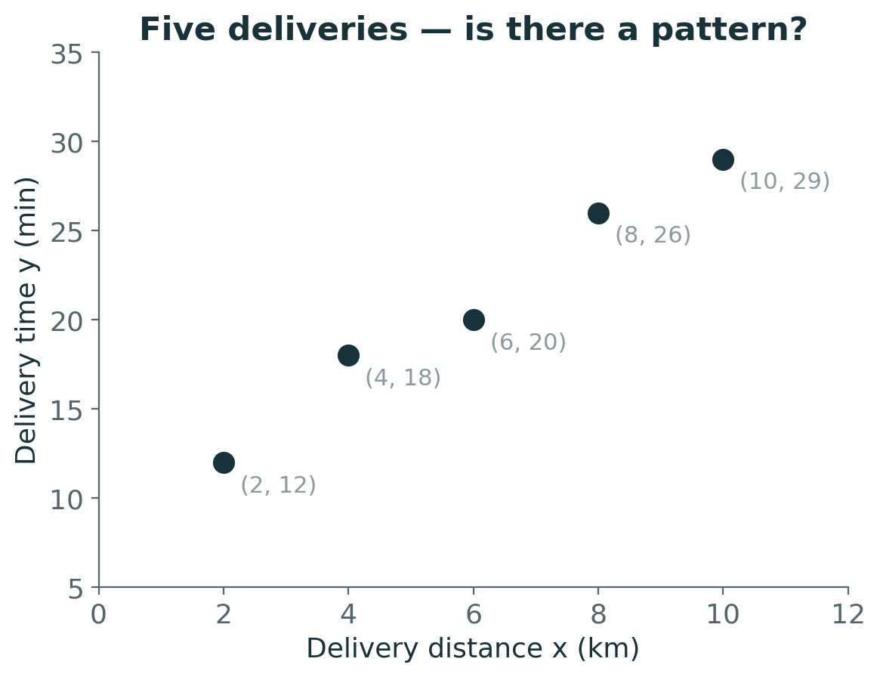
A food-delivery app wants to promise accurate times
PROBLEM
Five past deliveries: distance x (km) and time taken y (min)
Goal: predict y for a new order before it is dispatched
y is a continuous quantity → this is a regression problem
Look at the plot: what pattern do you see? Is it perfect?
Notes:
EXPLAIN: Introduce the running example of the hour. Five deliveries; distance in km on x, minutes on y. The relationship rises but not perfectly.
HOW TO INTRODUCE: Ask students to look at the plot silently for 20 seconds before speaking.
LIKELY CONFUSION: Some think regression requires a perfect line. Real data always scatter around a trend.
ASK: If a new order is 7 km away, roughly how long will it take?
EXPECTED RESPONSES: Somewhere around 23–24 minutes — most students interpolate between 6 km (20 min) and 8 km (26 min).
TIME: 3 min
TRANSITION: Let them commit to a guess before we formalise it.

Slide 7
Pause and predict
PREDICT
Sketch one straight line through these five points by eye.
Where does your line cross x = 0, and how steep is it?
Use your line to predict the time for a 7 km delivery.
Discuss first — answer is in the speaker notes
Notes:
EXPLAIN: Give 2 minutes. Collect three different student lines on the board (intercept and steepness).
HOW TO INTRODUCE: Say: 'Everyone drew a slightly different line. Today's question is: which line is best, and who decides?'
LIKELY CONFUSION: Students may draw the line through the first and last points. That is one choice, not necessarily the best.
ASK: Whose line is best? How could we decide objectively?
EXPECTED RESPONSES: 'The one closest to the points' — good, push them to define 'closest'.
TIME: 4 min
TRANSITION: Define regression formally.
ANSWER (reveal after discussion): Typical sketches: crossing near 8–10 min, rising about 2 min per km; prediction ≈ 23 min. Our least-squares line (later) gives ŷ = 8.4 + 2.1·7 = 23.1 min.

Slide 8
What a regression model is
INTUITION
Target y
the continuous quantity we predict — delivery time in minutes
Feature x
the input we predict from — distance in km (independent variable)
Model ŷ = f(x)
a rule producing a prediction ŷ (‘y-hat’) for any x
Parameters
numbers inside f learned from data — today: slope and intercept
Dependent variable = y (it depends on x). Independent variable = x. The hat in ŷ always means ‘predicted’.
Notes:
EXPLAIN: Name the parts once and use the names consistently all day: y, x, ŷ, parameters.
HOW TO INTRODUCE: Link each card to the delivery example.
LIKELY CONFUSION: y versus ŷ: y is what happened, ŷ is what the model says. Their difference is the error.
ASK: In house-price prediction, what are x and y?
EXPECTED RESPONSES: y = price; x = area, bedrooms, etc.
MISCONCEPTION TO ADDRESS: Independent does not mean statistically independent; it only means 'input'.
TIME: 3 min
TRANSITION: Look at the direction of relationships.

Slide 9
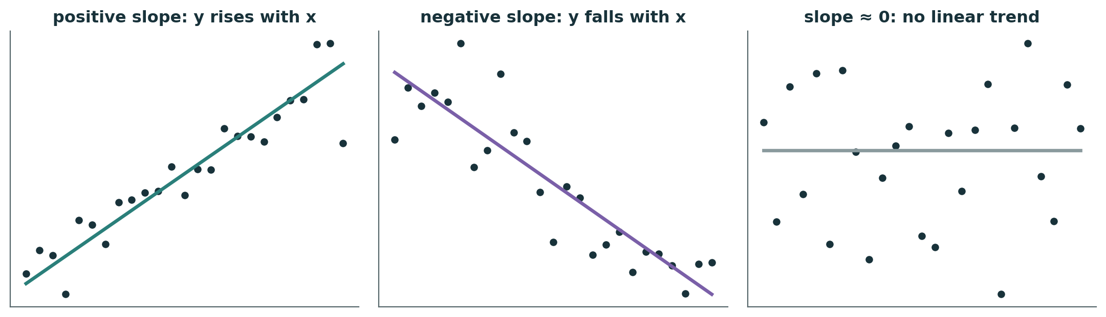
Relationships have a direction and a steepness
VISUAL
Positive slope: larger x → larger y (distance vs delivery time)
Negative slope: larger x → smaller y (age of house vs price)
Slope near 0: no linear trend — a straight line will not help much
Notes:
EXPLAIN: Three panels: positive, negative, no trend. The scatter around each line is noise.
HOW TO INTRODUCE: Ask students to give one real example of each before revealing the bullets.
LIKELY CONFUSION: Zero slope does not mean 'no relationship at all' — there could be a curved relationship (hour 4).
ASK: Give a real example of a negative relationship.
EXPECTED RESPONSES: Speed vs travel time; age vs resale value; price vs demand.
TIME: 3 min
TRANSITION: Write the line as an equation.

Slide 10
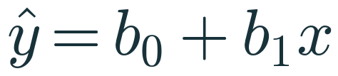
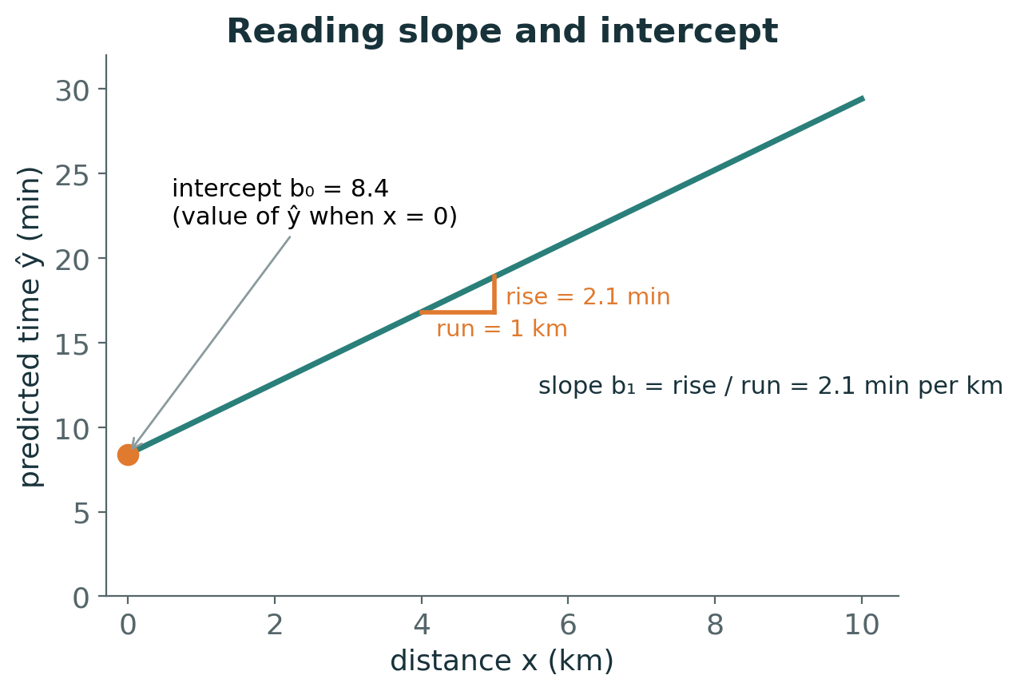
The equation of a straight line
MATHEMATICS
b₀ — intercept
predicted y when x = 0; units of y (min)
b₁ — slope
change in ŷ per 1-unit increase in x; units of y per unit of x (min per km)
Why this form?
the simplest rule that can rise or fall at a constant rate — two numbers describe it completely
Notes:
EXPLAIN: Introduce ŷ = b₀ + b₁x. Read the figure: the line crosses the vertical axis at 8.4; moving 1 km right raises it 2.1 min.
HOW TO INTRODUCE: Recall y = mx + c from school; we rename c → b₀ and m → b₁ because later we will have b₂, b₃, … for more features.
WHY IT IS VALID: Any non-vertical straight line is fixed by one point and its steepness; the intercept supplies the point at x = 0, the slope the steepness.
LIKELY CONFUSION: Units: slope has units of y per unit x. Students often drop units — insist on them.
ASK: If b₁ = 2.1, how much longer does a 5 km trip take than a 3 km trip?
EXPECTED RESPONSES: 2 km × 2.1 = 4.2 min longer.
MISCONCEPTION TO ADDRESS: The intercept is not always meaningful physically (x = 0 may be impossible), but it is still needed to place the line.
TIME: 4 min
TRANSITION: Measure how wrong a line is.

Slide 11
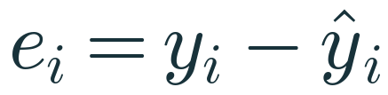
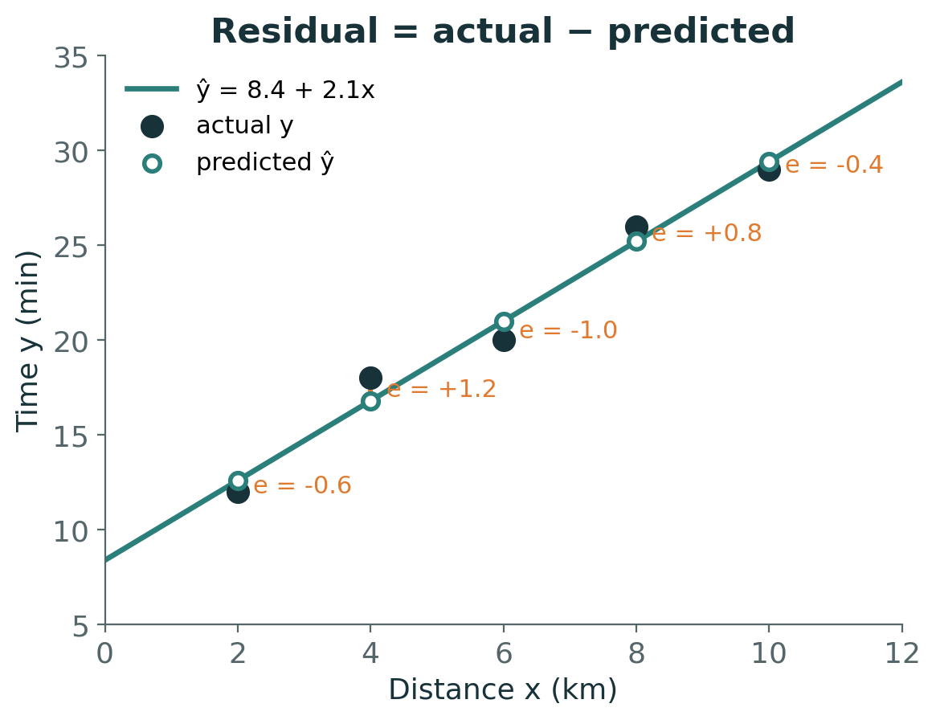
Residual: how far each point is from the line
VISUAL
Positive residual
the point lies above the line — the model under-predicted
Negative residual
the point lies below — the model over-predicted
Measured vertically
because the error is in y; we predict y from a known x
Notes:
EXPLAIN: Each orange segment is a residual eᵢ = yᵢ − ŷᵢ, measured vertically. For x = 4 the actual time is 18, predicted 16.8, residual +1.2.
HOW TO INTRODUCE: Trace one residual with your finger on the projected figure.
WHY IT IS VALID: Vertical distance is used because x is treated as known; only y is being predicted.
LIKELY CONFUSION: Students ask: why not perpendicular distance? That is a different method (total least squares / PCA); ordinary regression minimises vertical errors.
ASK: Read off the residual at x = 6. Is the point above or below?
EXPECTED RESPONSES: −1.0, below the line.
TIME: 4 min
TRANSITION: Compare whole lines using their residuals.

Slide 12
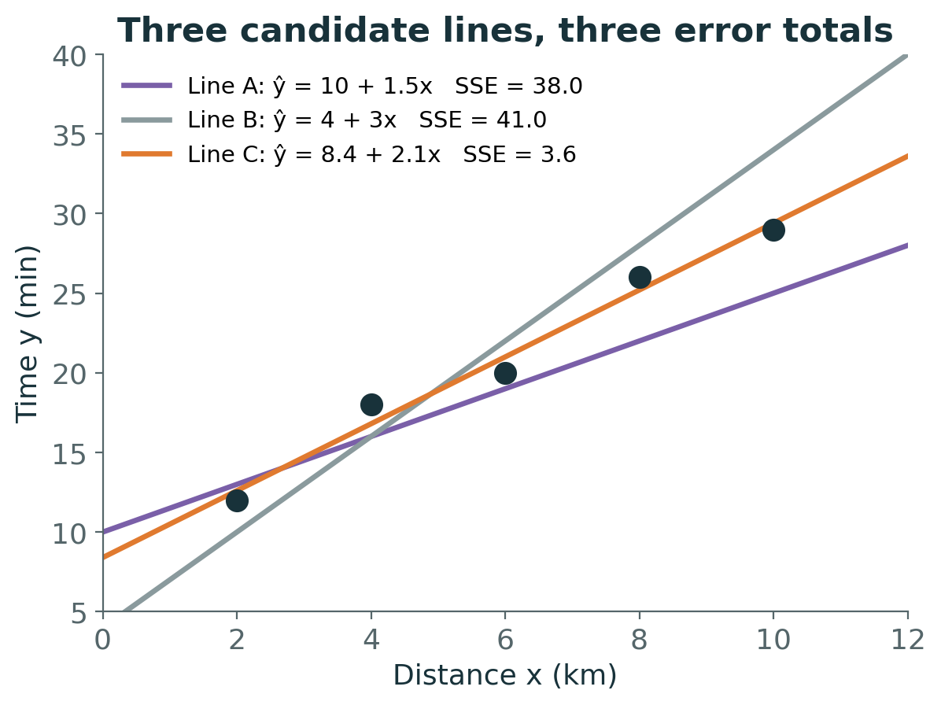
Many lines are possible — which one is best?
VISUAL
Each candidate line gives five residuals
Summarise them in one number: SSE = sum of squared residuals
Line A: SSE = 38.0 Line B: SSE = 41.0 Line C: SSE = 3.6
Least squares chooses the line with the smallest SSE → Line C
Notes:
EXPLAIN: Three lines, each with its total squared error. Line C is far better. Verify one together: Line A predicts 13,16,19,22,25; residuals −1,2,1,4,4; squares 1,4,1,16,16; total 38.
HOW TO INTRODUCE: Before revealing the SSE values, ask the class to rank the lines by eye.
WHY IT IS VALID: SSE is a single score where smaller means closer to all points simultaneously.
LIKELY CONFUSION: Some think the best line must pass through at least two points. Line C passes through none of them.
ASK: Which line would you choose and why?
EXPECTED RESPONSES: Line C — visually closest; confirmed by SSE.
TIME: 5 min
TRANSITION: Why squared errors and not plain errors?

Slide 13
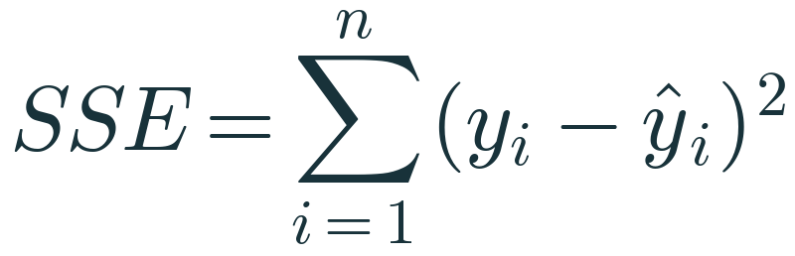
Why square the residuals?
MATHEMATICS
Signs would cancel
raw residuals +5 and −5 sum to 0, as if the line were perfect
Large misses cost more
a residual of 4 contributes 16; a residual of 1 contributes 1
Smooth to optimise
a squared function has a derivative everywhere — calculus can find its minimum
Limitation
one outlier with a huge residual can drag the whole line towards it
Notes:
EXPLAIN: Three reasons for squaring and one cost. Absolute values also fix the sign problem but are not differentiable at zero and lead to a different method (least absolute deviations).
HOW TO INTRODUCE: Write residuals +5 and −5 on the board; ask what their sum says about the fit.
WHY IT IS VALID: Squaring gives a smooth, bowl-shaped function of the parameters with one lowest point — that is why calculus works in hour 2.
LIKELY CONFUSION: Students may think squaring is arbitrary. It is a choice with consequences: sensitivity to outliers.
ASK: If one residual doubles, by how much does its contribution to SSE grow?
EXPECTED RESPONSES: Four times.
MISCONCEPTION TO ADDRESS: 'Least squares is always the right loss' — not with heavy outliers.
TIME: 4 min
TRANSITION: Compute the best line by hand.

Slide 14
Worked example 1 · deviations from the mean
MANUAL CALC
xᵢ (km) | yᵢ (min) | xᵢ − x̄ | yᵢ − ȳ | (xᵢ − x̄)(yᵢ − ȳ) | (xᵢ − x̄)²
2 | 12 | −4 | −9 | 36 | 16
4 | 18 | −2 | −3 | 6 | 4
6 | 20 | 0 | −1 | 0 | 0
8 | 26 | 2 | 5 | 10 | 4
10 | 29 | 4 | 8 | 32 | 16
x̄ = 6 | ȳ = 21 | Σ = 0 | Σ = 0 | Σ = 84 | Σ = 40
x̄ = (2+4+6+8+10)/5 = 30/5 = 6 ȳ = (12+18+20+26+29)/5 = 105/5 = 21
Notes:
EXPLAIN: Fill this table with the class, one column at a time. Ask different students to read each value.
HOW TO INTRODUCE: Explain that centring (subtracting means) makes the cross-product column show whether x and y move together: both negative or both positive → positive product.
WHY IT IS VALID: Deviations from a mean always sum to zero — a useful arithmetic check.
LIKELY CONFUSION: Students often mix up (xᵢ − x̄)(yᵢ − ȳ) with xᵢyᵢ.
ASK: Why are most cross-products positive?
EXPECTED RESPONSES: Because when x is below its mean, y tends to be below its mean too — a positive relationship.
TIME: 6 min
TRANSITION: Plug the sums into the slope formula.

Slide 15
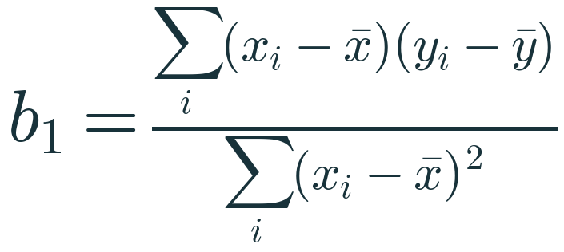
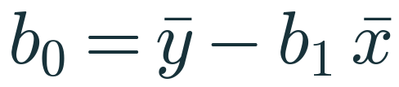
Worked example 1 · slope and intercept
MANUAL CALC
Slope
b₁ = 84 / 40 = 2.1 min per km
Intercept
b₀ = 21 − 2.1 × 6 = 21 − 12.6 = 8.4 min
Fitted line
ŷ = 8.4 + 2.1x
Prediction for 7 km
ŷ = 8.4 + 2.1 × 7 = 23.1 min
Notes:
EXPLAIN: Substitute. Slope 2.1 minutes per extra km. Intercept 8.4 minutes: think of it as fixed overhead (pickup, handover), though x = 0 is outside the data.
HOW TO INTRODUCE: Compare with the sketches students drew earlier.
WHY IT IS VALID: The derivation of these formulas is hour 2; for now treat them as the result of minimising SSE.
LIKELY CONFUSION: Order matters: compute b₁ first, b₀ depends on it.
ASK: Interpret b₁ in one sentence with units.
EXPECTED RESPONSES: 'Each additional km adds about 2.1 minutes to predicted delivery time.'
MISCONCEPTION TO ADDRESS: Interpreting b₀ = 8.4 as 'time to deliver 0 km' literally — it is an extrapolation.
TIME: 4 min
TRANSITION: Check the residuals.

Slide 16
Worked example 1 · predictions and residuals
INTERPRET
xᵢ | yᵢ | ŷᵢ = 8.4 + 2.1xᵢ | eᵢ = yᵢ − ŷᵢ | eᵢ²
2 | 12 | 12.6 | −0.6 | 0.36
4 | 18 | 16.8 | +1.2 | 1.44
6 | 20 | 21.0 | −1.0 | 1.00
8 | 26 | 25.2 | +0.8 | 0.64
10 | 29 | 29.4 | −0.4 | 0.16
 |  |  | Σ = 0 | SSE = 3.6
Residuals of a least-squares line with an intercept always sum to 0. No other straight line gives SSE below 3.6 for these points.
Notes:
EXPLAIN: Complete the table. SSE = 3.6 matches Line C on the earlier slide.
HOW TO INTRODUCE: Ask: 'Can anyone find a line with SSE below 3.6?' — let them try one (e.g., 8 + 2.2x gives SSE 4.0).
WHY IT IS VALID: Zero-sum residuals follow from ∂SSE/∂b₀ = 0, which we derive next hour.
LIKELY CONFUSION: Zero-sum residuals do not mean zero error; it means over- and under-predictions balance.
ASK: Which delivery did the model predict worst?
EXPECTED RESPONSES: The 4 km delivery, residual +1.2 min.
TIME: 4 min
TRANSITION: Same calculation in Python.

Slide 17
The same line in scikit-learn
PYTHON
import numpy as np
from sklearn.linear_model import LinearRegression
x = np.array([[2], [4], [6], [8], [10]]) # 2-D input
y = np.array([12, 18, 20, 26, 29])
model = LinearRegression() # b0, b1 still unknown
model.fit(x, y) # least-squares b0, b1
print(model.coef_) # [2.1] -> b1
print(model.intercept_) # 8.4 -> b0
print(model.predict([[7]])) # [23.1] -> ŷ at 7 km
fit() solves the least-squares problem — no loop, no learning rate
coef_ is an array: one slope per feature
intercept_ is b₀
predict() evaluates b₀ + b₁x
Output matches our hand calculation exactly
Notes:
EXPLAIN: Run this live. Show that coef_ = [2.1], intercept_ = 8.4, predict(7) = 23.1 — identical to the board.
HOW TO INTRODUCE: Ask students to predict each printed value before you press Run.
WHY IT IS VALID: fit() computes the same OLS solution we derived, using a numerically stable linear-algebra solver.
LIKELY CONFUSION: The double brackets [[2],[4],…] — X must be 2-D even with one feature.
ASK: What would coef_ look like with three features?
EXPECTED RESPONSES: An array of three numbers.
MISCONCEPTION TO ADDRESS: 'fit() uses gradient descent' — not LinearRegression; it solves least squares directly.
TIME: 4 min
TRANSITION: Quick knowledge check.

Slide 18
Knowledge check · Hour 1
CHECK
A new dataset gives Σ(xᵢ − x̄)(yᵢ − ȳ) = −30, Σ(xᵢ − x̄)² = 15, x̄ = 4 and ȳ = 50.
1. Compute b₁ and b₀.
2. Interpret the sign of the slope.
3. Predict y when x = 6.
Discuss first — answer is in the speaker notes
Notes:
EXPLAIN: Individual work, 3 minutes, then compare with a neighbour.
LIKELY CONFUSION: Sign errors in b₀ = ȳ − b₁x̄ when b₁ is negative: 50 − (−8) = 58, not 42.
ASK: Who got 42 for b₀? What went wrong?
EXPECTED RESPONSES: Sign slip: subtracting a negative.
TIME: 5 min
TRANSITION: Hour 2: where do these formulas come from?
ANSWER (reveal after discussion): b₁ = −30/15 = −2; b₀ = 50 − (−2)(4) = 58. Negative slope: y falls by 2 units per unit increase in x. ŷ(6) = 58 − 12 = 46.

Slide 19
2
HOUR 2 · 10:00–11:00
OLS and Gradient Descent
Two ways to find the bottom of the error bowl
Notes:
EXPLAIN: Hour 2 answers 'why those formulas?' with calculus, then shows the iterative alternative that powers most of modern ML.
TIME: 30 s
TRANSITION: Set up the optimisation problem.

Slide 20
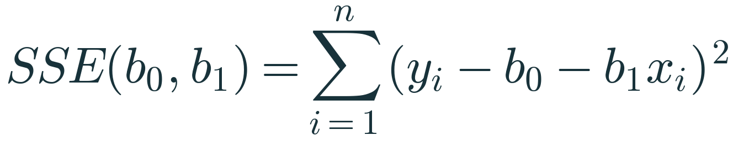
Ordinary Least Squares turns ‘best line’ into a minimisation
OPTIMISATION
The objective
SSE written as a function of the two unknowns b₀ and b₁ — the data are fixed numbers
The task
find the (b₀, b₁) that makes this function as small as possible
Shape of the function
a smooth bowl: squares of linear expressions → one lowest point (when the xᵢ are not all equal)
Notes:
EXPLAIN: Key shift in viewpoint: after the data are collected, xᵢ and yᵢ are constants; b₀ and b₁ are the variables. SSE is a function of the parameters.
HOW TO INTRODUCE: Write SSE(b₀, b₁) for our five points and expand one term: (12 − b₀ − 2b₁)².
WHY IT IS VALID: Each term is a square of something linear in b₀, b₁, so the sum is a quadratic bowl; if the xᵢ vary, the bowl has a unique bottom.
LIKELY CONFUSION: Students think x is the variable. Here, it is not.
ASK: Which quantities change when we try a different line?
EXPECTED RESPONSES: Only b₀, b₁ and therefore ŷ, residuals and SSE.
TIME: 4 min
TRANSITION: Recall what a derivative tells us.

Slide 21
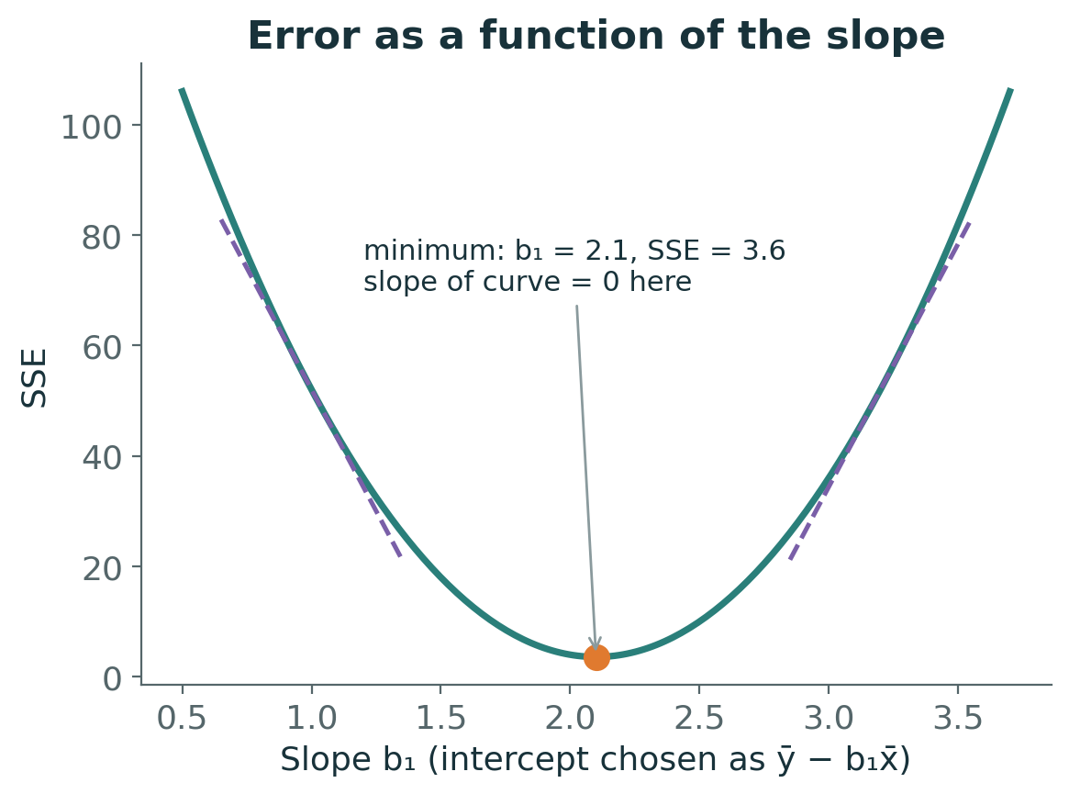
A derivative is the slope of a curve at a point
INTUITION
Fix b₀ = ȳ − b₁x̄ and vary only b₁: SSE traces a U-shaped curve
Dashed tangents: steep negative on the left, steep positive on the right
At the bottom the tangent is flat → derivative = 0
So: to minimise, set the derivative to zero and solve
Notes:
EXPLAIN: Derivative recap without jargon: the derivative of f at a point is the slope of the tangent there — how fast f changes as you nudge the input. At a minimum of a smooth curve, the slope is zero.
HOW TO INTRODUCE: Use a hand gesture for tangent slope going from steep-down to flat to steep-up.
WHY IT IS VALID: For a smooth function, a lowest interior point must have zero slope — otherwise moving slightly would lower it further. For a bowl (convex) function, zero slope also guarantees the global minimum.
LIKELY CONFUSION: Zero derivative can also mean a maximum in general; for SSE (convex) it is always the minimum.
ASK: What is the sign of the derivative to the left of the minimum? To the right?
EXPECTED RESPONSES: Negative left, positive right.
TIME: 5 min
TRANSITION: Apply this to b₀ first.

Slide 22
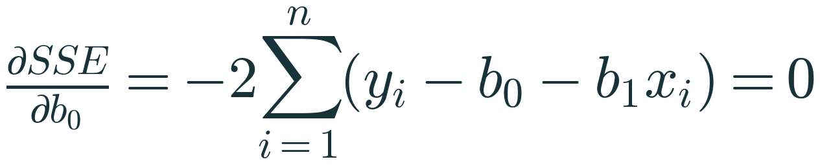
Derivation step A · differentiate with respect to b₀
MATHEMATICS
Chain rule
d/db₀ of (yᵢ − b₀ − b₁xᵢ)² = 2(yᵢ − b₀ − b₁xᵢ)·(−1)
Set to zero, divide by −2
Σyᵢ − n·b₀ − b₁Σxᵢ = 0
Divide by n
b₀ = ȳ − b₁x̄ : the line passes through (x̄, ȳ)
Bonus fact
Σ(yᵢ − ŷᵢ) = 0 — residuals sum to zero
Notes:
EXPLAIN: Step by step on the board: (1) derivative of a square is 2 × inside × derivative of inside; (2) derivative of the inside with respect to b₀ is −1; (3) sum over i; (4) set to 0; (5) divide by −2n.
HOW TO INTRODUCE: Keep b₁ treated as a constant while differentiating with respect to b₀ — that is what 'partial' derivative means.
WHY IT IS VALID: Setting the partial derivative to zero gives a necessary condition; with the second condition (step B) we get the unique minimum.
LIKELY CONFUSION: Partial derivative notation ∂ — explain as 'derivative with respect to one variable, holding others fixed'.
ASK: What does b₀ = ȳ − b₁x̄ tell us geometrically?
EXPECTED RESPONSES: The fitted line always passes through the point of means (6, 21).
TIME: 6 min
TRANSITION: Now differentiate with respect to b₁.

Slide 23
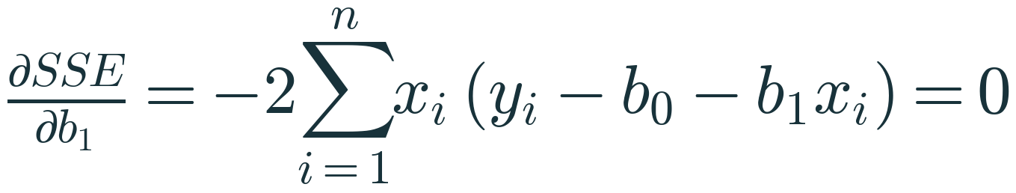
Derivation step B · differentiate with respect to b₁
MATHEMATICS
Substitute b₀
yᵢ − b₀ − b₁xᵢ = (yᵢ − ȳ) − b₁(xᵢ − x̄)
Condition becomes
Σxᵢ[(yᵢ − ȳ) − b₁(xᵢ − x̄)] = 0
Replace xᵢ by (xᵢ − x̄)
allowed because Σ(yᵢ − ȳ) = 0 and Σ(xᵢ − x̄) = 0, so x̄ times either sum vanishes
Solve
b₁ = Σ(xᵢ−x̄)(yᵢ−ȳ) / Σ(xᵢ−x̄)² — needs the xᵢ not all equal
Notes:
EXPLAIN: Derivation in the notes for the board:
1) ∂SSE/∂b₁ = −2Σxᵢ(yᵢ − b₀ − b₁xᵢ) = 0.
2) Substitute b₀ = ȳ − b₁x̄: yᵢ − ȳ + b₁x̄ − b₁xᵢ = (yᵢ − ȳ) − b₁(xᵢ − x̄).
3) Σxᵢ(yᵢ − ȳ) − b₁Σxᵢ(xᵢ − x̄) = 0.
4) Since Σx̄(yᵢ − ȳ) = 0 and Σx̄(xᵢ − x̄) = 0, we may subtract them: Σ(xᵢ − x̄)(yᵢ − ȳ) − b₁Σ(xᵢ − x̄)² = 0.
5) Divide.
HOW TO INTRODUCE: Go slowly; this is the hardest algebra of the day. Let students copy each line.
WHY IT IS VALID: The denominator Σ(xᵢ − x̄)² is zero only if every x is the same — then no slope can be identified.
LIKELY CONFUSION: Step 4 (swapping xᵢ for xᵢ − x̄) is where students get lost; show numerically with our data that both give 84 after subtracting.
ASK: What happens if all deliveries were exactly 5 km?
EXPECTED RESPONSES: Denominator 0 — slope undefined; there is no information about how time changes with distance.
MISCONCEPTION TO ADDRESS: 'The formula is memorised' — it is derived from setting two derivatives to zero.
TIME: 8 min
TRANSITION: The same idea in matrix form.

Slide 24
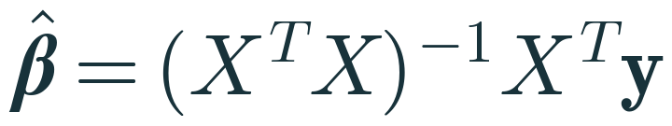
Matrix form: the same problem for any number of features
MATHEMATICS
Design matrix X
n rows (observations) × (p+1) columns: a column of 1s for the intercept, then one column per feature
Normal equations
setting all partial derivatives to zero gives (XᵀX)β = Xᵀy
Inverse needs full rank
XᵀX is invertible only if no feature is an exact linear combination of others (and n ≥ p+1)
In practice
libraries solve least squares with stable decompositions (QR / SVD) rather than computing the inverse
Notes:
EXPLAIN: For our 5 points X is 5 × 2 (column of 1s, column of distances), β is 2 × 1, y is 5 × 1. XᵀX is 2 × 2: [[5, 30],[30, 220]]; Xᵀy = [105, 714]. Solving gives β = [8.4, 2.1] — check on the board.
HOW TO INTRODUCE: Only after the scalar version is solid. Emphasise dimensions — write them under each symbol.
WHY IT IS VALID: Differentiating ‖y − Xβ‖² with respect to β and setting it to zero gives −2Xᵀ(y − Xβ) = 0, i.e. the normal equations.
LIKELY CONFUSION: Students think the inverse is always computed. scikit-learn's LinearRegression uses a least-squares solver (LAPACK via SciPy), which also handles rank-deficient X.
ASK: What are the dimensions of XᵀX with 6 features?
EXPECTED RESPONSES: 7 × 7 (6 features + intercept).
MISCONCEPTION TO ADDRESS: 'A singular XᵀX means the data are wrong' — it means some features are redundant (perfect multicollinearity).
TIME: 5 min
TRANSITION: Why bother with an iterative method?

Slide 25
If OLS has a formula, why learn Gradient Descent?
PROBLEM
No formula elsewhere
Lasso, logistic regression and neural networks have no closed-form solution
Scale
with millions of rows or features, step-by-step updates can be cheaper than solving the full system
Streaming data
parameters can be updated as new batches arrive
Foundation
the update rule you learn today is the core of how deep learning trains
Notes:
EXPLAIN: Motivate GD honestly: for plain linear regression OLS is usually best. We learn GD on linear regression because we can check its answer against OLS.
HOW TO INTRODUCE: Ask: 'What would you do if setting the derivative to zero gave an equation you cannot solve?'
ASK: Name a model you know that cannot be solved with a formula.
EXPECTED RESPONSES: Neural networks; (later) logistic regression.
MISCONCEPTION TO ADDRESS: 'Gradient descent is a different model' — it is an optimisation algorithm, not a model. Same model, same loss, different way to find the minimum.
TIME: 3 min
TRANSITION: Define the cost function.

Slide 26
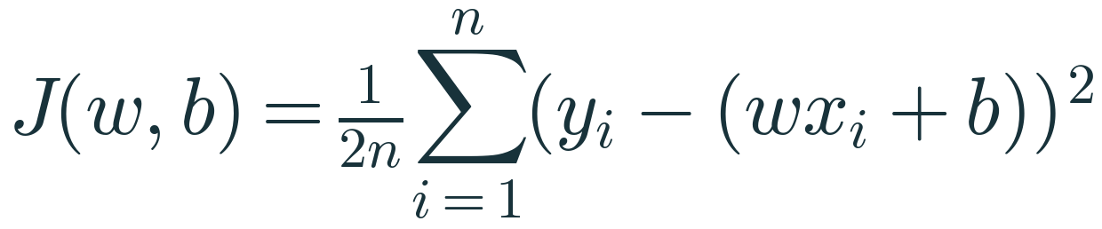
The cost function we will descend
MATHEMATICS
w and b
the same slope and intercept as b₁ and b₀ — ML notation: weight and bias
1/n
averages the squared error, so the cost does not grow just because n grows
1/2
cancels the 2 produced by differentiating a square — purely for neat gradients
Same minimiser
scaling SSE by a positive constant does not move its lowest point
Notes:
EXPLAIN: J(w, b) is SSE scaled by 1/(2n). Scaling by a positive constant changes heights, not the location of the minimum, so the best (w, b) is identical to OLS.
HOW TO INTRODUCE: Point out the notation switch: b₁ → w, b₀ → b. Write both on the board.
WHY IT IS VALID: argmin of c·f equals argmin of f for c > 0.
LIKELY CONFUSION: Students ask whether 1/2 changes the answer. It does not; it changes gradient magnitudes and therefore how the learning rate behaves.
ASK: Would using 1/n instead of 1/(2n) change the best w?
EXPECTED RESPONSES: No — only the gradient size by a factor of 2.
TIME: 4 min
TRANSITION: Differentiate J.

Slide 27
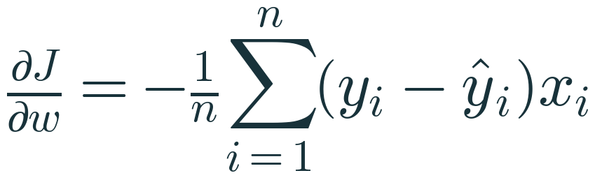
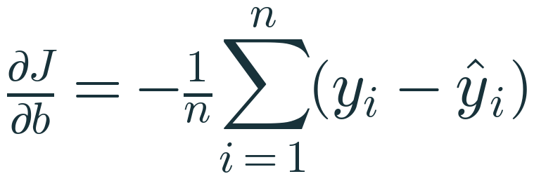
Deriving the gradients
MATHEMATICS
Chain rule for w
inside derivative w.r.t. w is −xᵢ
Chain rule for b
inside derivative w.r.t. b is −1
Gradient
the pair (∂J/∂w, ∂J/∂b) points in the direction of steepest increase of J
Notes:
EXPLAIN: One term: d/dw [½(yᵢ − wxᵢ − b)²] = (yᵢ − wxᵢ − b)(−xᵢ). Average over i to get ∂J/∂w = −(1/n)Σ(yᵢ − ŷᵢ)xᵢ. Similarly with −1 for b.
HOW TO INTRODUCE: Reuse the chain-rule pattern from step A; students should now be able to predict the result.
WHY IT IS VALID: Linearity of differentiation lets us differentiate each term of the sum separately.
LIKELY CONFUSION: Sign: residual × (−x). A positive residual (under-prediction) gives a negative gradient for w when x > 0.
ASK: If all residuals are positive, what are the signs of the gradients?
EXPECTED RESPONSES: Both negative (for positive x).
TIME: 5 min
TRANSITION: Turn gradients into updates.

Slide 28
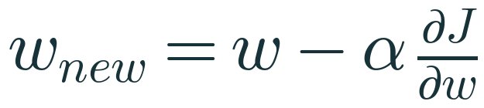
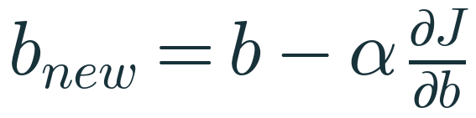
The update rule: step downhill, repeat
OPTIMISATION
Minus sign
the gradient points uphill, so we move the opposite way
α — learning rate
a hyperparameter you choose; controls step size
Simultaneous update
compute both gradients with the old w, b, then update both
Stop when
the cost stops changing meaningfully or after a fixed number of iterations
Notes:
EXPLAIN: Picture standing on a foggy hillside: you feel the slope under your feet and take a step downhill, then feel again. α is your stride length.
HOW TO INTRODUCE: Ask: what does the update do when the gradient is zero?
WHY IT IS VALID: For a small enough α, each step reduces J for a smooth convex function such as ours.
LIKELY CONFUSION: Parameters (w, b) are learned; hyperparameters (α, iterations) are set by you.
ASK: If the gradient is 0, what happens to w?
EXPECTED RESPONSES: Nothing — we are at the minimum.
MISCONCEPTION TO ADDRESS: 'A bigger α is always faster' — beyond a limit it overshoots and diverges.
TIME: 4 min
TRANSITION: Run one iteration by hand.

Slide 29
Worked example 2 · first gradient-descent step
MANUAL CALC
Quantity | Calculation | Value
Data | x = [1, 2, 3], y = [2, 4, 5], start w = 0, b = 0, α = 0.1
Predictions ŷ | 0·x + 0 | [0, 0, 0]
Residuals y − ŷ |  | [2, 4, 5]
Cost J | (4 + 16 + 25) / (2·3) | 7.5000
∂J/∂w | −(2·1 + 4·2 + 5·3) / 3 = −25/3 | −8.3333
∂J/∂b | −(2 + 4 + 5) / 3 = −11/3 | −3.6667
w new | 0 − 0.1 × (−8.3333) | 0.8333
b new | 0 − 0.1 × (−3.6667) | 0.3667
Teaching data chosen so the arithmetic fits on a board. Exact OLS answer for this data: w = 1.5, b = 0.6667.
Notes:
EXPLAIN: Do every line on the board. Students should reproduce it with a calculator.
HOW TO INTRODUCE: Ask a student to compute the cost, another the gradients.
LIKELY CONFUSION: Forgetting to divide by n in the gradient (we used 1/(2n) in J, so gradient has 1/n).
ASK: Both parameters increased. Why?
EXPECTED RESPONSES: Gradients were negative; minus a negative is a positive step.
TIME: 6 min
TRANSITION: Second iteration.

Slide 30
Worked example 2 · second step and the trend
MANUAL CALC
Iteration | w | b | ŷ | Residuals | Cost J | ∂J/∂w | ∂J/∂b
0 | 0.0000 | 0.0000 | 0, 0, 0 | 2, 4, 5 | 7.5000 | −8.3333 | −3.6667
1 | 0.8333 | 0.3667 | 1.2, 2.0333, 2.8667 | 0.8, 1.9667, 2.1333 | 1.5098 | −3.7111 | −1.6333
2 | 1.2044 | 0.5300 | 1.7344, 2.9389, 4.1433 | 0.2656, 1.0611, 0.8567 | 0.3217 | −1.6526 | −0.7278
… | → 1.5 | → 0.6667 |  |  | → 0.0278 | → 0 | → 0
Cost falls 7.5 → 1.51 → 0.32; gradients shrink as we approach the bottom, so steps automatically get smaller. Values rounded to 4 d.p.; verified in Python.
Notes:
EXPLAIN: Iteration 1 in detail: ŷ = 0.8333x + 0.3667 → 1.2, 2.0333, 2.8667. Residuals 0.8, 1.9667, 2.1333. J = (0.64 + 3.8678 + 4.5511)/6 = 1.5098. ∂J/∂w = −(0.8 + 3.9333 + 6.4)/3 = −3.7111; ∂J/∂b = −4.9/3 = −1.6333. Update: w = 0.8333 + 0.37111 = 1.2044; b = 0.3667 + 0.16333 = 0.5300.
HOW TO INTRODUCE: Let pairs compute iteration 1 themselves, then reveal.
WHY IT IS VALID: As the gradient shrinks near the minimum, α × gradient shrinks — steps slow down without changing α.
LIKELY CONFUSION: The final cost is not 0: the three points are not collinear, so even the best line has error (0.0278).
ASK: Why does the cost never reach exactly zero here?
EXPECTED RESPONSES: No straight line passes through all three points.
TIME: 6 min
TRANSITION: See the path on the cost surface.

Slide 31
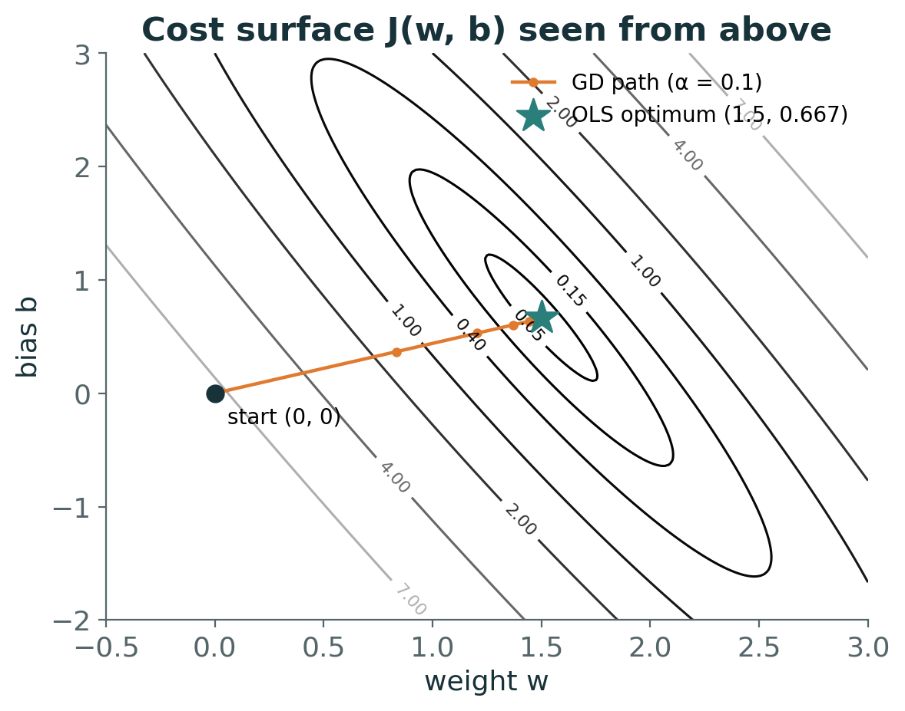
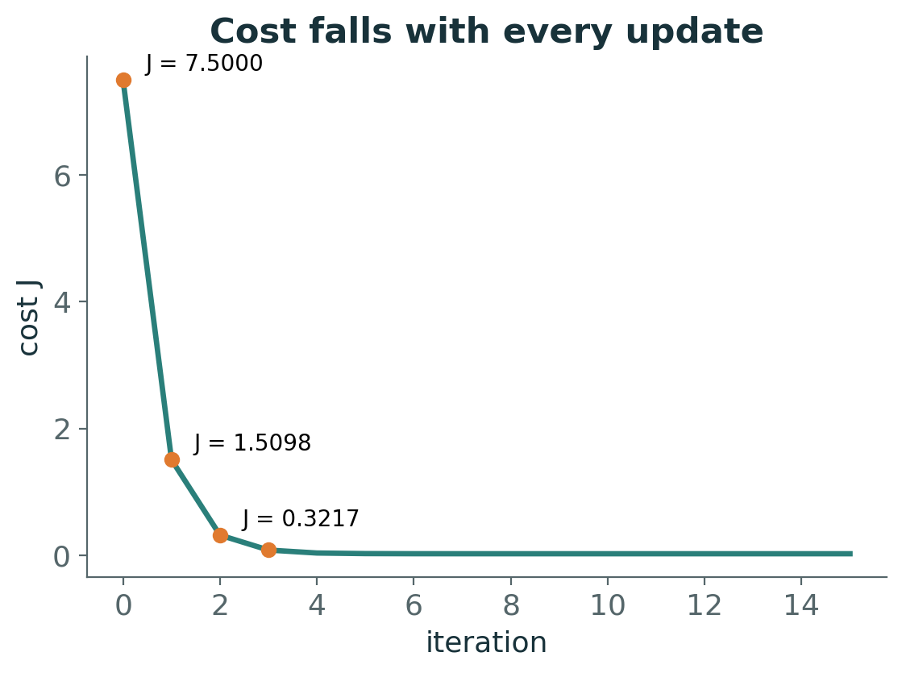
Watching gradient descent find the bottom
VISUAL
Left: contour lines of J(w, b) seen from above; each orange dot is one update, ending at the OLS optimum (star). Right: the cost after each iteration.
Notes:
EXPLAIN: The contour map is the bowl seen from above; each ellipse is a level of equal cost. The path starts at (0, 0) and curves into the valley. The path bends because the valley is long and narrow — w and b are correlated in this problem.
HOW TO INTRODUCE: Ask students to trace the path with a finger and count how many big steps happen before progress slows.
WHY IT IS VALID: Each step is perpendicular to the contour where it starts (the gradient direction), which explains the curved path.
LIKELY CONFUSION: Students expect a straight path to the minimum; GD follows local steepest descent, not the straight line.
ASK: Why is the path not straight?
EXPECTED RESPONSES: It follows the local slope; the bowl is elongated.
TIME: 4 min
TRANSITION: What if α is chosen badly?

Slide 32
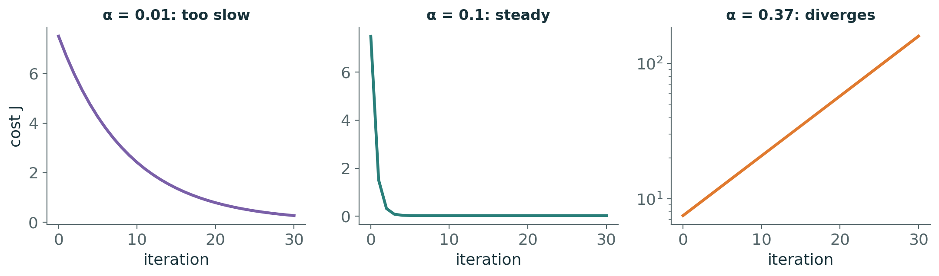
The learning rate decides everything
EXPERIMENT
α = 0.01: every step is safe but tiny — still far from the minimum after 30 steps
α = 0.1: steady decrease to the minimum
α = 0.37: each step overshoots further; cost explodes (note the log scale)
For this data, steps are stable only for α below about 0.36
Notes:
EXPLAIN: Show three runs from the same start. The stability threshold for batch GD on a quadratic cost is α < 2/λmax, where λmax is the largest eigenvalue of the cost's curvature (Hessian) matrix; here λmax ≈ 5.55, so α < 0.36.
HOW TO INTRODUCE: Ask for predictions first: 'What happens if we make α ten times bigger?'
WHY IT IS VALID: Too large: the step jumps past the valley floor to a higher point on the other side, and the gradient there is even larger.
LIKELY CONFUSION: Students think divergence is a bug in the code; it is a property of α relative to the curvature.
ASK: Your cost goes up each iteration. What do you change first?
EXPECTED RESPONSES: Reduce α (and check for a sign error in the update).
MISCONCEPTION TO ADDRESS: 'Scaling features does not matter for GD' — unscaled features make the bowl elongated and force a tiny α.
TIME: 4 min
TRANSITION: Code it.

Slide 33
Batch gradient descent in 12 lines of NumPy
PYTHON
def gradient_descent(x, y, alpha=0.1, iterations=200):
w, b, n = 0.0, 0.0, len(x)
for it in range(iterations):
y_hat = w * x + b
residuals = y - y_hat
dJ_dw = -np.sum(residuals * x) / n
dJ_db = -np.sum(residuals) / n
w = w - alpha * dJ_dw # both gradients used
b = b - alpha * dJ_db # the OLD w and b
return w, b
gradient_descent(np.array([1., 2, 3]), np.array([2., 4, 5]))
# -> (1.5002, 0.6662) vs OLS (1.5, 0.6667)
Every line maps to one equation from the previous slides
After 200 steps: within 0.001 of the exact OLS answer
LinearRegression does not run this loop — it solves least squares directly
scikit-learn's SGDRegressor is the gradient-based alternative
Notes:
EXPLAIN: Map line by line: y_hat = model, residuals = e, dJ_dw and dJ_db = gradient formulas, two update lines = update rule.
HOW TO INTRODUCE: Run it with α = 0.1, then 0.37, live.
LIKELY CONFUSION: The comparison with OLS uses a tolerance; tiny differences remain because we stopped after a finite number of iterations.
ASK: How would you add a stopping rule?
EXPECTED RESPONSES: Stop when |J_old − J_new| < tolerance.
MISCONCEPTION TO ADDRESS: 'LinearRegression uses gradient descent' — false; SGDRegressor does.
TIME: 4 min
TRANSITION: Knowledge check, then break.

Slide 34
Knowledge check · Hour 2
CHECK
Current values: w = 1, b = 0, α = 0.05.
At this point ∂J/∂w = −4 and ∂J/∂b = 2.
1. Compute the updated w and b.
2. Explain in words why w increases while b decreases.
3. What would you expect if α were 50× larger?
Discuss first — answer is in the speaker notes
Notes:
EXPLAIN: 3 minutes individually.
LIKELY CONFUSION: Sign errors on b.
ASK: Who changed b in the wrong direction?
EXPECTED RESPONSES: Those who added α·gradient.
TIME: 5 min
TRANSITION: Break (11:00–11:15), then evaluation metrics.
ANSWER (reveal after discussion): w = 1 − 0.05(−4) = 1.2; b = 0 − 0.05(2) = −0.1. Cost falls if w goes up (negative slope in w) and if b goes down (positive slope in b). With α = 2.5 the step (Δw = +10) would almost certainly overshoot and the cost could increase or diverge.

Slide 35
3
HOUR 3 · 11:15–12:15
Evaluation and Multiple Linear Regression
How good is the line — and what if one input is not enough?
Notes:
EXPLAIN: First half: metrics. Second half: many features.
TIME: 30 s
TRANSITION: Why we need metrics.

Slide 36
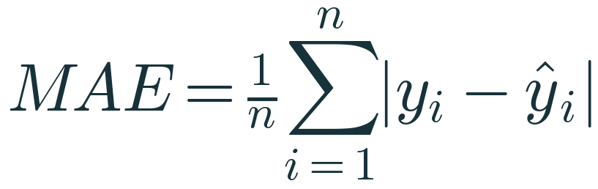
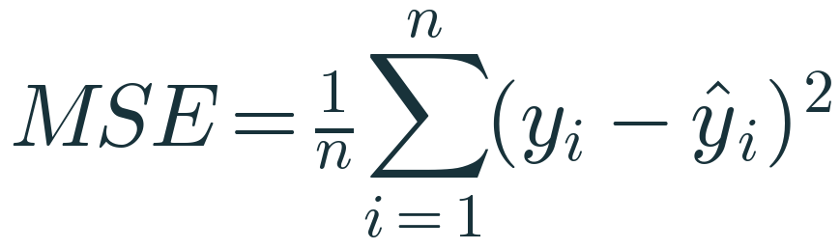
MAE and MSE on our five deliveries
MATHEMATICS
Residuals
−0.6, +1.2, −1.0, +0.8, −0.4
MAE
(0.6 + 1.2 + 1.0 + 0.8 + 0.4) / 5 = 4.0 / 5 = 0.80 min
MSE
(0.36 + 1.44 + 1.00 + 0.64 + 0.16) / 5 = 3.6 / 5 = 0.72 min²
Reading them
MAE: typical miss in minutes. MSE: squared units, used for optimisation and comparison
Notes:
EXPLAIN: Use the residuals students already computed. MAE averages absolute errors (units: minutes). MSE averages squared errors (units: minutes squared) — hard to interpret directly, but it is what OLS minimises (MSE = SSE/n).
HOW TO INTRODUCE: Ask which metric they would show a delivery manager.
WHY IT IS VALID: MSE = SSE / n, so the OLS line also has the smallest training MSE of any straight line.
LIKELY CONFUSION: Units of MSE confuse students — 'square minutes' is not a natural unit, which motivates RMSE.
ASK: Which is larger for these residuals, MAE or RMSE?
EXPECTED RESPONSES: RMSE (0.849 > 0.80); RMSE ≥ MAE always.
MISCONCEPTION TO ADDRESS: This is a teaching calculation on the training points; it says nothing about performance on new deliveries.
TIME: 5 min
TRANSITION: RMSE and the outlier effect.

Slide 37

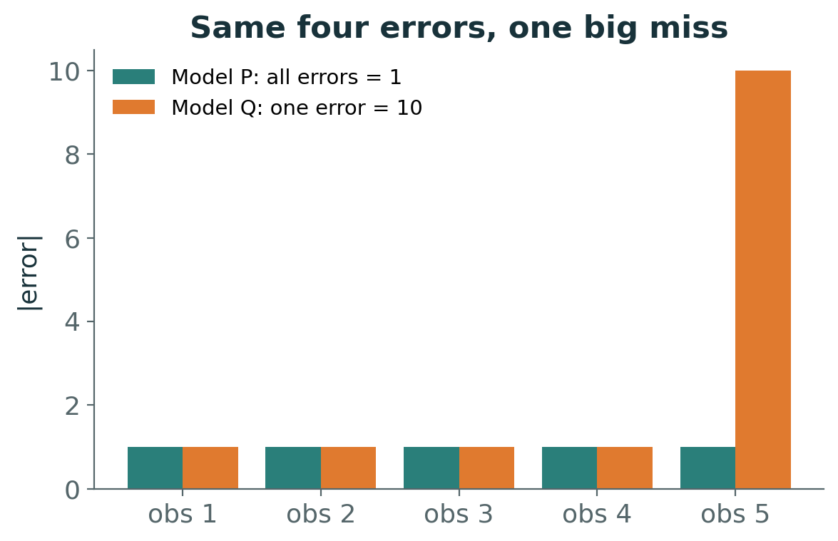
RMSE and why one big miss changes everything
INTERPRET
RMSE here
√0.72 = 0.849 min — back in the units of y
Model P vs Q
MAE 1.0 → 2.8; MSE 1.0 → 20.8; RMSE 1.0 → 4.56
Lesson
squared metrics punish large errors heavily; MAE is more robust to occasional big misses
Notes:
EXPLAIN: Experiment: actual [10,12,15,20,25]; P predicts [11,11,16,19,26] (all errors 1); Q differs only in the last prediction (35, error 10). MAE: 5/5 = 1 vs 14/5 = 2.8. MSE: 5/5 = 1 vs (4 + 100)/5 = 20.8. RMSE: 1 vs 4.56.
HOW TO INTRODUCE: Before showing numbers ask: 'Which metric will change the most?'
WHY IT IS VALID: Squaring makes a 10-unit error contribute 100, i.e. as much as one hundred 1-unit errors.
LIKELY CONFUSION: RMSE is not 'the average error'; it is the square root of the average squared error, always ≥ MAE.
ASK: When would you prefer RMSE?
EXPECTED RESPONSES: When big errors are especially costly (late deliveries, safety margins).
TIME: 5 min
TRANSITION: R²: error relative to a baseline.

Slide 38
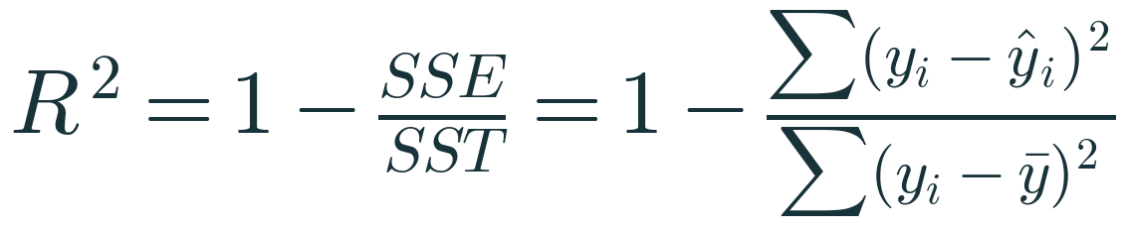
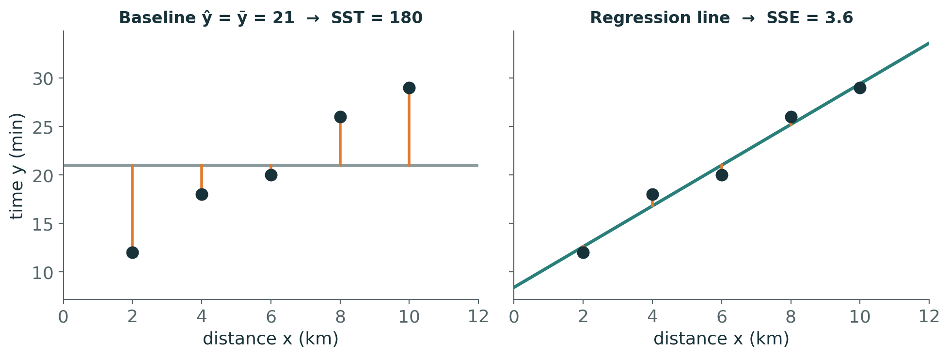
R²: how much better than predicting the mean?
MATHEMATICS
SST = 180
errors of the naïve model ŷ = ȳ = 21: 81 + 9 + 1 + 25 + 64
SSE = 3.6
errors left after the regression line
R² = 1 − 3.6/180 = 0.98
the line removes 98% of the squared error of the mean-only baseline
Can be negative
on new data, a model worse than the mean of those targets gets R² < 0
Notes:
EXPLAIN: SST measures total variation of y around its mean. SSE measures what remains after the model. R² is the fraction of SST explained. On training data with OLS and an intercept, 0 ≤ R² ≤ 1; on test data it can be negative.
HOW TO INTRODUCE: Draw both panels: baseline flat line, then fitted line; ask which orange segments are shorter.
WHY IT IS VALID: With OLS + intercept on training data, SST = SSR + SSE (explained + residual), giving the 'fraction explained' reading.
LIKELY CONFUSION: R² = 0.98 does not prove the model is correct or causal; with 5 points it is a training number.
ASK: A model scores R² = −0.3 on the test set. What does that mean?
EXPECTED RESPONSES: Its squared error is 30% larger than just predicting the test-set mean.
MISCONCEPTION TO ADDRESS: 'High R² means good predictions everywhere' — R² is relative and unitless; always also report RMSE/MAE.
TIME: 6 min
TRANSITION: Adjusting R² for model size.

Slide 39
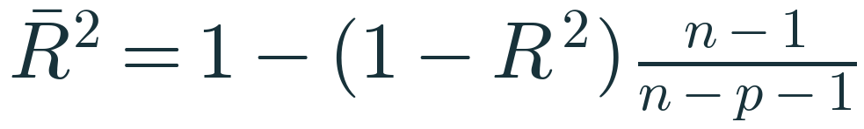
Adjusted R² — a small extension
MATHEMATICS
n, p
n = number of observations, p = number of predictors (not counting the intercept)
Our example
n = 5, p = 1: 1 − (1 − 0.98)·4/3 = 0.9733
Why adjust?
training R² never decreases when a feature is added — even pure noise
Defined only if
n − p − 1 > 0; it is a training-data diagnostic, not a substitute for test evaluation
Notes:
EXPLAIN: Adjusted R² penalises extra predictors through the factor (n − 1)/(n − p − 1) > 1. It rises only if a new feature improves fit more than expected by chance.
HOW TO INTRODUCE: Compute the example live: 0.02 × 4/3 = 0.02667; 1 − 0.02667 = 0.9733.
WHY IT IS VALID: Adding a column to X cannot increase the minimum SSE (the old solution with the new coefficient 0 is still available), so training R² cannot fall.
LIKELY CONFUSION: With n = p + 1 the formula divides by zero; with few observations it becomes unstable.
ASK: Why can training R² never go down when you add a feature?
EXPECTED RESPONSES: Least squares can always set the new coefficient to 0.
TIME: 3 min
TRANSITION: Metrics in scikit-learn.

Slide 40
Metrics in scikit-learn — always on held-out data
PYTHON
from sklearn.model_selection import train_test_split
from sklearn.metrics import (mean_absolute_error,
mean_squared_error, r2_score)
X_train, X_test, y_train, y_test = train_test_split(
X, y, test_size=0.2, random_state=42)
model = LinearRegression().fit(X_train, y_train)
y_pred = model.predict(X_test) # unseen rows only
mae = mean_absolute_error(y_test, y_pred)
mse = mean_squared_error(y_test, y_pred)
rmse = np.sqrt(mse)
r2 = r2_score(y_test, y_pred) # (y_true, y_pred)
Training-set metrics measure fit; test-set metrics estimate performance on new data
Pass (y_true, y_pred) — r2_score is not symmetric
Use the same split for every model you compare
Our 5-point calculations were for arithmetic practice only
Notes:
EXPLAIN: Real evaluation: split first, fit on train, evaluate on test. Report MAE/RMSE in units and R² as a relative score.
HOW TO INTRODUCE: Contrast with the toy example — clearly a training calculation.
WHY IT IS VALID: A model can memorise training data; only unseen data reveal generalisation.
LIKELY CONFUSION: r2_score(y_pred, y_test) silently returns a different number.
ASK: Why fix random_state?
EXPECTED RESPONSES: Reproducibility and fair comparisons across models.
TIME: 3 min
TRANSITION: Quick reasoning question.

Slide 41
Pause and reason
CHECK
Two models are evaluated on the same 100 test houses.
Model A: MAE = ₹4 lakh, RMSE = ₹5 lakh. Model B: MAE = ₹3.5 lakh, RMSE = ₹9 lakh.
1. What does the gap between MAE and RMSE tell you about Model B?
2. Which would you deploy for a bank that loses heavily on large mis-valuations?
Discuss first — answer is in the speaker notes
Notes:
EXPLAIN: Discussion in pairs, 3 minutes.
LIKELY CONFUSION: Students pick B because 'lower MAE'.
ASK: What would you inspect next?
EXPECTED RESPONSES: The largest residuals of B — maybe a segment of houses it handles badly.
TIME: 4 min
TRANSITION: Multiple linear regression.
ANSWER (reveal after discussion): B's RMSE ≫ MAE means most errors are small but a few are very large (a heavy tail). A bank sensitive to big misses should prefer Model A, whose errors are more consistent (lower RMSE), despite its slightly higher MAE.

Slide 42
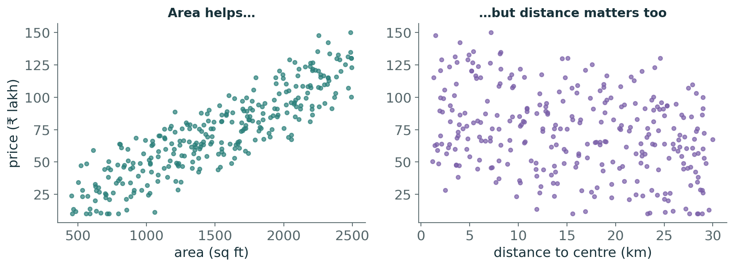
One feature is rarely enough
PROBLEM
House prices rise with area — but at the same area, central houses cost more
Area alone (Lab A2): test R² ≈ 0.74, RMSE ≈ ₹16 lakh
We need a model that combines several inputs at once
Notes:
EXPLAIN: Show both scatterplots from the 300-house synthetic dataset. Area explains a lot, but distance clearly matters too: at any area, far houses are cheaper.
HOW TO INTRODUCE: Ask: 'How would you combine area and distance into one prediction?'
ASK: Name two other features you would add.
EXPECTED RESPONSES: Age, bedrooms, floor, parking, amenities.
TIME: 3 min
TRANSITION: Write the equation.

Slide 43
Multiple Linear Regression
MATHEMATICS
One coefficient per feature
b₁ … bₚ, plus one intercept b₀
Holding others fixed
bⱼ = change in ŷ for +1 unit of xⱼ when all other features stay the same
Geometry
with 2 features the model is a flat plane; with p features, a hyperplane
Same learning rule
still minimise SSE — the matrix form from hour 2 does it for any p
Notes:
EXPLAIN: Same idea as before, more inputs. The crucial new phrase is 'holding the other features fixed'.
HOW TO INTRODUCE: Draw a plane over the (area, distance) floor; price is the height.
WHY IT IS VALID: Each partial derivative ∂ŷ/∂xⱼ = bⱼ, i.e. the effect of xⱼ with the rest held constant.
LIKELY CONFUSION: Students compare coefficients by size — wrong when units differ.
ASK: If b for distance is −1.5, how do you read it?
EXPECTED RESPONSES: Each extra km lowers predicted price by ₹1.5 lakh, holding other features fixed.
MISCONCEPTION TO ADDRESS: 'Holding fixed' is a statement about the model, not a controlled experiment; it does not prove causation.
TIME: 4 min
TRANSITION: A prediction by hand.

Slide 44
Worked example 3 · predict one house by hand
MANUAL CALC
Term | Coefficient (given) | Feature value | Contribution (₹ lakh)
Intercept b₀ | 20 | — | 20.0
Area (sq ft) | 0.045 per sq ft | 1,200 | +54.0
Bedrooms | 3 per bedroom | 2 | +6.0
Age (years) | −0.6 per year | 10 | −6.0
Distance (km) | −1.8 per km | 8 | −14.4
Predicted price ŷ |  |  | 59.6
Illustrative coefficients chosen for easy arithmetic. The lab model fitted to our data gives its own coefficients — compare in Lab A7.
Notes:
EXPLAIN: Compute each contribution: 0.045 × 1200 = 54; 3 × 2 = 6; −0.6 × 10 = −6; −1.8 × 8 = −14.4. Sum with intercept: 59.6 lakh.
HOW TO INTRODUCE: Let students compute before revealing the last column.
LIKELY CONFUSION: Mixing units: area per sq ft vs per 100 sq ft.
ASK: How much does the prediction change if the house were 2 km closer?
EXPECTED RESPONSES: +3.6 lakh (−1.8 × −2).
TIME: 4 min
TRANSITION: Pitfalls of interpretation.

Slide 45
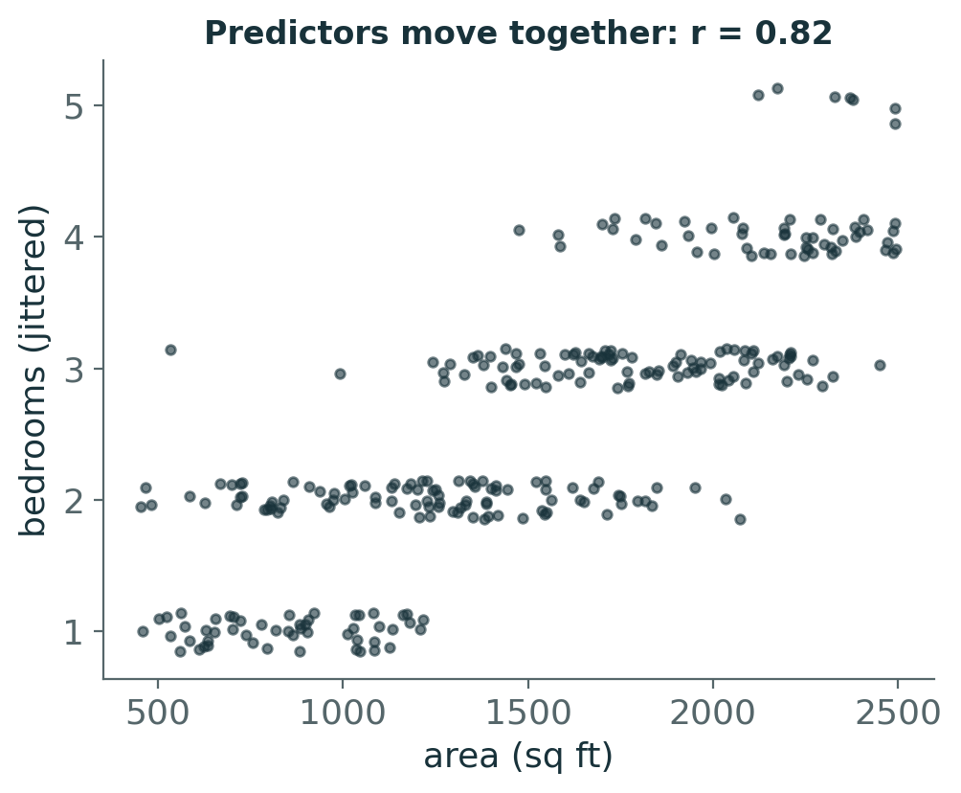
Reading coefficients responsibly
INTERPRET
Units differ → raw coefficient sizes are not comparable (per sq ft vs per bedroom)
Correlated predictors (area and bedrooms, r ≈ 0.82) — multicollinearity makes individual coefficients unstable
Predictions can stay good even when individual coefficients are unreliable
Correlation is not causation: adding a bedroom by partitioning a room need not raise the price by bⱼ
Notes:
EXPLAIN: Three cautions. (1) Scale: compare after standardising. (2) Multicollinearity: when two features move together, the data cannot cleanly separate their effects, so coefficients have high variance — they can change a lot between samples or even flip sign. (3) Causation requires design, not regression alone.
HOW TO INTRODUCE: Show the scatter: big houses have more bedrooms. Ask what 'more bedrooms at the same area' means physically.
WHY IT IS VALID: Holding area fixed while adding a bedroom means smaller rooms; the coefficient answers exactly that, which may differ from intuition.
LIKELY CONFUSION: Students think multicollinearity hurts predictions; it mostly hurts interpretation.
ASK: What happens to XᵀX with perfect multicollinearity?
EXPECTED RESPONSES: It becomes singular — no unique solution.
TIME: 5 min
TRANSITION: Code and real results.

Slide 46
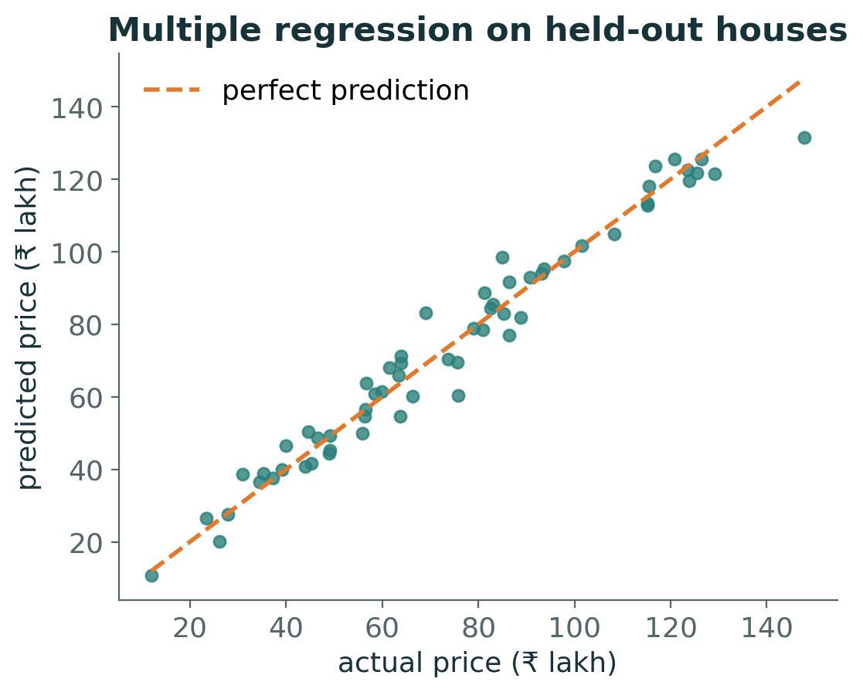
Multiple regression on the house data
PYTHON
FEATURES = ["area_sqft", "bedrooms",
"property_age_yrs", "distance_city_km",
"floor_number", "parking"]
mlr = LinearRegression()
mlr.fit(X_train[FEATURES], y_train)
pd.Series(mlr.coef_, index=FEATURES)
# area 0.050 bedrooms 1.93 age -0.38
# distance -1.46 floor 0.23 parking 4.07
# Same 60 test houses:
# area only : RMSE 16.1 R2 0.74
# 6 features: RMSE 5.8 R2 0.97
Notes:
EXPLAIN: Results from the trainer notebook (same split, random_state = 42). RMSE drops from ₹16.1 to ₹5.8 lakh. Point at the actual-vs-predicted plot: points hug the diagonal.
HOW TO INTRODUCE: Interpret two coefficients aloud with units.
LIKELY CONFUSION: Because the data are synthetic, we know the generating coefficients (0.05, 2.5, −0.4, −1.5, 0.3, 4): the fit recovers them approximately — a nice sanity check you can never do with real data.
ASK: Why is the bedrooms estimate (1.93) further from its true value (2.5) than distance's?
EXPECTED RESPONSES: It is correlated with area, so it is estimated less precisely.
TIME: 5 min
TRANSITION: Hour 4: curves.

Slide 47
4
HOUR 4 · 12:15–13:15
Polynomial Regression and Regularisation
Flexible models, and how to keep them honest
Notes:
EXPLAIN: Curves, overfitting, bias–variance, then Ridge and Lasso as introductions (full derivations next session).
TIME: 30 s
TRANSITION: A curved relationship.

Slide 48
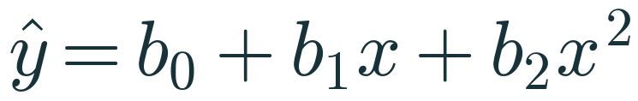
When the relationship bends
PROBLEM
The data
fuel efficiency rises with speed, peaks, then falls — a straight line cannot bend
The trick
create a new column x² and fit ordinary least squares on [x, x²]
Linear in coefficients
ŷ is curved in x, but each bⱼ still enters linearly → OLS still works
Degree d
adding x³ … xᵈ allows more bends: more flexibility, more risk
Notes:
EXPLAIN: Speed vs fuel efficiency (synthetic): efficiency peaks at moderate speed. A line underfits.
HOW TO INTRODUCE: Ask: can we keep everything we learned and still fit a curve?
WHY IT IS VALID: 'Linear regression' means linear in the parameters. b₀ + b₁x + b₂x² is a weighted sum of known columns 1, x, x²; the normal equations apply unchanged.
LIKELY CONFUSION: Students think polynomial regression is a different algorithm. It is a feature transformation + linear regression.
ASK: Is ŷ = b₀ + b₁·log(x) a linear model?
EXPECTED RESPONSES: Yes — linear in b₀, b₁.
TIME: 4 min
TRANSITION: Build the features by hand.

Slide 49
Polynomial features, by hand then by scikit-learn
MANUAL CALC
x | x (degree 1) | x² (degree 2) | x³ (degree 3)
1 | 1 | 1 | 1
2 | 2 | 4 | 8
3 | 3 | 9 | 27
4 | 4 | 16 | 64
PolynomialFeatures(degree=2, include_bias=False).fit_transform(x) returns exactly the first two columns. With several features it also creates interaction terms such as x₁·x₂.
Notes:
EXPLAIN: Build the table with students. Then show that scikit-learn produces the same columns. Mention the number of columns grows quickly with several features (degree 2 with 6 features → 27 columns).
HOW TO INTRODUCE: Ask a student to read off row x = 3.
LIKELY CONFUSION: include_bias=False: LinearRegression already fits an intercept, so the constant column of 1s is not needed.
ASK: Why do the values in the x³ column grow so fast, and why might that matter?
EXPECTED RESPONSES: Large, highly correlated columns → numerical issues; scaling helps.
TIME: 3 min
TRANSITION: Compare degrees.

Slide 50
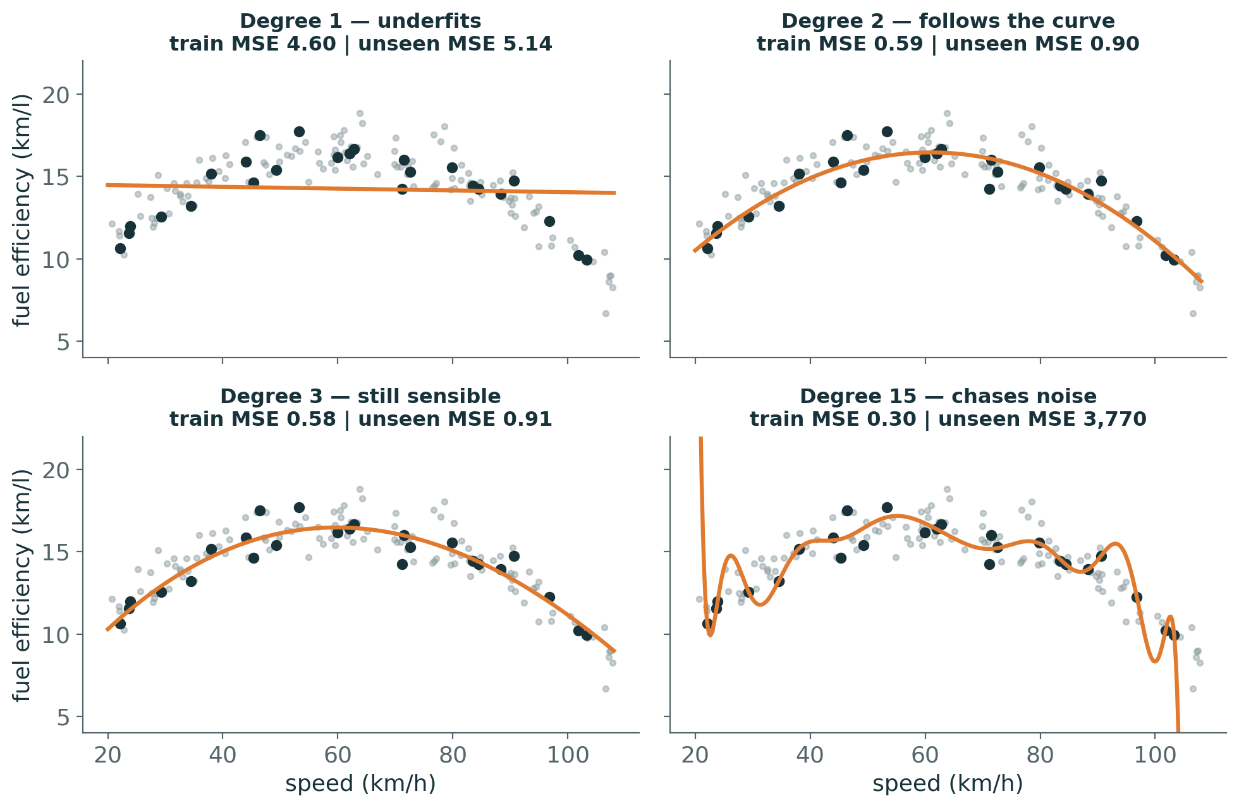
Degree controls flexibility
VISUAL
Trained on only 25 trips (black); grey = unseen trips
Degree 1: too rigid → underfits (high error everywhere)
Degree 2–3: follow the true shape
Degree 15: lowest training error, wild swings → unseen MSE explodes
Notes:
EXPLAIN: Small training set on purpose — overfitting is easiest to see when data are scarce. Read the titles: training MSE falls with degree; unseen MSE does not.
HOW TO INTRODUCE: Before revealing, ask which panel has the lowest training error.
WHY IT IS VALID: A degree-15 polynomial has 16 coefficients and can bend to pass close to 25 noisy points; the bends between points are unconstrained.
LIKELY CONFUSION: Students think 'more complex = more accurate'.
ASK: Which model would you trust for a speed of 105 km/h?
EXPECTED RESPONSES: Degree 2 — degree 15 behaves erratically near the edge.
MISCONCEPTION TO ADDRESS: Low training error is evidence of fitting the sample, not of generalising.
TIME: 4 min
TRANSITION: Measure it systematically.

Slide 51
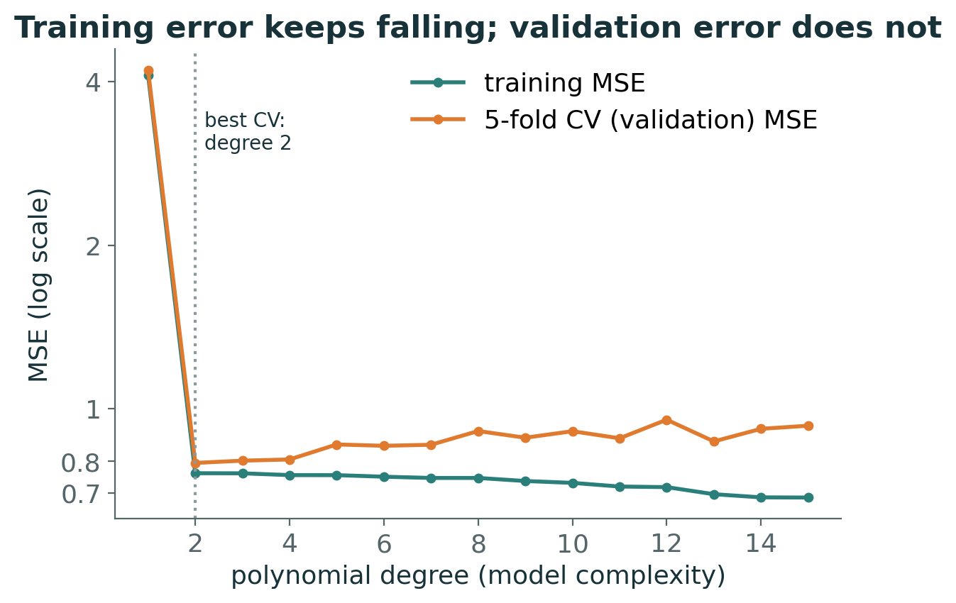
Training error vs validation error
EXPERIMENT
105 training trips, 5-fold cross-validation for each degree
Training MSE keeps falling as degree rises
CV MSE drops sharply at degree 2, then slowly rises
Choose the degree by validation error (here: 2), then test once
Notes:
EXPLAIN: Cross-validation splits the training set into 5 folds; each fold takes a turn as validation. Average validation MSE estimates generalisation without touching the test set.
HOW TO INTRODUCE: Point to the gap between the curves as complexity rises.
WHY IT IS VALID: Higher-degree models nest lower ones, so training error is non-increasing; validation error reflects both bias and variance.
LIKELY CONFUSION: Choosing the degree by test-set score leaks information from the test set.
ASK: Why might CV MSE be noisy from degree 3 to 15?
EXPECTED RESPONSES: Small data, random fold assignment; differences are small.
TIME: 4 min
TRANSITION: Name the two failure modes.

Slide 52
Pause and reason
PREDICT
A degree-10 polynomial has lower training error than a degree-2 polynomial on the same data, but higher test error.
1. Explain how both statements can be true.
2. Which model has higher variance? Higher bias?
Discuss first — answer is in the speaker notes
Notes:
EXPLAIN: Pairs, 2 minutes.
ASK: What would make degree 10 safer?
EXPECTED RESPONSES: More data, or regularisation.
TIME: 3 min
TRANSITION: Bias and variance precisely.
ANSWER (reveal after discussion): Degree 10 contains degree 2 as a special case, so it can always fit training data at least as well; its extra flexibility fits the noise in this particular sample, which does not repeat in new data. Degree 10: higher variance; degree 2: higher bias (but here a small one).

Slide 53
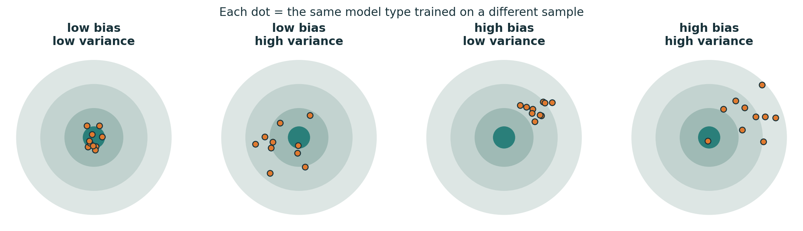
Bias and variance: imagine retraining many times
INTUITION
Bias: how far the average prediction (over many training samples) is from the truth — systematic error
Variance: how much predictions change from one training sample to another — instability
Simple models: high bias, low variance. Flexible models: low bias, high variance
Notes:
EXPLAIN: Thought experiment: draw many training sets from the same population, train the same model on each. Bias asks whether the average shot hits the centre; variance asks how scattered the shots are.
HOW TO INTRODUCE: Ask students to place degree-1 and degree-15 polynomials on the four targets.
WHY IT IS VALID: Both are defined over repeated sampling — which is why they cannot be read off a single train/test split.
LIKELY CONFUSION: Students compute 'bias' and 'variance' from one split. One split gives one error number, not its decomposition.
ASK: Where do degree 1 and degree 15 sit?
EXPECTED RESPONSES: Degree 1: high bias/low variance. Degree 15: low bias/high variance.
TIME: 4 min
TRANSITION: The decomposition.

Slide 54
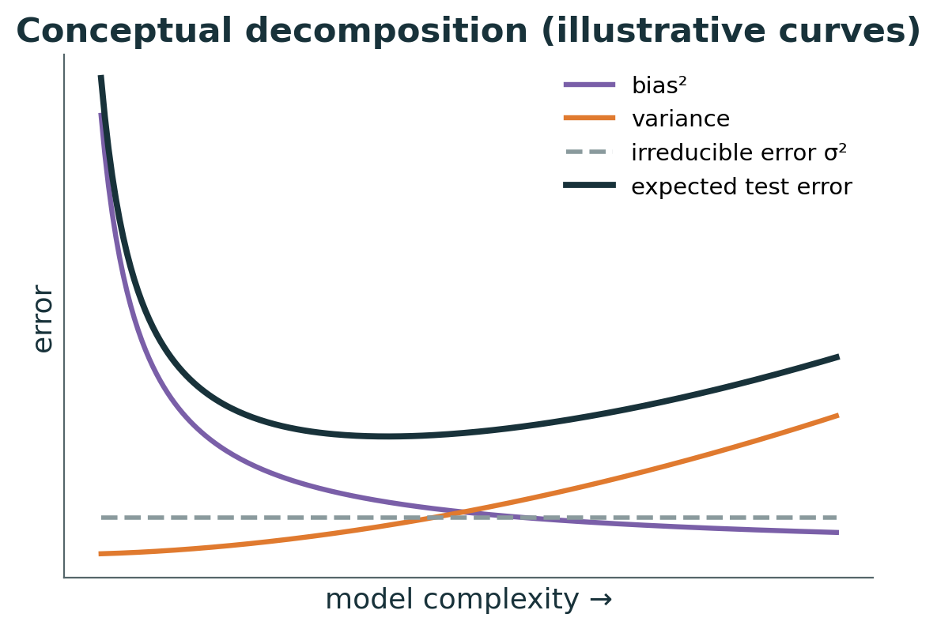
The bias–variance decomposition
MATHEMATICS
Bias²
error from wrong assumptions — falls as complexity rises
Variance
sensitivity to the particular sample — rises with complexity
σ² irreducible
noise in y itself; no model can remove it
Trade-off
best expected test error sits where the sum is smallest
Notes:
EXPLAIN: For squared error at a point x, averaging over training sets and noise: expected error = bias² + variance + σ². Curves on the right are schematic, not computed.
HOW TO INTRODUCE: Connect each term to the target picture.
WHY IT IS VALID: Expand E[(y − f̂)²] with y = f(x) + ε, add and subtract E[f̂]; cross terms vanish because ε has mean 0 and is independent of the training sample (derivation in the handbook).
LIKELY CONFUSION: The decomposition is for the expected error at a point, over hypothetical repeated datasets.
ASK: Can more data reduce irreducible error?
EXPECTED RESPONSES: No; it can reduce variance.
MISCONCEPTION TO ADDRESS: 'Overfitting = high bias' — it is high variance.
TIME: 5 min
TRANSITION: Regularisation as a variance reducer.

Slide 55
Why regularise?
PROBLEM
Large coefficients
wild polynomial curves need huge, opposite-signed coefficients
Correlated features
multicollinearity lets coefficients grow large and unstable
High variance
small changes in data → big changes in the model
Idea
add a cost for large coefficients: accept a little more training error for a lot less variance
Notes:
EXPLAIN: Regularisation changes the objective: fit the data AND keep coefficients small. It is a direct tool for moving along the bias–variance trade-off.
HOW TO INTRODUCE: Recall the degree-15 curve: what would its coefficients look like?
ASK: Which is worse for new data: slightly higher training error, or much higher variance?
EXPECTED RESPONSES: Usually the variance.
MISCONCEPTION TO ADDRESS: 'Regularisation always improves accuracy' — only when variance is the problem.
TIME: 3 min
TRANSITION: Ridge.

Slide 56
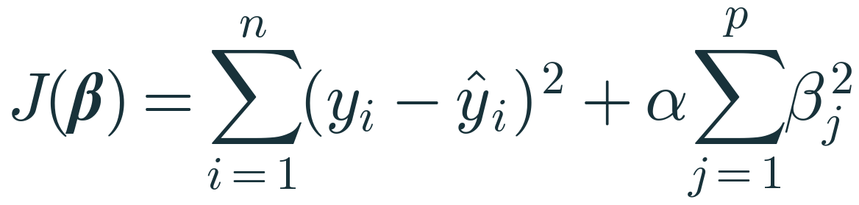
Ridge regression — L2 penalty (introduction)
MATHEMATICS
SSE term
fit to the data, exactly as in OLS
Penalty αΣβⱼ²
grows with the squared size of every coefficient
α ≥ 0
α = 0 → OLS; larger α → stronger shrinkage towards 0 (rarely exactly 0)
Conventions
intercept not penalised (j starts at 1); scale features first, or units decide who is penalised
Notes:
EXPLAIN: Our classroom convention: SSE + α·Σβⱼ² over j = 1…p, intercept excluded. scikit-learn's Ridge uses the same form (‖y − Xβ‖² + α‖β‖²). Full matrix derivation (β = (XᵀX + αI)⁻¹Xᵀy) is next session.
HOW TO INTRODUCE: Emphasise: the penalty depends on coefficient size, which depends on feature units — hence StandardScaler inside a Pipeline.
WHY IT IS VALID: Penalising the intercept would make predictions depend on where y's origin is, which is arbitrary.
LIKELY CONFUSION: Students think Ridge removes features. L2 shrinks but almost never gives exact zeros.
ASK: What does Ridge become when α = 0? When α → ∞?
EXPECTED RESPONSES: OLS; all slopes → 0 (predict the mean).
TIME: 4 min
TRANSITION: See α change the preferred model.

Slide 57
Worked example 4 · the penalty changes which model wins
MANUAL CALC
Candidate | β = (β₁, β₂) | SSE | Σβⱼ² | Ridge J, α = 0 | Ridge J, α = 1
A | (4, −3) | 10 | 16 + 9 = 25 | 10 | 35
B | (1.5, 1) | 14 | 2.25 + 1 = 3.25 | 14 | 17.25
C | (2, 0) | 15 | 4 | 15 | 19
With α = 0 the best fit (A) wins. With α = 1 the small-coefficient model B wins, despite fitting the training data worse. Values are illustrative SSEs for one dataset.
Notes:
EXPLAIN: Compute together: A's penalty 25 makes J = 35; B's 3.25 gives 17.25. Ask at what α A and B tie: 10 + 25α = 14 + 3.25α → α = 4/21.75 ≈ 0.18.
HOW TO INTRODUCE: Students compute the last column in pairs.
WHY IT IS VALID: Any candidate's J is SSE + α × penalty; changing α re-weights the two goals.
LIKELY CONFUSION: The 'winner' at α = 1 has higher training error — that is the point.
ASK: For which α do A and B tie?
EXPECTED RESPONSES: α ≈ 0.18.
TIME: 4 min
TRANSITION: Lasso.

Slide 58
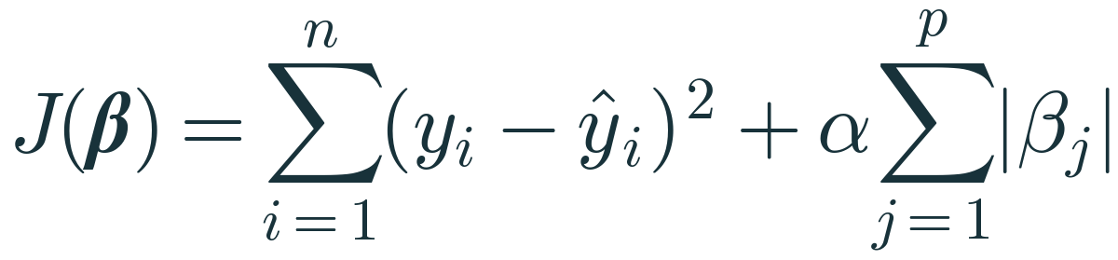
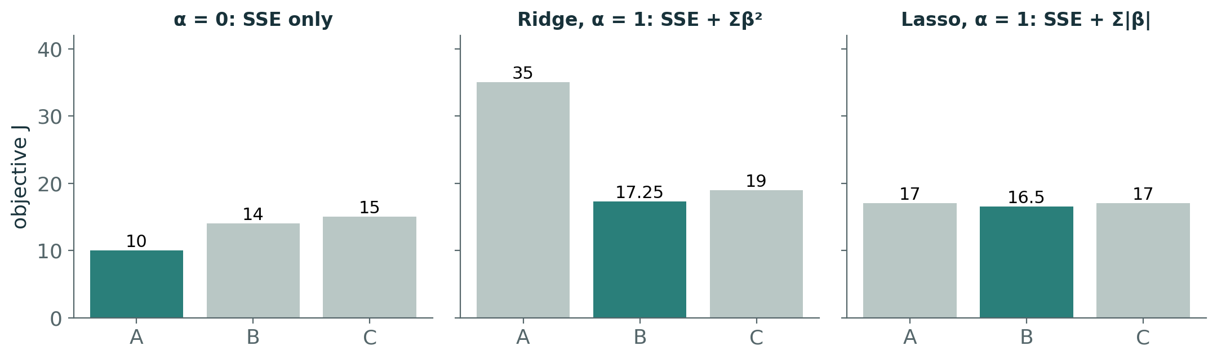
Lasso regression — L1 penalty (introduction)
MATHEMATICS
Penalty α Σ|βⱼ|
absolute values instead of squares
Same candidates, α = 1
A: 10 + 7 = 17 B: 14 + 2.5 = 16.5 C: 15 + 2 = 17
Sparsity
L1 can push coefficients exactly to 0 → built-in feature selection
Caveat
with correlated features Lasso may keep one arbitrarily and drop the others
Notes:
EXPLAIN: L1 penalty totals: A 4 + 3 = 7, B 1.5 + 1 = 2.5, C 2 + 0 = 2. Notice how L1 is kinder to C (which has a zero coefficient) than L2 relative to B: C's penalty is 2 under L1 but 4 under L2.
HOW TO INTRODUCE: Ask why a coefficient of exactly 0 is 'cheap' under L1.
WHY IT IS VALID: The L1 penalty's slope stays ±α right down to 0, so shrinking a small coefficient keeps paying off until it hits zero. The L2 penalty's slope 2αβ vanishes near 0, so it stops pushing.
LIKELY CONFUSION: Whether a coefficient becomes zero depends on the data and α — not guaranteed.
ASK: Which penalty would you pick to find which of 200 features matter?
EXPECTED RESPONSES: Lasso (L1).
TIME: 4 min
TRANSITION: Geometry of the difference.

Slide 59
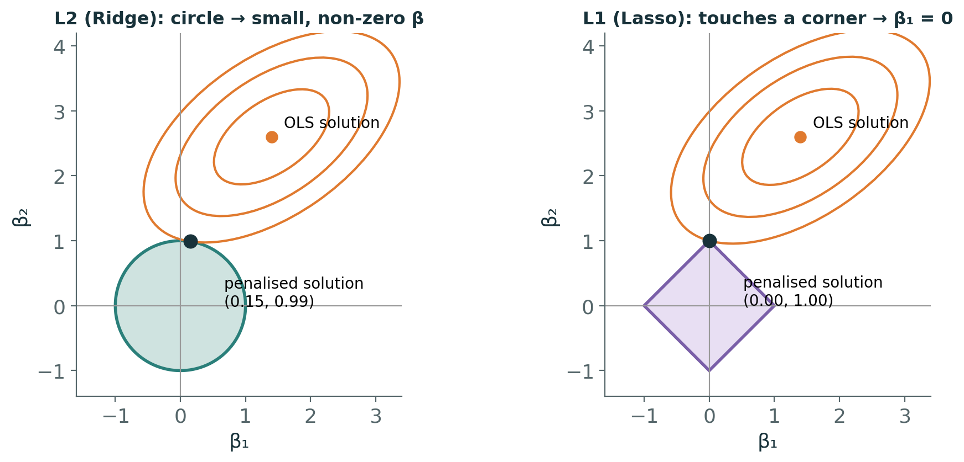
Why L1 gives zeros and L2 does not
VISUAL
Orange ellipses: equal-SSE contours around the OLS solution
The penalty keeps β inside a budget region: circle (L2) or diamond (L1)
The solution is where the smallest ellipse first touches the region — corners of the diamond lie on the axes
Notes:
EXPLAIN: Equivalent constrained view: minimise SSE subject to Σβⱼ² ≤ t (circle) or Σ|βⱼ| ≤ t (diamond). The first contact point between expanding ellipses and the region is the solution. Diamonds have corners on the axes, so contact often happens at a corner → one coefficient exactly 0.
HOW TO INTRODUCE: Trace the ellipses growing from the OLS point until they touch the shape.
WHY IT IS VALID: Penalised and constrained forms are equivalent (Lagrange multipliers) for a matching pair (α, t).
LIKELY CONFUSION: The picture is 2-D; in high dimensions the L1 region has many more corners and edges, so sparsity is common.
ASK: On the circle, can the touching point lie exactly on an axis?
EXPECTED RESPONSES: Only by coincidence.
TIME: 3 min
TRANSITION: Coefficient paths on real data.

Slide 60
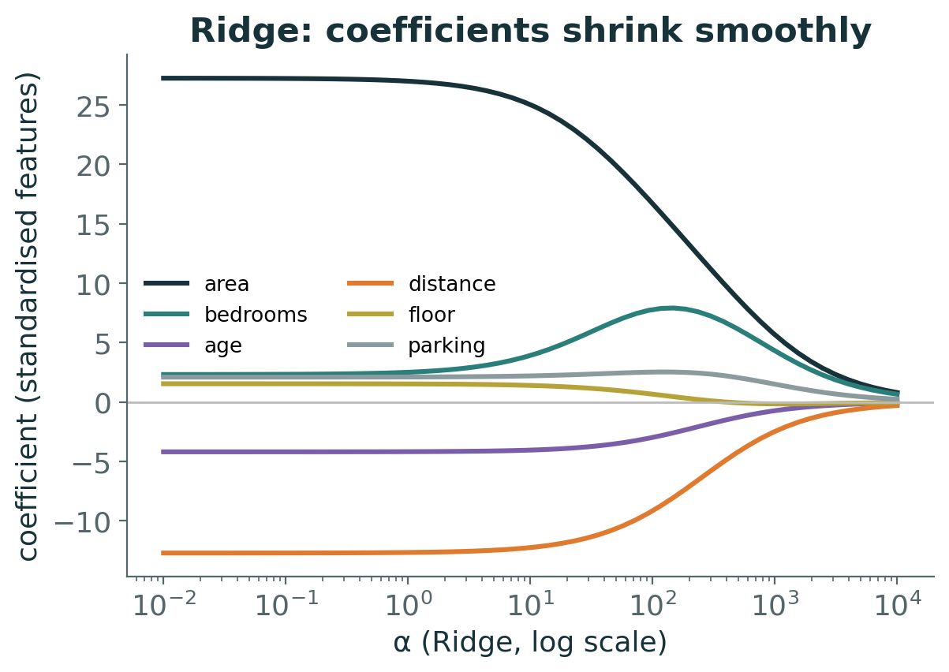
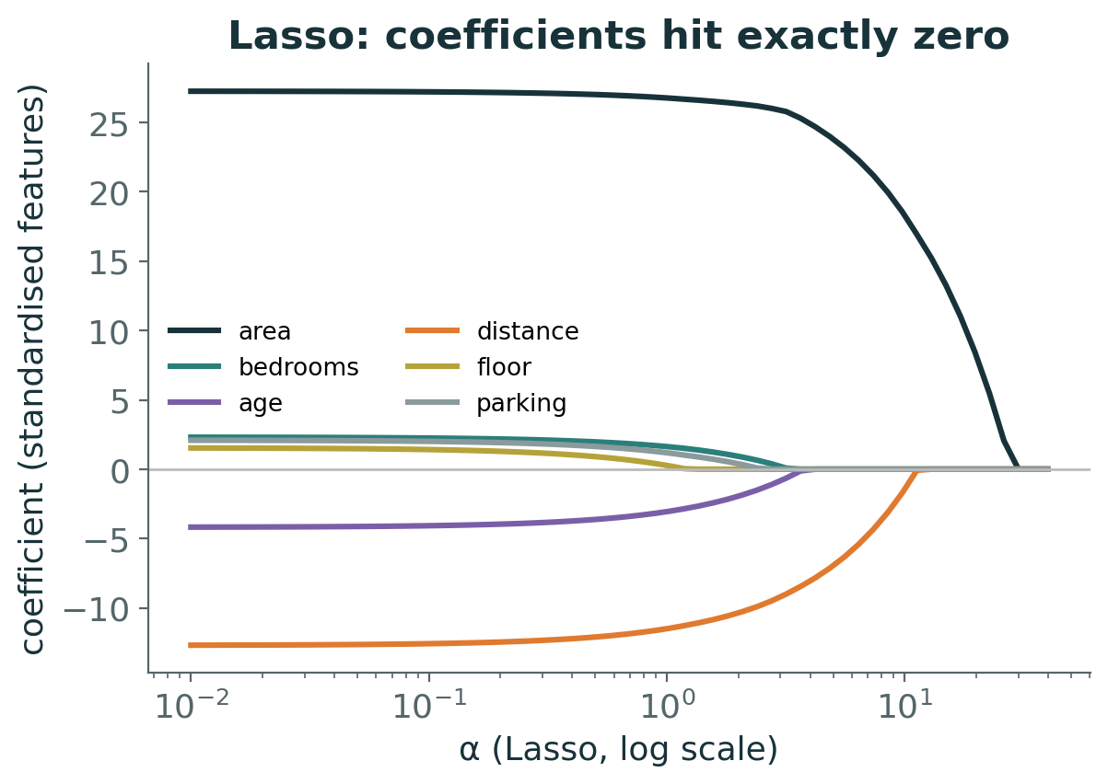
Coefficient paths on the house data
EXPERIMENT
Standardised features. As α grows, Ridge shrinks all coefficients smoothly; Lasso drops floor_number first, then others. scikit-learn's Ridge and Lasso scale their objectives differently, so the two α axes are not comparable.
Notes:
EXPLAIN: Left: Ridge — all coefficients shrink towards zero together; bedrooms even rises briefly as area shrinks (correlated features share credit). Right: Lasso — coefficients hit exactly zero one after another; distance and area survive longest.
HOW TO INTRODUCE: Ask: 'If you had to keep only two features, which would Lasso tell you?'
LIKELY CONFUSION: The x-axes differ because scikit-learn's Lasso objective is (1/2n)‖y − Xβ‖² + α‖β‖₁ while Ridge is ‖y − Xβ‖² + α‖β‖².
ASK: Which feature does Lasso remove first?
EXPECTED RESPONSES: floor_number (weakest effect).
MISCONCEPTION TO ADDRESS: 'The same alpha means the same strength for Ridge and Lasso' — false.
TIME: 3 min
TRANSITION: Side-by-side comparison.

Slide 61
Linear vs Ridge vs Lasso
PYTHON
Linear (OLS)
Ridge (L2)
Lasso (L1)
Objective: SSE
No penalty, no α
Unbiased coefficients; can have high variance
Coefficients on house data (std.): area 28.1, bedrooms 2.0, floor 1.4
SSE + α Σβ²
Shrinks all, rarely to 0
Handles correlated features by sharing weight
α = 10: area 25.2, bedrooms 4.1, floor 1.3
(1/2n)·SSE + α Σ|β| in sklearn
Can set coefficients to exactly 0
Feature selection; unstable with correlated groups
α = 1.5: area 27.6, bedrooms 0.8, floor 0.0
make_pipeline(StandardScaler(), Ridge(alpha=10)) # scaler is fitted on training data only
Notes:
EXPLAIN: Numbers from Lab A10 (train split, standardised features). Note how Ridge moved weight from area to its correlated partner bedrooms, while Lasso shrank bedrooms and zeroed floor.
HOW TO INTRODUCE: Ask which model they would use if interpretability with few features mattered.
LIKELY CONFUSION: On this dataset, cross-validation prefers almost no regularisation (6 features, 240 rows). Regularisation shines when models are flexible or p is large — e.g. degree-15 + Ridge on 25 trips: unseen MSE 3,770 → 1.2.
ASK: Why must the scaler be inside the pipeline?
EXPECTED RESPONSES: So cross-validation and test evaluation do not leak statistics from validation/test rows.
TIME: 4 min
TRANSITION: Final knowledge check.

Slide 62
Knowledge check · Hour 4
CHECK
1. Why do Ridge coefficients usually get smaller as α increases?
2. A Lasso model sets the coefficient of 'parking' to exactly 0. Does that prove parking has no effect on price?
3. Why should you not compare Ridge(alpha=1) and Lasso(alpha=1) as 'equally strong'?
Discuss first — answer is in the speaker notes
Notes:
EXPLAIN: Individual, 4 minutes; then cold-call.
TIME: 5 min
TRANSITION: Lunch, then labs.
ANSWER (reveal after discussion): 1. The penalty α·Σβ² grows with coefficient size; as α rises, smaller coefficients minimise SSE + penalty even though SSE increases. 2. No — it means that at this α the fit improvement from parking did not outweigh its penalty; with correlated features or another α it might be kept. 3. scikit-learn scales the two objectives differently (Lasso divides the squared error by 2n), so the same α number is a different strength.

Slide 63
5–7
HOURS 5–7 · 14:00–17:15
Labs, Challenge and Assessment
From derivation to a model you can defend
Notes:
EXPLAIN: After lunch: two guided lab hours and an independent challenge hour.
TIME: 30 s
TRANSITION: Lab 1 brief.

Slide 64
Guided Lab 1 · Simple and Multiple Regression (Hour 5)
LAB 1
A1
Load house data; identify features and target; spot target leakage
A2
Single split (20% test, random_state 42); fit area-only model; plot it
A3
Interpret slope and intercept with units; predict 1,200 sq ft by hand
A4
Manual OLS on the 5 deliveries; verify with scikit-learn and lstsq
A5
Complete gradient-descent functions; reproduce J = 7.5 → 1.5098 → 0.3217
A6
Write your own metric function; outlier experiment; evaluate on test set
A7
Fit all six features; coefficient table; adjusted R²; one manual prediction
Notebook: 04_PML_Regression_Student_Exercises.ipynb · Guide: 07_PML_Regression_Student_Lab_Guide.docx
Notes:
EXPLAIN: Timing: A1–A3 15 min, A4 10 min, A5 15 min, A6–A7 15 min, 5 min debrief. Walk the room; the most common blockers are 2-D X shapes and the gradient sign.
HOW TO INTRODUCE: Show where the TODO cells are.
ASK: Check-in at 14:30: who has reproduced J = 1.5098?
TIME: 60 min
TRANSITION: Lab 2.

Slide 65
Guided Lab 2 · Polynomial and Regularised (Hour 6)
LAB 2
A8
Build [x, x²] by hand, confirm with PolynomialFeatures; compare degrees 1, 2, 3, 15
A9
5-fold CV over degrees 1–15 on training data; pick degree; test once; resampling variance demo
A10
Linear vs Ridge vs Lasso coefficients in a scaled Pipeline; choose α by CV; rescue degree 15
Rule of the lab: every comparison uses the same split, and the test set is touched only for the final chosen model.
Notes:
EXPLAIN: Timing: A8 20 min, A9 20 min, A10 15 min, debrief 5 min. In the debrief ask three students to state their chosen degree and the evidence.
LIKELY CONFUSION: Students may scale before splitting — catch this; it leaks test statistics.
TIME: 60 min
TRANSITION: Challenge.

Slide 66
Final challenge · predict delivery time (Hour 7, 60 min)
CHALLENGE
Data
delivery_time_challenge.csv — 260 synthetic orders, 5 features, target delivery_time_min
Build
inspect → split → baseline → metrics → interpret two coefficients
Improve
one justified alternative, compared by 5-fold CV RMSE on training data
Defend
test the final model once; discuss overfitting; one manual calculation
Marking: data prep 15 · implementation 20 · mathematics 20 · evaluation 20 · interpretation 15 · code quality 10 = 100
Notes:
EXPLAIN: Brief: 08_Final_Regression_Challenge.docx. Answer key and rubric: 09_Final_Challenge_Trainer_Key.docx. Do not hint at the traffic² effect; reward students who look at residuals or relationships before choosing an alternative.
TIME: 5 min brief + 50 min work + 5 min wrap-up
TRANSITION: Common misconceptions.

Slide 67
Common misconceptions — and the correct idea
REVIEW
Misconception | Correct idea
“Linear regression can only fit straight lines.” | It is linear in the coefficients; polynomial features give curves.
“LinearRegression trains with gradient descent.” | It solves least squares directly; GD is one alternative optimiser.
“Lowest training error = best model.” | Choose by validation / CV error; training error always favours complexity.
“A bigger coefficient means a more important feature.” | Only comparable after scaling — and importance ≠ causation.
“R² is between 0 and 1.” | On held-out data R² can be negative.
“Lasso’s zero proves a feature is useless.” | It reflects this α and these data; correlated features can swap.
Notes:
EXPLAIN: Use as a quick-fire quiz: read the left column, students shout the correction.
TIME: 4 min
TRANSITION: Summary.

Slide 68
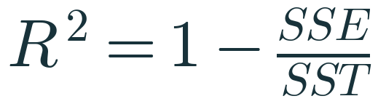
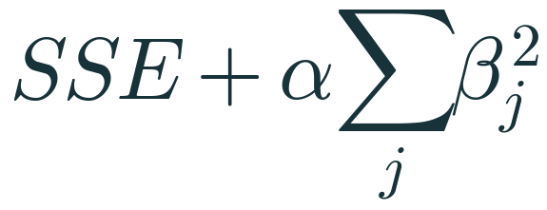

One-page formula sheet
SUMMARY
Simple line
OLS slope
OLS intercept
GD update
RMSE
R²
Ridge (classroom form)
Lasso (classroom form)
Notes:
EXPLAIN: Ask students to photograph this slide. Each formula should now come with a story: what it minimises or measures, and why.
ASK: Pick any formula and explain one term to your neighbour.
TIME: 3 min
TRANSITION: What comes next.

Slide 69
WHAT COMES NEXT
Next session
1
Ridge and Lasso: full derivations, closed form for Ridge, coordinate descent for Lasso
2
Elastic Net: combining L1 and L2
3
Feature selection approaches (including stepwise methods)
4
Logistic Regression — a classification method despite its name — and classification metrics
References: scikit-learn User Guide (linear models, model evaluation); Hastie, Tibshirani & Friedman, The Elements of Statistical Learning; CampusX ‘100 Days of ML’ used only as a topic-coverage checklist. Full list: 07_Supporting_Files/References.md
Notes:
EXPLAIN: Close the loop: return to the confidence ratings from the morning.
ASK: Which objective are you now most confident about?
TIME: 3 min

