Slide 1
PRACTICAL MACHINE LEARNING
Regression, From the Ground Up
Practical Machine Learning · Linear, Polynomial and Regularised Regression
CDAC Kharghar, Mumbai · PML · 26 October 2026 · 7 instructional hours
Student edition — worked examples included; in-class challenge answers are discussed live
Notes:
Revision note: Today's theme: understand the mathematics behind regression — derive it, compute it by hand, then verify it in Python.

Slide 2
Seven hours, one storyline
ROADMAP
Hour | Topic | You will be able to…
1 | Simple Linear Regression | read slope, intercept and residuals; compute a best-fit line by hand
2 | OLS and Gradient Descent | derive the OLS formulas; run gradient-descent updates manually
3 | Evaluation + Multiple Regression | compute MAE, MSE, RMSE, R²; interpret several coefficients
4 | Polynomial + Regularisation | explain over/underfitting, bias–variance, Ridge and Lasso penalties
5 | Guided Lab 1 | build simple and multiple regression models (A1–A7)
6 | Guided Lab 2 | compare polynomial degrees and regularised models (A8–A10)
7 | Challenge + Assessment | build, evaluate and defend a model independently (A11)
Hours 1–4 are theory with short live demos; hours 5–7 are hands-on. Breaks are not counted in the 7 hours.
Notes:
Revision note: The day moves from one straight line, to finding the best line, to judging it, to many inputs, to curves, to controlling flexible models.

Slide 3
By the end of today you can…
GOALS
Explain
what problem each regression method solves, and what its equation means term by term
Derive
the least-squares slope and intercept, and the gradient-descent update rules
Calculate
a fitted line, residuals, gradient steps, error metrics and penalties by hand
Connect
each calculation to its NumPy / scikit-learn implementation
Interpret
coefficients, predictions and metrics in the units of the problem
Judge
when a model underfits or overfits, and how regularisation helps
Notes:
Revision note: Six skills: explain, derive, calculate, connect to code, interpret, judge model fit.

Slide 4
How every topic will unfold
METHOD
1
2
3
4
5
6
7
8
9
Problem
Intuition
Visual
Mathematics
Manual calc
Optimisation
Python
Interpret
Challenge
We never show an equation before you have a reason to want it — and we never trust code before checking it against a hand calculation.
Notes:
Revision note: Each topic: Problem → Intuition → Visual → Mathematics → Manual calculation → Optimisation → Python → Interpretation → Challenge.

Slide 5
1
HOUR 1 · 09:00–10:00
Simple Linear Regression
One input, one output, one straight line

Slide 6
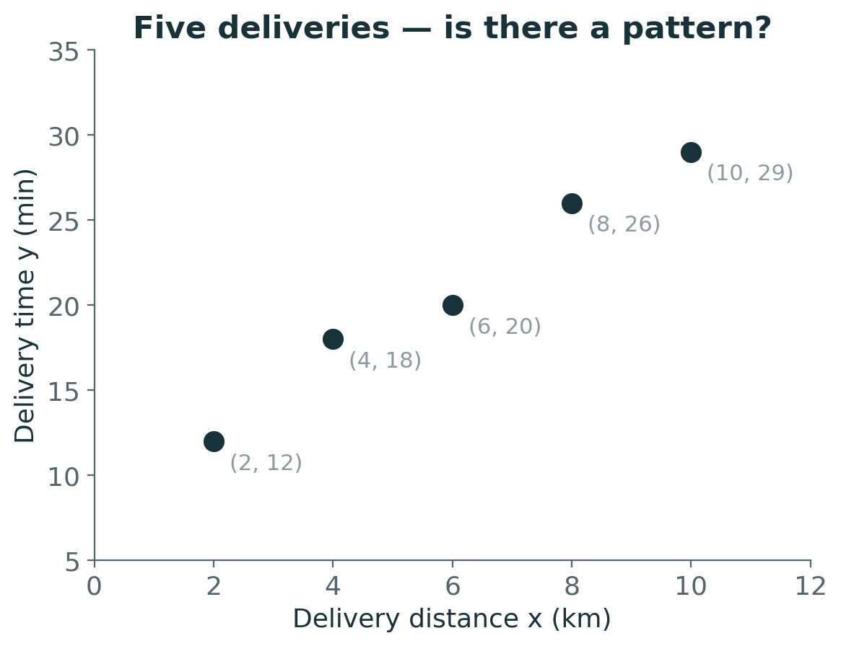
A food-delivery app wants to promise accurate times
PROBLEM
Five past deliveries: distance x (km) and time taken y (min)
Goal: predict y for a new order before it is dispatched
y is a continuous quantity → this is a regression problem
Look at the plot: what pattern do you see? Is it perfect?
Notes:
Revision note: Running example: 5 deliveries (2,12) (4,18) (6,20) (8,26) (10,29). Distance in km, time in minutes. Rising but not perfectly straight.

Slide 7
Pause and predict
PREDICT
Sketch one straight line through these five points by eye.
Where does your line cross x = 0, and how steep is it?
Use your line to predict the time for a 7 km delivery.
Work it out individually, then compare with a neighbour

Slide 8
What a regression model is
INTUITION
Target y
the continuous quantity we predict — delivery time in minutes
Feature x
the input we predict from — distance in km (independent variable)
Model ŷ = f(x)
a rule producing a prediction ŷ (‘y-hat’) for any x
Parameters
numbers inside f learned from data — today: slope and intercept
Dependent variable = y (it depends on x). Independent variable = x. The hat in ŷ always means ‘predicted’.
Notes:
Revision note: Regression predicts a continuous target y from features x. ŷ is the prediction; parameters are learned numbers inside the model.

Slide 9
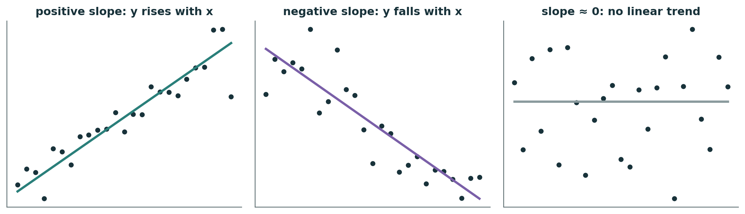
Relationships have a direction and a steepness
VISUAL
Positive slope: larger x → larger y (distance vs delivery time)
Negative slope: larger x → smaller y (age of house vs price)
Slope near 0: no linear trend — a straight line will not help much
Notes:
Revision note: Slope sign tells direction: positive, negative, or roughly zero (no linear trend).

Slide 10
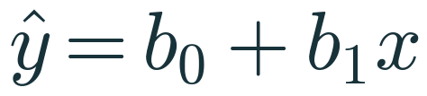
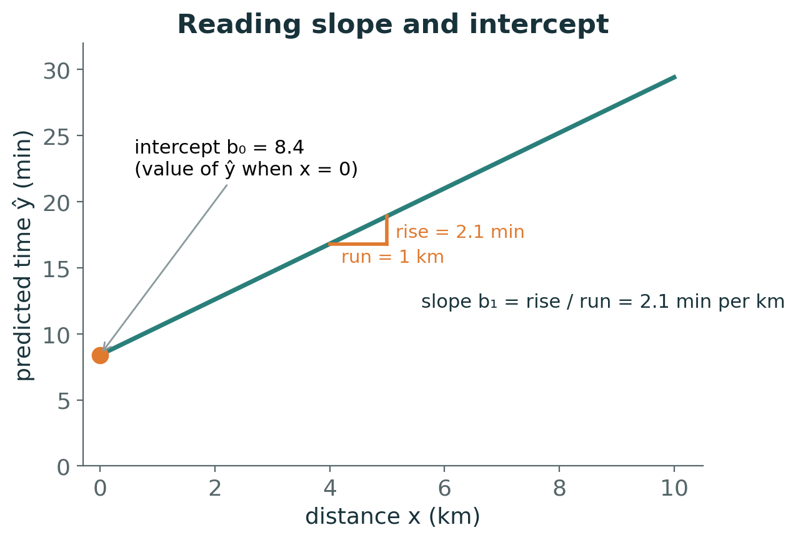
The equation of a straight line
MATHEMATICS
b₀ — intercept
predicted y when x = 0; units of y (min)
b₁ — slope
change in ŷ per 1-unit increase in x; units of y per unit of x (min per km)
Why this form?
the simplest rule that can rise or fall at a constant rate — two numbers describe it completely
Notes:
Revision note: ŷ = b₀ + b₁x. b₀ is the predicted value at x = 0; b₁ is the change in ŷ per unit increase in x, in units of y per unit x.

Slide 11
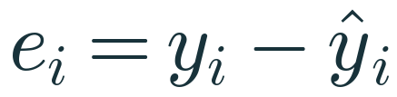
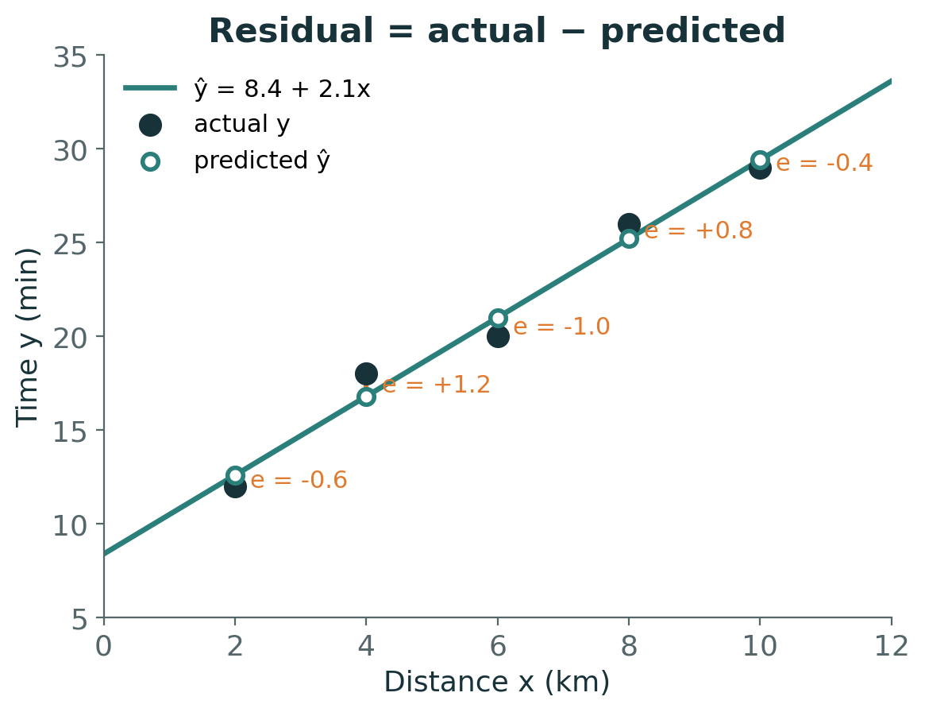
Residual: how far each point is from the line
VISUAL
Positive residual
the point lies above the line — the model under-predicted
Negative residual
the point lies below — the model over-predicted
Measured vertically
because the error is in y; we predict y from a known x
Notes:
Revision note: Residual eᵢ = yᵢ − ŷᵢ is the vertical gap from point to line. Positive = point above line (under-prediction).

Slide 12
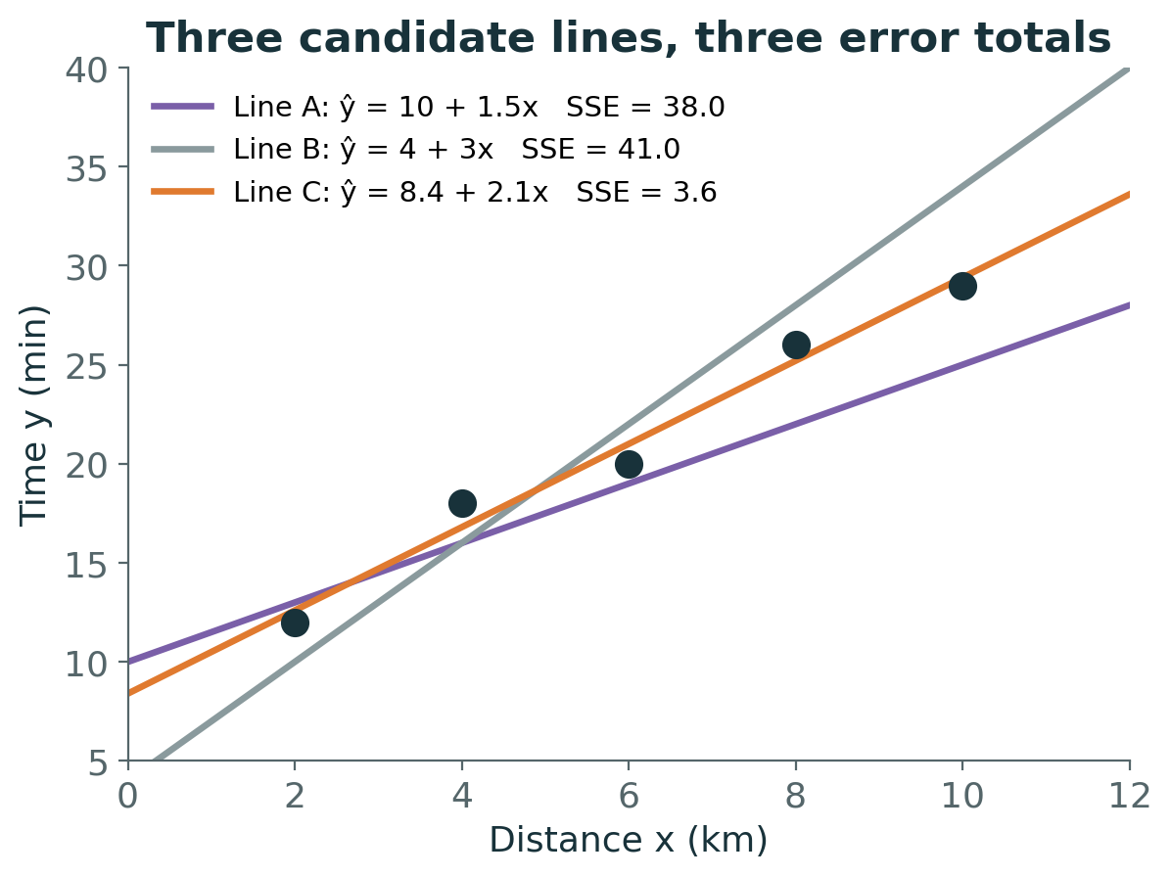
Many lines are possible — which one is best?
VISUAL
Each candidate line gives five residuals
Summarise them in one number: SSE = sum of squared residuals
Line A: SSE = 38.0 Line B: SSE = 41.0 Line C: SSE = 3.6
Least squares chooses the line with the smallest SSE → Line C
Notes:
Revision note: Score each candidate line by SSE = Σ(yᵢ − ŷᵢ)². Line A 38.0, Line B 41.0, Line C (ŷ = 8.4 + 2.1x) 3.6 — the least-squares line.

Slide 13
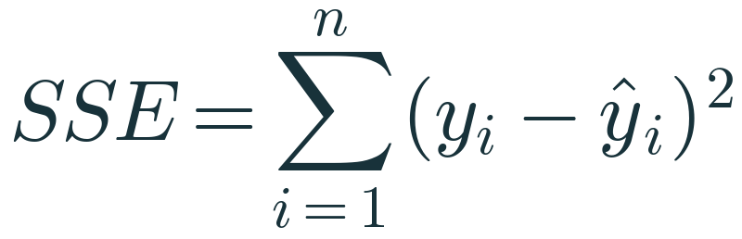
Why square the residuals?
MATHEMATICS
Signs would cancel
raw residuals +5 and −5 sum to 0, as if the line were perfect
Large misses cost more
a residual of 4 contributes 16; a residual of 1 contributes 1
Smooth to optimise
a squared function has a derivative everywhere — calculus can find its minimum
Limitation
one outlier with a huge residual can drag the whole line towards it
Notes:
Revision note: Squaring stops positive and negative errors cancelling, penalises big errors more, and gives a smooth function to minimise. Cost: outlier sensitivity.

Slide 14
Worked example 1 · deviations from the mean
MANUAL CALC
xᵢ (km) | yᵢ (min) | xᵢ − x̄ | yᵢ − ȳ | (xᵢ − x̄)(yᵢ − ȳ) | (xᵢ − x̄)²
2 | 12 | −4 | −9 | 36 | 16
4 | 18 | −2 | −3 | 6 | 4
6 | 20 | 0 | −1 | 0 | 0
8 | 26 | 2 | 5 | 10 | 4
10 | 29 | 4 | 8 | 32 | 16
x̄ = 6 | ȳ = 21 | Σ = 0 | Σ = 0 | Σ = 84 | Σ = 40
x̄ = (2+4+6+8+10)/5 = 30/5 = 6 ȳ = (12+18+20+26+29)/5 = 105/5 = 21
Notes:
Revision note: Means: x̄ = 6, ȳ = 21. Σ(x−x̄)(y−ȳ) = 84, Σ(x−x̄)² = 40. Deviation columns each sum to 0 (check).

Slide 15
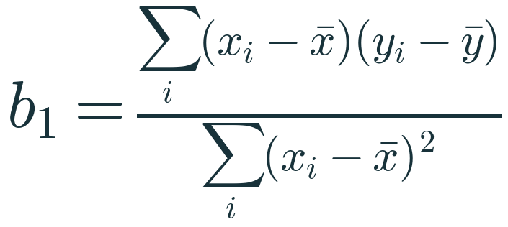
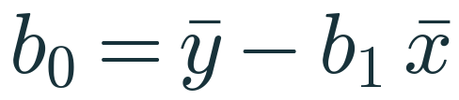
Worked example 1 · slope and intercept
MANUAL CALC
Slope
b₁ = 84 / 40 = 2.1 min per km
Intercept
b₀ = 21 − 2.1 × 6 = 21 − 12.6 = 8.4 min
Fitted line
ŷ = 8.4 + 2.1x
Prediction for 7 km
ŷ = 8.4 + 2.1 × 7 = 23.1 min
Notes:
Revision note: b₁ = 84/40 = 2.1 min/km; b₀ = 21 − 2.1×6 = 8.4 min. Line: ŷ = 8.4 + 2.1x. For 7 km: 23.1 min.

Slide 16
Worked example 1 · predictions and residuals
INTERPRET
xᵢ | yᵢ | ŷᵢ = 8.4 + 2.1xᵢ | eᵢ = yᵢ − ŷᵢ | eᵢ²
2 | 12 | 12.6 | −0.6 | 0.36
4 | 18 | 16.8 | +1.2 | 1.44
6 | 20 | 21.0 | −1.0 | 1.00
8 | 26 | 25.2 | +0.8 | 0.64
10 | 29 | 29.4 | −0.4 | 0.16
 |  |  | Σ = 0 | SSE = 3.6
Residuals of a least-squares line with an intercept always sum to 0. No other straight line gives SSE below 3.6 for these points.
Notes:
Revision note: Predictions 12.6, 16.8, 21.0, 25.2, 29.4; residuals −0.6, +1.2, −1.0, +0.8, −0.4 (sum 0); SSE = 3.6.

Slide 17
The same line in scikit-learn
PYTHON
import numpy as np
from sklearn.linear_model import LinearRegression
x = np.array([[2], [4], [6], [8], [10]]) # 2-D input
y = np.array([12, 18, 20, 26, 29])
model = LinearRegression() # b0, b1 still unknown
model.fit(x, y) # least-squares b0, b1
print(model.coef_) # [2.1] -> b1
print(model.intercept_) # 8.4 -> b0
print(model.predict([[7]])) # [23.1] -> ŷ at 7 km
fit() solves the least-squares problem — no loop, no learning rate
coef_ is an array: one slope per feature
intercept_ is b₀
predict() evaluates b₀ + b₁x
Output matches our hand calculation exactly
Notes:
Revision note: LinearRegression().fit(X, y) computes OLS directly. coef_ → slopes, intercept_ → b₀, predict() → ŷ. X must be 2-D.

Slide 18
Knowledge check · Hour 1
CHECK
A new dataset gives Σ(xᵢ − x̄)(yᵢ − ȳ) = −30, Σ(xᵢ − x̄)² = 15, x̄ = 4 and ȳ = 50.
1. Compute b₁ and b₀.
2. Interpret the sign of the slope.
3. Predict y when x = 6.
Work it out individually, then compare with a neighbour

Slide 19
2
HOUR 2 · 10:00–11:00
OLS and Gradient Descent
Two ways to find the bottom of the error bowl

Slide 20
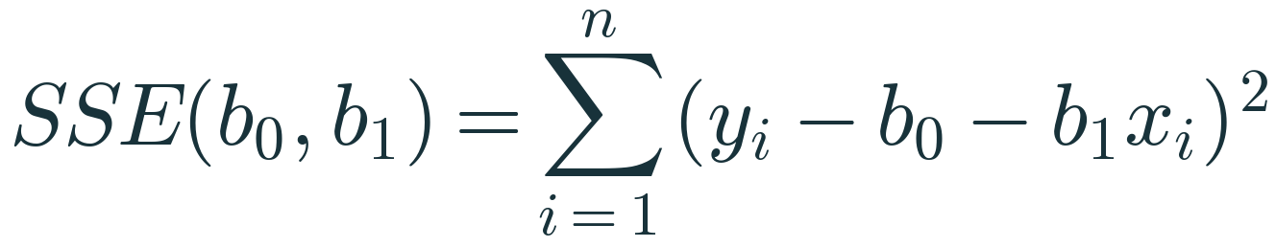
Ordinary Least Squares turns ‘best line’ into a minimisation
OPTIMISATION
The objective
SSE written as a function of the two unknowns b₀ and b₁ — the data are fixed numbers
The task
find the (b₀, b₁) that makes this function as small as possible
Shape of the function
a smooth bowl: squares of linear expressions → one lowest point (when the xᵢ are not all equal)
Notes:
Revision note: OLS: choose b₀, b₁ to minimise SSE(b₀, b₁) = Σ(yᵢ − b₀ − b₁xᵢ)². The data are constants; the parameters are the variables.

Slide 21
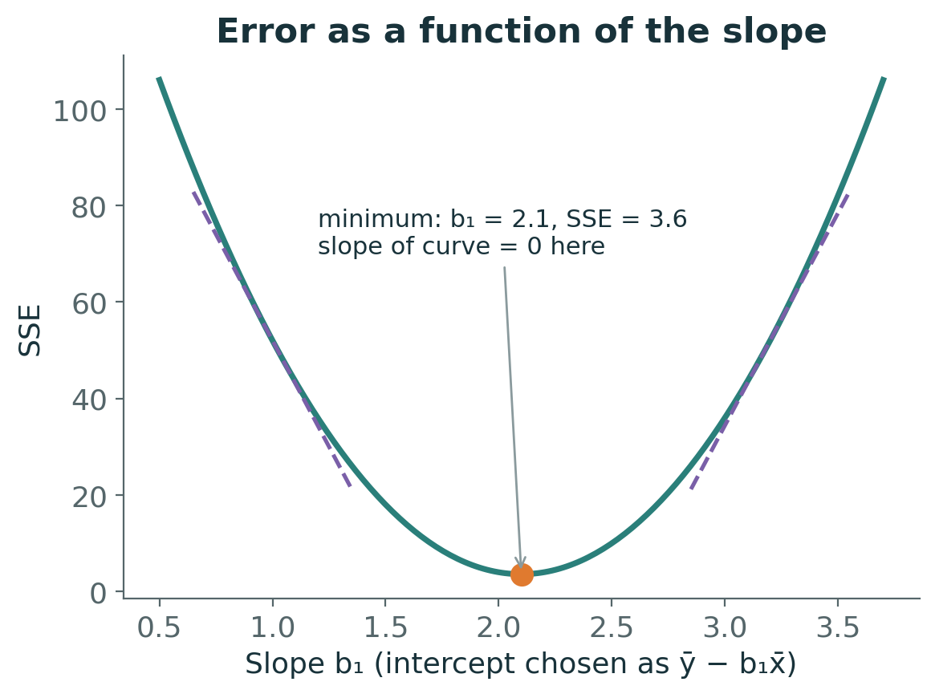
A derivative is the slope of a curve at a point
INTUITION
Fix b₀ = ȳ − b₁x̄ and vary only b₁: SSE traces a U-shaped curve
Dashed tangents: steep negative on the left, steep positive on the right
At the bottom the tangent is flat → derivative = 0
So: to minimise, set the derivative to zero and solve
Notes:
Revision note: Derivative = slope of the tangent. At the bottom of a smooth bowl the derivative is zero. SSE as a function of b₁ is minimised at b₁ = 2.1, SSE = 3.6.

Slide 22
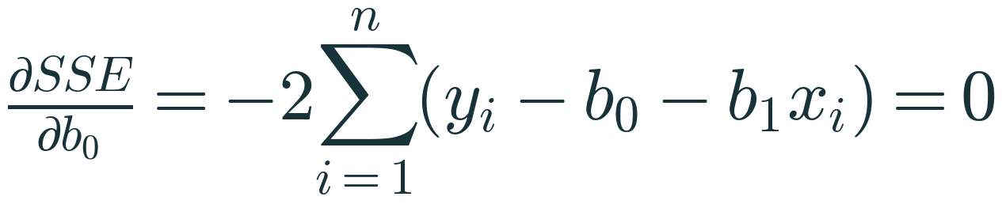
Derivation step A · differentiate with respect to b₀
MATHEMATICS
Chain rule
d/db₀ of (yᵢ − b₀ − b₁xᵢ)² = 2(yᵢ − b₀ − b₁xᵢ)·(−1)
Set to zero, divide by −2
Σyᵢ − n·b₀ − b₁Σxᵢ = 0
Divide by n
b₀ = ȳ − b₁x̄ : the line passes through (x̄, ȳ)
Bonus fact
Σ(yᵢ − ŷᵢ) = 0 — residuals sum to zero
Notes:
Revision note: ∂SSE/∂b₀ = −2Σ(yᵢ − b₀ − b₁xᵢ) = 0 ⇒ b₀ = ȳ − b₁x̄. The OLS line passes through (x̄, ȳ) and residuals sum to zero.

Slide 23
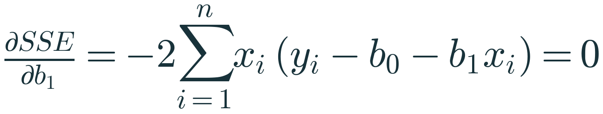
Derivation step B · differentiate with respect to b₁
MATHEMATICS
Substitute b₀
yᵢ − b₀ − b₁xᵢ = (yᵢ − ȳ) − b₁(xᵢ − x̄)
Condition becomes
Σxᵢ[(yᵢ − ȳ) − b₁(xᵢ − x̄)] = 0
Replace xᵢ by (xᵢ − x̄)
allowed because Σ(yᵢ − ȳ) = 0 and Σ(xᵢ − x̄) = 0, so x̄ times either sum vanishes
Solve
b₁ = Σ(xᵢ−x̄)(yᵢ−ȳ) / Σ(xᵢ−x̄)² — needs the xᵢ not all equal
Notes:
Revision note: ∂SSE/∂b₁ = 0 plus b₀ = ȳ − b₁x̄ gives b₁ = Σ(x−x̄)(y−ȳ)/Σ(x−x̄)². Requires x values that are not all identical.

Slide 24
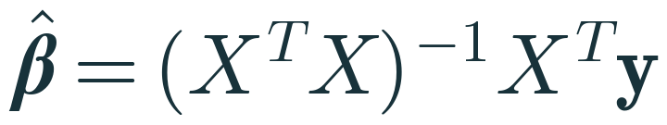
Matrix form: the same problem for any number of features
MATHEMATICS
Design matrix X
n rows (observations) × (p+1) columns: a column of 1s for the intercept, then one column per feature
Normal equations
setting all partial derivatives to zero gives (XᵀX)β = Xᵀy
Inverse needs full rank
XᵀX is invertible only if no feature is an exact linear combination of others (and n ≥ p+1)
In practice
libraries solve least squares with stable decompositions (QR / SVD) rather than computing the inverse
Notes:
Revision note: ŷ = Xβ with X: n×(p+1). Normal equations (XᵀX)β = Xᵀy. Inverse exists only with full column rank; software uses QR/SVD solvers.

Slide 25
If OLS has a formula, why learn Gradient Descent?
PROBLEM
No formula elsewhere
Lasso, logistic regression and neural networks have no closed-form solution
Scale
with millions of rows or features, step-by-step updates can be cheaper than solving the full system
Streaming data
parameters can be updated as new batches arrive
Foundation
the update rule you learn today is the core of how deep learning trains
Notes:
Revision note: Gradient descent is an optimisation method, not a model. It is needed when there is no closed form, for very large data, and in deep learning.

Slide 26
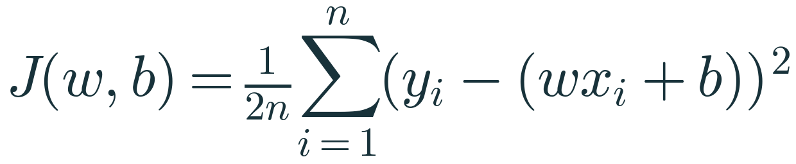
The cost function we will descend
MATHEMATICS
w and b
the same slope and intercept as b₁ and b₀ — ML notation: weight and bias
1/n
averages the squared error, so the cost does not grow just because n grows
1/2
cancels the 2 produced by differentiating a square — purely for neat gradients
Same minimiser
scaling SSE by a positive constant does not move its lowest point
Notes:
Revision note: J(w,b) = (1/2n)Σ(yᵢ − (wxᵢ + b))². 1/n averages; 1/2 tidies the derivative. Same minimiser as SSE.

Slide 27
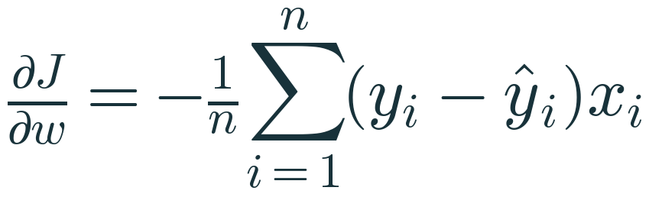
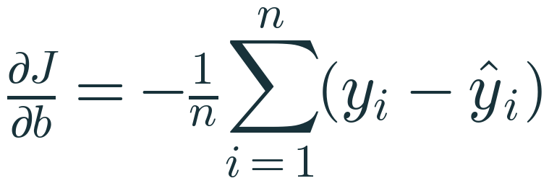
Deriving the gradients
MATHEMATICS
Chain rule for w
inside derivative w.r.t. w is −xᵢ
Chain rule for b
inside derivative w.r.t. b is −1
Gradient
the pair (∂J/∂w, ∂J/∂b) points in the direction of steepest increase of J
Notes:
Revision note: ∂J/∂w = −(1/n)Σ(yᵢ − ŷᵢ)xᵢ, ∂J/∂b = −(1/n)Σ(yᵢ − ŷᵢ). The gradient points uphill.

Slide 28
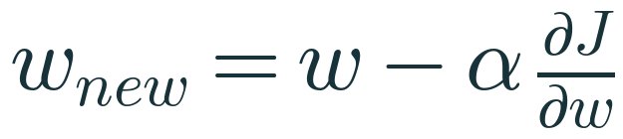
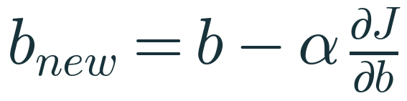
The update rule: step downhill, repeat
OPTIMISATION
Minus sign
the gradient points uphill, so we move the opposite way
α — learning rate
a hyperparameter you choose; controls step size
Simultaneous update
compute both gradients with the old w, b, then update both
Stop when
the cost stops changing meaningfully or after a fixed number of iterations
Notes:
Revision note: w ← w − α·∂J/∂w, b ← b − α·∂J/∂b. α is a hyperparameter. Update both using gradients from the old values.

Slide 29
Worked example 2 · first gradient-descent step
MANUAL CALC
Quantity | Calculation | Value
Data | x = [1, 2, 3], y = [2, 4, 5], start w = 0, b = 0, α = 0.1
Predictions ŷ | 0·x + 0 | [0, 0, 0]
Residuals y − ŷ |  | [2, 4, 5]
Cost J | (4 + 16 + 25) / (2·3) | 7.5000
∂J/∂w | −(2·1 + 4·2 + 5·3) / 3 = −25/3 | −8.3333
∂J/∂b | −(2 + 4 + 5) / 3 = −11/3 | −3.6667
w new | 0 − 0.1 × (−8.3333) | 0.8333
b new | 0 − 0.1 × (−3.6667) | 0.3667
Teaching data chosen so the arithmetic fits on a board. Exact OLS answer for this data: w = 1.5, b = 0.6667.
Notes:
Revision note: Iteration 0: J = 7.5, ∂J/∂w = −8.3333, ∂J/∂b = −3.6667 → w = 0.8333, b = 0.3667.

Slide 30
Worked example 2 · second step and the trend
MANUAL CALC
Iteration | w | b | ŷ | Residuals | Cost J | ∂J/∂w | ∂J/∂b
0 | 0.0000 | 0.0000 | 0, 0, 0 | 2, 4, 5 | 7.5000 | −8.3333 | −3.6667
1 | 0.8333 | 0.3667 | 1.2, 2.0333, 2.8667 | 0.8, 1.9667, 2.1333 | 1.5098 | −3.7111 | −1.6333
2 | 1.2044 | 0.5300 | 1.7344, 2.9389, 4.1433 | 0.2656, 1.0611, 0.8567 | 0.3217 | −1.6526 | −0.7278
… | → 1.5 | → 0.6667 |  |  | → 0.0278 | → 0 | → 0
Cost falls 7.5 → 1.51 → 0.32; gradients shrink as we approach the bottom, so steps automatically get smaller. Values rounded to 4 d.p.; verified in Python.
Notes:
Revision note: Iteration 1: J = 1.5098, w = 1.2044, b = 0.53 after update. Iteration 2: J = 0.3217. Converges to w = 1.5, b = 0.6667, J = 0.0278.

Slide 31
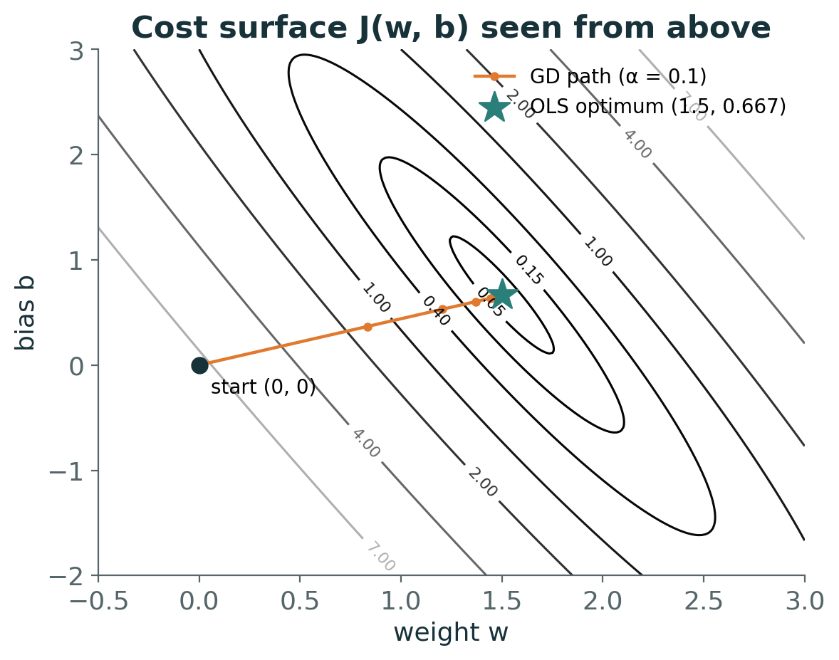
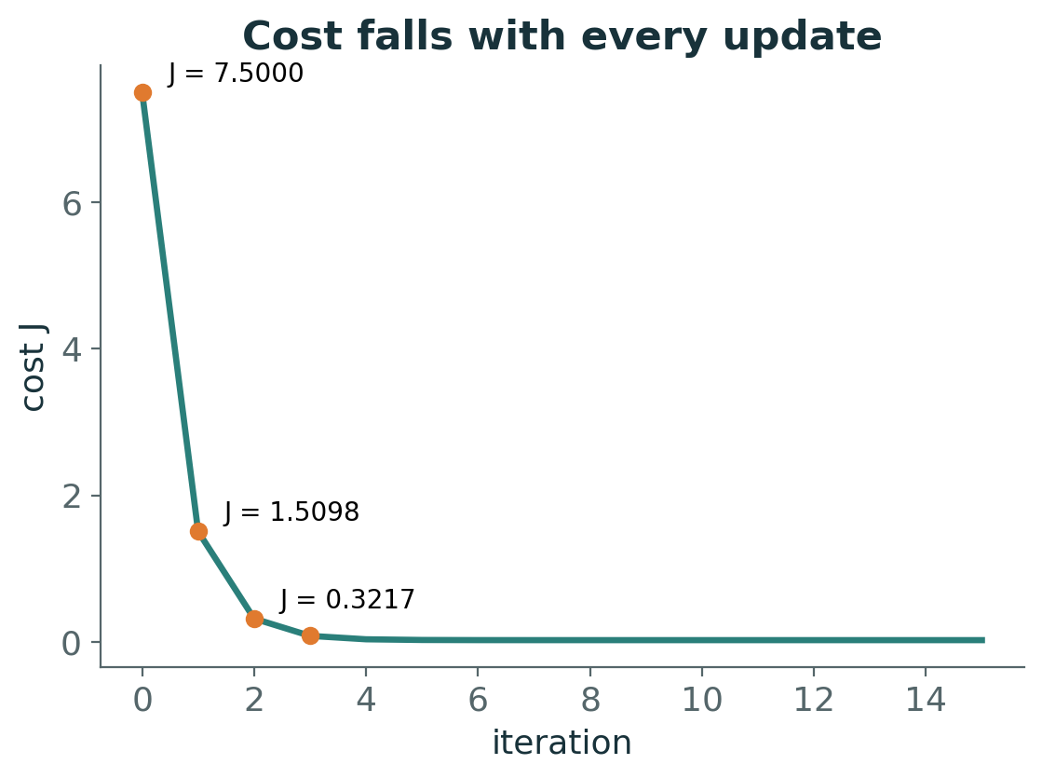
Watching gradient descent find the bottom
VISUAL
Left: contour lines of J(w, b) seen from above; each orange dot is one update, ending at the OLS optimum (star). Right: the cost after each iteration.
Notes:
Revision note: Contours = levels of the cost bowl. GD steps follow the local steepest descent and converge to the OLS solution (1.5, 0.667).

Slide 32
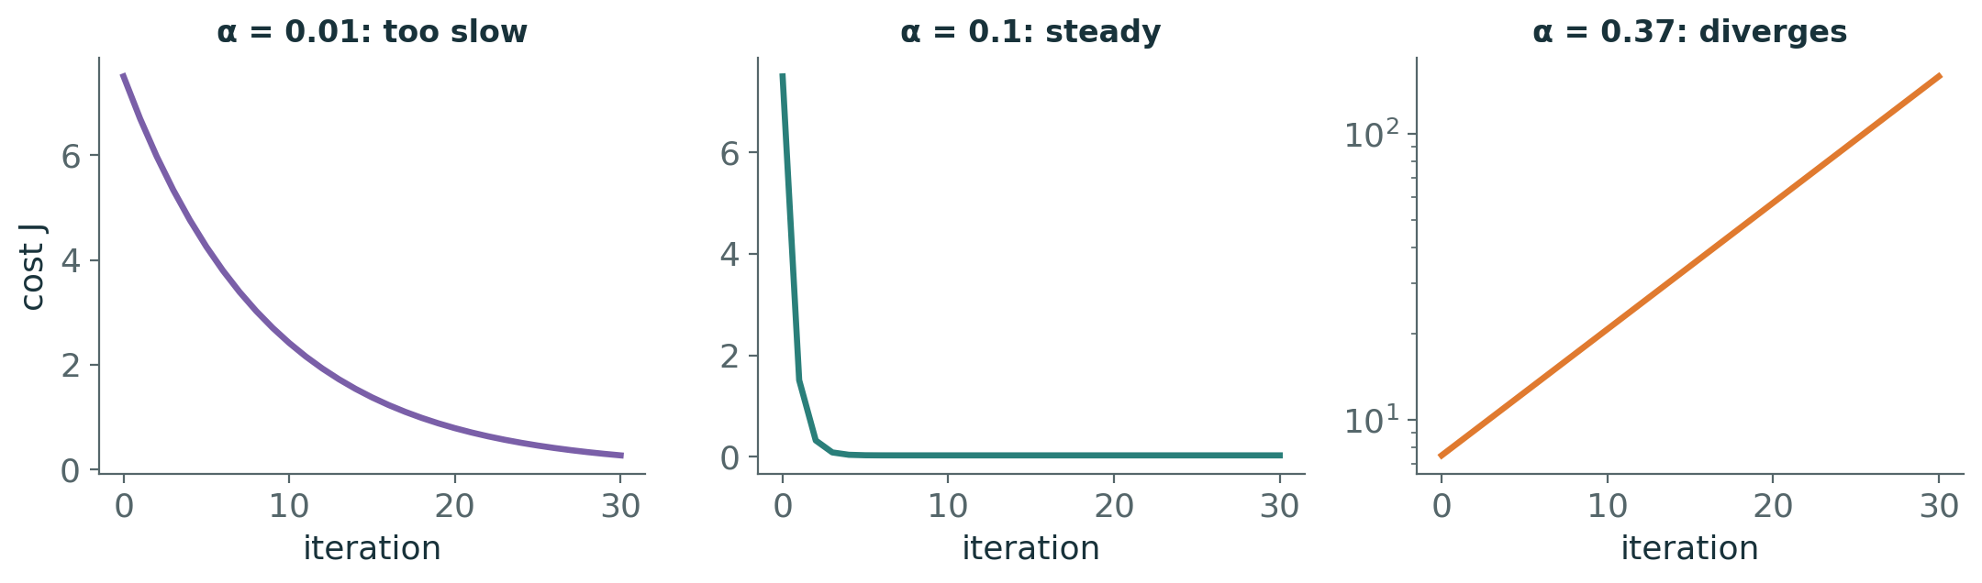
The learning rate decides everything
EXPERIMENT
α = 0.01: every step is safe but tiny — still far from the minimum after 30 steps
α = 0.1: steady decrease to the minimum
α = 0.37: each step overshoots further; cost explodes (note the log scale)
For this data, steps are stable only for α below about 0.36
Notes:
Revision note: Small α: slow. Moderate α: converges. Too large α (> ≈0.36 here): overshoots and diverges. Scale features to make GD easier.

Slide 33
Batch gradient descent in 12 lines of NumPy
PYTHON
def gradient_descent(x, y, alpha=0.1, iterations=200):
w, b, n = 0.0, 0.0, len(x)
for it in range(iterations):
y_hat = w * x + b
residuals = y - y_hat
dJ_dw = -np.sum(residuals * x) / n
dJ_db = -np.sum(residuals) / n
w = w - alpha * dJ_dw # both gradients used
b = b - alpha * dJ_db # the OLD w and b
return w, b
gradient_descent(np.array([1., 2, 3]), np.array([2., 4, 5]))
# -> (1.5002, 0.6662) vs OLS (1.5, 0.6667)
Every line maps to one equation from the previous slides
After 200 steps: within 0.001 of the exact OLS answer
LinearRegression does not run this loop — it solves least squares directly
scikit-learn's SGDRegressor is the gradient-based alternative
Notes:
Revision note: GD code mirrors the maths: predict → residuals → gradients → update. Result converges to OLS. LinearRegression itself does not use GD.

Slide 34
Knowledge check · Hour 2
CHECK
Current values: w = 1, b = 0, α = 0.05.
At this point ∂J/∂w = −4 and ∂J/∂b = 2.
1. Compute the updated w and b.
2. Explain in words why w increases while b decreases.
3. What would you expect if α were 50× larger?
Work it out individually, then compare with a neighbour

Slide 35
3
HOUR 3 · 11:15–12:15
Evaluation and Multiple Linear Regression
How good is the line — and what if one input is not enough?

Slide 36
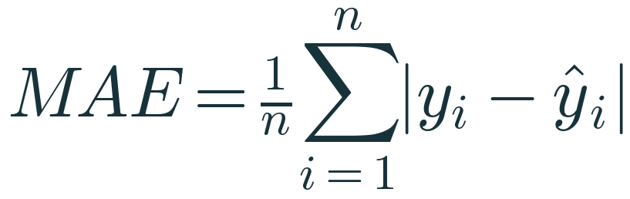
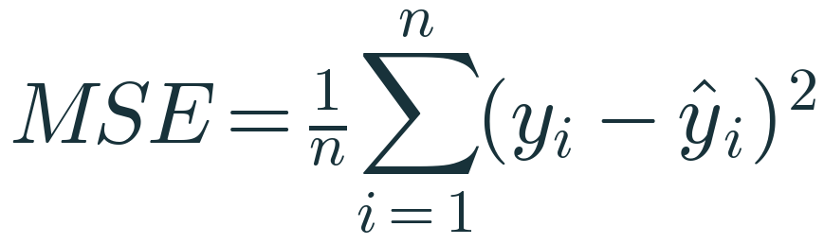
MAE and MSE on our five deliveries
MATHEMATICS
Residuals
−0.6, +1.2, −1.0, +0.8, −0.4
MAE
(0.6 + 1.2 + 1.0 + 0.8 + 0.4) / 5 = 4.0 / 5 = 0.80 min
MSE
(0.36 + 1.44 + 1.00 + 0.64 + 0.16) / 5 = 3.6 / 5 = 0.72 min²
Reading them
MAE: typical miss in minutes. MSE: squared units, used for optimisation and comparison
Notes:
Revision note: On the 5 training points: MAE = 0.80 min, MSE = 0.72 min² (= SSE/n). Teaching calculation, not a generalisation estimate.

Slide 37

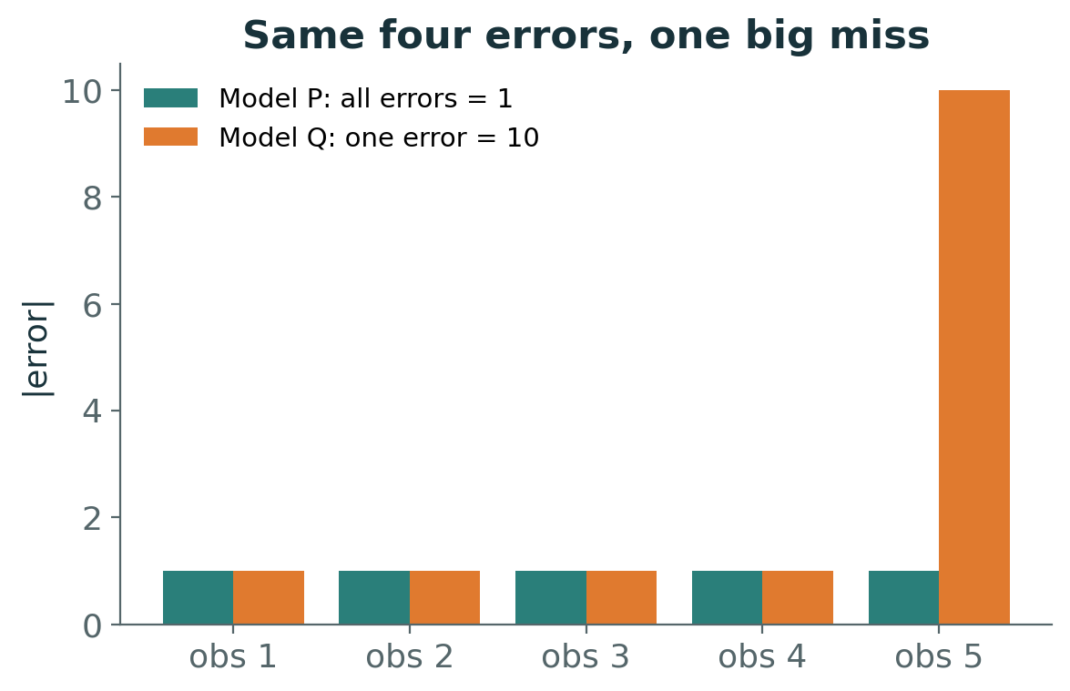
RMSE and why one big miss changes everything
INTERPRET
RMSE here
√0.72 = 0.849 min — back in the units of y
Model P vs Q
MAE 1.0 → 2.8; MSE 1.0 → 20.8; RMSE 1.0 → 4.56
Lesson
squared metrics punish large errors heavily; MAE is more robust to occasional big misses
Notes:
Revision note: RMSE = √MSE, in units of y. One error of 10 among four errors of 1: MAE 2.8, MSE 20.8, RMSE 4.56 — squared metrics are outlier-sensitive.

Slide 38
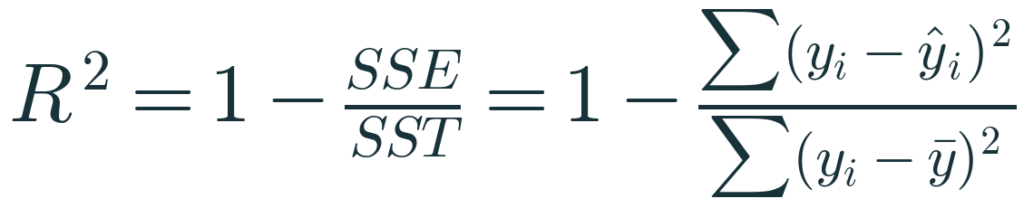
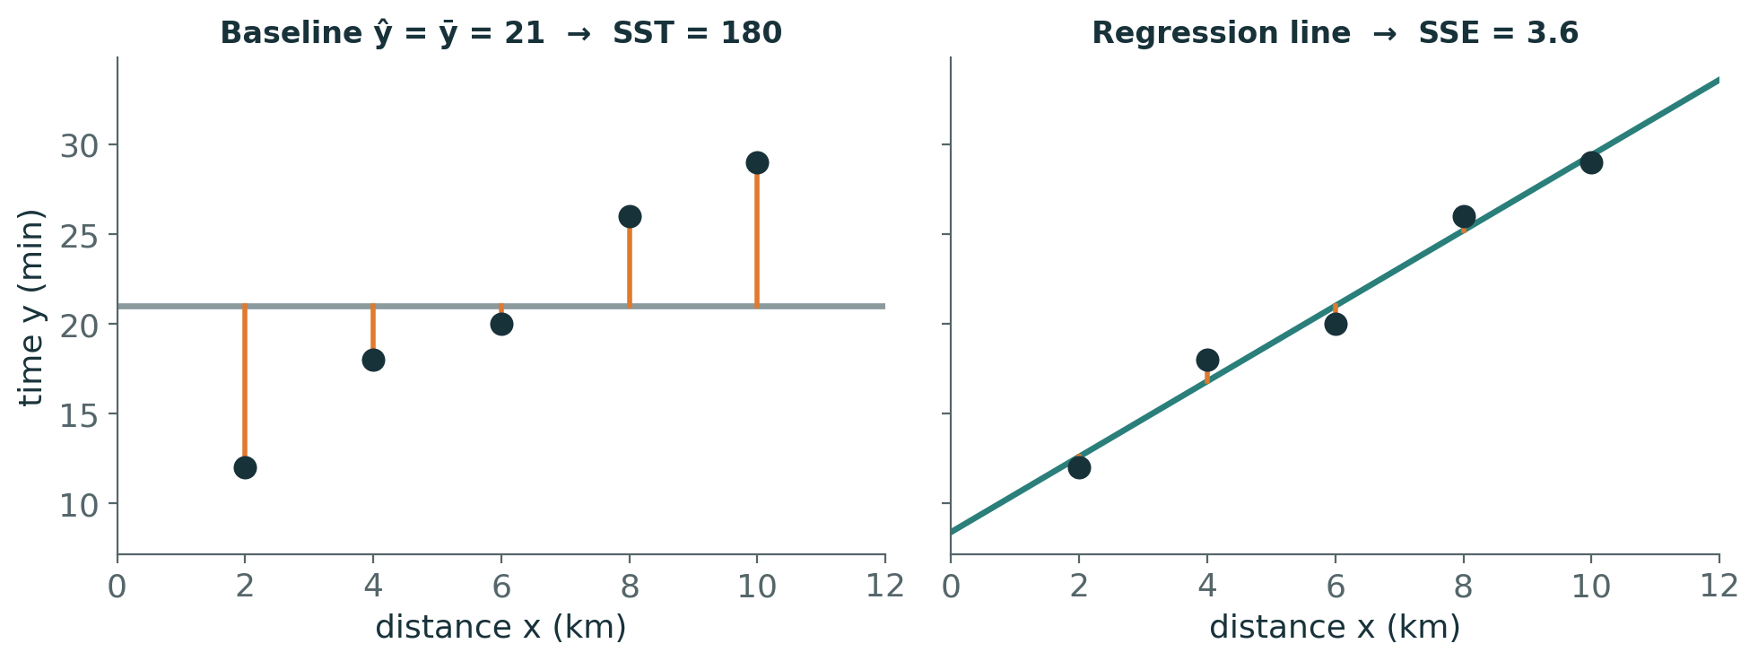
R²: how much better than predicting the mean?
MATHEMATICS
SST = 180
errors of the naïve model ŷ = ȳ = 21: 81 + 9 + 1 + 25 + 64
SSE = 3.6
errors left after the regression line
R² = 1 − 3.6/180 = 0.98
the line removes 98% of the squared error of the mean-only baseline
Can be negative
on new data, a model worse than the mean of those targets gets R² < 0
Notes:
Revision note: R² = 1 − SSE/SST. Here 1 − 3.6/180 = 0.98. R² can be negative on held-out data (worse than predicting the mean).

Slide 39
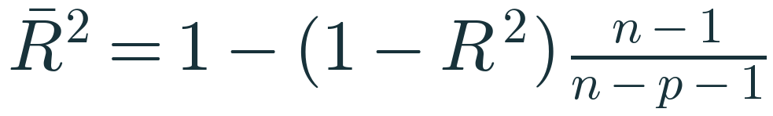
Adjusted R² — a small extension
MATHEMATICS
n, p
n = number of observations, p = number of predictors (not counting the intercept)
Our example
n = 5, p = 1: 1 − (1 − 0.98)·4/3 = 0.9733
Why adjust?
training R² never decreases when a feature is added — even pure noise
Defined only if
n − p − 1 > 0; it is a training-data diagnostic, not a substitute for test evaluation
Notes:
Revision note: Adjusted R² = 1 − (1 − R²)(n − 1)/(n − p − 1). Example: 0.9733. Penalises extra predictors; needs n − p − 1 > 0.

Slide 40
Metrics in scikit-learn — always on held-out data
PYTHON
from sklearn.model_selection import train_test_split
from sklearn.metrics import (mean_absolute_error,
mean_squared_error, r2_score)
X_train, X_test, y_train, y_test = train_test_split(
X, y, test_size=0.2, random_state=42)
model = LinearRegression().fit(X_train, y_train)
y_pred = model.predict(X_test) # unseen rows only
mae = mean_absolute_error(y_test, y_pred)
mse = mean_squared_error(y_test, y_pred)
rmse = np.sqrt(mse)
r2 = r2_score(y_test, y_pred) # (y_true, y_pred)
Training-set metrics measure fit; test-set metrics estimate performance on new data
Pass (y_true, y_pred) — r2_score is not symmetric
Use the same split for every model you compare
Our 5-point calculations were for arithmetic practice only
Notes:
Revision note: Split → fit on train → predict test → metrics(y_true, y_pred). Compare models on the same split.

Slide 41
Pause and reason
CHECK
Two models are evaluated on the same 100 test houses.
Model A: MAE = ₹4 lakh, RMSE = ₹5 lakh. Model B: MAE = ₹3.5 lakh, RMSE = ₹9 lakh.
1. What does the gap between MAE and RMSE tell you about Model B?
2. Which would you deploy for a bank that loses heavily on large mis-valuations?
Work it out individually, then compare with a neighbour

Slide 42
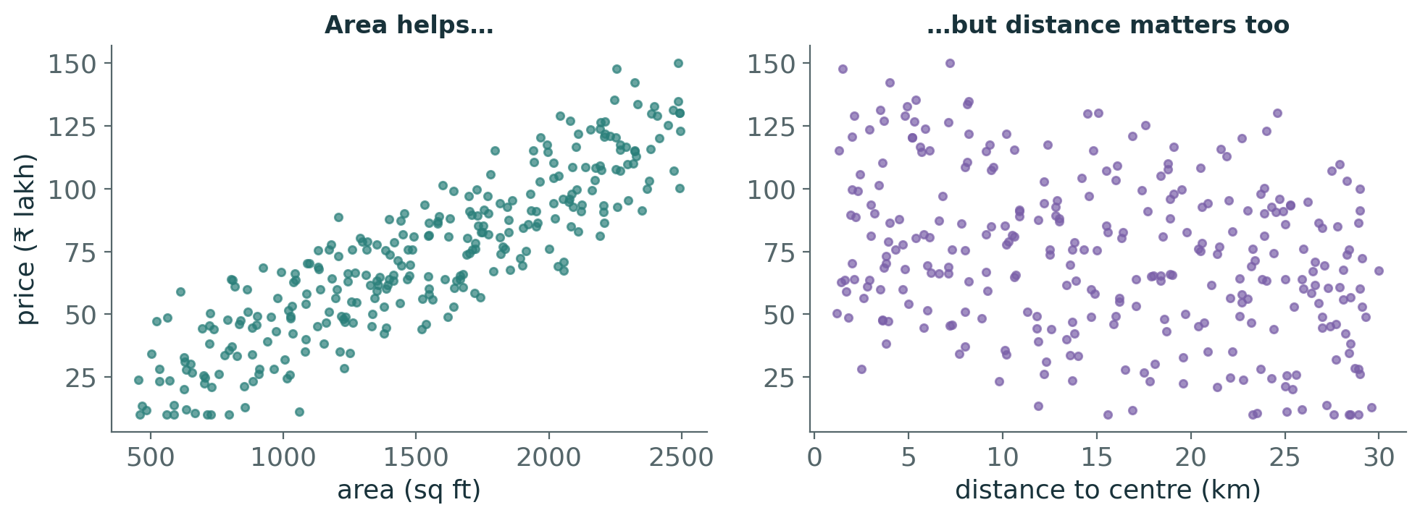
One feature is rarely enough
PROBLEM
House prices rise with area — but at the same area, central houses cost more
Area alone (Lab A2): test R² ≈ 0.74, RMSE ≈ ₹16 lakh
We need a model that combines several inputs at once
Notes:
Revision note: Price depends on several features simultaneously. Area alone leaves large errors (test R² ≈ 0.74).

Slide 43
Multiple Linear Regression
MATHEMATICS
One coefficient per feature
b₁ … bₚ, plus one intercept b₀
Holding others fixed
bⱼ = change in ŷ for +1 unit of xⱼ when all other features stay the same
Geometry
with 2 features the model is a flat plane; with p features, a hyperplane
Same learning rule
still minimise SSE — the matrix form from hour 2 does it for any p
Notes:
Revision note: ŷ = b₀ + b₁x₁ + … + bₚxₚ. Each bⱼ: change in ŷ per unit xⱼ with other features held fixed. Still fitted by least squares.

Slide 44
Worked example 3 · predict one house by hand
MANUAL CALC
Term | Coefficient (given) | Feature value | Contribution (₹ lakh)
Intercept b₀ | 20 | — | 20.0
Area (sq ft) | 0.045 per sq ft | 1,200 | +54.0
Bedrooms | 3 per bedroom | 2 | +6.0
Age (years) | −0.6 per year | 10 | −6.0
Distance (km) | −1.8 per km | 8 | −14.4
Predicted price ŷ |  |  | 59.6
Illustrative coefficients chosen for easy arithmetic. The lab model fitted to our data gives its own coefficients — compare in Lab A7.
Notes:
Revision note: ŷ = 20 + 0.045·1200 + 3·2 − 0.6·10 − 1.8·8 = 59.6 (₹ lakh).

Slide 45
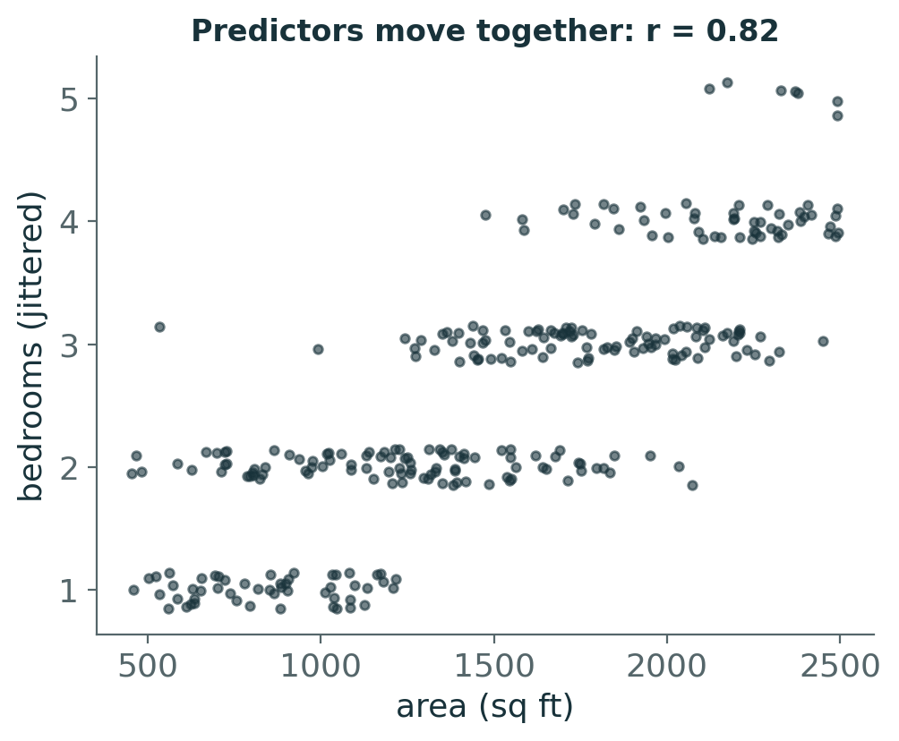
Reading coefficients responsibly
INTERPRET
Units differ → raw coefficient sizes are not comparable (per sq ft vs per bedroom)
Correlated predictors (area and bedrooms, r ≈ 0.82) — multicollinearity makes individual coefficients unstable
Predictions can stay good even when individual coefficients are unreliable
Correlation is not causation: adding a bedroom by partitioning a room need not raise the price by bⱼ
Notes:
Revision note: Don't compare raw coefficient magnitudes across units. Correlated predictors make coefficients unstable. Regression shows association, not causation.

Slide 46
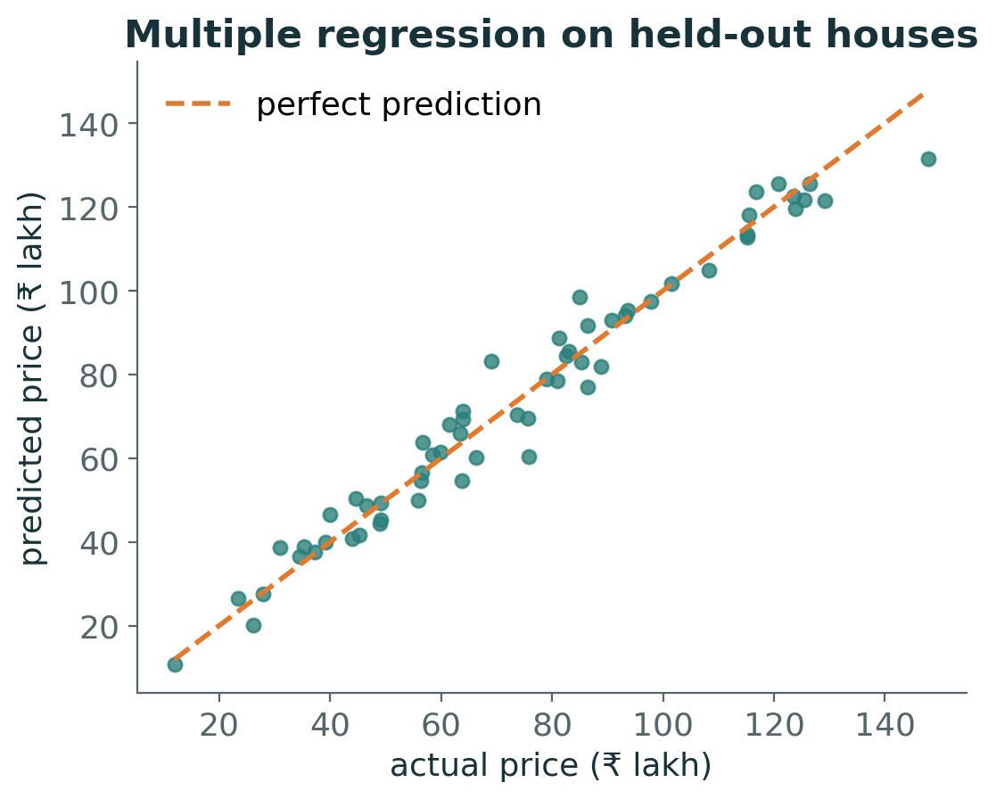
Multiple regression on the house data
PYTHON
FEATURES = ["area_sqft", "bedrooms",
"property_age_yrs", "distance_city_km",
"floor_number", "parking"]
mlr = LinearRegression()
mlr.fit(X_train[FEATURES], y_train)
pd.Series(mlr.coef_, index=FEATURES)
# area 0.050 bedrooms 1.93 age -0.38
# distance -1.46 floor 0.23 parking 4.07
# Same 60 test houses:
# area only : RMSE 16.1 R2 0.74
# 6 features: RMSE 5.8 R2 0.97
Notes:
Revision note: With 6 features on the same test split: RMSE ≈ ₹5.8 lakh, R² ≈ 0.97 (area only: RMSE ≈ ₹16.1 lakh, R² ≈ 0.74).

Slide 47
4
HOUR 4 · 12:15–13:15
Polynomial Regression and Regularisation
Flexible models, and how to keep them honest

Slide 48
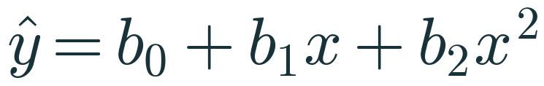
When the relationship bends
PROBLEM
The data
fuel efficiency rises with speed, peaks, then falls — a straight line cannot bend
The trick
create a new column x² and fit ordinary least squares on [x, x²]
Linear in coefficients
ŷ is curved in x, but each bⱼ still enters linearly → OLS still works
Degree d
adding x³ … xᵈ allows more bends: more flexibility, more risk
Notes:
Revision note: Polynomial regression = add columns x², x³, … then run ordinary linear regression. Curved in x, linear in the coefficients.

Slide 49
Polynomial features, by hand then by scikit-learn
MANUAL CALC
x | x (degree 1) | x² (degree 2) | x³ (degree 3)
1 | 1 | 1 | 1
2 | 2 | 4 | 8
3 | 3 | 9 | 27
4 | 4 | 16 | 64
PolynomialFeatures(degree=2, include_bias=False).fit_transform(x) returns exactly the first two columns. With several features it also creates interaction terms such as x₁·x₂.
Notes:
Revision note: PolynomialFeatures creates [x, x², …]; with multiple features it also adds interactions. Scale the generated columns before fitting.

Slide 50
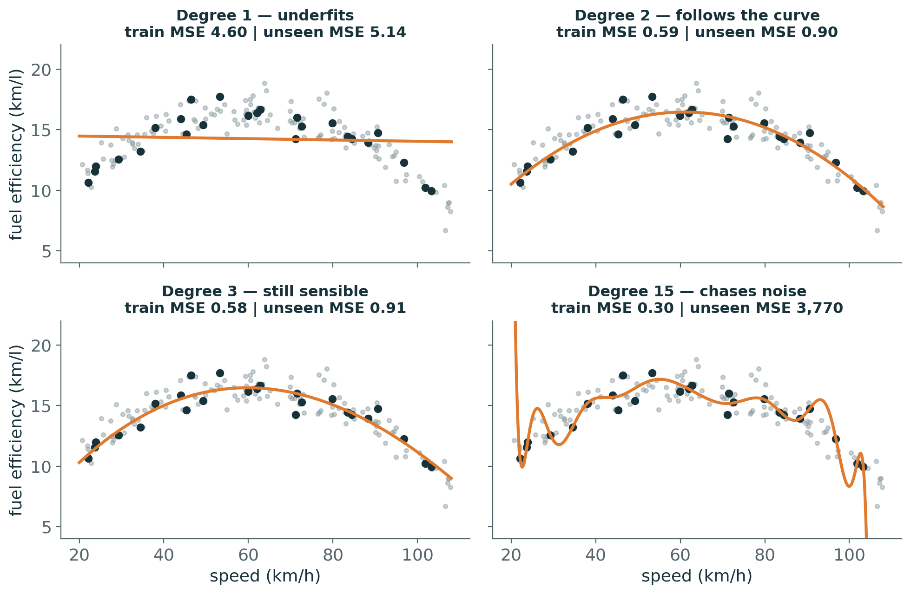
Degree controls flexibility
VISUAL
Trained on only 25 trips (black); grey = unseen trips
Degree 1: too rigid → underfits (high error everywhere)
Degree 2–3: follow the true shape
Degree 15: lowest training error, wild swings → unseen MSE explodes
Notes:
Revision note: Degree 1 underfits, degrees 2–3 fit, degree 15 overfits (tiny training error, huge unseen error).

Slide 51
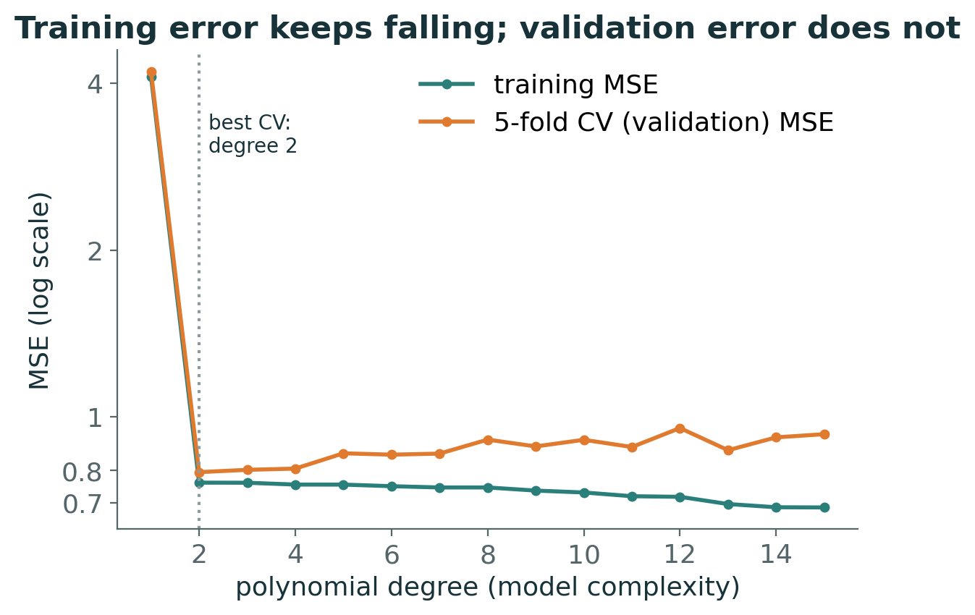
Training error vs validation error
EXPERIMENT
105 training trips, 5-fold cross-validation for each degree
Training MSE keeps falling as degree rises
CV MSE drops sharply at degree 2, then slowly rises
Choose the degree by validation error (here: 2), then test once
Notes:
Revision note: Training error falls with complexity; validation (CV) error is U-shaped. Pick complexity by CV, report test error once.

Slide 52
Pause and reason
PREDICT
A degree-10 polynomial has lower training error than a degree-2 polynomial on the same data, but higher test error.
1. Explain how both statements can be true.
2. Which model has higher variance? Higher bias?
Work it out individually, then compare with a neighbour

Slide 53
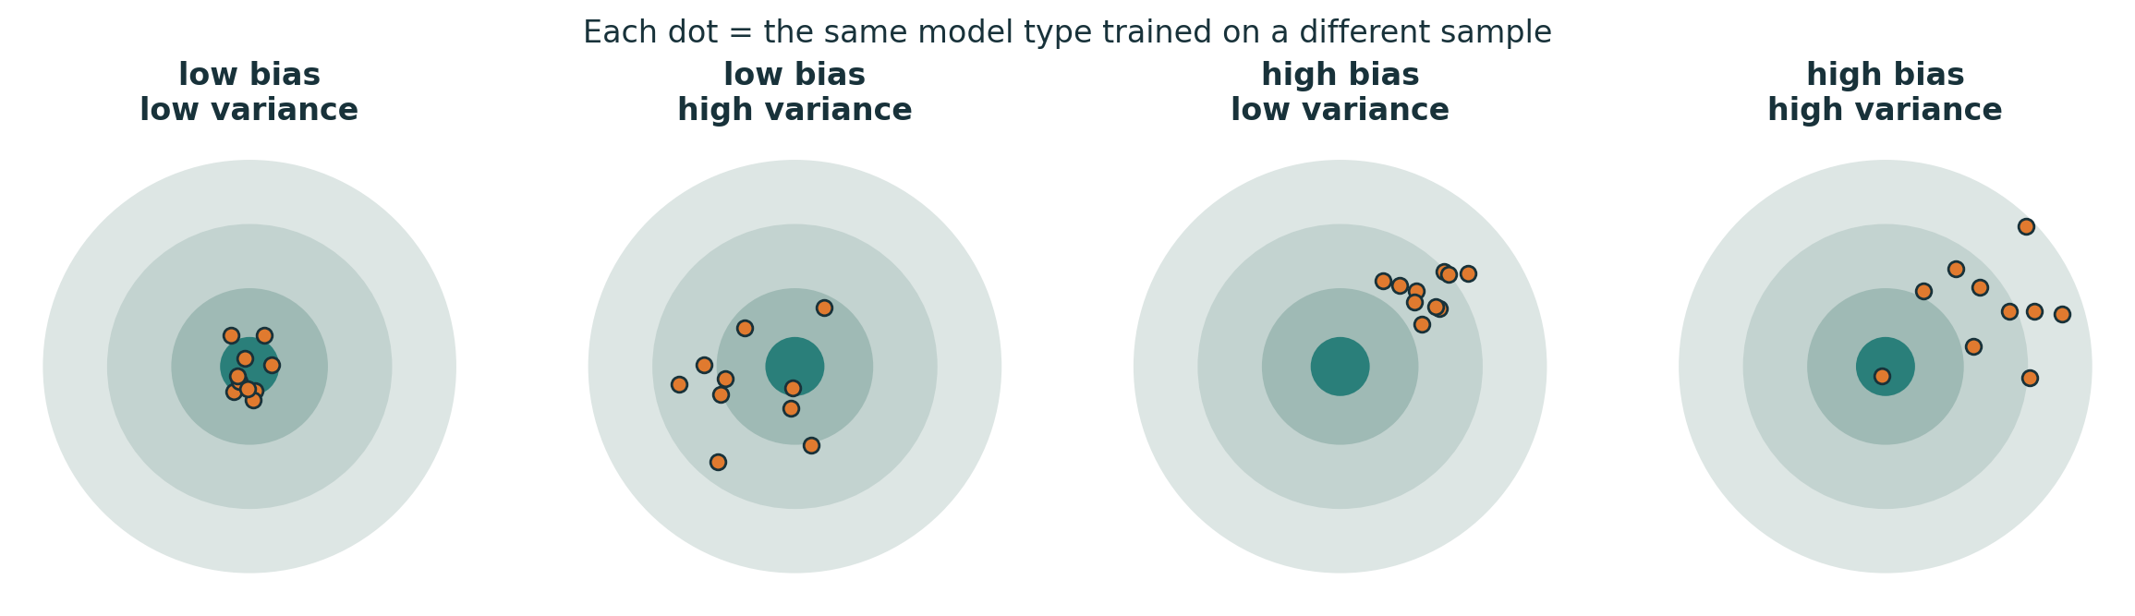
Bias and variance: imagine retraining many times
INTUITION
Bias: how far the average prediction (over many training samples) is from the truth — systematic error
Variance: how much predictions change from one training sample to another — instability
Simple models: high bias, low variance. Flexible models: low bias, high variance
Notes:
Revision note: Bias = systematic error of the average model; variance = spread of models across training samples. Defined over repeated sampling.

Slide 54
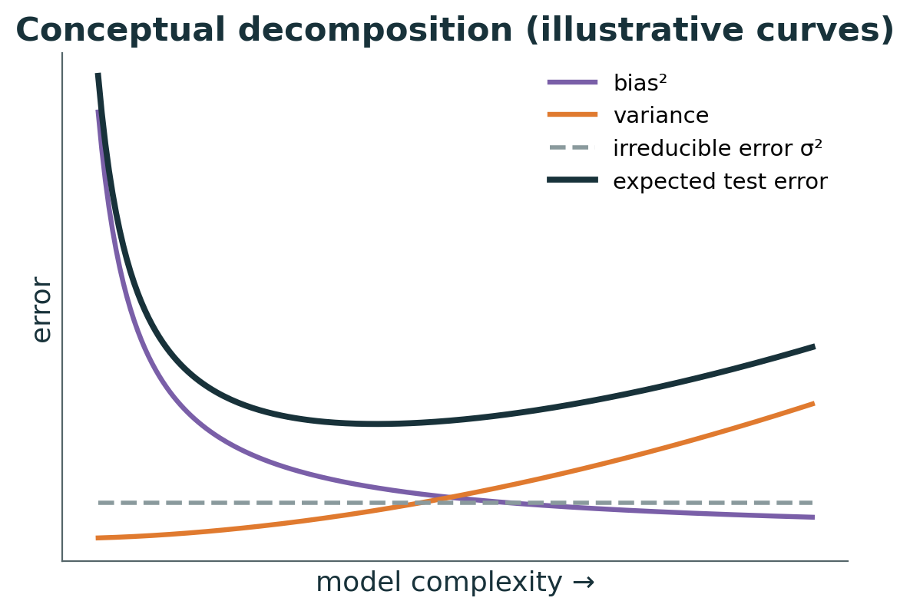
The bias–variance decomposition
MATHEMATICS
Bias²
error from wrong assumptions — falls as complexity rises
Variance
sensitivity to the particular sample — rises with complexity
σ² irreducible
noise in y itself; no model can remove it
Trade-off
best expected test error sits where the sum is smallest
Notes:
Revision note: Expected squared error = Bias² + Variance + σ². Complexity trades bias for variance; σ² cannot be removed. (Curves are illustrative.)

Slide 55
Why regularise?
PROBLEM
Large coefficients
wild polynomial curves need huge, opposite-signed coefficients
Correlated features
multicollinearity lets coefficients grow large and unstable
High variance
small changes in data → big changes in the model
Idea
add a cost for large coefficients: accept a little more training error for a lot less variance
Notes:
Revision note: Regularisation adds a penalty on coefficient size to reduce variance at the cost of slightly higher bias.

Slide 56
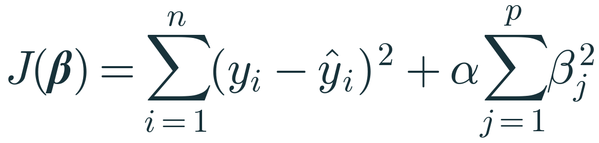
Ridge regression — L2 penalty (introduction)
MATHEMATICS
SSE term
fit to the data, exactly as in OLS
Penalty αΣβⱼ²
grows with the squared size of every coefficient
α ≥ 0
α = 0 → OLS; larger α → stronger shrinkage towards 0 (rarely exactly 0)
Conventions
intercept not penalised (j starts at 1); scale features first, or units decide who is penalised
Notes:
Revision note: Ridge: minimise SSE + αΣβⱼ² (intercept excluded). α = 0 is OLS; large α shrinks coefficients. Scale features first.

Slide 57
Worked example 4 · the penalty changes which model wins
MANUAL CALC
Candidate | β = (β₁, β₂) | SSE | Σβⱼ² | Ridge J, α = 0 | Ridge J, α = 1
A | (4, −3) | 10 | 16 + 9 = 25 | 10 | 35
B | (1.5, 1) | 14 | 2.25 + 1 = 3.25 | 14 | 17.25
C | (2, 0) | 15 | 4 | 15 | 19
With α = 0 the best fit (A) wins. With α = 1 the small-coefficient model B wins, despite fitting the training data worse. Values are illustrative SSEs for one dataset.
Notes:
Revision note: With α = 0, A (SSE 10) wins. With α = 1: A = 35, B = 17.25, C = 19 → B wins. Penalty trades training fit for smaller coefficients.

Slide 58
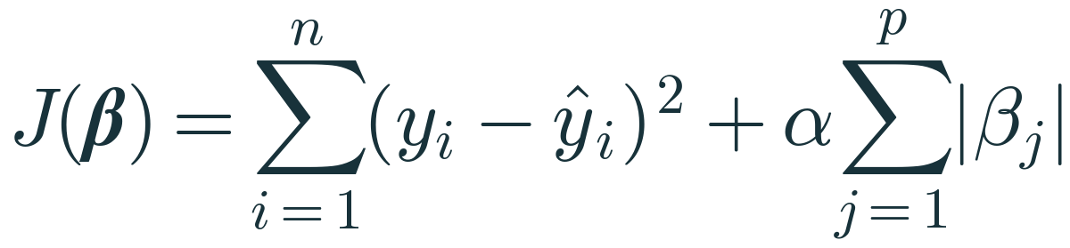
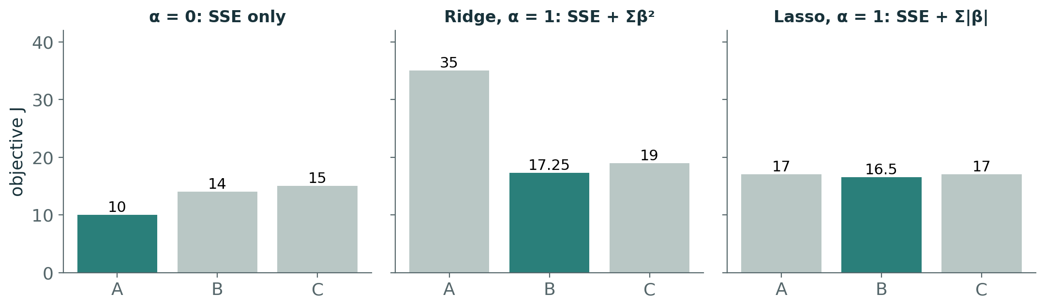
Lasso regression — L1 penalty (introduction)
MATHEMATICS
Penalty α Σ|βⱼ|
absolute values instead of squares
Same candidates, α = 1
A: 10 + 7 = 17 B: 14 + 2.5 = 16.5 C: 15 + 2 = 17
Sparsity
L1 can push coefficients exactly to 0 → built-in feature selection
Caveat
with correlated features Lasso may keep one arbitrarily and drop the others
Notes:
Revision note: Lasso: SSE + αΣ|βⱼ|. α = 1 on the same candidates: A 17, B 16.5, C 17. L1 can set coefficients exactly to zero (feature selection).

Slide 59
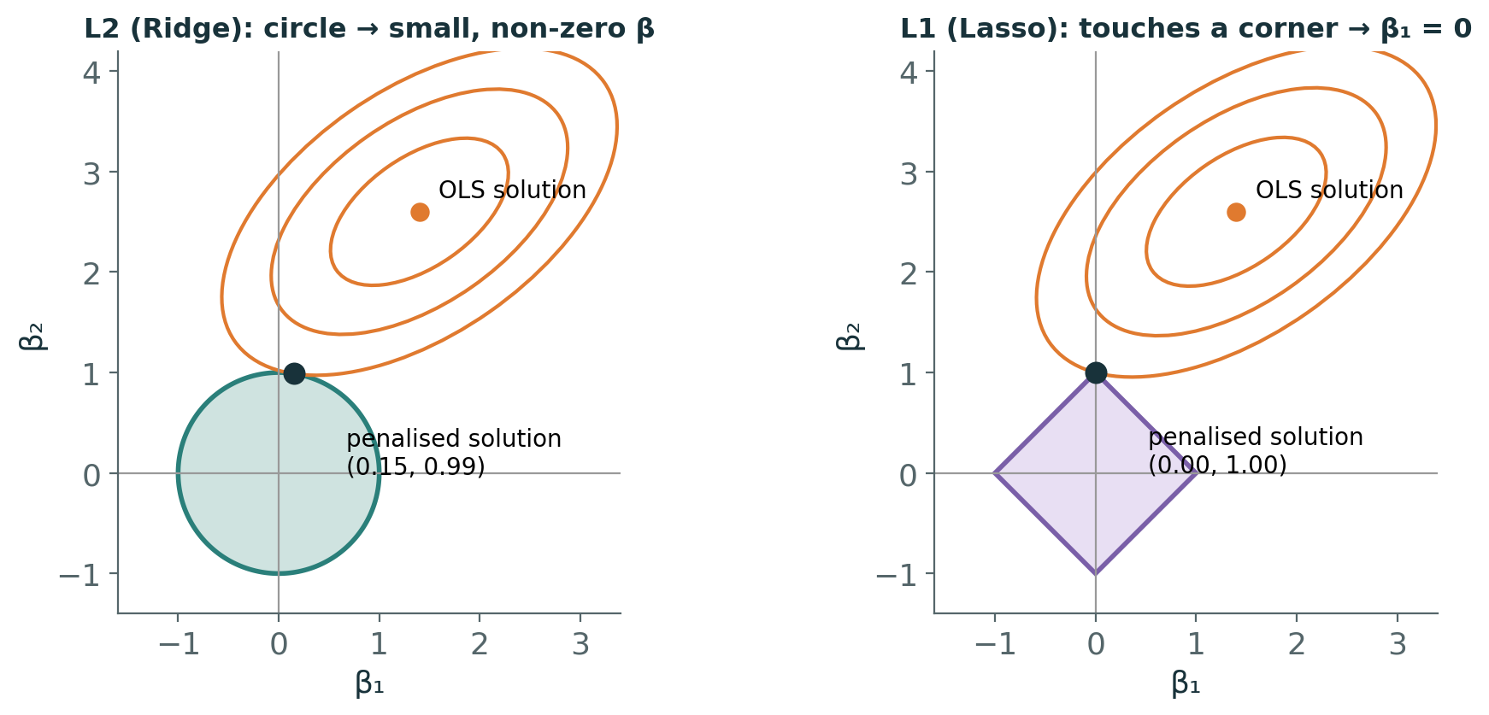
Why L1 gives zeros and L2 does not
VISUAL
Orange ellipses: equal-SSE contours around the OLS solution
The penalty keeps β inside a budget region: circle (L2) or diamond (L1)
The solution is where the smallest ellipse first touches the region — corners of the diamond lie on the axes
Notes:
Revision note: Constrained view: L2 region is a circle (no corners) → small non-zero β; L1 region is a diamond (corners on axes) → some β exactly 0.

Slide 60
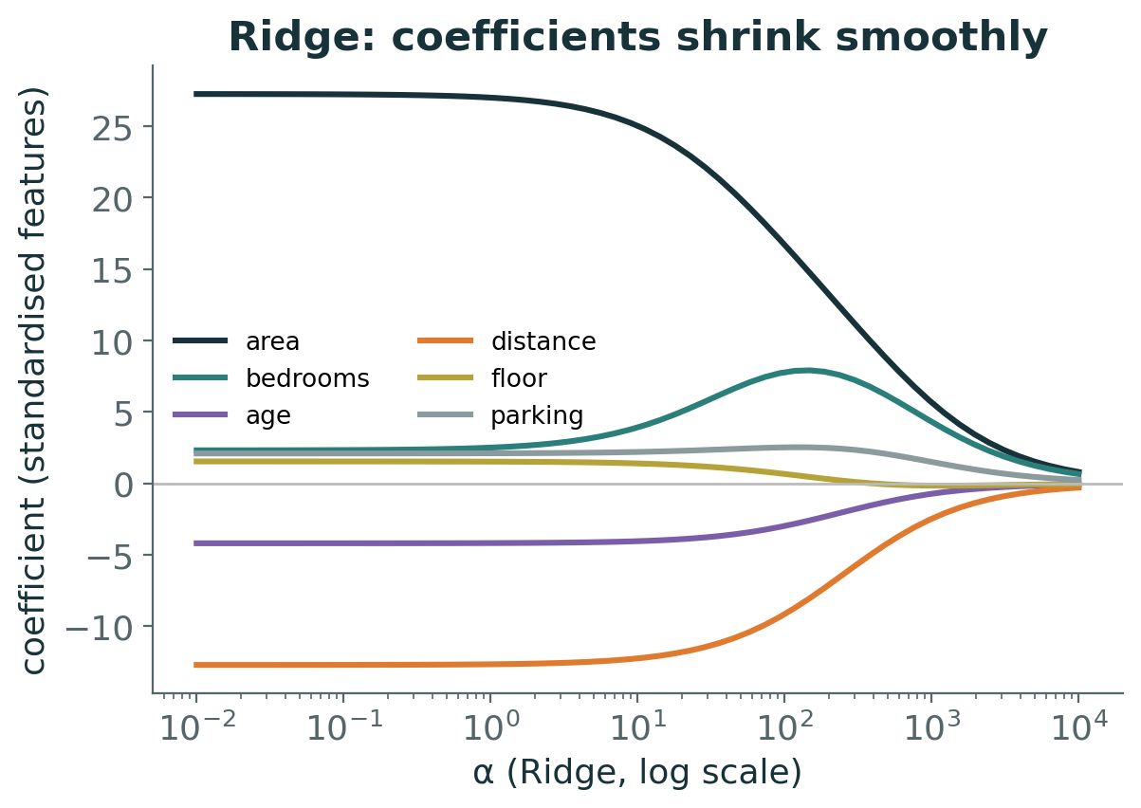
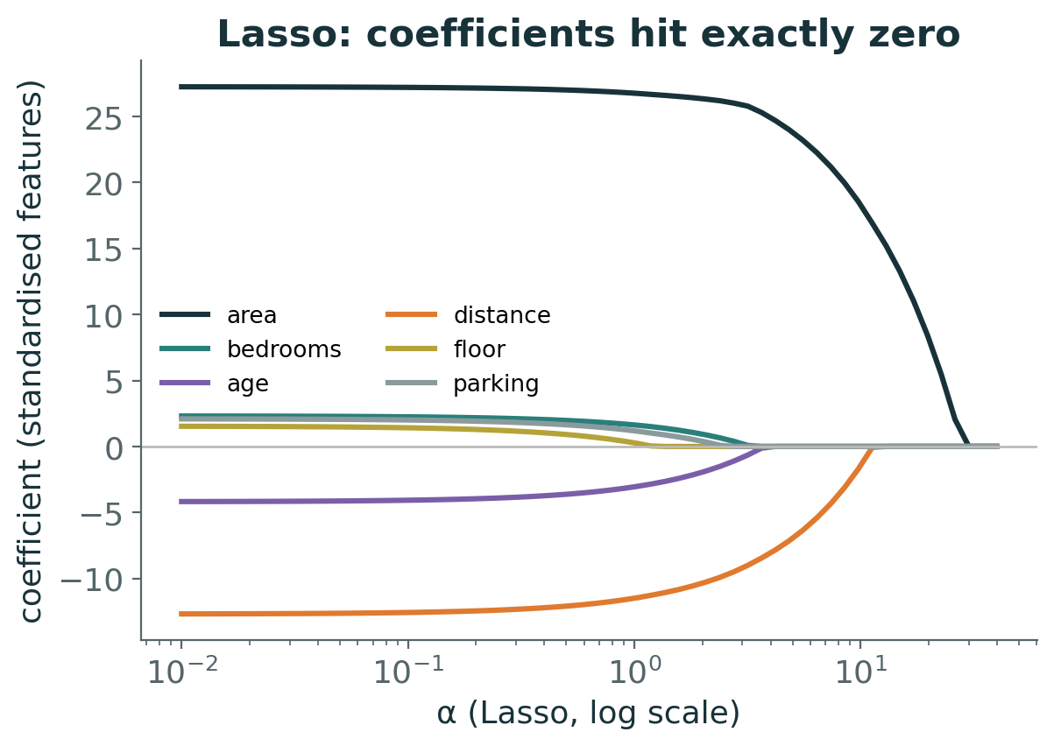
Coefficient paths on the house data
EXPERIMENT
Standardised features. As α grows, Ridge shrinks all coefficients smoothly; Lasso drops floor_number first, then others. scikit-learn's Ridge and Lasso scale their objectives differently, so the two α axes are not comparable.
Notes:
Revision note: Ridge paths shrink smoothly; Lasso paths hit zero (floor_number first). α scales differ between sklearn's Ridge and Lasso.

Slide 61
Linear vs Ridge vs Lasso
PYTHON
Linear (OLS)
Ridge (L2)
Lasso (L1)
Objective: SSE
No penalty, no α
Unbiased coefficients; can have high variance
Coefficients on house data (std.): area 28.1, bedrooms 2.0, floor 1.4
SSE + α Σβ²
Shrinks all, rarely to 0
Handles correlated features by sharing weight
α = 10: area 25.2, bedrooms 4.1, floor 1.3
(1/2n)·SSE + α Σ|β| in sklearn
Can set coefficients to exactly 0
Feature selection; unstable with correlated groups
α = 1.5: area 27.6, bedrooms 0.8, floor 0.0
make_pipeline(StandardScaler(), Ridge(alpha=10)) # scaler is fitted on training data only
Notes:
Revision note: OLS: no penalty. Ridge: shrink all (L2). Lasso: shrink and select (L1). Always scale inside a Pipeline; choose α by cross-validation.

Slide 62
Knowledge check · Hour 4
CHECK
1. Why do Ridge coefficients usually get smaller as α increases?
2. A Lasso model sets the coefficient of 'parking' to exactly 0. Does that prove parking has no effect on price?
3. Why should you not compare Ridge(alpha=1) and Lasso(alpha=1) as 'equally strong'?
Work it out individually, then compare with a neighbour

Slide 63
5–7
HOURS 5–7 · 14:00–17:15
Labs, Challenge and Assessment
From derivation to a model you can defend

Slide 64
Guided Lab 1 · Simple and Multiple Regression (Hour 5)
LAB 1
A1
Load house data; identify features and target; spot target leakage
A2
Single split (20% test, random_state 42); fit area-only model; plot it
A3
Interpret slope and intercept with units; predict 1,200 sq ft by hand
A4
Manual OLS on the 5 deliveries; verify with scikit-learn and lstsq
A5
Complete gradient-descent functions; reproduce J = 7.5 → 1.5098 → 0.3217
A6
Write your own metric function; outlier experiment; evaluate on test set
A7
Fit all six features; coefficient table; adjusted R²; one manual prediction
Notebook: 04_PML_Regression_Student_Exercises.ipynb · Guide: 07_PML_Regression_Student_Lab_Guide.docx
Notes:
Revision note: Lab 1 covers A1–A7: data understanding, simple regression, interpretation, manual OLS, gradient descent, metrics, multiple regression.

Slide 65
Guided Lab 2 · Polynomial and Regularised (Hour 6)
LAB 2
A8
Build [x, x²] by hand, confirm with PolynomialFeatures; compare degrees 1, 2, 3, 15
A9
5-fold CV over degrees 1–15 on training data; pick degree; test once; resampling variance demo
A10
Linear vs Ridge vs Lasso coefficients in a scaled Pipeline; choose α by CV; rescue degree 15
Rule of the lab: every comparison uses the same split, and the test set is touched only for the final chosen model.
Notes:
Revision note: Lab 2 covers A8–A10: polynomial features, cross-validated degree selection, bias–variance, Ridge and Lasso.

Slide 66
Final challenge · predict delivery time (Hour 7, 60 min)
CHALLENGE
Data
delivery_time_challenge.csv — 260 synthetic orders, 5 features, target delivery_time_min
Build
inspect → split → baseline → metrics → interpret two coefficients
Improve
one justified alternative, compared by 5-fold CV RMSE on training data
Defend
test the final model once; discuss overfitting; one manual calculation
Marking: data prep 15 · implementation 20 · mathematics 20 · evaluation 20 · interpretation 15 · code quality 10 = 100
Notes:
Revision note: Challenge: build a baseline, propose one improvement justified by CV, test once, interpret, and do one manual calculation.

Slide 67
Common misconceptions — and the correct idea
REVIEW
Misconception | Correct idea
“Linear regression can only fit straight lines.” | It is linear in the coefficients; polynomial features give curves.
“LinearRegression trains with gradient descent.” | It solves least squares directly; GD is one alternative optimiser.
“Lowest training error = best model.” | Choose by validation / CV error; training error always favours complexity.
“A bigger coefficient means a more important feature.” | Only comparable after scaling — and importance ≠ causation.
“R² is between 0 and 1.” | On held-out data R² can be negative.
“Lasso’s zero proves a feature is useless.” | It reflects this α and these data; correlated features can swap.
Notes:
Revision note: Six misconceptions and their corrections — review before the assessment.

Slide 68
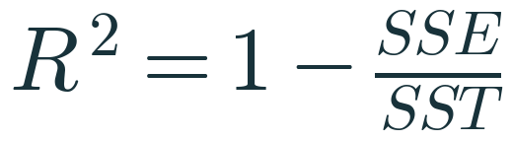
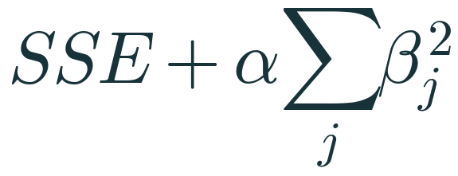

One-page formula sheet
SUMMARY
Simple line
OLS slope
OLS intercept
GD update
RMSE
R²
Ridge (classroom form)
Lasso (classroom form)
Notes:
Revision note: Formula sheet: line, OLS slope/intercept, GD update, RMSE, R², Ridge, Lasso.

Slide 69
WHAT COMES NEXT
Next session
1
Ridge and Lasso: full derivations, closed form for Ridge, coordinate descent for Lasso
2
Elastic Net: combining L1 and L2
3
Feature selection approaches (including stepwise methods)
4
Logistic Regression — a classification method despite its name — and classification metrics
References: scikit-learn User Guide (linear models, model evaluation); Hastie, Tibshirani & Friedman, The Elements of Statistical Learning; CampusX ‘100 Days of ML’ used only as a topic-coverage checklist. Full list: 07_Supporting_Files/References.md
Notes:
Revision note: Next: full regularisation derivations, Elastic Net, feature selection, logistic regression (classification).

