Slide 1
MACHINE LEARNING / TRAINER EDITION
Decision Trees
From Gini impurity to a complete classification model
One dataset · Every calculation · Real scikit-learn workflow
Updated and expanded from your original 14-slide deck
Notes:
Open by asking: If a model can ask questions, who decides the questions? The learning objective is to show the tree discovers them from labeled data.

Slide 2
Learning outcomes
By the end, students can explain and train a Decision Tree.
01 Read a tree
02 Choose a split
Root, decision node, leaf, binary branches and prediction path.
Calculate parent Gini, child Gini, weighted Gini and gain.
03 Control complexity
04 Build and evaluate
Recognize underfitting, overfitting, pre-pruning and post-pruning.
Use train/test split, StratifiedKFold, GridSearchCV and metrics.
DECISION TREES / TRAINER EDITION
02
Notes:
Tell learners the session has two modes: manual calculations using the fruit data, then scikit-learn implementation on Iris.

Slide 3
Core idea: learned yes/no questions
A Decision Tree is a flowchart learned from labeled examples.
Diameter ≤ 2.75 cm?
YES
NO
Predict Grape
Ask another question
2 Grapes · 0 Apples
Still mixed: 4 Apples · 1 Grape
The split is learned from data; it is not manually coded as an if/else rule.
DECISION TREES / TRAINER EDITION
03
Notes:
Distinguish hand-written business rules from trained tree rules. The model chooses features and thresholds by evaluating class impurity.

Slide 4
Classification vs. regression trees
Same sequence of questions; different predictions at leaves.
Classification tree
Regression tree
Target: category
Example: Apple / Grape
Leaf prediction: majority class
Split criteria: Gini or entropy
Target: numeric value
Example: apartment price
Leaf prediction: a numeric value
Common criterion: squared error
Today: classification trees only
DECISION TREES / TRAINER EDITION
04
Notes:
Make clear both are trees. Classification typically uses Gini/entropy, and regression often squared-error reduction. Regression predicts the mean target at a leaf for squared_error.

Slide 5
Parts of a classification tree
Each sample follows one path from root to leaf.
Root node
first split
Leaf node
Decision node
final prediction
another split
Leaf: Apple
Leaf: Grape
branch = outcome of the question • depth = number of split edges below the root
DECISION TREES / TRAINER EDITION
05
Notes:
Terminology check: root is also a decision node if it splits; a parent may be any non-leaf. Leaf makes the output.

Slide 6
Why two-way (binary) splits?
scikit-learn decision trees split a node into exactly two children.
Numeric split
Encoded category split
Is Diameter ≤ 2.75?
Yes → left child
No → right child
Is Color = Green?
Yes → one child
No → other child
Important distinction
A categorical feature such as Color must be encoded before using scikit-learn DecisionTreeClassifier.
DECISION TREES / TRAINER EDITION
06
Notes:
Tree algorithms vary: not all decision tree methods are binary; scikit-learn CART-style trees are. Examples: diameter <= 2.75 and one-hot color_Green <= 0.5.

Slide 7
The same seven-row fruit dataset
A complete example for every split calculation.
ID
Color
Diameter (cm)
Fruit
Target
1
Yellow
3.5
Apple
Apple or Grape
2
Yellow
7.0
Apple
3
Red
2.0
Grape
4
Red
2.5
Grape
Class counts
5
Green
4.0
Grape
4 Apples / 3 Grapes
6
Green
3.0
Apple
7
Red
6.0
Apple
Features: Color (categorical) and Diameter (numeric)
DECISION TREES / TRAINER EDITION
07
Notes:
This is the seven-record illustrative dataset from the supplied presentation. It is intentionally small and should not be treated as a real-world fruit identification system.

Slide 8
What candidate splits does a tree test?
The algorithm compares alternative questions, not visual guesses.
Color-based questions
Diameter-based questions
Color = Red?
Color = Yellow?
Color = Green?
Each gives two groups.
Diameter ≤ 2.25?
Diameter ≤ 2.75?
Diameter ≤ 3.25?
… and other midpoints.
The “best” question produces the greatest impurity reduction.
DECISION TREES / TRAINER EDITION
08
Notes:
Explain the human-readable equality questions for color. For actual scikit-learn classification, transform categories with OneHotEncoder and split one-hot columns.

Slide 9
Find numeric thresholds
Sort distinct values; candidate thresholds lie between adjacent values.
Sorted diameters (ordered; not to scale)
2
2.5
3
3.5
4
6
7
2.25
2.75
3.25
3.75
5
6.5
Example candidate: (2.5 + 3.0) / 2 = 2.75 cm
Next: evaluate each candidate by calculating class impurity in its children.
DECISION TREES / TRAINER EDITION
09
Notes:
Numeric thresholds between sorted distinct samples: 2.25,2.75,3.25,3.75,5.0,6.5. For an efficient algorithm, many redundant splits can be skipped.

Slide 10
Gini impurity: “How mixed is this node?”
For two classes, 0 means pure; 0.5 is maximum impurity.
Gini = 1 − Σ (class proportion)²
Pure: 4A / 0G
Mostly A: 3A / 1G
Even: 2A / 2G
1 − (1² + 0²) = 0.00
1 − (.75² + .25²) = .375
1 − (.50² + .50²) = .500
Lower Gini ⇒ a purer node
DECISION TREES / TRAINER EDITION
10
Notes:
Gini measures class proportions at a node. It is not accuracy and not a probability of error for a particular prediction.

Slide 11
Calculate impurity before splitting
All seven fruit records start together at the root.
Parent node
Gini(parent) = 1 − (4/7)² − (3/7)²
Apples = 4
Grapes = 3
Total = 7
= 1 − 16/49 − 9/49 = 24/49
= 0.4898
This is our benchmark: a useful split should reduce weighted impurity.
DECISION TREES / TRAINER EDITION
11
Notes:
Manually calculate 4 Apples divided by 7 and 3 Grapes divided by 7. 1 -16/49 -9/49 = 24/49 = 0.4897959.

Slide 12
Candidate split: Diameter ≤ 2.75
First, identify exactly which examples go left and right.
Diameter ≤ 2.75?
YES
NO
Left child: 2 fruits
Right child: 5 fruits
Diameter 2.0 and 2.5
0 Apples / 2 Grapes
Gini = 0
Diameter 3.0, 3.5, 4.0, 6.0, 7.0
4 Apples / 1 Grape
Gini = 0.32
DECISION TREES / TRAINER EDITION
12
Notes:
The left node contains records 3 and 4, two Grapes. The right contains records 1,2,5,6,7: four Apples and one Grape.

Slide 13
Why weighted Gini matters
Each child contributes according to the number of records it contains.
Weighted Gini = (n_left/n) × Gini_left + (n_right/n) × Gini_right
Left contribution
Right contribution
(2/7) × 0 = 0
(5/7) × 0.32 = 0.2286
Weighted Gini = 0.2286 | Gini gain = 0.4898 − 0.2286 = 0.2612
DECISION TREES / TRAINER EDITION
13
Notes:
Weighted Gini for diameter <= 2.75 is 2/7*0 + 5/7*(1-(4/5)^2-(1/5)^2) = 8/35=.228571. Gain parent minus children = .261224.

Slide 14
Compare all numeric split candidates
We calculate weighted impurity for each threshold.
Diameter threshold
Weighted Gini
Gini reduction
2.25
0.3810
0.1088
2.75
0.2286
0.2612
3.25
0.4048
0.0850
3.75
0.4762
0.0136
5.00
0.3429
0.1469
6.50
0.4286
0.0612
Best diameter split: 2.75 (lowest weighted Gini = 0.2286)
DECISION TREES / TRAINER EDITION
14
Notes:
The previously supplied deck mentioned a best Option E without defining candidates. This updated table replaces that with actual recalculated values.

Slide 15
Compare categorical split candidates
The same impurity test works for yes/no category questions.
Question
Yes group
No group
Weighted Gini
Color = Red?
1A / 2G
3A / 1G
0.4048
Color = Yellow?
2A / 0G
2A / 3G
0.3429
Color = Green?
1A / 1G
3A / 2G
0.4857
Compare numeric and categorical
2.75 diameter (0.2286) beats the best Color split (0.3429).
DECISION TREES / TRAINER EDITION
15
Notes:
These values are for manually constructed category equals yes/no splits. Scikit-learn requires encoded numeric data (one-hot columns), so actual split tests become <=0.5 on indicator features.

Slide 16
Choose the first split (root)
A greedy tree chooses the best available split at the current node.
Best numeric candidate
Best categorical candidate
Diameter ≤ 2.75
Weighted Gini: 0.2286
Gain: 0.2612
Color = Yellow
Weighted Gini: 0.3429
Gain: 0.1469
Winner: Diameter ≤ 2.75 cm
DECISION TREES / TRAINER EDITION
16
Notes:
Comparisons use the same parent impurity 0.4898. Maximizing impurity reduction is equivalent to minimizing weighted child impurity.

Slide 17
Grow the tree recursively
Now apply the exact same process to each impure child.
Diameter ≤ 2.75?
Grape leaf
Color = Green?
0A / 2G (pure)
4A / 1G before splitting
Mixed: 1A / 1G
Apple leaf
needs another split
3A / 0G
After the first split, only the right child needs further splitting.
DECISION TREES / TRAINER EDITION
17
Notes:
The right child contains 4 Apples and 1 Grape, Gini 0.32. Color=Green yields a pure non-green child (3 Apples) and a green child with 1 Apple,1 Grape. Weighted Gini right node is 2/5*0.5+3/5*0=.2.

Slide 18
Completed example: a three-level tree
The same rule-building process continues until leaves are pure.
Diameter ≤ 2.75?
YES
NO
Grape (2G / 0A)
Color = Green?
Diameter ≤ 3.50?
Apple (3A)
Apple (1A)
Grape (1G)
For green fruit, diameter separates the remaining Apple (3.0 cm) and Grape (4.0 cm).
DECISION TREES / TRAINER EDITION
18
Notes:
This tree corresponds to a scikit-learn Gini tree fitted on this toy dataset after one-hot encoding Color. The exact feature name in scikit-learn is color_Green <= 0.5 rather than Color = Green.

Slide 19
Trace a new record through the tree
Prediction means answering the learned questions in sequence.
New fruit
Prediction path
Color: Green
Diameter: 3.2 cm
Actual fruit: unknown
1 Is 3.2 ≤ 2.75? No
2 Is Color Green? Yes
3 Is 3.2 ≤ 3.50? Yes
Predicted fruit: APPLE
DECISION TREES / TRAINER EDITION
19
Notes:
Ask a student to predict Green 3.2 then Green 4.2 and Red 2.4. For Green 3.2, pass root > 2.75; color green yes; diameter <=3.5 yes; Apple. Green4.2 ends Grape. Red2.4 ends Grape.

Slide 20
What does a leaf predict?
Class label comes from the leaf’s class composition.
Mixed leaf example
Estimated class probabilities
Suppose a leaf contains:
8 Apples and 2 Grapes
Class prediction = Apple
P(Apple) = 8/10 = 0.80
P(Grape) = 2/10 = 0.20
These are leaf proportions.
A decision tree is not automatically a reliable probability-calibration model.
DECISION TREES / TRAINER EDITION
20
Notes:
For normal DecisionTreeClassifier, predict_proba gives the weighted class proportions in the reached leaf. With all pure leaves, proportions are 0 or 1; these may be poorly calibrated probabilities.

Slide 21
Gini impurity vs. entropy
Both favor child nodes with better class separation.
Gini impurity
Entropy (information theory)
1 − Σ pᵢ²
For 50% / 50%:
Gini = 1 − .25 − .25 = .5
− Σ pᵢ log₂(pᵢ)
For 50% / 50%:
Entropy = 1 bit
Both are 0 for a pure node; their numeric scales differ.
DECISION TREES / TRAINER EDITION
21
Notes:
Entropy H = -sum p log2 p, with zero-probability terms treated as zero. Gini is default criterion for DecisionTreeClassifier; entropy and log_loss are alternative criteria.

Slide 22
Training algorithm: the CART-style idea
Repeat split search at each node; it is a greedy procedure.
1
Start with all rows at root
2
Generate valid candidate splits
3
Compute weighted child impurity
4
Choose best improvement
5
Recurse until stop condition
DECISION TREES / TRAINER EDITION
22
Notes:
Greedy means each node optimizes the next split locally. It does not search every possible complete tree. Draw attention to stop conditions and pruning.

Slide 23
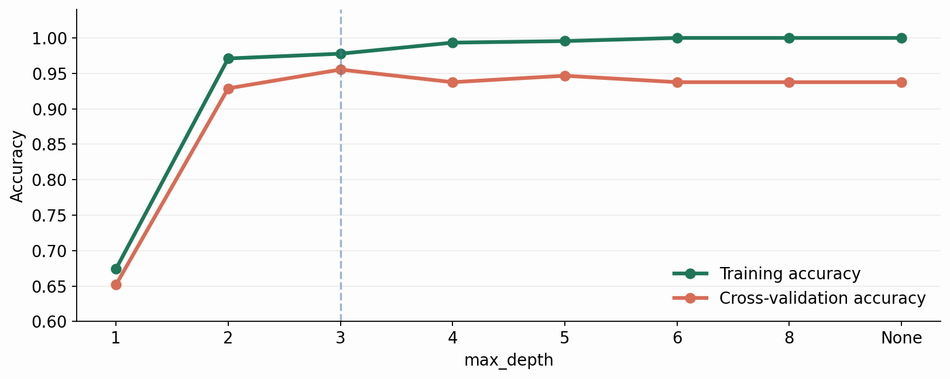
Tree depth: underfitting vs. overfitting
Real cross-validation curve from the Iris dataset.
Depth 1 underfits. Deeper trees can memorize training samples without improving CV accuracy.
DECISION TREES / TRAINER EDITION
23
Notes:
This plot uses ONLY training portion of data, with five stratified folds and cross_validate(return_train_score=True). As max_depth increases training scores rise while held-out CV may flatten or drop. Test set stays untouched.

Slide 24
Hyperparameters that control complexity
Most important knobs for DecisionTreeClassifier.
Hyperparameter
What it controls
max_depth
Maximum levels of split decisions
min_samples_split
Minimum samples at a node to split
min_samples_leaf
Minimum samples in every leaf
max_leaf_nodes
Maximum number of terminal leaves
criterion
gini / entropy / log_loss
class_weight
Adjust influence of minority classes
Practical start: tune max_depth and min_samples_leaf using cross-validation.
DECISION TREES / TRAINER EDITION
24
Notes:
Clarify min_samples_split and min_samples_leaf. Split = minimum at parent to consider splitting; leaf = minimum retained in each child. max_depth counts split edges; ccp_alpha controls post-pruning.

Slide 25
Pruning: control a tree that grows too large
Pre-pruning limits growth; post-pruning removes weak branches.
Pre-pruning
Post-pruning
Stop during growth using:
• max_depth
• min_samples_leaf
• max_leaf_nodes
Grow a tree, then remove branches
whose contribution does not justify
the added complexity.
In scikit-learn: ccp_alpha
Choose pruning strength on validation/CV data, never on the final test set.
DECISION TREES / TRAINER EDITION
25
Notes:
Cost complexity post-pruning uses ccp_alpha in scikit-learn. Value zero means no cost complexity pruning. Larger positive values generally simplify the tree.

Slide 26
Decision Tree preprocessing: what matters?
Trees use thresholds, not Euclidean distance.
Usually NOT required
Still important
• StandardScaler or MinMaxScaler
• Feature normalization
• Large polynomial expansion
• Encode categorical variables
• Define a missing-value strategy
• Validate data and target labels
• Handle class imbalance when needed
Important: a tree is scale-insensitive, not data-quality-insensitive.
DECISION TREES / TRAINER EDITION
26
Notes:
The original deck said trees can work with categorical variables; clarify theoretical ability vs scikit-learn implementation. Some current versions support missing values under selected criteria, but an explicit robust imputation policy should be demonstrated to avoid version-dependent behavior.

Slide 27
Practical dataset: Iris classification
A standard scikit-learn dataset: 150 flowers, 3 species, 4 numerical features.
Input features (X)
Target classes (y)
Sepal length (cm)
Sepal width (cm)
Petal length (cm)
Petal width (cm)
0 Setosa
1 Versicolor
2 Virginica
Total: 50 samples per class
Training: 112 samples | Test: 38 samples | No scaling required
DECISION TREES / TRAINER EDITION
27
Notes:
The next slides show verified executions with sklearn Iris. Split is stratified 75% training / 25% testing with random_state=42.

Slide 28
Train your first classification tree
fit() discovers rules; predict() applies those rules.
from sklearn.datasets import load_iris
from sklearn.model_selection import train_test_split
from sklearn.tree import DecisionTreeClassifier
iris = load_iris(as_frame=True)
X, y = iris.data, iris.target
X_train, X_test, y_train, y_test = train_test_split(
X, y, test_size=0.25, stratify=y, random_state=42)
model = DecisionTreeClassifier(max_depth=3, random_state=42)
model.fit(X_train, y_train)
y_pred = model.predict(X_test)
Question for students: Where are the feature thresholds learned? Answer: model.fit().
DECISION TREES / TRAINER EDITION
28
Notes:
Walk through the code line-by-line. train_test_split stratifies class labels. Code uses all four features. No scaling in the pipeline because threshold-based tree training does not require it.

Slide 29
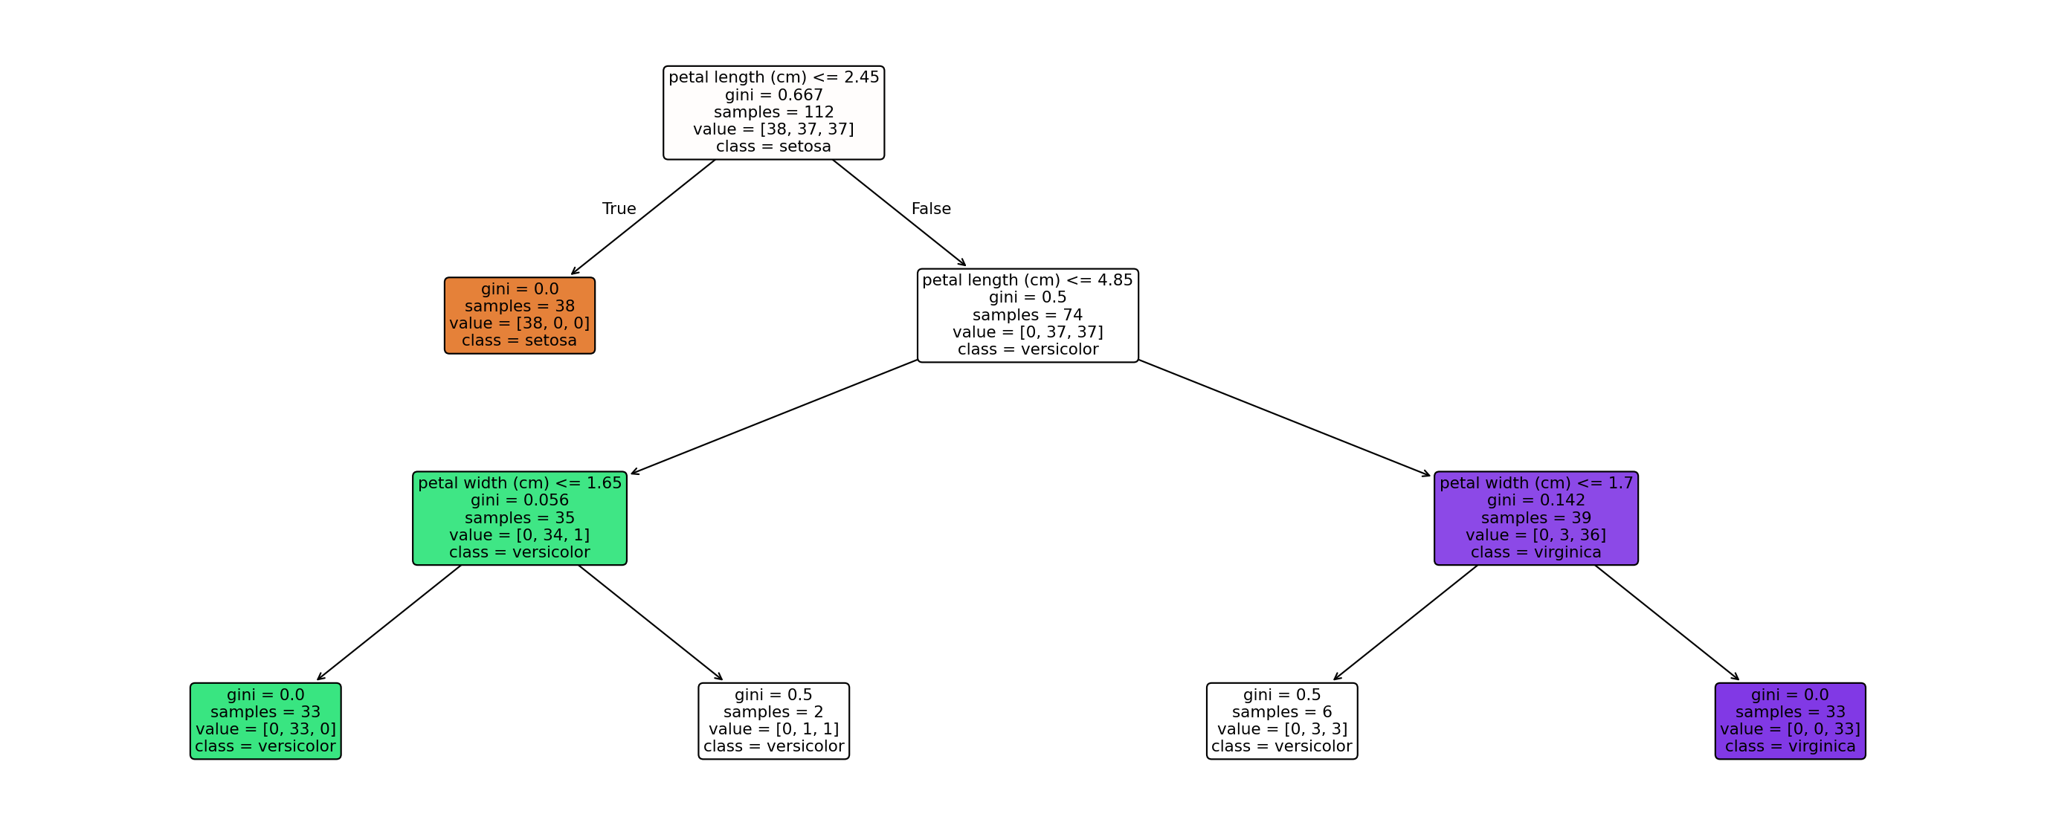
What did the tree actually learn?
The following tree was fitted on Iris training data.
Read top-down: petal length is the first question. Other features may appear deeper.
DECISION TREES / TRAINER EDITION
29
Notes:
This is the tuned best tree from GridSearchCV, not the plain default tree. Plot shows Gini, node sample counts and majority class; long feature names are available for interpretation.

Slide 30
How to evaluate a classifier
Accuracy is useful, but confusion matrices show which classes are confused.
Useful evaluation outputs
from sklearn.metrics import (
accuracy_score, confusion_matrix,
classification_report
)
print(accuracy_score(y_test, y_pred))
print(confusion_matrix(y_test, y_pred))
print(classification_report(y_test, y_pred))
Accuracy
Confusion matrix
Precision and recall
F1-score by class
Never evaluate the same data used to choose the hyperparameters as the final unbiased test.
DECISION TREES / TRAINER EDITION
30
Notes:
Accuracy=correct/total. Precision is TP/(TP+FP). Recall is TP/(TP+FN). For multi-class compute one-vs-rest metrics by class; macro averages treat classes equally.

Slide 31
Cross-validation: why one train/validation split is not enough
Keep the test set untouched; tune only inside training data.
Fold 1
VALIDATION
TRAIN
TRAIN
TRAIN
TRAIN
Fold 2
TRAIN
VALIDATION
TRAIN
TRAIN
TRAIN
Fold 3
TRAIN
TRAIN
VALIDATION
TRAIN
TRAIN
Fold 4
TRAIN
TRAIN
TRAIN
VALIDATION
TRAIN
Fold 5
TRAIN
TRAIN
TRAIN
TRAIN
VALIDATION
Mean CV score = average of five validation scores; final test set not used.
DECISION TREES / TRAINER EDITION
31
Notes:
The five folds show validation turns. StratifiedKFold preserves class proportions as closely as possible across folds. Scores are averaged. A common use: each split trains on four of five folds and validates on the fifth.

Slide 32
Tune the tree with GridSearchCV
Search depth, leaf size and split criterion using stratified 5-fold CV.
from sklearn.model_selection import GridSearchCV, StratifiedKFold
cv = StratifiedKFold(n_splits=5, shuffle=True, random_state=42)
params = {
"criterion": ["gini", "entropy"],
"max_depth": [2, 3, 4, 5, None],
"min_samples_leaf": [1, 2, 4, 6]
}
search = GridSearchCV(
DecisionTreeClassifier(random_state=42),
param_grid=params, cv=cv, scoring="accuracy", n_jobs=-1
)
search.fit(X_train, y_train)
40 parameter sets × 5 folds = 200 CV fits
DECISION TREES / TRAINER EDITION
32
Notes:
The defined parameter grid has 2 criteria x5 depths x4 leaf sizes =40 combinations, each evaluated on five folds =200 CV fits, with refit=True final refit on complete training set.

Slide 33
Verified CV search result
The best CV model is not guaranteed to achieve the same score on new data.
Best hyperparameters
Mean 5-fold CV accuracy
Gini | max_depth = 3 | min_samples_leaf = 1
95.53%
Final training accuracy
Untouched test accuracy
96.43%
89.47% (34 / 38 correct)
CV estimates performance during tuning; test accuracy checks the selected model once.
DECISION TREES / TRAINER EDITION
33
Notes:
Computed locally with sklearn current installed version. CV mean 0.9553359683794. Holdout accuracy 0.8947368421053. Best parameters from GridSearchCV. This result may differ with other splits, sklearn versions or parameter grids.

Slide 34
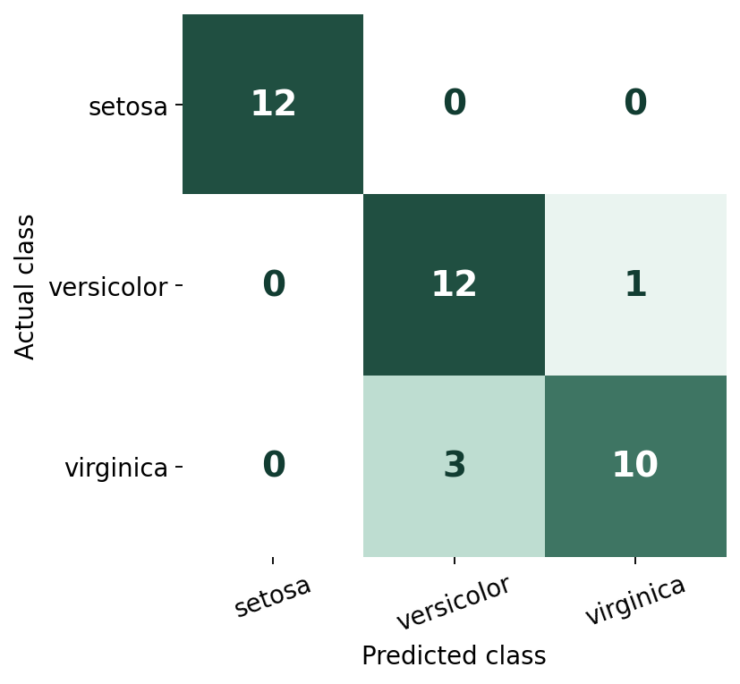
Read the actual confusion matrix
Rows = actual flower species; columns = predicted species.
Interpret the mistakes
Setosa: 12 / 12 correct
Versicolor: 12 / 13 correct
Virginica: 10 / 13 correct
Total: 4 mistakes
DECISION TREES / TRAINER EDITION
34
Notes:
Test confusion matrix: [[12,0,0],[0,12,1],[0,3,10]]. 34 out of 38 samples correct. Versicolor: one predicted virginica; Virginica: three predicted versicolor.

Slide 35
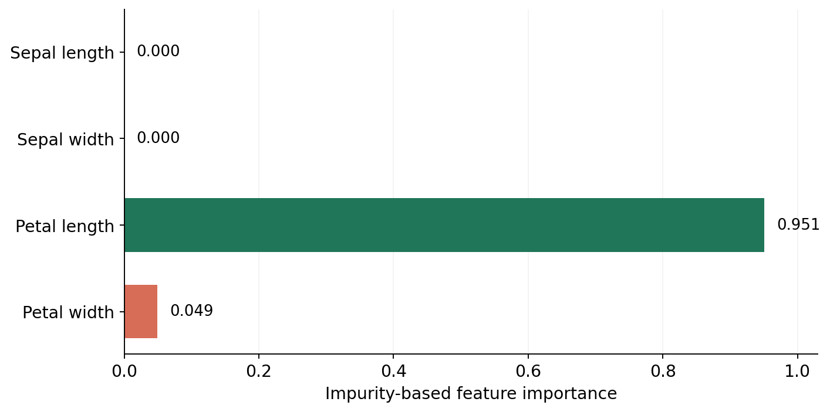
Feature importance: useful, but not causal
Impurity-based importance summarizes where the model reduces impurity.
Takeaway
This tree relies mainly on petal length.
Importance ≠ causation.
A feature receiving zero importance may still be useful in another tree or dataset.
DECISION TREES / TRAINER EDITION
35
Notes:
These values describe this fitted model, not biological causal importance. Impurity-based importances can be biased toward high-cardinality features; permutation importance can be a complementary check.

Slide 36
Strengths and limitations
Decision Trees are intuitive, but unconstrained trees are unstable.
Strengths
Limitations
• Easy to explain and visualize
• Captures nonlinear relationships
• No scaling typically needed
• Learns feature interactions
• Overfits without controls
• Sensitive to small data changes
• Greedy splits may miss a global optimum
• Leaf probabilities may be poorly calibrated
DECISION TREES / TRAINER EDITION
36
Notes:
Update original advantages/disadvantages to distinguish theory and particular library. The model handles numerical inputs naturally; categorical data needs encoding in scikit-learn. Training/prediction complexity depends on tree size and data.

Slide 37
Classroom exercise: calculate a candidate split
Use the original fruit dataset; work without Python first.
Candidate: Diameter ≤ 5.0 cm
Left child: 5 fruits
Right child: 2 fruits
2 Apples / 3 Grapes
Calculate Gini = ?
2 Apples / 0 Grapes
Calculate Gini = ?
Question: Does ≤ 5.0 beat ≤ 2.75, and why?
DECISION TREES / TRAINER EDITION
37
Notes:
Give students three minutes. For diameter <=5 cm: the left child contains records 1,3,4,5,6: 2 apples and 3 grapes. Right contains records2,7: 2 apples pure. Ask for left Gini, weighted Gini and comparison vs 2.75.

Slide 38
Exercise solution: the split at 5.0 cm
Compare weighted Gini; lower is better.
Calculate both child impurities
Weighted impurity
Left = 1 − (2/5)² − (3/5)²
= 0.48
Right = 0 (pure)
(5/7) × 0.48 + (2/7) × 0
= 0.3429
0.2286 < 0.3429
Diameter ≤ 2.75 gives a better split than Diameter ≤ 5.0.
DECISION TREES / TRAINER EDITION
38
Notes:
Solution: left 1-(2/5)^2-(3/5)^2=.48, right 0. Weighted 5/7*.48+2/7*0=.342857. 2.75 weighted Gini .228571 lower, so 2.75 wins.

Slide 39
Final recap: the entire learning flow
One algorithm — from observations to interpretable predictions.
01
Collect labeled data
02
Test feature/threshold candidates
03
Choose maximum impurity reduction
04
Repeat recursively and control depth
05
Predict by following a branch path
06
Tune by CV; evaluate on held-out test
Exit ticket: Why does a deeper tree not always generalize better?
DECISION TREES / TRAINER EDITION
39
Notes:
Close by asking students to explain the difference between calculating Gini for a node and weighted Gini for a split, and why CV is used before final test evaluation.

