Slide 1
CLASSIFICATION • MODEL 01
K-Nearest
Neighbors (KNN)
From two-feature intuition to GridSearchCV
01
MEASURE
02
SELECT
03
VOTE
Distance between examples
K closest neighbors
Predict the class
Trainer presentation • Iris dataset • 5-fold stratified CV
Notes:
Open by emphasizing that KNN is a standalone instance-based classification method. We will first calculate predictions by hand, then reproduce the workflow using the Iris dataset and 5-fold cross-validation.

Slide 2
SESSION ROADMAP
What students will be able to do
01
Explain KNN
Similarity, distance, nearest neighbors and voting
02
Work manually
Two-feature Euclidean distance and K=3 prediction
03
Prevent leakage
Scale inside a model pipeline
04
Tune responsibly
5-fold stratified CV + GridSearchCV on training data
05
Evaluate correctly
Confusion matrix and untouched test accuracy
K-NEAREST NEIGHBORS • CLASSIFICATION
02
Notes:
Use the same narrative all session: understand a prediction; choose how many neighbors; prevent leakage; tune on cross-validation; test exactly once.

Slide 3
INTUITION
A classification problem with two input features
Predict whether a new student passes or fails.
X₁
X₂
y
Hours studied
Mock score
Pass / Fail
New student
Hours = 4.6
Score = 66
Result = ?
Question: Which labeled students are most similar to (4.6, 66)?
K-NEAREST NEIGHBORS • CLASSIFICATION
03
Notes:
Clarify inputs X and target y. KNN measures similarity using only X; class labels are used at the voting stage.

Slide 4
MANUAL EXAMPLE
Our labeled training dataset
Each row is one known example with two numeric inputs.
Student
Hours (X₁)
Score (X₂)
Result
A
1
20
Fail
NEW STUDENT
B
2
30
Fail
(4.6, 66)
C
3
50
Fail
D
4
60
Pass
Unknown class
E
5
70
Pass
F
6
80
Pass
G
7
85
Pass
H
4
45
Fail
K-NEAREST NEIGHBORS • CLASSIFICATION
04
Notes:
Ask: With two features, what does it mean for two students to be close? Point out that target labels do not enter the distance equation.

Slide 5
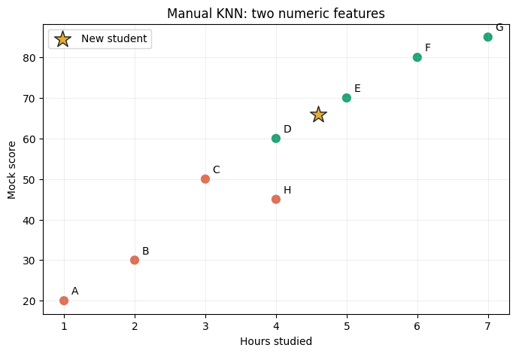
MANUAL EXAMPLE
Plot two features on X and Y axes
Distance on this graph is the foundation of KNN.
Every student becomes a point (X₁, X₂).
Colors show known class labels.
The star is the new, unlabeled student.
KNN finds nearby labeled points.
K-NEAREST NEIGHBORS • CLASSIFICATION
05
Notes:
This chart is extracted from the notebook. Explain that points are geometric representations of feature vectors, and displayed physical distance depends on axes scaling.

Slide 6
THE MATH
Euclidean distance: How close are two points?
d = √[(x₁,new − x₁,train)² + (x₂,new − x₂,train)²]
WORKED EXAMPLE: STUDENT E
New: (4.6, 66)
E: (5, 70)
Distance ≈ 4.02
d(E) = √[(4.6 − 5)² + (66 − 70)²] = √(0.16 + 16) = √16.16 ≈ 4.02
K-NEAREST NEIGHBORS • CLASSIFICATION
06
Notes:
Go step-by-step: subtract feature values, square, add, square root. Explain that this operates on X features only.

Slide 7
MANUAL EXAMPLE
Calculate distances to every training record
Sorted from the closest neighbor to the farthest.
Rank
Student
Distance
Result
1
E
4.02
Pass
K = 3
2
D
6.03
Pass
Use the top
three rows
3
F
14.07
Pass
4
C
16.08
Fail
5
G
19.15
Pass
6
H
21.01
Fail
7
B
36.09
Fail
8
A
46.14
Fail
K-NEAREST NEIGHBORS • CLASSIFICATION
07
Notes:
Sort distances ascending; when K=3 the first three records vote. Distances rounded for display only.

Slide 8
MANUAL EXAMPLE
K=3: Nearest-neighbor majority voting
STUDENT E
STUDENT D
STUDENT F
PASS
PASS
PASS
Distance 4.02
Distance 6.03
Distance 14.07
3 Pass • 0 Fail → PREDICTION: PASS
K-NEAREST NEIGHBORS • CLASSIFICATION
08
Notes:
Voting is independent of distance once the top K are chosen under weights=uniform. The closest neighbor is not automatically more influential in this mode.

Slide 9
CHOOSE K
What does changing K do?
K
Nearest student IDs
Pass votes
Fail votes
Prediction
1
E
1
0
Pass
3
E, D, F
3
0
Pass
5
E, D, F, C, G
4
1
Pass
7
E, D, F, C, G, H, B
4
3
Pass
Notice: changing K can change predictions, but it does not change this example’s result.
K-NEAREST NEIGHBORS • CLASSIFICATION
09
Notes:
This factual table avoids claiming a prediction change that does not happen for this example. Use a separate hypothetical arrangement to illustrate flips if asked.

Slide 10
CHOOSE K
Small K vs large K: Bias–variance tradeoff
SMALL K
LARGE K
Sensitive to local noise
Smooths over local patterns
Detailed / jagged boundaries
Simpler / smoother boundaries
Higher variance
Higher bias if K is too large
Can overfit training points
Can underfit
Choose K using cross-validation — not by guessing.
K-NEAREST NEIGHBORS • CLASSIFICATION
10
Notes:
Define overfitting and underfitting in terms of held-out performance. Large K can over-smooth local class structure.

Slide 11
CHOOSE K
Class voting: Equal vs distance-weighted
A conceptual example in which the two methods disagree.
Neighbor
Distance
Class
1 / distance
UNIFORM VOTING
1
2
Fail
0.500
2 Pass vs 1 Fail
2
5
Pass
0.200
3
8
Pass
0.125
WEIGHTED VOTING
Fail: 0.500
Pass: 0.325
Uniform → PASS
Distance-weighted → FAIL
K-NEAREST NEIGHBORS • CLASSIFICATION
11
Notes:
Scikit-learn weights=distance uses inverse distance by default; special handling applies for exact zero distances. Here the arithmetic illustrates why mode can change decisions.

Slide 12
SCALING
Why KNN generally needs feature scaling
Large numerical ranges can dominate the distance calculation.
Feature
Example difference
Squared contribution
Study hours
1 hour
1² = 1
Mock score
10 marks
10² = 100
The mock score contributes 100× as much to squared distance — solely due to its scale.
K-NEAREST NEIGHBORS • CLASSIFICATION
12
Notes:
Contrast feature importance with numerical range. KNN does not automatically know that study hours matters. The algorithm sees geometry in feature space.

Slide 13
SCALING
StandardScaler and the correct pipeline
STANDARDIZATION
DURING CV
z = (x − μtrain) / σtrain
Fit the scaler only on each fold’s training partition.
PYTHON
Pipeline([(“scaler”, StandardScaler()), (“knn”, KNeighborsClassifier())])
K-NEAREST NEIGHBORS • CLASSIFICATION
13
Notes:
Introduce an imperative rule: transformations that learn statistics should be fitted inside each cross-validation fold. Train and test must not influence each other.

Slide 14
DISTANCE METRICS
Euclidean vs Manhattan distance
Both are supported by KNN; each defines “nearby” differently.
EUCLIDEAN • P = 2
MANHATTAN • P = 1
√(ΔX₁² + ΔX₂²)
|ΔX₁| + |ΔX₂|
New → E: √(0.4² + 4²)
New → E: 0.4 + 4
≈ 4.02
= 4.40
Both distances are scale-sensitive; tune the metric inside CV.
K-NEAREST NEIGHBORS • CLASSIFICATION
14
Notes:
For metric=minkowski, p=1 is Manhattan and p=2 is Euclidean. On transformed data the numerical distances will change.

Slide 15
LEARNING MECHANISM
What exactly happens in fit() and predict()?
.FIT(X, Y)
.PREDICT(NEW X)
VOTING
Stores labeled examples
Transforms new features
Aggregates neighbor labels
Prepares neighbor search
Finds nearest neighbors
Returns predicted class
Unlike linear or logistic regression, KNN does not learn slope and intercept coefficients.
K-NEAREST NEIGHBORS • CLASSIFICATION
15
Notes:
KNN is instance-based / lazy learning. Sklearn may build a search index during fit, so do not say zero computation happens. The point is that no global linear coefficients are estimated.

Slide 16
MODEL INTUITION
KNN: advantages, limitations, and use cases
Where KNN works well
Watch-outs
Simple to understand
Sensitive to scaling and noise
Non-linear decision boundaries
Prediction may be expensive
Useful as a strong baseline
Irrelevant features distort distance
Works with multiple classes
Distance degrades in high dimensions
K-NEAREST NEIGHBORS • CLASSIFICATION
16
Notes:
This is a useful transition from intuition to the practical. Keep the discussion anchored to feature geometry and test performance.

Slide 17
DATASET
The standard dataset: Iris
Built into scikit-learn; no download, Kaggle account, or CSV required.
150
3
4
Flower records
Species/classes
Original input features
FOR THIS EXERCISE WE SELECT 2 FEATURES
Petal length (cm)
Petal width (cm)
Target classes: setosa, versicolor, virginica
K-NEAREST NEIGHBORS • CLASSIFICATION
17
Notes:
Iris is a three-class classification task; odd K does not guarantee a tie-free outcome in multiclass classification. Two features are selected to show a boundary plot.

Slide 18
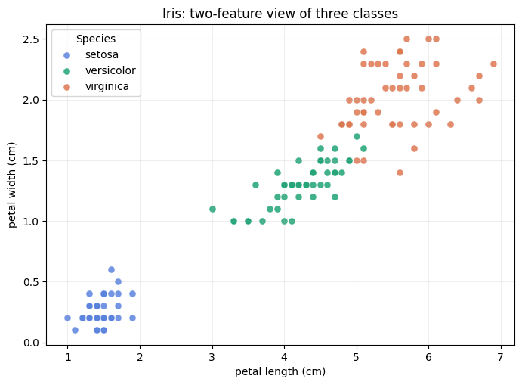
DATASET
Visualize Iris: petal length and width
Can you spot where classes overlap?
Setosa is clearly separated.
Versicolor and virginica overlap.
KNN predicts using nearby labeled flowers.
K-NEAREST NEIGHBORS • CLASSIFICATION
18
Notes:
Ask trainees what mistakes they expect, based on overlaps. No need to derive a separating line. That is part of why KNN is easy to visualize.

Slide 19
EVALUATION PLAN
Train/test split: Keep the test set untouched
75% TRAINING • 112 FLOWERS
25% TEST • 38
Cross-validation and hyperparameter selection
Final evaluation once
stratify=y • random_state=42
K-NEAREST NEIGHBORS • CLASSIFICATION
19
Notes:
Iris has 150 rows. With test_size=.25 the split yields 112 train and 38 test. Stratification keeps approximately equal class proportions.

Slide 20
EVALUATION PLAN
Five-fold stratified cross-validation
Each round holds out one training fold for validation.
Round 1
VALIDATE
TRAIN
TRAIN
TRAIN
TRAIN
Round 2
TRAIN
VALIDATE
TRAIN
TRAIN
TRAIN
Round 3
TRAIN
TRAIN
VALIDATE
TRAIN
TRAIN
Round 4
TRAIN
TRAIN
TRAIN
VALIDATE
TRAIN
Round 5
TRAIN
TRAIN
TRAIN
TRAIN
VALIDATE
Report mean validation score and standard deviation across folds.
K-NEAREST NEIGHBORS • CLASSIFICATION
20
Notes:
Stress that test fold in cv_results is validation on training data, not the reserved X_test. Stratified folds preserve the class distribution approximately.

Slide 21
GRID SEARCH
Which hyperparameters shall we tune?
Parameter
Candidates
Meaning
knn__n_neighbors
1, 3, 5, …, 21
Number of neighbors
knn__weights
uniform / distance
Equal or distance-weighted votes
knn__p
1 / 2
Manhattan / Euclidean
11
× 2
× 2
= 44
K values
Voting choices
Distance choices
Total models
K-NEAREST NEIGHBORS • CLASSIFICATION
22
Notes:
With 5 folds: 44 parameter combinations multiplied by 5 gives 220 cross-validation fits, then GridSearchCV refits the winner on all training rows.

Slide 22
GRID SEARCH
GridSearchCV: The essential Python code
cv = StratifiedKFold(n_splits=5, shuffle=True, random_state=42)
grid = GridSearchCV(
estimator=knn_pipeline,
param_grid={"knn__n_neighbors": range(1, 22, 2),
"knn__weights": ["uniform", "distance"],
"knn__p": [1, 2]},
scoring="accuracy", cv=cv, refit=True
)
grid.fit(X_train, y_train)
K-NEAREST NEIGHBORS • CLASSIFICATION
23
Notes:
Explain the estimator receives a Pipeline, why parameters have prefix knn__, the meaning of scoring, cv, refit and why X_test is not passed to .fit().

Slide 23
GRID SEARCH
How to interpret CV results
mean_test_score
Mean fold validation accuracy
std_test_score
Spread of validation scores
mean_train_score
Mean performance on fold train data
rank_test_score
Rank across parameter combinations
best_params_
Winning hyperparameters
best_score_
Best mean CV validation accuracy
“test_score” inside CV ≠ the final hold-out test score.
K-NEAREST NEIGHBORS • CLASSIFICATION
24
Notes:
Point out the confusing naming in sklearn: CV results call validation data test folds, but this is different from the held-out X_test used once at the end.

Slide 24
GRID SEARCH
Observed results from the executed notebook
K = 5
p = 1
uniform
Selected neighbors
Manhattan distance
Voting weights
97.4%
94.7%
Mean 5-fold CV accuracy
Held-out test accuracy
The winning model did not outperform the K=5 baseline’s CV score; tuning verified the choice.
K-NEAREST NEIGHBORS • CLASSIFICATION
25
Notes:
Fixed seed and 5-fold stratified CV produced best_params_: k=5,p=1,uniform; best_score about 0.974, test 0.947. Cross-validation does not guarantee improvement relative to a good baseline.

Slide 25
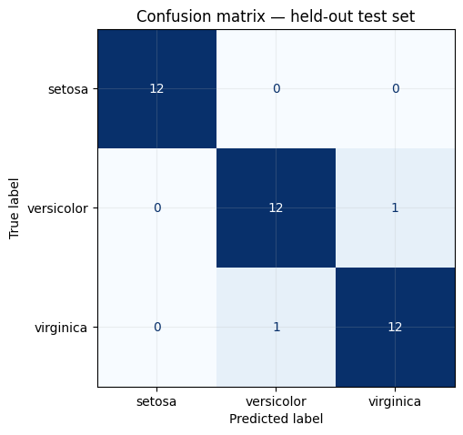
RESULTS
Final evaluation: 38 untouched Iris examples
The confusion matrix reveals *which* classes are confused.
36 / 38
Correct predictions
94.7%
Held-out test accuracy
Precision • Recall • F1
K-NEAREST NEIGHBORS • CLASSIFICATION
27
Notes:
Explain diagonal of confusion matrix = correct predictions. Two incorrect observations total. Test accuracy is not the same as CV accuracy and may differ because of sampling variability.

