Slide 1
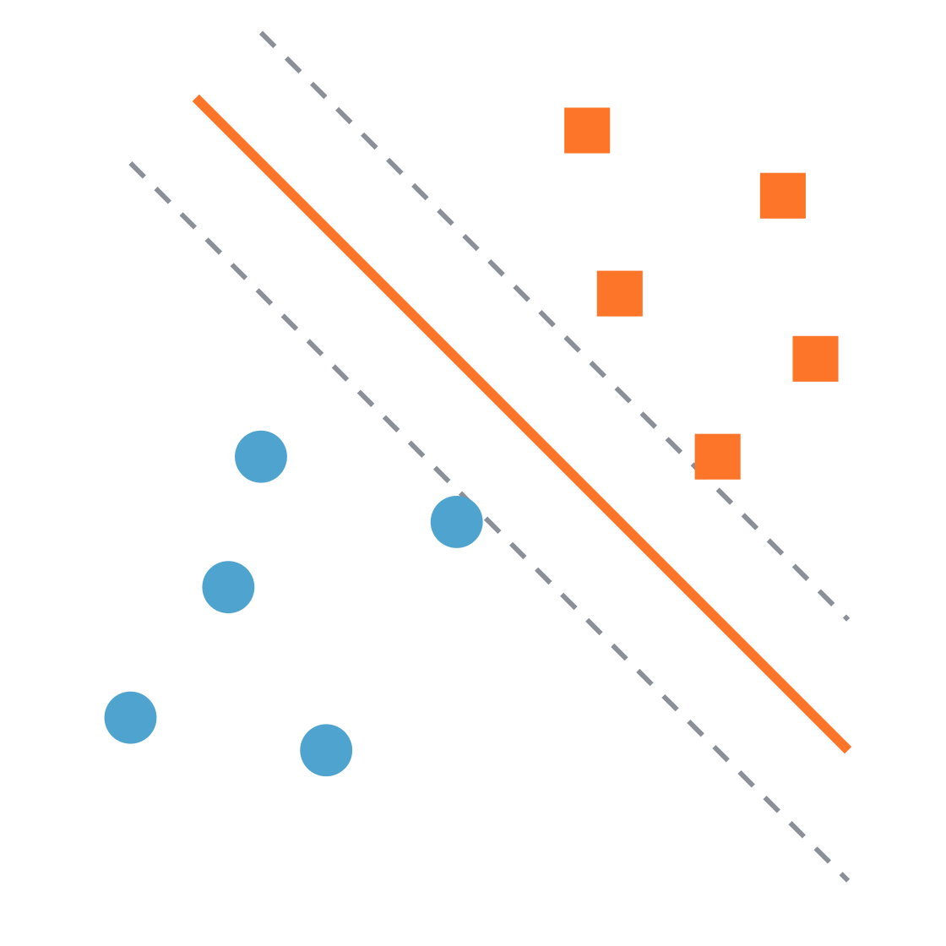
Support vector machines
Practical machine learning
Finding the widest street between two classes
Notes:
Welcome. Today we learn one classifier, SVM, built up in four small steps. The picture on the right is the whole idea: two groups of points, and a line that sits in the middle of the widest empty street between them. By the end, every part of that picture will have a name.

Slide 2
Four ideas, one after another
Roadmap
01
02
03
04
Maximum margin
Support vectors
Soft margin and C
Kernels
Pick the line with the widest street
Only the points on the edge matter
Allow a few mistakes, at a price
Bend the boundary when a line is not enough
Support vector machines · Practical machine learning
Notes:
Each step answers a problem raised by the previous one. Step 1: many lines separate the data, so which one? Step 2: which points decide that line? Step 3: what if the data is messy? Step 4: what if no straight line works at all? Keep pointing back to this slide as you move between sections.

Slide 3
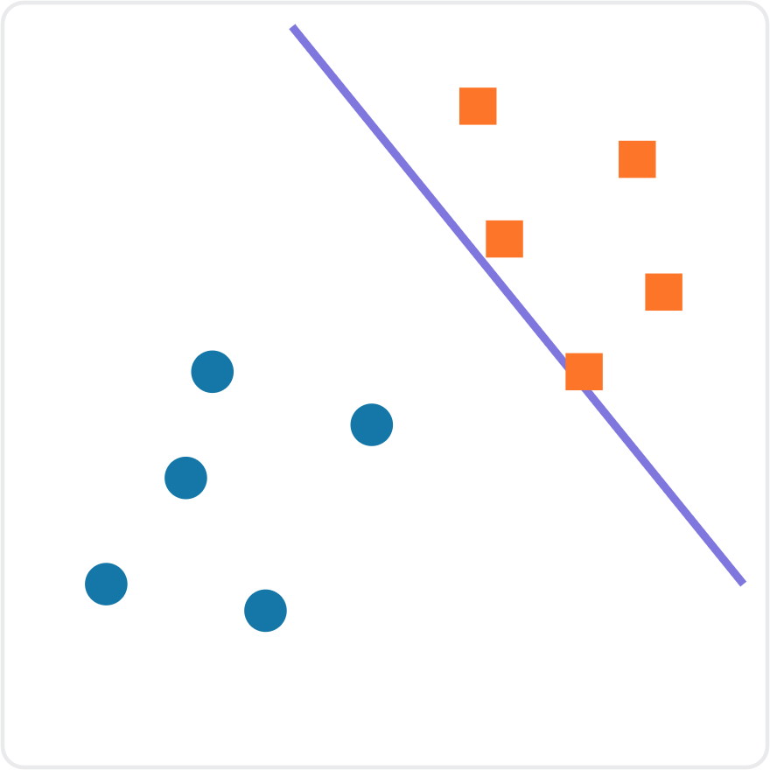
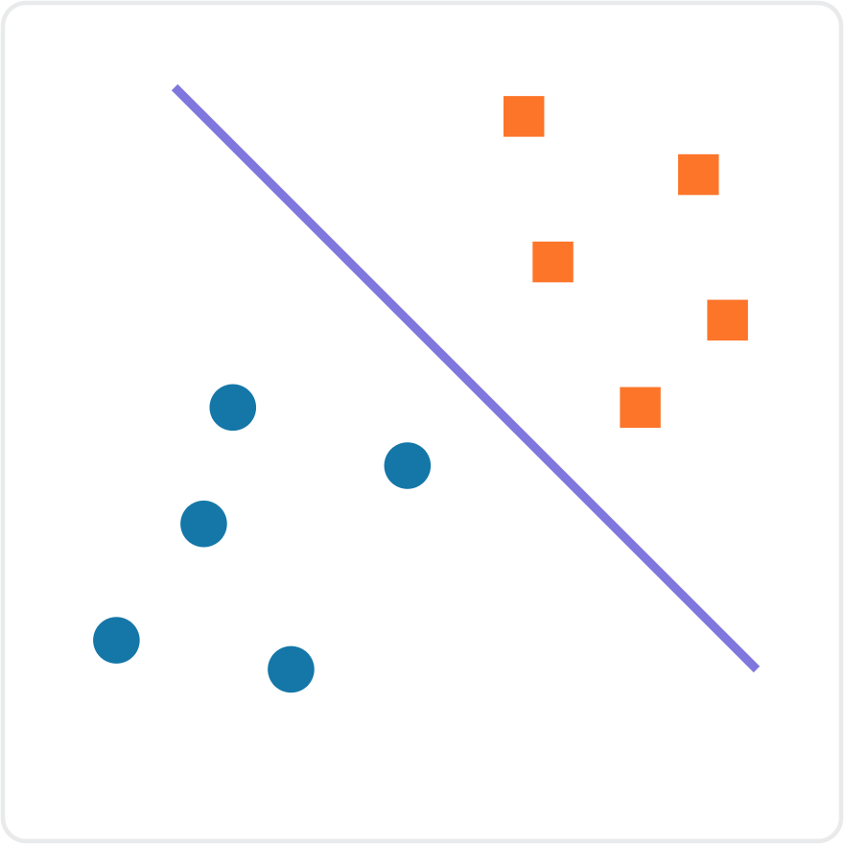
Both lines separate the data. Which one would you trust?
Step 1 · Maximum margin
Line A
Line B
Support vector machines · Practical machine learning
Notes:
Ask the class before revealing anything: both lines classify every training point correctly, so which one would you trust when a new point arrives near the boundary, and why? Expected answer: Line B, because it leaves room on both sides. Line A squeezes right past the squares, so a new square that lands slightly closer to the circles would be misclassified.

Slide 4
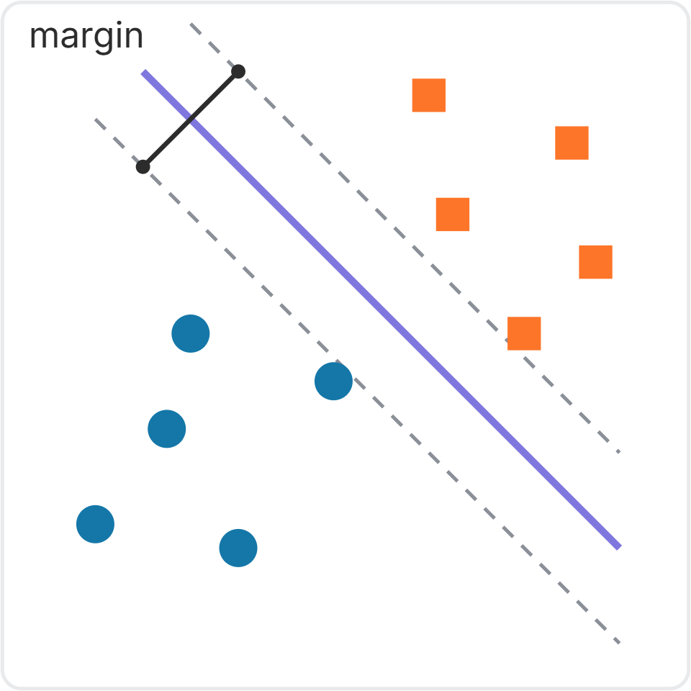
Choose the line with the widest gap
Step 1 · Maximum margin
For perfectly separated data, the margin is the gap between the closest points of the two classes.
The dashed lines mark the edges of this margin, with the decision boundary in the middle.
SVM's goal: find the line with the maximum margin.
A wide margin often improves generalization, but it does not guarantee higher test accuracy.
Support vector machines · Practical machine learning
Notes:
Define the decision boundary as the solid line. In hard-margin SVM, the dashed lines pass through the closest training points, and the width between them is the full margin. A larger margin makes small data changes less likely to flip predictions, but test performance also depends on noise, feature quality, and model flexibility. Do not claim a guarantee.

Slide 5
In any number of dimensions, the boundary is a hyperplane
Step 1 · Maximum margin
1 feature
2 features
3 features
n features
A single point
A line
A flat plane
A hyperplane
SVM finds the maximum-margin hyperplane: the widest street, in as many dimensions as your data has features.
Support vector machines · Practical machine learning
Notes:
Students will meet the word hyperplane in every SVM resource, so name it now. It is just the general name for the dividing boundary: a point on a number line, a line on a plane, a flat sheet in 3D. With 20 features you cannot picture it, but it is still a flat wall splitting the space into two sides.

Slide 6
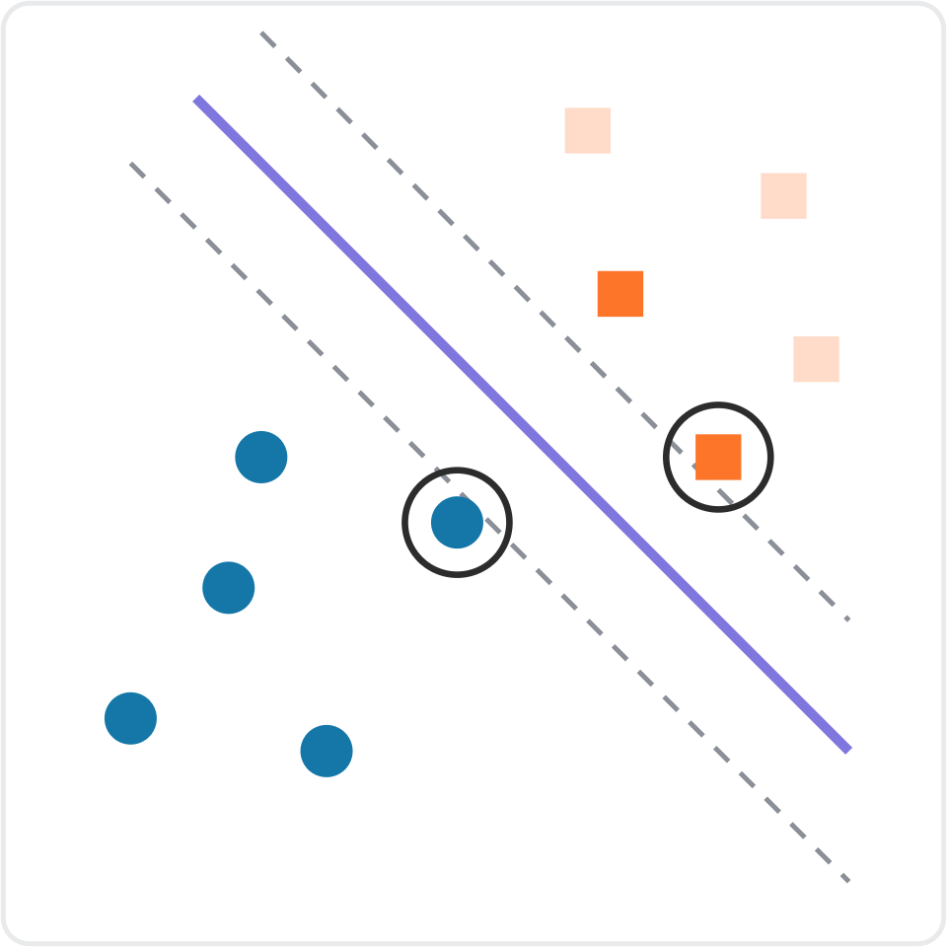
Support vectors are the points that shape the boundary
Step 2 · Support vectors
Here, the ringed points touch the margin edges. These are support vectors.
A point far from the margin usually has no effect on the boundary.
Moving a support vector can shift the separating boundary.
With a soft margin, points inside the margin can also be support vectors.
Support vector machines · Practical machine learning
Notes:
In this perfectly separable illustration, the ringed observations touching the dashed lines are support vectors. The other, distant observations normally do not constrain the optimum. In soft-margin SVM, some support vectors lie inside the margin or can even be misclassified; they are not limited to points exactly on the margin. Moving a support vector can influence the fitted boundary, but this is not guaranteed for every tiny movement.

Slide 7
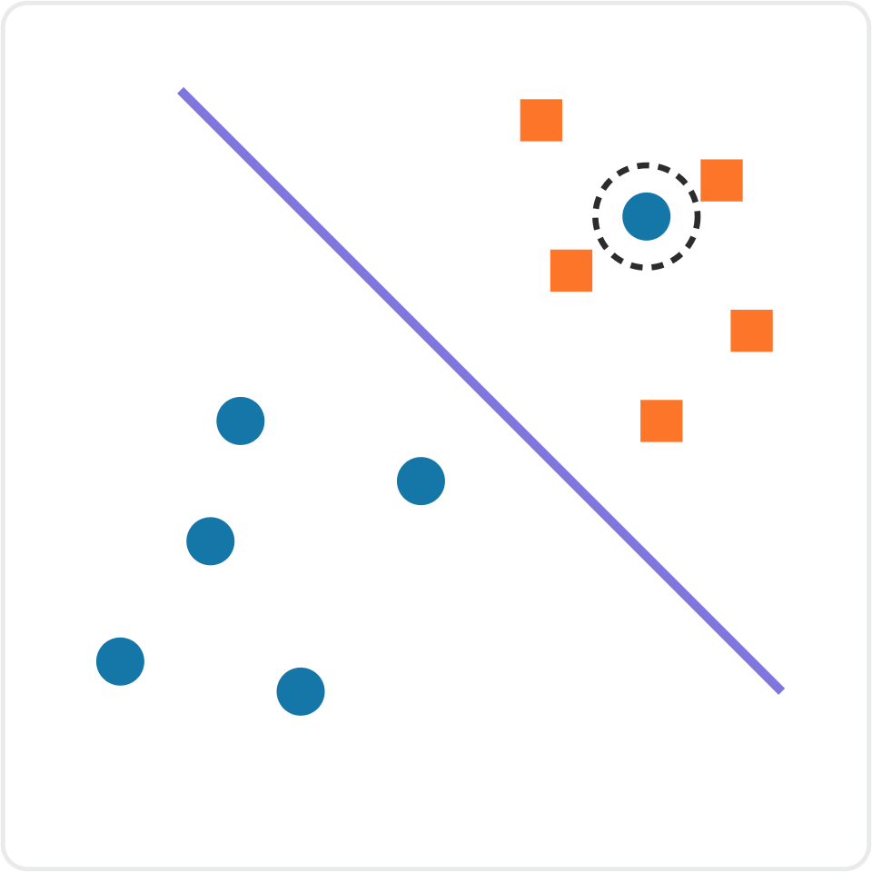
Real data is messy
Step 3 · Soft margin
One stray circle sits among the squares: perhaps noise, perhaps a labelling mistake.
Now no straight line separates the classes perfectly. Forcing a near-perfect split makes the street very narrow.
Discuss
Should SVM bend over backwards to classify this point, or accept it as a mistake to keep the wide street? What does each choice cost?
Support vector machines · Practical machine learning
Notes:
Let students argue both sides. Fitting the stray point costs margin and risks learning noise. Ignoring it costs one training error but keeps a wide, stable street. The honest answer is that it depends on whether the point is noise or a real pattern, which is exactly why SVM gives us a dial on the next slides.

Slide 8
Soft margin: allow a few mistakes, at a price
Step 3 · Soft margin
Allow
Penalize
Balance
Some points may sit inside the street, or even on the wrong side.
Every violation adds a penalty to what SVM is minimizing.
SVM trades off a wide street against a small total penalty.
A hard margin demands a perfect split. A soft margin is the default in practice, because real data is rarely perfectly separable.
Support vector machines · Practical machine learning
Notes:
Hard margin: no point may violate the street, which only works on perfectly separable data. Soft margin: violations are allowed but cost a penalty. SVM now has two goals that pull against each other, a wide street and few violations. The next slide shows the dial that sets the balance.

Slide 9
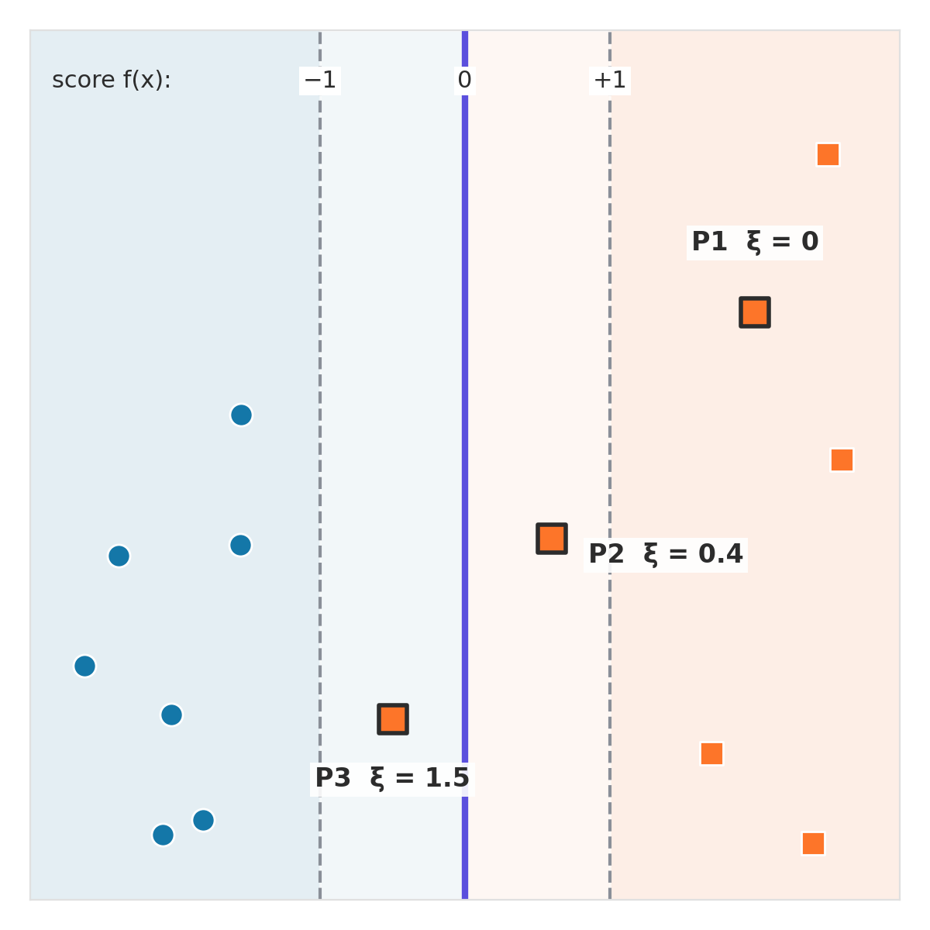
What counts as a mistake: the slack ξ
Step 3 · Soft margin
Each point gets a score f(x). The street runs from −1 to +1, with the boundary at 0.
P1: outside the street, on its own side. No penalty: ξ = 0.
P2: inside the street but still correct: 0 < ξ < 1. P3: on the wrong side: ξ > 1.
Slack ξ ("xi") = how far a point sits past its own margin edge.
Support vector machines · Practical machine learning
Notes:
Introduce the score f(x) = w · x + b. The solid line is where f(x) = 0, and the dashed margin edges are where f(x) = −1 and +1. Slack, written ξ (the Greek letter xi), measures how far a point is past its own margin edge. Three cases: outside the street on its own side, ξ = 0; inside the street but still correct, ξ between 0 and 1; on the wrong side of the boundary, ξ greater than 1. All three highlighted points are orange squares with true class +1.

Slide 10
How the slack ξ is calculated
Step 3 · Soft margin
ξ = max(0, 1 − y · f(x)) y = true class (+1 or −1)
Point (true class y = +1) | Score f(x) | ξ = max(0, 1 − y · f(x)) | Where it sits
P1 | 2.0 | max(0, 1 − 2.0) = 0 | Outside: no penalty
P2 | 0.6 | max(0, 1 − 0.6) = 0.4 | Inside: small penalty
P3 | −0.5 | max(0, 1 + 0.5) = 1.5 | Wrong side: misclassified
Total penalty = C × (0 + 0.4 + 1.5) = C × 1.9. With C = 0.1 that adds 0.19; with C = 10 it adds 19.
Support vector machines · Practical machine learning
Notes:
Walk through the formula one row at a time. For these orange points y = +1, so y times f(x) is just the score. A score of 1 or more means the point is at or beyond its own margin edge, so the penalty is 0. Below 1, the penalty grows in a straight line the further the point goes. This penalty is called the hinge loss. The total penalty is C times the sum of the slacks, which is exactly why C is the price of each mistake. For a blue point (y = −1), a score of −2 gives max(0, 1 − 2) = 0.

Slide 11
The one formula SVM minimizes
Step 3 · Soft margin
Wide street: ½‖w‖²
Few mistakes: Σξᵢ
C sets the balance
The margin width is 2 ÷ ‖w‖, so a smaller ‖w‖ means a wider street.
Add up the slack of every training point, as on the previous slide.
Cost = ½‖w‖² + C × Σξᵢ. C decides which part matters more.
SVM does not try lines one by one. An optimizer finds the w and b with the lowest total cost; in scikit-learn this happens inside fit().
Support vector machines · Practical machine learning
Notes:
This is the soft-margin SVM objective: minimize half the squared length of w plus C times the sum of the slacks. The first term keeps the street wide because the margin width is 2 divided by the length of w. The second term keeps mistakes small. C decides which term matters more. The problem is convex, so there is one best solution, and scikit-learn finds it with an optimizer inside fit(). Students do not need to solve it by hand.

Slide 12
C sets the price of each mistake
Step 3 · Soft margin
 | Small C | Large C
Each mistake is | Cheap | Expensive
The street is | Typically wider | Typically narrower
Training errors | More violations tolerated | Fewer violations preferred
Main risk | May underfit (high bias) | May overfit (high variance)
In scikit-learn, SVC(C=1.0) is the default. Tune C with cross-validation rather than guessing.
Support vector machines · Practical machine learning
Notes:
C is the regularization strength in inverse form: larger C penalizes margin violations more strongly, smaller C less strongly. The table describes tendencies rather than guarantees. A large C can fit noisy points more tightly and increase overfitting risk, whereas very small C can underfit. SVC defaults to C=1.0. Use stratified cross-validation to select C; use a pipeline with scaling before CV.

Slide 13
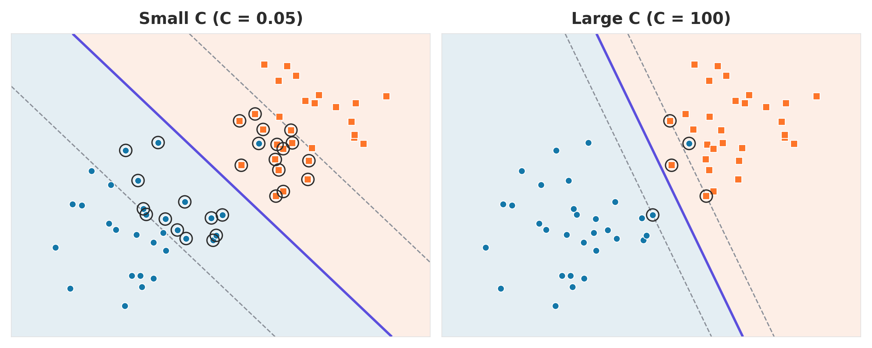
The same data with small C and large C
Step 3 · Soft margin
Small C: wide street, many support vectors (ringed)
Large C: narrow street that tilts to the stray point
Support vector machines · Practical machine learning
Notes:
Synthetic data with one stray blue point among the orange squares, trained twice with a linear kernel after scaling. With C = 0.05 the street is about three times wider, and 28 points are support vectors because many sit inside the wide street. With C = 100 the street narrows and tilts toward the stray point, and only 5 points are support vectors. In both cases the stray point stays misclassified: a straight line cannot reach it without misclassifying other points.

Slide 14
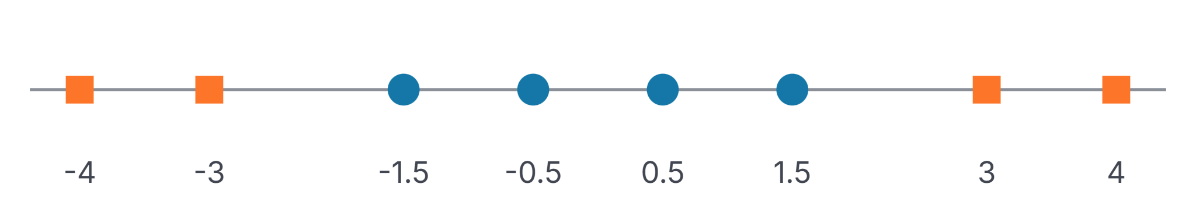
When no straight line can separate the data
Step 4 · Kernels
On a number line, the boundary is a single cut point. The squares sit at both ends, so no single cut can put all circles on one side and all squares on the other.
Support vector machines · Practical machine learning
Notes:
Ask: if each point could get a second coordinate computed from x, which formula would lift the outer squares high and keep the middle circles low? Accept x squared or the absolute value of x. Both work; x squared is the textbook choice and the one the next slide uses.

Slide 15
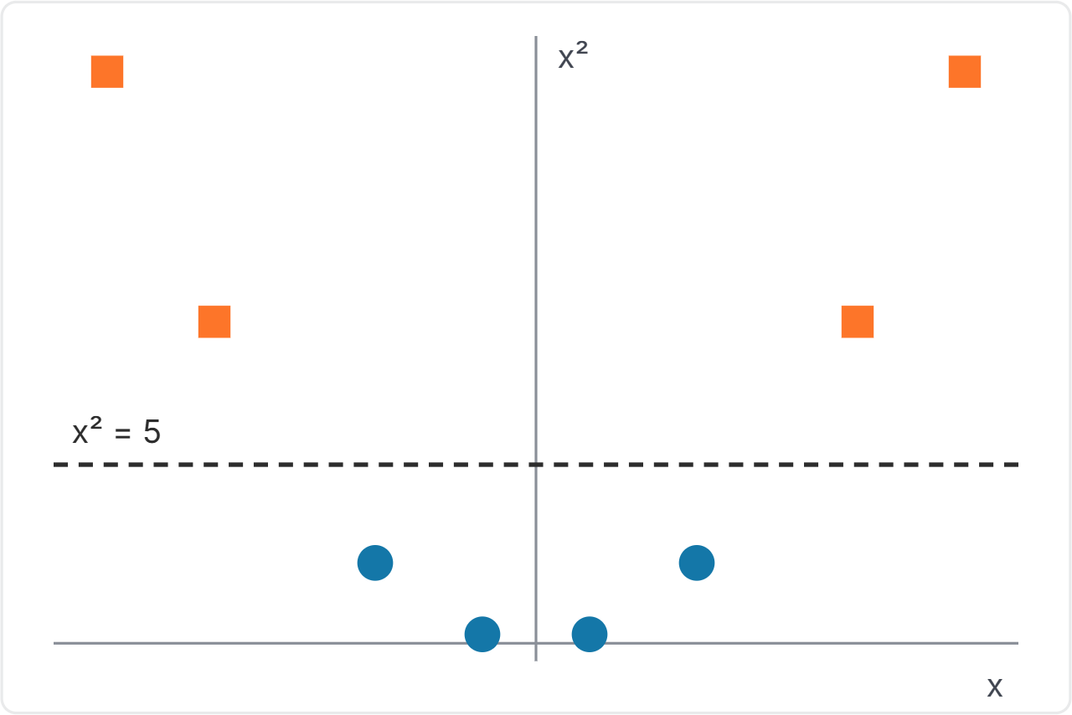
Add a feature: map each x to (x, x²)
Step 4 · Kernels
The squares rise high. The circles stay low.
A flat line at x² = 5 now separates them perfectly.
Back on the original number line, that line is two cut points: x = ±√5, about ±2.24.
The idea: if the data cannot be separated where it is, move it to a higher dimension where it can.
Support vector machines · Practical machine learning
Notes:
Walk through the numbers: the squares at plus or minus 3 and 4 land at heights 9 and 16, the circles at heights 2.25 and 0.25. A straight line in the new space corresponds to a curved, or here split, boundary in the original space. That is the core idea behind kernels. The next slides explain how SVM does this cheaply.

Slide 16
Kernels you will use in scikit-learn
Step 4 · Kernels
Kernel | What it does | Use it when
linear | No transformation | The data is roughly separable as it is
poly | Adds powers and products of features | You expect a smooth curved boundary
rbf (default) | Similarity falls off with distance | General-purpose curved or island-shaped boundaries
gamma (RBF) controls how locally each point influences the boundary. Higher gamma may overfit; tune it with C.
Support vector machines · Practical machine learning
Notes:
In scikit-learn SVC, the default kernel is rbf. Linear uses the original feature space; polynomial allows polynomial boundaries; RBF can capture local nonlinear patterns. Gamma governs the scale of influence for RBF: large gamma usually means more localized influence and potentially a more complex boundary, though this is only a tendency. For linear SVM, gamma is not used. Scale features, then use GridSearchCV to tune kernel, C, and RBF gamma.

Slide 17
What gamma does: the RBF similarity
Step 4 · Kernels
K(x, z) = exp(−γ × distance²) 1 = same point, 0 = no influence
Distance x to z | γ = 0.1 | γ = 1 | γ = 10
0.5 | 0.98 | 0.78 | 0.08
1 | 0.90 | 0.37 | 0.00005
3 | 0.41 | 0.0001 | ≈ 0
Small γ: distant points still count, so the boundary is smooth. Large γ: only close points count, so it can overfit.
Support vector machines · Practical machine learning
Notes:
The RBF kernel measures how similar two points are: 1 when they are the same point, falling toward 0 as they move apart. Gamma sets how fast it falls. With gamma 0.1, points 3 units apart are still 0.41 similar, so each training point influences a wide area. With gamma 10, points only 1 unit apart are almost unrelated, so each point influences just its immediate neighbourhood. That is why a large gamma gives a wiggly boundary. Distances are measured after scaling.

Slide 18
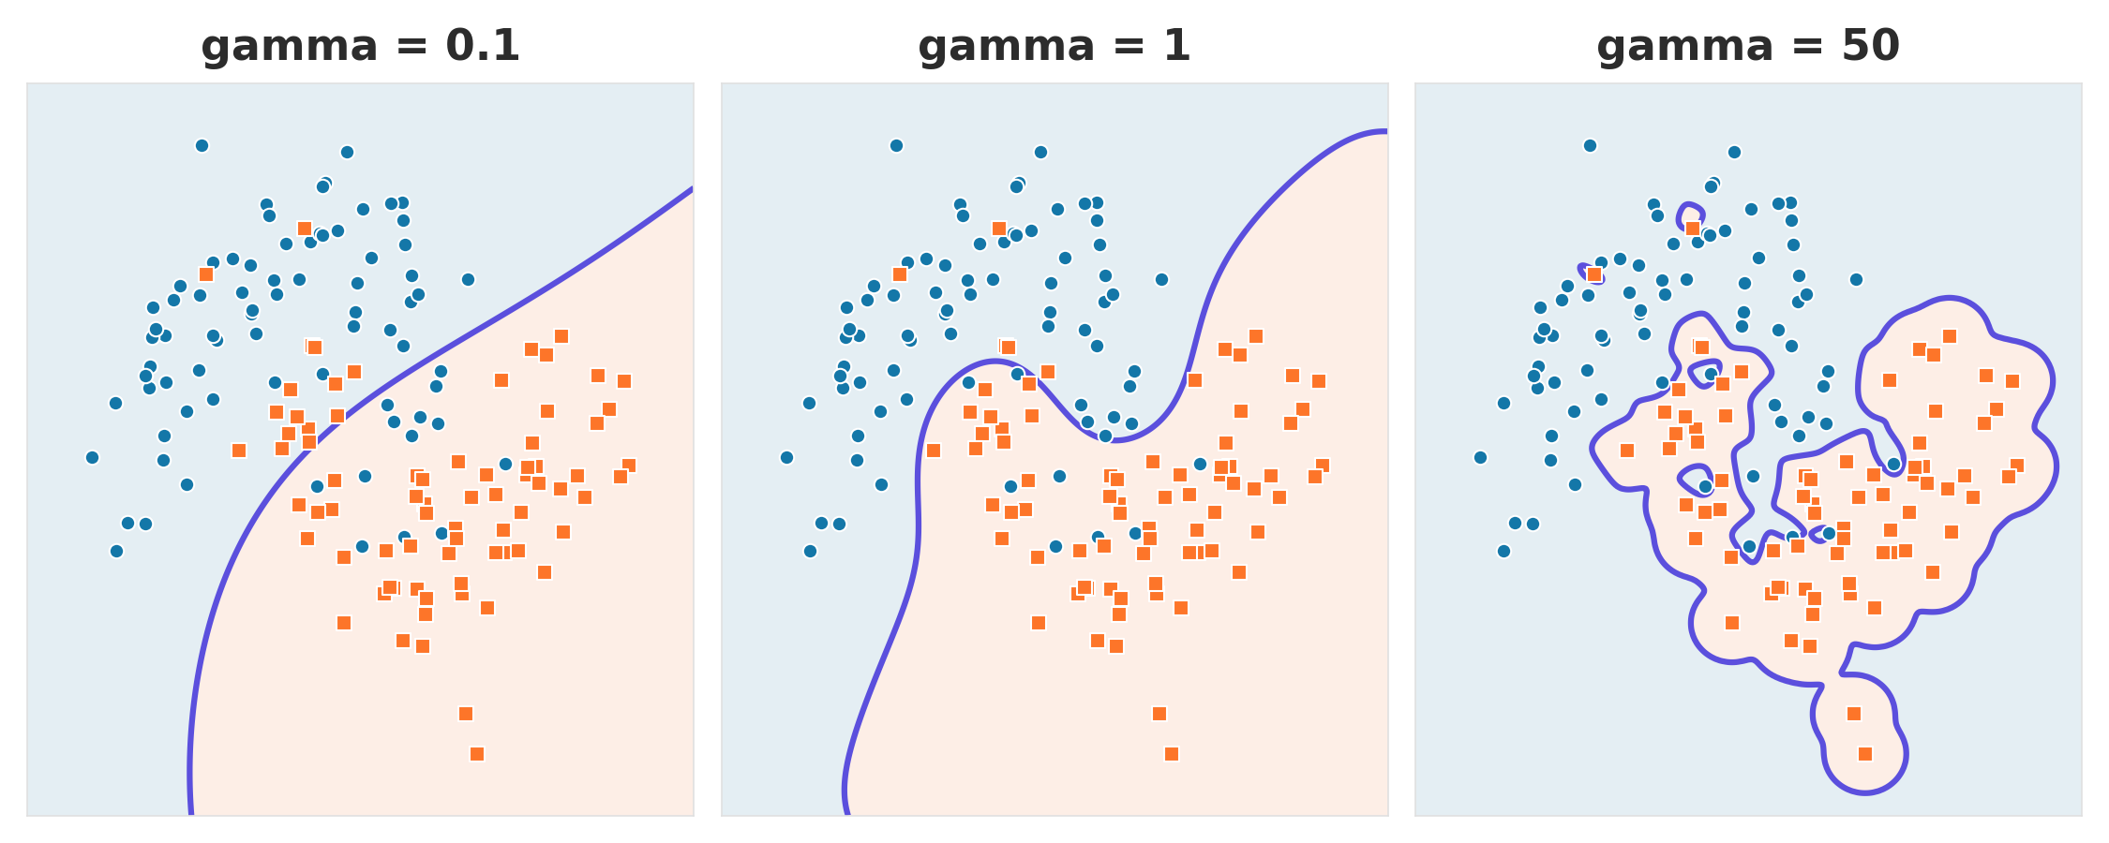
The same data with three gamma values
Step 4 · Kernels
0.1: too smooth · 1: follows the curve · 50: wraps single points and overfits
Support vector machines · Practical machine learning
Notes:
Same noisy two-moons data, RBF kernel, C = 1, three gamma values. Gamma 0.1 is too smooth and underfits. Gamma 1 follows the curved pattern. Gamma 50 draws small islands around individual points: it fits the training data closely but will generalize badly. Tune gamma together with C using cross-validation. Synthetic illustration.

Slide 19
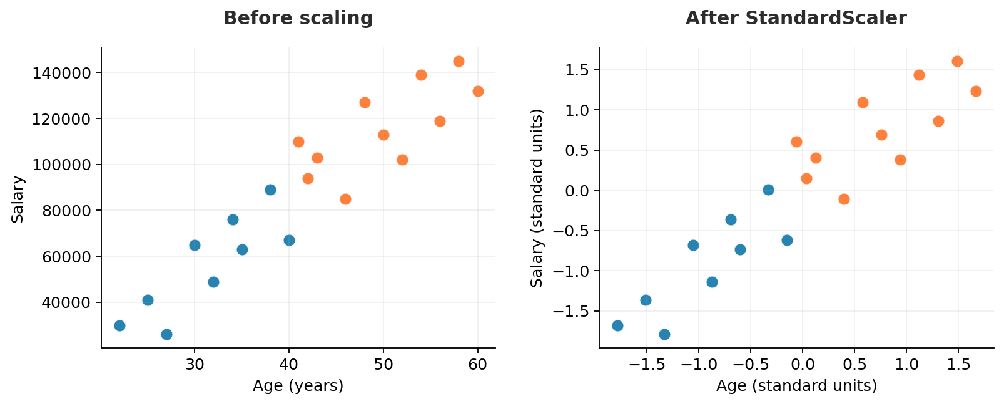
Why SVM needs feature scaling
Practical SVM · Data preparation
Think about the units
Age: 20–60
Salary: ₹20,000–₹150,000
Scaling puts them on comparable numerical scales.
In practice: StandardScaler inside a Pipeline — fit only on training folds.
Support vector machines · Practical machine learning
Notes:
Explain that SVM with RBF uses distances between feature vectors, so a salary variable ranging in thousands can dominate age measured in tens. StandardScaler subtracts the training mean and divides by training standard deviation. The plot is a synthetic illustration, not a real dataset. Critically: do not fit the scaler on all data before splitting or before cross-validation. Use make_pipeline(StandardScaler(), SVC()) so training folds fit their own scaling parameters.

Slide 20
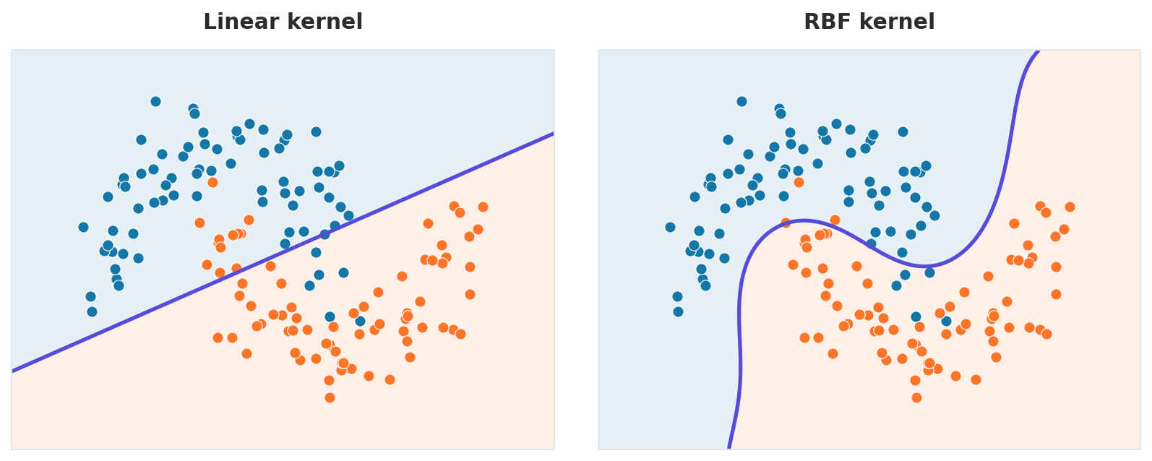
The same data: linear boundary vs RBF
Practical SVM · Kernel choice
Linear: a straight boundary misses part of the curve.
RBF: a curved boundary can capture the pattern.
Support vector machines · Practical machine learning
Notes:
Both plots use exactly the same synthetic two-moons dataset, standardized before fitting for demonstration. The linear SVM has a straight boundary and cannot represent the curved pattern well. The RBF SVM creates a nonlinear boundary. Explain that nonlinear does not automatically mean better: noisy data can cause overfitting, so evaluate on held-out data and tune C and gamma using cross-validation.

Slide 21
SVM separates two classes. Wine has three.
Practical SVM · Multiclass
Model 1
Model 2
Model 3
Prediction
Class 0 vs 1
Class 0 vs 2
Class 1 vs 2
Most votes wins
SVC uses one-vs-one: one model per pair of classes, k(k − 1) ÷ 2 in total. scikit-learn does this automatically.
Support vector machines · Practical machine learning
Notes:
SVM on its own is a binary classifier. SVC handles more classes with one-vs-one: it trains one model for every pair of classes, each model votes for one of its two classes, and the class with the most votes is the prediction. With 3 classes that is 3 models; with 10 classes it is 45. LinearSVC uses one-vs-rest instead, one model per class. fit() and predict() handle all of this automatically.

Slide 22
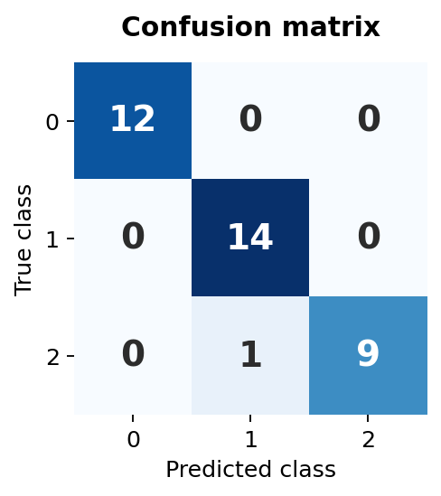
Train and evaluate SVM on the Wine dataset
Practical SVM · scikit-learn
Minimal Python workflow
from sklearn.datasets import load_wine
from sklearn.model_selection import train_test_split
from sklearn.pipeline import make_pipeline
from sklearn.preprocessing import StandardScaler
from sklearn.svm import SVC
X, y = load_wine(return_X_y=True)
X_train, X_test, y_train, y_test = train_test_split(
X, y, test_size=0.2, stratify=y, random_state=42)
model = make_pipeline(StandardScaler(), SVC())
model.fit(X_train, y_train)
y_pred = model.predict(X_test)
Illustrative held-out accuracy: 97.2%
Support vector machines · Practical machine learning
Notes:
This example is reproducible using scikit-learn load_wine (three wine classes, not Iris). Train/test split is stratified with 20% held out and random_state=42. make_pipeline(StandardScaler(), SVC()) prevents scaling leakage because the scaler is fit on the training data. SVC defaults to the RBF kernel and C=1.0. The displayed matrix is computed from the exact code on this slide; test accuracy is 97.2%. To plot the matrix, run ConfusionMatrixDisplay.from_predictions(y_test,y_pred). Inspect class-by-class errors, not accuracy alone.

Slide 23
Tune kernel, C and gamma with GridSearchCV
Practical SVM · Parameter tuning
Use the same training split from the previous slide
C
Penalty for margin violations
params = [
{"svc__kernel": ["linear"], "svc__C": [0.1, 1, 10]},
{"svc__kernel": ["rbf"], "svc__C": [0.1, 1, 10],
"svc__gamma": ["scale", 0.1]}
]
grid = GridSearchCV(
make_pipeline(StandardScaler(), SVC()),
params, cv=5, scoring="accuracy")
grid.fit(X_train, y_train)
print(grid.best_params_)
print(grid.score(X_test, y_test))
gamma
RBF influence range
5-fold CV best:
linear, C=0.1
CV 98.6% · Test 97.2%
Important: tune only using training data. Report the test score once after selecting the model.
Support vector machines · Practical machine learning
Notes:
Run the grid only on X_train and y_train; the scaler is inside the pipeline and is refit separately on each cross-validation training fold. We use distinct grid settings for linear and RBF because gamma is irrelevant to linear. GridSearchCV uses 5-fold stratified CV for this classifier, picks the highest mean validation accuracy and refits on the full training set by default. In this reproducible illustrative Wine split, best parameters are {'svc__C': 0.1, 'svc__kernel': 'linear'} with mean CV accuracy 0.9862 and held-out test accuracy 0.9722. Do not tune on the test set.

Slide 24
SVM in four steps
Recap
01
Maximum margin
Of all separating hyperplanes, pick the one with the widest street.
02
Support vectors
The observations with nonzero dual weights determine the fitted decision boundary.
03
Soft margin and C
Allow some mistakes; C sets how much each one costs.
04
Kernels
Use a kernel to handle nonlinear patterns, without explicitly creating high-dimensional features.
Notes:
Recap the four conceptual steps. First maximize the separation margin. Second understand that support vectors determine the classifier, including points inside the margin in the soft-margin setting. Third allow violations and use C to control their penalty. Fourth use kernels to handle nonlinear relationships. Reinforce that feature scaling and cross-validated hyperparameter tuning are practical requirements.

Slide 25
Answer in your own words
Check your understanding
Question 1
Question 2
Why might a wider margin help generalization?
What happens to the boundary if you delete a point that is not a support vector?
Question 3
Question 4
Which setting of C risks overfitting, and why?
Why does SVM only need the support vectors to make a prediction?
Support vector machines · Practical machine learning
Notes:
Suggested answers: 1. A large margin makes the boundary less sensitive to modest changes, but does not guarantee generalization. 2. Removing a non-support vector generally does not alter the learned decision function, provided the optimum is otherwise unchanged. 3. Large C may overfit by penalizing violations heavily; small C may underfit. 4. In a dual/kernel SVM, non-support vectors have alpha equal to zero, so only support vectors contribute to predictions. Ask students additionally why we scale the features and when RBF may be preferable to linear. Bonus: a point has true class y = +1 and score f(x) = 0.2. What is its slack? (Answer: max(0, 1 − 0.2) = 0.8, inside the street on the correct side.)

Slide 26
OPTIONAL DEEP DIVE
How the kernel trick works
Dot products · dual coefficients · mathematical kernels
Use these four slides only if the class needs the mathematical explanation.
Notes:
The main practical lesson is complete. The remaining four slides are optional for groups that want to understand how the mathematical kernel trick is implemented. The primary learning objective is to train and validate a scaled SVC correctly; these advanced formulas are not required to use scikit-learn.

Slide 27
Dot product: alignment also depends on vector size
Step 4 · Kernels
a · b = a₁b₁ + a₂b₂ Multiply matching coordinates, then add.
Compare a = (3, 1) with | Dot product | Direction | Meaning
b = (3, 2) | 9 + 2 = 11 | Same way | Similar
c = (1, −3) | 3 − 3 = 0 | Right angle | Unrelated
d = (−3, −1) | −9 − 1 = −10 | Opposite | Dissimilar
The sign indicates alignment; the value also depends on vector lengths. It is not a normalized similarity score.
Support vector machines · Practical machine learning
Notes:
This mathematical appendix illustrates dot products: for vectors a and b, multiply corresponding coordinates and sum them. Positive means an acute angle, zero means perpendicular and negative means an obtuse angle. The size of the dot product also depends on each vector’s length, so do not interpret 11 as a normalized similarity score. Cosine similarity divides by both lengths to focus on orientation. In kernels, the dot product helps express the SVM decision function.

Slide 28
Dot products are already inside SVM
Step 4 · Kernels
Which side of the street?
How SVM predicts
w · x + b
sign( Σ αᵢ yᵢ (xᵢ · x) + b )
Positive: one class. Negative: the other. Zero: on the boundary. The margin edges are where it equals +1 and −1.
Each training example has a weighted contribution; only support vectors have nonzero αᵢ.
The margin is the goal. The dot product is the tool SVM uses to reach it and to make predictions.
Support vector machines · Practical machine learning
Notes:
For the binary linear SVM decision rule, the sign of w dot x + b sets the predicted class. Margin boundaries are at +1 and −1 under the usual canonical scaling. In the dual form, the decision score is the sum over training samples of alpha_i times y_i times a dot product, plus b. This is a weighted mathematical contribution, not a KNN-style majority vote. Only support vectors have nonzero alpha_i; the model chooses these coefficients during optimization. The formula is an optional advanced topic.

Slide 29
Predictions depend only on the support vectors
Step 4 · Kernels
αᵢ = 0
αᵢ > 0
For every point far from the street. It drops out of the sum.
Only for the support vectors, the points holding the street in place.
Example: train on 10,000 points and end up with 50 support vectors. Each prediction then needs 50 comparisons, not 10,000.
Support vector machines · Practical machine learning
Notes:
In the dual decision function, alpha is zero for non-support vectors and positive for support vectors. Therefore, only the support vectors appear in the sum. A model might have 50 support vectors out of 10,000 observations, but 50 is illustrative, not typical or guaranteed. Do not infer that all SVM models are fast: if many observations become support vectors, kernel SVM prediction can become costly.

Slide 30
The kernel trick: dot products in a new feature space
Step 4 · Kernels
Map each point: x → (x, x²)
Why it works
Dot product in the new space: (a, a²) · (b, b²) = ab + a²b²
In the dual SVM formulation, samples appear through dot products. Replace them with K(xᵢ, x).
The margin idea and C remain; the learned boundary and support vectors can change.
Kernel: K(a, b) = ab + (ab)²
Compute this value using a and b, without explicitly building the mapped coordinates.
Support vector machines · Practical machine learning
Notes:
Explicitly mapping x to (x, x squared) turns the 1D example into a linearly separable 2D problem. The dot product of mapped a and mapped b is ab + a-squared times b-squared, which equals ab + (ab) squared. Thus define the valid kernel K(a,b) = ab + (ab)^2. Kernelized SVM uses this dot product indirectly without calculating mapped coordinates. The optimization retains its margin-based goal and parameter C, but the solution, including which observations are support vectors, may differ by kernel. Other polynomial kernels and RBF use different formulas.

