Slide 1
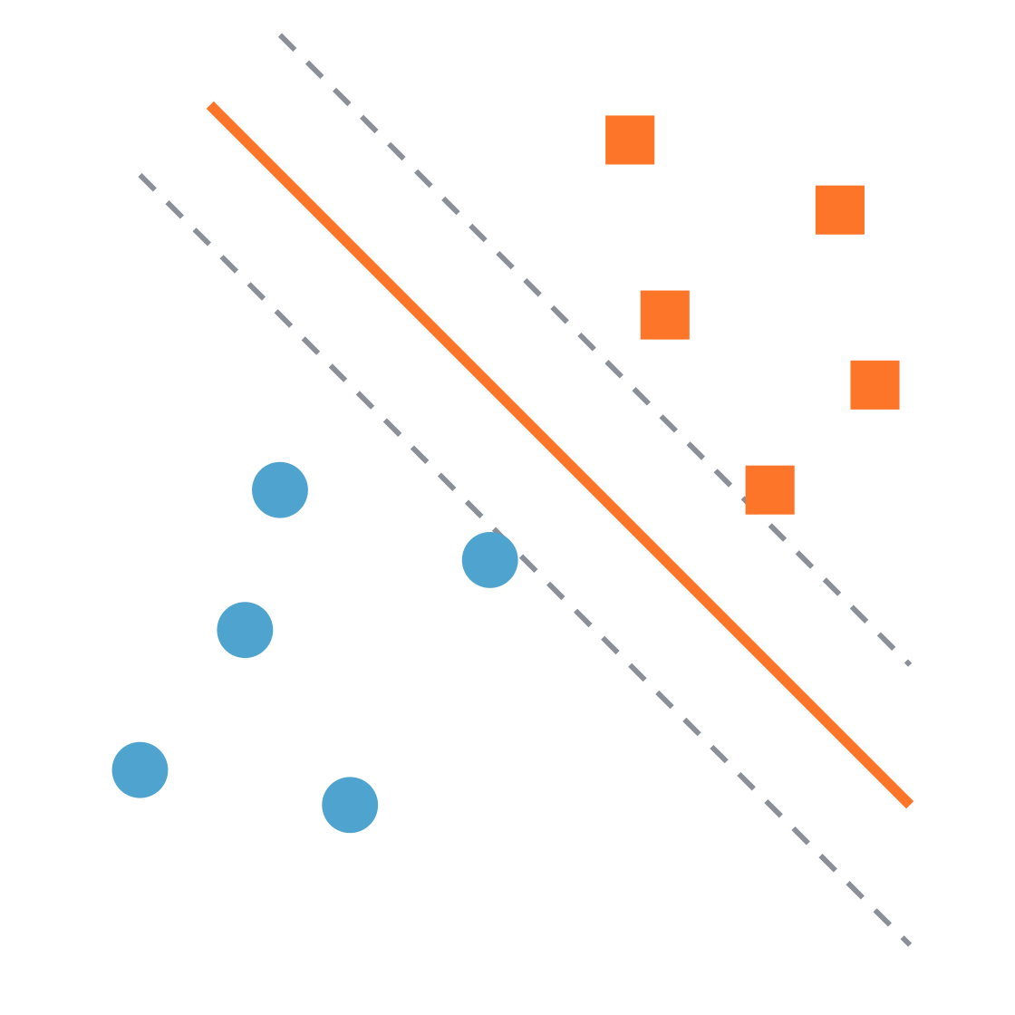
Support vector machines
Practical machine learning
Finding the widest street between two classes
Notes:
Welcome. Today we learn one classifier, SVM, built up in four small steps. The picture on the right is the whole idea: two groups of points, and a line that sits in the middle of the widest empty street between them. By the end, every part of that picture will have a name.

Slide 2
Four ideas, one after another
Roadmap
01
02
03
04
Maximum margin
Support vectors
Soft margin and C
Kernels
Pick the line with the widest street
Only the points on the edge matter
Learn one equation; balance margin violations
Bend the boundary when a line is not enough
Support vector machines · Practical machine learning
Notes:
Each step answers a problem raised by the previous one. Step 1: many lines separate the data, so which one? Step 2: which points decide that line? Step 3: what if the data is messy? Step 4: what if no straight line works at all? Keep pointing back to this slide as you move between sections.

Slide 3
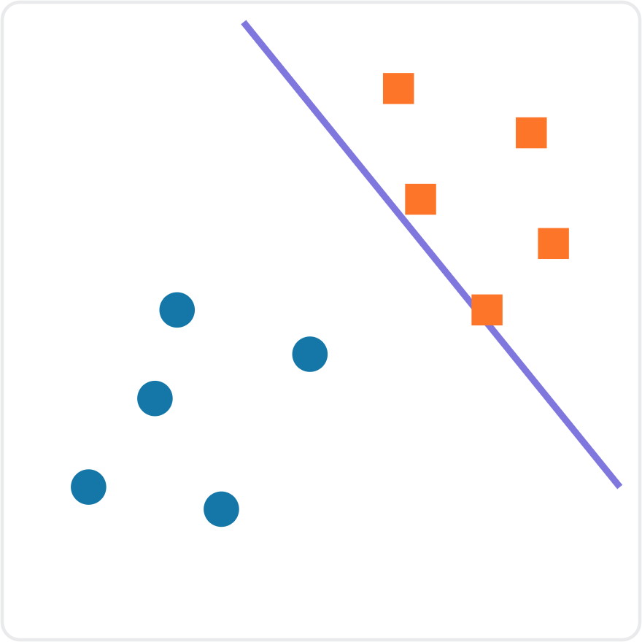
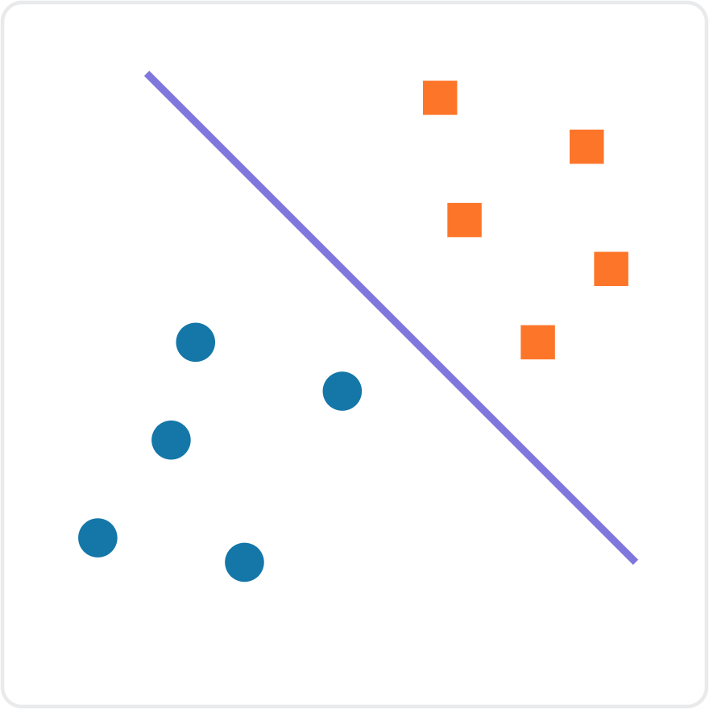
Both lines separate the data. Which one would you trust?
Step 1 · Maximum margin
Line A
Line B
Support vector machines · Practical machine learning
Notes:
Ask the class before revealing anything: both lines classify every training point correctly, so which one would you trust when a new point arrives near the boundary, and why? Expected answer: Line B, because it leaves room on both sides. Line A squeezes right past the squares, so a new square that lands slightly closer to the circles would be misclassified.

Slide 4
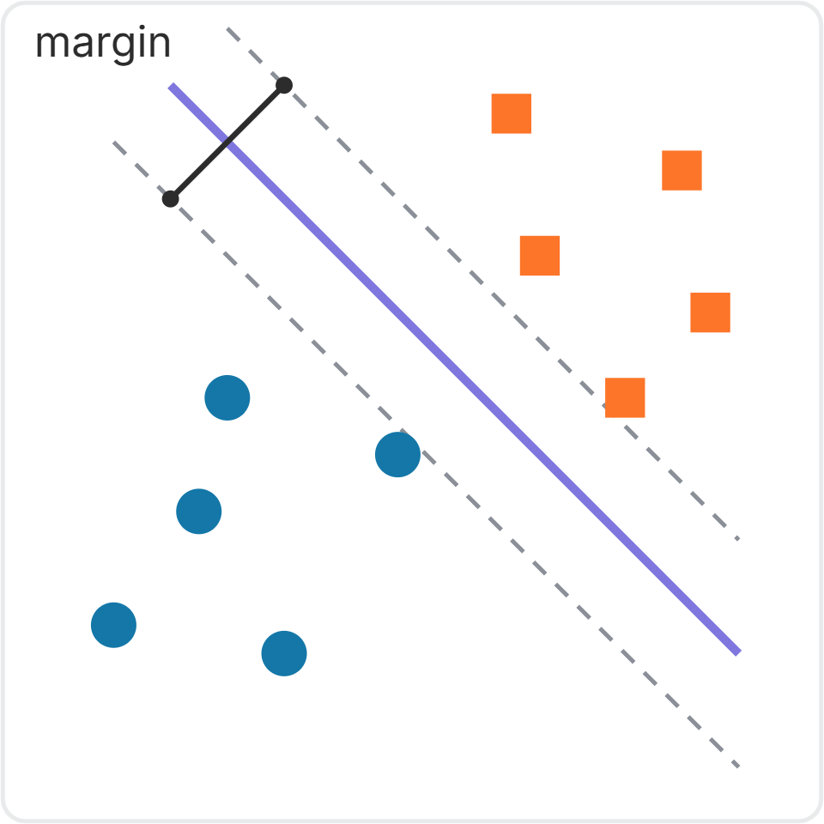
Choose the line with the widest gap
Step 1 · Maximum margin
For perfectly separated data, the margin is the gap between the closest points of the two classes.
The dashed lines mark the edges of this margin, with the decision boundary in the middle.
SVM's goal: find the line with the maximum margin.
A wide margin often improves generalization, but it does not guarantee higher test accuracy.
Support vector machines · Practical machine learning
Notes:
Define the decision boundary as the solid line. In hard-margin SVM, the dashed lines pass through the closest training points, and the width between them is the full margin. A larger margin makes small data changes less likely to flip predictions, but test performance also depends on noise, feature quality, and model flexibility. Do not claim a guarantee.

Slide 5
In any number of dimensions, the boundary is a hyperplane
Step 1 · Maximum margin
1 feature
2 features
3 features
n features
A single point
A line
A flat plane
A hyperplane
SVM finds the maximum-margin hyperplane: the widest street, in as many dimensions as your data has features.
Support vector machines · Practical machine learning
Notes:
Students will meet the word hyperplane in every SVM resource, so name it now. It is just the general name for the dividing boundary: a point on a number line, a line on a plane, a flat sheet in 3D. With 20 features you cannot picture it, but it is still a flat wall splitting the space into two sides.

Slide 6
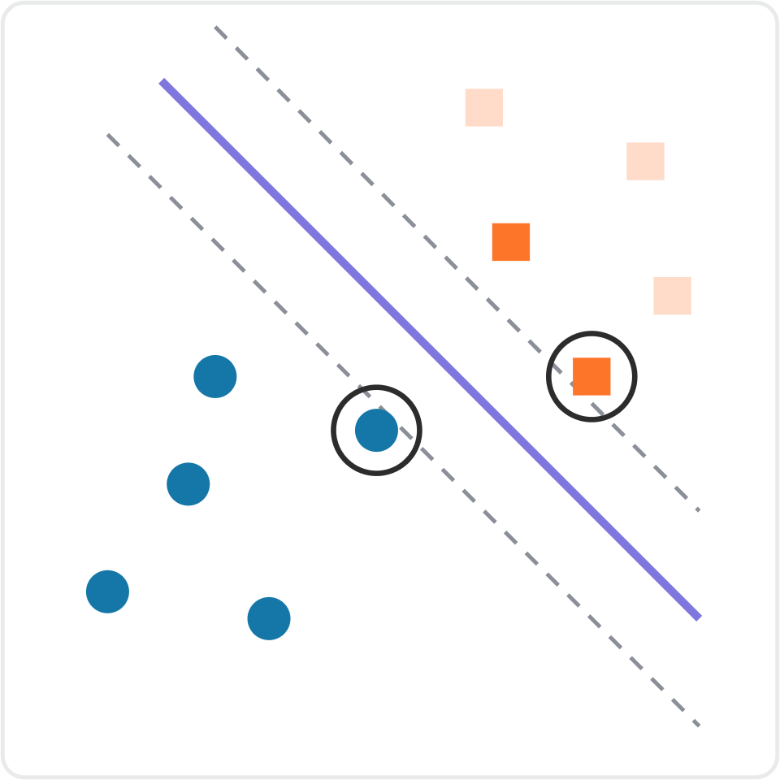
Support vectors are the points that shape the boundary
Step 2 · Support vectors
Here, the ringed points touch the margin edges. These are support vectors.
A point far from the margin usually has no effect on the boundary.
Moving a support vector can shift the separating boundary.
With a soft margin, points inside the margin can also be support vectors.
Support vector machines · Practical machine learning
Notes:
In this perfectly separable illustration, the ringed observations touching the dashed lines are support vectors. The other, distant observations normally do not constrain the optimum. In soft-margin SVM, some support vectors lie inside the margin or can even be misclassified; they are not limited to points exactly on the margin. Moving a support vector can influence the fitted boundary, but this is not guaranteed for every tiny movement.

Slide 7
Step 3 · From decision function to soft margin
One trained linear SVM gives ONE equation
Just like linear regression, the coefficients are learned during fit().
LINEAR REGRESSION
LINEAR SVM
ŷ = b₀ + b₁x
f(x) = wx + b
Example: ŷ = 2 + 3x
Example: f(x) = x − 2
The equation produces a numerical prediction.
The sign of f(x) predicts which class the input belongs to.
ONE fitted linear SVM → ONE decision function → predictions
Support vector machines · Practical machine learning
Notes:
Start with the prior regression knowledge. Linear regression returns an equation for numeric predictions. A linear SVM returns one decision function and uses its sign for class predictions. Both learn coefficients when fit is called. The equations shown are examples, not the results of the same model.

Slide 8
Step 3 · From decision function to soft margin
How do we get f(x) = x − 2?
A worked hard-margin example with just two training observations.
OUR TRAINING DATA
SOLVE FOR THE COEFFICIENTS
x = 1 → class −1
w(1) + b = −1
x = 3 → class +1
w(3) + b = +1
Subtract: 2w = 2 → w = 1
At the optimum, each point touches its own margin edge.
Then: b = −2
Learned decision function: f(x) = x − 2
This particular dataset gives w = 1 and b = −2; other datasets learn different values.
Support vector machines · Practical machine learning
Notes:
For one negative point at x=1 and one positive point at x=3, both observations lie exactly on their respective canonical margin edges at the hard-margin optimum. Solve w+b=-1 and 3w+b=1 to get w=1 and b=-2. This gives one learned decision function, not a list of three functions.

Slide 9
Step 3 · From decision function to soft margin
The learned weights determine the margin width
We calculate the size of the weights AFTER training.
‖w‖ = √(w₁² + w₂² + …) Full margin width = 2 ÷ ‖w‖
ONE FEATURE
TWO FEATURES
f(x) = x − 2 → w = 1
‖w‖ = |1| = 1
Margin width = 2 ÷ 1 = 2
If w₁ = 3 and w₂ = 4:
‖w‖ = √(3² + 4²) = 5
Margin width = 2 ÷ 5 = 0.4
Remember: fit() learns w and b. The formula ‖w‖ only calculates their magnitude.
Support vector machines · Practical machine learning
Notes:
For one feature f(x)=x-2, w=1 and the full margin width is 2/|1|=2. With two features and weights 3 and 4, the length of the weight vector is sqrt(3 squared plus 4 squared)=5 and the full width is 2/5=0.4. The weight-norm formula measures an existing vector; it does not learn individual weights.

Slide 10
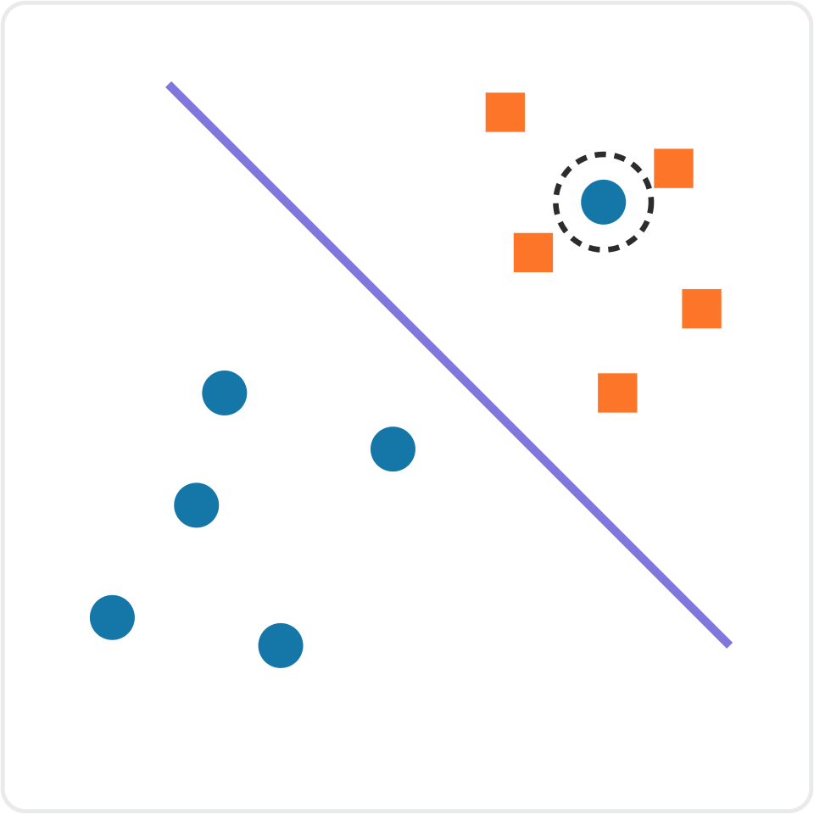
Real data is messy
Step 3 · Soft margin
One stray circle sits among the squares: perhaps noise, perhaps a labelling mistake.
Now no straight line separates the classes perfectly. Forcing a near-perfect split makes the street very narrow.
Discuss
Should SVM bend over backwards to classify this point, or accept it as a mistake to keep the wide street? What does each choice cost?
Support vector machines · Practical machine learning
Notes:
Let students argue both sides. Fitting the stray point costs margin and risks learning noise. Ignoring it costs one training error but keeps a wide, stable street. The honest answer is that it depends on whether the point is noise or a real pattern, which is exactly why SVM gives us a dial on the next slides.

Slide 11
Soft margin: allow a few mistakes, at a price
Step 3 · Soft margin
Allow
Penalize
Balance
Some points may sit inside the street, or even on the wrong side.
Every violation adds a penalty to what SVM is minimizing.
SVM trades off a wide street against a small total penalty.
A hard margin demands a perfect split. A soft margin is the default in practice, because real data is rarely perfectly separable.
Support vector machines · Practical machine learning
Notes:
Hard margin: no point may violate the street, which only works on perfectly separable data. Soft margin: violations are allowed but cost a penalty. SVM now has two goals that pull against each other, a wide street and few violations. The next slide shows the dial that sets the balance.

Slide 12
With multiple features, still ONE decision function
Step 3 · Soft margin
f(x) = w · x + b = w₁ × feature₁ + w₂ × feature₂ + b
Point (feature₁, feature₂) | Calculation with w = (1, 0.5), b = −4 | Score f(x) | What SVM says
(5, 2) | 1×5 + 0.5×2 − 4 | 2.0 | Orange, outside the street
(4, 0.5) | 1×4 + 0.5×0.5 − 4 | 0.25 | Orange, inside the street
(2, 2) | 1×2 + 0.5×2 − 4 | −1.0 | Blue, on the margin edge
Illustrative coefficients w = (1, 0.5), b = −4. Actual weights and bias are learned by fit().
Support vector machines · Practical machine learning
Notes:
Students already saw a fitted 1D example. Extend the same rule to two features. These numerical coefficients are illustrative, not the result of fitting the three example observations in the table. Compute the first row: 1×5 + 0.5×2 − 4 = 2. Positive scores indicate class +1; negative class -1. These are scores, not probabilities. There remains only one decision function per trained binary linear model.

Slide 13
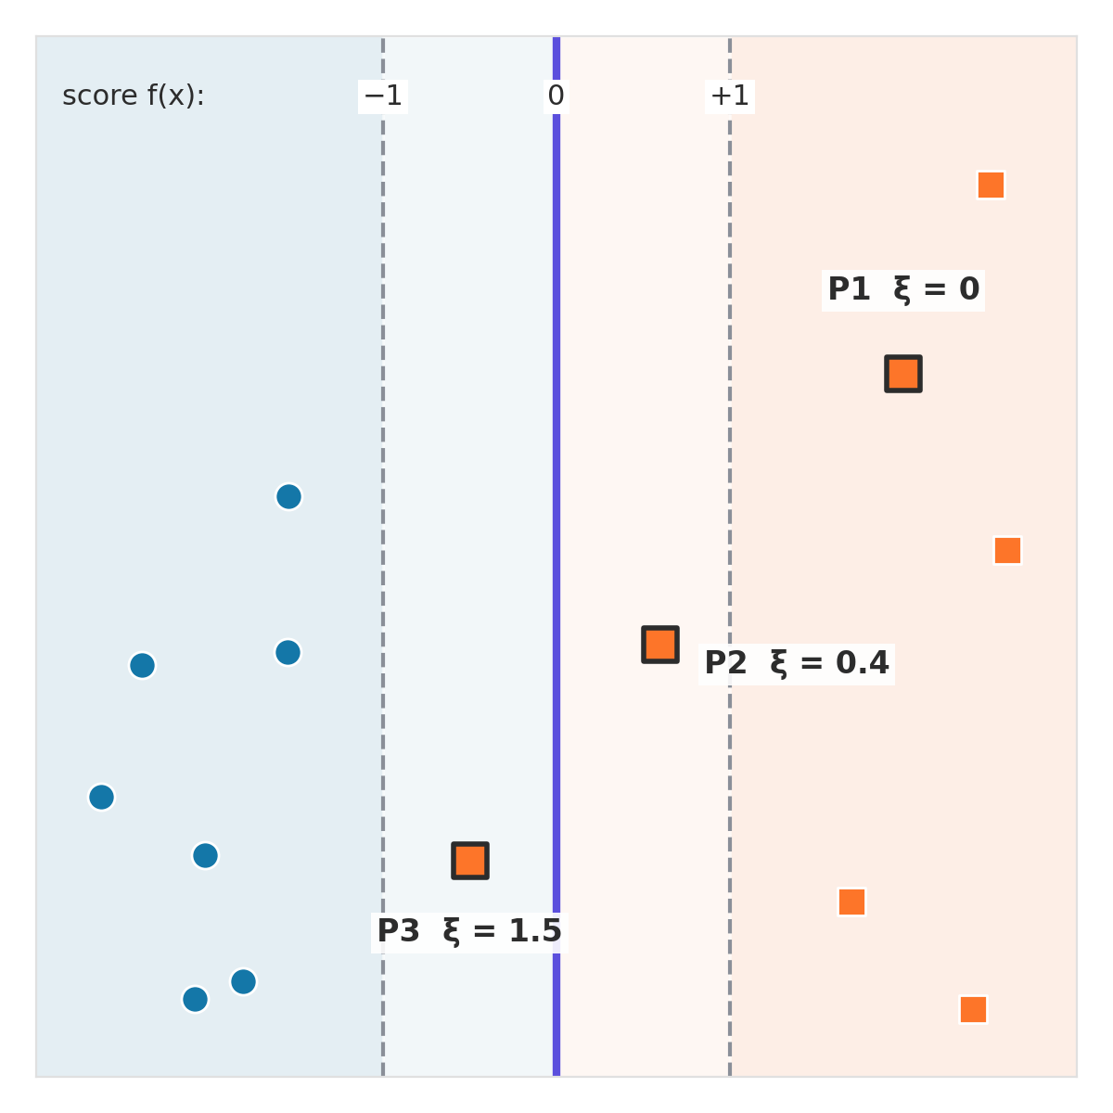
Margin violation: what is slack ξ?
Step 3 · Soft margin
Each point gets a score f(x). The street runs from −1 to +1, with the boundary at 0.
P1: outside the street, on its own side. No penalty: ξ = 0.
P2: inside the street but still correct: 0 < ξ < 1. P3: on the wrong side: ξ > 1.
Slack ξ ("xi") = how far a point sits past its own margin edge.
Support vector machines · Practical machine learning
Notes:
Introduce the score f(x) = w · x + b. The solid line is where f(x) = 0, and the dashed margin edges are where f(x) = −1 and +1. Slack, written ξ (the Greek letter xi), measures how far a point is past its own margin edge. Three cases: outside the street on its own side, ξ = 0; inside the street but still correct, ξ between 0 and 1; on the wrong side of the boundary, ξ greater than 1. All three highlighted points are orange squares with true class +1.

Slide 14
How the slack ξ is calculated
Step 3 · Soft margin
ξ = max(0, 1 − y · f(x)) y = true class (+1 or −1)
Point (true class y = +1) | Score f(x) | ξ = max(0, 1 − y · f(x)) | Where it sits
P1 | 2.0 | max(0, 1 − 2.0) = 0 | Outside: no penalty
P2 | 0.6 | max(0, 1 − 0.6) = 0.4 | Inside: small penalty
P3 | −0.5 | max(0, 1 + 0.5) = 1.5 | Wrong side: misclassified
Total slack = 0 + 0.4 + 1.5 = 1.9. Later, C determines the price of these violations.
Support vector machines · Practical machine learning
Notes:
This slide calculates slack for true positive-class observations. Slack is hinge loss: max(0,1-y*f(x)). A margin violation can be a correctly classified point within the street, not necessarily a wrong classification. P1 has slack 0, P2 0.4, P3 1.5; total slack 1.9. Do not multiply by C yet; introduce that in the total objective slide.

Slide 15
The same rule for blue points (y = −1)
Step 3 · Soft margin
ξ = max(0, 1 − y · f(x)) y = true class (+1 or −1)
Point (true class y = −1) | f(x), then y · f(x) | ξ = max(0, 1 − y · f(x)) | Where it sits
B1 | −2.0 → 2.0 | max(0, 1 − 2.0) = 0 | Outside: no penalty
B2 | −0.6 → 0.6 | max(0, 1 − 0.6) = 0.4 | Inside: small penalty
B3 | +0.5 → −0.5 | max(0, 1 + 0.5) = 1.5 | Wrong side: misclassified
Multiplying by y = −1 flips the sign. Then, for both classes, a bigger y · f(x) means more safely correct.
Support vector machines · Practical machine learning
Notes:
Same formula as the previous slide, now for blue points whose true class is y = −1. Step 1: compute the score. Step 2: multiply by −1, which flips the sign. Step 3: apply max(0, 1 − y·f(x)). B1 has score −2, safely blue, so slack 0. B2 is inside the street on the blue side, slack 0.4. B3 has a positive score, so SVM calls it orange: misclassified, slack 1.5. The penalties mirror the orange example exactly. The flip is why the formula works for both classes.

Slide 16
SVM minimizes ½‖w‖² + C × Σξᵢ
Step 3 · Soft margin
½‖w‖²: wide street
Σξᵢ: total margin violations
C: the balance
Reducing weight magnitude widens the margin and lowers this term.
Add up all slacks: inside-margin points and wrong predictions both count.
Large C: violations cost more. Small C: violations cost less.
fit() optimizes w and b to minimize the total cost while satisfying the margin constraints. It does not manually test equations one by one.
Support vector machines · Practical machine learning
Notes:
Now combine the ingredients. SVM minimizes 1/2||w|| squared + C sum xi, subject to y_i(w dot x_i+b)>=1-xi and xi>=0. The first term encourages a wide margin, second penalizes ALL margin violations (not just mistakes). C controls trade-off. The factor half simplifies differentiation; squaring smooths and penalizes large norm. A solver finds an optimal solution; do not claim convexity always implies a unique w,b pair. Follow with numerical candidate cost example.

Slide 17
C sets the price of margin violations
Step 3 · Soft margin
 | Small C | Large C
Each violation costs | Cheap | Expensive
The street is | Typically wider | Typically narrower
Margin violations | More violations tolerated | Fewer violations preferred
Main risk | May underfit (high bias) | May overfit (high variance)
In scikit-learn, SVC(C=1.0) is the default. Tune C with cross-validation.
Support vector machines · Practical machine learning
Notes:
C is the coefficient multiplying the total hinge loss. A large C makes margin violations more expensive, often causing a narrower margin; small C permits more violations and often a wider margin. These are tendencies not guarantees. Scaling, training data, kernel choice, and cross-validation matter. In scikit-learn SVC, C=1 is the default. Use Pipeline and GridSearchCV to tune on training folds.

Slide 18
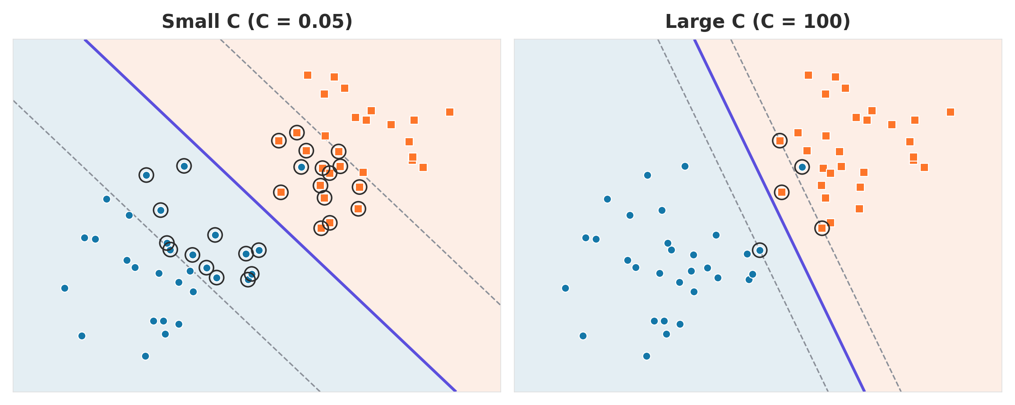
The same data with small C and large C
Step 3 · Soft margin
Small C: wide street, many support vectors (ringed)
Large C: narrow street that tilts to the stray point
Support vector machines · Practical machine learning
Notes:
Synthetic data with one stray blue point among the orange squares, trained twice with a linear kernel after scaling. With C = 0.05 the street is about three times wider, and 28 points are support vectors because many sit inside the wide street. With C = 100 the street narrows and tilts toward the stray point, and only 5 points are support vectors. In both cases the stray point stays misclassified: a straight line cannot reach it without misclassifying other points.

Slide 19
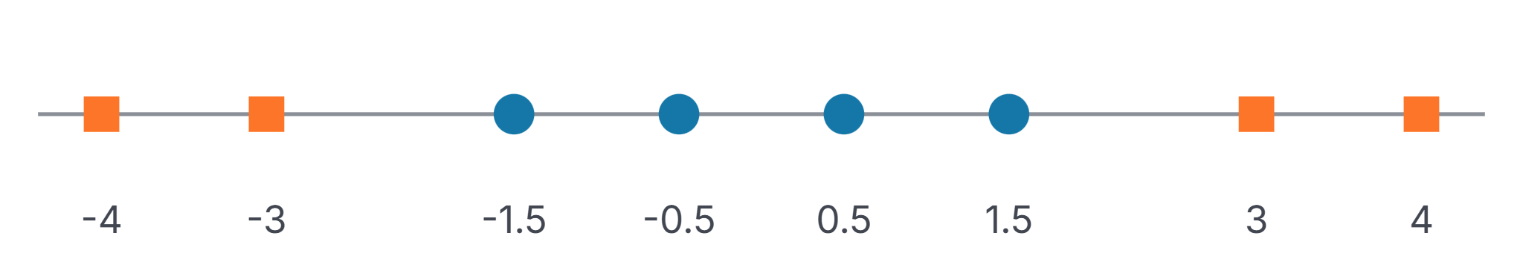
When no straight line can separate the data
Step 4 · Kernels
On a number line, the boundary is a single cut point. The squares sit at both ends, so no single cut can put all circles on one side and all squares on the other.
Support vector machines · Practical machine learning
Notes:
Ask: if each point could get a second coordinate computed from x, which formula would lift the outer squares high and keep the middle circles low? Accept x squared or the absolute value of x. Both work; x squared is the textbook choice and the one the next slide uses.

Slide 20
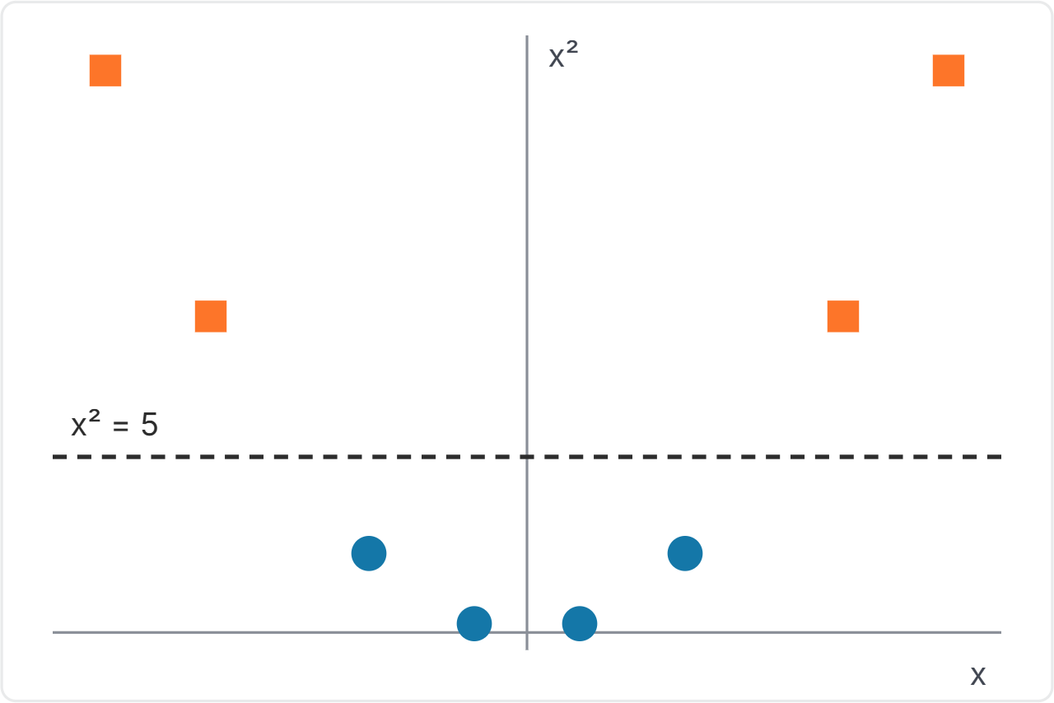
Add a feature: map each x to (x, x²)
Step 4 · Kernels
The squares rise high. The circles stay low.
A flat line at x² = 5 now separates them perfectly.
Back on the original number line, that line is two cut points: x = ±√5, about ±2.24.
The idea: if the data cannot be separated where it is, move it to a higher dimension where it can.
Support vector machines · Practical machine learning
Notes:
Walk through the numbers: the squares at plus or minus 3 and 4 land at heights 9 and 16, the circles at heights 2.25 and 0.25. A straight line in the new space corresponds to a curved, or here split, boundary in the original space. That is the core idea behind kernels. The next slides explain how SVM does this cheaply.

Slide 21
Kernels you will use in scikit-learn
Step 4 · Kernels
Kernel | What it does | Use it when
linear | No transformation | The data is roughly separable as it is
poly | Adds powers and products of features | You expect a smooth curved boundary
rbf (default) | Similarity falls off with distance | General-purpose curved or island-shaped boundaries
rbf = radial basis function. gamma (γ) sets how far each point's influence reaches; higher gamma may overfit, so tune it with C.
Support vector machines · Practical machine learning
Notes:
In scikit-learn SVC, the default kernel is rbf. Linear uses the original feature space; polynomial allows polynomial boundaries; RBF can capture local nonlinear patterns. Gamma governs the scale of influence for RBF: large gamma usually means more localized influence and potentially a more complex boundary, though this is only a tendency. For linear SVM, gamma is not used. Scale features, then use GridSearchCV to tune kernel, C, and RBF gamma.

Slide 22
What gamma (γ) does: the RBF similarity
Step 4 · Kernels
K(x, z) = exp(−γ × distance²) exp(n) means eⁿ, with e ≈ 2.718, Smaller Gamma = Broader influence, large gamma =local influence
Distance x to z | γ = 0.1 | γ = 1 | γ = 10
0.5 | 0.98 | 0.78 | 0.08
1 | 0.90 | 0.37 | 0.00005
3 | 0.41 | 0.0001 | ≈ 0
Example: distance 1, γ = 1 gives exp(−1) ≈ 0.37. K = 1 means the same point; K near 0 means no influence.
Support vector machines · Practical machine learning
Notes:
The RBF kernel measures how similar two points are: 1 when they are the same point, falling toward 0 as they move apart. Gamma sets how fast it falls. With gamma 0.1, points 3 units apart are still 0.41 similar, so each training point influences a wide area. With gamma 10, points only 1 unit apart are almost unrelated, so each point influences just its immediate neighbourhood. That is why a large gamma gives a wiggly boundary. Distances are measured after scaling.

Slide 23
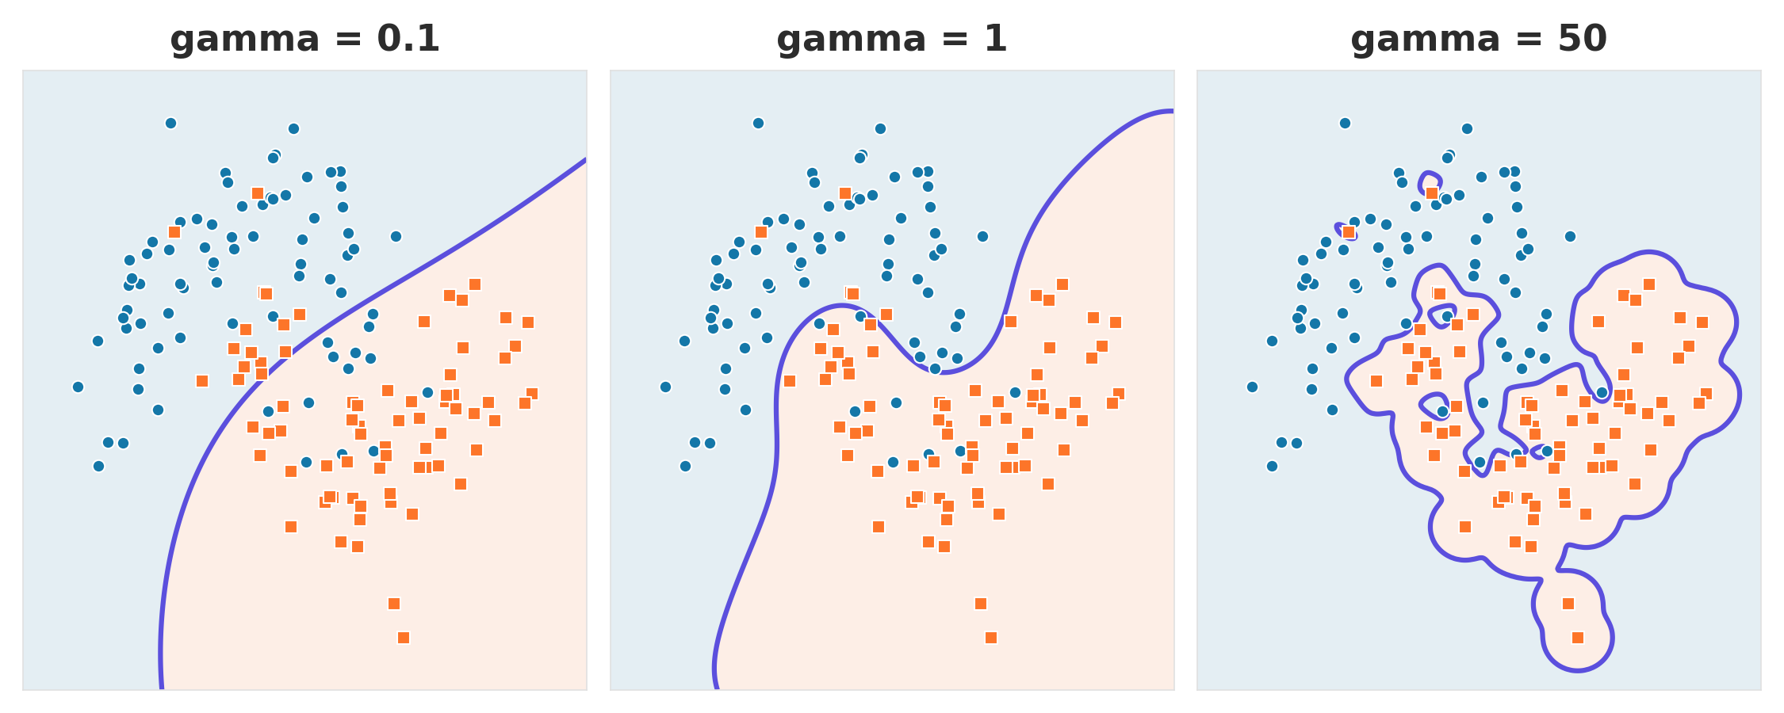
The same data with three gamma values
Step 4 · Kernels
0.1: too smooth · 1: follows the curve · 50: wraps single points and overfits
Support vector machines · Practical machine learning
Notes:
Same noisy two-moons data, RBF kernel, C = 1, three gamma values. Gamma 0.1 is too smooth and underfits. Gamma 1 follows the curved pattern. Gamma 50 draws small islands around individual points: it fits the training data closely but will generalize badly. Tune gamma together with C using cross-validation. Synthetic illustration.

