Slide 1
PRACTICAL MACHINE LEARNING
Principal Component
Analysis (PCA)
From the curse of dimensionality to reducing 2 features into 1
One dataset • Every calculation • Visible reference tables • scikit-learn notebook
Student-friendly, step-by-step lesson

Slide 2
MOTIVATION
Two ways to reduce the number of features
The methods answer different questions.
Feature selection
PCA — feature extraction
Keep some original columns.
Create NEW columns by combining the originals.
From: X1, X2, X3, X4
To: X1, X3
From: X1, X2, X3, X4
To: PC1, PC2
PCA does not simply choose the columns with the highest variances.
PCA • PRACTICAL MACHINE LEARNING • CONTINUOUS FOUR-RECORD EXAMPLE
6

Slide 3
DEFINITION
What exactly is PCA?
Principal Component Analysis creates new axes that retain as much variance as possible.
Input: 25 columns
→
Output: perhaps 2 PCs
PC1 = direction containing the greatest variance.
PC2 = next greatest variance, perpendicular to PC1.
The number of retained components controls information loss.
PCA • PRACTICAL MACHINE LEARNING • CONTINUOUS FOUR-RECORD EXAMPLE
7

Slide 4
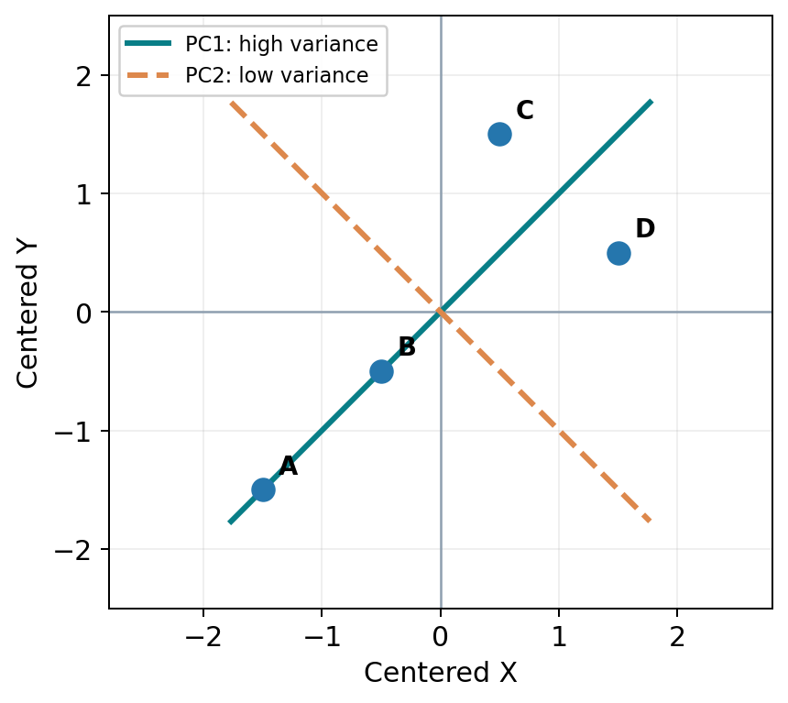
INTUITION
Imagine rotating the axes
PCA finds new directions; it does not delete records.
PC1
Direction of greatest variation.
PC2
Perpendicular direction with smaller variation.
PCA • PRACTICAL MACHINE LEARNING • CONTINUOUS FOUR-RECORD EXAMPLE
8

Slide 5
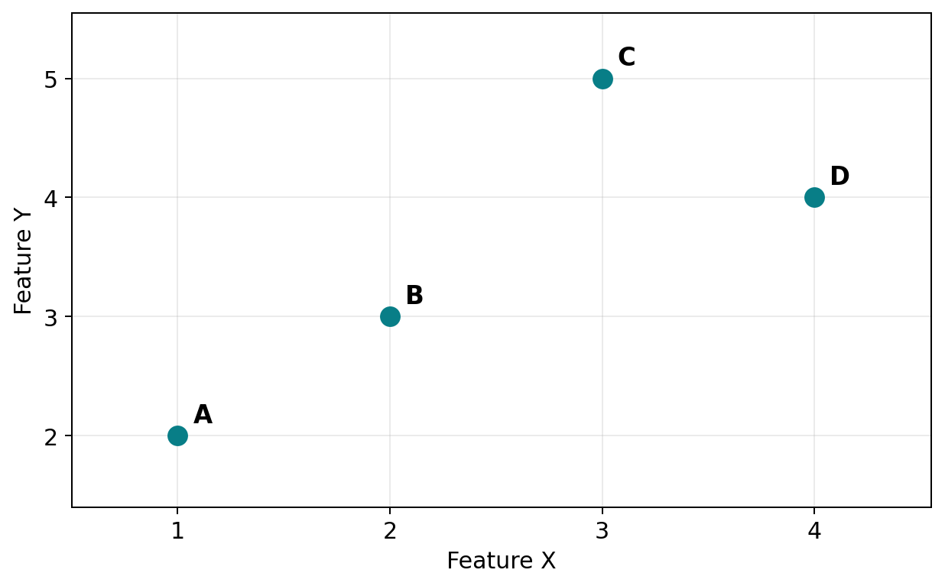
EXAMPLE • ORIGINAL DATA
Our four-record dataset
We will reduce two original features to one new feature.
Record
X
Y
A
1
2
B
2
3
C
3
5
D
4
4
Keep this dataset in view. All the mathematical steps that follow use these same four rows.
PCA • PRACTICAL MACHINE LEARNING • CONTINUOUS FOUR-RECORD EXAMPLE
9

Slide 6
WORKED EXAMPLE • ROADMAP
How will PCA transform these numbers?
A complete 2-feature → 1-component calculation.
1
Center X and Y
2
Calculate sample variance and covariance
3
Build the covariance matrix
4
Find new directions and their variances
5
Retain PC1 and project every record
PCA • PRACTICAL MACHINE LEARNING • CONTINUOUS FOUR-RECORD EXAMPLE
10

Slide 7
STEP 1 • MEAN
Find the mean of both features
We center each column using its own mean.
REFERENCE DATA
Mean of X = (1 + 2 + 3 + 4) / 4 = 2.5
ID
X
Y
A
1
2
Mean of Y = (2 + 3 + 5 + 4) / 4 = 3.5
B
2
3
C
3
5
D
4
4
We subtract 2.5 from every X value and 3.5 from every Y value.
Original values: A(1,2), B(2,3), C(3,5), D(4,4).
PCA • PRACTICAL MACHINE LEARNING • CONTINUOUS FOUR-RECORD EXAMPLE
11

Slide 8
STEP 1 • CENTERING
Subtract the mean from each value
Centered X = X − 2.5 | Centered Y = Y − 3.5
REFERENCE DATA
Record
X − 2.5
Y − 3.5
ID
X
Y
A
−1.5
−1.5
A
1
2
B
−0.5
−0.5
B
2
3
C
+0.5
+1.5
C
3
5
D
4
4
D
+1.5
+0.5
Centering changes the origin, not the distances between records.
Both centered columns now have mean 0. The record-to-record geometry is unchanged.
PCA • PRACTICAL MACHINE LEARNING • CONTINUOUS FOUR-RECORD EXAMPLE
12

Slide 9
STEP 2 • VARIANCE
What does variance measure?
Variance measures the average squared deviation from the mean.
Sample variance = Σ(value − mean)² / (n − 1)
REFERENCE DATA
ID
X
Y
A
1
2
X
X − 2.5
Squared deviation
1
−1.5
2.25
B
2
3
2
−0.5
0.25
C
3
5
3
+0.5
0.25
D
4
4
4
+1.5
2.25
Total
5.00
For sample variance, the denominator is n − 1 = 3.
Var(X) = 5 / 3 = 1.6667
PCA • PRACTICAL MACHINE LEARNING • CONTINUOUS FOUR-RECORD EXAMPLE
13

Slide 10
STEP 2 • VARIANCE
Calculate variance of Y
Exactly the same rule: subtract its mean, square, add, then divide by 3.
Y
Y − 3.5
Squared deviation
REFERENCE DATA
2
−1.5
2.25
ID
X
Y
A
1
2
3
−0.5
0.25
B
2
3
5
+1.5
2.25
C
3
5
4
+0.5
0.25
D
4
4
Total
5.00
X and Y happen to have equal variance in this dataset.
Var(Y) = 5 / (4 − 1) = 1.6667
PCA • PRACTICAL MACHINE LEARNING • CONTINUOUS FOUR-RECORD EXAMPLE
14

Slide 11
STEP 3 • COVARIANCE
Why is variance alone not enough?
X and Y both have variance 1.6667 — which direction should PCA choose?
Both features vary equally
But they tend to increase together. Variance of X and Y alone cannot describe this shared movement.
We need COVARIANCE: how do X and Y vary together?
PCA • PRACTICAL MACHINE LEARNING • CONTINUOUS FOUR-RECORD EXAMPLE
16

Slide 12
STEP 3 • COVARIANCE
What does covariance mean?
Positive: they rise together. Negative: one rises while the other tends to fall.
Positive covariance
REFERENCE DATA
When X is above its mean, Y is often above its mean.
ID
X
Y
A
1
2
Negative covariance
B
2
3
When X is above its mean, Y is often below its mean.
C
3
5
D
4
4
Cov(X,Y) = Σ[(X−X̄)(Y−Ȳ)] / (n−1)
Our dataset has positive covariance between X and Y.
PCA • PRACTICAL MACHINE LEARNING • CONTINUOUS FOUR-RECORD EXAMPLE
17

Slide 13
STEP 3 • CALCULATION
Calculate covariance row by row
Multiply each pair of centered values, add, and divide by n − 1 = 3.
Record
X − 2.5
Y − 3.5
Product
REFERENCE DATA
A
−1.5
−1.5
2.25
ID
X
Y
A
1
2
B
−0.5
−0.5
0.25
B
2
3
C
+0.5
+1.5
0.75
C
3
5
D
+1.5
+0.5
0.75
D
4
4
Sum
4.00
Use the same centered X and Y values obtained earlier.
Cov(X,Y) = 4 / 3 = 1.3333
PCA • PRACTICAL MACHINE LEARNING • CONTINUOUS FOUR-RECORD EXAMPLE
18

Slide 14
STEP 3 • THE WHY
Why does PCA need the covariance matrix?
It needs BOTH individual spread and shared movement to choose the best NEW axis.
Individual variance
REFERENCE DATA
How far does X spread? How far does Y spread?
ID
X
Y
A
1
2
Covariance
B
2
3
When X moves, how does Y tend to move?
C
3
5
Together in a matrix
D
4
4
Calculate variance along ANY direction, not only X or Y.
Var(X)=Var(Y)=1.6667; covariance=1.3333.
This is the bridge: covariance matrix → principal directions → new PCA features.
PCA • PRACTICAL MACHINE LEARNING • CONTINUOUS FOUR-RECORD EXAMPLE
19

Slide 15
STEP 3 • MATRIX
Arrange these values in the covariance matrix
Diagonal = each feature’s variance; off-diagonal = shared variation.
REFERENCE DATA
C = [ 1.6667 1.3333 ]
ID
X
Y
A
1
2
[ 1.3333 1.6667 ]
B
2
3
C
3
5
Var(X) = top-left Var(Y) = bottom-right
D
4
4
Cov(X,Y) = both off-diagonal entries
Sample covariance and sample variance use n−1 = 3.
PCA • PRACTICAL MACHINE LEARNING • CONTINUOUS FOUR-RECORD EXAMPLE
20

Slide 16
STEP 4 • CALCULATION
How do we find the principal directions?
From the covariance matrix, calculate eigenvalues first, then eigenvectors.
START WITH C = [ 5/3 4/3 ; 4/3 5/3 ]
REFERENCE DATA
ID
X
Y
1 FIND THE EIGENVALUES — how much variance?
det(C − λI) = 0
A
1
2
(5/3 − λ)² − (4/3)² = 0 → λ₁ = 3, λ₂ = 1/3
B
2
3
C
3
5
2 FIND THE EIGENVECTORS — which directions?
For λ₁ = 3: (C − 3I)v = 0 → a = b
D
4
4
v₁ = (0.7071, 0.7071)
v₂ = (0.7071, −0.7071)
We already know Var(X) = Var(Y) = 5/3 and Cov(X,Y) = 4/3.
PC1 uses v₁: its eigenvalue (variance) 3 is the largest.
PCA • PRACTICAL MACHINE LEARNING • CONTINUOUS FOUR-RECORD EXAMPLE
21

Slide 17
STEP 3 • WHY IT MATTERS
Compare the two diagonal directions
The signs of the weights change the contribution from covariance.
REFERENCE DATA
Direction
Unit weights
Variance
ID
X
Y
Together ↗
(+0.7071, +0.7071)
3.0000
A
1
2
Opposite ↘
(+0.7071, −0.7071)
0.3333
B
2
3
X only
(1, 0)
1.6667
C
3
5
D
4
4
Y only
(0, 1)
1.6667
Both directions have length 1; their weights are normalized.
PCA looks for the direction with the MAXIMUM variance: the “together” direction.
PCA • PRACTICAL MACHINE LEARNING • CONTINUOUS FOUR-RECORD EXAMPLE
22

Slide 18
STEP 4 • RESULTS
Our covariance matrix gives two components
PC1 has the largest variance. PC2 is perpendicular to PC1.
Component
Eigenvector
Eigenvalue
REFERENCE DATA
ID
X
Y
PC1
(0.7071, 0.7071)
3.0000
A
1
2
B
2
3
PC2
(0.7071, −0.7071)
0.3333
C
3
5
D
4
4
Covariance matrix × eigenvector = eigenvalue × eigenvector
The direction vector can change sign without changing the PCA solution.
PCA • PRACTICAL MACHINE LEARNING • CONTINUOUS FOUR-RECORD EXAMPLE
24

Slide 19
STEP 5 • EXPLAINED VARIANCE
How much information does each component keep?
Explained variance ratio = component eigenvalue / sum of eigenvalues.
REFERENCE DATA
PC1: 3 / 3.3333 = 90%
ID
X
Y
A
1
2
PC2: 0.3333 / 3.3333 = 10%
B
2
3
C
3
5
D
4
4
90% PC1
10%
The total sample variance = 3.0000 + 0.3333 = 3.3333.
We can keep just PC1 and retain 90% of the ORIGINAL variance.
PCA • PRACTICAL MACHINE LEARNING • CONTINUOUS FOUR-RECORD EXAMPLE
25

Slide 20
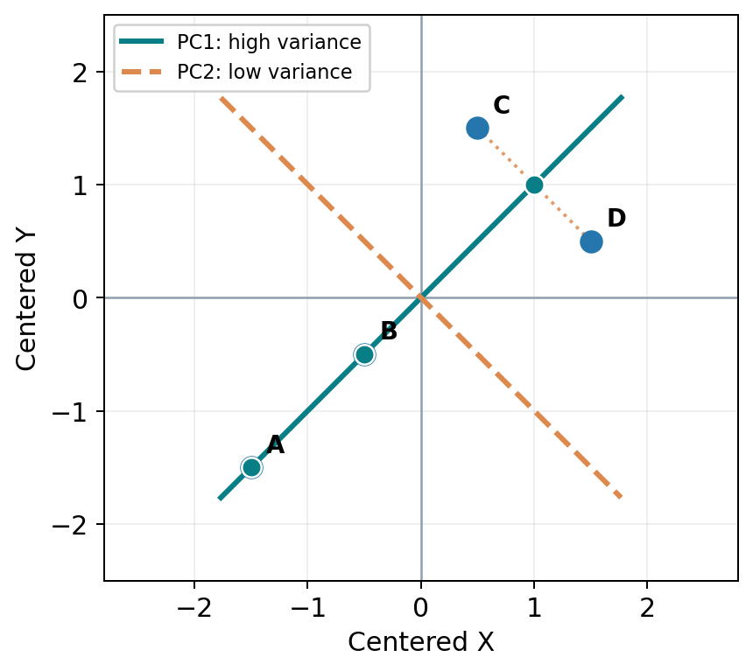
STEP 5 • PROJECTION
What does projection mean?
Now use our calculated PC1 eigenvector (0.7071, 0.7071) to project each CENTERED row.
REFERENCE DATA
ID
X
Y
A
1
2
B
2
3
C
3
5
D
4
4
PC1 direction = (0.7071, 0.7071).
Each 2D point becomes a 1D coordinate: its position along the new PC1 axis.
PCA • PRACTICAL MACHINE LEARNING • CONTINUOUS FOUR-RECORD EXAMPLE
32

Slide 21
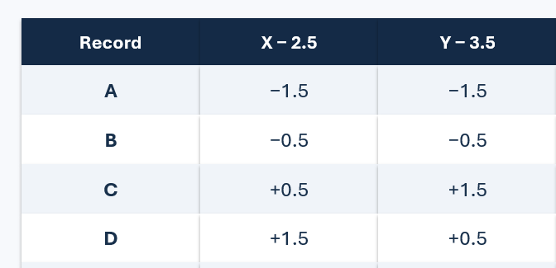
STEP 5 • PROJECTION MATH
Calculate the new PC1 value for record A
The new coordinate uses BOTH original features.
PC1 = 0.7071 × Centered X + 0.7071 × Centered Y
A = 0.7071 × (−1.5) + 0.7071 × (−1.5)
PC1(A) = −2.1213
This is why PCA is not column selection: the new value mixes X and Y.
PCA • PRACTICAL MACHINE LEARNING • CONTINUOUS FOUR-RECORD EXAMPLE
33

Slide 22
STEP 5 • ALL ROWS
Transform all four records
One new number per row replaces two original feature values.
REFERENCE DATA
Record
Centered X
Centered Y
PC1 score
ID
X
Y
A
−1.5
−1.5
−2.1213
A
1
2
B
−0.5
−0.5
−0.7071
B
2
3
C
+0.5
+1.5
+1.4142
C
3
5
D
4
4
D
+1.5
+0.5
+1.4142
C and D get the same PC1 score because they differ only along PC2.
Before: [X, Y] (2 features) → After: [PC1] (1 feature).
PCA • PRACTICAL MACHINE LEARNING • CONTINUOUS FOUR-RECORD EXAMPLE
34

Slide 23
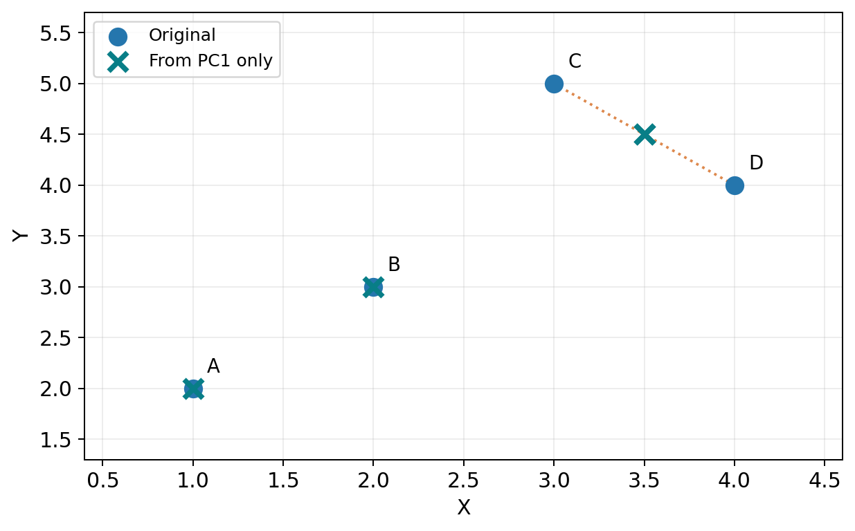
STEP 5 • INFORMATION RETAINED
We have reduced 2 features to 1
PC1 retains 90% of total variance. The remaining 10% is discarded.
C and D overlap on PC1
Their reconstructed coordinates both become (3.5, 4.5).
Different original rows can share a PC1 score.
PCA • PRACTICAL MACHINE LEARNING • CONTINUOUS FOUR-RECORD EXAMPLE
35

Slide 24
INTERPRETATION
What does 90% explained variance NOT mean?
PCA is unsupervised: it does not use the target label when finding components.
90% explained variance DOES mean: 90% of input feature variance is retained.
It does NOT mean: classification accuracy is 90%.
It does NOT guarantee: 90% of information useful for predicting y is retained.
Always evaluate the downstream model — explained variance and model accuracy are not the same.
PCA • PRACTICAL MACHINE LEARNING • CONTINUOUS FOUR-RECORD EXAMPLE
36

Slide 25
PRACTICAL WARNING
Do we need standardization before PCA?
Often yes, when features have different units or very different scales.
Feature
Typical values
Without scaling
House size (sq. ft.)
600 – 3,000
Large numerical spread
Number of rooms
1 – 6
Small numerical spread
Age (years)
20 – 80
Different scale
StandardScaler: z = (x − training mean) / training std
The four-record manual example uses raw values because X and Y have equal variances and the same scale.
PCA • PRACTICAL MACHINE LEARNING • CONTINUOUS FOUR-RECORD EXAMPLE
37

Slide 26
PRACTICAL CODE
Reproduce the manual PCA example in scikit-learn
The library computes the same component scores; eigenvector signs may be reversed.
df = pd.DataFrame({'X': [1, 2, 3, 4], 'Y': [2, 3, 5, 4]})
print(df.cov()) # covariance matrix
pca = PCA(n_components=1)
X_pca = pca.fit_transform(df) # learn PC1, then project
print(pca.components_) # weights/direction
print(pca.explained_variance_) # variance along PC1
print(pca.explained_variance_ratio_) # [0.90]
PCA • PRACTICAL MACHINE LEARNING • CONTINUOUS FOUR-RECORD EXAMPLE
38

Slide 27
PRACTICAL APPLICATION
A real dataset: 30 features → fewer PCs
PCA can be used before classification, but the target must not influence PCA fitting.
1 • Split
2 • Scale
3 • PCA
4 • Classify
X_train and X_test
Learn means/std only from X_train
Learn principal components only from training data
Fit Logistic Regression on PC scores
→
→
→
Using a Pipeline keeps the training and prediction transformations in the correct order.
PCA • PRACTICAL MACHINE LEARNING • CONTINUOUS FOUR-RECORD EXAMPLE
39

Slide 28
PIPELINE • TRAINING
What happens during model.fit(X_train, y_train)?
Each stage learns parameters from training data only.
StandardScaler.fit_transform
Learn mean/std and scale training X
↓
PCA.fit_transform
Learn principal axes and project training X
↓
LogisticRegression.fit
Learn classification model from PC scores
PCA • PRACTICAL MACHINE LEARNING • CONTINUOUS FOUR-RECORD EXAMPLE
40

Slide 29
PIPELINE • PREDICTION
What happens during model.predict(X_test)?
The test data is transformed automatically using previously learned parameters.
StandardScaler.transform
Use TRAIN means/std; do not fit again
↓
PCA.transform
Use TRAIN PC directions; do not fit again
↓
LogisticRegression.predict
Make predictions from transformed test rows
PCA • PRACTICAL MACHINE LEARNING • CONTINUOUS FOUR-RECORD EXAMPLE
41

Slide 30
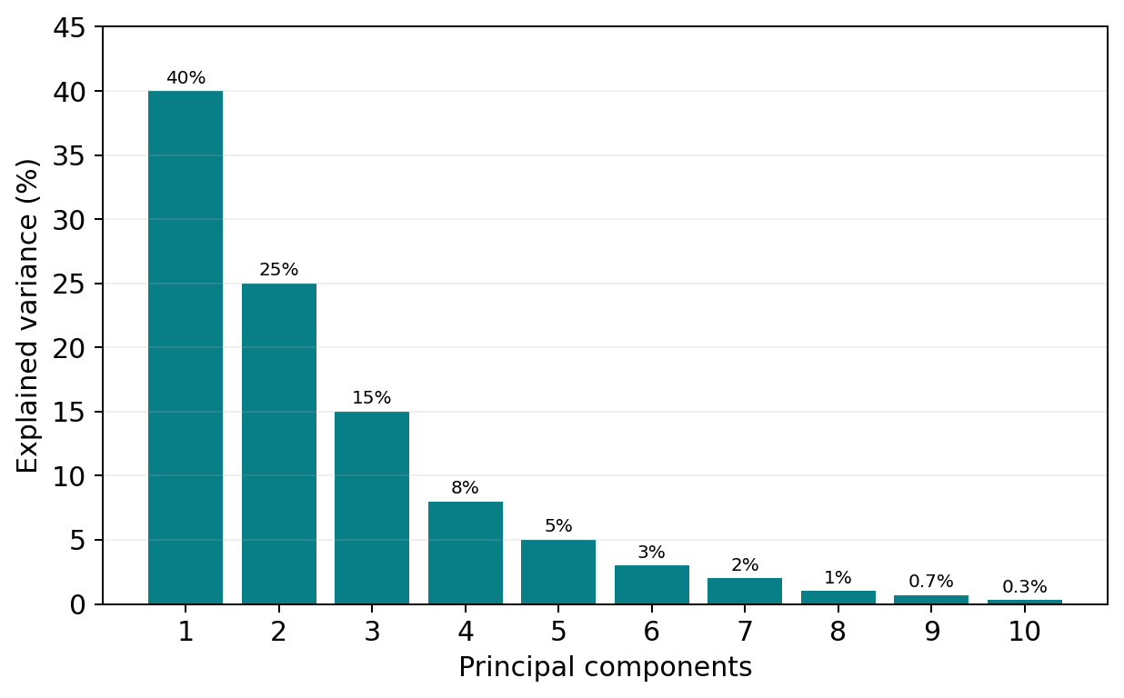
PRACTICAL APPLICATION
How many components should we keep?
This is an illustrative scree plot for 10 features (not our four-record dataset).
Cumulative variance
PC1–PC3: 80%
PC1–PC5: 93%
n_components=0.95
Chooses enough PCs to retain at least 95% variance.
PCA • PRACTICAL MACHINE LEARNING • CONTINUOUS FOUR-RECORD EXAMPLE
42

Slide 31
APPLIED PCA
Where PCA helps — and where it may not
Component retention should be chosen using validation performance, not variance alone.
Consider PCA when…
Think carefully when…
Many numeric features with overlap
Original feature meaning must be preserved
Distance-based algorithms struggle
Predictive signal is low-variance
Need 2D or 3D visualization
Tree-based models already work well
Want a compact feature representation
Features are categorical/unscaled
For KNN / Logistic Regression, compare model scores with and without PCA on the same split or CV folds.
PCA • PRACTICAL MACHINE LEARNING • CONTINUOUS FOUR-RECORD EXAMPLE
43

Slide 32
RECAP
The full PCA story — one more time
Every mathematical step has a clear purpose.
Curse of dimensionality
Motivation for reduction
Center and (when needed) scale
Put features on a fair basis
Variance + covariance
How features vary alone and together
Covariance matrix
Summarize relationships across feature directions
Eigenvectors / eigenvalues
Find directions and corresponding variances
Explained variance + projection
Choose PCs and produce new feature values
Key idea: PCA creates new axes that capture as much variance as possible with fewer dimensions.
PCA • PRACTICAL MACHINE LEARNING • CONTINUOUS FOUR-RECORD EXAMPLE
46

