Slide 1



Forecast_XRP_LSTM
View in Power BI
Last data refresh:
10/26/2024 2:34:56 PM UTC
Downloaded at:
10/26/2024 2:37:57 PM UTC

Slide 2


Slide 3
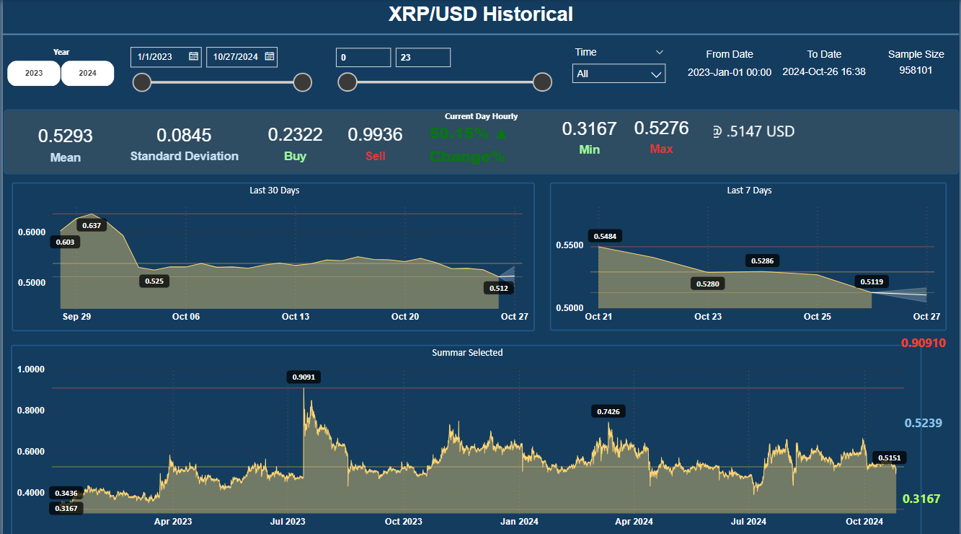
XRP_HIST_Monthly_Change
Notes:
card
No alt text provided
card
No alt text provided
card
No alt text provided
slicer
No alt text provided
textbox
No alt text provided
shape
No alt text provided
slicer
No alt text provided
advancedSlicerVisual
No alt text provided
Monthly HIg Low Trends
No alt text provided
htmlContent443BE3AD55E043BF878BED274D3A6855
No alt text provided
card
No alt text provided
card
No alt text provided
htmlContent443BE3AD55E043BF878BED274D3A6855
No alt text provided
card
No alt text provided
card
No alt text provided
card
No alt text provided
card
No alt text provided
card
No alt text provided
15 min Strategy
No alt text provided
textbox
No alt text provided
To Date
No alt text provided
textbox
No alt text provided
From Date
No alt text provided
Monthly Change Percent(%)
No alt text provided
shape
No alt text provided
advancedSlicerVisual
No alt text provided

Slide 4
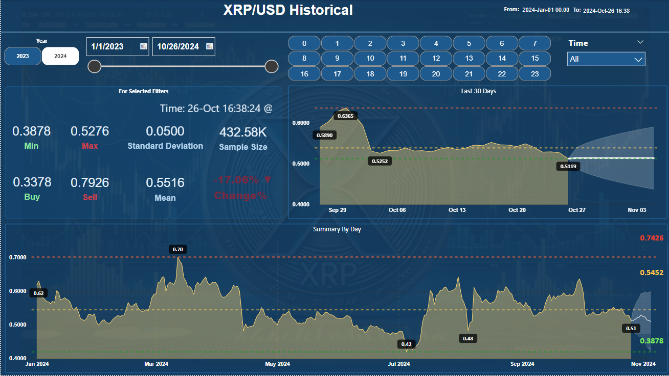
XRP_HIST_Monthly_Change
Notes:
card
No alt text provided
card
No alt text provided
card
No alt text provided
slicer
No alt text provided
textbox
No alt text provided
shape
No alt text provided
slicer
No alt text provided
advancedSlicerVisual
No alt text provided
Monthly HIg Low Trends
No alt text provided
htmlContent443BE3AD55E043BF878BED274D3A6855
No alt text provided
card
No alt text provided
card
No alt text provided
htmlContent443BE3AD55E043BF878BED274D3A6855
No alt text provided
card
No alt text provided
card
No alt text provided
card
No alt text provided
card
No alt text provided
card
No alt text provided
15 min Strategy
No alt text provided
textbox
No alt text provided
To Date
No alt text provided
textbox
No alt text provided
From Date
No alt text provided
Monthly Change Percent(%)
No alt text provided
shape
No alt text provided
advancedSlicerVisual
No alt text provided

Slide 5
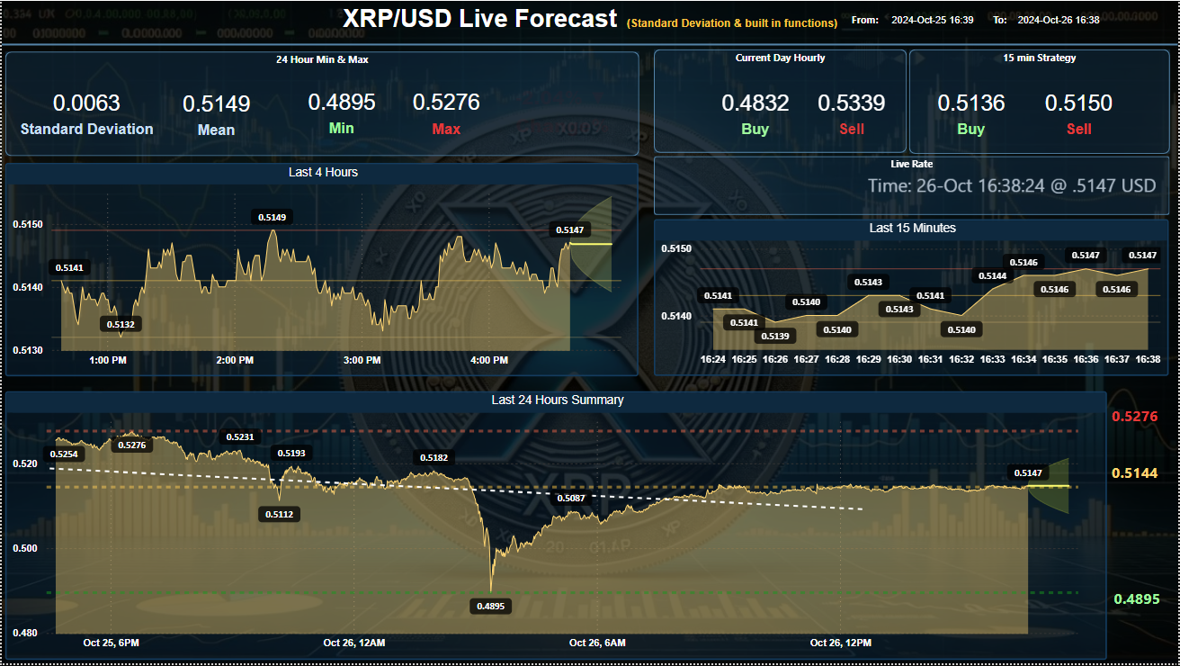
XRP_HIST_Monthly_Change
Notes:
card
No alt text provided
card
No alt text provided
card
No alt text provided
slicer
No alt text provided
textbox
No alt text provided
shape
No alt text provided
slicer
No alt text provided
advancedSlicerVisual
No alt text provided
Monthly HIg Low Trends
No alt text provided
htmlContent443BE3AD55E043BF878BED274D3A6855
No alt text provided
card
No alt text provided
card
No alt text provided
htmlContent443BE3AD55E043BF878BED274D3A6855
No alt text provided
card
No alt text provided
card
No alt text provided
card
No alt text provided
card
No alt text provided
card
No alt text provided
15 min Strategy
No alt text provided
textbox
No alt text provided
To Date
No alt text provided
textbox
No alt text provided
From Date
No alt text provided
Monthly Change Percent(%)
No alt text provided
shape
No alt text provided
advancedSlicerVisual
No alt text provided

Slide 6
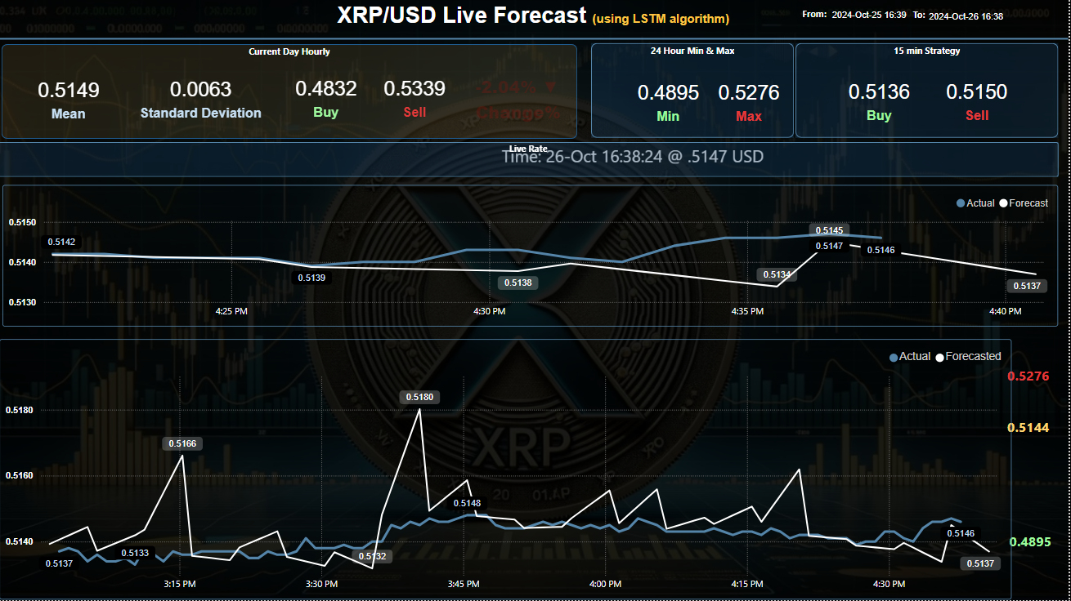
XRP_HIST_Monthly_Change
Notes:
card
No alt text provided
card
No alt text provided
card
No alt text provided
slicer
No alt text provided
textbox
No alt text provided
shape
No alt text provided
slicer
No alt text provided
advancedSlicerVisual
No alt text provided
Monthly HIg Low Trends
No alt text provided
htmlContent443BE3AD55E043BF878BED274D3A6855
No alt text provided
card
No alt text provided
card
No alt text provided
htmlContent443BE3AD55E043BF878BED274D3A6855
No alt text provided
card
No alt text provided
card
No alt text provided
card
No alt text provided
card
No alt text provided
card
No alt text provided
15 min Strategy
No alt text provided
textbox
No alt text provided
To Date
No alt text provided
textbox
No alt text provided
From Date
No alt text provided
Monthly Change Percent(%)
No alt text provided
shape
No alt text provided
advancedSlicerVisual
No alt text provided

